Slide 1
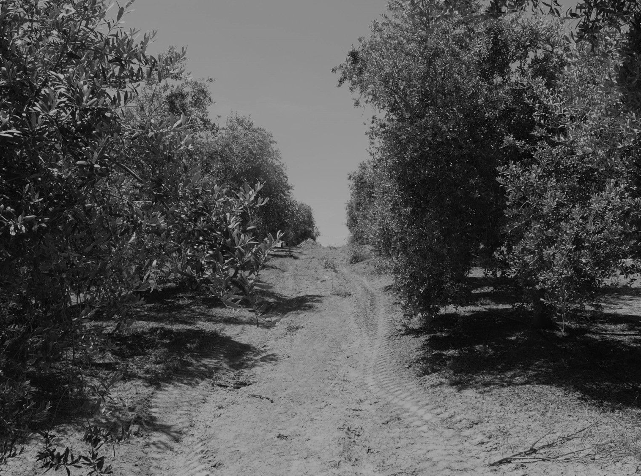
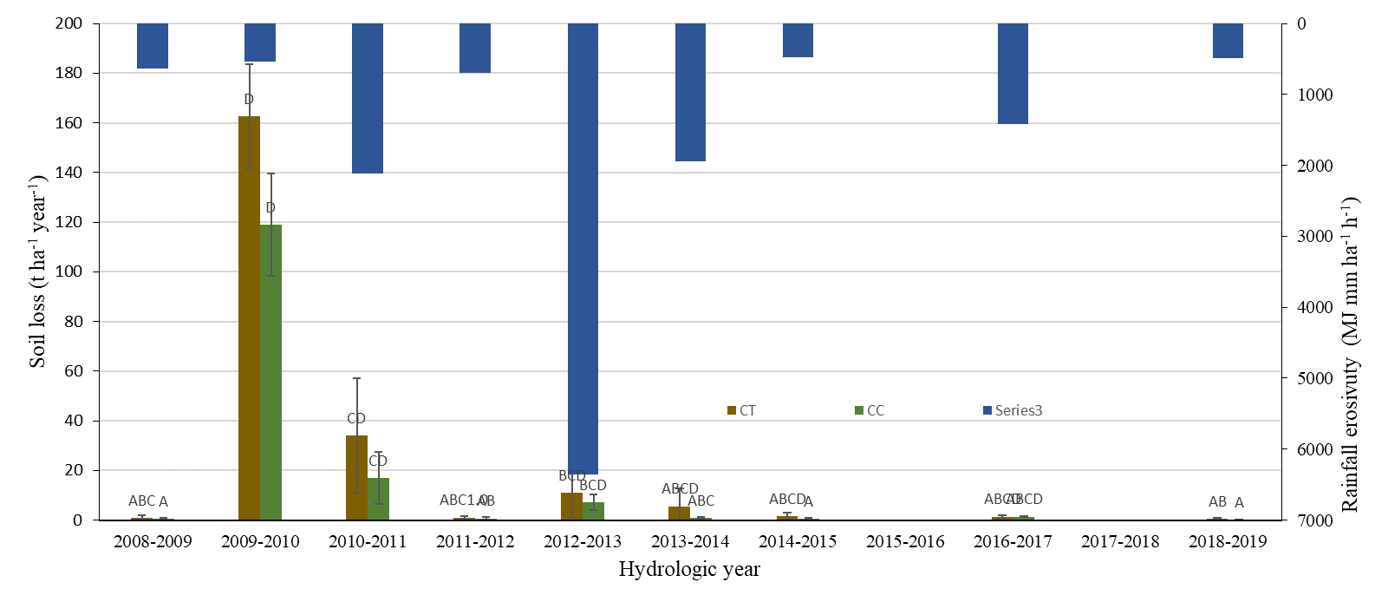
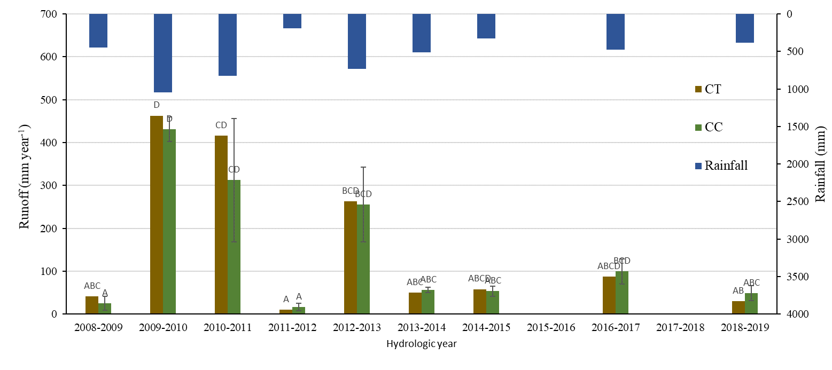
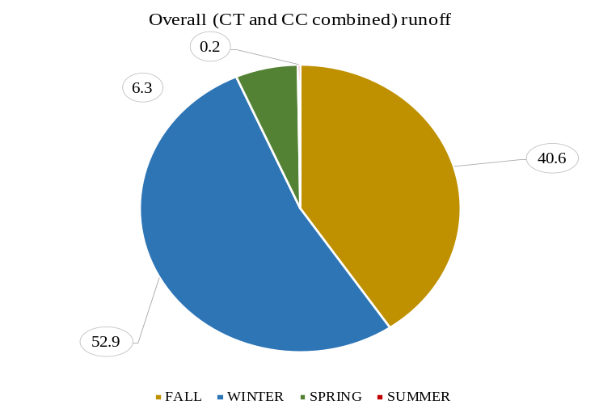
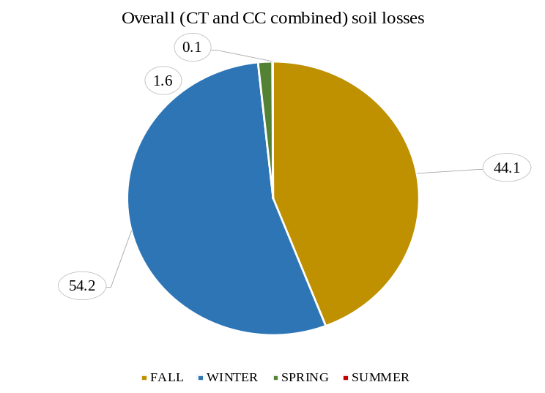
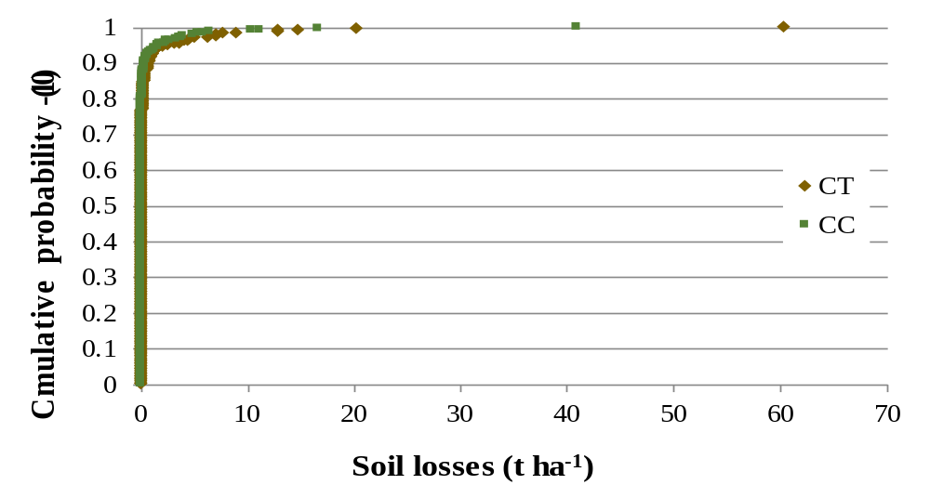
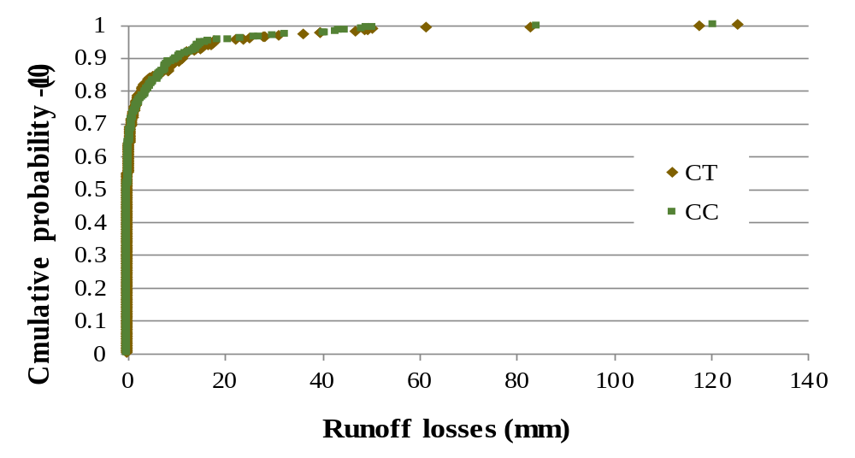
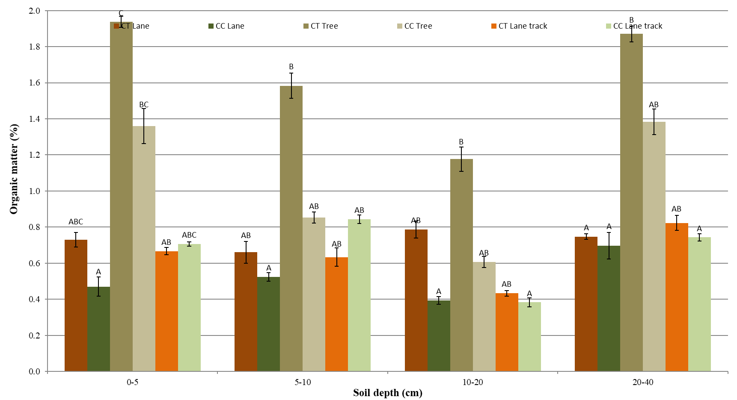
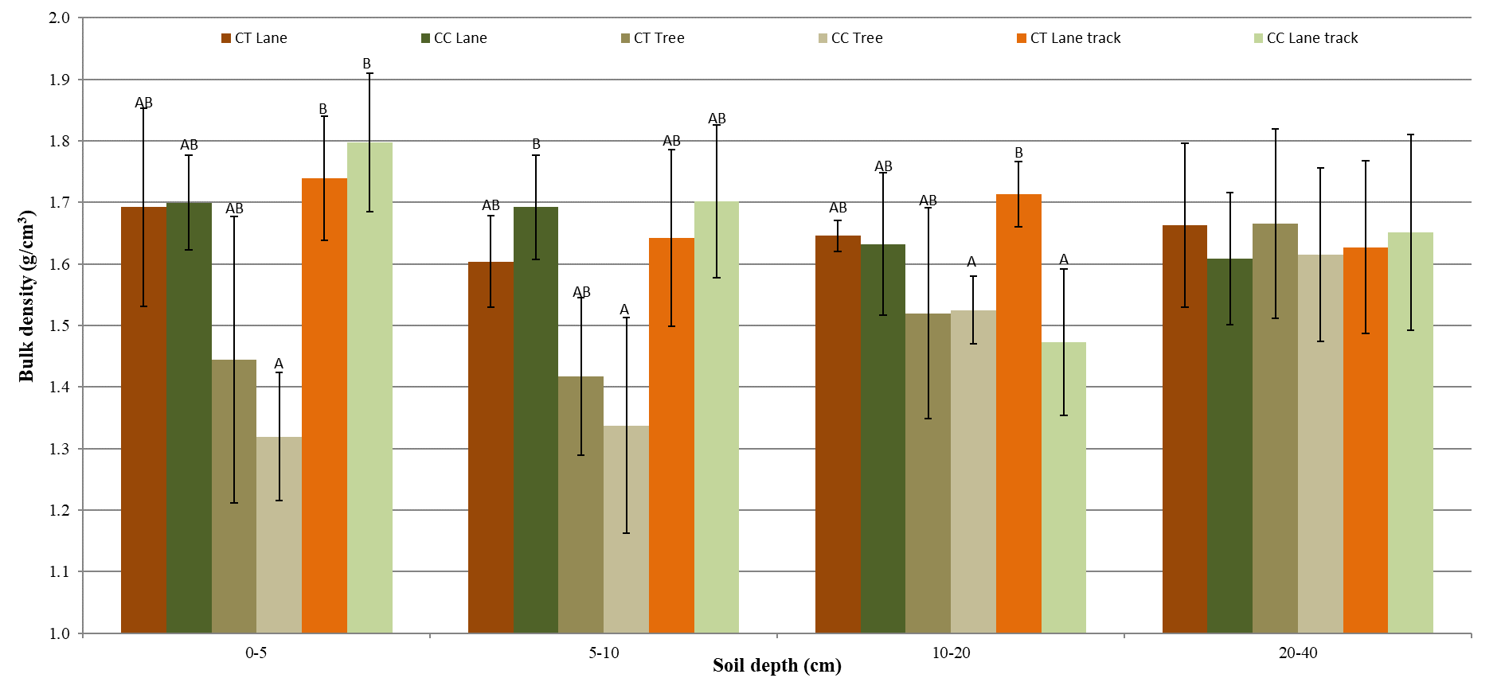
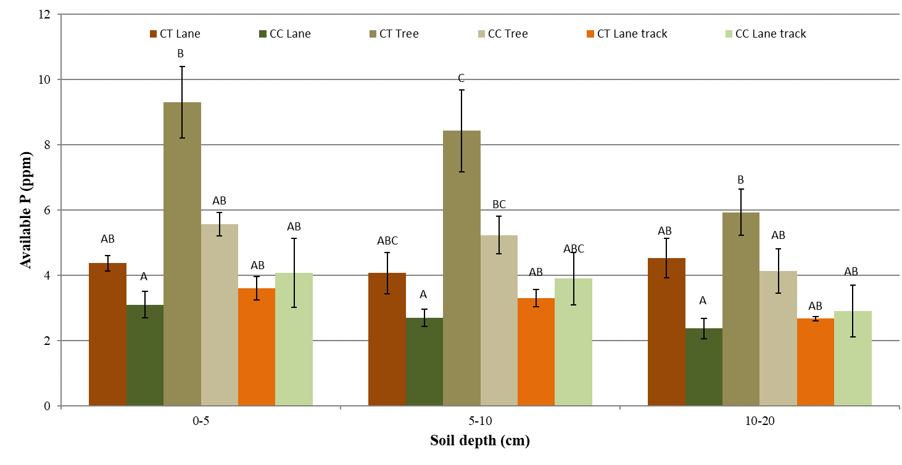



Long-term evaluation of cover crops on soil and runoff losses under trafficked conditions in olive orchards
Introduction
José A. Gómez¹, Gema Guzmán ¹,
José A. Gómez¹, Gema Guzmán ¹,
Click to see affiliations
Soil degradation by water erosion is a major environmental threat in olive cultivation. In recent decades use of temporary cover crops has provided a feasible strategy for addressing this threat.
Results
Runoff and soil losses during the study period did not differed significantly between the two treatments., although were slightly higher in the tilled treatment.
Runoff and sediment losses are concentrated during the rainy period, mostly infall and early winter. These are the seasons where the temporary cover crop has to grow again and the harvest occurs.
Most of the information on the effectiveness of cover crops comes from runoff plot experiments. They are usually of limited duration (2-3 years at most) and tend to isolate the plot from the usual machine traffic, which is particularly intense during the harvest occurring during the rainy season.
Click to enlarge
Click to enlarge
Distribution of runoff and sediment events was highly skewed to the left, with a few events of low probability contributing to a large share of runoff and sediment losses.
Although it might results counterintuitive, a detailed look to the farm operations taking place in the orchard, and in the plots as well, and the actual ground cover observed during winter might provide some clue.
These two features (limited duration and traffic restriction) might altered significantly our understanding of the actual impact of soil management on the soils and hydrology of the orchards.
We present here the results of a 10 year experiment on trafficked runoff plots comparing tillage and temporary cover crops under conditions mimicking those of an commercial olive farm in Southern Spain.
Click for these clues
Analysis of soil properties show moderate or none differences between lanes of tilled and cover crop plots. There are more differences in soil properties between lanes and the under canopy area, where water erosion is much less intense (Guzman et al,, 2013).
Click to enlarge
Conclusions
1- Nine years of measurement in runoff plots accommodating the usual olive farm traffic showed non-significant differences between tillage and temporary cover crops as implemented by the farmer.
2- This might be explained to the major disturbance suffered by the cover crop, particularly during re-establishment in fall.
3- Our results reminds of the need of a critical extrapolation of results from experimental conditions to farm situation. Also of the need to keep improving soil conservation strategies in orchards.
Material and methods
Click for material and methods
Click to enlarge
Acknowledgements:
Click here
References:
Click here for references

Slide 2

Affiliations
¹ Institute for Sustainable Agriculture, Spanish National Research. Cordoba, Spain.
joseagomez@ias.csic.es
gemaguzmandiaz@ias.csic.es
Click the icon to go to the main page

Slide 3
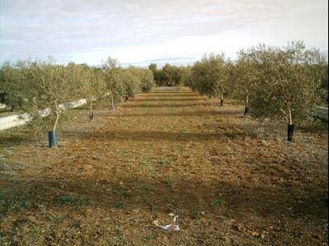
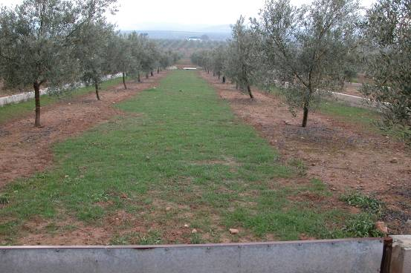
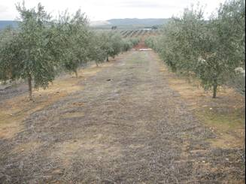
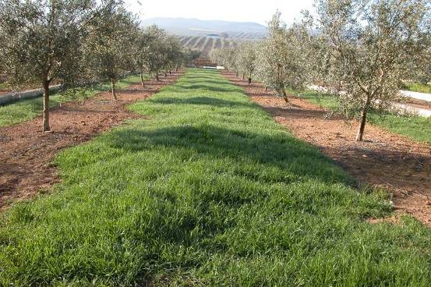
Temporary cover crops in olives.
Late summer
Fall
Mid-spring
Winter
From Gómez (2016).
Click the icon to go to the main page

Slide 4
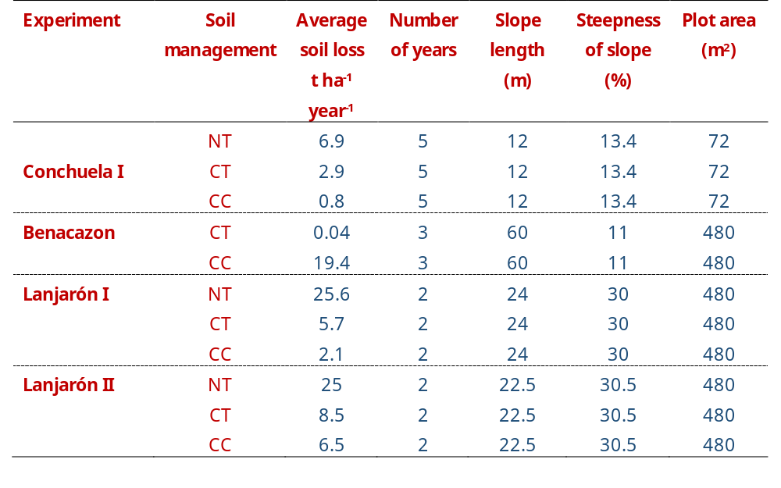
Erosion reduction using cover crops
Adapted from Gómez et al. (2014).
Click the icon to go to the main page

Slide 5
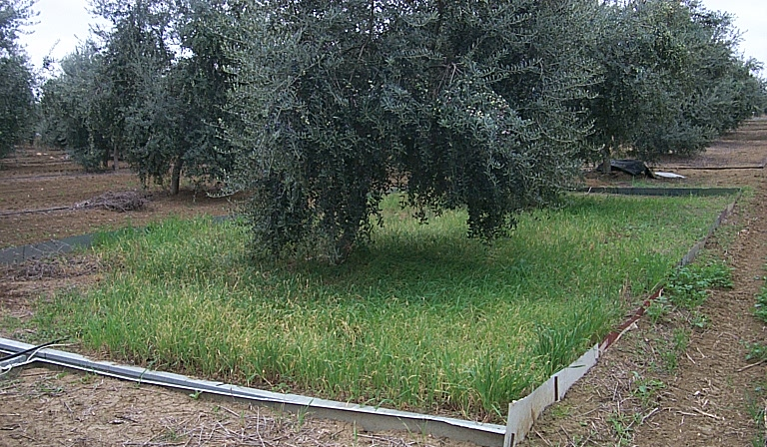
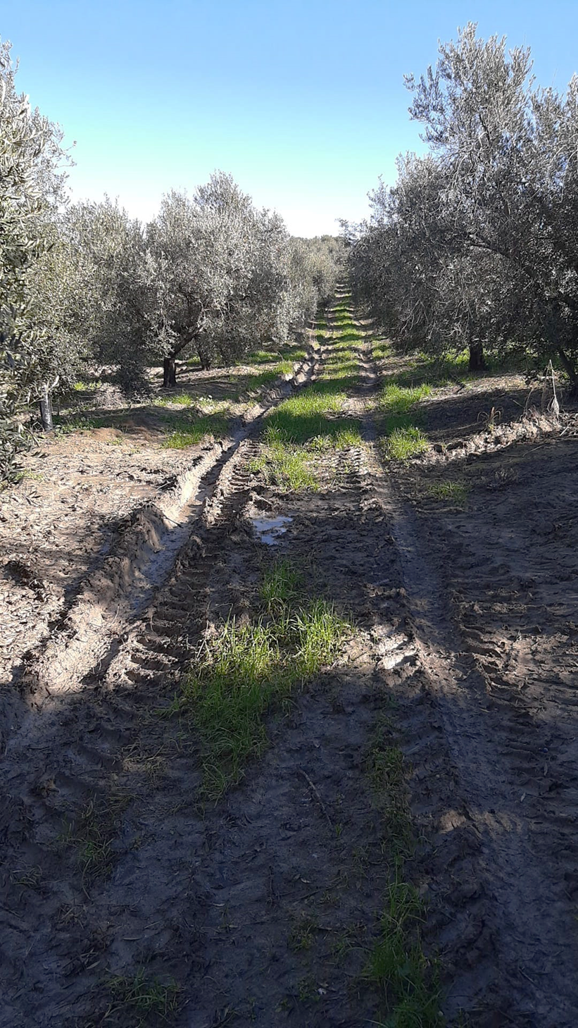
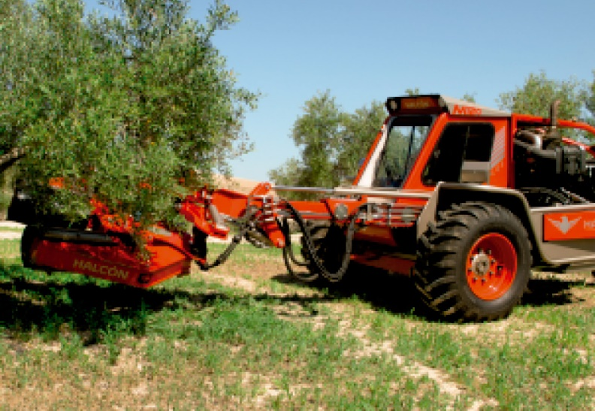
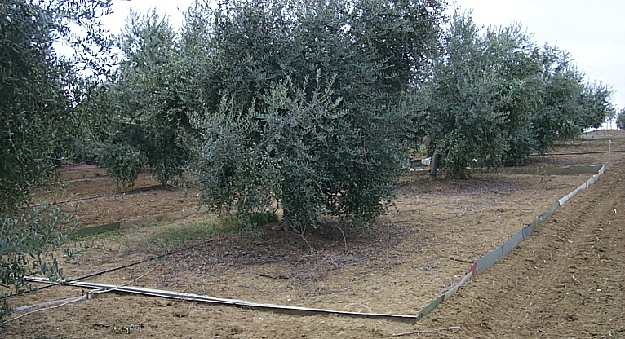
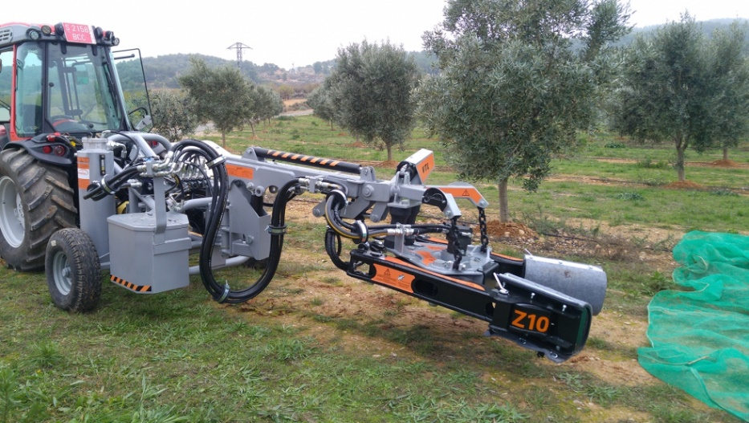
Runoff plots and actual farm traffic
Source: Interempresas.net
Source: Interempresas.net
Source: A. Ramos
Click the icon to go to the main page

Slide 6
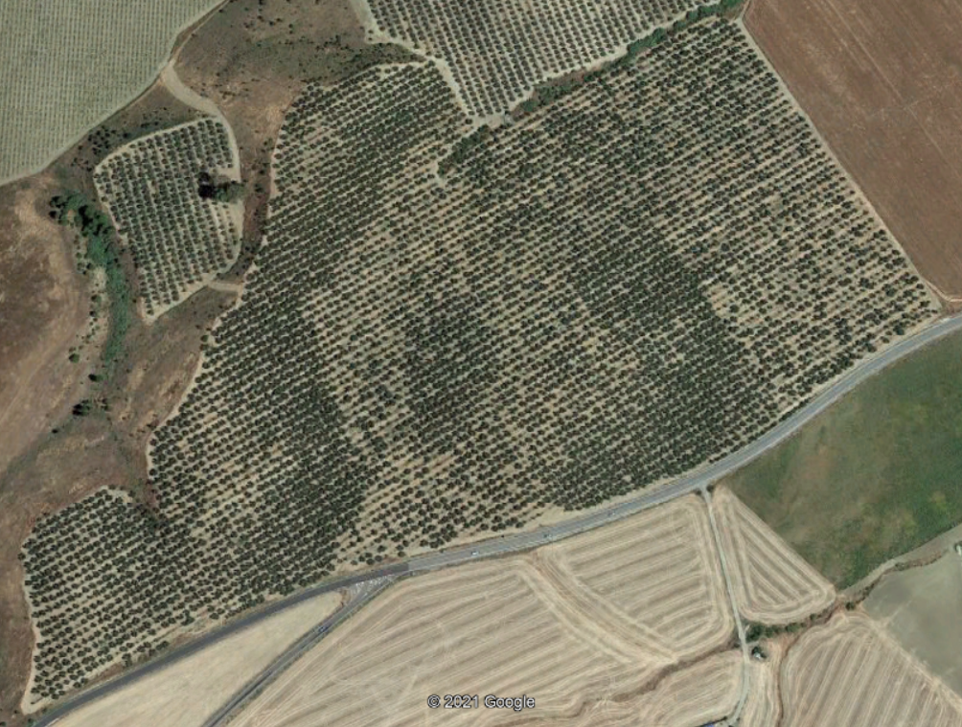
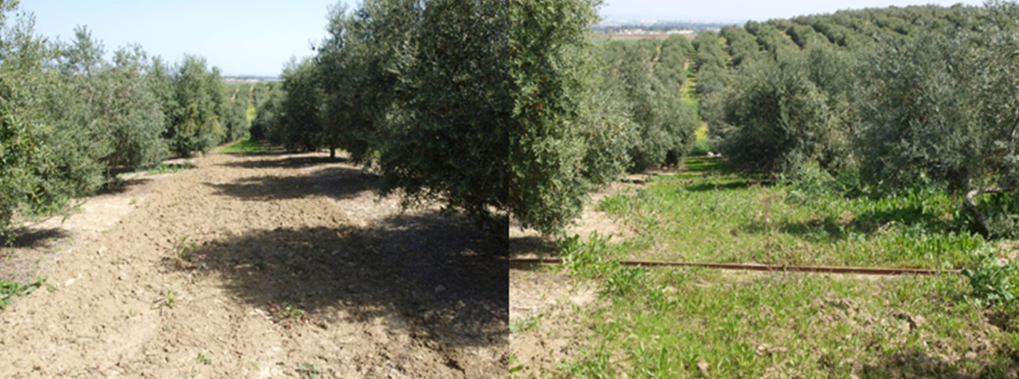
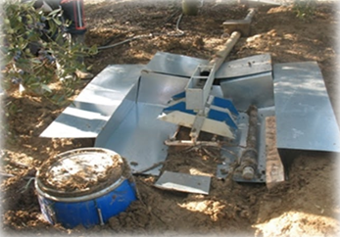
Material and methods
A) La Conchuela is an 8 ha rainfed olive farm at Córdoba (Southern Spain) with a mean slope of 9 %. Textural class is clay loam and soil type is a Vertisol (FAO). Average annual precipitation is 642 mm.
B) From 2008, six closed runoff plots of 14x24 m were built with steel beams on concrete foundation, with the longest dimension parallel to the maximum slope (13.4 %). These boundaries allows regular machine traffic during farm operations. Three rows of trees are within each plots. Two soil managements have been evaluated: bare soil and cover crops.
C) Runoff water was channeled from the plots and collected by tipping-bucket gauges with 5-min resolution. This is completed with a sediment trap located upstream of the tipping buckets and a device to collect an integrated sample of the runoff downstream of the tipping buckets.
Click the icon to go to the main page

Slide 7
Results sediment and runoff
A Kruskal-Wallis test (P<0.01) was performed to evaluate differences in soil losses and runoff between the two treatments for the different years.
At the same year, there is no statistical differences between managements.
With bare soil, there is no differences among years either for runoff and soil losses. However, with cover crops, there are significant differences for both.
Click the icon to go to the main page
Notes:
(Runoff1=11≠ 2; Soil loss 1=4≠ 2)

Slide 8
Results farm management and ground cover.
Management |  | CT | CC
Number of plots |  | 2 plots since 2008-09. | 4 plots since 2008-09.
Vegetation control | Lanes | Bare soil by chisel plowing (2-3 times per year) varying as a function of annual precipitation and vegetation growth. | During the first three years the CC was sown manually in November with (Lolium multiflorum) at 80 kg·ha-1. In year 2011-12 the CC grew up spontaneously from the seed produced by the CC the previous year. During April of years 2010, 2011, and 2012 the CC was chemically mowed using Touchdown Premium (3 l ha-1 using 300 l of solution per ha).
 |  |  | In 2011–2012 CC grew up spontaneously from seed produced the previous year.
 |  |  | During 2012-13, CC were sown with Bromus rubens at a dose of 15 kg·ha-1. In early April, CC were mechanically mowed.
 |  |  | In years 2013-14, 2014-15 and 2015-16 the CC grew up spontaneously from the seed produced by the CC the previous year. Occasionally an extra dose of seeds were sown in late Winter.
 |  |  | In year 2016-2017, two plots were sown with Bromus rubens at a dose of 45 kg·ha-1 and the other two with a mix of Anthemis arvensis, Medicago truncatula and Bromus rubens at a dose of 52 kg·ha-1.
 |  |  | During 2017-18 the CC grew up spontaneously from the seed produced by the CC the previous year.
 |  |  | In years 2018-19 and 2019-20 occasional doses of B. rubens were resown.
 | Tree lanes | Periodical use of herbicide.
Fertilization |  |  | 14N 14P 16K fertilizer at 200 kg/ha at the time of seeding.Olive trees were ferti-irrigated with ammonium sulfate in February (1.6 kg·tree-1) and from April to October, during the irrigation season.
Irrigation |  | The trees were deficit irrigated (drip irrigation), and the water applied during the irrigation season was, on average, the equivalent of 200 mm.
Pruning |  | Pruning is semi- mechanised from early to mid Spring, with the specific dates for a given year varying as a function of climate conditions.
Harvesting |  | Harvesting is semi-mechanised using tree-shakers and mechanical vibrators combined with a buggy with an umbrella to collect the olives. It is done from late November to mid-February, with the specific dates for a given year varying as a function of climate conditions and fruit ripening.
Click the icon to go to the main page

Slide 9
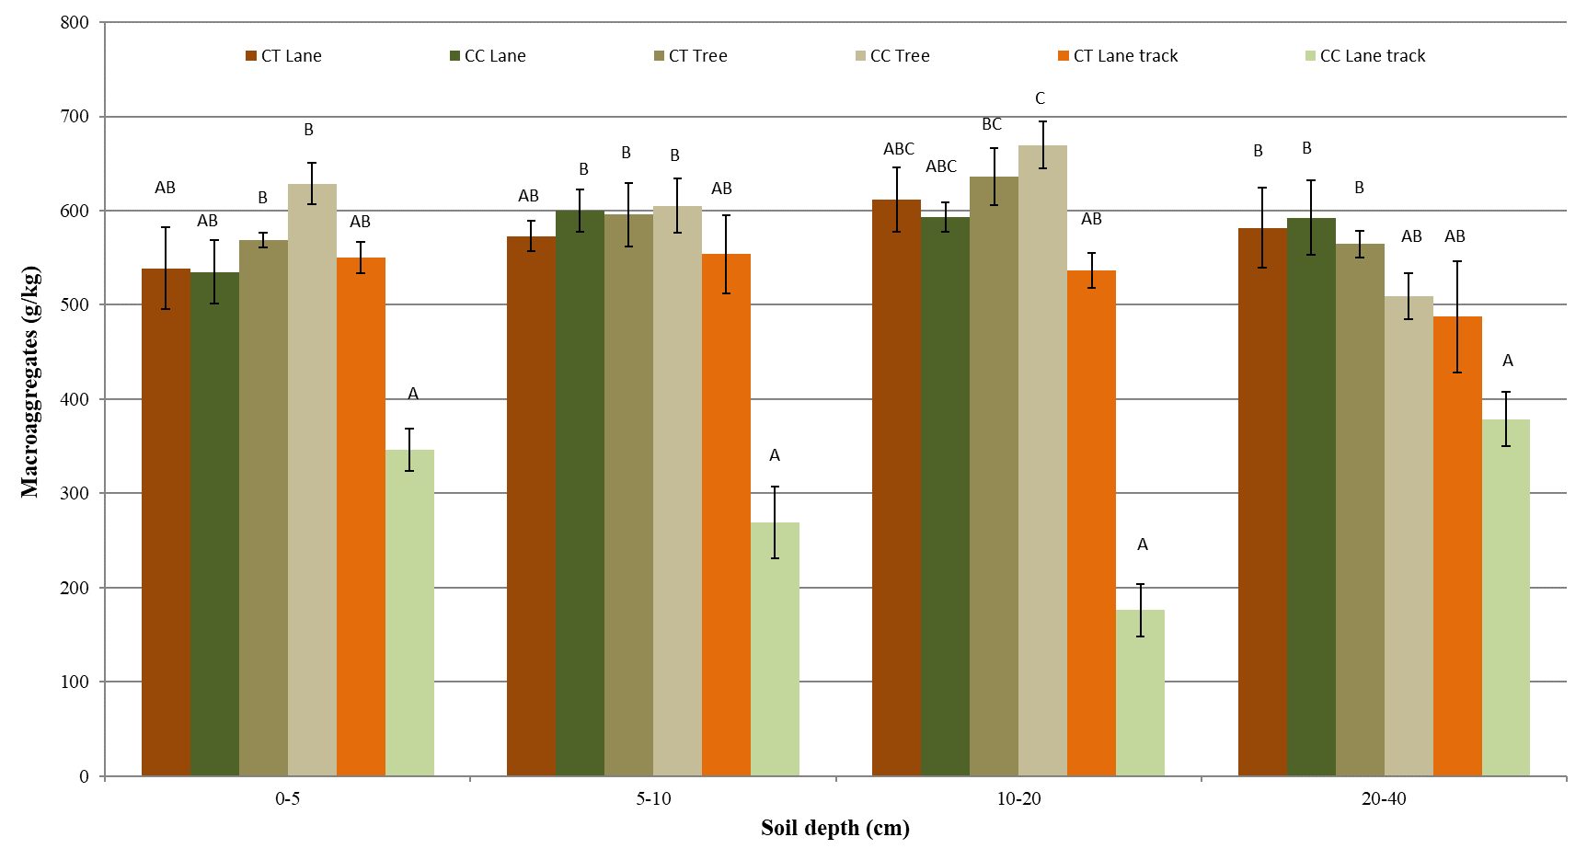
Results soil properties.
There is no clear trend among properties (Kruskal-Wallis test, P<0.01), depths and zones due to the variability in the managements’ behavior at the different plots. Lower degradation parameters were observed under the tree canopies in all the cases.
Click the icon to go to the main page

Slide 10
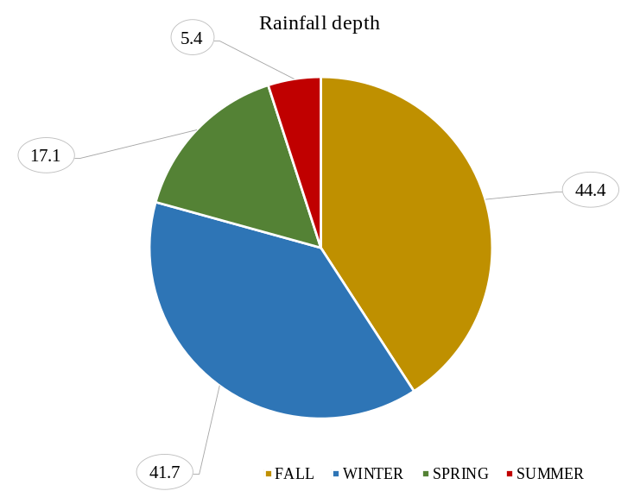
Results seasonal distribution
Click the icon to go to the main page

Slide 11
Events statistical distribution
Cumulative probability functions for runoff and soil loss are similar for both managements showing, as expected, low occurrence of intense events which result in high runoff and soil loss.
It also reflects the similarity in the hydrological response of both treatments.
Click the icon to go to the main page

Slide 12

Selected references
1- Guzmán, M.G., Vanderlinden, K.,Giráldez, J.V., Gómez, J.A. 2013. Assessment of Spatial Variability in Water Erosion Rates in an Olive Orchard at Plot Scale using a Magnetic Iron Oxide Tracer. Soil Sci. Soc. Am. J. 77:350–361.
2- Gómez, J.A., Infante-Amate, J., González de Molina, M., Vanwalleghem, T., Taguas, E.V., Lorite, I. 2014. Review:
Olive Cultivation, its Impact on Soil Erosion and its Progression
into Yield Impacts in Southern Spain in the Past as a Key to a
Future of Increasing Climate Uncertainty. Agriculture 2014, 4, 170-198.
3- Gómez, J.A. 2017. Sustainability using cover crops in Mediterranean tree crops, olives and vines – Challenges and current knowledge. Hungarian Geographical Bulletin 66: 13-28.
Click the icon to go to the main page

Slide 13
Acknowledgements
To projects PID2019-105793RB-I00 funded by the Spanish Ministry of Science and project SHui “Soil Hydrology research platform underpinning innovation to manage water scarcity in European and Chinese cropping systems”, co-funded by the European Union Project and the Chinese MOST through the H2020 program, GA 773903.
Click the icon to go to the main page

