Slide 1









Mountain agro-ecosystems long-term trajectories in the North Western Alps
Charline Giguet-Covex, Manon Bajard, Wentao Chen, Kevin James Walsh, Pierre-Jérôme Rey, Erwan Messager, Pierre Sabatier, Francesco Gentile Ficetola, Ludovic Gielly, David Etienne, Claire Blanchet, Christophe Guffond, Fabien Arnaud, Jérôme Poulenard
Submitted; Regional Environmental Changes

Slide 2
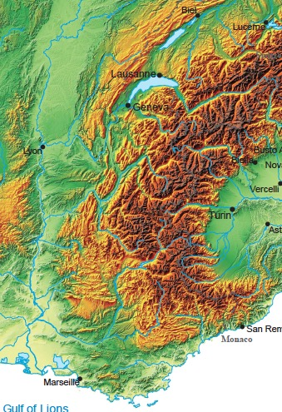
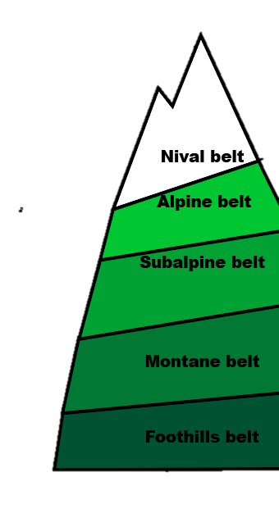
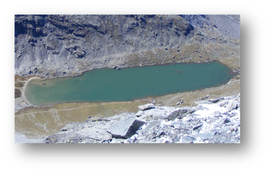
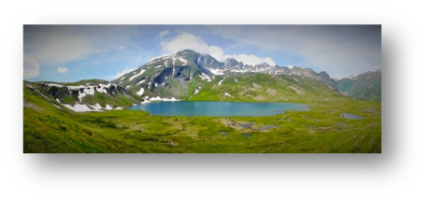
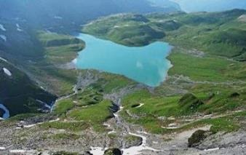
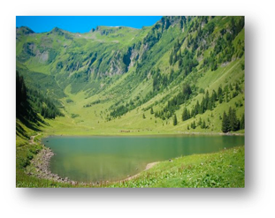
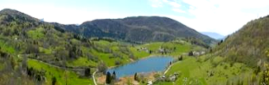
Context:
The Alps has a long story of exploitation due to the diversity of resources. People developed a vertical mobility and adapted their activities/land use according to the season
& the ecological zones
Mountains are also sensitive to climatic and environmental changes
Scientific question:
How, when and where did agro-pastoral activities impact their environments ?
1,2
3
5. Savine, 2443 m
4
5
Strategy:
Study of sediment records from 5 lakes in the North Western Alps distributed along an altitudinal gradient
1. Anterne, 2063 m
4. Verney, 2090 m
2. Gers, 1537 m
3. La Thuile, 875 m
Notes:
The study area stretches across the western French Alps and so far we sampled 6 lakes close to archaeological sites which indicate pastoral activity or along known pastoral pathways and range from ~900m to ~2200m altitude.
I removed Serre de l’Homme because of the negative results (see Giguet-Covex et al. 2019 in scientific reports)

Slide 3
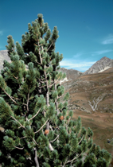
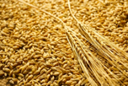

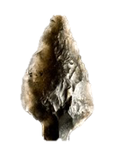





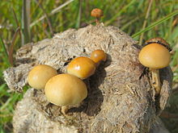


Approaches and methods
Archaeological remains
Mammal & plant DNA
Coprophilous fungi
Notes:
My research interest is on studying past agro-ecosystem trajectories in mountain areas characterised by climatic and ecological gradients leading to a diversity of biological ressources. In these environments people developed a vertical mobility and adapted their land uses according to the ecological zones and the season.
The research question is : What is the story of these mountain people and how they impacted their environments (especially the vegetation and erosion dynamic). Here I will not have time to speak about erosion.
To answer these questions, I will mostly present DNA metabarcoding results on plants and mammals from extracellular DNA.

Slide 4
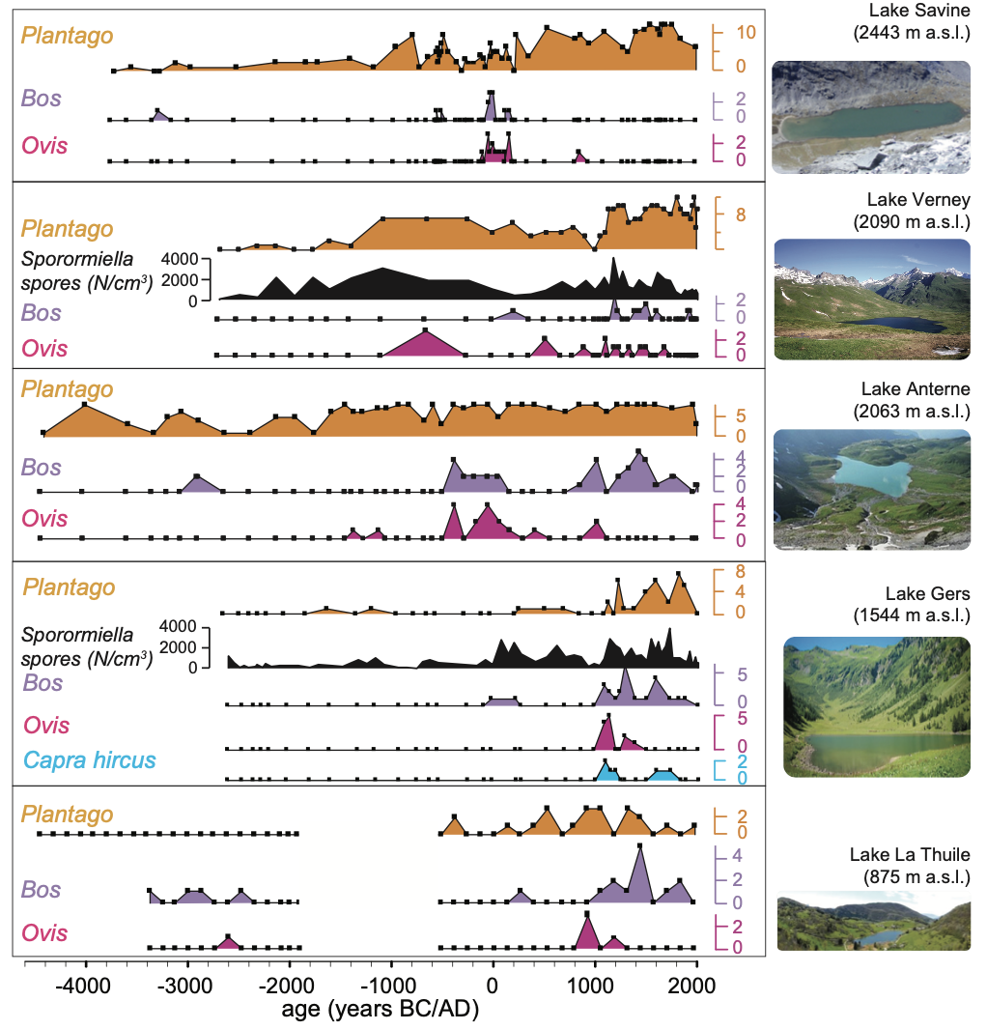




Pastoral history: multi-proxy records
First possible activities
First significant and robustly (indirectly) detected pastoral activities in the Neolithic at low altitude, mid/late-Bronze Age at high altitude and Roman Period at mid-altitude
→ Often difficult to detect low intensity activities with mammal DNA due to low DNA production and transfer (i.e. taphonomic biases)
New activities during the Iron Age and/or the Roman Period
Intensive activities from 1000 AD (all sites except in Alpine belt)
Change in animal composition: mostly cows from the 13th-15th centuries
Notes:
For the pastoral history we focused on lakes in the North
Interestingly, first robust detections of activities appear earlier at high altitude than at mid altitudes. These signs of activities are often difficult to detect with mammal DNA. We see them indirectly through indicator taxa as plantago and coprophilous fungi. This difficulty is probably due to a relatively low intensity activity, which means low DNA production and low DNA transfer as the erosion process (supposed to be the main transfer process of extracellular DNA) is often also reduced.
Here, I want to draw your attention on potential taphonomic processes that may bias the DNA records.
Another important result from these data is the dominance of cow herds from the 13th-15th centuries. The DNA is nearly the only way to provide such information on past animal composition

Slide 5

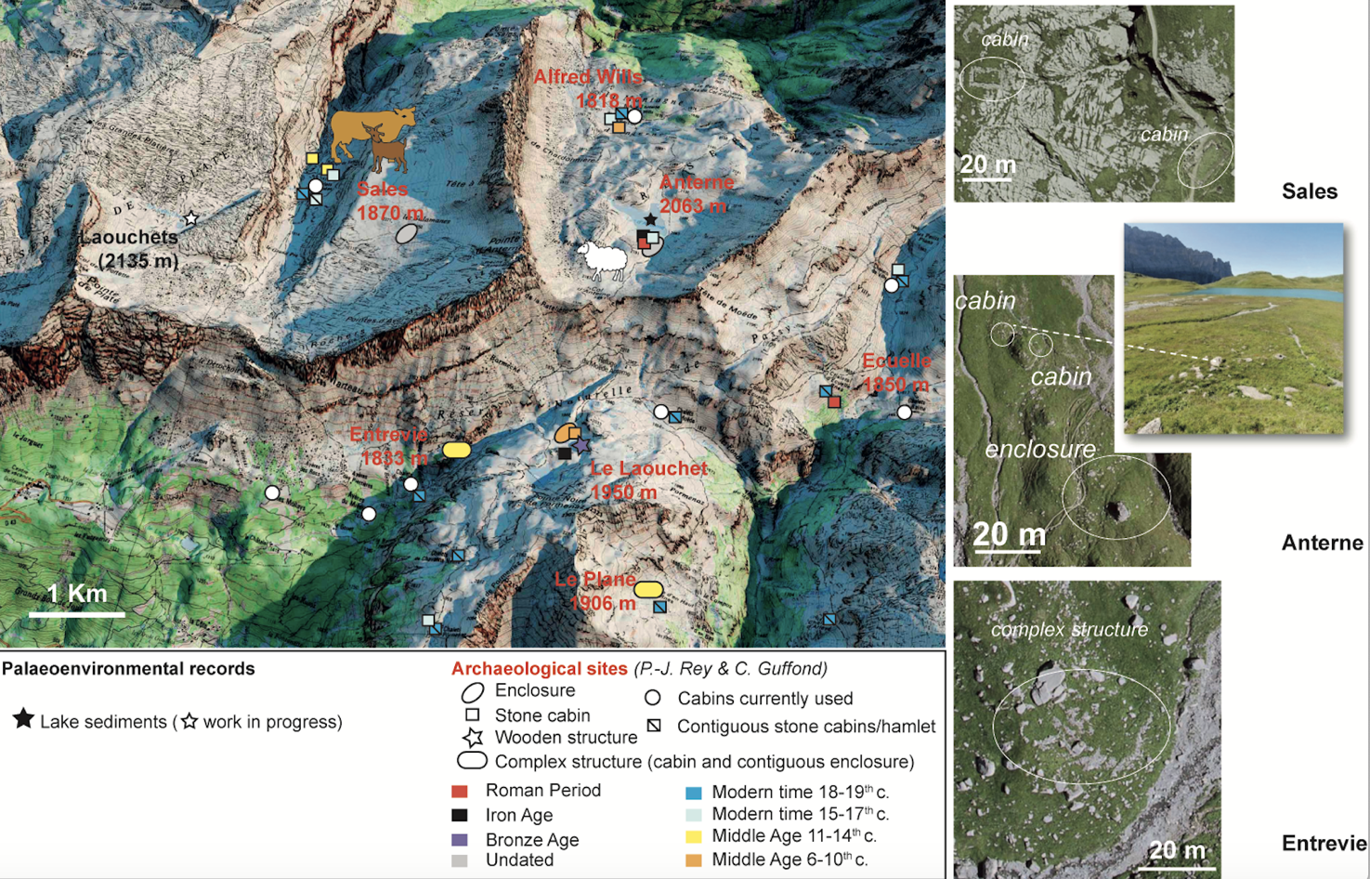
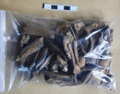
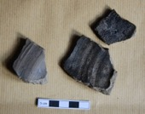
Pastoral structures and archaeological remains- agreement with paleo records
Significant development of pastoral cabins in the last centuries (18th-19th centuries)
Several Middle Age sites with an increase in complexity of structure probably to develop cheese production
2 or 3 Iron Age sites & 2 Roman Age site
1 Bronze Age structure (wood)
Anterne, 2063 m
Increase in pastoral development
Sheep bones
Survey: Pierre-Jérôme Rey; Christophe Guffond et al.

Slide 6
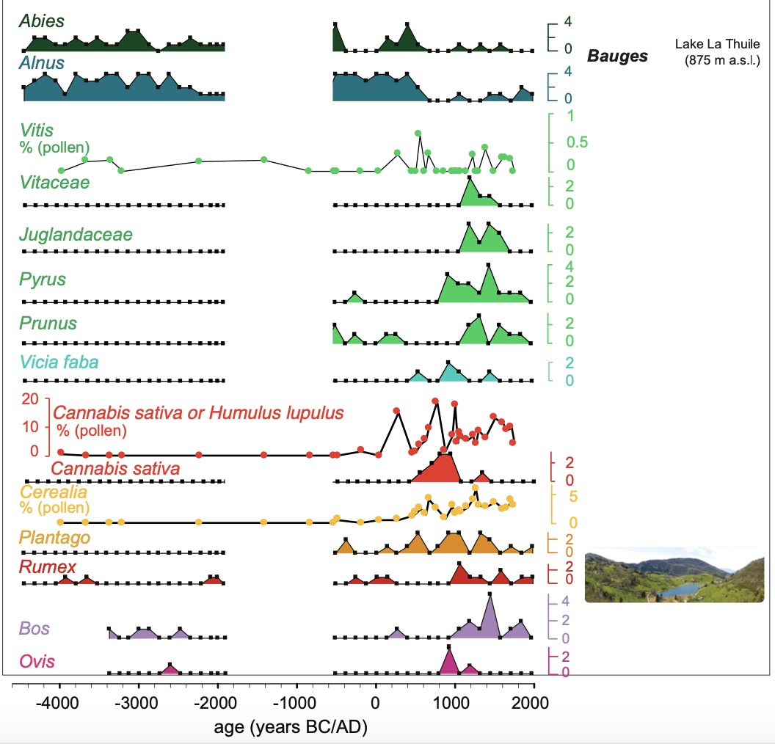
Agro-pastoral history in the Montane Belt
Important development of fields with cereals (based on pollen due to the low taxonomic resolution with the gh primer for Poaceae) and hemp and vegetable garden plants (beans) from the Early Middle Age, 1500 years ago
Diversification of activities from the High Middle Age, i.e. from 1000 AD, with the development of fruit trees and livestock farming

Slide 7
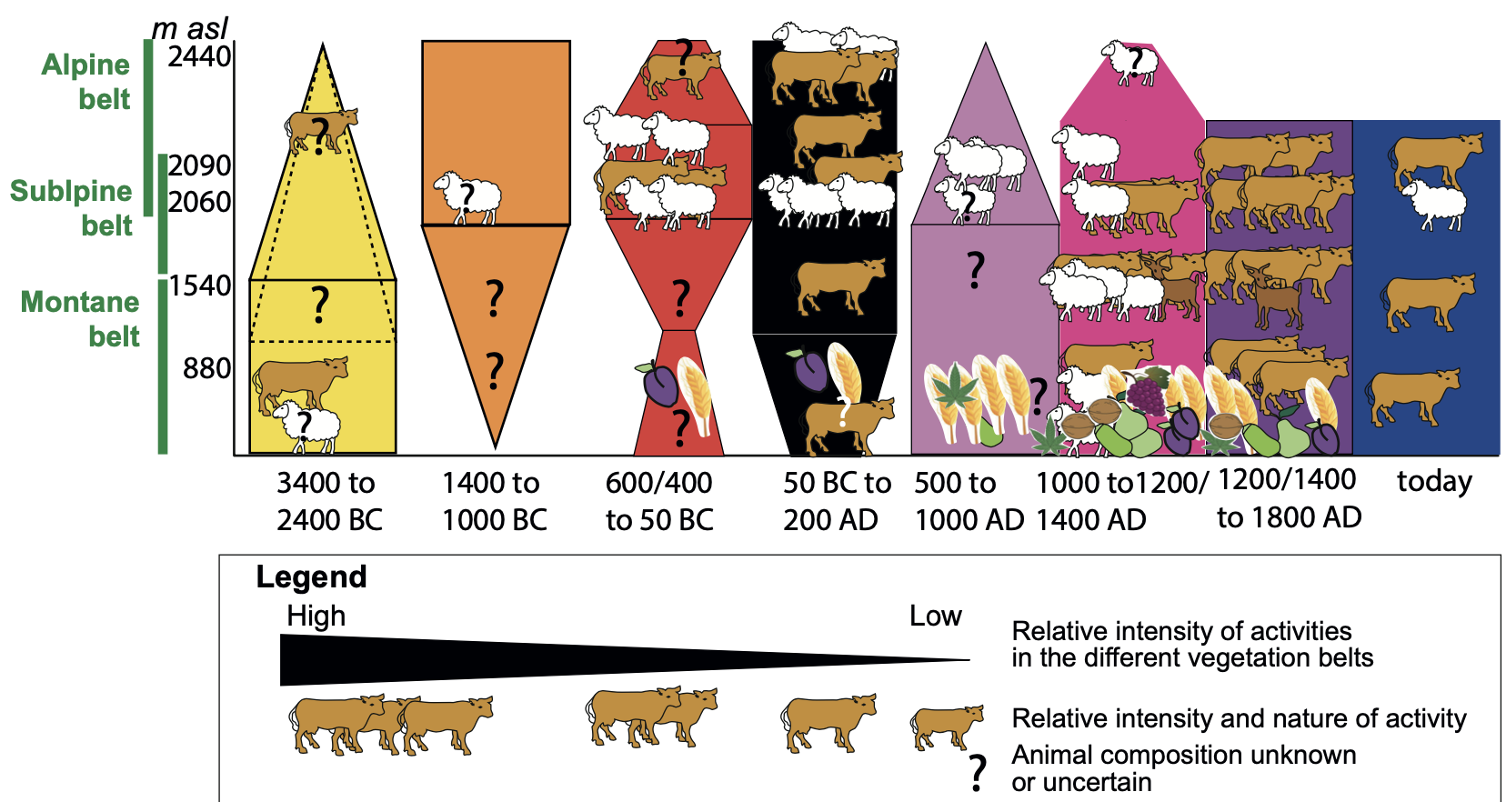
Synthesis of Agro-pastoral development across the vegetation belts
Increase in altitude from the Neolithic to the Bronze Age and Iron Age.
Development at all altitude during the Roman period
Highest development at all altitudes (except in the Alpine belt) from 1000 to 1800 AD
This synthesis is used to develop a relative scale of agro-pastoral intensities and study their impact on plant communities

Slide 8

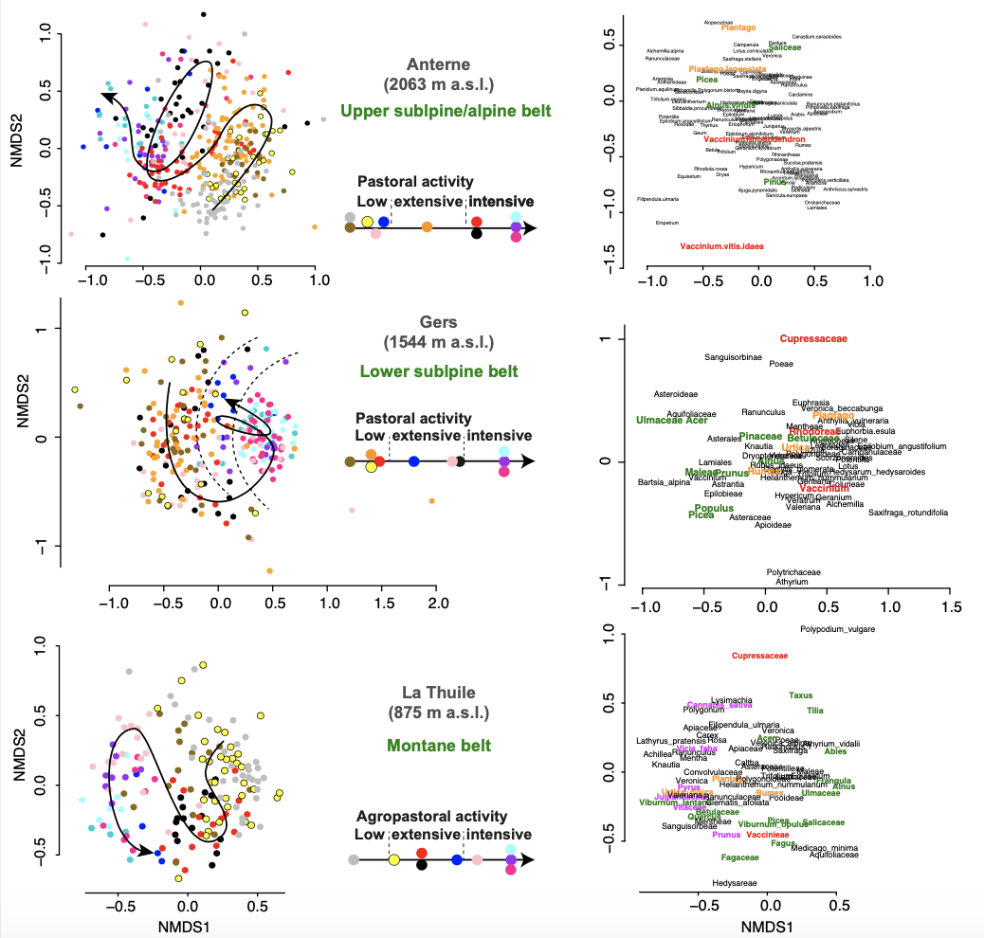
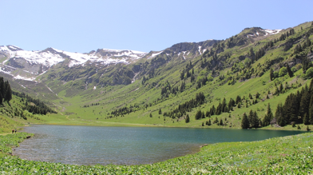
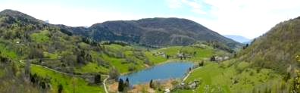
Plant community trajectories in response to agro-pastoral activities: NMDS analyses
According to the periods, characterised by different intensities of agro-pastoralism, we have different plant communities
non-metric multidimensional scaling (NMDS)
Notes:
Based on these previous data, I determined a relative scale of intensity of agro-pastoral activities. The color code represents the different time periods. Then, using an NMDS analysis, I looked the trajectories of plant communities at the different altitudes and periods.

Slide 9
Plant community trajectories in response to agro-pastoral activities
Few loops (resilience)
First tipping point in mid-Bronze Age at high altitude (>2000 m asl), but later in mid and low altitude (900-1500 m asl), following the human history
non-metric multidimensional scaling (NMDS)
Giguet-Covex et al. submitted; REEC
Notes:
We can note that some loops are observed. They reflect phases of resilience.
The second interesting result is as in response to the development of pastoral activities, the first tipping point in plant communities occur earlier in high altitude (during the bronze age in orange compared to grey, yellow or brown from previous periods). In mid altitude it is more during the Iron Age or Middle Age that we can see shifts in plant communities.

Slide 10
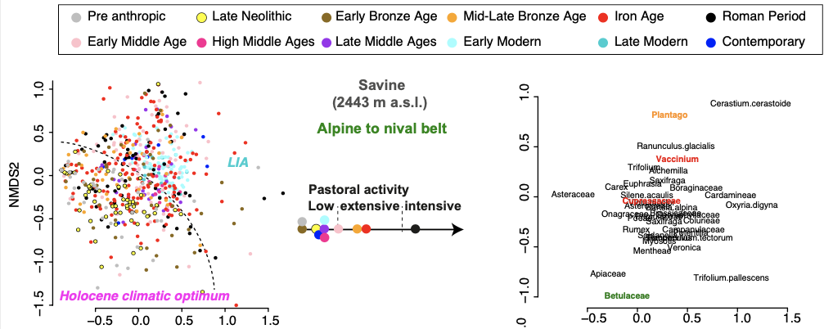
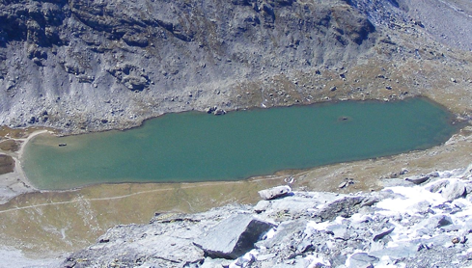
Plant community trajectories in the alpine to nival belt
non-metric multidimensional scaling (NMDS)
Above 2400 m asl, no visible trajectory.
But climatic fingerprint (different communities in the two climatic extremes of the Holocene (i.e. Holocene Climatic Optimum and Little Ice Age)
Notes:
in the alpine to nival belt there are no visible trajectory
But, we can note that the grey and yellow dots corresponding to the Holocene climatic optimum are all located in one part of the graph. Dots in light blue corresponding to the coldest phase of the LIA are on the opposite side. The dots from the other periods are everywhere. This means that this system mostly respond to the most important climatic changes of the Holocene period.

Slide 11
Take-home messages
Lake sedDNA brought new information by detecting taxa impossible to detect with other methods
Because lake sedDNA gives a signal at the catchment scale, we were able to study the agropastoral history and its impact on the vegetation cover at the local scale and thus along the altitudinal gradient
The NMDS analyses are powerful to reconstruct temporal trajectories of plant community composition and to assess the roles of human activities and climate on changes in composition.
Notes:
In conclusion…
These are some of the reasons to develop Multi-proxy approaches and interdisciplinarity

