Slide 1


Coupling meteorological forecasts with hydrologic and hydraulic models
The Itaipu Dam ensemble inflow forecasting system
José Quevedo, Daniel Firmo Kazay, Mariana Maria Werlang, Giovanni Gomes, Roberto Takahashi, Marcelo Zaicovski, Tannia Villanueva Aguero, and José Maria Fariña Jara
Itaipu Hydropower Plant, Division of Hydrology, Paraguay
Case Study
Conclusions
Overview
Operational Routine
Decision Making
PICO Navigation
The orange ‘Home’
Button takes you to
the section menu
The left/right arrows
take you to the
next page

Slide 2
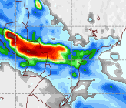
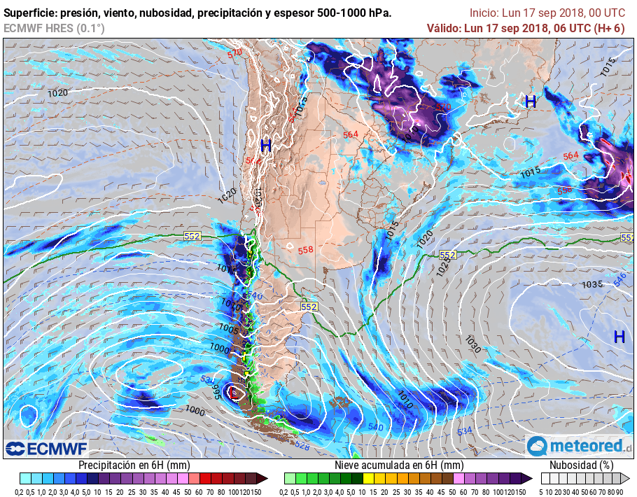
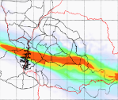
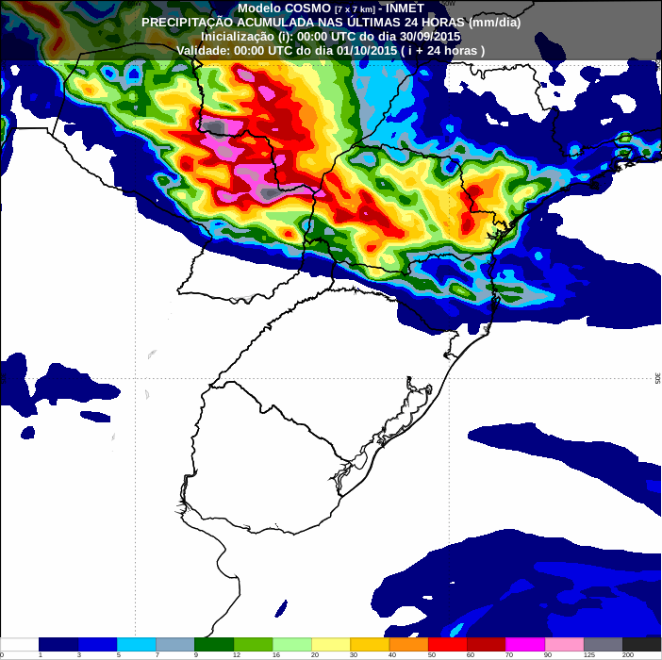
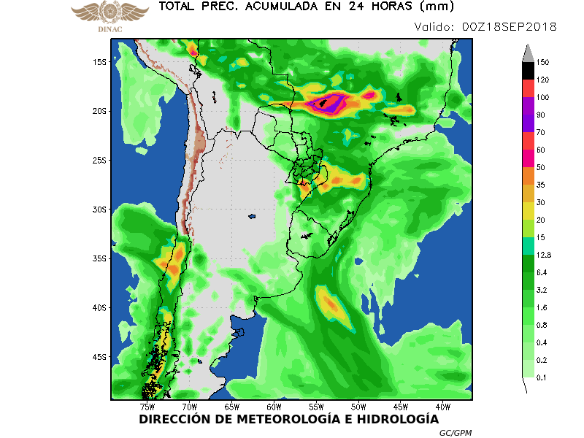





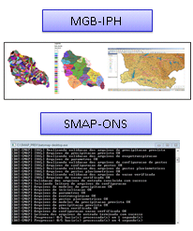
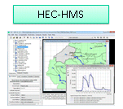
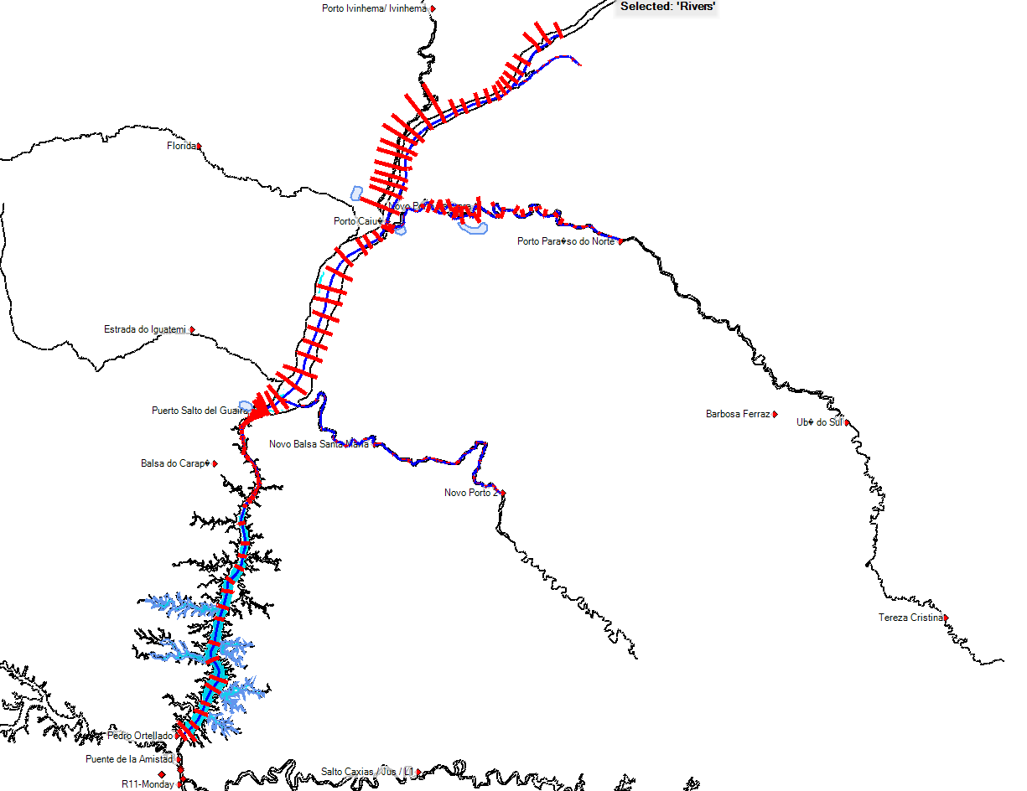

Coupling meteorological forecasts with hydrologic and hydraulic models
The Itaipu Dam ensemble inflow forecasting system
José Quevedo, Daniel Firmo Kazay, Mariana Maria Werlang, Giovanni Gomes, Roberto Takahashi, Marcelo Zaicovski, Tannia Villanueva Aguero, and José Maria Fariña Jara
Itaipu Hydropower Plant, Division of Hydrology, Paraguay
Overview
Challenge: Consistent scenarios for decision-making
Dealing with uncertainty
Operational forecast
Quantitative Precipitation Forecasts
Hydrological Models
Hydrodynamic Model
15 scenarios
Overview
Photo: Itaipu Binacional

Slide 3
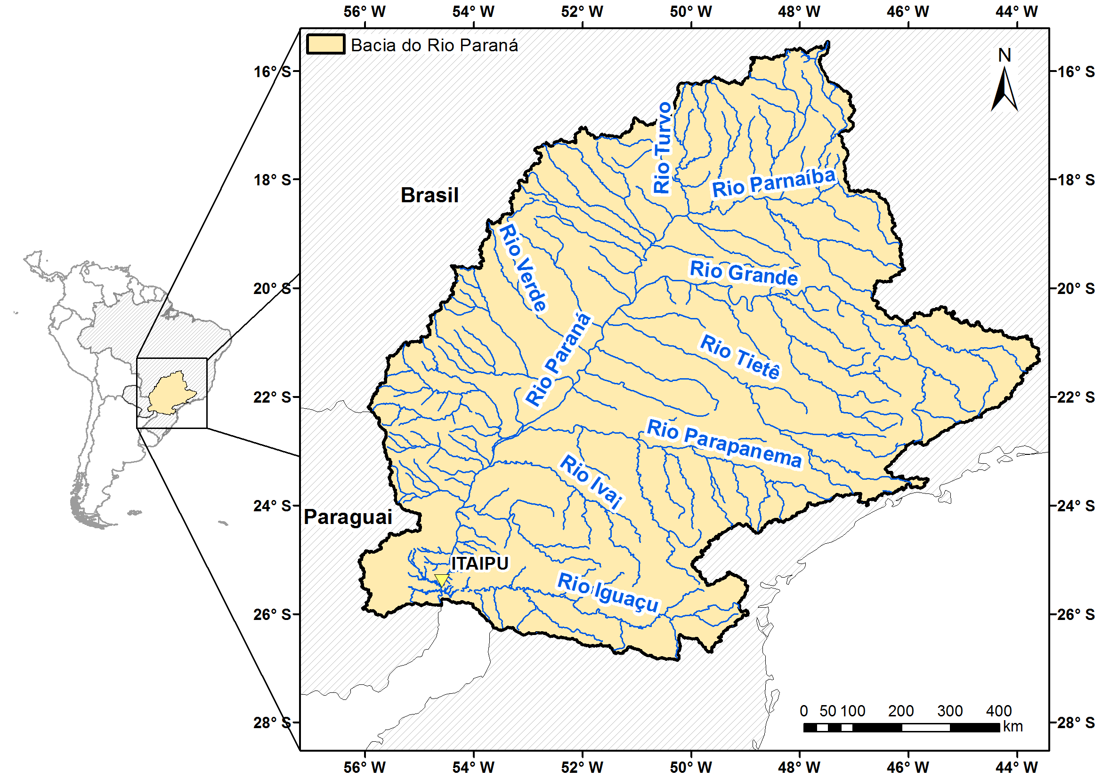
SURFACE AREAS
Upstream
Itaipu: 820.000 km²
Downstream
R11: 908.203 km²
Case Study
Photo: Itaipu Binacional

Slide 4
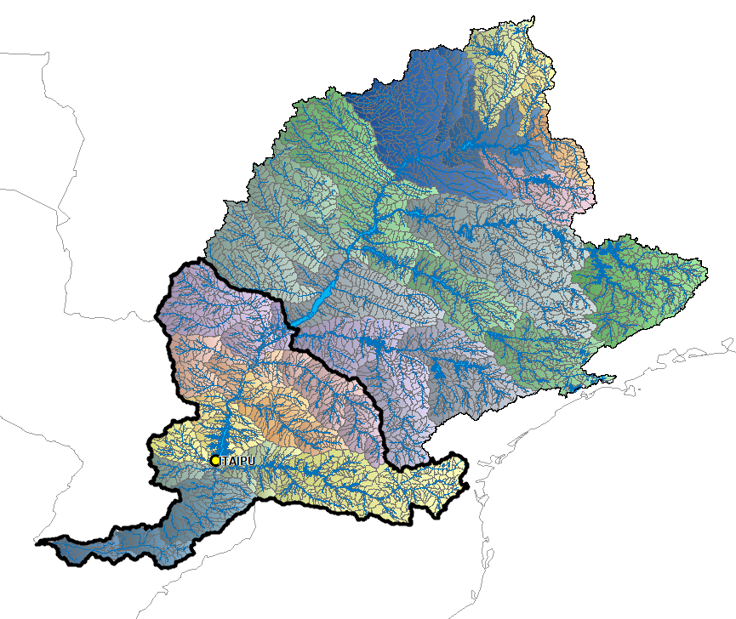





Brazil
Upstream Incremental : 147.000 km² (18%)
Upstream:
Electric Generation
Case Study
CH Primavera
CH Rosana
Paraguay
CH Itaipu
CH Salto Caxias
Argentina
Photo: Itaipu Binacional

Slide 5
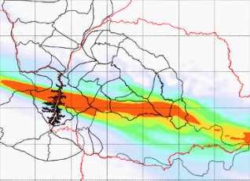
Weather forecasts
Hydrological model
GFS (NOAA)
9
COSMOS (INMET)
Operational Routine
ECMWF (ECMWF)
9
Hydrodynamic model
WRF (DINAC)
Ensemble (Simepar)
Photo: Itaipu Binacional

Slide 6


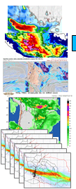
Weather forecasts
Weather forecasts
Hydrological model
GEFS
ECMWF
ETA
3
9
Operational Routine
Hydrological models
9
Hydrodynamic model
15
6
Photo: Itaipu Binacional

Slide 7
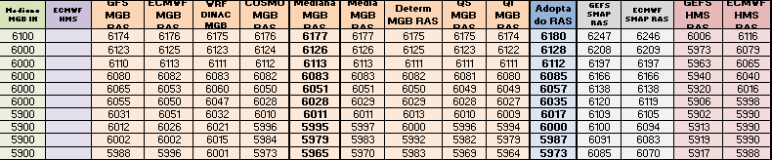
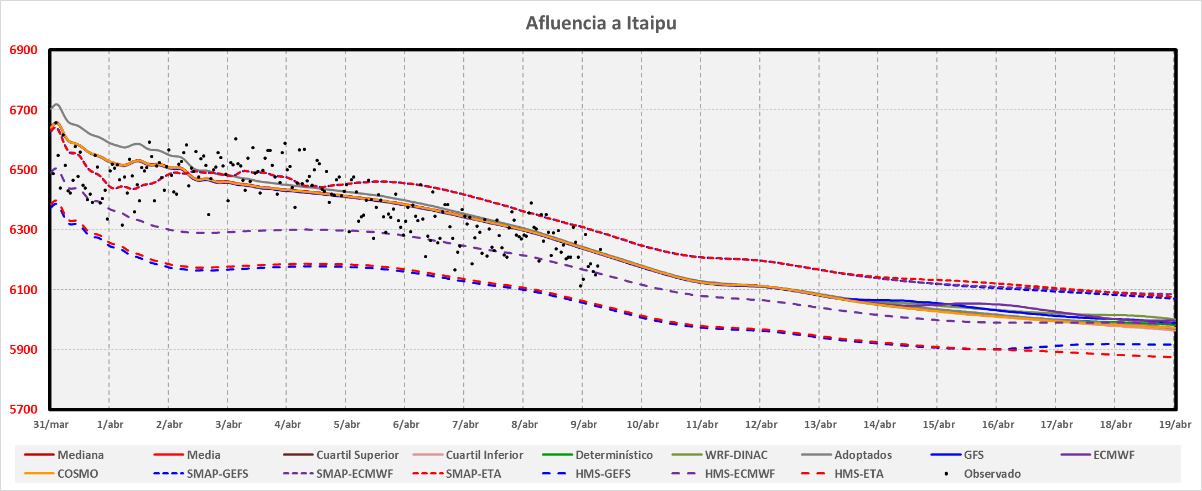
Decision Making
Forecast
Photo: Itaipu Binacional

Slide 8
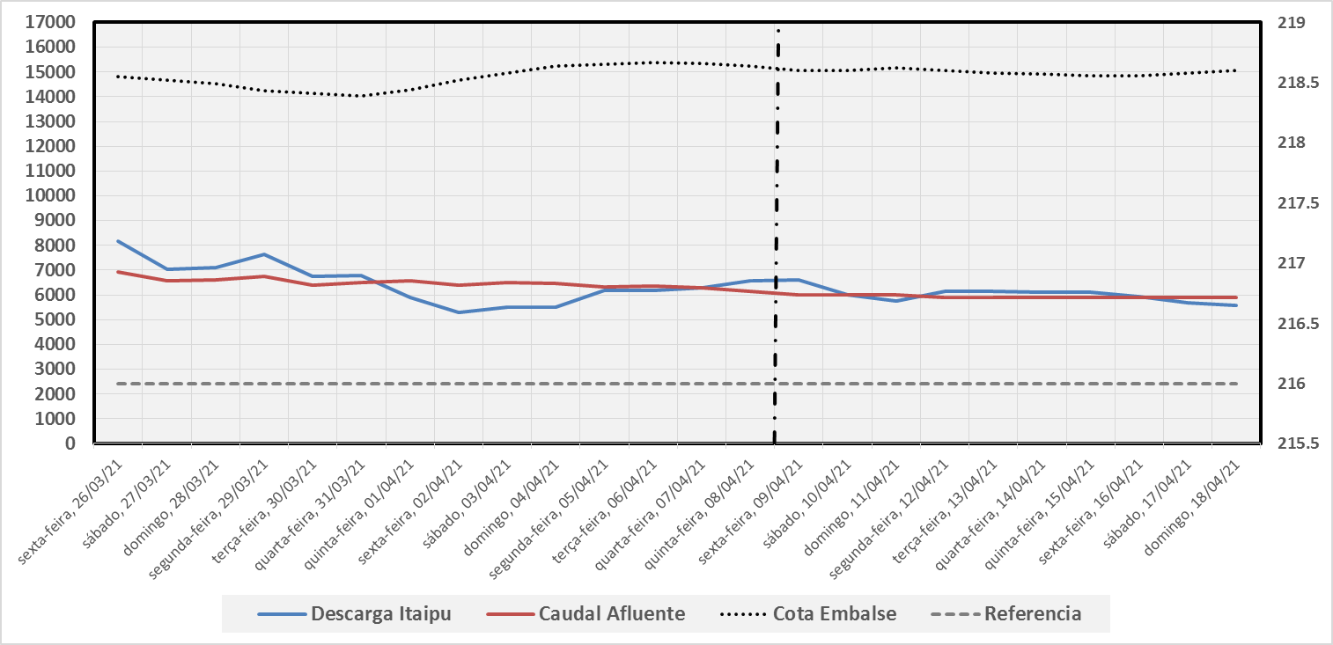
Reservoir impacts
Decision Making
Photo: Itaipu Binacional

Slide 9
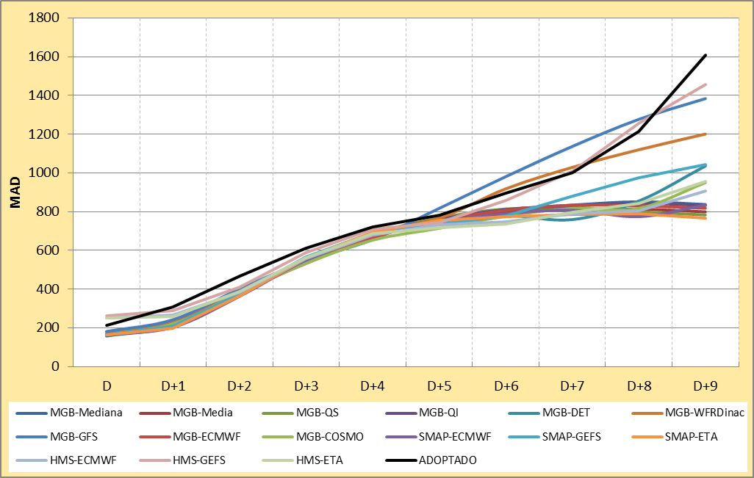
Forecast Metrics
Mean Average Error
Decision Making
Photo: Itaipu Binacional

Slide 10
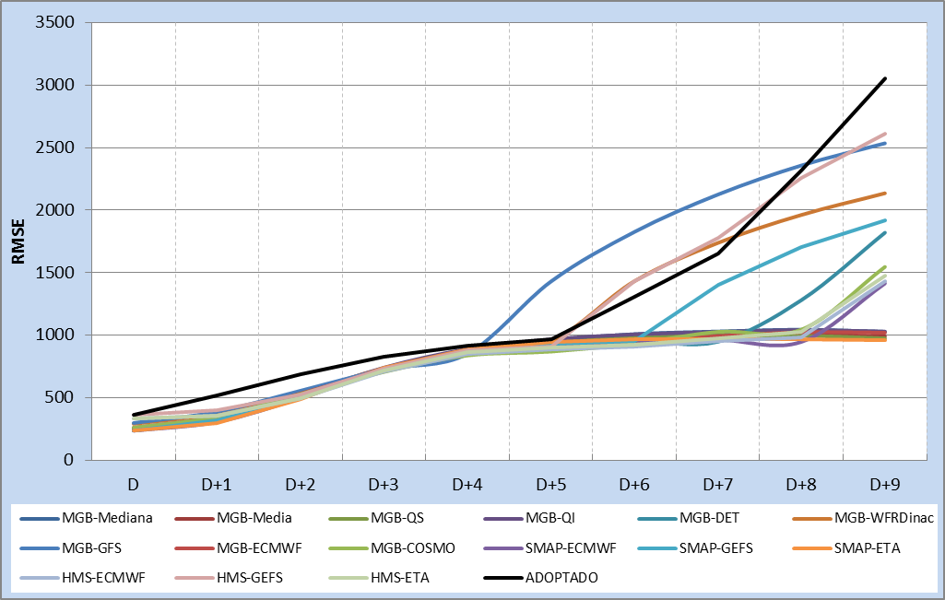
Forecast Metrics
Root Mean Square Error
Decision Making
Photo: Itaipu Binacional

Slide 11
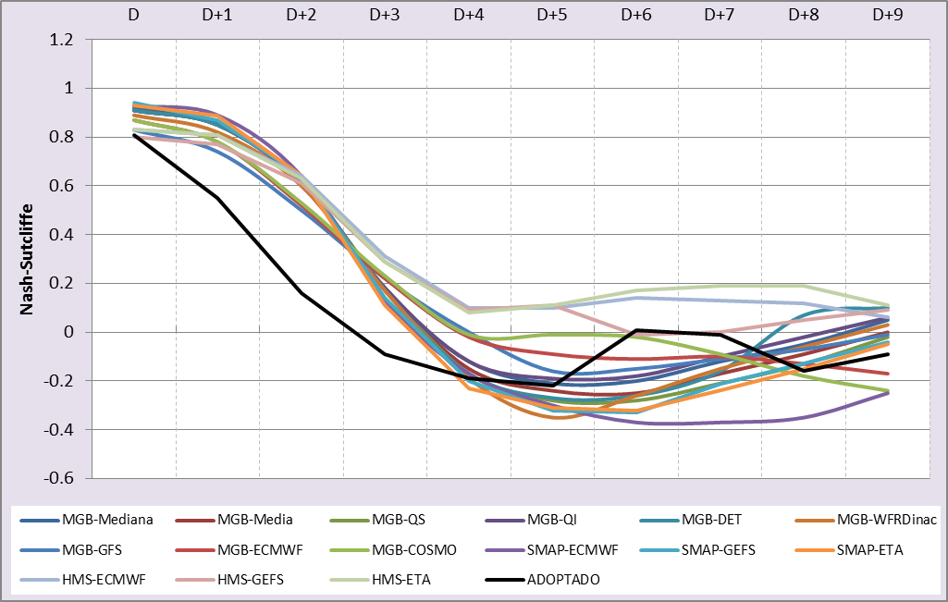
Forecast Metrics
Nash-Sutcliffe
Decision Making
Photo: Itaipu Binacional

Slide 12
Conclusions
The simulations are complementary and provides to the forecaster a general overview of the hydrologic situation.
Operational analysis of accuracy and reliability of the prediction are very important.
However, the forecaster needs to appeal to its own expertise to assure the consistence of the scenarios for decision-making.
Quantitative Precipitation Forecasts
Hydrological Models
Hydrodynamic Model
15 scenarios
Conclusions
Photo: Itaipu Binacional

