Slide 1
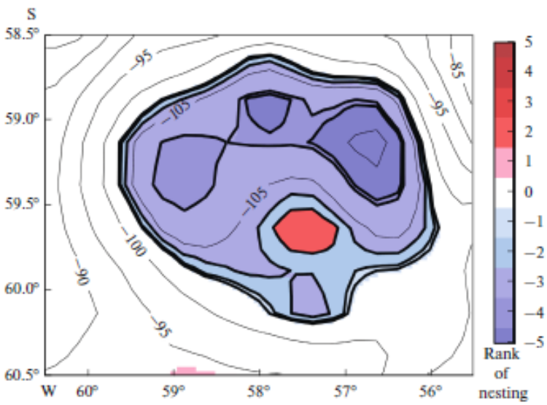
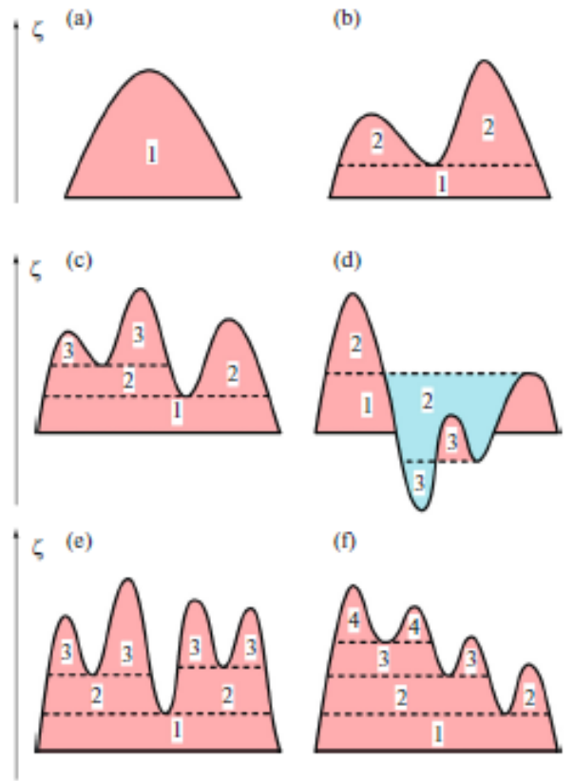
Distinguishing Closed Circulations from the Satellite Maps of the Dynamic Topography of the Ocean Surface
R.Y. Tarakanov, Shirshov Institute of Oceanology of RAS
An algorithm for distinguishing closed multicore circulations from digital maps of dynamic topography (DT) is described. The algorithm is based on the expansion of circulations over the area from their cores (local maxima/minima of the DT) until the DT thresholds corresponding to these cores are reached. The algorithm is performed in several iterations until the points belonging to the closed circulations are completely exhausted. The algorithm is an exact numerical solution of the problem of determining the value of the DT for a closed loop, the most distant from the core of circulation. The algorithm takes into account the problems of nesting circulations of different signs into each other, the possible intersecting of circulations with different signs on the numerical grid, and the possible existence of islands or floating ice inside the circulations. A method is described for merging smaller DT maps to larger maps with the circulations distinguished from the smaller maps.
Examples of schematic vertical sections (in the DT field) of circulations: (a) single-core, (b) dual-core, (c, d) three-core, and (e, f) four-core. Numbers indicate nesting ranks of the corresponding circulations.
Example of a multicore cyclonic circulation with an anticyclone nested in it. Isolines with digitization are lines of equal DT (cm).

Slide 2
The suggested algorithm for distinguishing multicore closed circulations is a successive iteration carried out until the grid points belonging to the closed circulations fully disappear on the map. Each iteration is divided into two steps:
Detection of the circulation core of both signs, including flat ones, i.e., consisting of several grid points with the same DT values. In order to do this, we use an eight-point scheme. In the case of part of the map with the same DT values, all such points forming a connected area are detected, and then this area is checked for compliance with a flat maximum/minimum. In this case, the edge points of the map are excluded from analysis.
Selection of the set of grid points around each core belonging to the closed circulation corresponding to this core. In this case, first we distinguish the circulations of one sign, then the circulations of another sign. The described procedure is illustrated in Figs. 4 and 5. First, we use the eight-point scheme to determine the sets of core points contacting the outer space (inner perimeter) and points of outer space adjacent to the core (outer perimeter). Then, in the outer perimeter, a point is found whose value is the closest to the value of DT in the core (the closest lower value for anticyclonic, and the nearest greater value for cyclonic circulations), which is marked to belong to the circulation and to its inner perimeter; then it is excluded from the outer perimeter. The points adjacent to it that do not belong to this circulation are defined as new points of the outer perimeter. Circulation points that do not contact the external space are excluded from the inner perimeter. At each subsequent step of the procedure, the values of the DT points from the outer perimeter are compared with the values of the DT of the last detected circulation point. The procedure continues until at least one of the following conditions is reached:

Slide 3
(A) Among the points of the outer perimeter, adjacent to the last identified (checked) point, such points appear whose DT values are greater than the DT at the tested point for anticyclones and smaller for cyclones. The last point identified in this case is the saddle (threshold).
(B) The circulation concerns the boundary of the map. In this case, the boundaries of land and ice as the boundaries of the map at this stage of the algorithm are not considered. The contact is determined by the fact that the second-to-last identified circulation point is on the edge of the map.
(C) A point appears in the outer perimeter that belongs to the circulation of the same sign identified at one of the previous iterations. The condition takes into account that different circulations of the same sign cannot have adjacent points. Otherwise, they would constitute a single circulation.
(D) A new tested point of circulation coincides with the point of circulation of the opposite sign identified at one of the previous iterations. The condition takes into account that the circulation of different sign can have adjacent points.

Slide 4
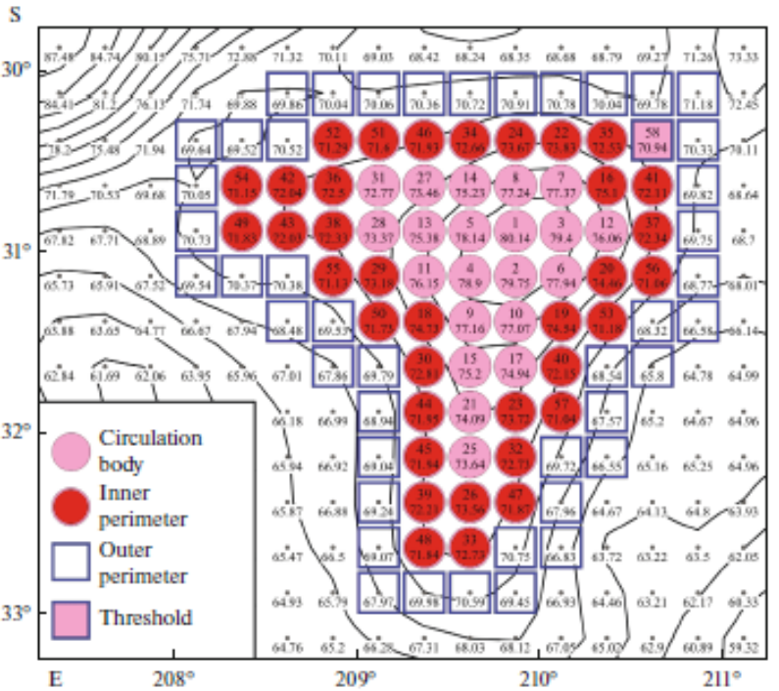
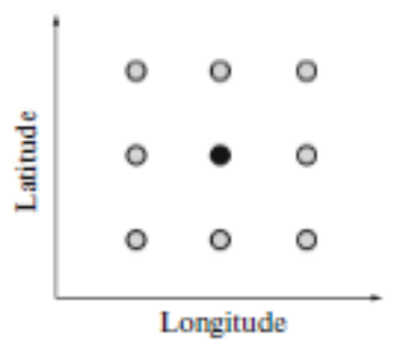
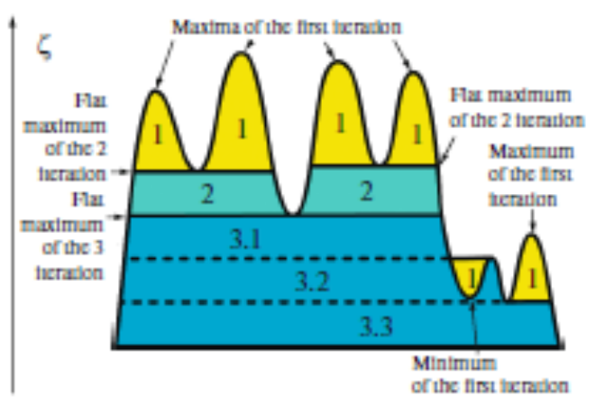
Body, inner and outer perimeters, and saddle (threshold) on the example of anticyclonic circulation. Numbers of circles correspond to the sequence of determining the nodes of the grid that make up the body of circulation. Numbers indicate DT units (cm). Isolines are lines of equal DT.
Eight-point (light circles) scheme for determining the local extremum relative to the center point (dark circle).
Schematic vertical section (in the field of DT, ζ) of multicore circulation. Numbers indicate iterations of the procedure for distinguishing circulations.

Slide 5
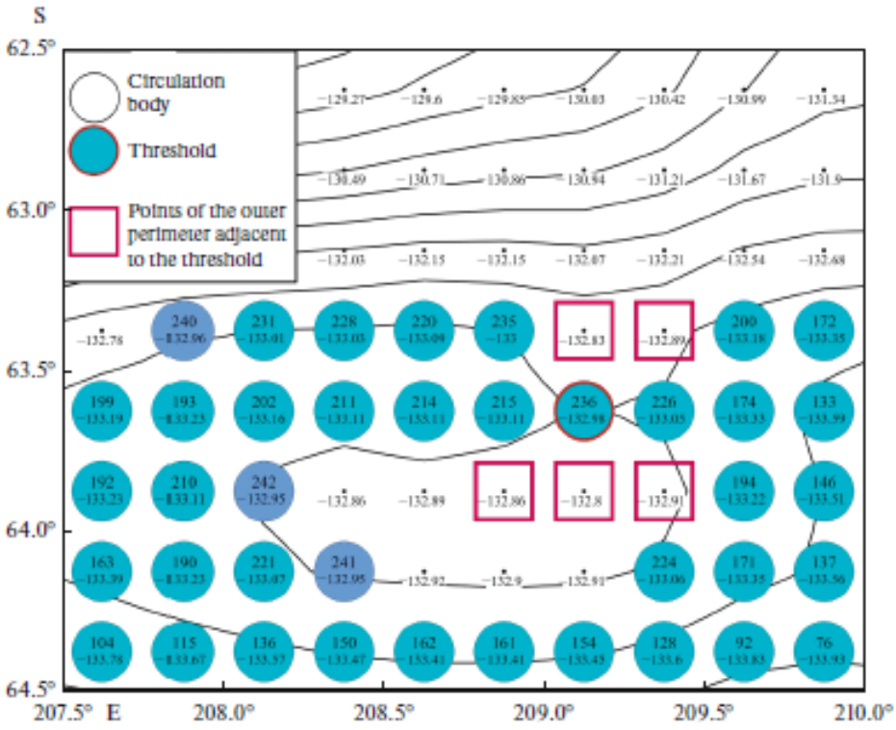
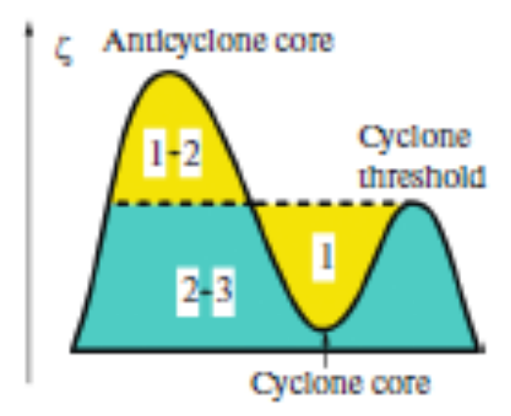
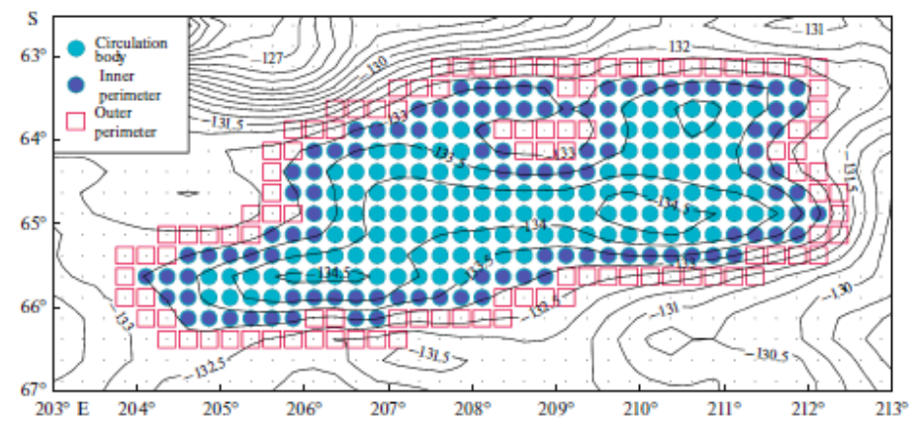
Schematic vertical section (in the field of DT, ζ) of anticyclonic circulation with a nested cyclone during one iteration. Numbers indicate iterations of the procedure for distinguishing circulations. Distinguishing a doubly connected anticyclone proceeds from the first iteration to the second, and distinguishing the anticyclone of the first rank proceeds from the second to the third iteration.
Region of non-simply connected cyclonic circulation containing a local threshold among its points (point 236). The values of the DT at the points adjacent to it that do not belong to the circulation body (marked with squares) appear greater than the values of the DT of the local saddle. As a result, the expansion procedure does not stop under the condition (A) indicated in the text of the paper and a number of points (marked with darker circles) are distinguished as belonging to circulation. The numbers of circles correspond to the sequence of determining the nodes of the grid that make up the body of circulation. Numbers indicate DT units (cm). Isolines are lines of equal DT.
Example of distinguishing a non-simply connected circulation during one iteration. The points of the outer perimeter form two independent connected regions. Isolines are lines of equal ADT-AVISO (cm).

Slide 6
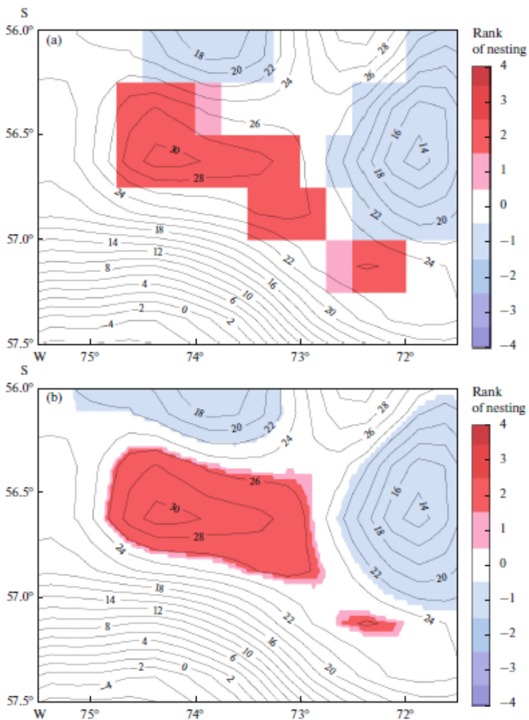
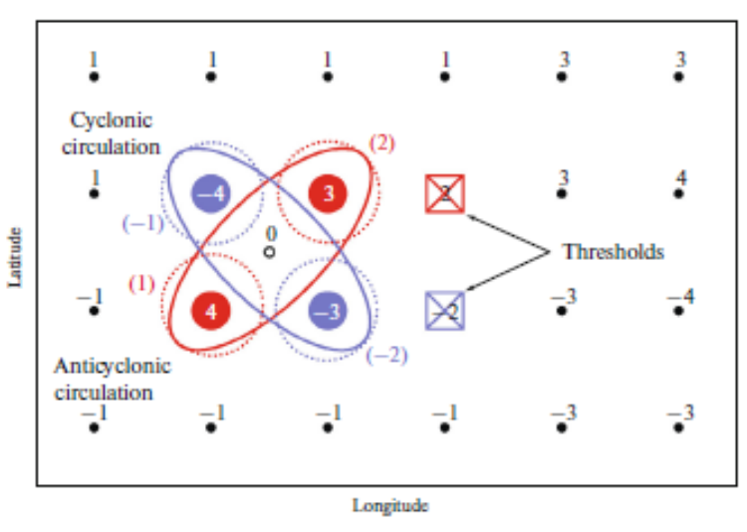
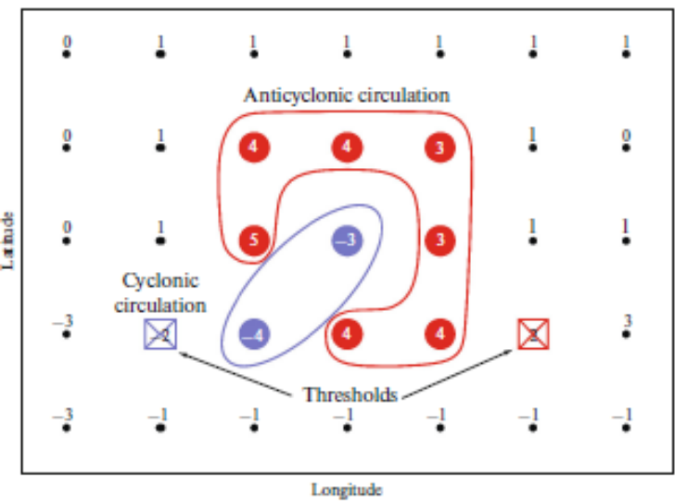
Intersection of two circulations of different signs in the algorithm used for distinguishing closed circulations. Numbers are values of DT at the corresponding points. Dotted lines indicate the distinguished parts of the circulations. The numbers in parentheses are their boundary values. The black circle shows the position of the center of the intersection square.
Example of a formal intersection along the diagonal of two circulations of different signs. The anticyclonic circulation has an additional internal connection; hence, there is no separation of the circulations into parts.
Example of dividing a connected anticyclonic circulation into two parts during interpolation into a smaller grid than the original one. (a) Initial quarter-degree grid of DT. (b) Interpolation with a step of 0.025°. Isolines are ADT lines in cm.

Slide 7
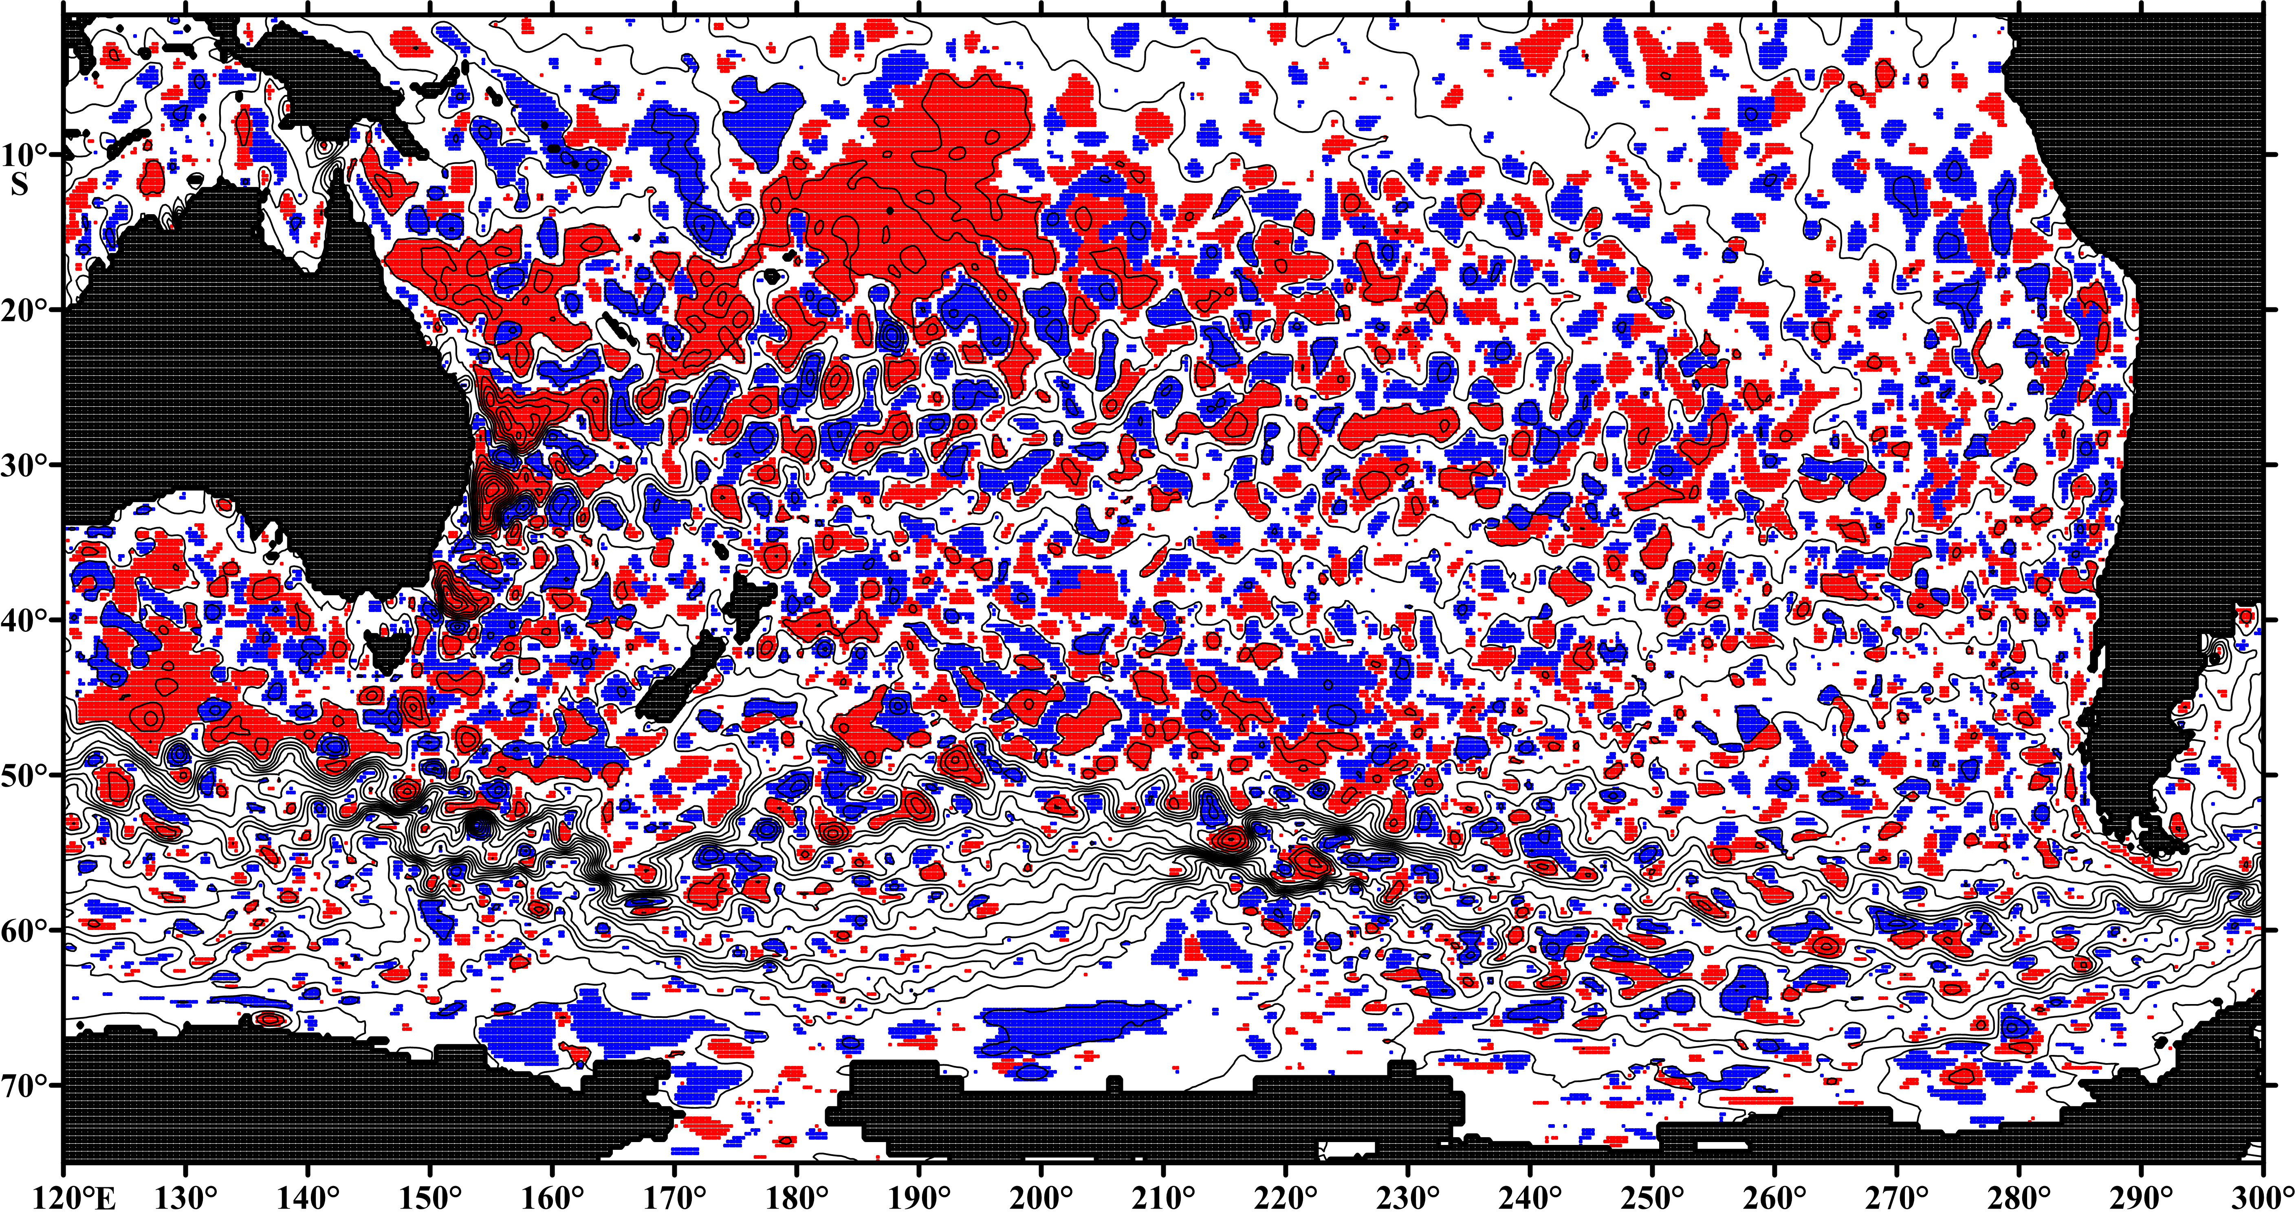
Closed circulation of rank 1 according to the ADT-AVISO data in the South Pacific (from 1° S to 75° S) on January 1, 1993. The map is constructed of five meridional bands: 120° –180° E, 150° –210° E, 180° –240° E, 210° –270° E and 240° –300° E Isolines are ADT lines with a step of 10 cm. Digitization of isolines is not shown not to overload the map.
Publication: Tarakanov R.Y. Distinguishing Closed Circulations from the Satellite Maps of the Dynamic Topography of the Ocean Surface // Izvestiya, Atmospheric and Oceanic Physics, 2019, Vol. 55, No. 5, pp. 480–491

