Slide 1
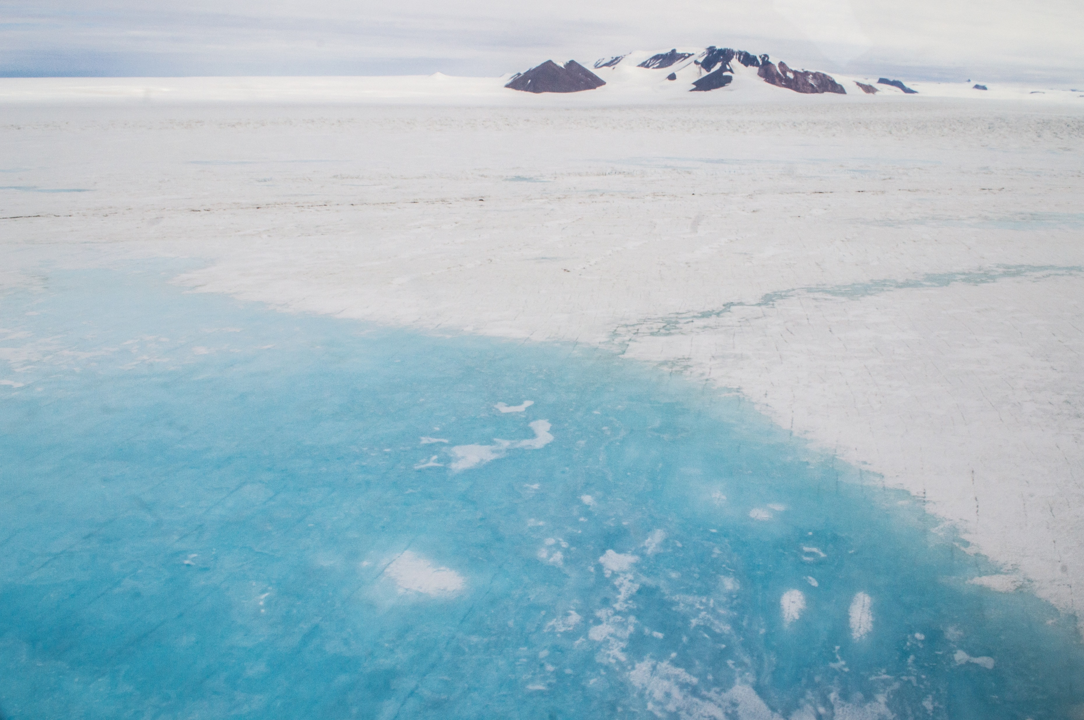









Large interannual variability in supraglacial lake areas and volumes around East Antarctica
Supraglacial lake on Mawson Glacier (Rich Selwyn Jones, Monash University)
¹
²
³
Jennifer Arthur¹, Chris Stokes¹, Stewart Jamieson¹, Rachel Carr², Amber Leeson³
jennifer.arthur@durham.ac.uk
@AntarcticJenny

Slide 2
Motivation to
Objectives
1. To quantify lake area and volume during the peak of the melt season in January from 2014 to 2020.
2. To explore potential climatic and surface controls on lake interannual variability.
Large interannual variability in supraglacial lake areas and volumes around East Antarctica Jennifer Arthur, Durham University
Supraglacial lakes have been linked to ice shelf collapse, but multiyear lake observations at the ice-sheet scale remain lacking in East Antarctica.
Constraining present-day lake distributions and interannual variability allows us to examine related controls and will help to constrain critical thresholds of ice shelf stability.
This will improve predictability of the impact of atmospheric warming on surface meltwater production and its delivery to ice shelves vulnerable to hydrofracture-driven collapse.
Our aim is to investigate the interannual variability of lakes around East Antarctica and related controls.
• • • • • • • •

Slide 3
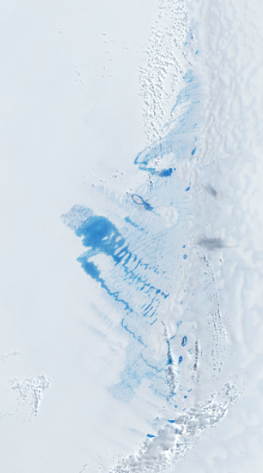
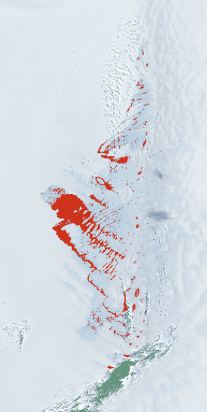
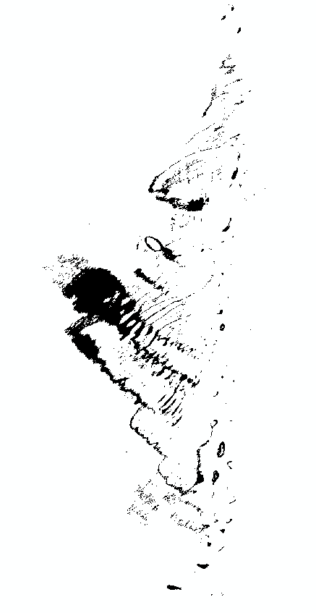
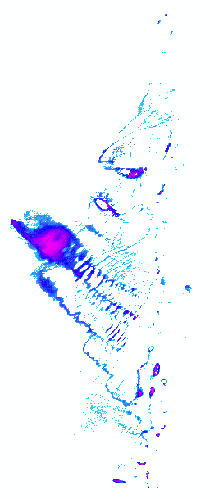

Interannual record of East Antarctic lake distributions and volumes (2014 – 2020)
Lake Depth (m)
Large interannual variability in supraglacial lake areas and volumes around East Antarctica Jennifer Arthur, Durham University
lake
cloud
4
0.9
10 km
Landsat 8 image
Binary lake mask
Pixel-based classification
(Moussavi et al. 2020)
Depth-reflectance model
(Pope et al. 2016)
• • • • • • • •

Slide 4
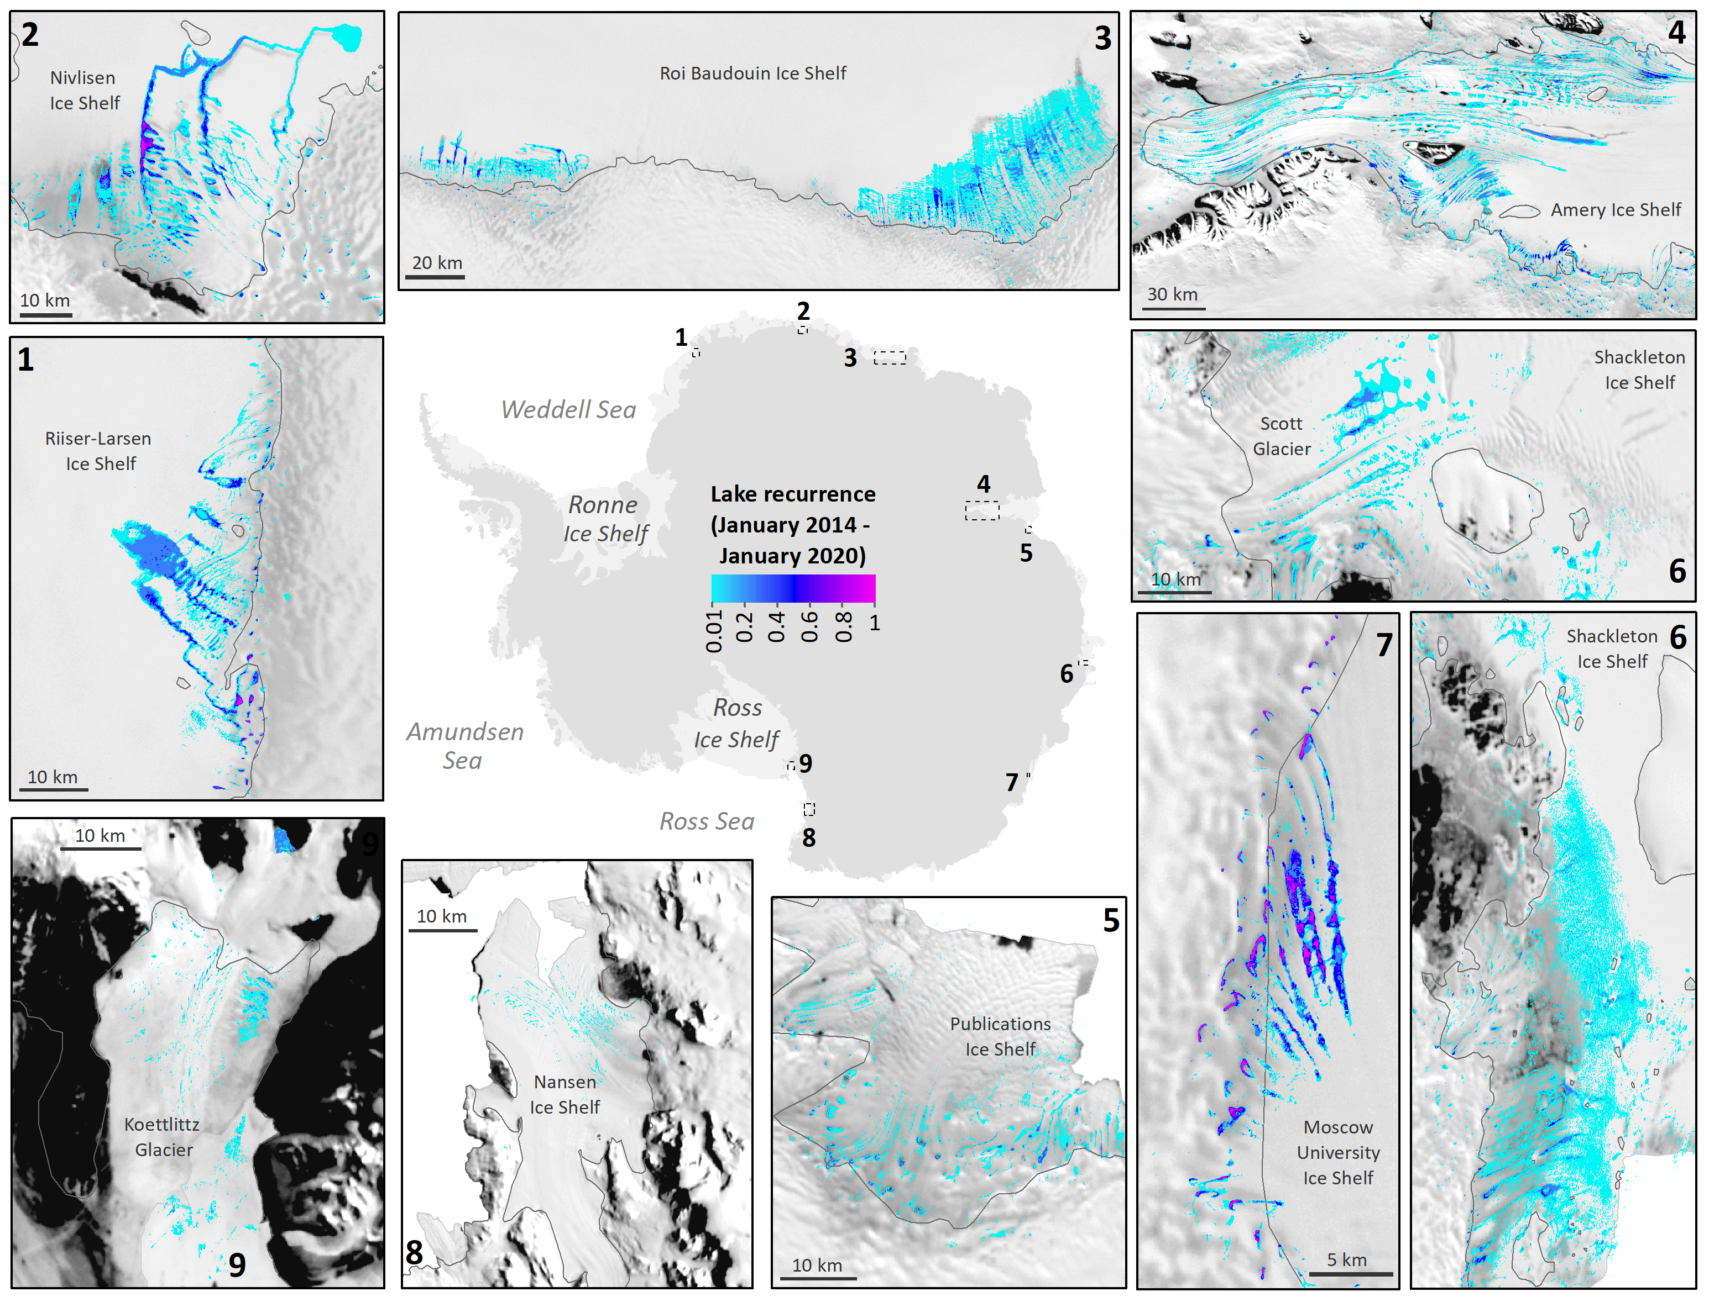
There is important spatial complexity in lake distributions interannually.
Turquoise/pale blue colours correspond to infrequently-forming lakes (i.e. that formed in a single year) and pink/purple colours correspond to frequently-forming lakes (i.e. that formed on multiple dates in January in several or all years).
Evidence of lakes expanding across ice shelves from 2014 to 2020 (e.g. Nivlisen).
Large interannual variability in supraglacial lake areas and volumes around East Antarctica Jennifer Arthur, Durham University
Interannual variability
in lake distributions
Colour bar = normalised count of overlapping lakes at their maximum extent during January from 2014 to 2020, weighted according to the number of useable (partially or totally cloud-free) satellite images.
• • • • • • • •

Slide 5
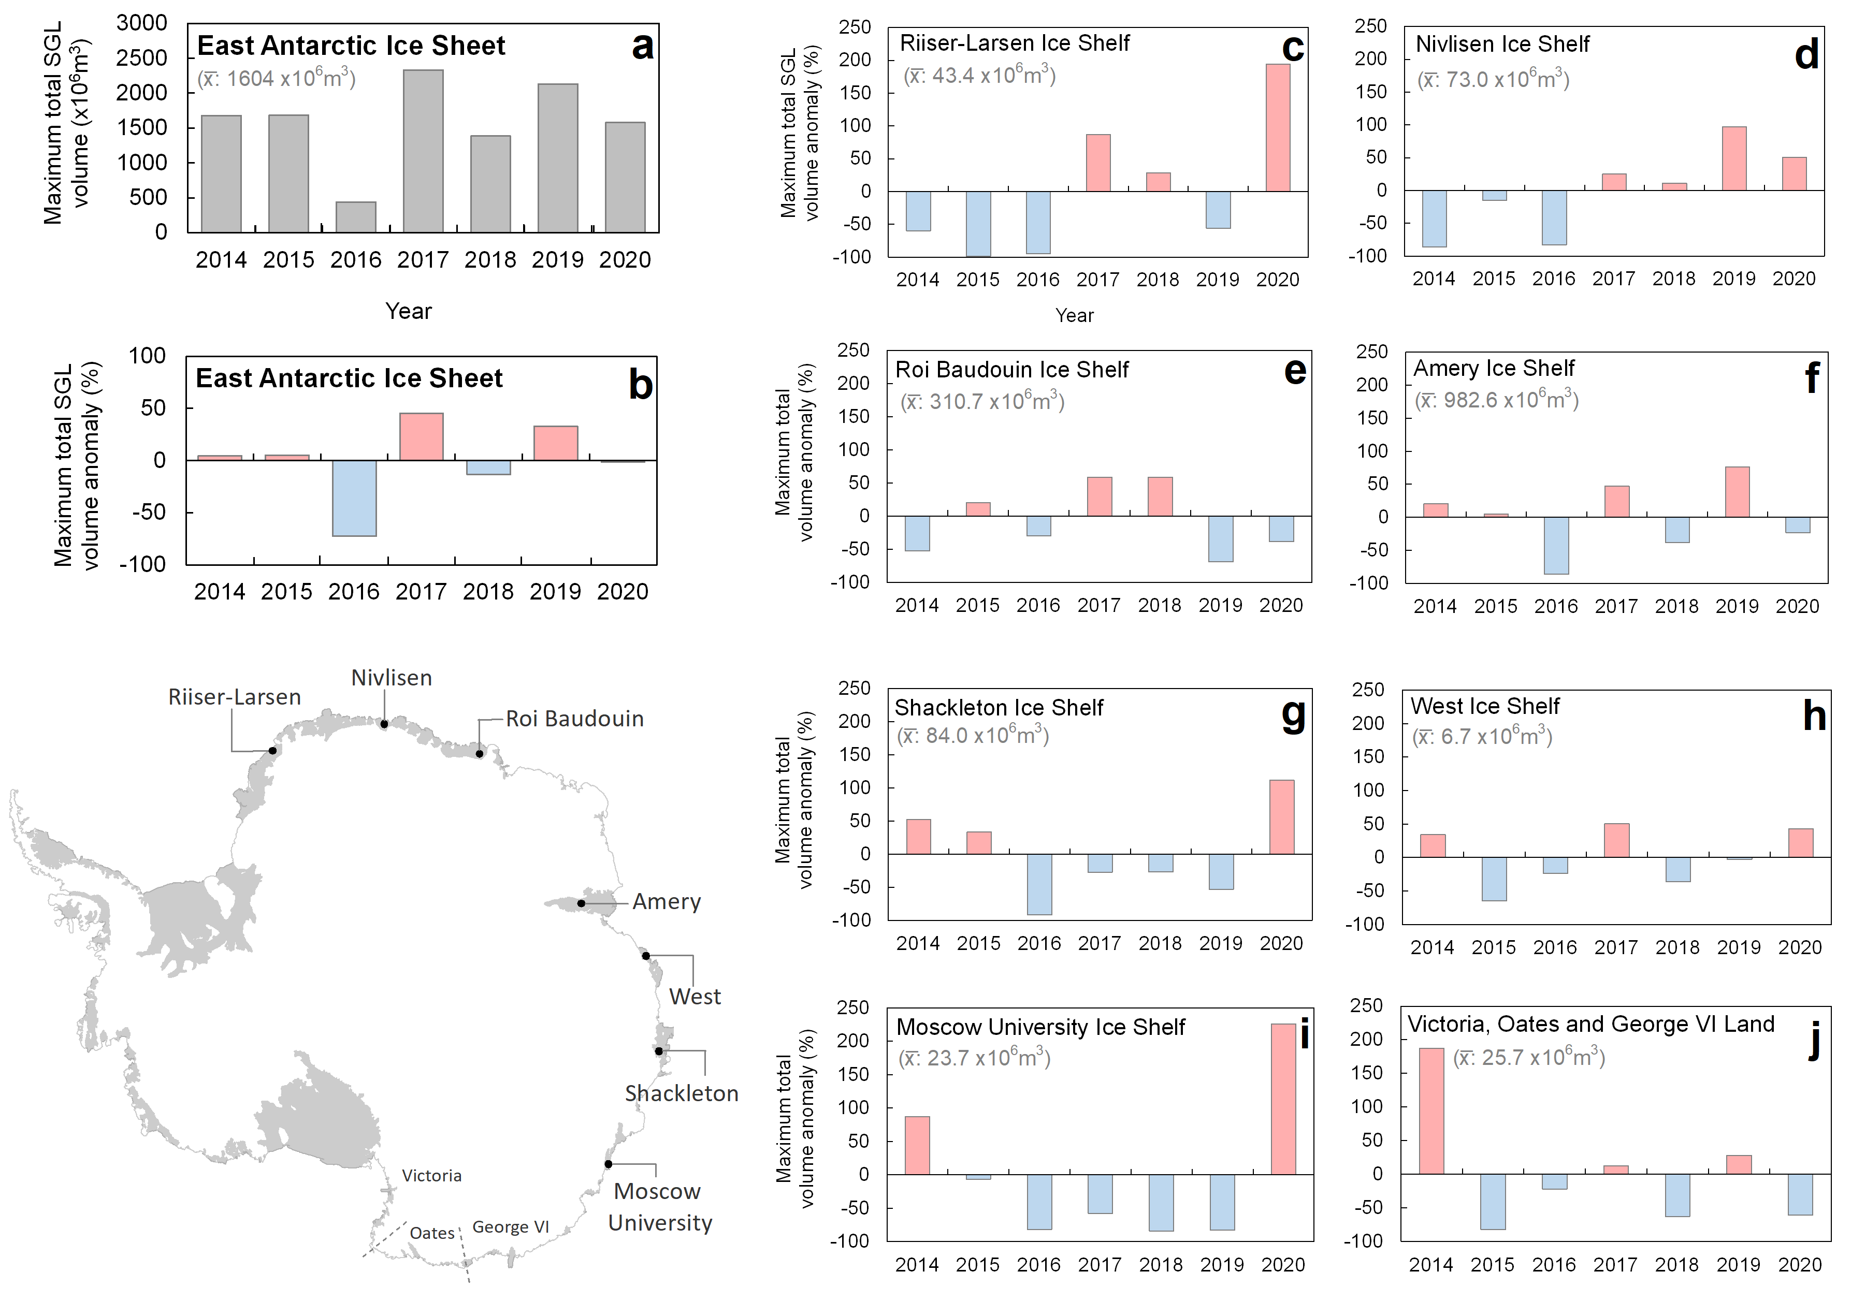
to
EAIS-wide total lake volume and area fluctuate interannually by up to ~72% and ~61% respectively.
EAIS-wide lake volume 2017 was substantially above average (>2300 million cubic m) and below average in 2016 (>430 million cubic m).
On individual ice shelves, lake volume can fluctuate interannually by over 200% (e.g. January 2020).
Ice shelves within the same EAIS region display asynchronicity in total lake volume between years (e.g. Nivlisen and Roi Baudouin).
Large interannual variability in supraglacial lake areas and volumes around East Antarctica Jennifer Arthur, Durham University
Interannual variability
in lake volumes
• • • • • • • •

Slide 6
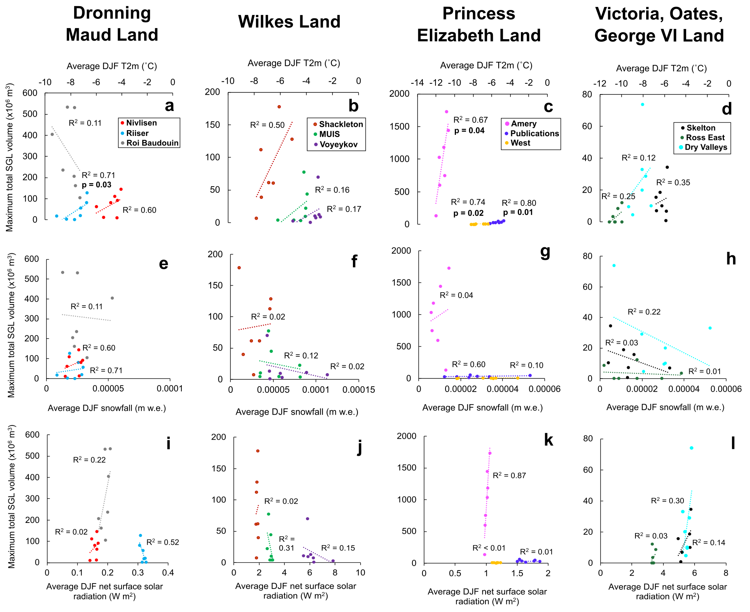
Relationships with climatic variables
At the ice-sheet scale, average DJF* 2-m air temperature (from ERA5 reanalysis) is most strongly correlated with interannual variability in total lake area (r² = 0.37) and volume (r² = 0.35).
This indicates that more extensive, deeper lakes form in ice shelf grounding zones with lower firn air content.
Lower correlations with average summer surface snowfall and net surface solar radiation.
Next step: will investigate relationship with snowfall over preceding year (Jan-Nov).
Large interannual variability in supraglacial lake areas and volumes around East Antarctica Jennifer Arthur, Durham University
*December-January-February
• • • • • • • •

Slide 7
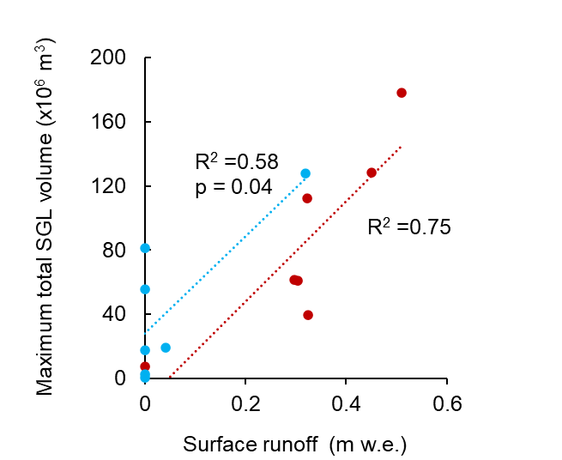
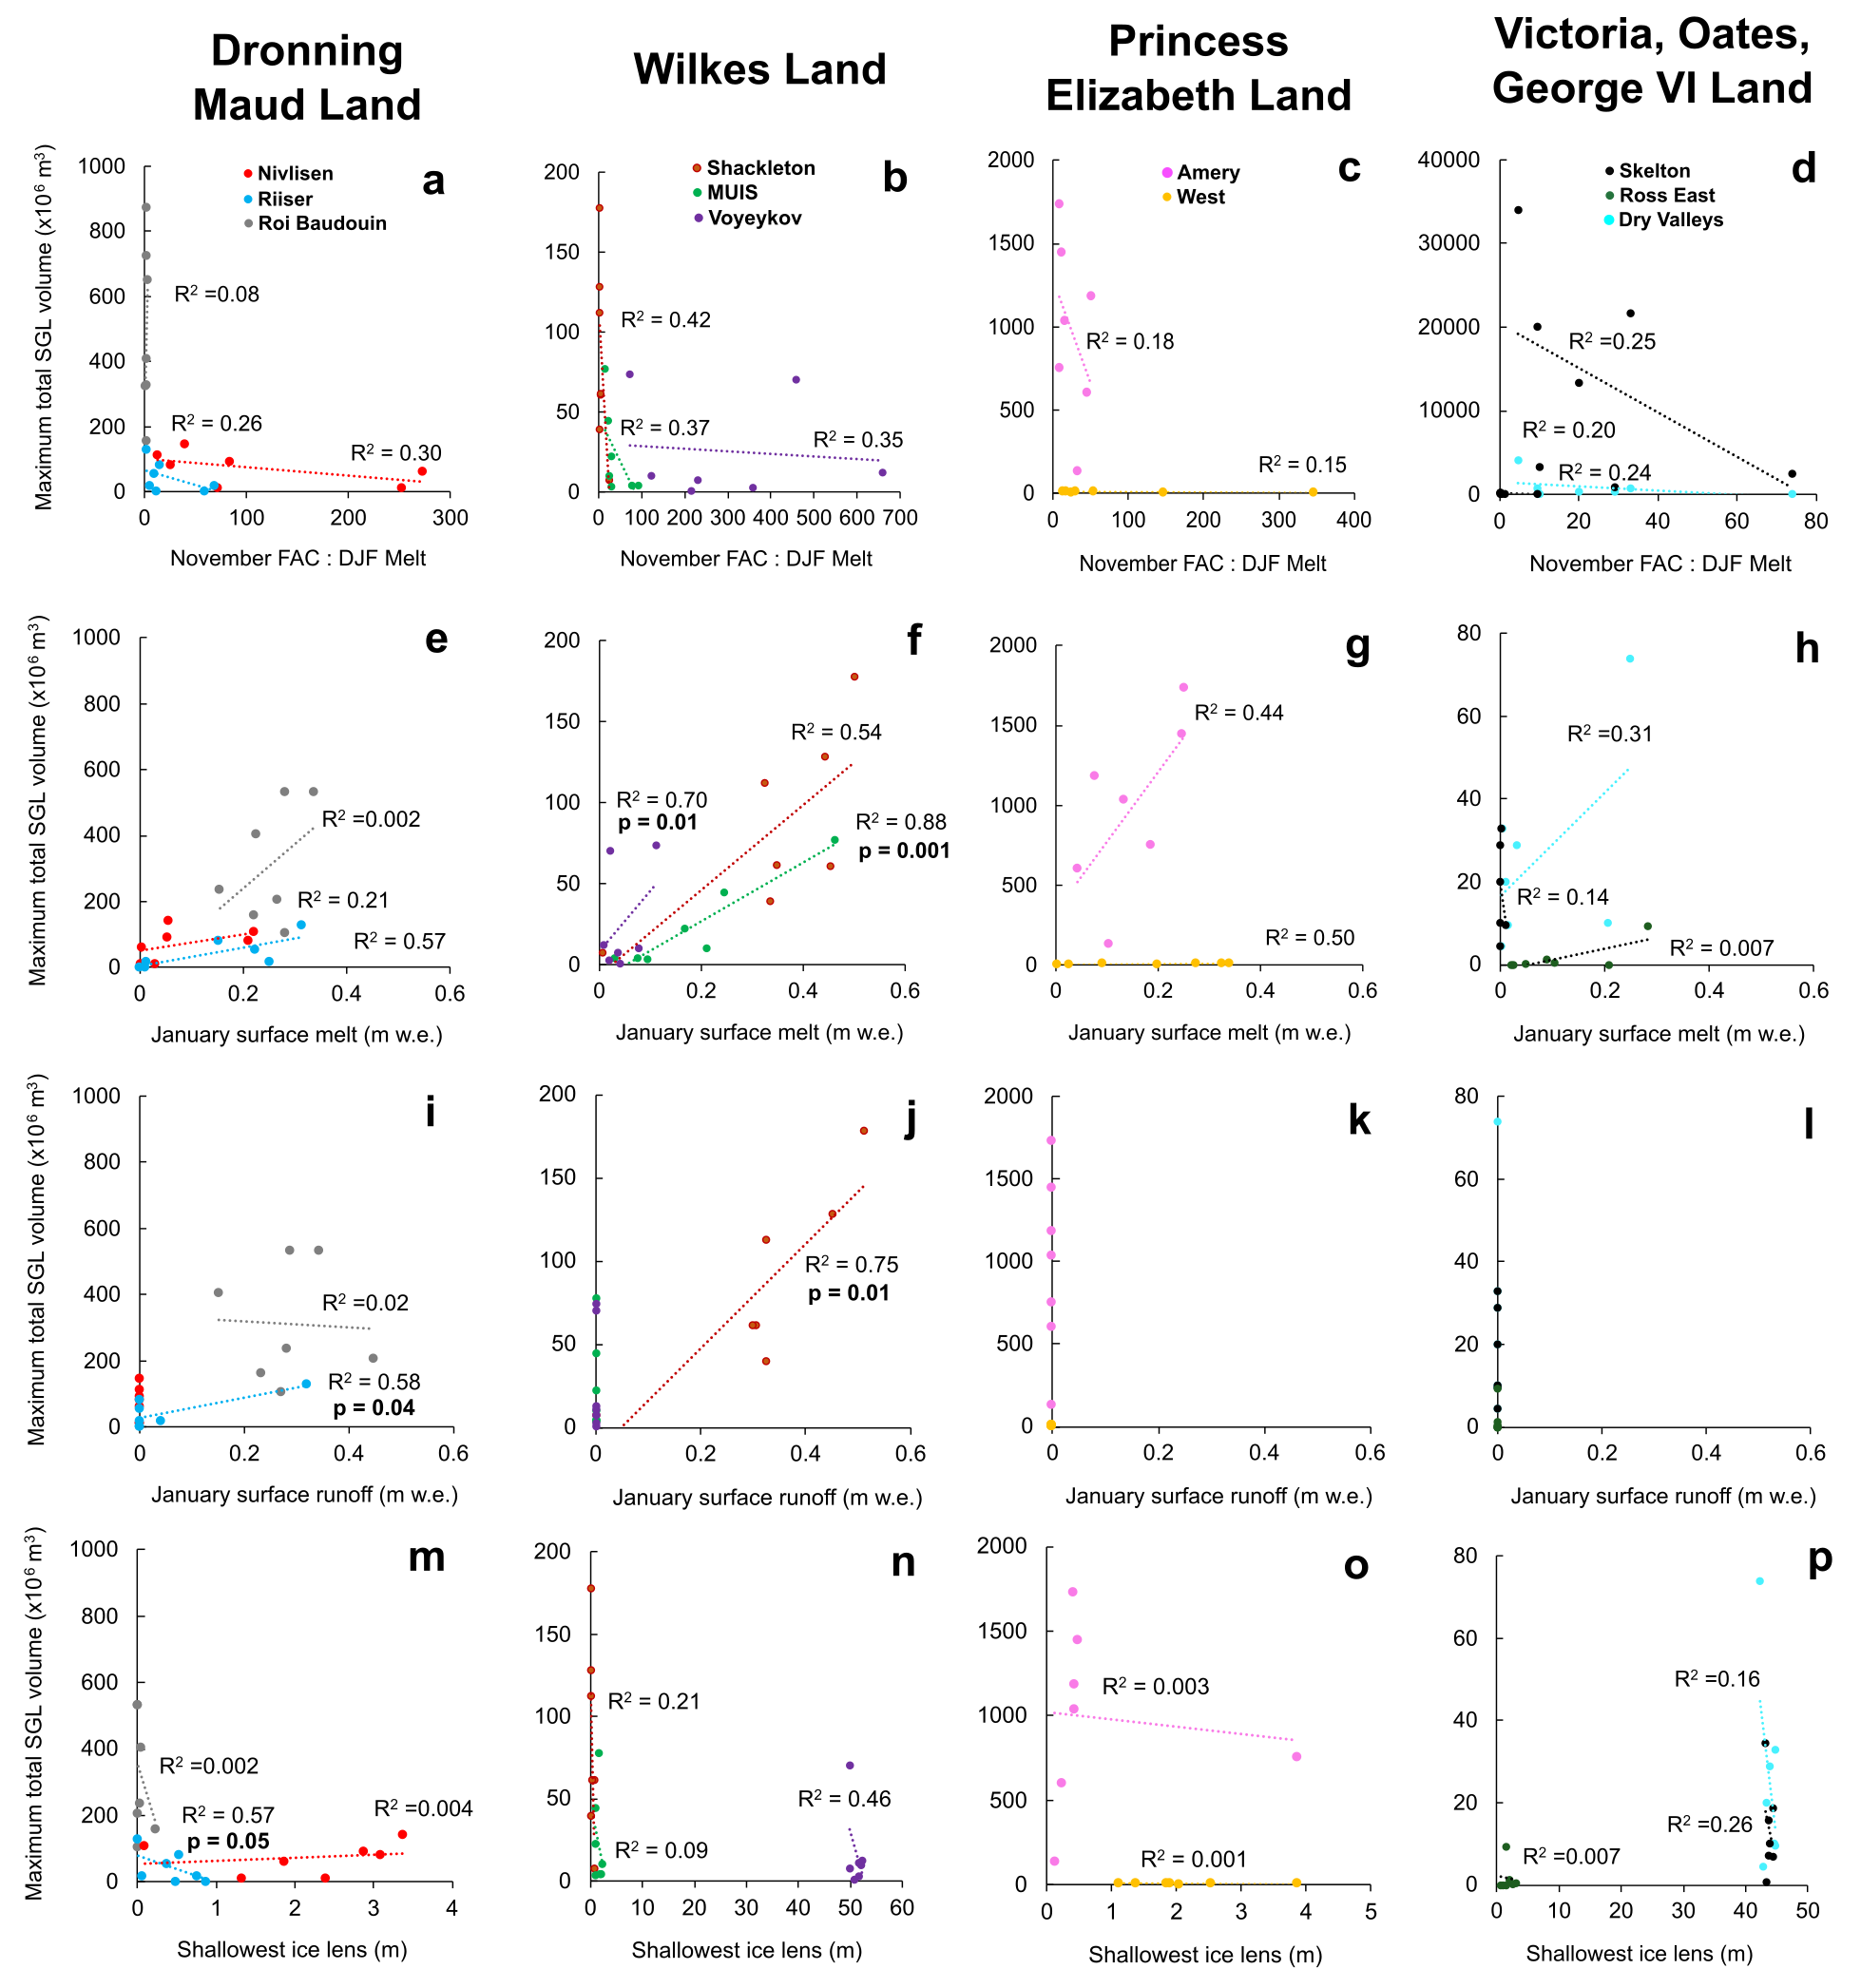
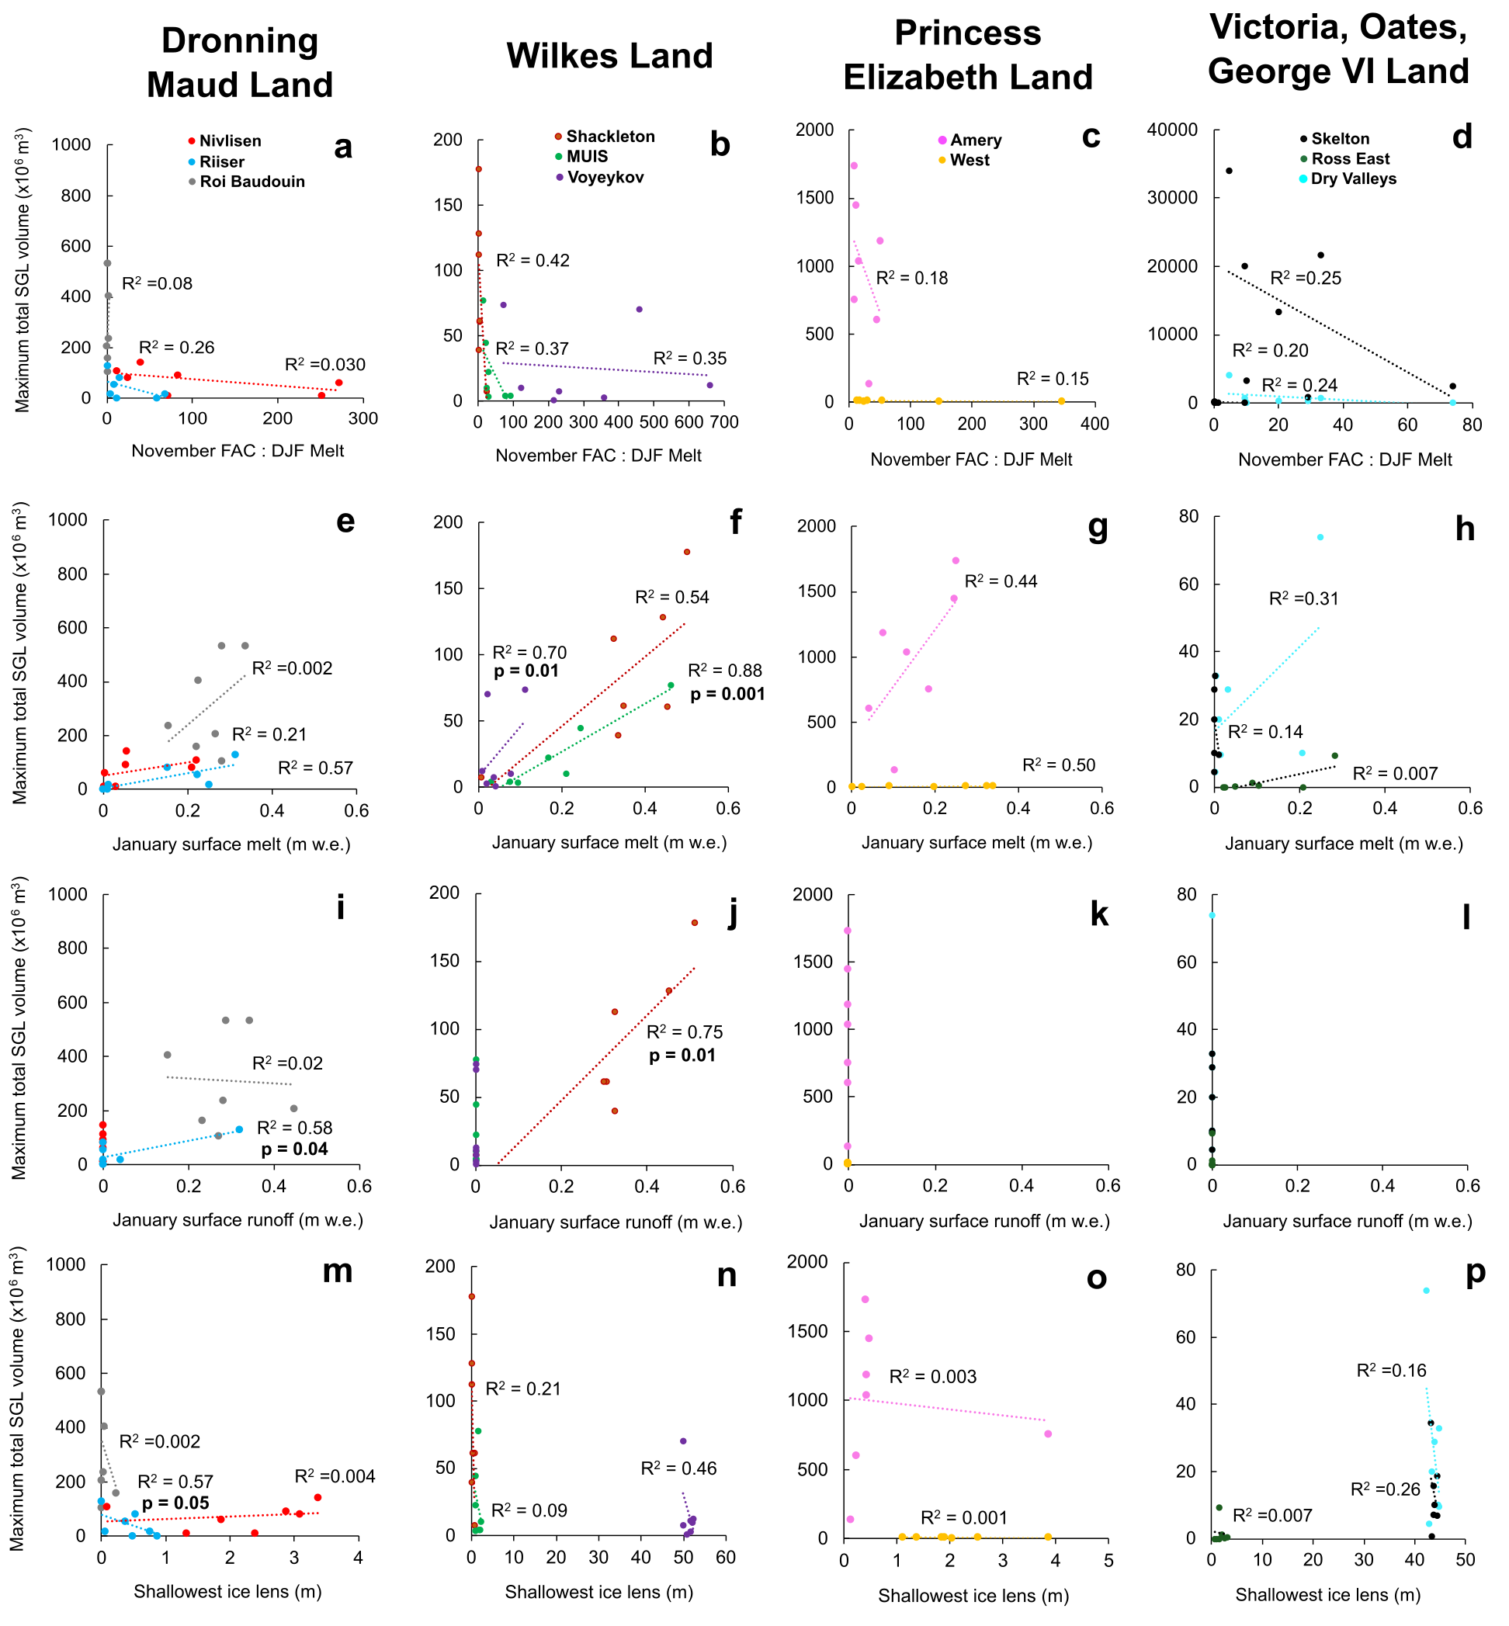
Large interannual variability in supraglacial lake areas and volumes around East Antarctica Jennifer Arthur, Durham University
Relationships with surface/firn conditions
At the ice-sheet scale, lake volume is significantly correlated with average summer firn air content.
Lake volume is significantly correlated with average January surface melt and runoff on ice shelves vulnerable to disintegration (e.g. Shackleton Ice Shelf^{3, 4}).
Weaker correlations between lake volume and FAC, runoff, melt and ice lens depth on other ice shelves with complex surface topography (e.g. Roi Baudouin, Nivlisen, Amery) suggest localised melt-albedo feedbacks are not fully resolved by MAR.
Low January runoff on most ice shelves suggests MAR may be overestimating accumulation, possibly related to absence of drifting snow processes in the model.
Firn air content
Surface runoff
Minimum ice
lens depth
Community Firn Model¹
MARv3.11²
Surface melt
p = 0.04
p = 0.01
January surface runoff (m w.e.)
¹Stevens et al. (2020), ²Kittel et al. (2021), ³Gilbert and Kittel (2021), ⁴Lai et al. (2020).
• • • • • • • •

Slide 8
Summary
Large interannual variability in supraglacial lake areas and volumes around East Antarctica Jennifer Arthur, Durham University
Our inventory of East Antarctic supraglacial lakes in January over seven melt season (2014 to 2020) shows lake interannual variability is spatially complex and asynchronous on different East Antarctic ice shelves.
Total lake volume fluctuates by as much as 200% between melt seasons on individual ice shelves.
Lake area and volume are significantly correlated with summer (DJF) air temperature, firn air content and ice lens depth. This relationship weakens on ice shelves with topographically-complex grounding zones.
Lake volumes are significantly correlated with modelled surface melt and runoff on some ice shelves potentially vulnerable to hydrofracture (e.g. Shackleton Ice Shelf).
• • • • • • • •

Slide 9
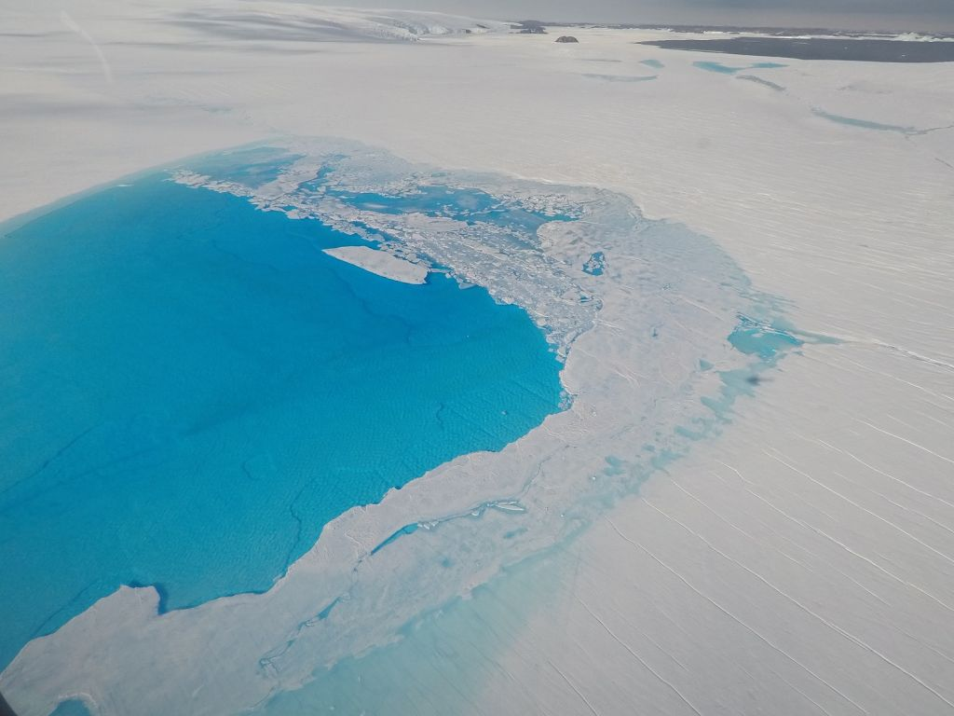
Questions?
Large interannual variability in supraglacial lake areas and volumes around East Antarctica Jennifer Arthur, Durham University
¹
²
³
CR3.6 Tuesday 27th April 9:00 CEST
https://meetingorganizer.copernicus.org/EGU21/EGU21-6263.html
References
Moussavi et al. (2020) Antarctic Supraglacial Lake Detection Using Landsat 8 and Sentinel-2 Imagery: Towards Continental Generation of Lake Volumes. Remote Sensing, 12, 134, doi:10.3390/rs12010134.
Pope et al. (2016) Estimating supraglacial lake depth in West Greenland using Landsat 8 and comparison with other multispectral methods. Cryosphere, 10, 15-27, doi:10.5194/tc-10-15-2016.
Stevens et al. (2020) ‘The Community Firn Model (CFM) v1.0’, Geoscientific Model Development, 13(9), pp. 4355–4377. doi: 10.5194/gmd-13-4355-2020.
Lai et al. (2020) Vulnerability of Antarctica’s ice shelves to meltwater-driven fracture. Nature 583, doi: 10.1038/s41586-020-2627-8/
Kittel et al. (2021) Diverging future surface mass balance between the Antarctic ice shelves and grounded ice sheet. Cryosphere 15, 1215-1236 doi: 10.5194/tc-2020-291/
Gilbert and Kittel (2021) Surface melt and runoff on Antarctic ice shelves at 1.5°C, 2°C and 4°C of future warming. Geophys. Res. Lett. doi: 10.1029/2020GL091733.
jennifer.arthur@durham.ac.uk
@AntarcticJenny
• • • • • • • •

