Slide 1

The use of environmental data in detailing the hydroregime of a temporary pond
Gavin Campbell and Eric Hyslop | University of the West Indies, Jamaica
Analysis of temperature and light intensity data on a fine temporal scale is a reliable measure of the hydroregime of a temporary pond, particularly with mean daily temperature range, maximum light intensity and rate of change of both parameters

Slide 2
Presentation Content
Introduction
Methodology
Results and Discussion
Conclusion
Future Work

Slide 3
Introduction

Slide 4
Temporary Ponds
Temporary waters are those which have a recurring dry phase (Williams 2006)
The length of the aquatic phase (hydroperiod) is key in determining ecological factors such as species richness and diversity (Tarr 2005; Crabot et al. 2019)
Determination of either aquatic or terrestrial (dry) phase to date relies on site visits and camera traps

Slide 5
The Model
Here we propose a model for determining temporary pond phase using data loggers of temperature and light intensity
Not only is phase determined, but key ecological criteria are collected throughout

Slide 6
Methodology

Slide 7
Study Site
The study site, Dragonfly Pond, is an exposed temporary pond located on the campus of the University of the West Indies in Jamaica
As a rain-fed pond, it cycles through aquatic and terrestrial phases in response to rainfall, infiltration and evapotranspiration
The peak wet season and thus main aquatic phase stretches from September to November annually

Slide 8
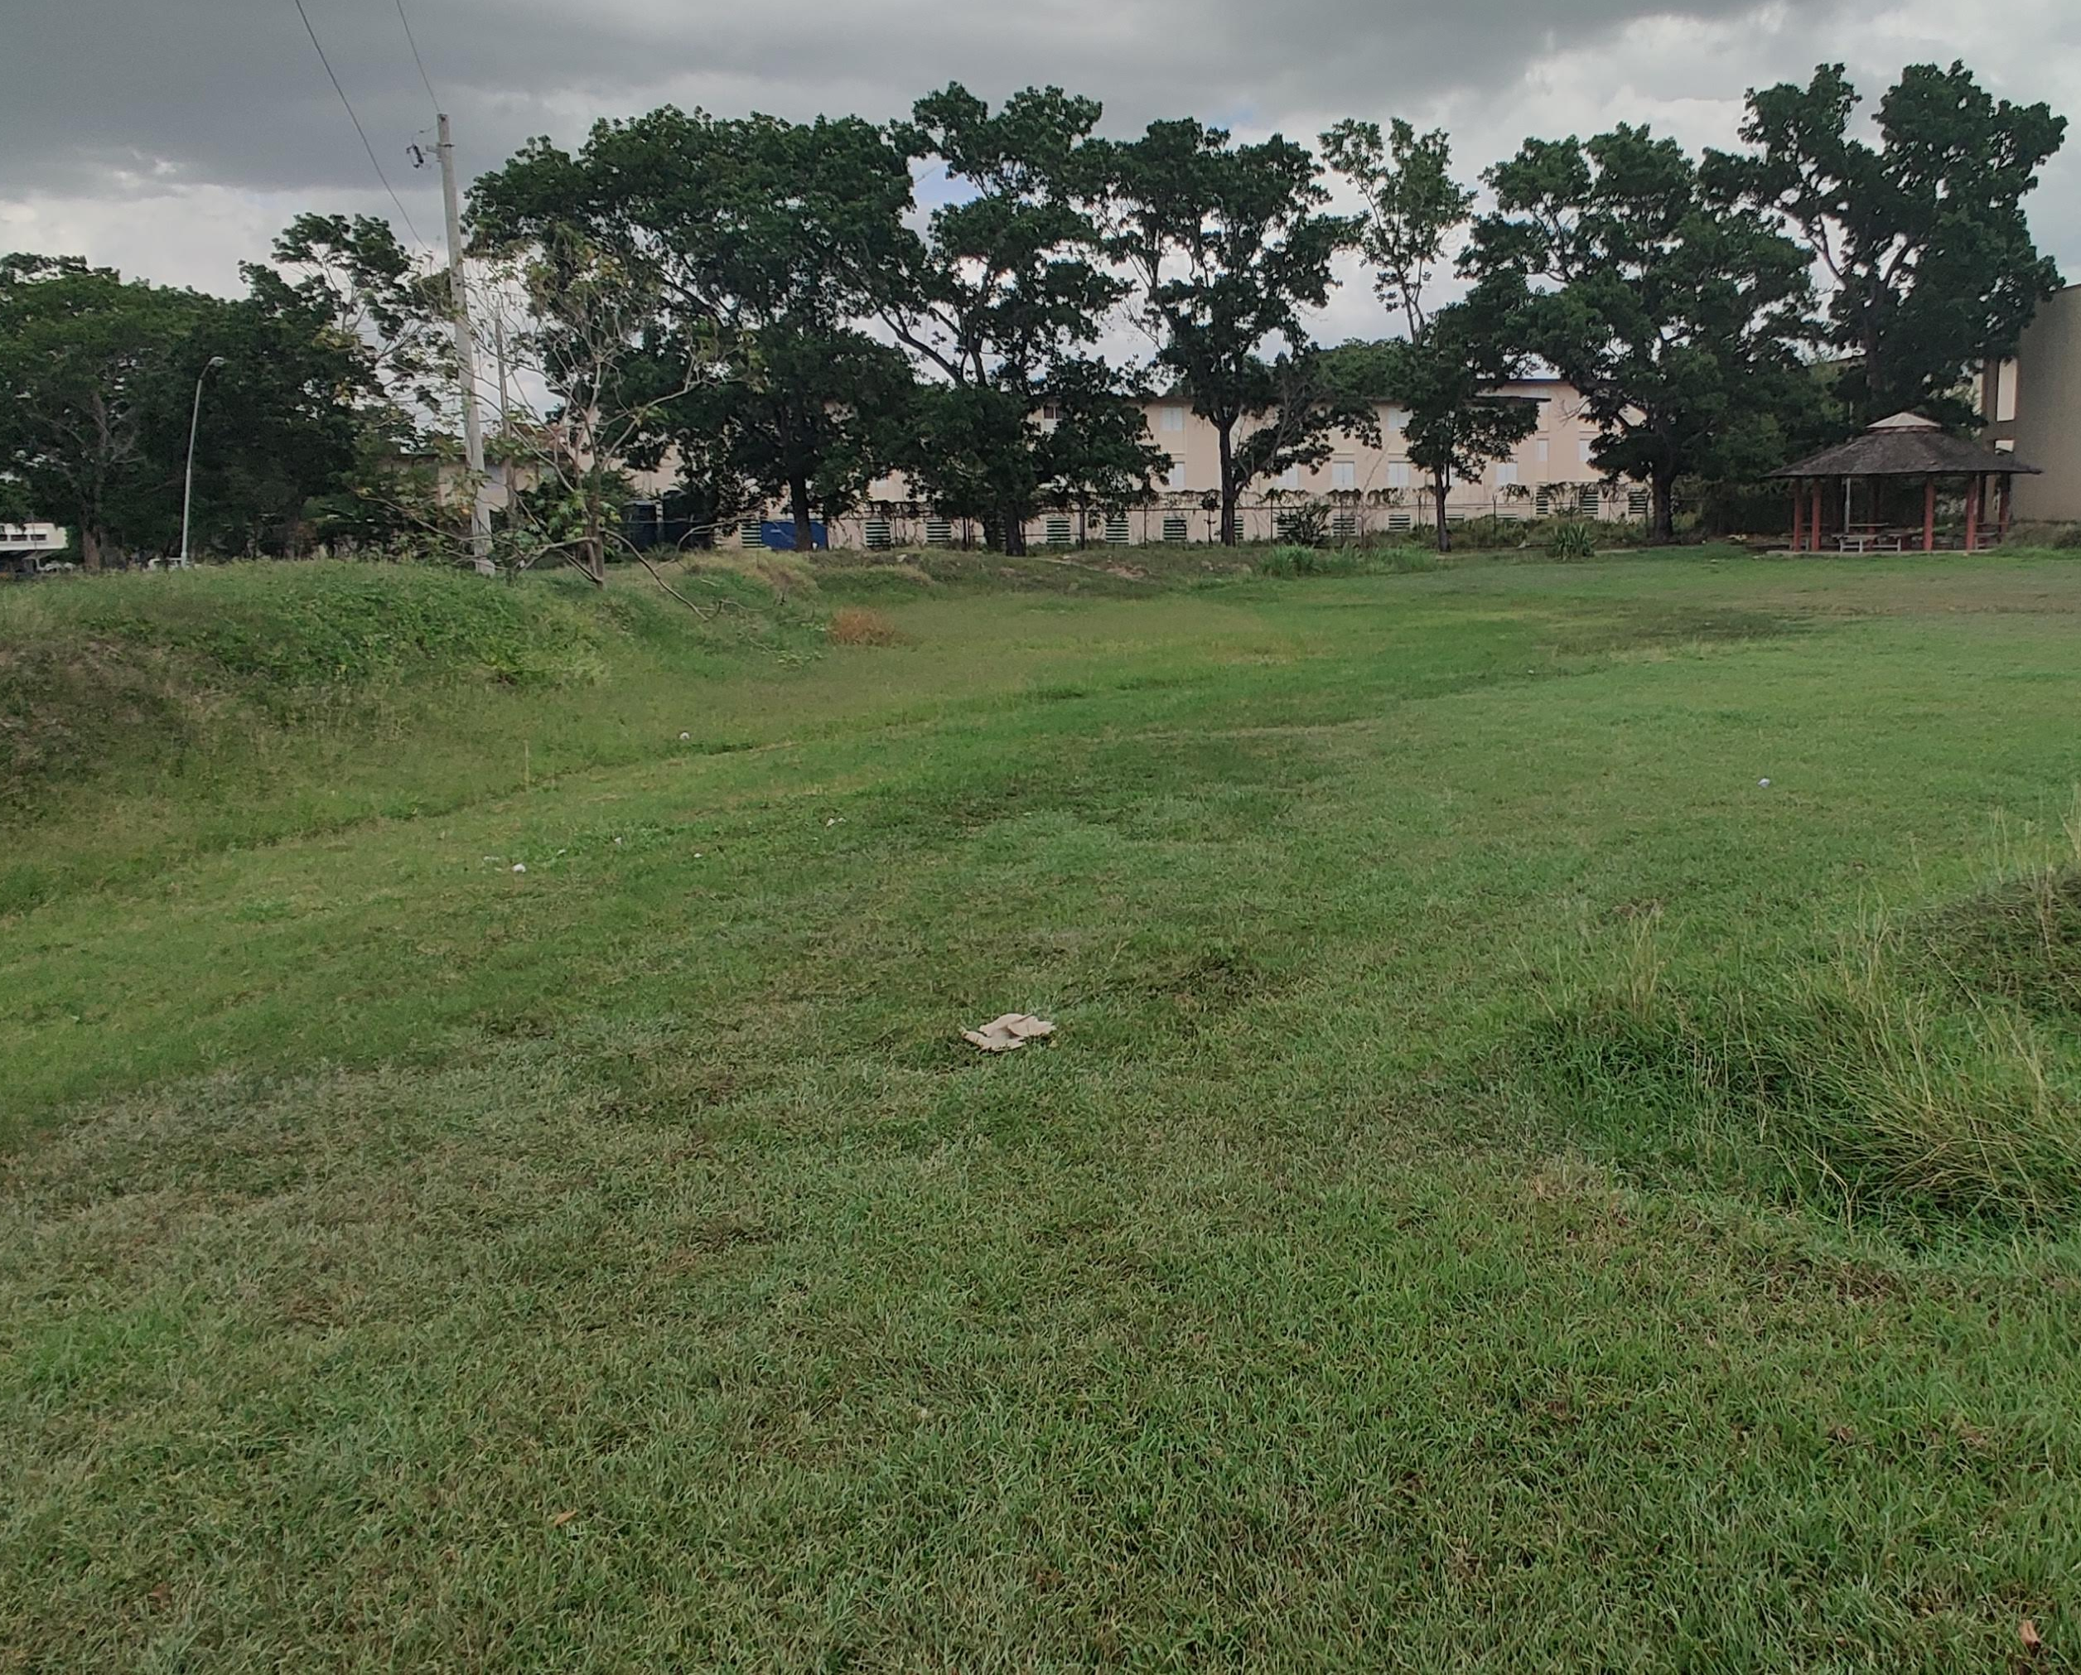
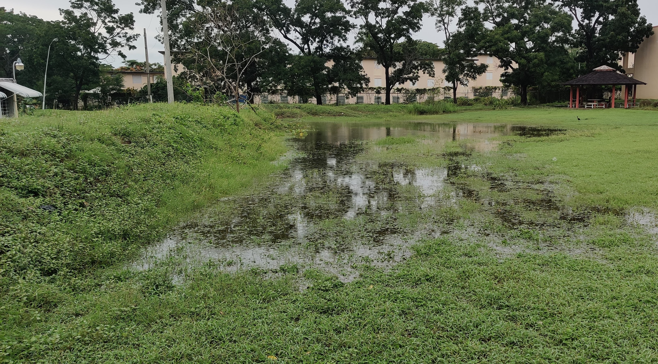
Dragonfly Pond

Slide 9
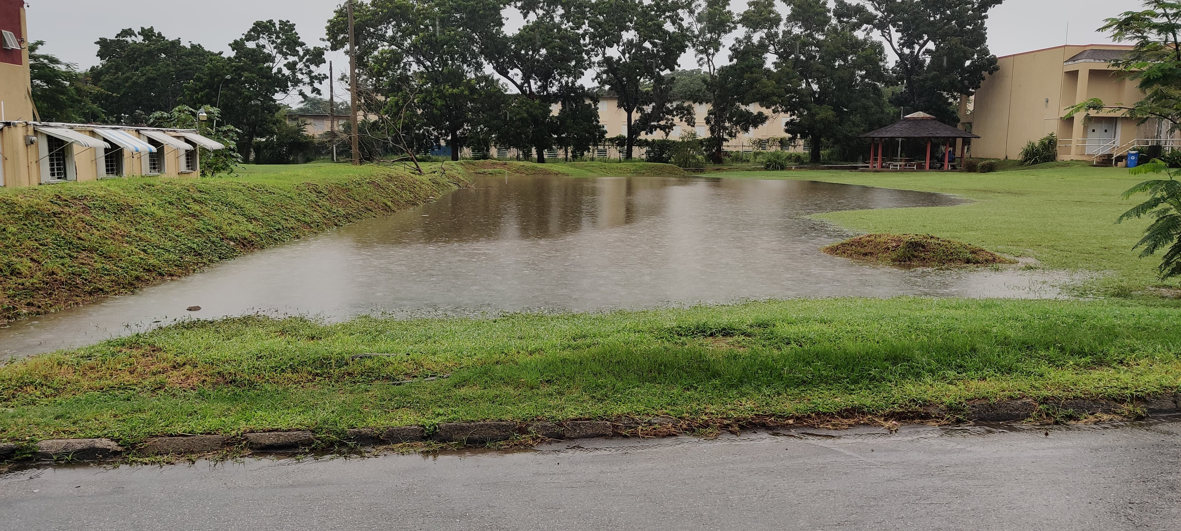
Dragonfly Pond

Slide 10
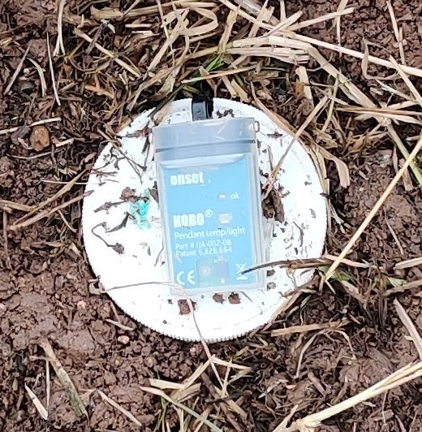
Data Collection
In Dragonfly Pond, temperature and light intensity were measured:
every 10 minutes
from June 2020 to January 2021
using a HOBO Pendant datalogger (UA-002-08)
This period spanned the aquatic and terrestrial phases of the pond

Slide 11
Analysis
Pond phase was validated by daily rainfall monitoring and site visits
A total of 214 full days were analysed, with 74 days aquatic and 140 days terrestrial
Data were analysed in R to identify trends in temperature and light intensity within each phase

Slide 12
Analysis
The main parameters analysed between phases were mean:
Temperature – daily and hourly
Daily temperature range
Maximum light Intensity
Rate of change in temperature and light intensity

Slide 13
Results and Discussion

Slide 14
Mean Daily Temperature
Only the terrestrial phase had mean daily temperature readings above 31°C
Large overlap between phases below 31°C

Slide 15
Mean Hourly Temperature
Temperature peaked at noon for both phases
Aquatic phase was more thermally stable due to the high specific heat capacity of water (Shah et al. 2020)
Cumulative mean water temperature between phases p < 2.2*10⁻¹⁶

Slide 16
Mean Daily Temperature Range
p < 2.2*10⁻¹⁶
The daily temperature range was greater in the terrestrial phase than in the aquatic

Slide 17
Daily Temperature Range

Slide 18
Mean Maximum Light Intensity
The mean maximum light intensity was lower in the aquatic phase due to absorption and scattering of light passing through water
p < 2.2*10⁻¹⁶

Slide 19
Mean Rate of Change
p < 2.2*10⁻¹⁶
The mean rate of change between data points was greater in the terrestrial environment for both temperature and light
Due to the greater stability of the aquatic phase
p < 2.2*10⁻¹⁶

Slide 20
Conclusion
Using mean daily temperature to determine the phase of the pond was helpful to a degree
Mean daily temperature range and rate of change were more exclusive and thus robust in determining the phase of Dragonfly Pond

Slide 21
Future Work
Validation and refining of the model is needed in:
different locations and climates
intermittent rivers and ephemeral streams (IRES)
shaded temporary ecosystems
brackish and saline temporary ecosystems
Different wavelengths of light

Slide 22
Future Work
Use of the model in arrays to identify changes in temporary and perennial aquatic environments across landscapes
Modelling local hydrology and identifying flood risk zones

Slide 23
References
Crabot, Julie, J. Heino, B. Launay, and Thibault Datry. 2019. “Drying Determines the Temporal Dynamics of Stream Invertebrate Structural and Functional Beta Diversity.” Ecography 43 (4): 620–35. https://doi.org/10.1111/ecog.04835.
Shah, Alisha A., Michael E. Dillon, Scott Hotaling, and H. Arthur Woods. 2020. “High Elevation Insect Communities Face Shifting Ecological and Evolutionary Landscapes.” Current Opinion in Insect Science 41: 1–6. https://doi.org/10.1016/j.cois.2020.04.002.
Tarr, T. L., M. J. Baber, and K. J. Babbitt. 2005. “Macroinvertebrate Community Structure across a Wetland Hydroperiod Gradient in Southern New Hampshire, USA.” Wetlands Ecology and Management 13 (3): 321–34. https://doi.org/10.1007/s11273-004-7525-6.
Williams, Dudley D. 2006. The Biology of Temporary Waters. Oxford University Press. H ttps://doi.org/10.1093/acprof:oso/9780198528128.001.0001.

