Slide 1
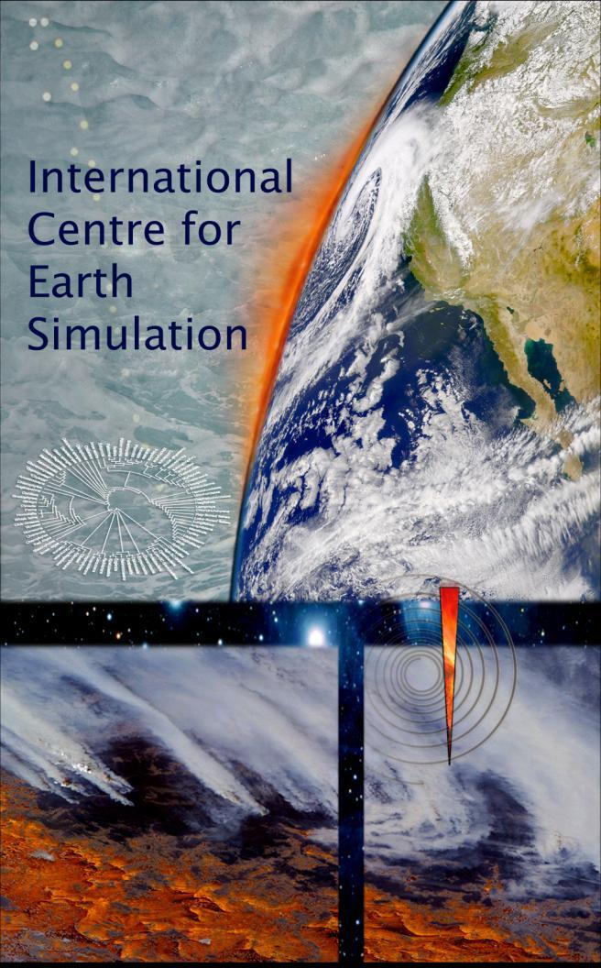

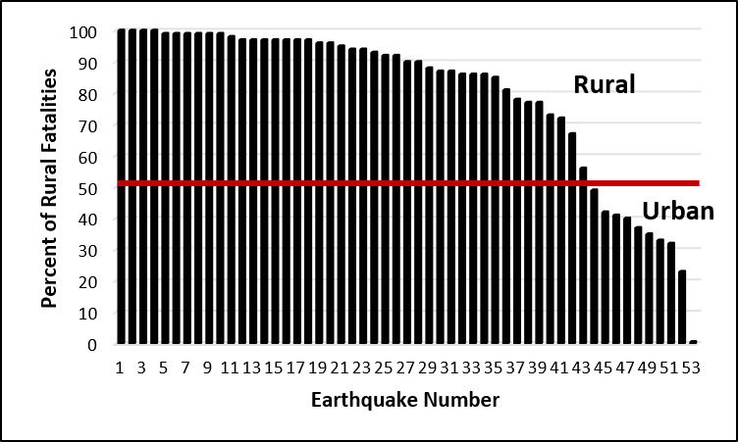
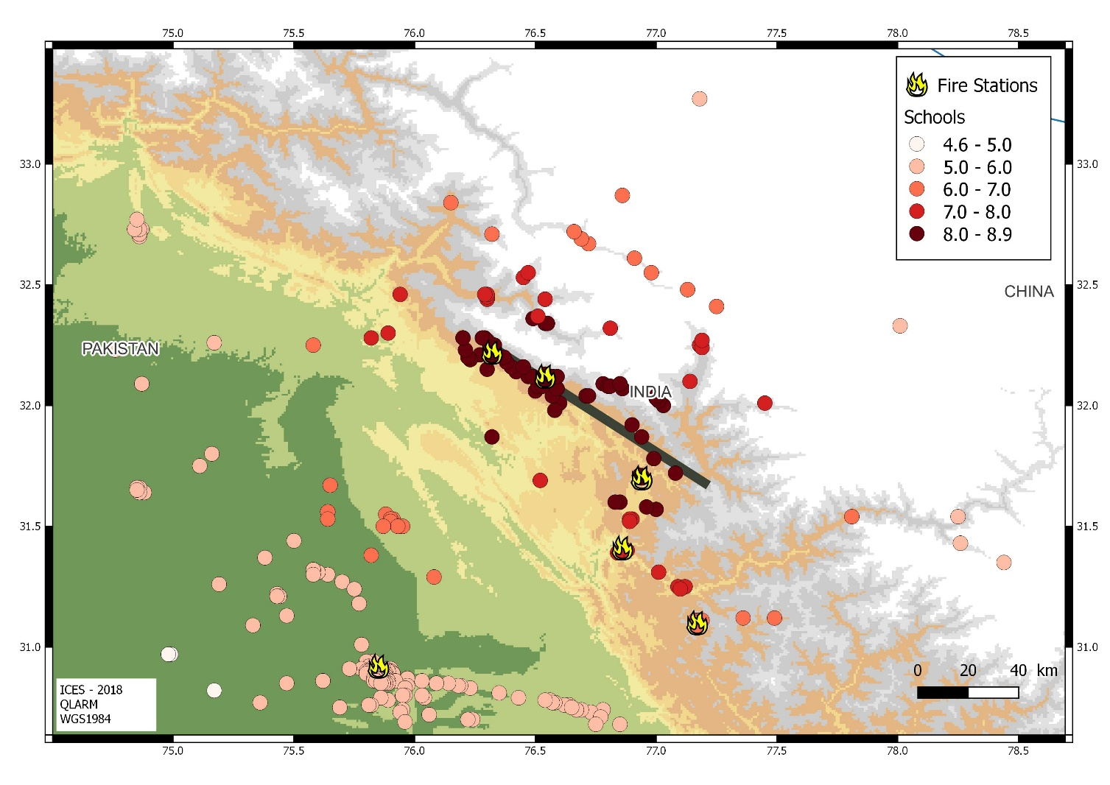
Earthquake loss alerts to save victims
Max Wyss, Philippe Rosset, Stavros Tolis, Michel Speiser
International Centre for Earth Simulation Foundation, Geneva, Switzerland
www.icesfoundation.org,
max@maxwyss.ch
QUESTION
Do decision makers follow best and up-to-date priorities in aiding earthquake victims?
FACTS NOT KNOWN TO ALL CONCERNED
1) QLARM and PAGER provide near-real-time earthquake loss estimates within less than one hour that are correct within factors of 2 to 3.
2) Based on 17 years of experience, scenarios for earthquake losses likely to occur exist
1
2
3
Ultimate count
Figure 3: Map of known schools with intensity colorcoded, if an earthquake rupture (black line) like that of 1905 at Kangra M7.9 would happen. However, based on the population present, these schools represent only 5% to 10% of those that really exist. (Wyss , M. et al. 2018, 20-22 December 2019, Paper presented at the 16th Symposium on Earthquake Engineering, Roorkee, India.)
Figure 2: Percent of rural fatalities for 53 historic and scenario earthquakes, ordered from most rural to must urban earthquake. (Wyss , M. (2018) SRL, 89(6), 1991-1997.)
Figure 1: Numbers of fatalities reported by the Chinese government as a function of time after the Wenchuan M8 earthquake, compared to the QLARM near-rea-time estimate after 100 minutes (vertical bar at left). (Wyss , M. 2017, Nature, 545, 151-153. doi:10.1038/545151a)
In addition, rural dwellings are more likely to collapse than urban ones. (Zúñiga, F. R., Merlo, J., & Wyss, M. (2015). In M. Wyss & S. Peppoloni (Eds.), Geoethics: Ethical challenges and case studies in Earth sciences (pp. 381-391). Waltham, Massachusetts: Elsevier.)
CONCLUSION 3: In many earthquake prone countries, the locations and sizes of schools are unknown, yet UNICEF ignores requests to assist in assembling a world data set on schools.
CONCLUSION 1: It is standard for decision makers and TV to underestimate earthquake losses for days, although the losses are known approximately by QLARM and PAGER within minutes.
CONCLUSION 2: In Great earthquakes, more than 90% of fatalities are in rural not in urban areas. Are decision makers and rescuers aware of this fact?

