Slide 1


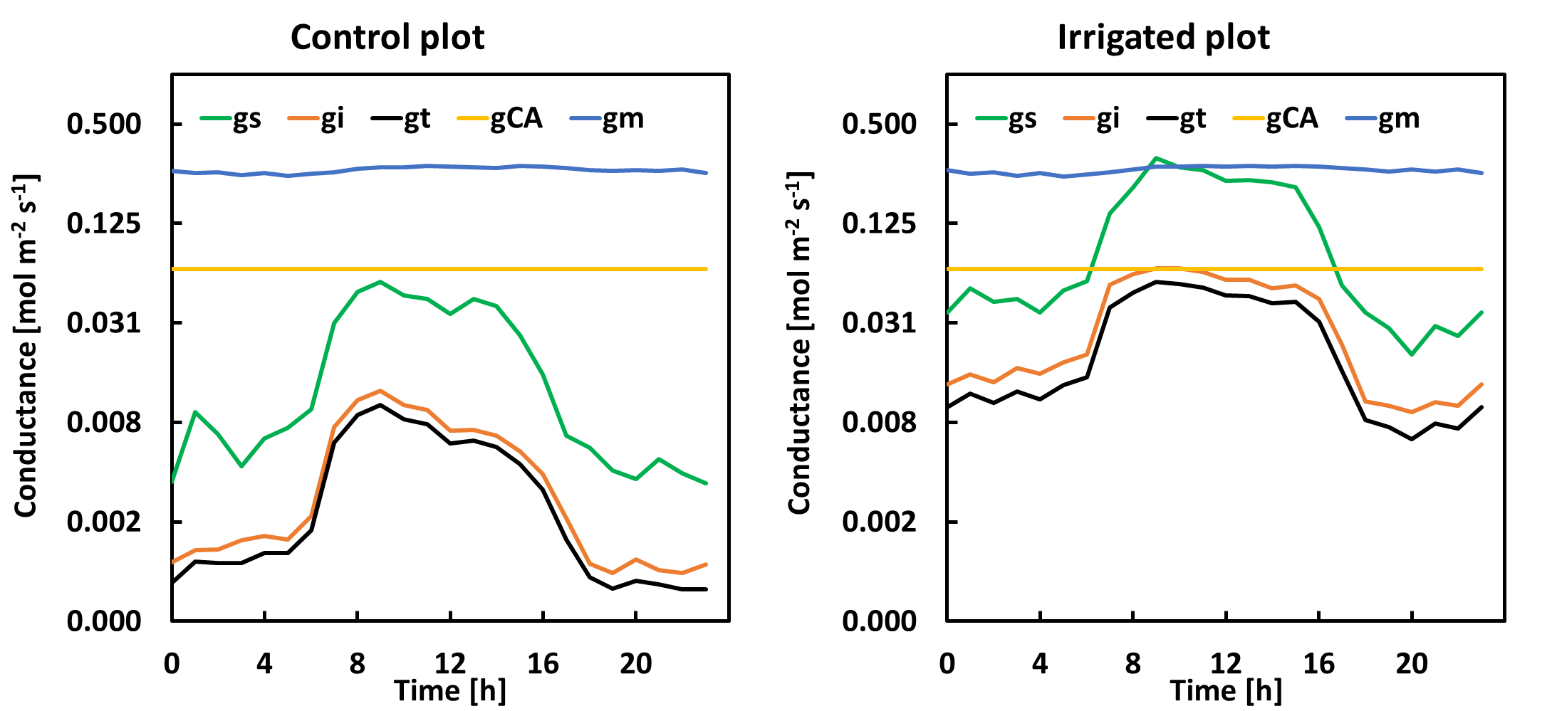

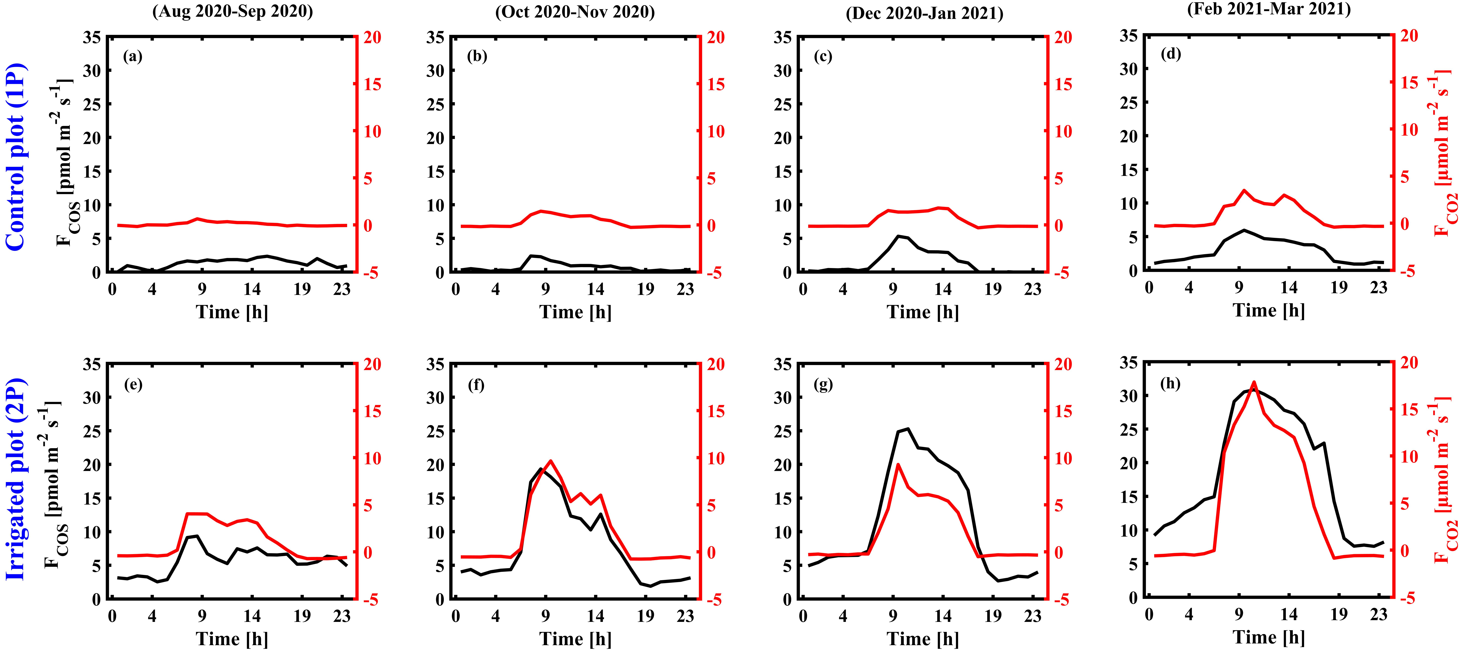
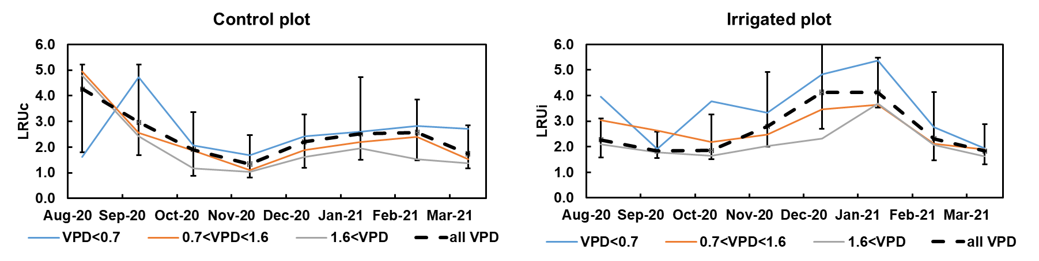


Combining branch-scale COS/CO2 exchange measurements to disentangle the effects of high VPD and low soil moisture in mature pine trees under field conditions
Rafat Qubaja, Rafael Stern, Itay Oz, Amnon Cochavi, Jonathan Muller, and Dan Yakir
Earth and Planetary Sciences, Weizmann Institute of Science, Rehovot, Israel 76100 (rafat.qubaja@weizmann.ac.il; dan.yakir@weizmann.ac.il)
Pinus
2. Conductance partitioning and Seasonal variation of LRU
Preliminary data
Average diurnal cycles of conductance (logarithmic scale)
1. Branch-scale ecophysiology empirical measurements
10 m
Average diurnal cycles of F_{COS} and F_{CO2} in the control and irrigated plots
Seasonal variation of light-saturated LRU (VPD in kPa)
F_{COS} and F_{CO2} fluxes: Both fluxes show a strong diurnal cycle with a sink during the daytime from both plots.
Conductance: During daytime gi for both plots is smaller than gs, which implies that during those hours gi limits fluxes.
LRU vs. VPD: LRU decreases with high VPD and increase with low VPD.

