Slide 1

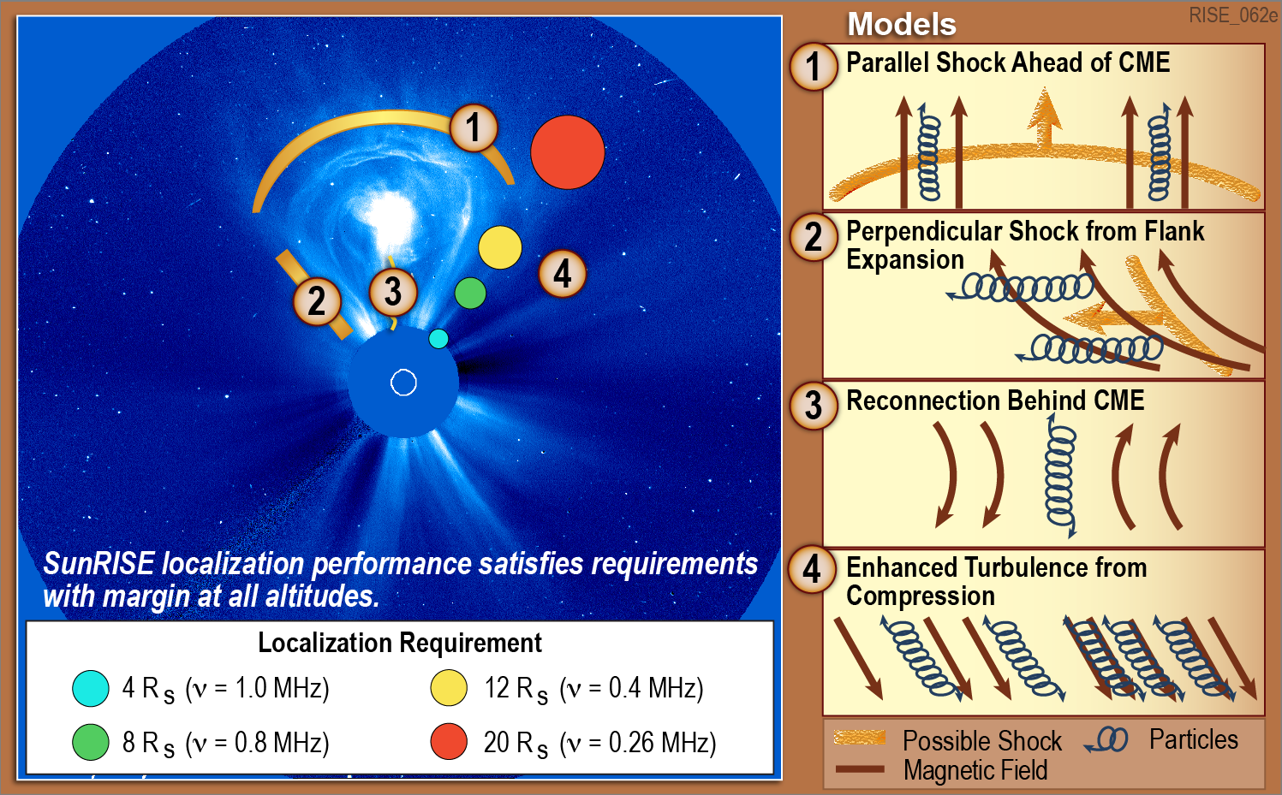
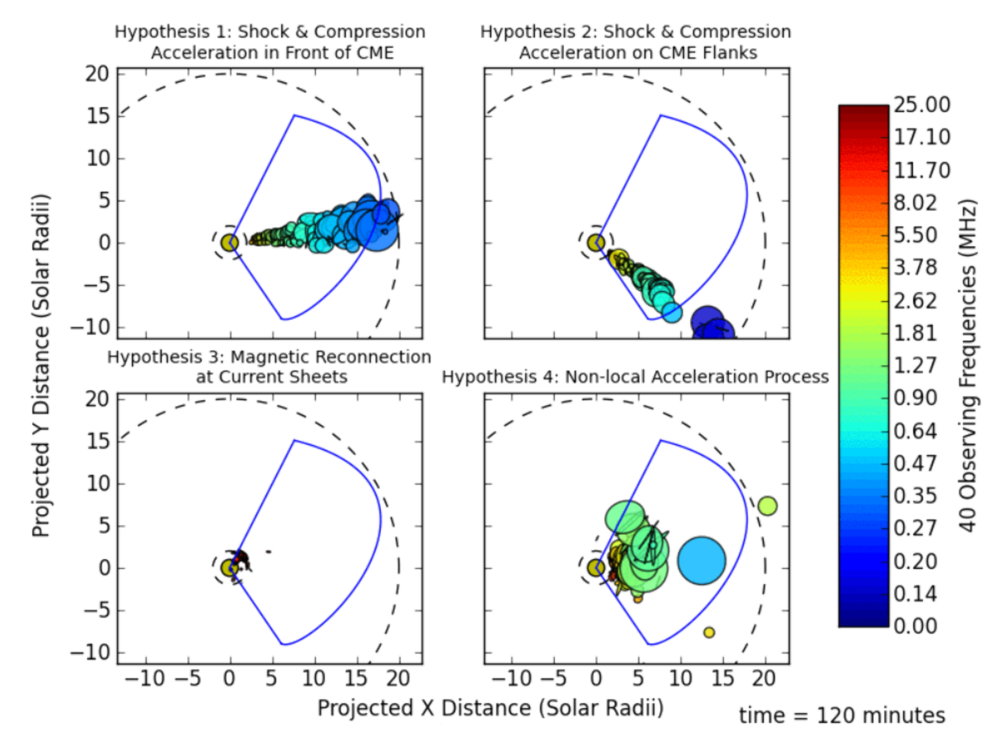
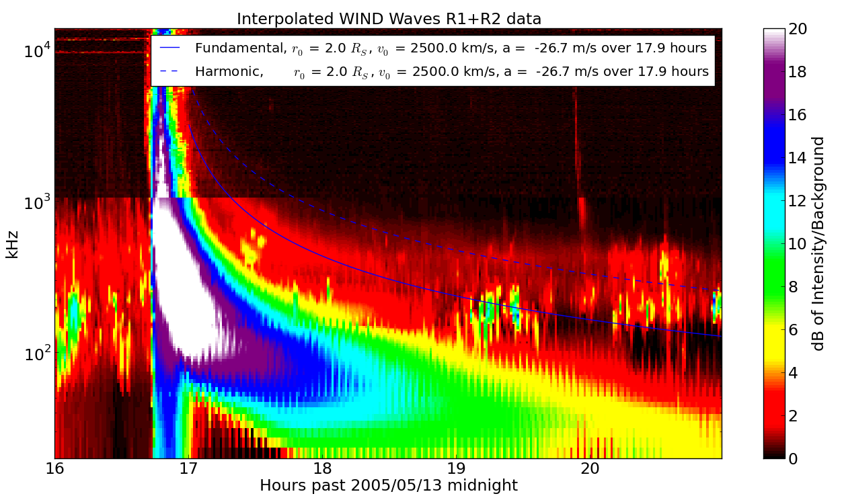
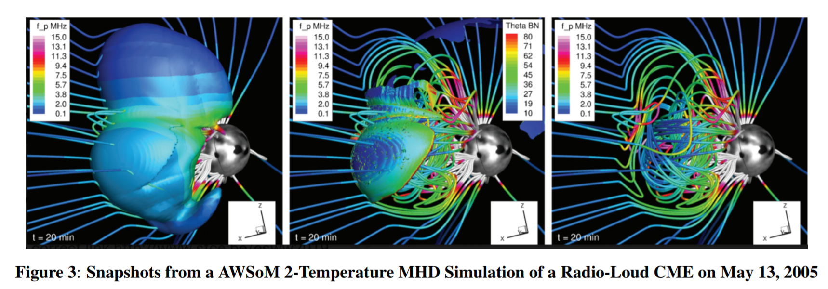
Localizing the Source of Type II Emission Around a CME with the Sun Radio Interferometer Space Experiment (SunRISE) and MHD Simulations
Summary:
SunRISE = 6 spacecraft radio array
MHD CME Simulation Subset
→ Simulated SunRISE Array
→ Simulated Imaging Performance
Reconstructions give visual proof of sufficiency to distinguish acceleration mechanism
SunRISE Reconstructions of 4 Type II Burst/SEP Generation Scenarios: Shock Front, Shock Flank, Current Sheet, Nonlocal Acceleration
CME Density Enhancement, Entropy Derived Shock, Magnetic Field
Alexander M. Hegedus¹, Ward Manchester IV¹, Justin C. Kasper¹, Joseph Lazio², Andrew Romero-Wolf², SunRISE Science Team
1 University of Michigan – Climate and Space Sciences and Engineering
2 Jet Propulsion Laboratory, California Institute of Technology
April 27, 2021 EGU21-6435, Session PS4.2

