Slide 1


Equality of Opportunity in Geosciences:
The EGU Awards Committee experience
Thomas Blunier
University of Copenhagen
Chair of the EGU Union Awards Committee

Slide 2
EGU awards & medals programme
Every year, the EGU awards & medals programme recognises eminent scientists for their outstanding research contribution in Earth, planetary, and space sciences. In addition, it identifies the awardees as role models for the next generation of early career scientists to foster geoscience research.
The EGU awards & medals programme features Union medals, the most prestigious awards, for life-time achievements or exceptional contributions to science as well as Union awards, such as the Arne Richter Award for Outstanding Early Career Scientists which recognises scientific achievements at an early career stage.
At the division level, the EGU awards various medals for active scientists, as well as the Division Outstanding Early Career Scientists Awards. The list of all recipients of EGU awards and medals, including Union, division and General Assembly awards, is available in the EGU web pages, https://www.egu.eu/awards-medals/.
Awards
Four prestigious Union medals, recognising excellence in scientific research
Four Union awards for Outstanding Early Career Scientists, services for the Union, science journalism, and outreach
28 division medals, awarded for significant disciplinary contributions in Earth, planetary and space sciences
22 division awards for Outstanding Early Career Scientists and General Assembly awards for students

Slide 3
Nomination statistics
Who can nominate?
There is no awards nomination committee in EGU. Following the bottom up structure of the union, all nominations for scientific achievements originate from EGU members, where self nominations are excluded.
An exception is the Angela Croome Award for Earth, space and planetary sciences journalism. Here also nominations by non-EGU-members and self-nominations are possible.
On average 128 valid nominations were sent in annually over the past eight years. Tendentially the number of nominations is increasing, that goes especially for OECS awards.

Slide 4
EGU Community
Gender
Origin
EGU2019 | % participants
Africa | 1%
Americas | 10%
Asia | 17%
Europe | 72%
Oceania | 1%
Concluding Remarks
Eastern Europe | 9%
Northern Europe | 22%
Southern Europe | 17%
Western Europe | 51%
37% of EGU members in 2021 are female
Gender is more balanced among younger EGU members
The vast majority of EGU members comes from Europe
50% of the European participants originate from Western Europe
(based on the participation numbers from the GA2019)

Slide 5
Long term statistics on EGU Awards & Medals (2014-2021)
Total # of Nominations
EGU has received a total of 1376 nominations for the 2014 - 2021 Union, Division and OECS medals & awards.
25% nominations for female candidates.
Total # of Medallists and Awardees
EGU has awarded total of 372 medals and awards during the period 2014-2021.
28% of the medallists and awardees were female.
On average, over the last 8 years, the fraction of medals and awards received by women outmatches slightly the fraction of nominations for female researchers.

Slide 6
Women among nominees & medallists (2014-2021)
The fraction of nominations for women has been increasing over the past years
The fraction of awards to women is matching, maybe slightly exceeding, the fraction of nominations
In recent years the fraction of awards obtained by women is reaching the range of female members

Slide 7
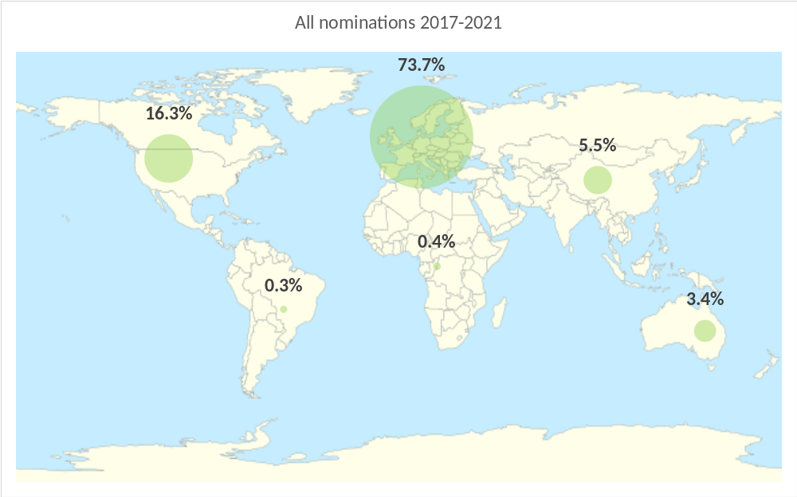
Geographic distribution of nominations (2017-2021)
Over the past 5 years EGU has receive a average total of 195 nominations yearly for all awards and medals from their members.
The vast majority of nominations are for scientists located in Europe; over the last 5 years over 70%. North America is the second largest group with about 16% followed by Asia with roughly 5%.
Nominations for Early Career Scientists are even higher for researchers in Europe, 78% (detailed on the next slide).

Slide 8
Geographic distribution of nominees and awardees (2017-2021)
Geographical distribution of awardees are roughly proportional to the distribution of the nominations
For mid-career and life achievement awards there is a tendency for over proportional number of medallists from the Americas (exclusively USA)

Slide 9
Geographic location of European nominations and awardees (2017-2021)
Among Europe, North and East Europe do not get many nominations and consequently not many awards

Slide 10
Concluding Remarks
Gender
63% of EGU members are male, where gender is more balanced among younger members
Over the last 8 years the %-age of nominations for women has roughly doubled
Nominations for women are approaching the fraction of female EGU members
The data show that there is no bias in the selection process; the fraction of female awardees matches the fraction of nominations for women
Geographic location
The vast majority of EGU members are from Europe followed from the USA
Nominations mirror where EGU members are located and where they have ties to
For mid-career and life achievement awards there is a tendency for over proportional number of medallists from the USA
Within Europe the majority of nominations and awardees comes from Central Europe
The statistics demonstrate that it is in the hands of the EGU-community to enhance diversity and equal opportunities for awards and medals by nominating deserving candidates from underrepresented groups
Nominations for all the medals and awards are to be submitted online by 15 June of each year (hard deadline). Check the EGU web pages for further information https://www.egu.eu/awards-medals/proposal-and-selection-of-candidates

