Slide 1


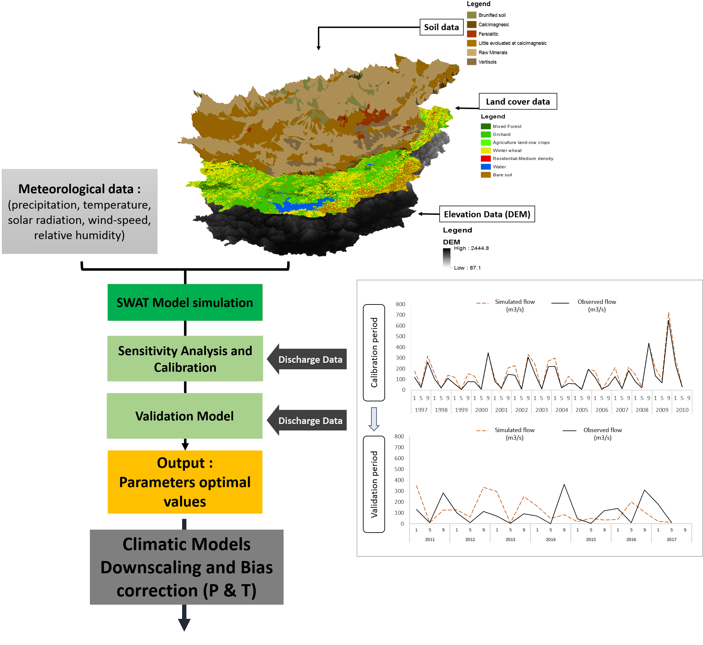
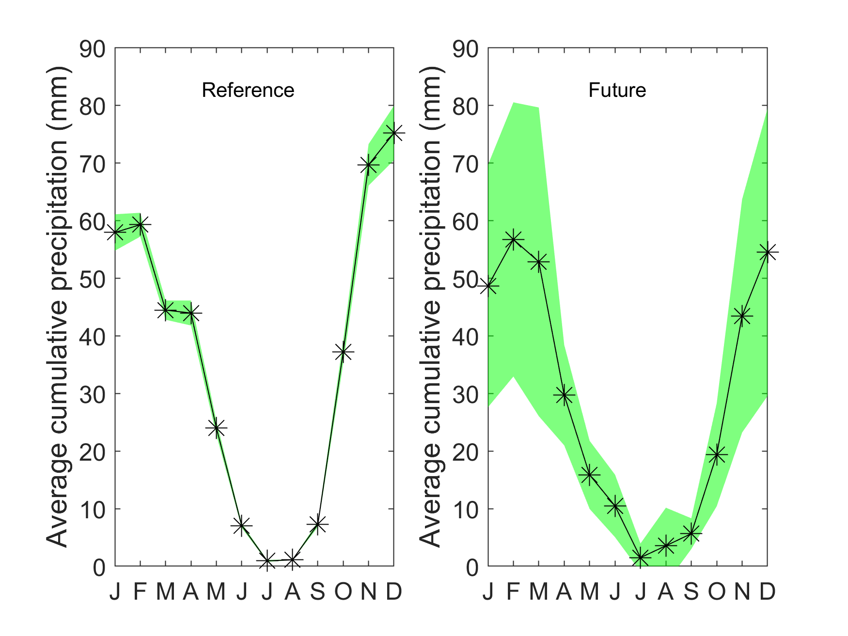
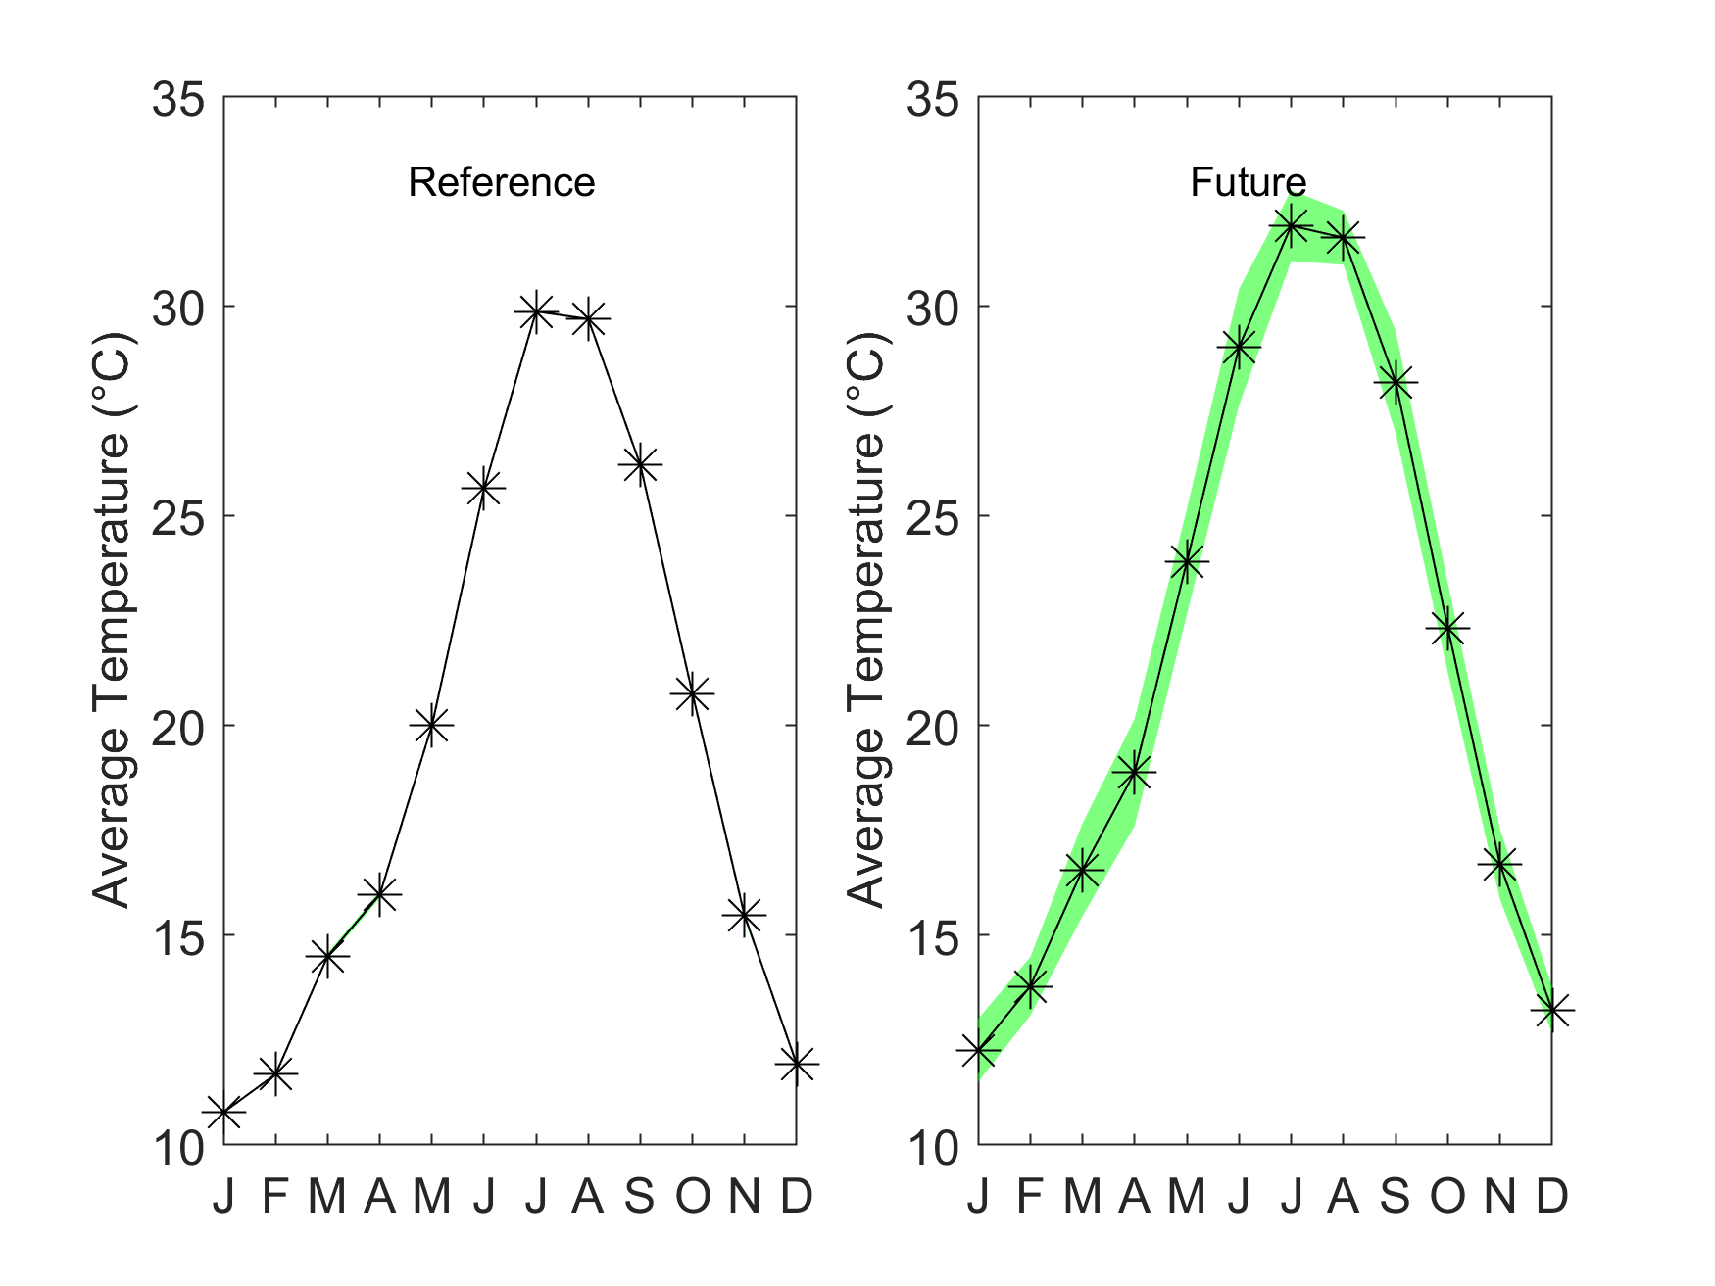
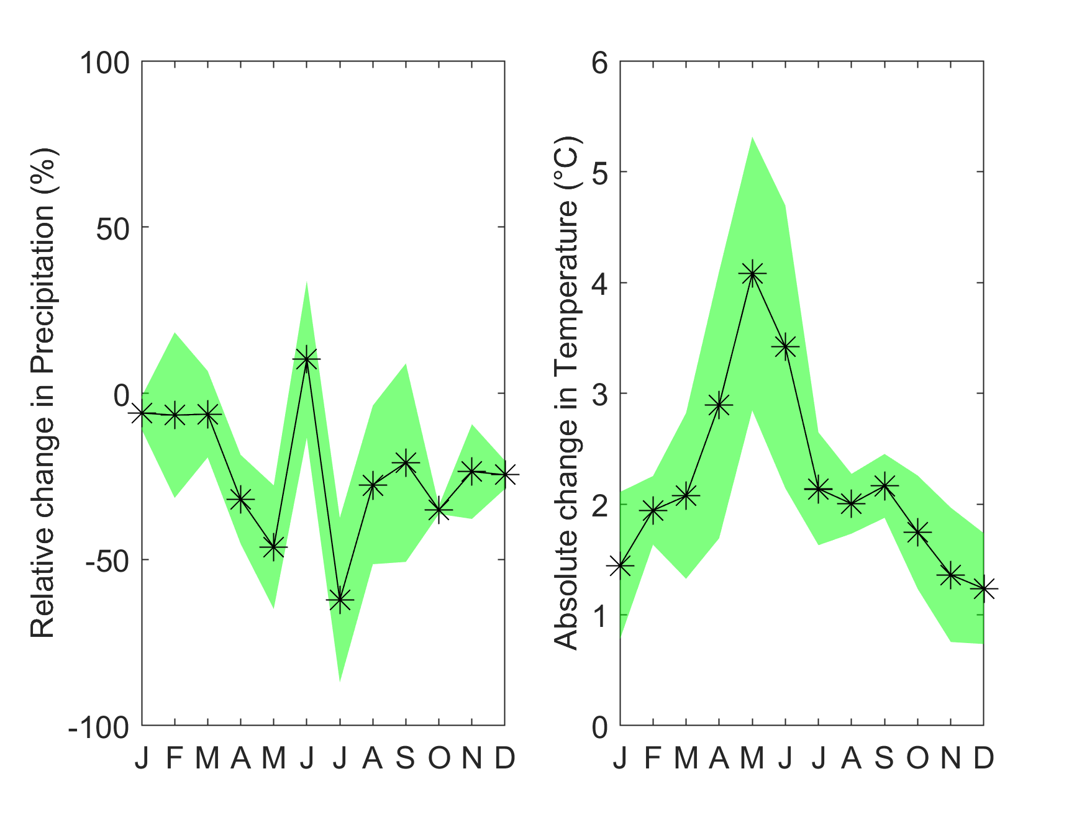
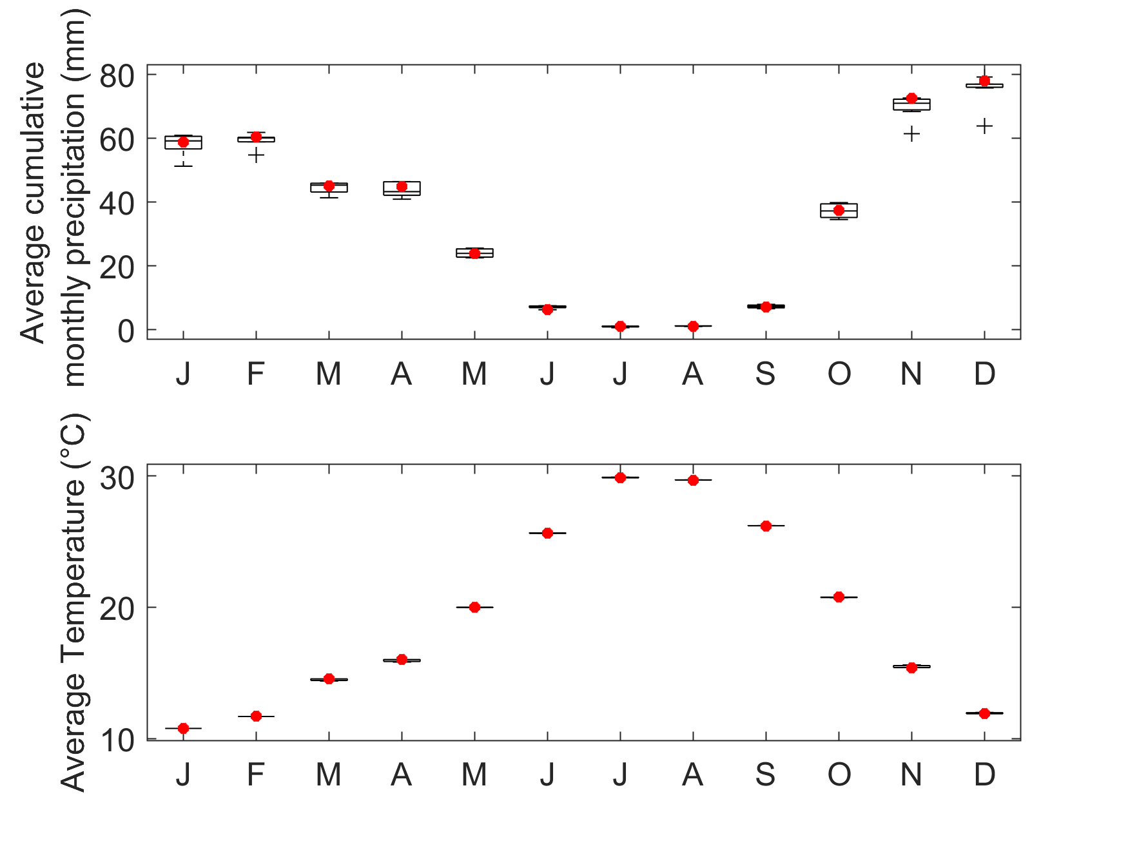

Assessing the water resources vulnerability of Ouergha catchment under climate change projection
Kaoutar Mounir^{1,2}, Haykel Sellami³, Imen El Ghoul^{3,4,5}, Abdessalam El Khanchoufi¹, and Isabelle La Jeunesse²
¹University of Sidi Mohamed Ben Abdallah, CED ST LGE2D, Fez, Morocco
²University of Tours. Laboratory CNRS 7324 Citeres, 33 allée Ferdinard de Lesseps, B.P. 60449, 37204 Tours cedex 3, France
³Centre for water Research and Technology. Laboratory of georessources, Tunisia
⁴UR-Gestion Durable des Ressources en Eau et en Sol, Ecole Supérieure des Ingénieurs de Medjez Elbab. Université de Jendouba, Tunisia
⁵Université catholique de Louvain, Earth and Life Institute (ELI), Louvain-la-Neuve, Belgium
Kaoutar.mounir@etu.univ-tours.fr
Problematic
Objectives
SWAT Model Methodology
The studied watershed is considered as risk area that is exposed to water stress, and the lack of groundwater due to impermeable geological formations.
- Study the catchment’s hydrological process.
- Assess the uncertainty on the catchment.
- Analyze these uncertainties with modelling approach based on the combination of hydrological model and a set of high resolution CORDEX climate models
Results
(a)
10 Climate models are used in this study from the CORDEX project EUR 11 Domain (resolution 11°) :
Reference period : 1/1/1979 – 31/12/2005
Future period (RCP 4.5 scenario) : 1/1/2041 – 31/12/2080
(b)
Figure 1 : Boxplot for climate model ensemble while red starts is for observation
Figure 2 : Climate models Ensemble uncertainty interval (green) and mean (black starts) for precipitation and temperature in the reference and future periods.
Figure 3 : CME uncertainty in change for P and T in the future as compared to the reference period
Notes:
Ouergha basin is in the Northern part of morocco and its climate is semi-arid.
The studied watershed is exposed to water stress, and the lack of groundwater due to impermeable geological formations.
To evaluate the hydrological process, we chose SWAT Model to assess its uncertainty on the catchment with modelling approach based on the combination of hydrological model for the period between 1984 to 2017and a set of high resolution CORDEX climate models.
The results where calibrated and validated using SUFI 2, where the performance results were promising, with a NS value higher than 75%.
Bias correction for both P and T is conducted using the cumulative distribution function (CDF) matching based on local historical observation covering the reference time period.
Figure 1 : The monthly mean values of the observed P and T are within the box plots of the climate model ensemble suggesting that the bias in the climate models was successfully corrected
Figure 2 : Shows that the uncertainty in the future is larger than in the reference although it has been corrected. Also, it’s shown that there is a clear tendency to reduction in monthly P and a tendency to reach warmer climate in the future.
Figure 3 : reveals that Temperature is expected to increase across all the months but with larger uncertainty during summer than winter period
To sum up, the results affirms a clear tendency towards drier and warmer climate in the Ourgha catchment
However, most of the climate models members agree on the direction of change which is negative in comparison to reference. The increase in P is due to one climate model that exhibits a sign different than all others CC models member.

