Slide 1






Changes in soil hydraulic conductivity and preferential flow pathways after assisted forest restoration on degraded land in the Khasi Hills (Meghalaya, NE India)
Chandra Prasad Ghimire¹, Bob W. Zwartendijk^{2, 3}, Felix Pde⁴, L. Adrian Bruijnzeel⁵
¹AgResearch Ltd., New Zealand
²Wageningen University and Research, The Netherlands
³Inholland University of Applied Sciences, The Netherlands (Bob.Zwartendijk@inholland.nl)
⁴Mawphlang Welfare Society, India
⁵King’s College London, London, United Kingdom

Slide 2
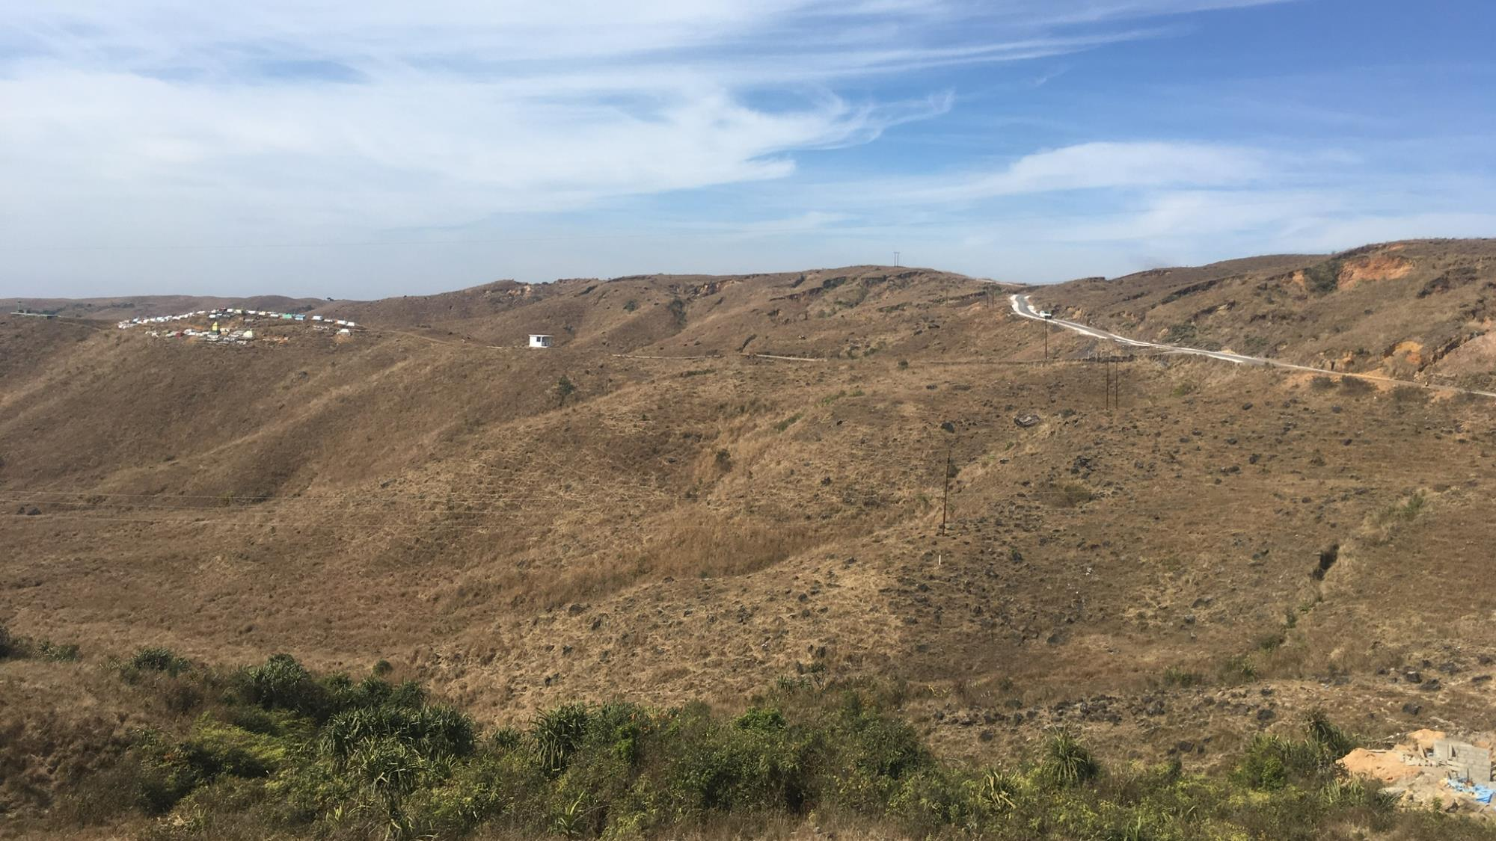
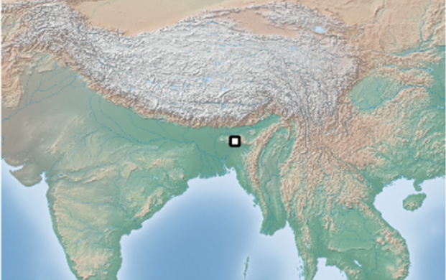
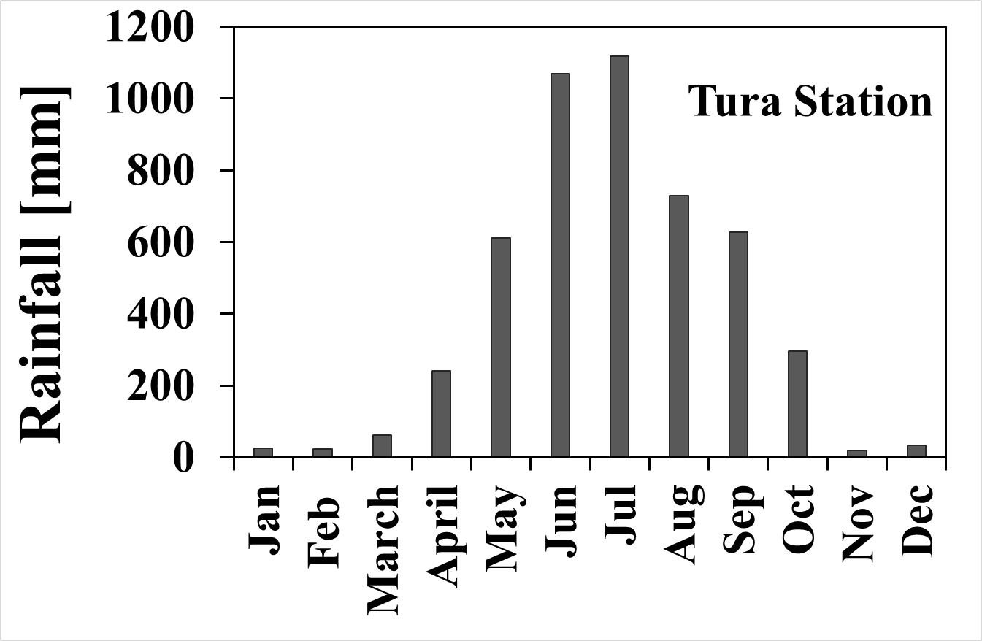
The Meghalaya Plateau
Slash-and-burn agriculture plus mining have led to severely degraded hillsides;
Receives some of the highest rainfall totals in the world (MAP up to 11,000 mm, 75% between May and September);
Severe water scarcity during dry season (November - April).
Meghalaya

Slide 3
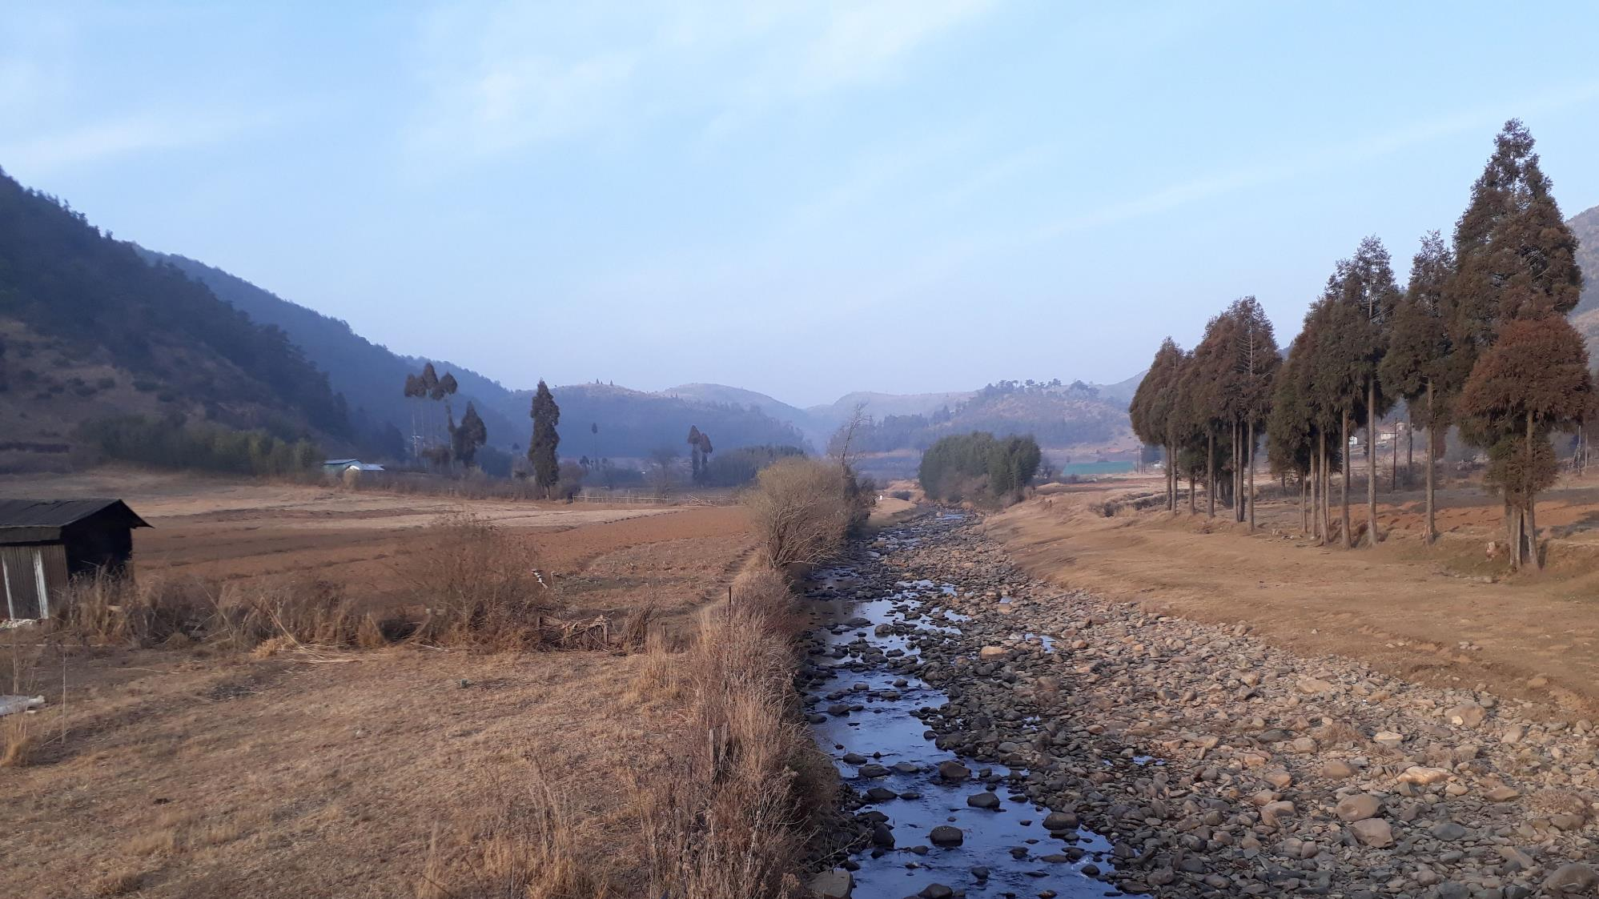
Excessive seasonal rainfall
Degraded hillsides
Increased overland flow and erosion during rainy season
Low topsoil infiltration capacity
Critical loss of soil water storage opportunity and groundwater recharge
Reduced dry-season flow and problematic water availability

Slide 4
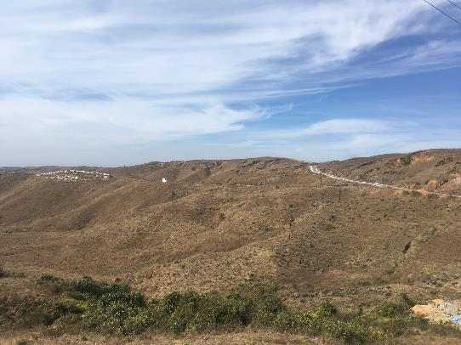
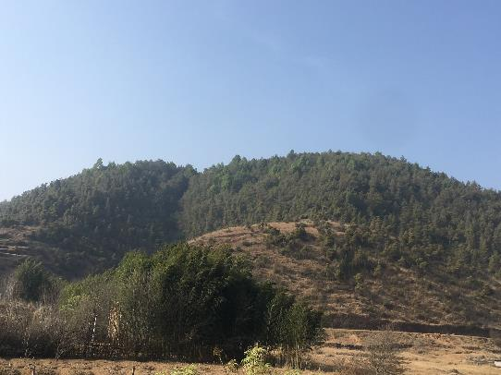
Can we restore dry-season flows through assisted forest restoration?
?
Forest restoration through reforestation and assisted natural regeneration (ANR) in the Khasi Hills;
Reforestation of degraded land increases rainfall absorption and soil water recharge via soil improvement;
But water-use of reforested trees tends to be much higher than that of degraded vegetation;
Net effect depends on the balance between changes in absorption (gain) and plant water-use (loss).

Slide 5
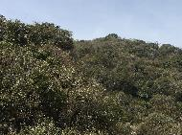
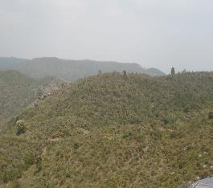
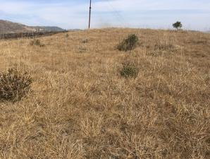
Assessing changes in soil hydrological functioning after forest restoration
Soil hydrological functioning
Sacred forest (natural baseline)
Assisted natural restoration (ANR)
Degraded grassland (reference)
Years since ANR
Measurement of topsoil (0-10 cm) saturated hydraulic conductivity (K_{sat}) by infiltrometry in:
degraded grassland (n = 3), 2–10-year-old ANR (n = 3), and sacred forest (n = 6) (less disturbed);
Blue dye infiltration experiments (n = 2 per site) to examine dominant percolation pathways.

Slide 6
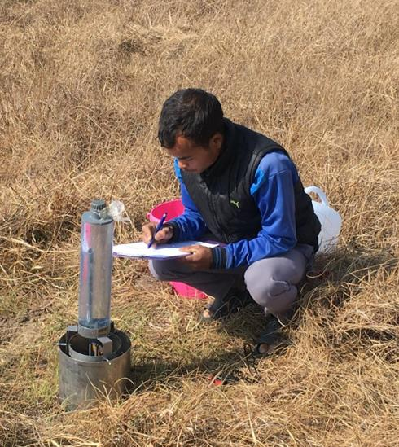
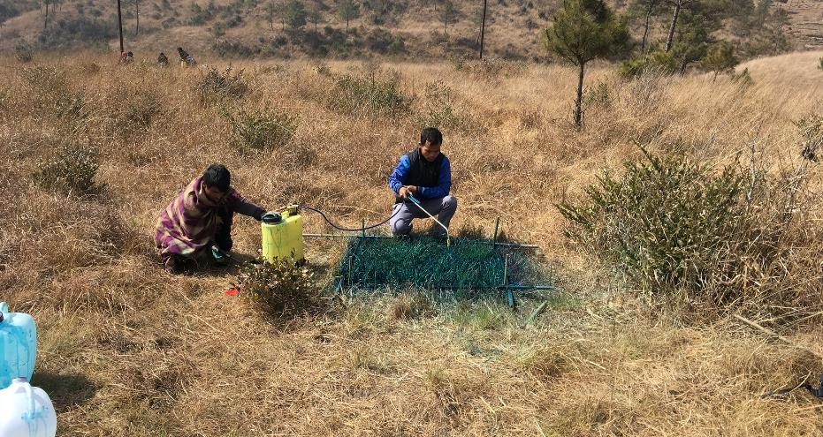
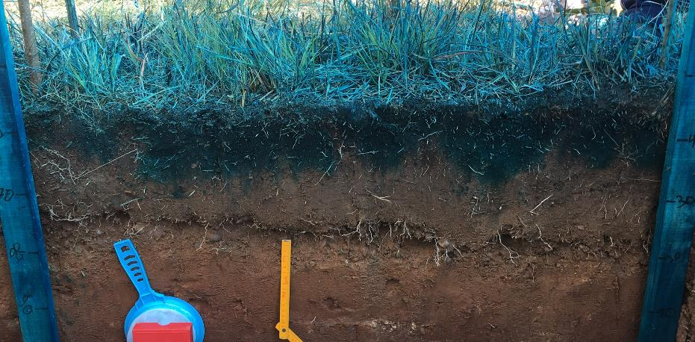
Topsoil (0-10 cm) K_{sat} measurements using double-ring infiltrometry
Blue dye experiments to determine dominant percolation paths

Slide 7
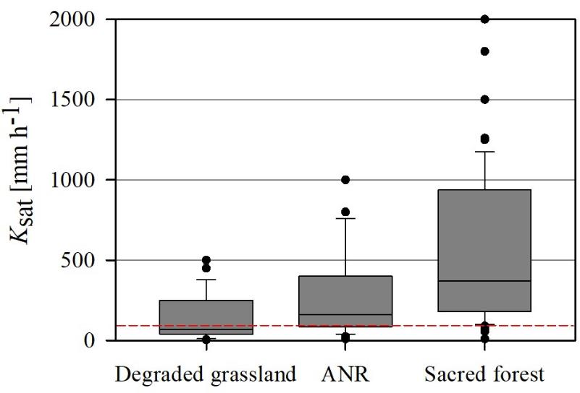
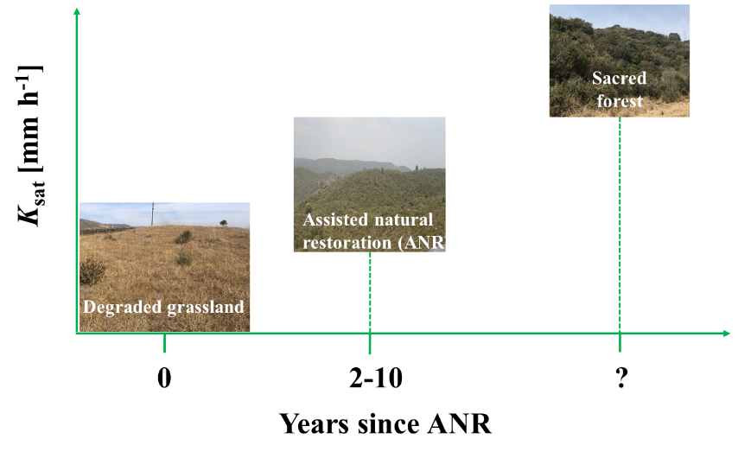
Results
Median K_{sat} highest in the relatively undisturbed sacred forest sites (target);
Median K_{sat} for ANR (2–10-year-old) already much higher than for degraded grasslands but still considerably lower than for natural forest;
Comparing median topsoil K_{sat} with (maximum) hourly rainfall intensities for Cherrapunji (red dashed line) suggests frequent occurrence of IOF in degraded grassland only.

Slide 8
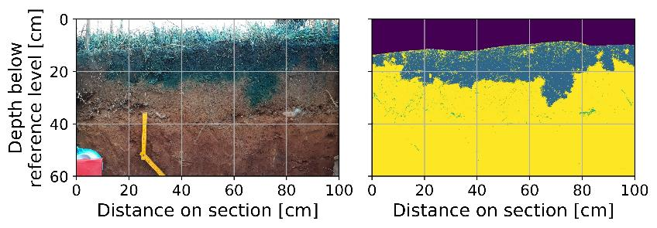
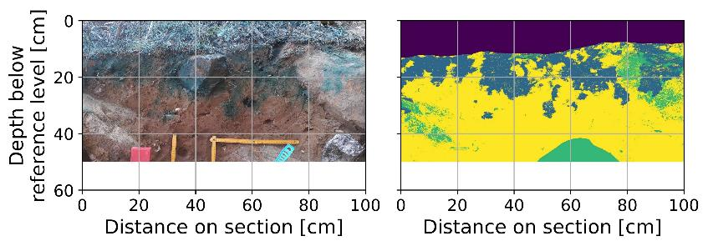
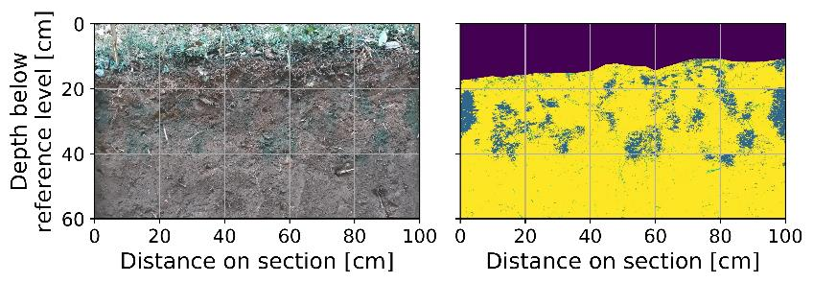
Results
Degraded grassland
Infiltration in degraded grassland dominated by matrix flow;
Preferential flow in ANR shows high matrix interaction;
Infiltration in the sacred forest mostly along roots and other preferential pathways.
ANR
Sacred forest

Slide 9
Conclusions and recommendations
Soil hydrological functioning is improved under assisted natural restoration (ANR) but it will take many more years before conditions will approach those of little disturbed natural forest;
Despite observed improvement in surface K_{sat} the generally shallow nature and high stoniness of the soils in the study area pose serious limitations to rebuilding soil water storage capacity;
Increases in K_{sat} under ANR can be expected to reduce erosion via reductions in overland flow;
For a complete assessment of the net impact of ANR on dry-season flows, changes in plant water-use and soil water recharge with time need to be evaluated.

