Slide 1
Active faulting offshore the Maltese Islands revealed by geophysical and geochemical observations
Aaron Micallef, Daniele Spatola, Antonio Caracausi, Francesco Italiano, Giovanni Barreca, Sebastiano D'Amico, Lorenzo Petronio, Franco Coren, Lorenzo Facchin, Rita Blanos, Alessandro Pavan, Paolo Paganini, Marco Taviani, Luca Baradello, and Emiliano Gordini

Slide 2
Figure 1. (a) Spatial coverage of the aerial data, marine data (multibeam echo-sounder data, sub-bottom profiles, water samples) and onshore data (groundwater and soil gas samples; LiDAR data). (b) Spatial coverage of the Boomer acoustic profiles, water and sediment samples, and air sample. c) Spatial coverage of the multichannel seismic reflection profiles.

Slide 3
Figure 2. Acoustic profile showing water column amplitude anomalies, seismic chimney, acoustic turbidity and offset seismic reflectors (denoted by blue lines). The facies on either side of the offset in (a) have different thicknesses. Location of the acoustic profile is shown in figure 2a.

Slide 4
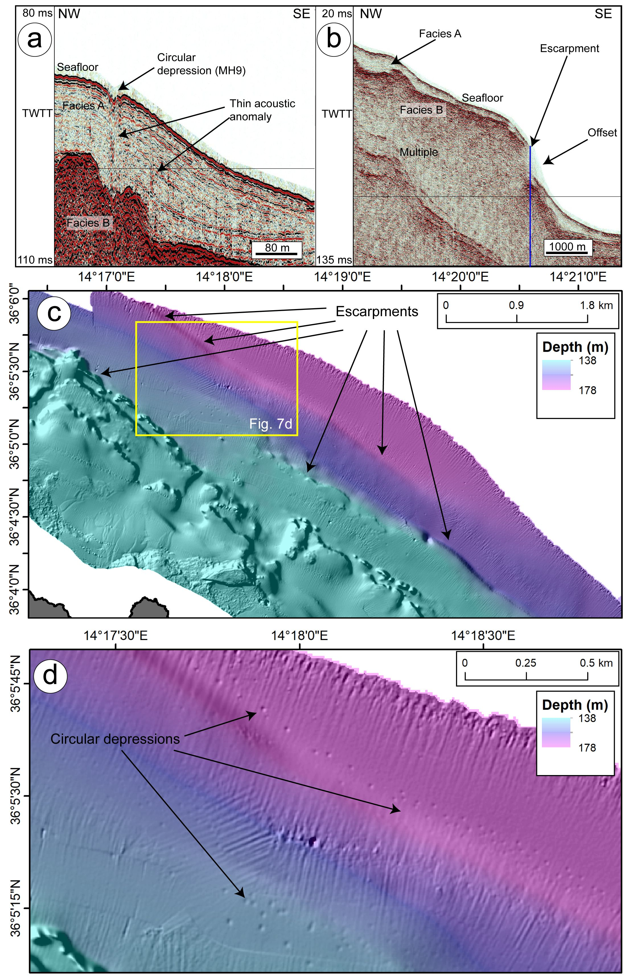
Figure 3. Seafloor and sub-seafloor anomalies and structures. (a) Acoustic profile (Boomer) showing a circular depression and seismic chimneys underneath. Location of the acoustic profiles is shown in Figure 2b. (b) Acoustic profile (Boomer) showing an escarpment and an offset seismic reflector (denoted by blue line). Location of the acoustic profiles is shown in figure 2b. (c) Bathymetric map of seafloor offshore NE Gozo showing NW-SE trending escarpments. (d) Zoom of the bathymetric map in (c) showing circular depressions, most of which are aligned NW-SE.

Slide 5
Figure 4. Multichannel seismic reflection profile showing extensive acoustic turbidity zones and offsets (denoted by blue lines) in the Gozo Channel. Facies A and B, interpreted from the acoustic profiles, are shown. The reflector separating the two facies is denoted by a yellow dashed line. Location shown in figure 2c.

Slide 6
Figure 5. Water column and sediment chemistry. (a) Measured concentrations of CH4 and CO2 in the water column samples. Red lines represent escarpments identified from multibeam echo-sounder data. (b) Diffractogram of sample MH9 (intensity in count per second vs 2-theta in degrees). c) δD vs δ18O plot for water column samples. Data points from our study are denoted by black dots. Plotted data for groundwater, seawater and Local Mediterranean Water Values (LMWV) are from Liotta et al. (2013).

Slide 7
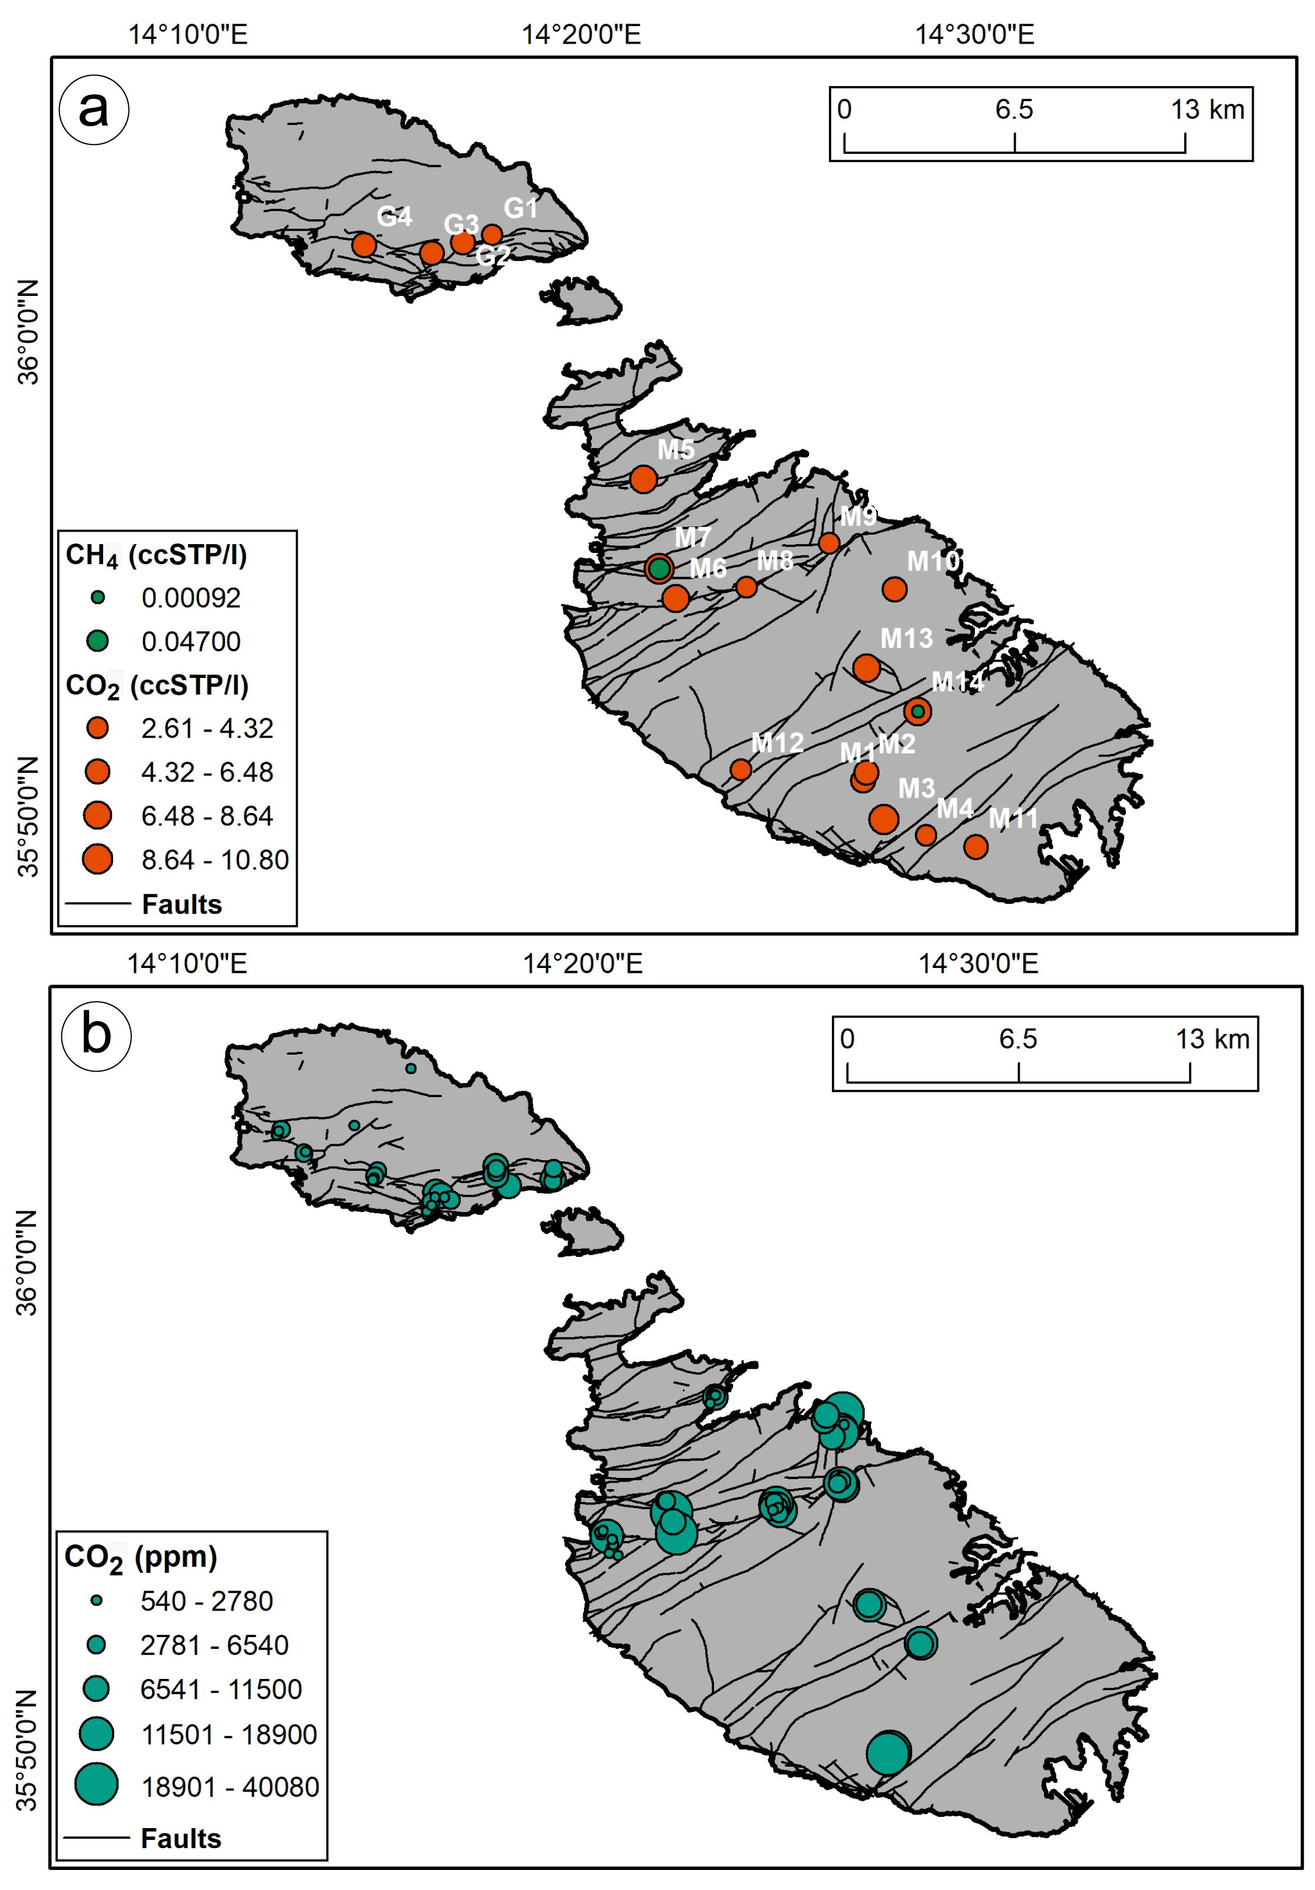
Figure 6. Onshore water and gas chemistry. (a) Measured concentration of CH4 and CO2 in the onshore groundwater samples. (b) Concentration of CO2 derived from soil gas measurements.

Slide 8
Figure 7. (a) Flight path for aerial survey. Atmospheric concentration of (b) CH4 and (c) CO2 (in ppm). Values range between 1.850 and 1.991 ppm for CH4, and between 403 and 406 ppm for CO2. The highest concentrations of these gases occur as SW to NE elongated anomalies located between Gozo and Comino.

Slide 9
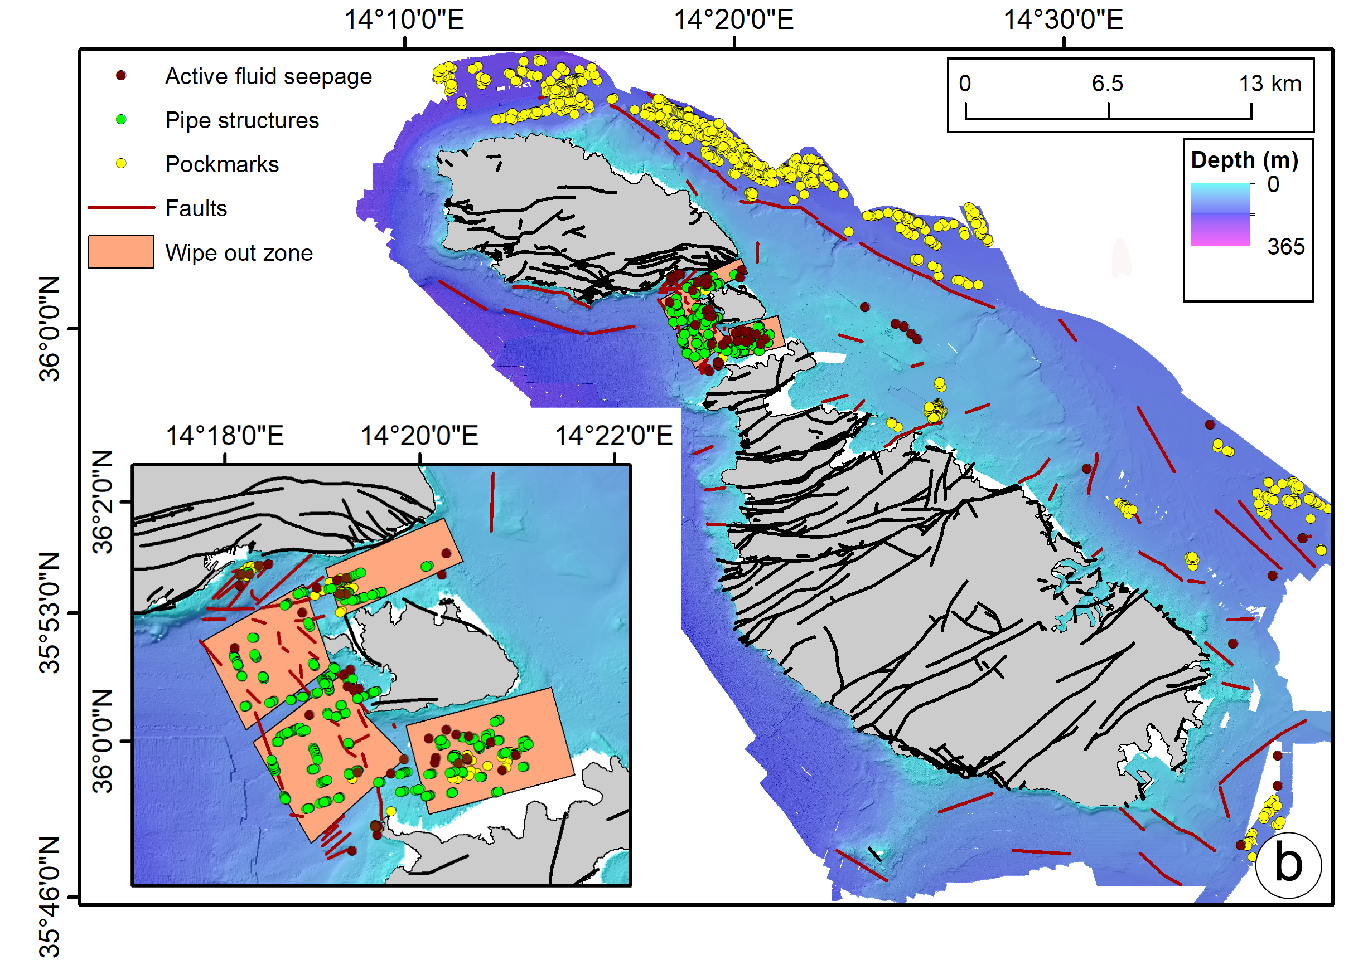
Figure 8. Identified seafloor and sub-seafloor features across the study area shown on a shaded relief bathymetric map of the seafloor. Inset shows a zoomed section of the Gozo Channel. Onshore faults are shown in black.

Slide 10
Figure 9. Proposed transtensional fault scenario and its relation to the present strain-stress regime across the Maltese Islands (derived from available Global Navigation Satellite System velocity field (Meccariello et al., 2017)). Inset on the left shows a cartoon of a scenario with two right-stepping, right-lateral NW-SE trending faults binding a pull-apart basin. Inset on the right shows vectors decomposition (LAMP: Lampedusa, MALT: Malta), which indicate that the area is undergoing stretching in a N50E direction (blue arrows). Onshore faults are shown in black whereas offshore faults, inferred from multibeam echo-sounder and seismic reflection data, are shown in dark red.

