Slide 1

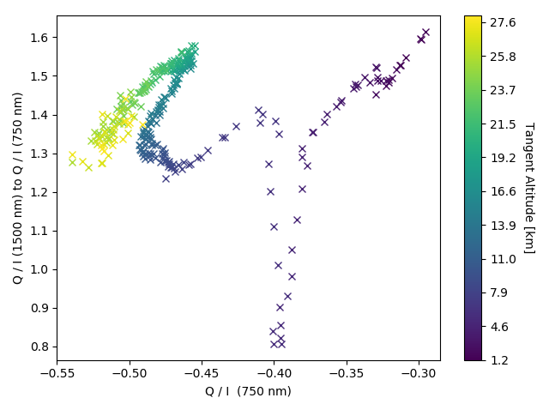
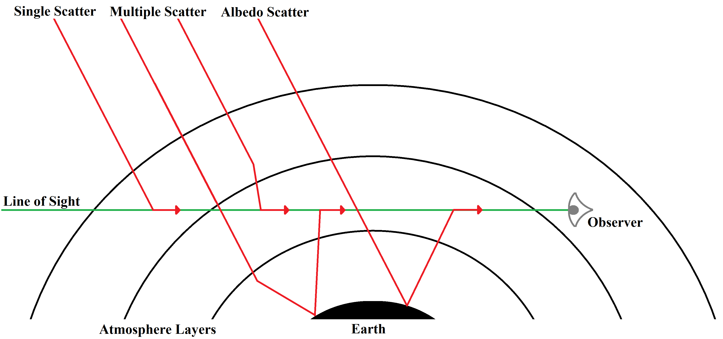
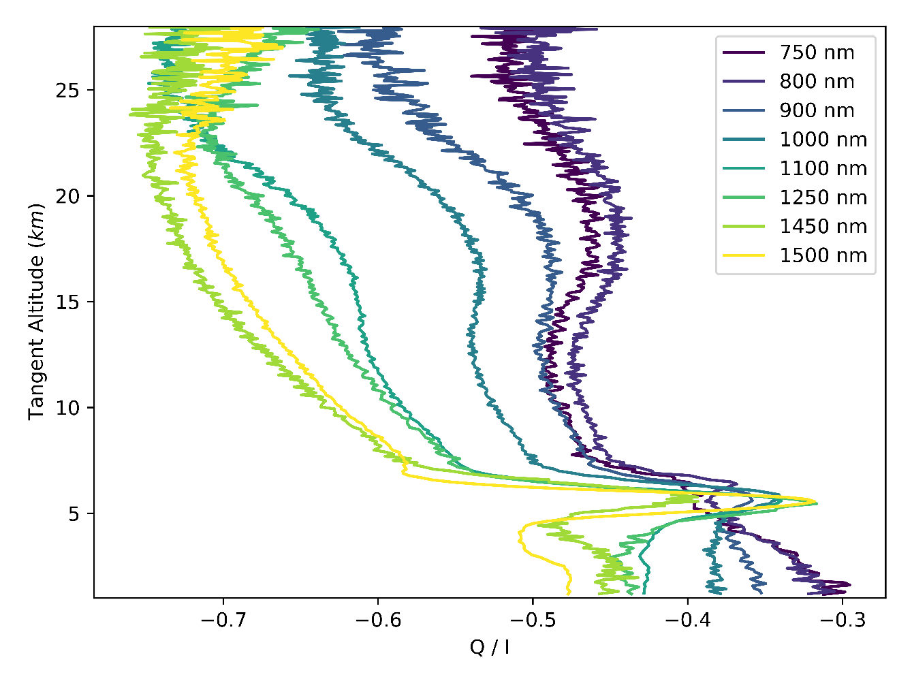
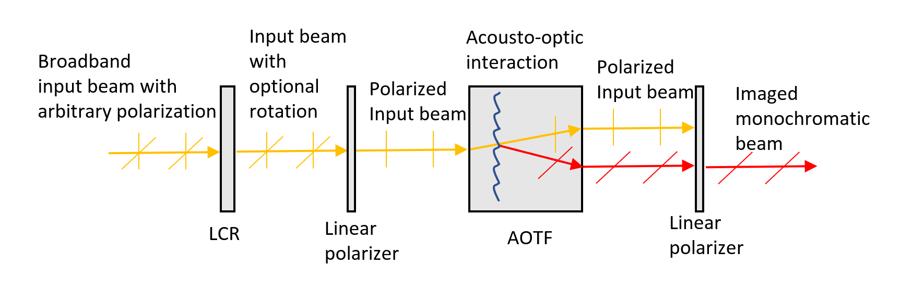
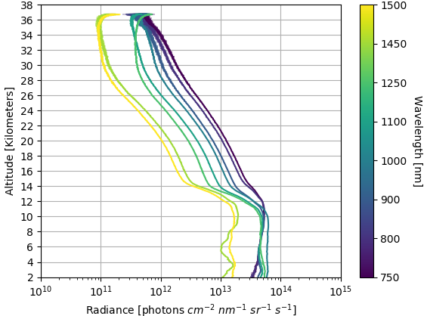
Improved multi-spectral polarimetric observations of UTLS aerosol and cloud from stratospheric balloon with the Aerosol Limb Imager
Aerosol
by Daniel Letros et al.
April 30th, 2021
Motivation
Aerosols are liquid or particulate matter suspended in the atmosphere.
  Plays an important role in the radiative balance (net cooling effect).
  Influences atmospheric chemistry.
Current interest:
  Contributions of anthropogenic emissions.
  Studying impacts forest fires and volcanic eruptions.
  General continuity of the aerosol record.
  Geo-engineering applications.
Cloud
The Aerosol Limb Imager (ALI)
Technical heritage coming from OSIRIS and OMPS.
Acousto-optic tunable filter (AOTF) for rapid imaging over 600-1500 nm.
Liquid crystal rotator (LCR) for dual linear polarization.
  Dual polarization allow for the distinction between clouds and aerosols in measurement data.
Two ALI iterations previously successful (2014 and 2018).
Current and third iteration set for demonstration this August
  HEMERA Kiruna, Sweden
Eventual goals of high-altitude aircraft and satellite deployment.

