Slide 1
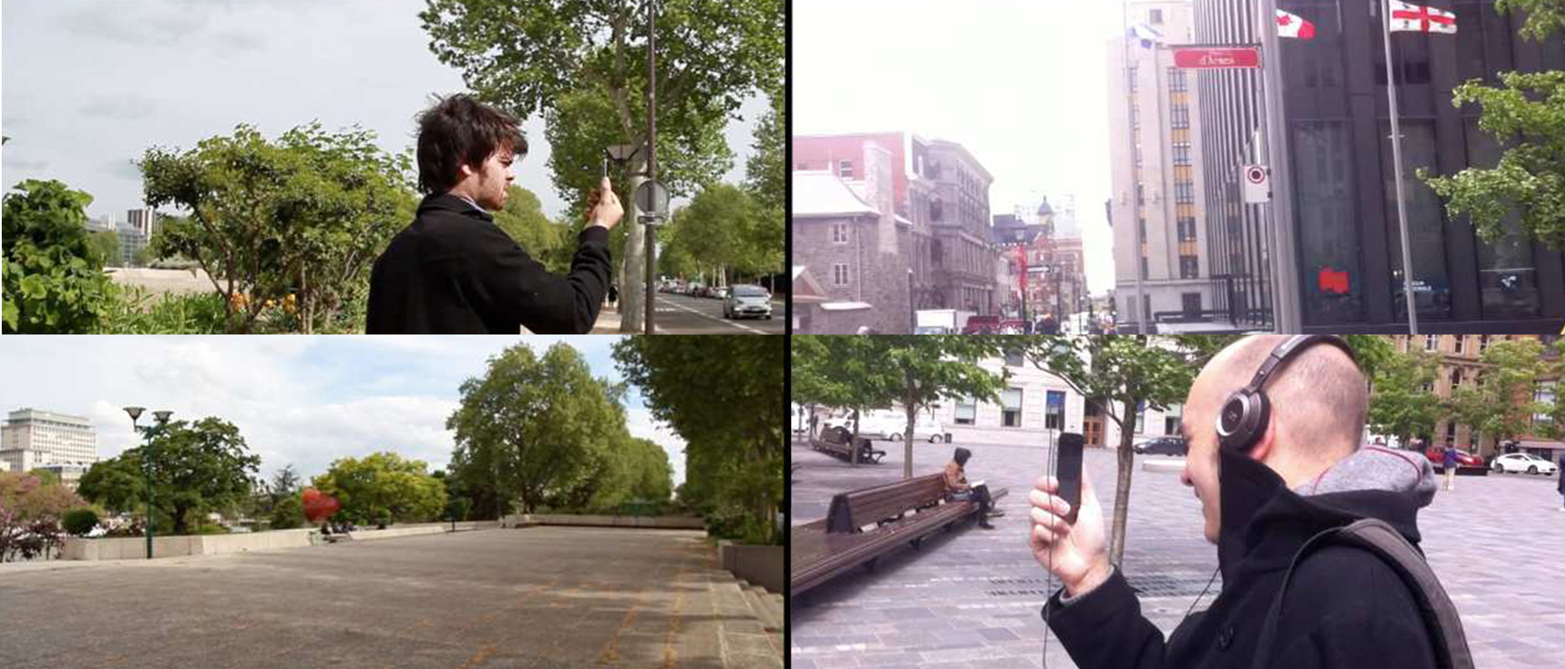
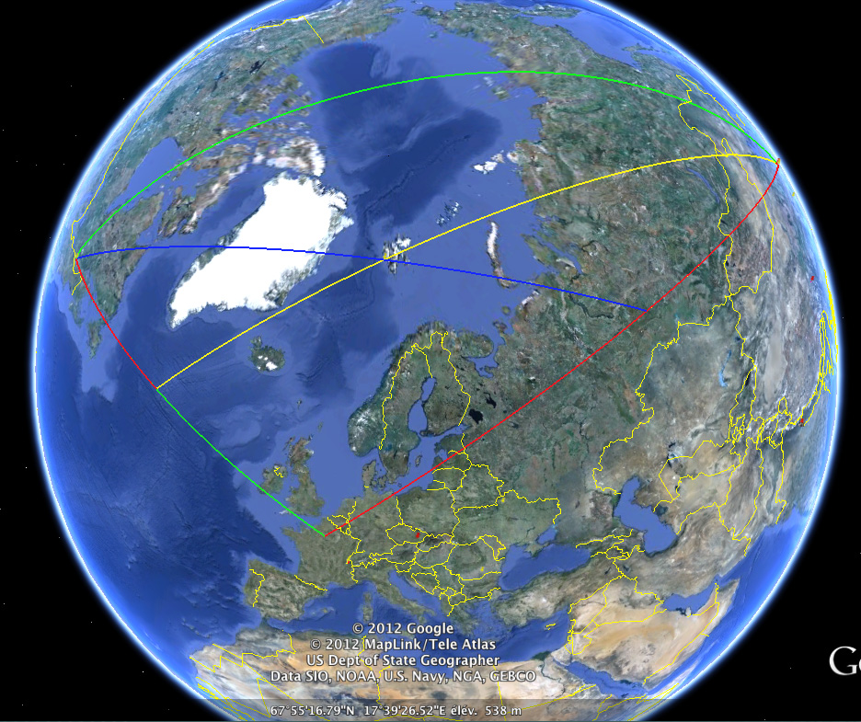
Bernard GUELTON – ANR CORES - Behaviours and collective spatial representations in urban areas Interactions of artistic and scientific perspectives
H U P A R E L: A WORLDWIDE CITY ART GAME AROUND THE WORLD & SCIENTIC COGNITIVE EXPLORATION
Fictions & interactions team / ORBE situated medias
https://fictions-et-interactions.net/
https://cores.pro

Slide 2
H U P A R E L: A WORLDWIDE CITY ART GAME AROUND THE WORLD

Slide 6
Bernard GUELTON – ANR CORES - Behaviours and collective spatial representations in urban areas interactions of artistic and scientific perspectives Rio : jardim botanico / Paris : jardin du Luxembourg

