Slide 1
Improving Operational SAR-based Flood Mapping in Arid Regions
Antara Dasgupta, Maxwell Goodman, Néstor Yague-Martínez, and Beth Tellman
Notes:
Hello everyone, I’m Antara Dasgupta and this EGU I’m happy to share with all of you, some of the latest work we’ve been doing at c2s to improve SAR-based flood mapping in arid regions

Slide 2
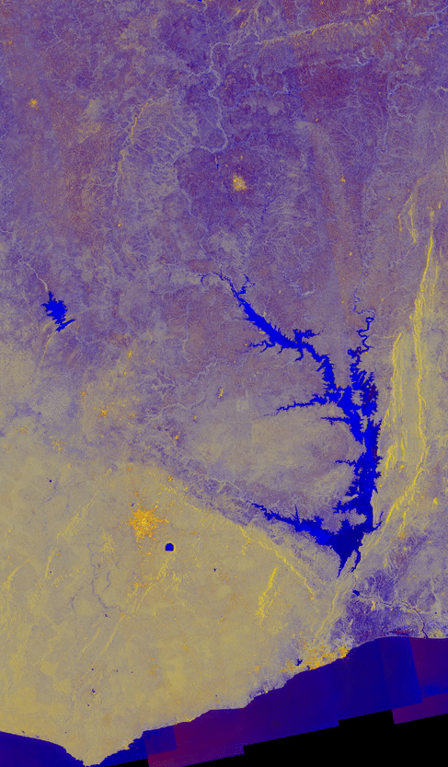
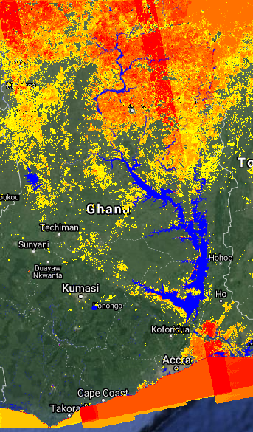
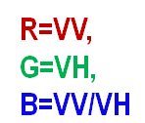
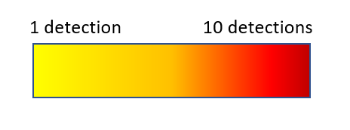
Problems with
Backscatter Dependence
in Arid Regions
Seasonal Backscatter Swing
S1 Recurrence
Landsat Max Extendecdet
Extent
Notes:
One of the main challenges for SAR-based flood mapping in arid regions is the seasonal backscatter swing. As the Sentinel-1 FCC GIF in the left panel shows, the dry sand in the summer season displays backscatter deceptively similar to permanent water due to its high electrical permittivity. This results in massive FPs in SAR based flood maps, as evident from the large discrepancy observable between long-term optical and SAR recurrence in the right panel.

Slide 3
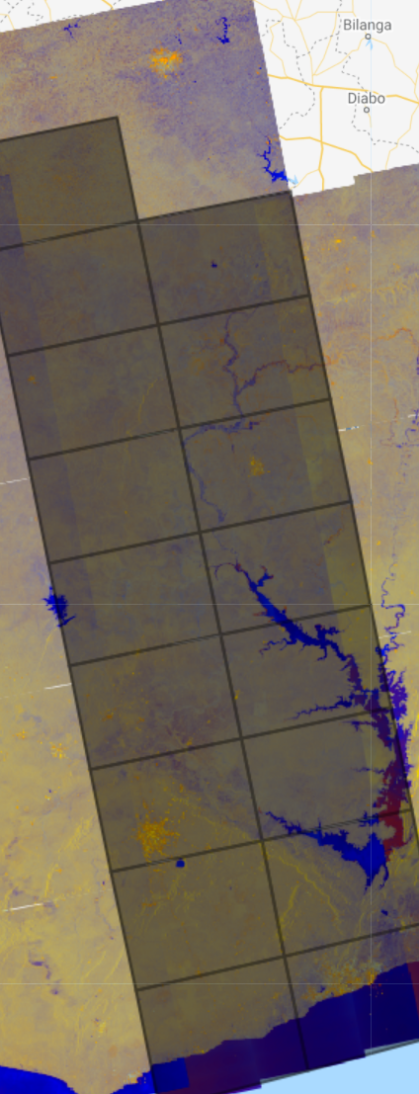
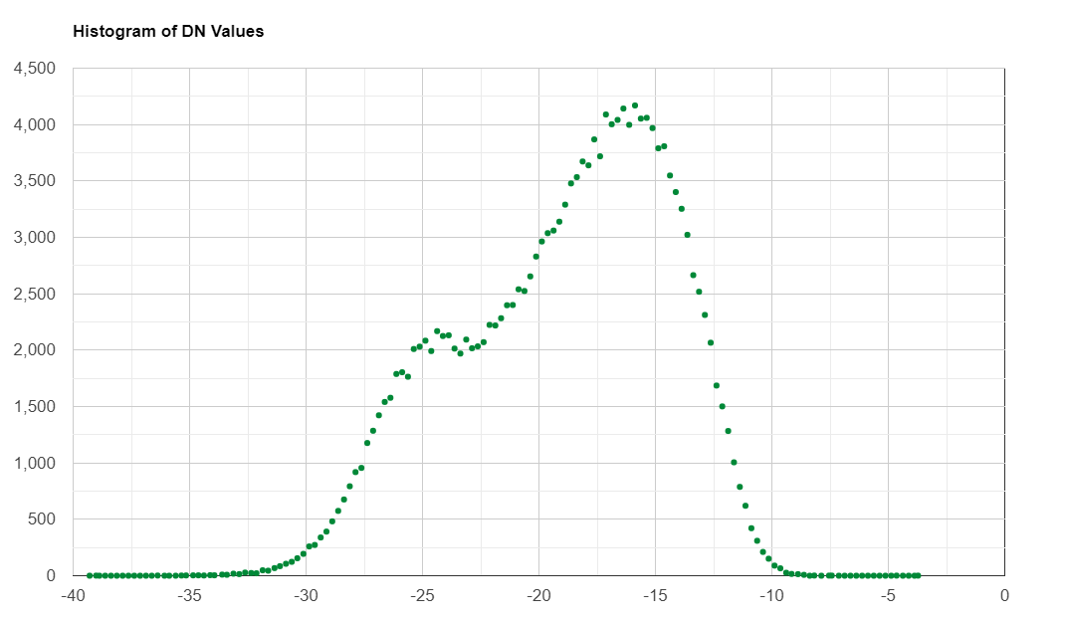
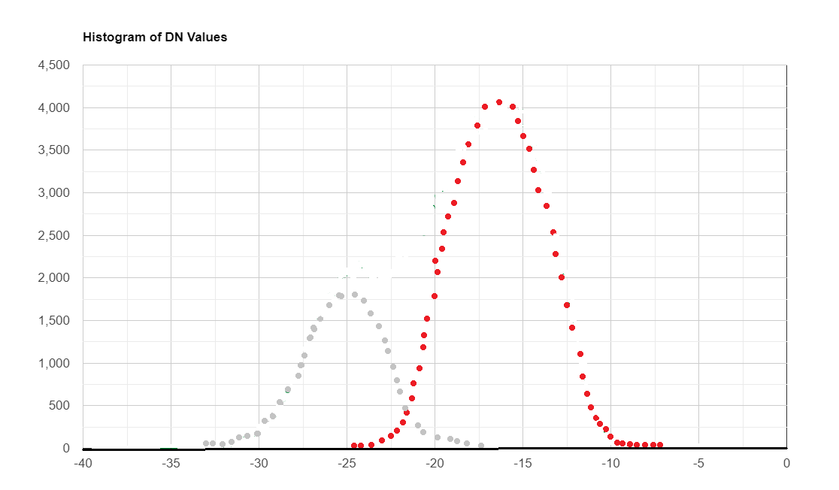
Histogram Building for Large-scale Mapping
Bimodal Tile Selection
“L1p” (Land at First Percentile)
Sampling Location:
Land-water edges
Thresholding Approach:
Otsu/Killingsworth/etc.
Initialized by:
“initial” Threshold
Sampling Location:
Known Land
Thresholding Approach:
Land 1st percentile
Initialized by:
Optical Recurrence
Thresholded by Swath
Thresholded by Tile
Notes:
Current operational mapping methods in literature share a common viewpoint that selecting strongly bimodal tiles with land water boundaries yields good thresholds which can then be globally applied. However, in reality we find that this is not the case – since the threshold optimization algorithms exhibit strong sensitivity to the initialization backscatter value. We propose the use of land’s first percentile backscatter as the threshold as the highest value at which a threshold can be set without consciously letting in more land pixels as FPs. This is achieved by sampling points far away from historical optical water recurrence, such that a backscatter distribution for dry land can be generated. To overcome the challenge of large FNs as a consequence of incidence angle and intrinsic geometric backscatter variations, the swath is tiled into smaller sections to enable local thresholding and sampling.

Slide 4
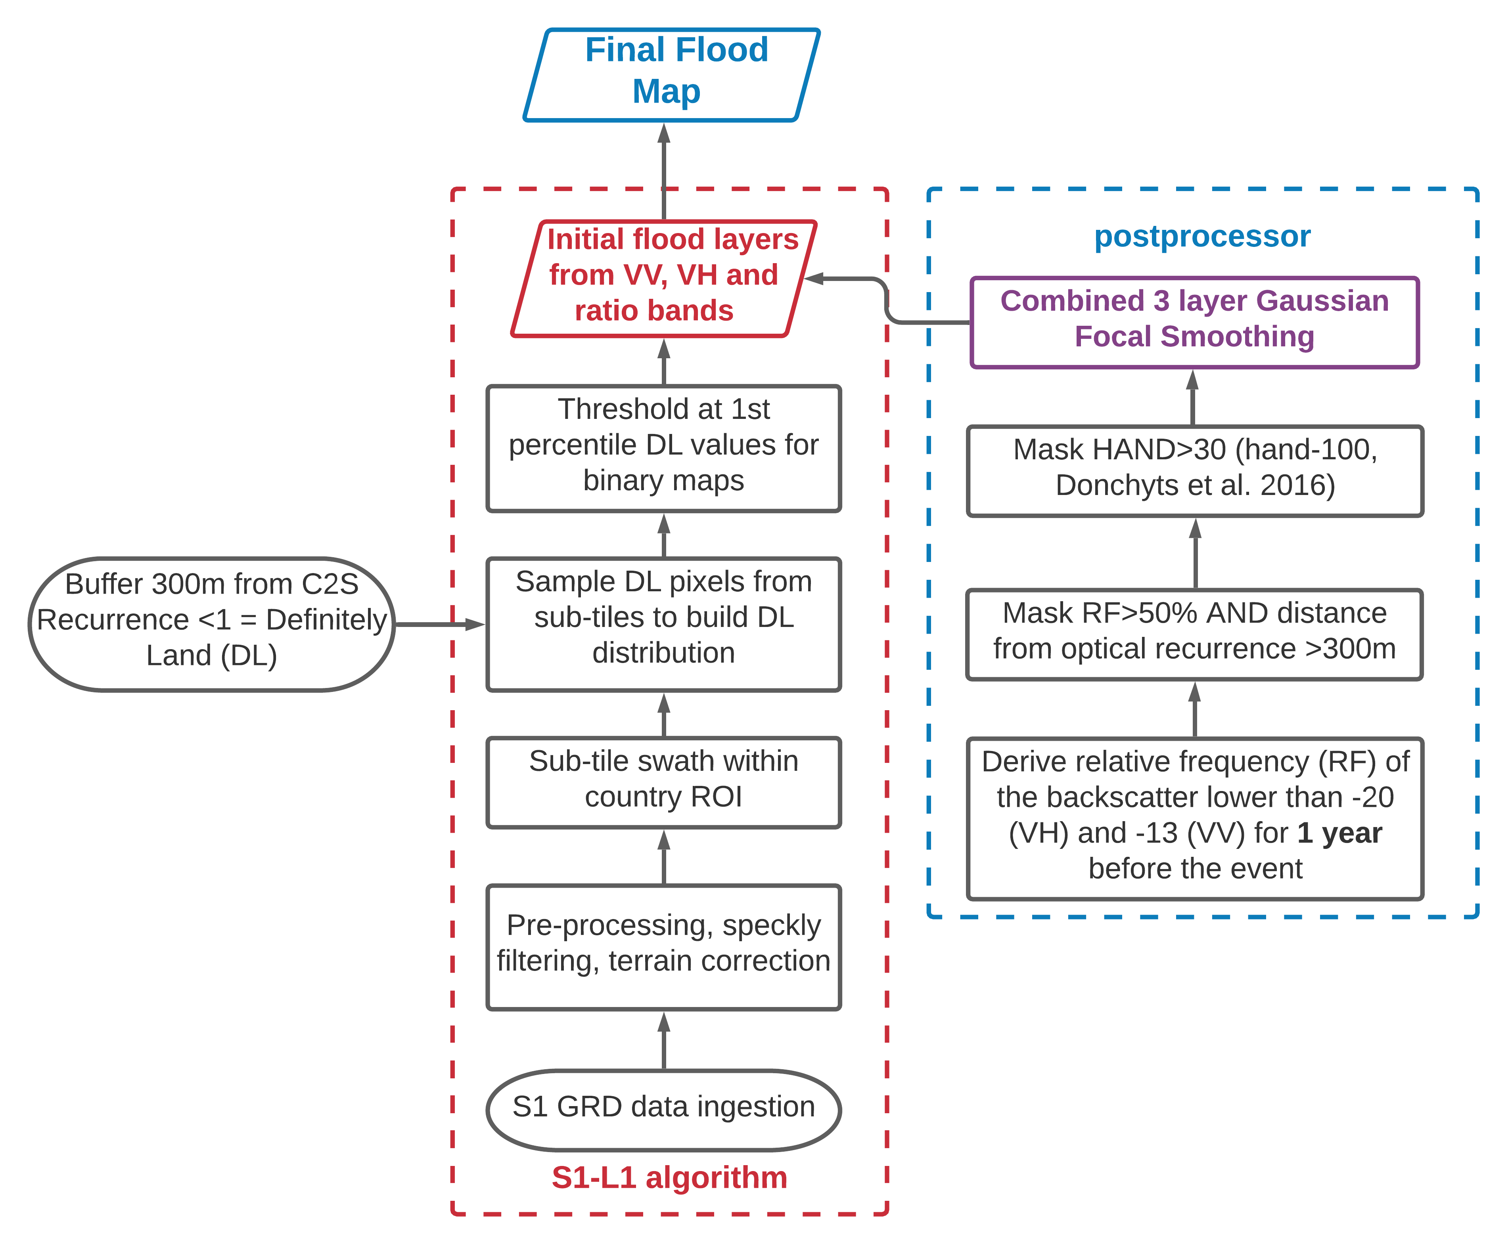
The Current
S1-L1p Algorithm
Notes:
Once the 3-band binary maps thresholded at Land 1st percentile are available – an annual SAR backscatter time series is combined with topography and optical recurrence to further refine the output map as shown in the blue postprocessor block on the slide. For relative low backscatter frequency greater than 50%, where RF is defined as the ratio of the low backscatter frequency and the imaging frequency, all pixels more than 300 m away from historical optical water recurrence are masked. This is followed by masking topographically implausible pixels with a Height above Nearest Drainage value >30m and combining the 3 bands into a single map using a Gaussian focal smoother to remove remaining disconnected isolated flood pixels resulting from speckle.

Slide 5
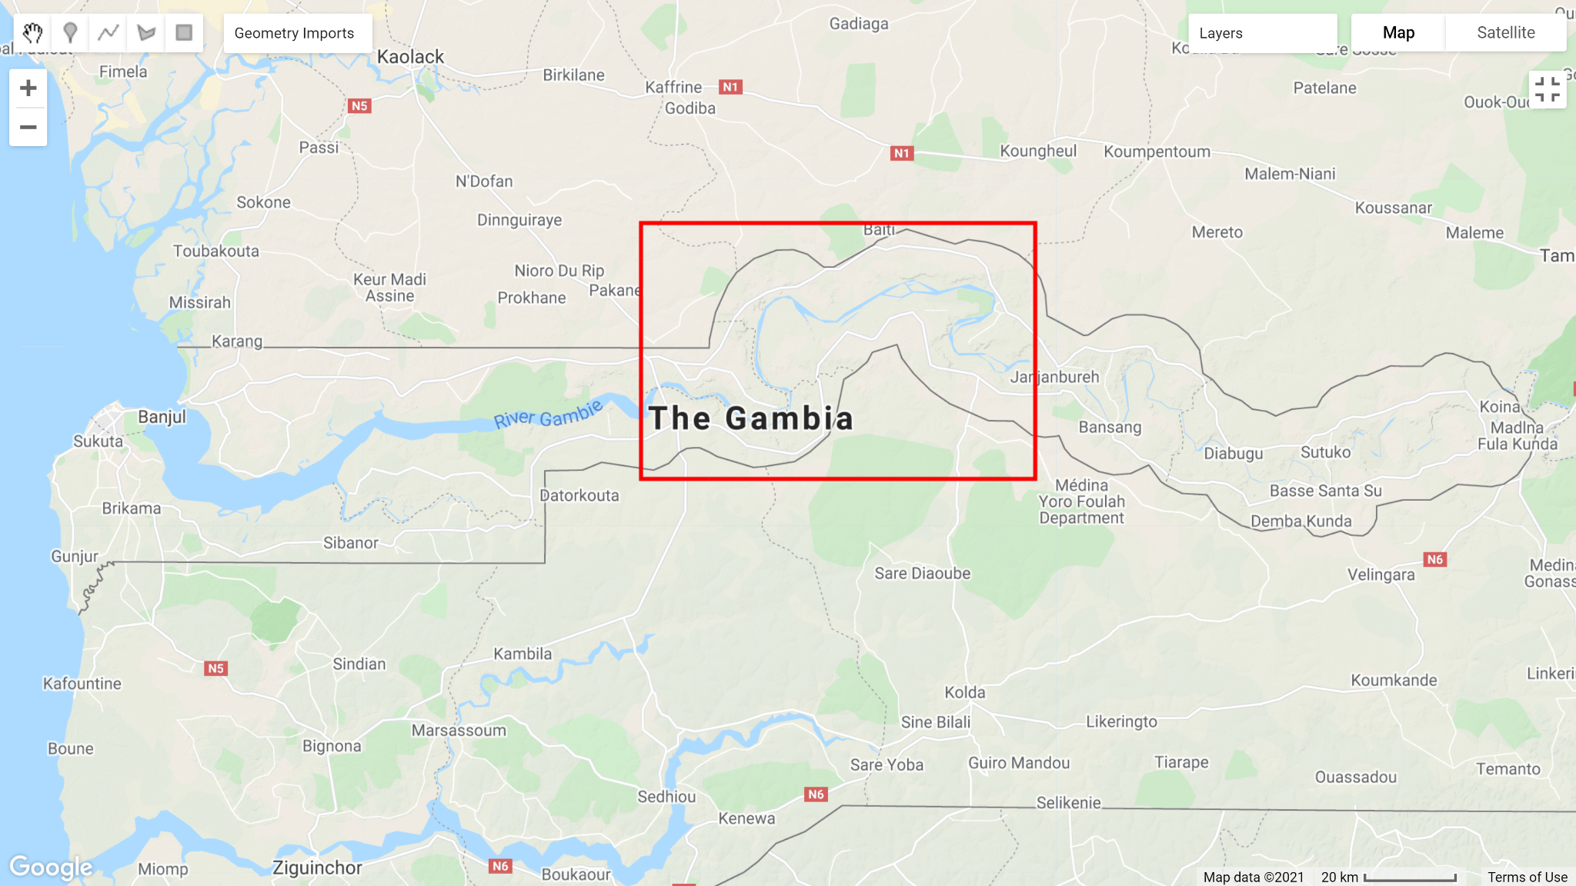
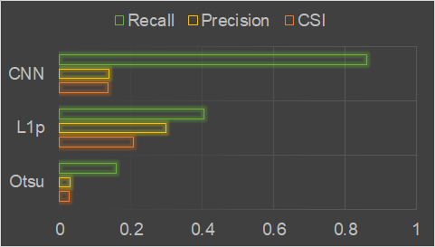
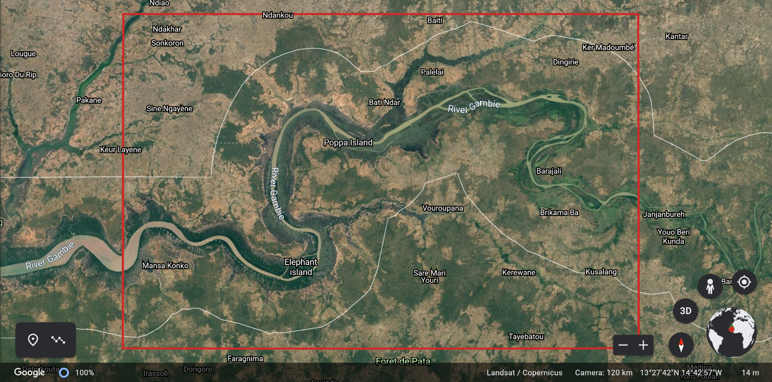
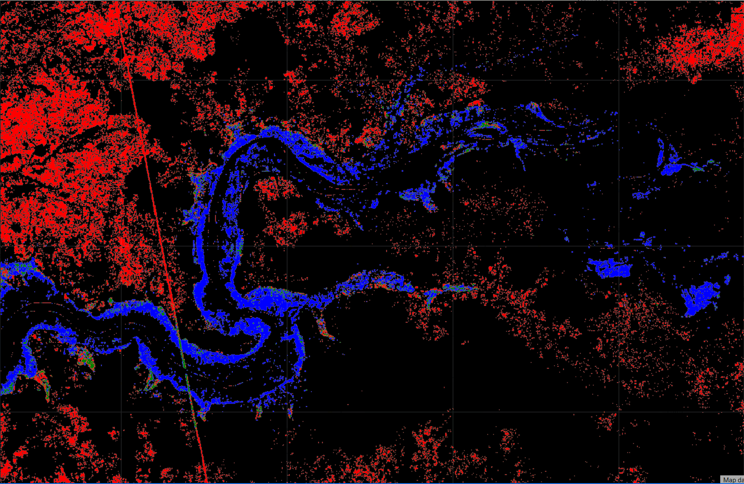
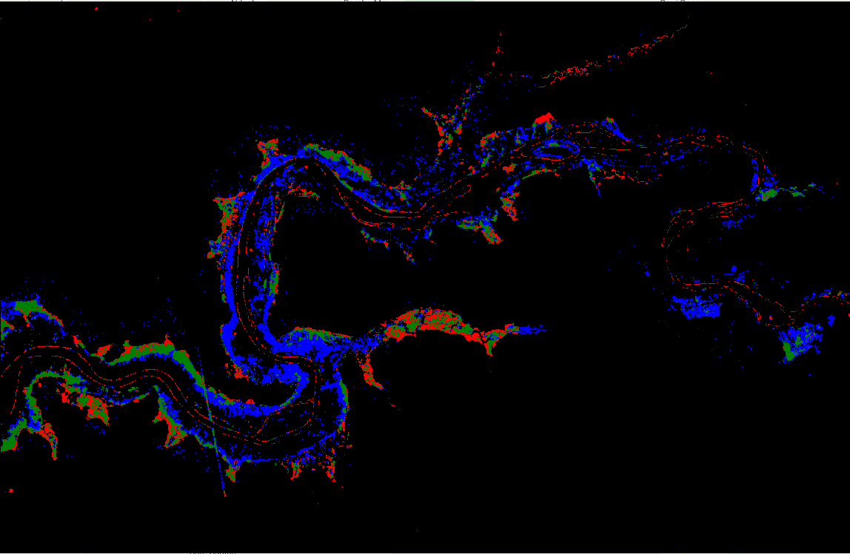
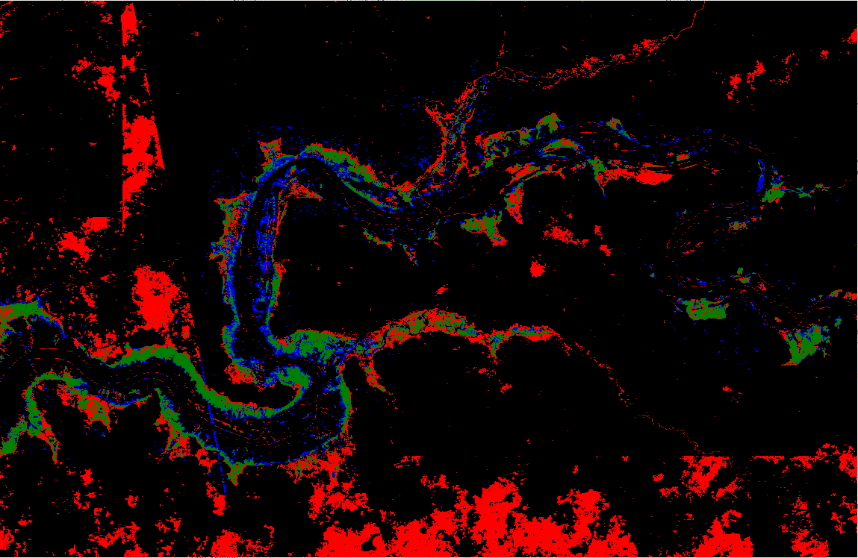
Test Case: Gambia Flooding July-Sept 2017
Otsu
L1p
CNN
True Positive False Positive True Negative False Negative
Notes:
The algorithm performance was tested for the July-Sept 2017 minor riparian flood event in Gambia, which occurred at the end of a sahel dry season when the sesonal backscatter swing is the strongest. S1-L1p was benchmarked against an Otsu classifier initialized with a -19 db threshold and a CNN classifier trained without desert specific training data. All algorithms were run over the entire flood duration, since the validation data was available as manually cleaned max flood extent maps over the entire event based on fused public satellite data.
Panels on the slide show contingency maps of each algorithm against the validation data, with FPs in red, FNs in blue, TPs in green and TNs in black with permanent water masked out. The L1p algorithm in the centre panel, outperforms the naive CNN as well as the Otsu, demonstrating the value of scalable physics based algorithms. The large FNs along the channel can be attributed to the presence of dense riparian vegetation, indicating that the ratio band needs to be better utilised in the algorithm.
Accuracy metrics are poor across all 3 algorithms because of many false negatives in the validation map as well, since flooding under vegetation at many locations could not be manually verified. L1p behaves conservatively, hence achieving best values of CSI and precision, however, since the CNN massively overpredicts but incorporates texture, it demonstrates a much higher recall as compared to the other algorithms. This highlights the need to reduce the dependence on optical recurrence which is often unable to detect water under vegetation, and including it as a driving factor in the post-processor leads to incorrectly discarding many true positive flooded pixels.

Slide 6
Persisting Challenges and Future Work
Fuzzification of the binary algorithm
Improve method to combine bandwise maps using land-use
Reduce dependence on optical recurrence – incorporate topography
Mask low backscatter prior to histogram sampling
Remove FPs from harvested croplands
Improve statistical time series information from S1

Slide 7
Thank You!

