Slide 1
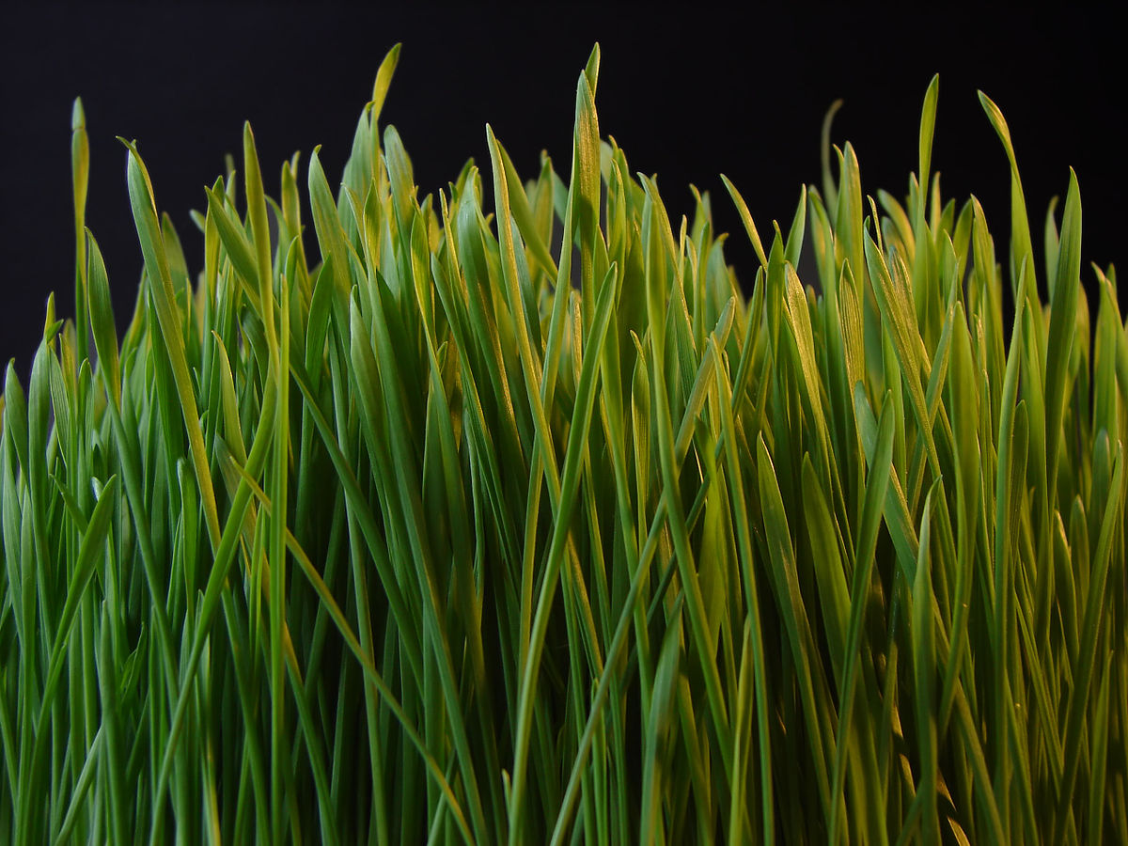
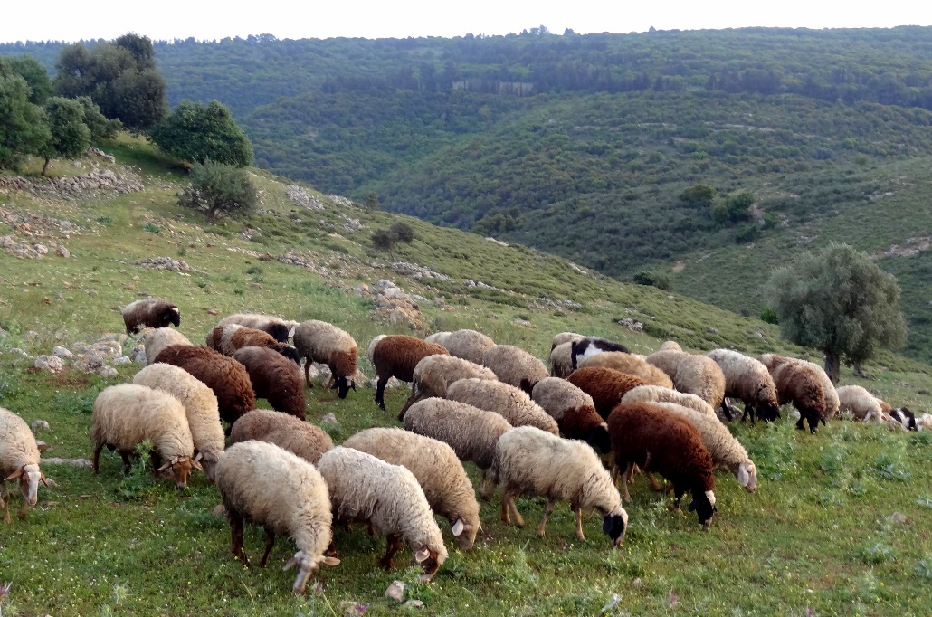
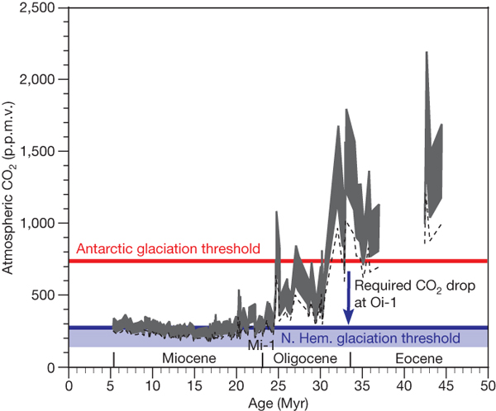
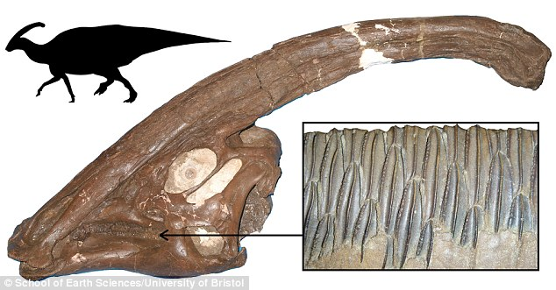
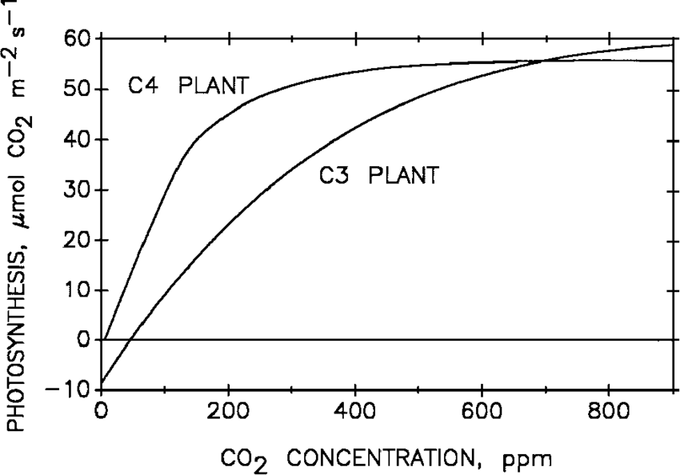



It is time to interact: chronology and ecology in studying plant Si
Deconto et al., 2008
Nevit Dilmen, Wikimedia
Noa Steiner, Wikimedia
Allen & Prasad, 2004
School of Earth Sciences, University of Bristol
New Phytol. 208 (2015): 642-646
Ann. Bot. 121 (2018): 1-8
Palebiology 45 (2019): 7-20
Plants 9 (2020): 430
Plants 10 (2021): 652

