Slide 1

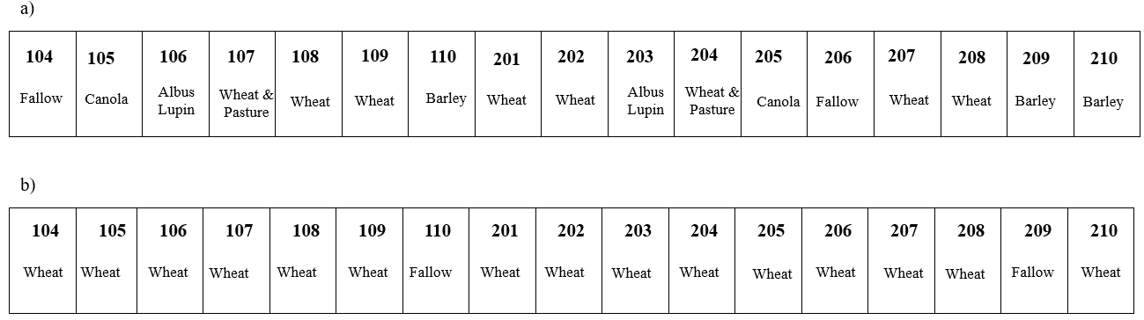
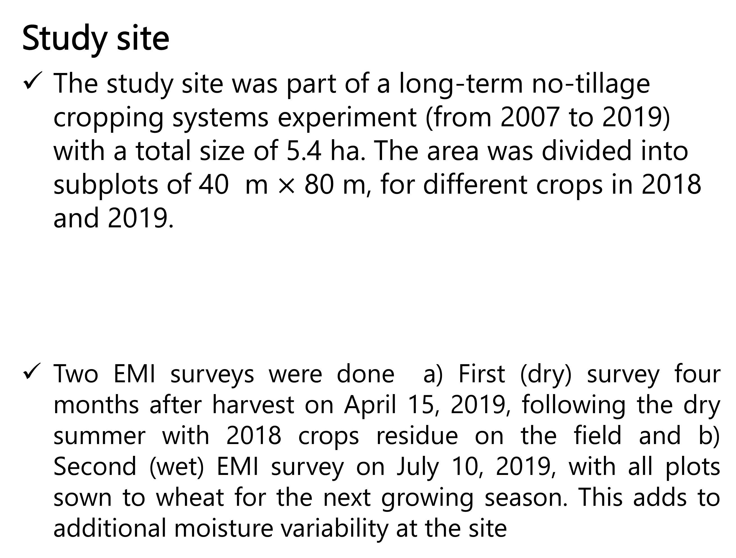
Quasi-3D mapping of soil moisture for agriculture using electric conductivity sensing
Gaps
Use of point sensor
Mostly mapping of salinity
Mostly at irrigated sites
Calibrations by excavated pit method
Extrapolation of transect data / soil samples
Inversion
A least square inversion algorithm (EM4Soil) was used to determine electric conductivities for individual soil layers (0-50cm, 50-80 cm and 80-160 cm) for two EMI surveys at a trial site, with different crop rotations and varying moisture conditions.
Discussion
EMI survey calibrated by ERT-EMI power law equation predicted field scale θ for different soil depth (upto 1.6 m) using inversion algorithm with R² of 0.902 and 0.541 for dry and wet soil conditions.
Inverted ECa was spatially variable, which increased with depth, measured conductivity in wet season was higher than dry season at all DOEs. Since the only variable factor from dry to wet season was moisture this suggested change in ECa is due to moisture
ERT– EMI power law calibration of field scale quasi-3D ECa data successfully predicted the soil moisture values at different soil depths validated by NMM measurements.
Average percentage difference between inverted and measured apparent conductivities was between 25 to 27 % resulting in difference of 19 to 23 % in volumetric soil moisture prediction
The impact of different crop rotations, resulting in additional moisture variability at the site, was clearly detected in the EMI survey. For dry season, except for fallow plots , average θ was close to wilting point of site soil texture, while in case of wet season average θ was at the field capacity in all depth. This may be important for prediction of potential yield and input rates, through modelling, for upcoming crops
Study site
The study site was part of a long-term no-tillage cropping systems experiment (from 2007 to 2019) with a total size of 5.4 ha. The area was divided into subplots of 40 m $×$ 80 m, for different crops in 2018 and 2019.
Two EMI surveys were done a) First (dry) survey four months after harvest on April 15, 2019, following the dry summer with 2018 crops residue on the field and b) Second (wet) EMI survey on July 10, 2019, with all plots sown to wheat for the next growing season. This adds to additional moisture variability at the site
Laboratory estimation of θ using electrical resistivity tomography (ERT)
A simplified calibration equation is generated assuming, assuming 1/Ro is uniform and established ERT vs θ (cm³ cm⁻³) for two DOEs (0.5 m and 0.8 m) fitted to a power law trend line (Leopold et al., 2021).
This means that soil solution is considered as constant that adds to the general misfit between our predicted θ (cm³ cm⁻³) from EMI data and in the field NMM measurements.
ERT – EMI power law calibration of field scale quasi-3D ECa data predicted soil moisture values at different soil depths ( 0 – 0.5, 0.5 – 0.8 & 0.8 – 1.6m)
Impact of soil water variability on ECa is most prominent in upper two depth slices in both seasons the depths most meaningful in agriculture
Methodology

Slide 2
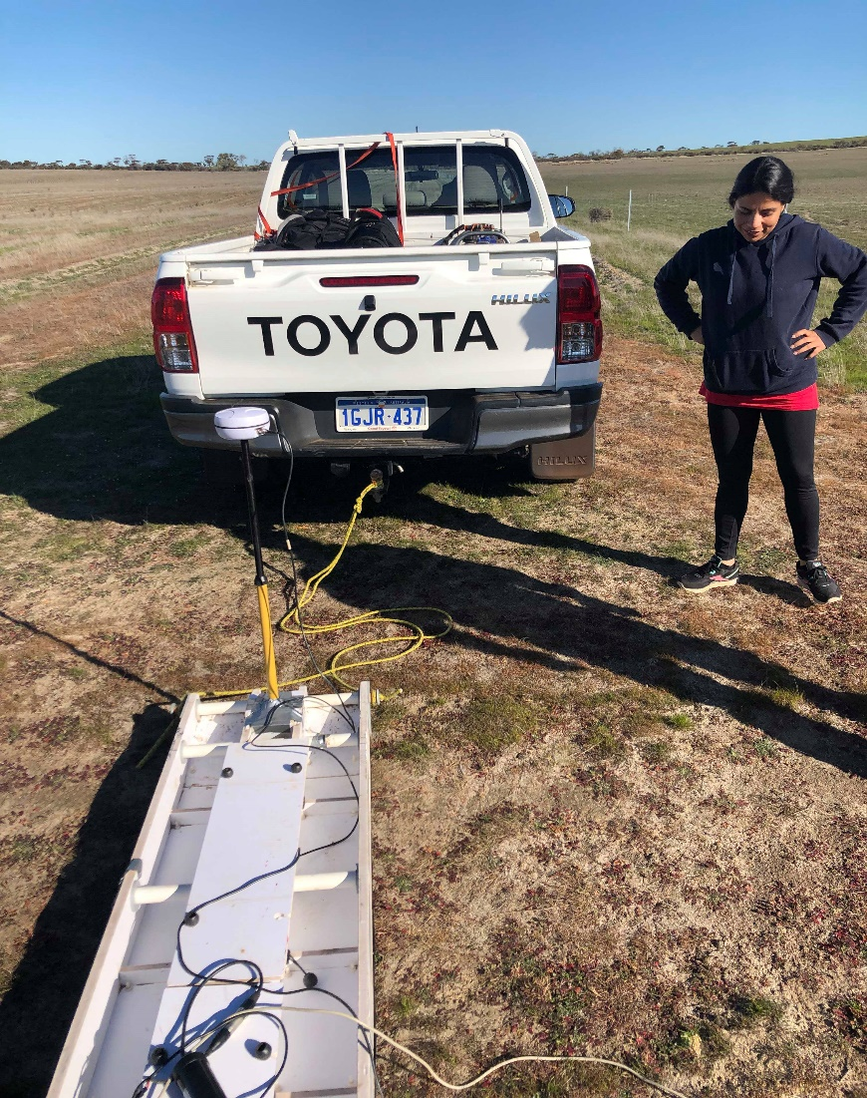
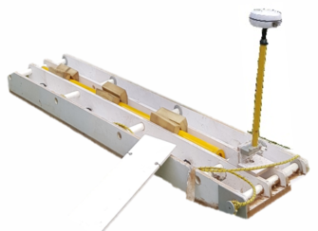

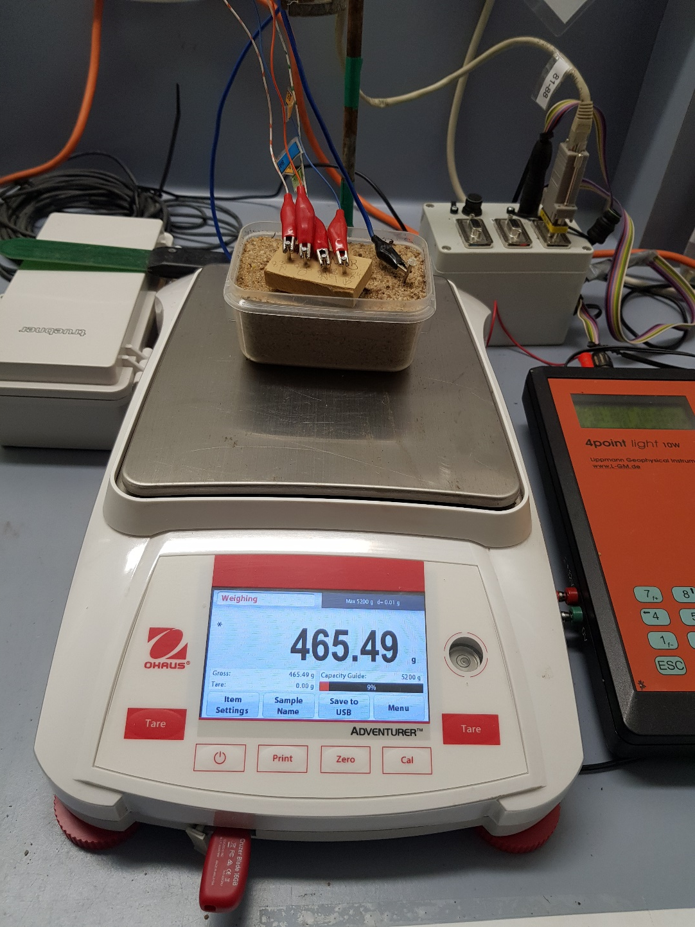
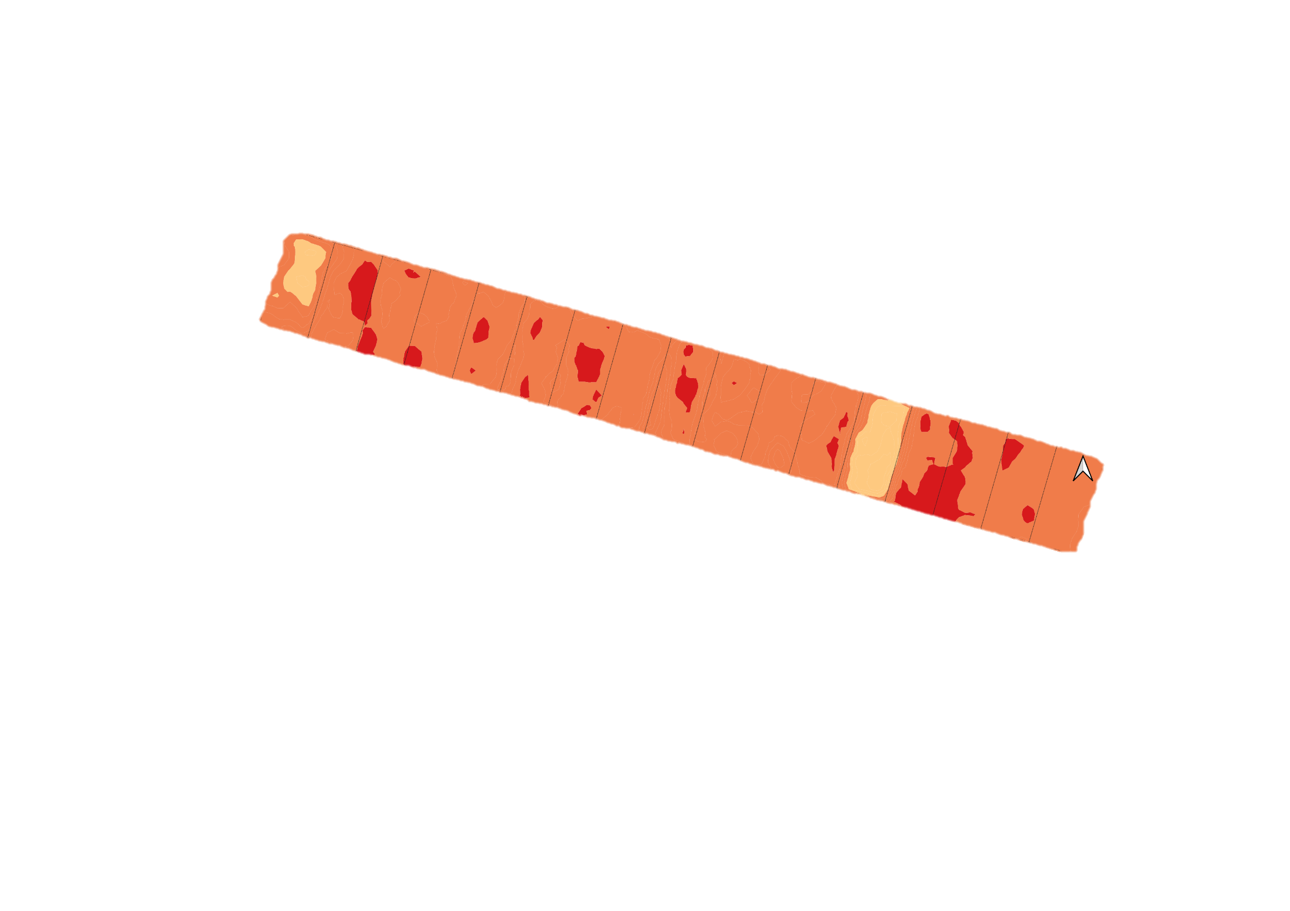
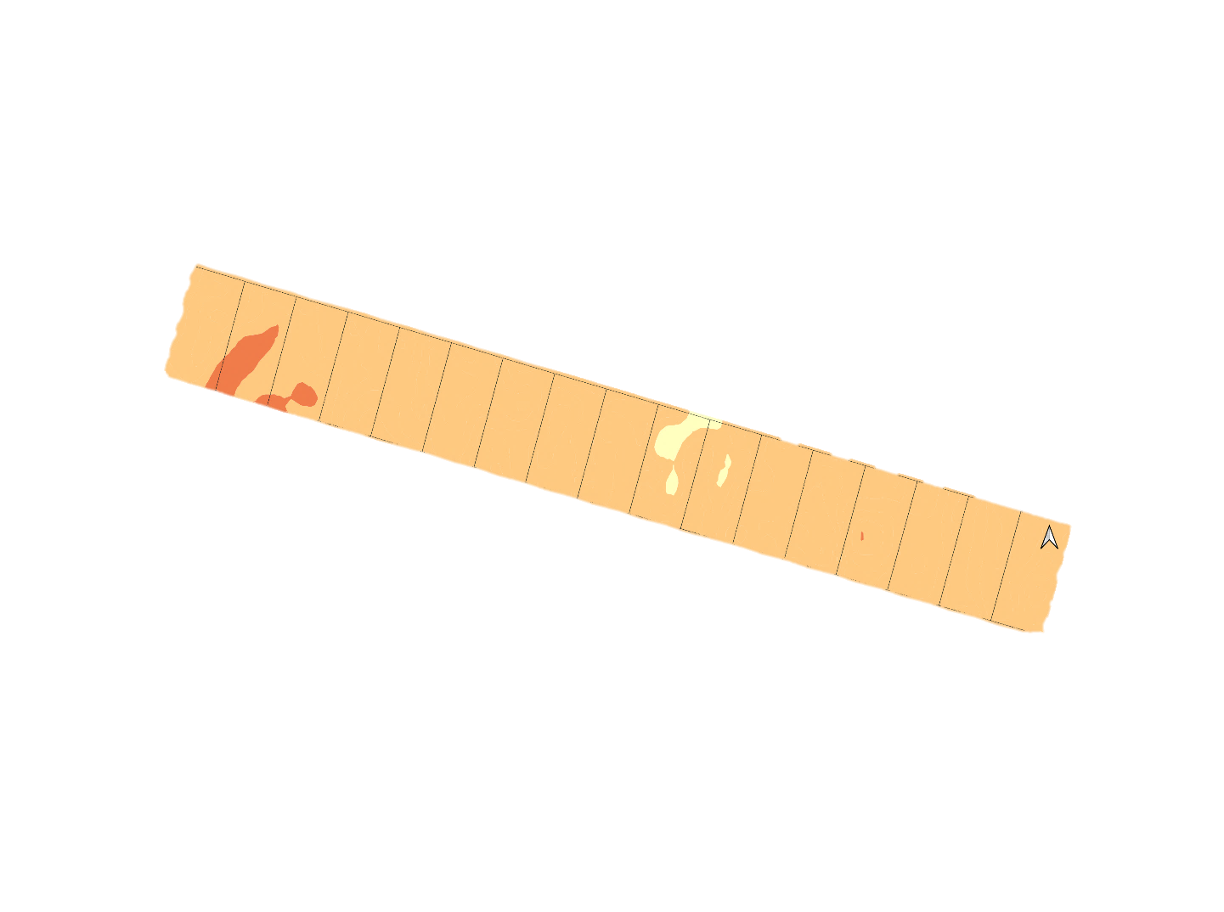
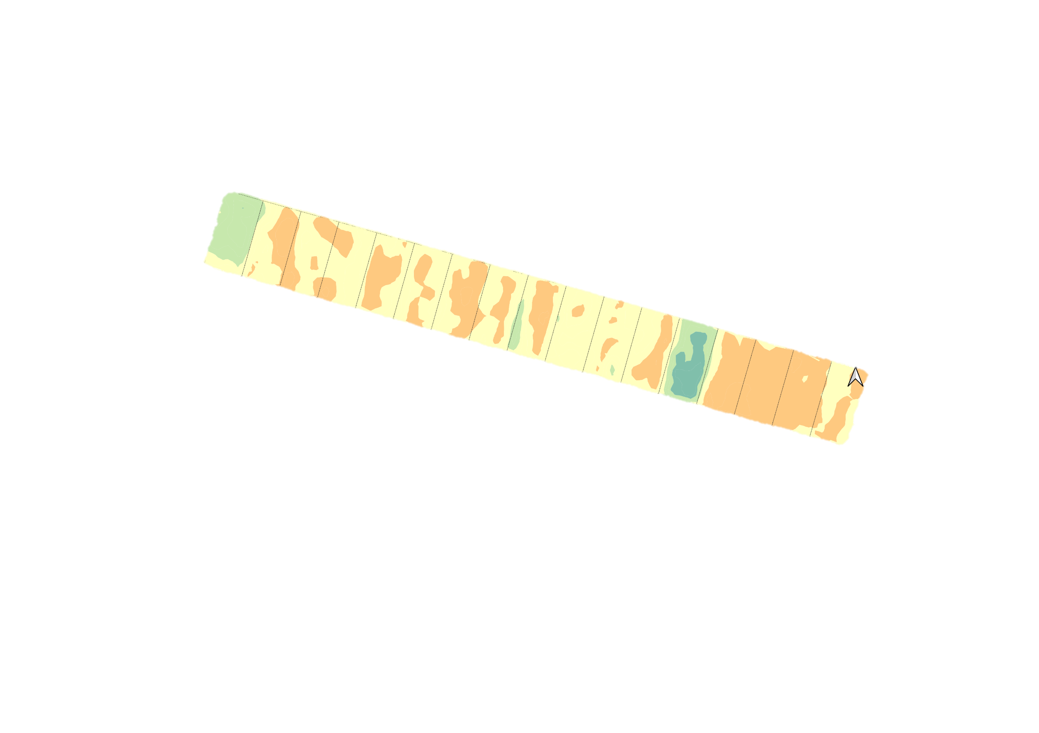
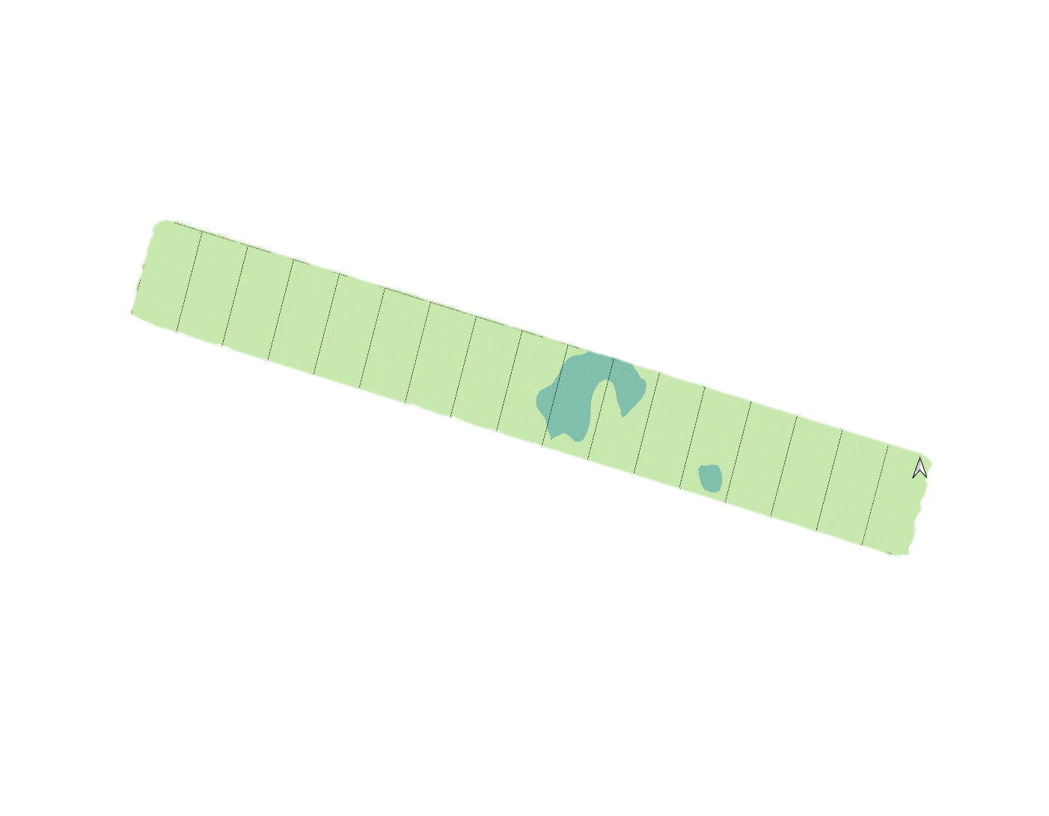
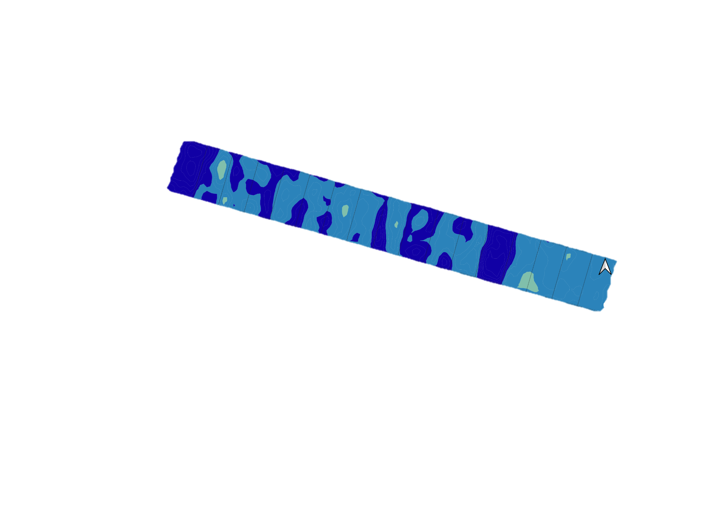
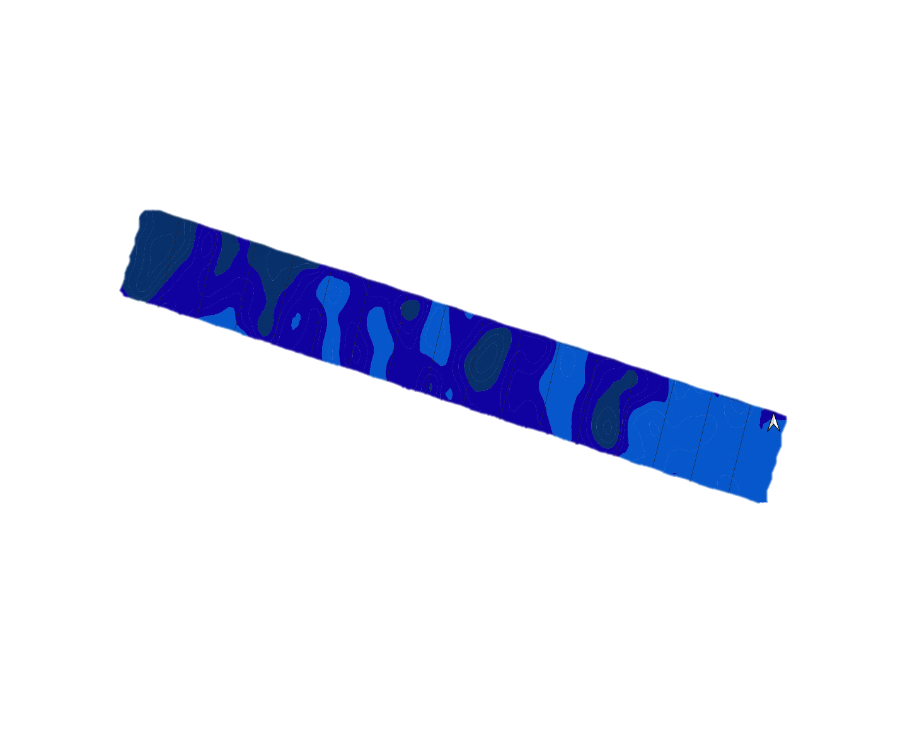

Quasi-3D mapping of soil moisture for agriculture using electric conductivity sensing
Predicting field scale volumetric soil moisture content using multicoil non-contact EMI instrument (Dualem-1HS)
EGU 21-7117
Author: H. Shaukat¹, K.C. Flower^{1,2}, M. Leopold^{1,2}
Summary
This study demonstrates how spatial ECa data acquired by a multicoil non-contact electromagnetic induction (EMI) instrument can be inverted and used to determine the volumetric soil moisture content using laboratory based electric resistivity tomography (ERT) – EMI power law calibration curves. This method is robust, relatively quick and inexpensive for estimating the soil moisture status in the field to help with farm management decisions.
Introducing a temperature controlled laboratory vol moisture content vs resistivity power law calibration curves for field scale soil moisture prediction
Key takeaway
EMI survey calibrated by ERT-EMI power law equation is an efficient way of predicting field scale θ for different soil depth (upto 1.6 m) using inversion algorithm
ERT – EMI power law moisture calibration resulted in strong correlation with on field NMM measurements
Inverted ECa – ERT calibrated moisture has higher R² (0.902 & 0.541) than measured ECa (0.890 & 0.440) for dry & wet season respectively
Dry season
Wet season
Establishing inverted layer conductivities for displaying ERT – EMI calibrated moisture prediction at three depths (0-0.5, 0.5-0.8 & 0.8-1.6 m) of a vertically contrasting soil profile
0 – 0.5 m
0.5 – 0.8 m
Vol. moisture content cm³ cm⁻³
0.8 – 1.6 m
Dry season
Wet season
Validating the field scale moisture profiling by neutron moisture meter (NMM) measurements
Pearson R = 0.950
Pearson R = 0.735
Let’s connect
Hira.Shaukat@research.uwa.edu.au
@Hirra_Shaukat
1 UWA School of Agriculture and Environment, The University of Western Australia, Australia
2 UWA Institute of Agriculture

