Slide 1
Evaluation of the new high resolution unstructured grid Marmara Sea model
milicak@itu.edu.tr

Slide 2




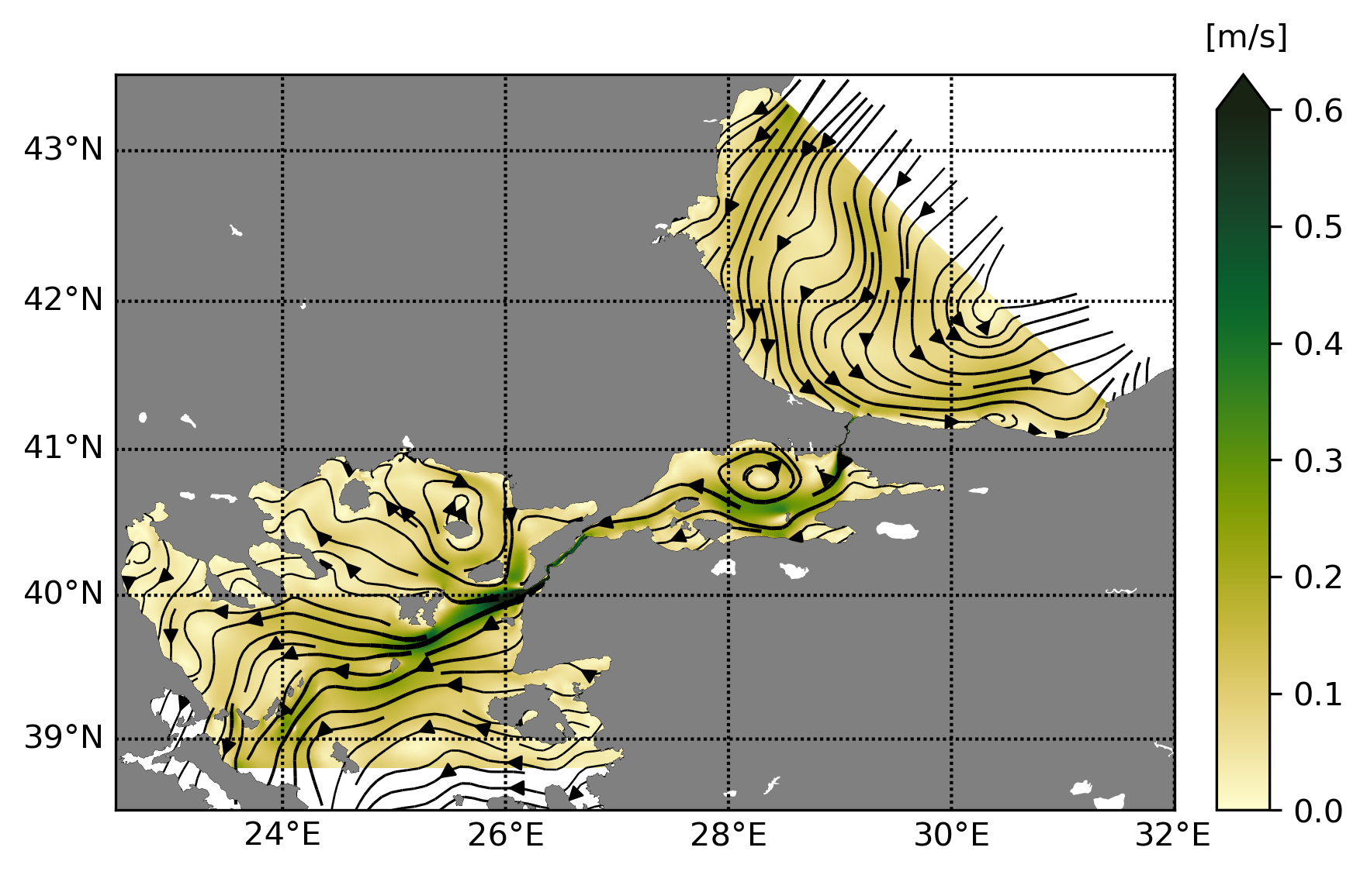
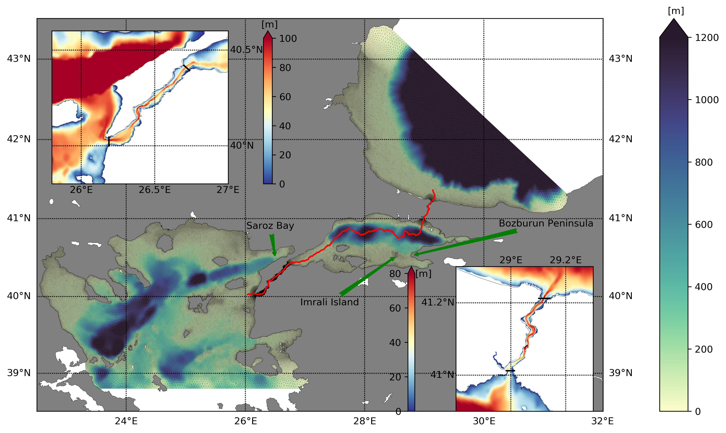
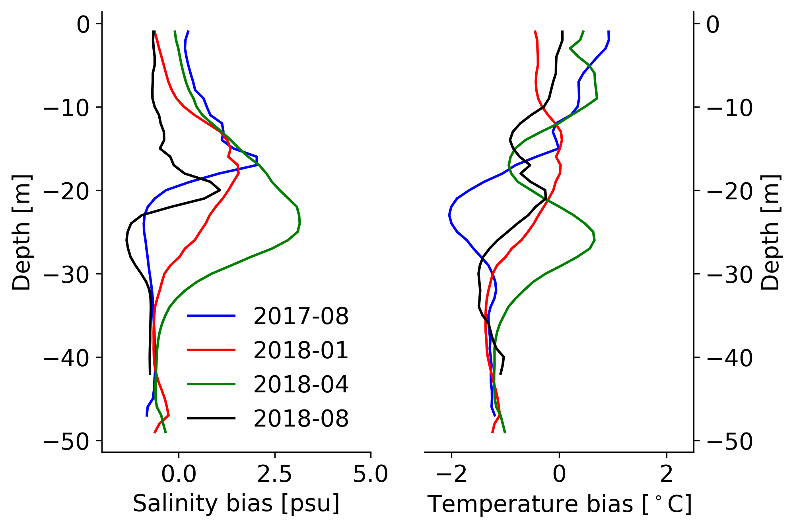
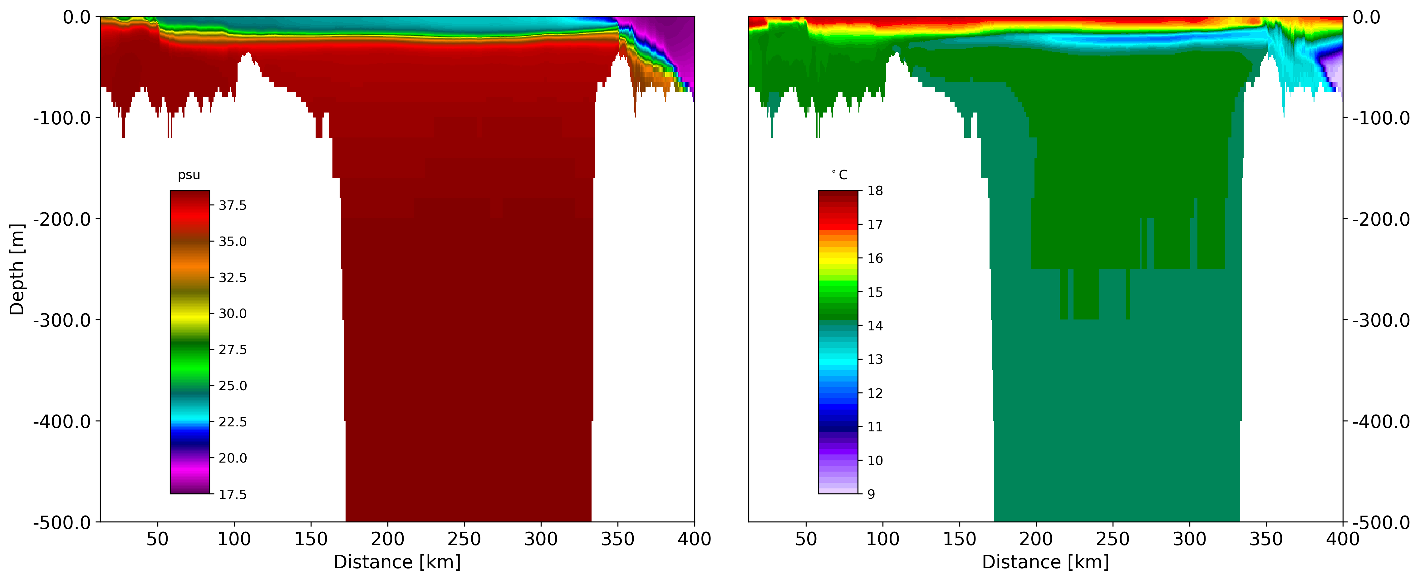
Evaluation of the new high resolution unstructured grid Marmara Sea model
Mehmet Ilicak¹, Ivan Federico², Ivano Barletta^{2,3}, Nadia Pinardi³, Stefania Ciliberti², Emanuela Clementi⁴, Giovanni Coppini², Rita Lecci², Sabri Mutlu⁵
1
2
4
3
5
Objective
to develop a high resolution Marmara Sea and Turkish Straits model which provides boundary conditions for the Copernicus Forecast models.
SHYFEM-unstructured grid model bathymetry
Mean model speed and streamlines
Results
The SHYFEM-TSS model has been run for 4 years and successfully reproduced vertical water mass structure, horizontal circulation and volume fluxes through the Bosporus and Dardanelles Straits.
The net transport across the Bosporus is around 140 km3/yr which is lower than the climatological estimates but more consistent with recent observations.
The largest bias in the temperature and salinity fields are around the mixed layer depth. The model underestimates mixing processes.
Model salinity and temperature biases
Vertical salinity and temperature section throughout the thalweg.
SHYFEM Model Setup
z- coordinate, hydrostatic
466377 elements, 240993 nodes
Smagorinsky, GOTM schemes used.
93 vertical levels
784 cores
ICs from Aydogdu et al. (2017).
Surface BCs from ECMWF.
Lateral BCs from Copernicus MSFS, BSFS.
Integrated between 2016-2019.

Slide 3
Outline
Objective: to develop a high resolution Marmara Sea model which provides boundary conditions.
Model setup
Results
Conclusion
Mediterranean Sea Forecast System (MSFS)
Black Sea Forecast System (BSFS)

Slide 4
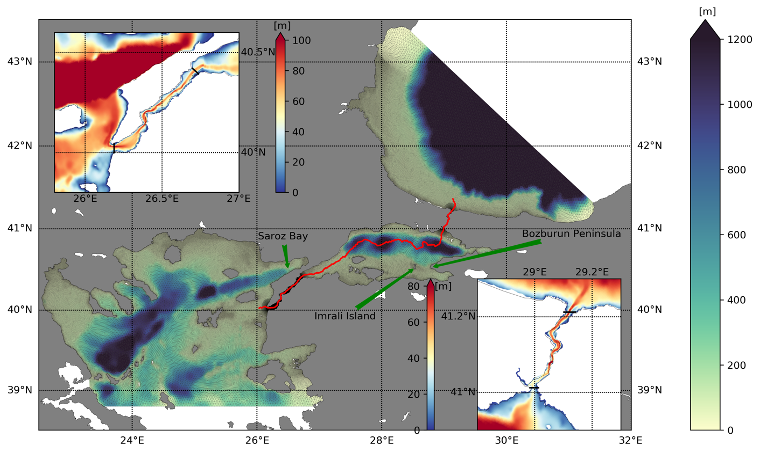
Unstructured Turkish Straits System
(uTSS) Model
SHYFEM-unstructured grid
z- coordinate, hydrostatic
466377 elements
240993 nodes
93 vertical levels
784 cores
ICs from Aydogdu et al. (2017).
Surface BCs from ECMWF.
Lateral BCs from Copernicus MSFS, BSFS.
Integrated between 2016-2019 (Free run).

Slide 5
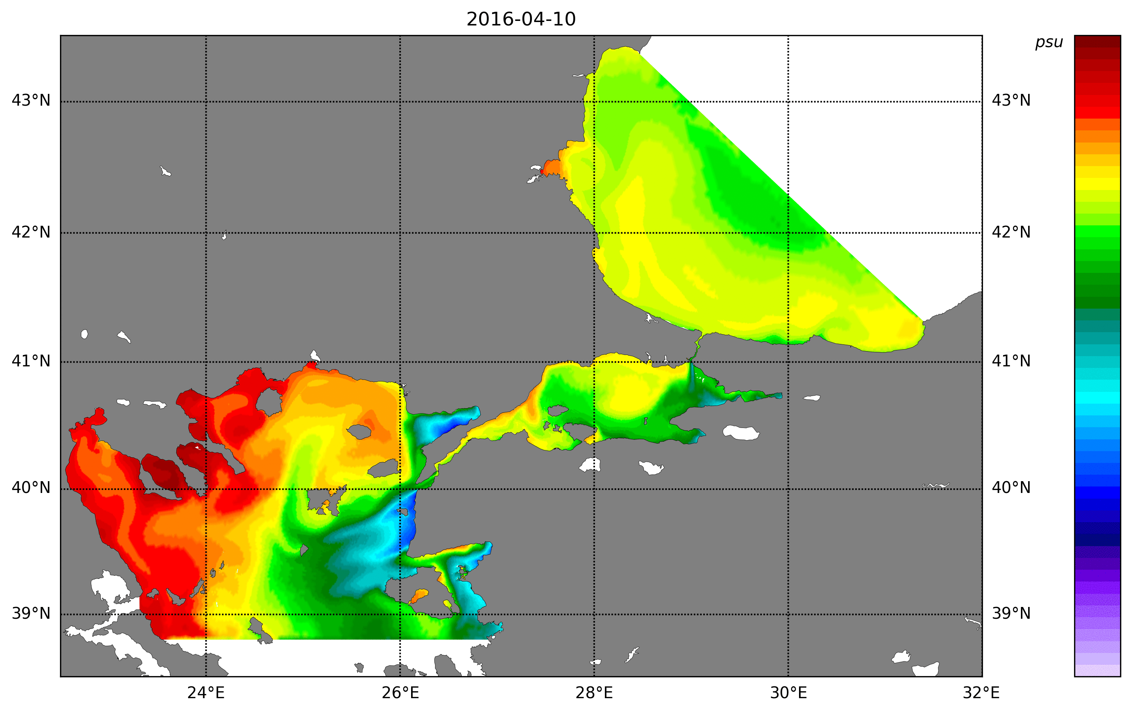
SST movie
C
32
25
20
15
10

Slide 6
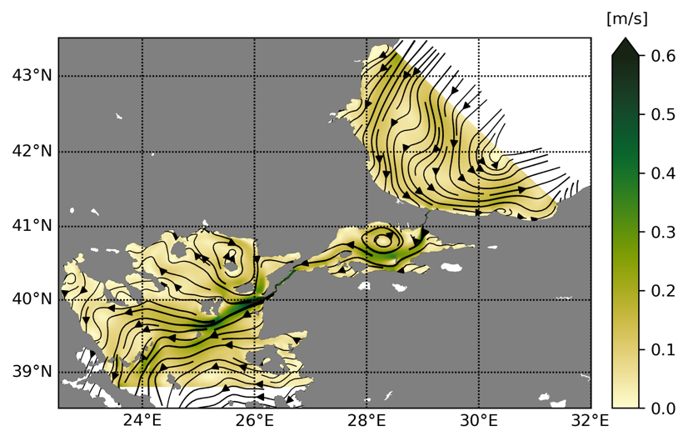
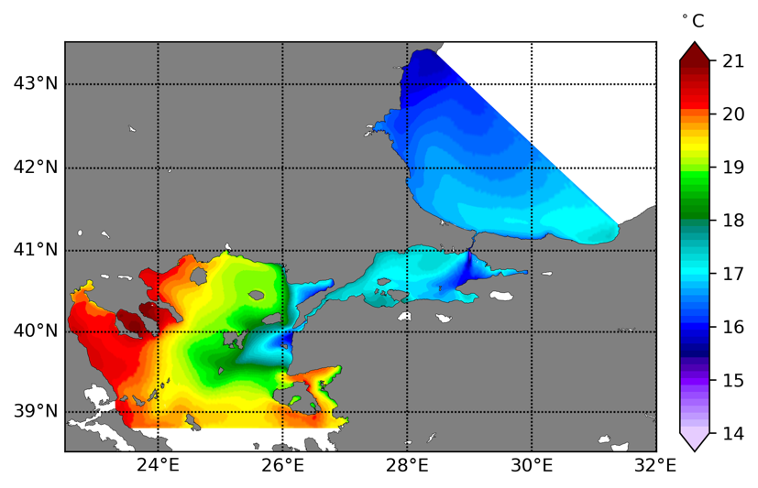
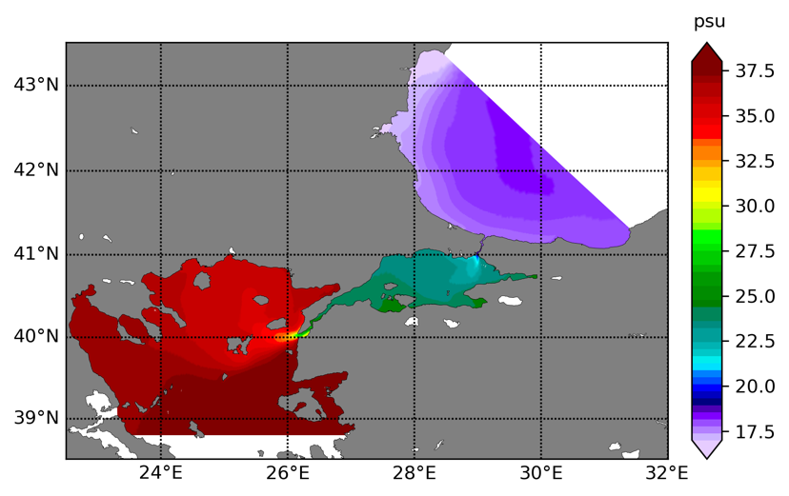
Mean properties
Speed
SST
SSS

Slide 7
Vertical structure
Salinity
Temperature

Slide 8
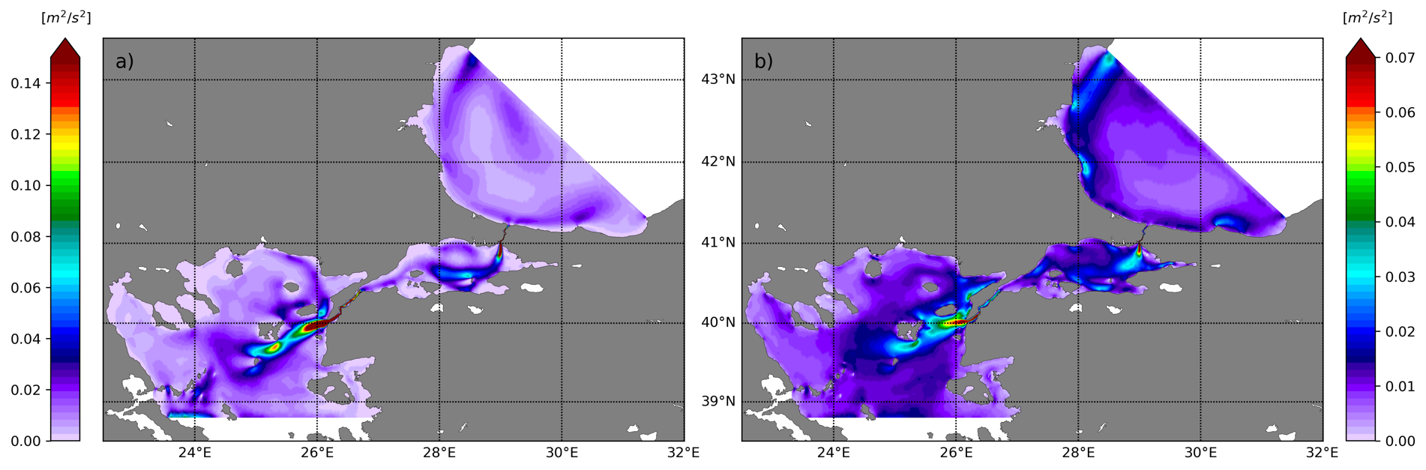
MKE vs EKE
MKE
EKE

Slide 9
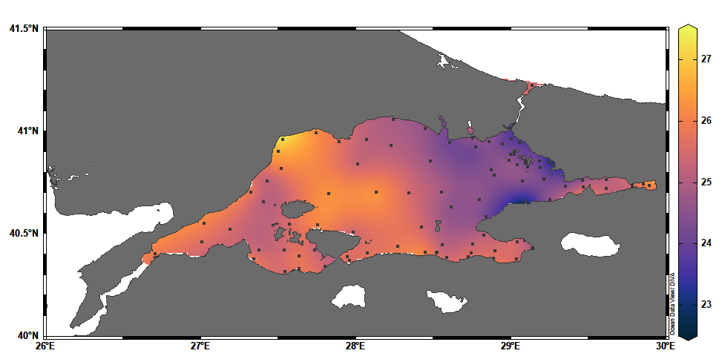
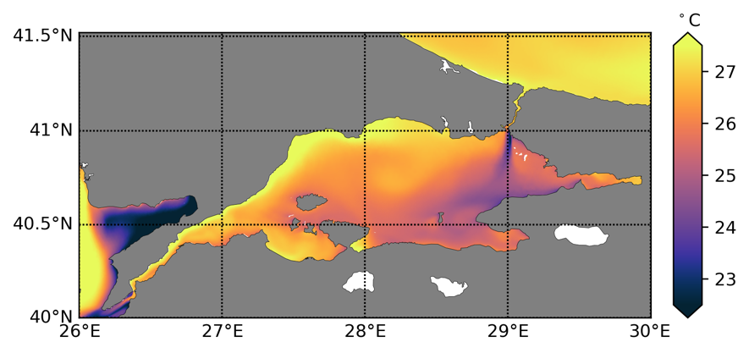
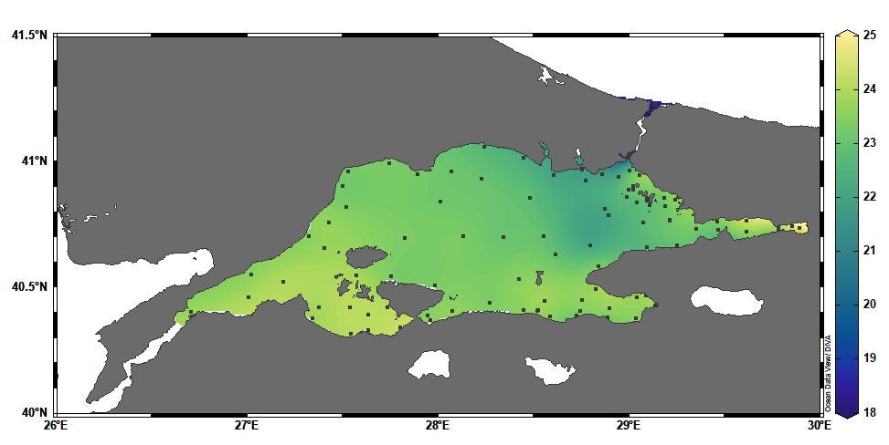
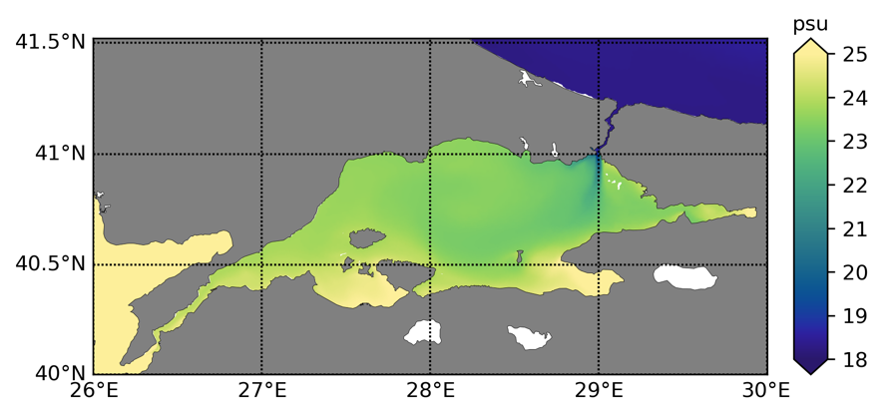
Model vs observations
2017 Summer the Marmara cruise
Observation
Model
Temp

Slide 10
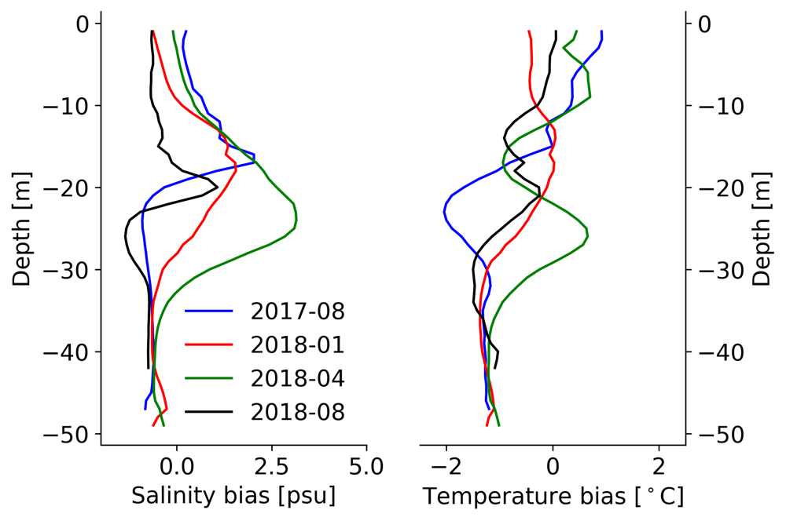
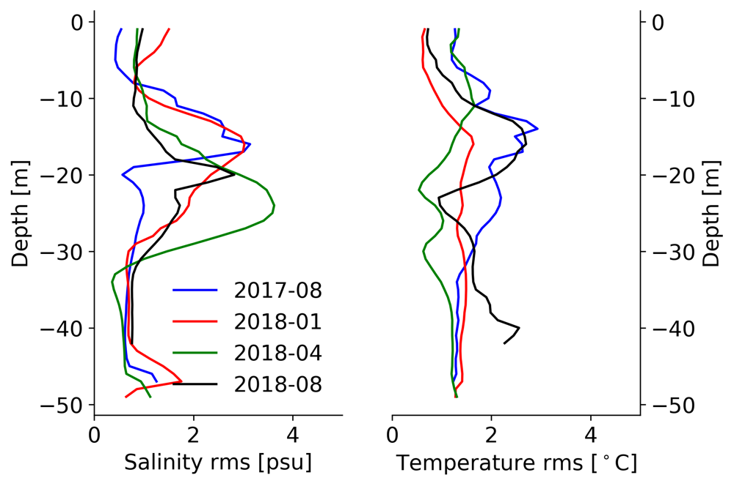
Temperature/Salinity bias and RMS

Slide 11
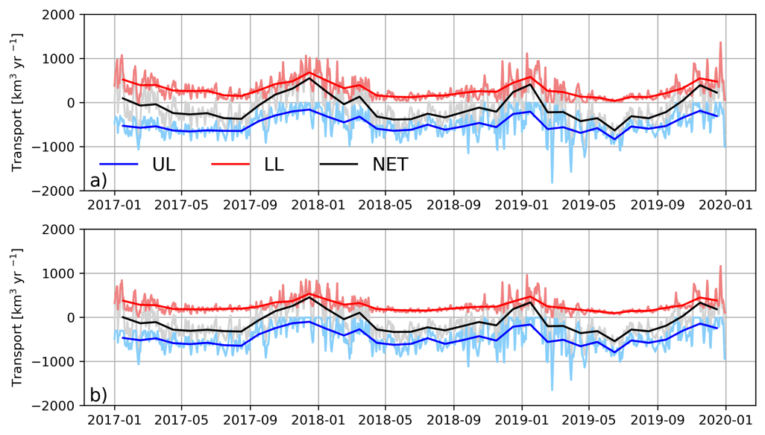
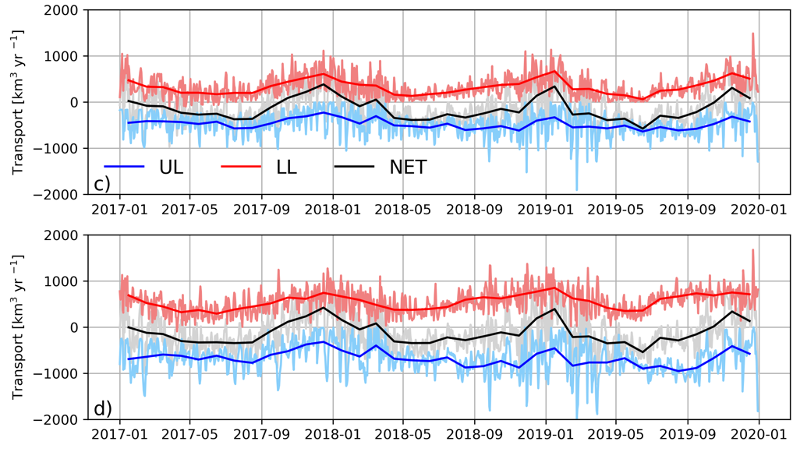
Transports at the Straits
Transports at the southern and northern section of the Bosporus
Transports at the southern and northern section of the Dardanlles

Slide 12
Summary
A new high resolution unstructured grid model for the Turkish Strait System using realistic atmospheric surface forcing and ocean lateral open boundary conditions has been developed.
The SHYFEM-TSS model has been run for 4 years and successfully reproduced vertical water mass structure, horizontal circulation and volume fluxes through the Bosporus and Dardanelles Straits.
The net transport across the Bosporus is around 140 km³/yr which is lower than the climatological estimates but more consistent with recent observations.
The largest bias in the temperature and salinity fields are around the mixed layer depth. The model underestimates mixing processes.

