Slide 1

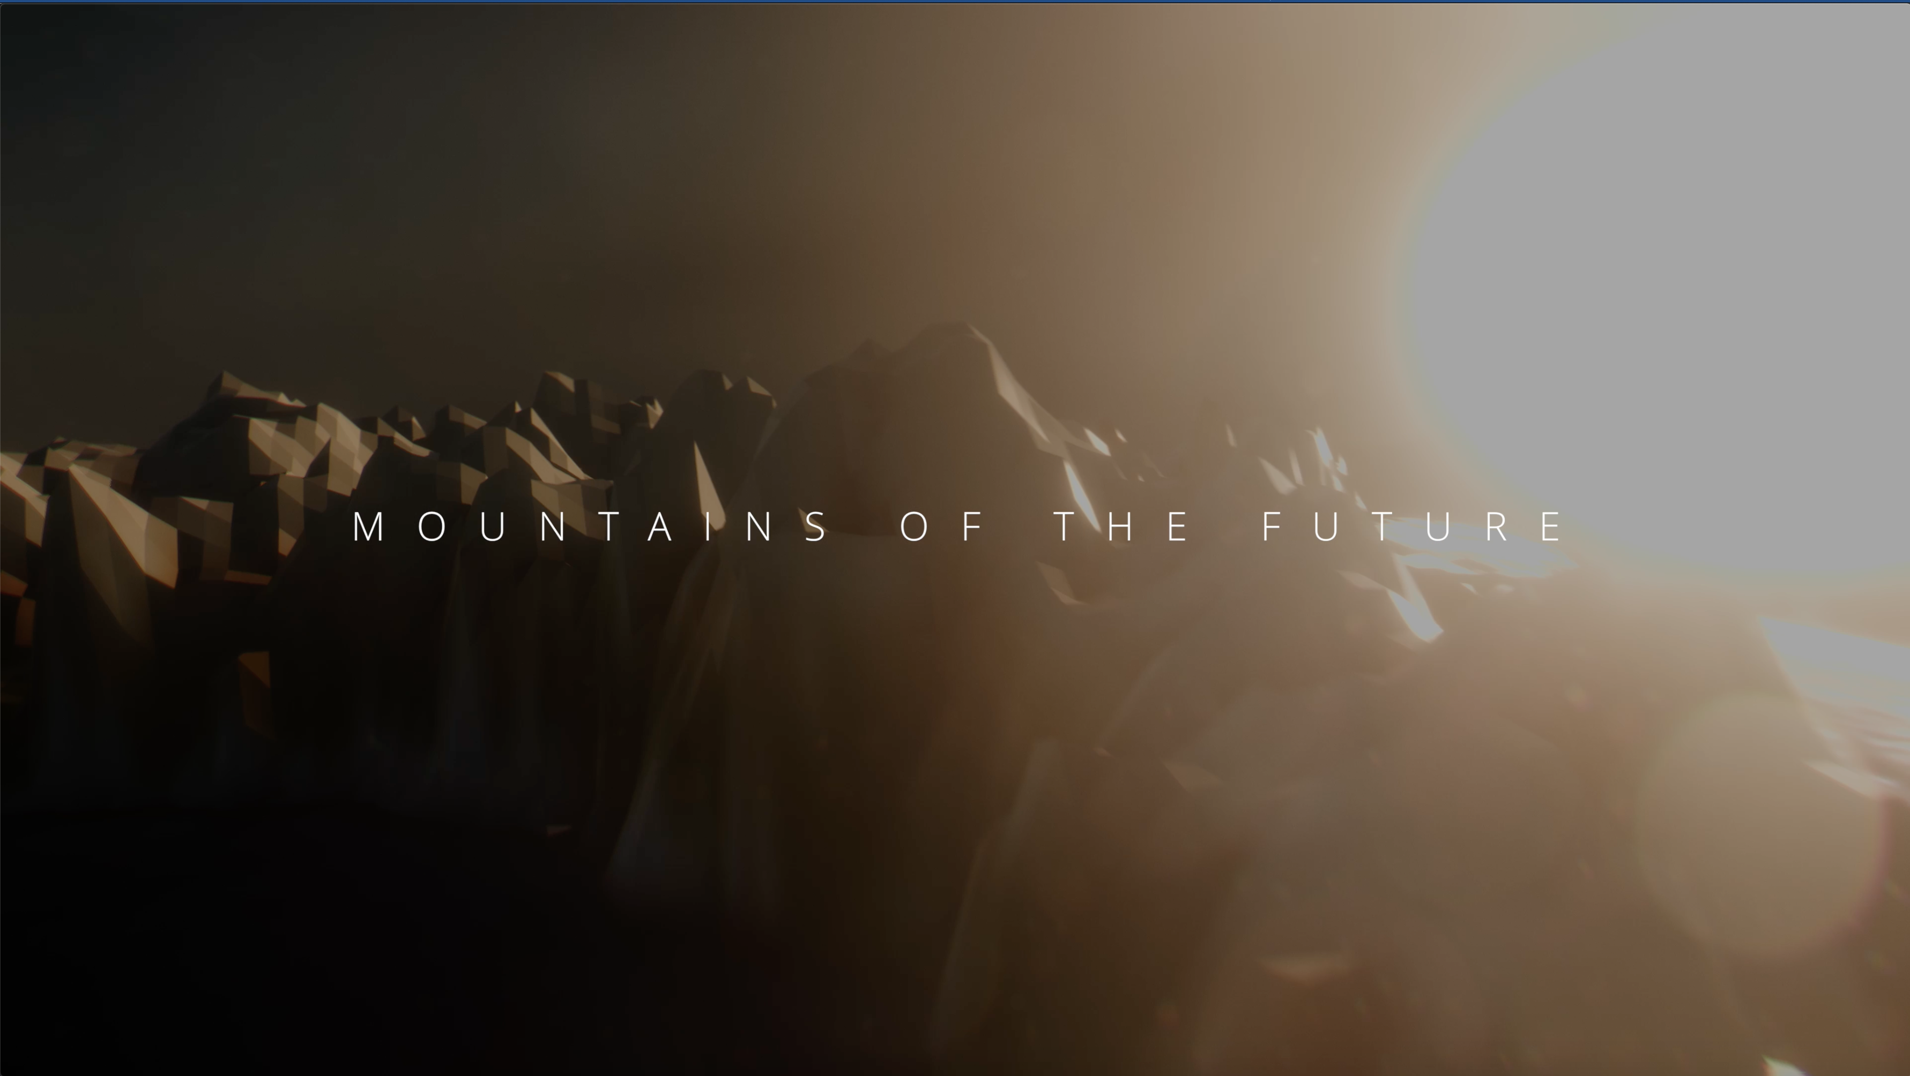

Deciphering paleogeography from orogenic architecture: constructing orogens in a future supercontinent as thought experiment
Douwe van Hinsbergen and Thomas Schouten

Slide 2


Slide 3



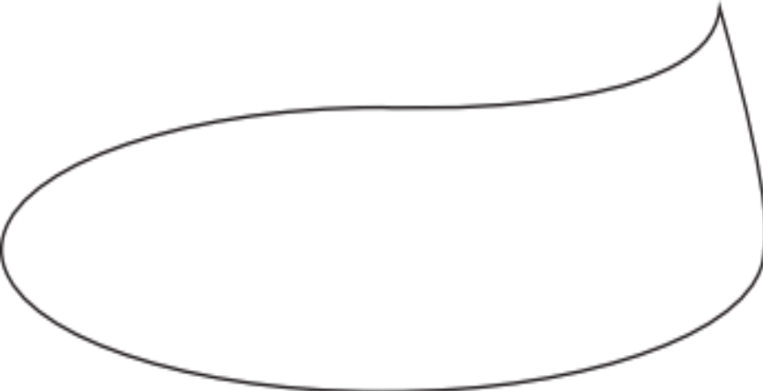

Studentworldonline.com
Well…
we can try
Can you predict the mountains of the future?

Slide 4
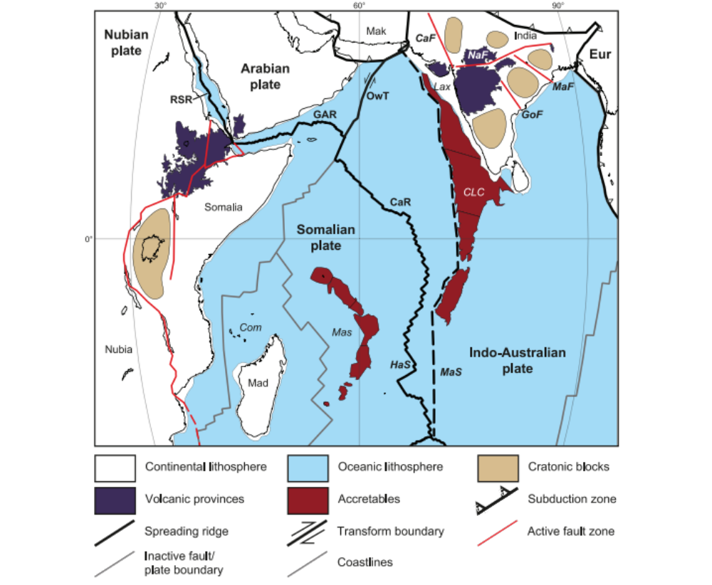
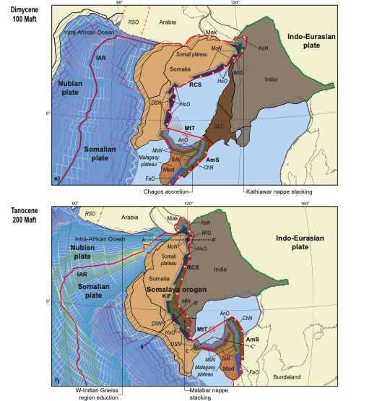
Predicting future orogens is essentially forward modeling of tectonic processes
Rules of orogenesis
Requires a set of ‘rules’ that explain how
modern geography
is translated into
orogenic architecture
through
subduction zone processes
Van Hinsbergen & Schouten,
Am J Sci, in press

Slide 5
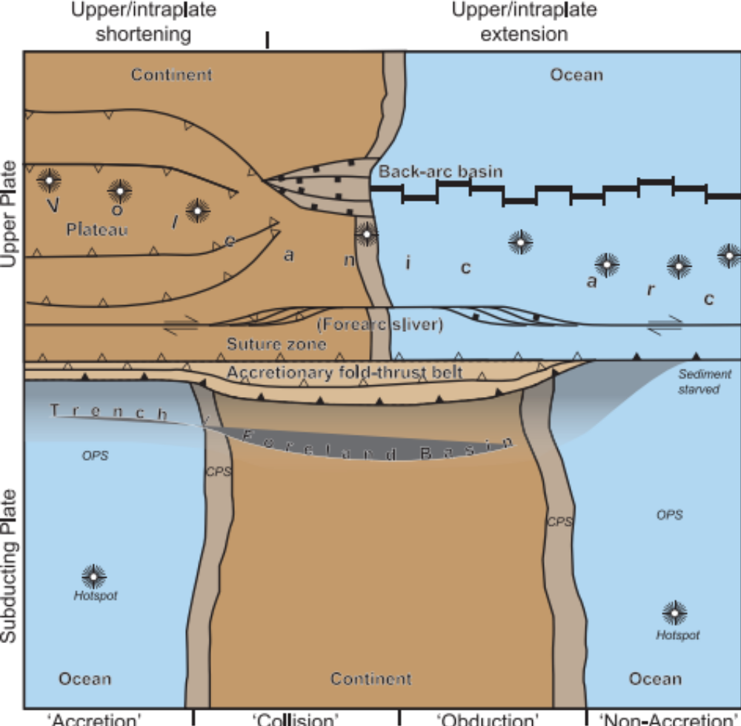
Orogenesis: accretionary vs intra-plate
Accretionary orogenesis:
Transfer of rock from downgoing to upper plate.
Lithospheric underpinnings lost to subduction
Van Hinsbergen & Schouten,
Am J Sci, in press

Slide 6
Orogenesis: accretionary vs intra-plate
Upper/intraplate orogenesis:
Shortening, transcurrent motion, or extension due to relative trench-upper plate motion
Lithospheric underpinnings included in orogenesis
Van Hinsbergen & Schouten,
Am J Sci, in press

Slide 7
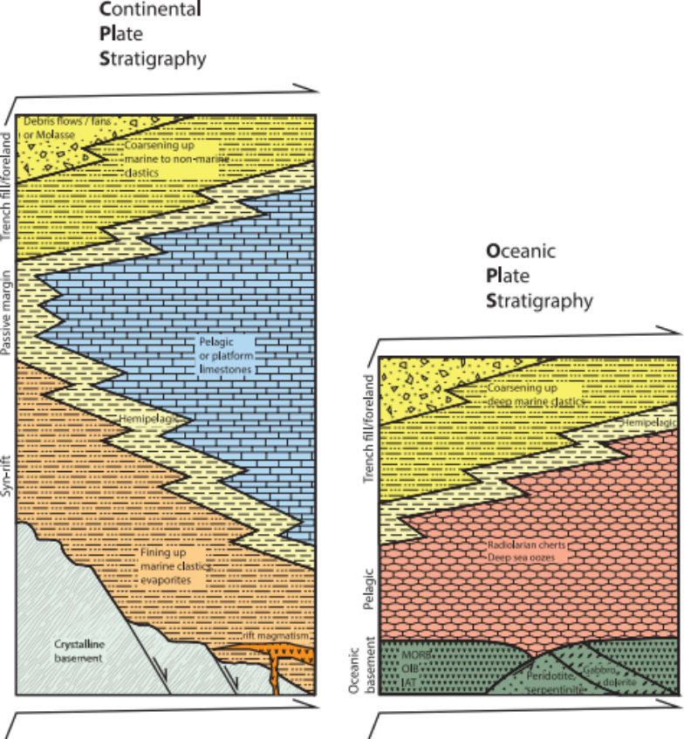
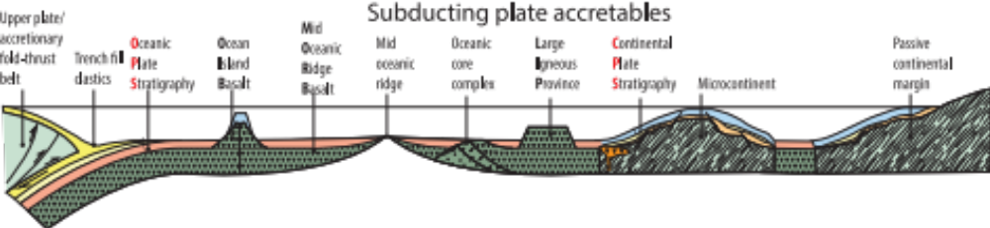
Lower plate-derived orogenic units
Continent
Plate
Stratigraphy
Ocean
Plate
Stratigraphy
Van Hinsbergen & Schouten, Am J Sci, in press

Slide 8
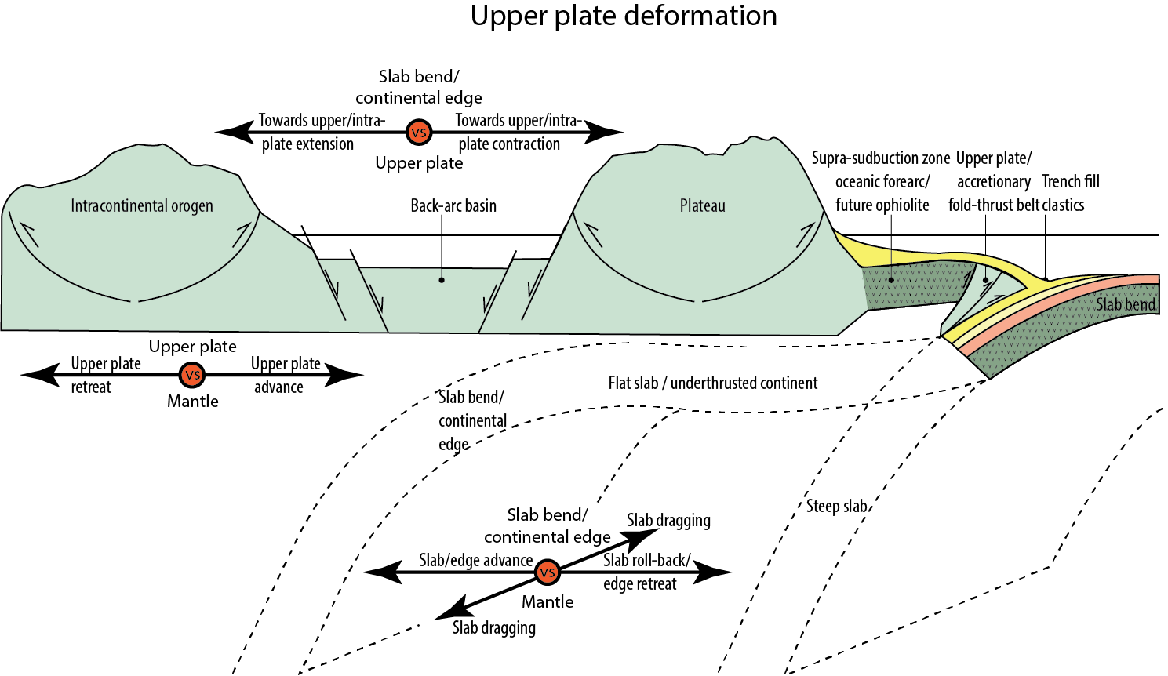
Upper plate-derived orogens
Competition between absolute upper plate motion and absolute slab motion
Important: there is no systematic relationship between the nature of downgoing plate and the style of deformation in the upper plate!
Upper plate shortening and extension both occur during oceanic and continental subduction. There is no ‘collisional orogenesis’
Van Hinsbergen & Schouten, Am J Sci, in press

Slide 9
Rules (of thumb) of orogenesis
1 | Pre-drift extension is typically ~300 km, and perhaps up to 500 km for thickened crust
2 | Ocean Plate Stratigraphy (OPS), derived from MORB, IAT, OIB, or LIP crust, may or may not accrete, as coherent nappes or as chaotic mélange
3 | Oceanic Large Igneous Provinces may cause subduction cessation or polarity reversals, but eventually subduct, while leaving only minor accreted crustal relics
4 | Subduction of continental crust will be associated with accretion of its Continental Plate Stratigraphy (CPS)
5 | Extended continental crust (microcontinents, continental margins) will typically subduct
6 | Non-extended continental crust does not subduct: if forced below an upper plate, it will likely horizontally underthrust untill the arrest of convergence
7 | The forearc of oceanic upper plate lithosphere will be preserved as ophiolites if underthrusted by OPS/CPS nappes and, eventually, a continental margin, followed by slab break-off and subduction arrest.
8 | Preservation of oceanic magmatic arcs lithosphere in the geological record requires a subduction polarity reversal oceanward of the arc following ophiolite obduction. Arcs on downgoing plates may leave OPS nappes in the geological record
9 | Upper plate deformation is the result of the competition between absolute motion of the upper plate and the subducting slab
10 | Upper plate lithospheric shortening is generally limited to 50-60%, after which shortening steps outboard
Van Hinsbergen & Schouten, Am J Sci, in press

Slide 10
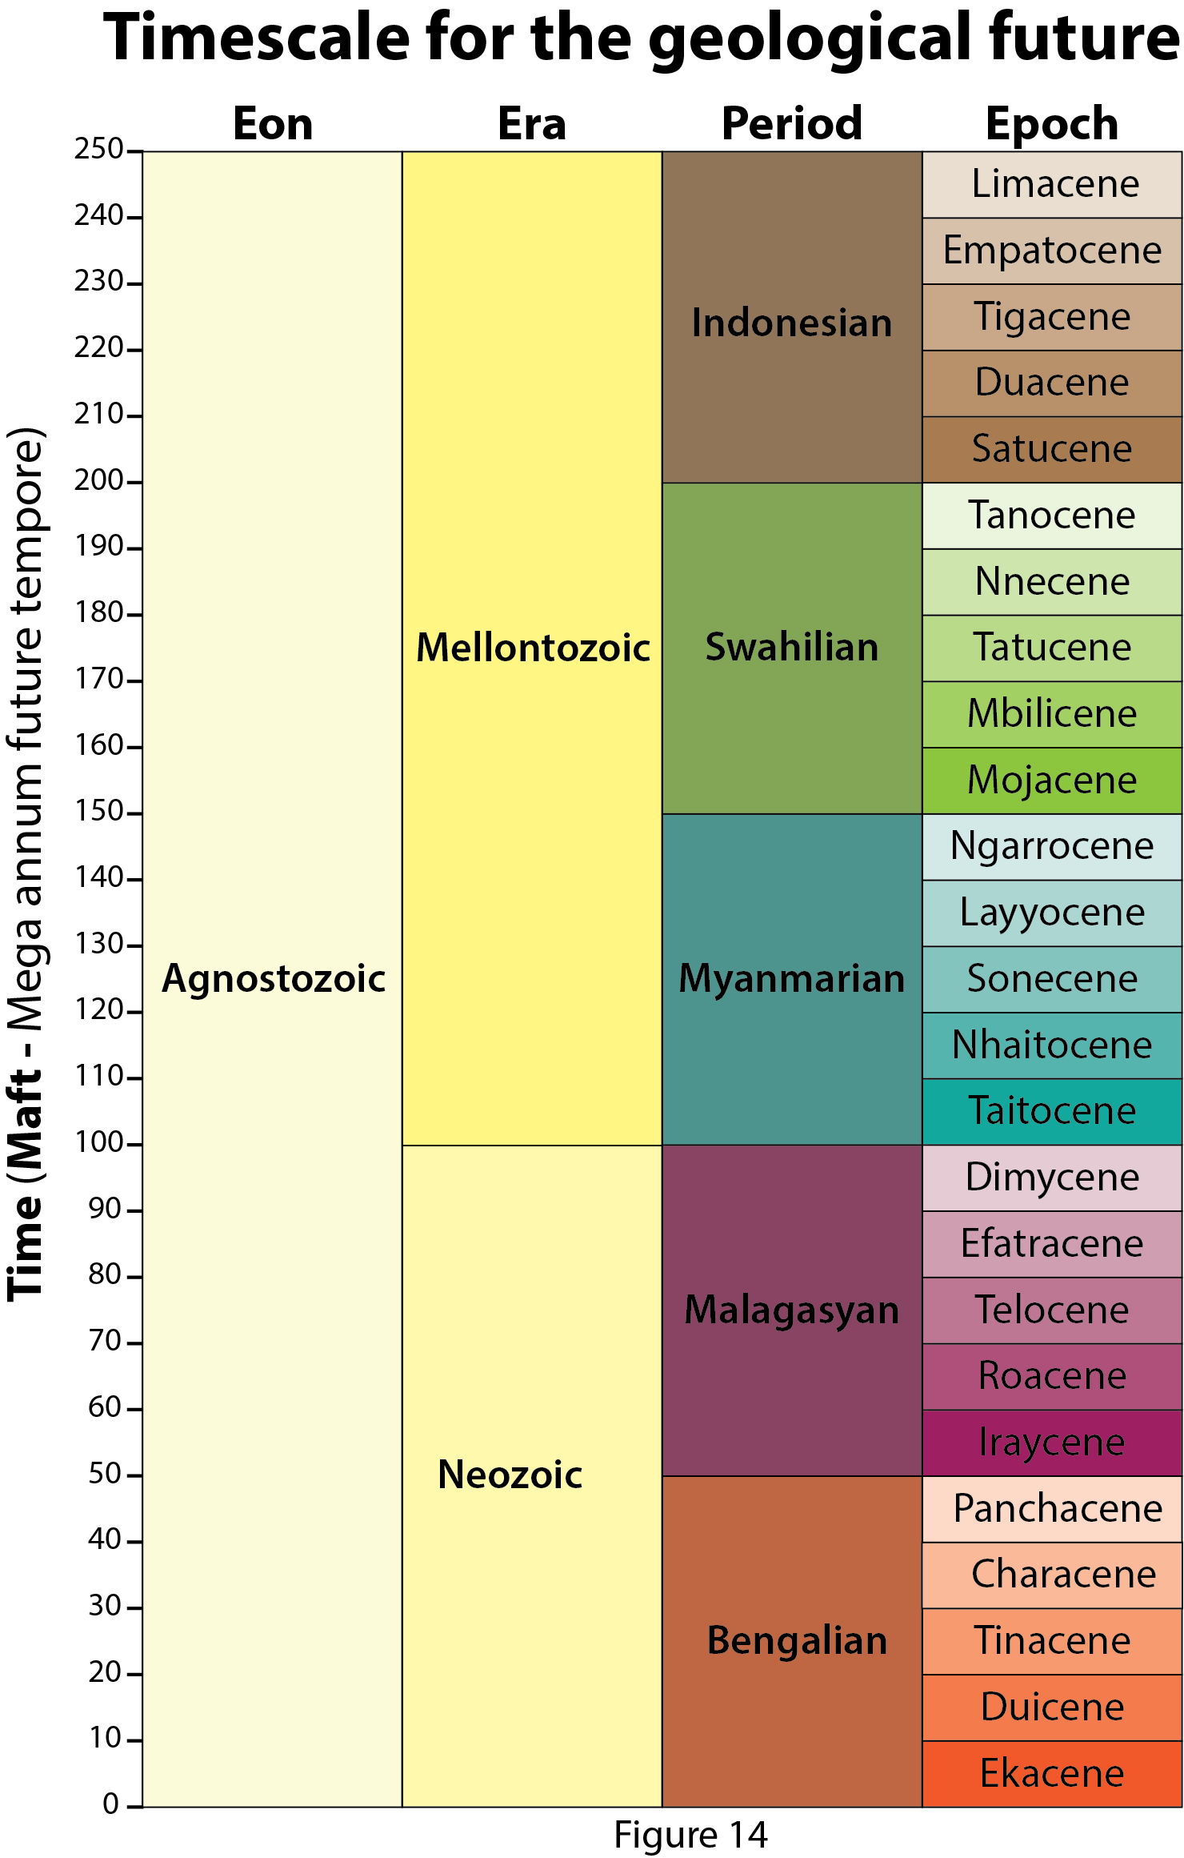
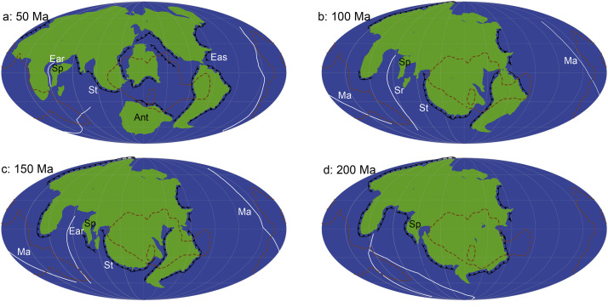
Application to Indian Ocean
Translate Indian Ocean geography into future orogenic architecture using a future continental drift scenario (Hannah Davies et al, 2018) and the rules of orogenesis, as function of two different initial subduction zone geometries
Davies et al., Global and Planetary Change 2018
Van Hinsbergen & Schouten, Am J Sci, in press

Slide 11
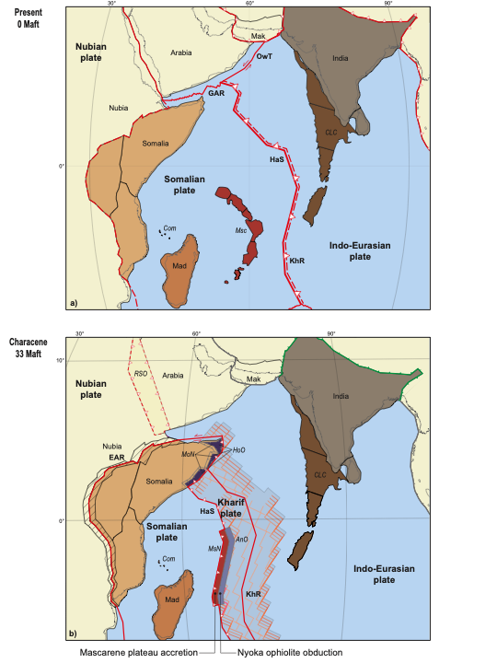
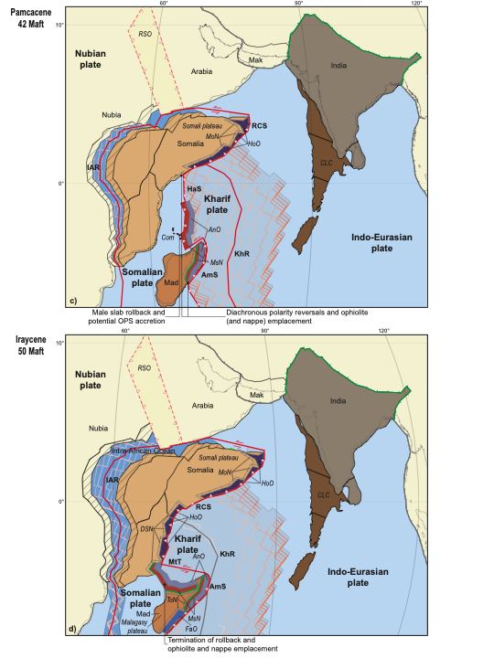
Scenario A: subduction initiation along Carlsberg Ridge

Slide 12
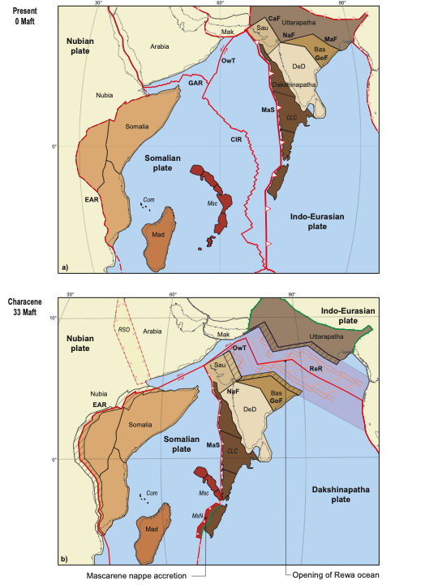
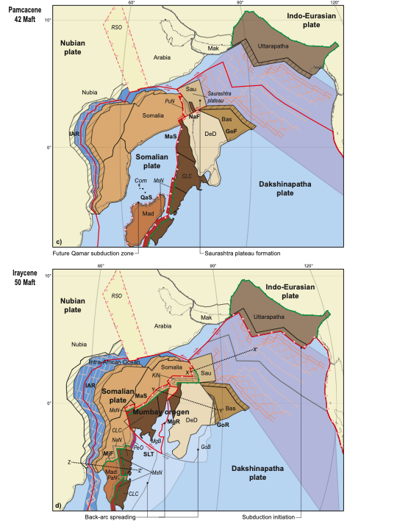
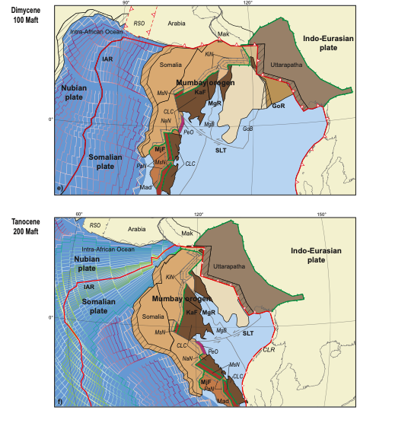
Scenario B: subduction initiation along Indian passive margin

Slide 13
Outlook
Developing ‘rules’ and ‘recipes’ of geological behavior based on our best understanding allows using paleogeographic reconstructions to predict modern geological phenomena, such as economic deposits. Failure to predict correctly means the reconstructions and/or the rules and recipes contain errors and drives targeted research and innovation.

