Slide 1

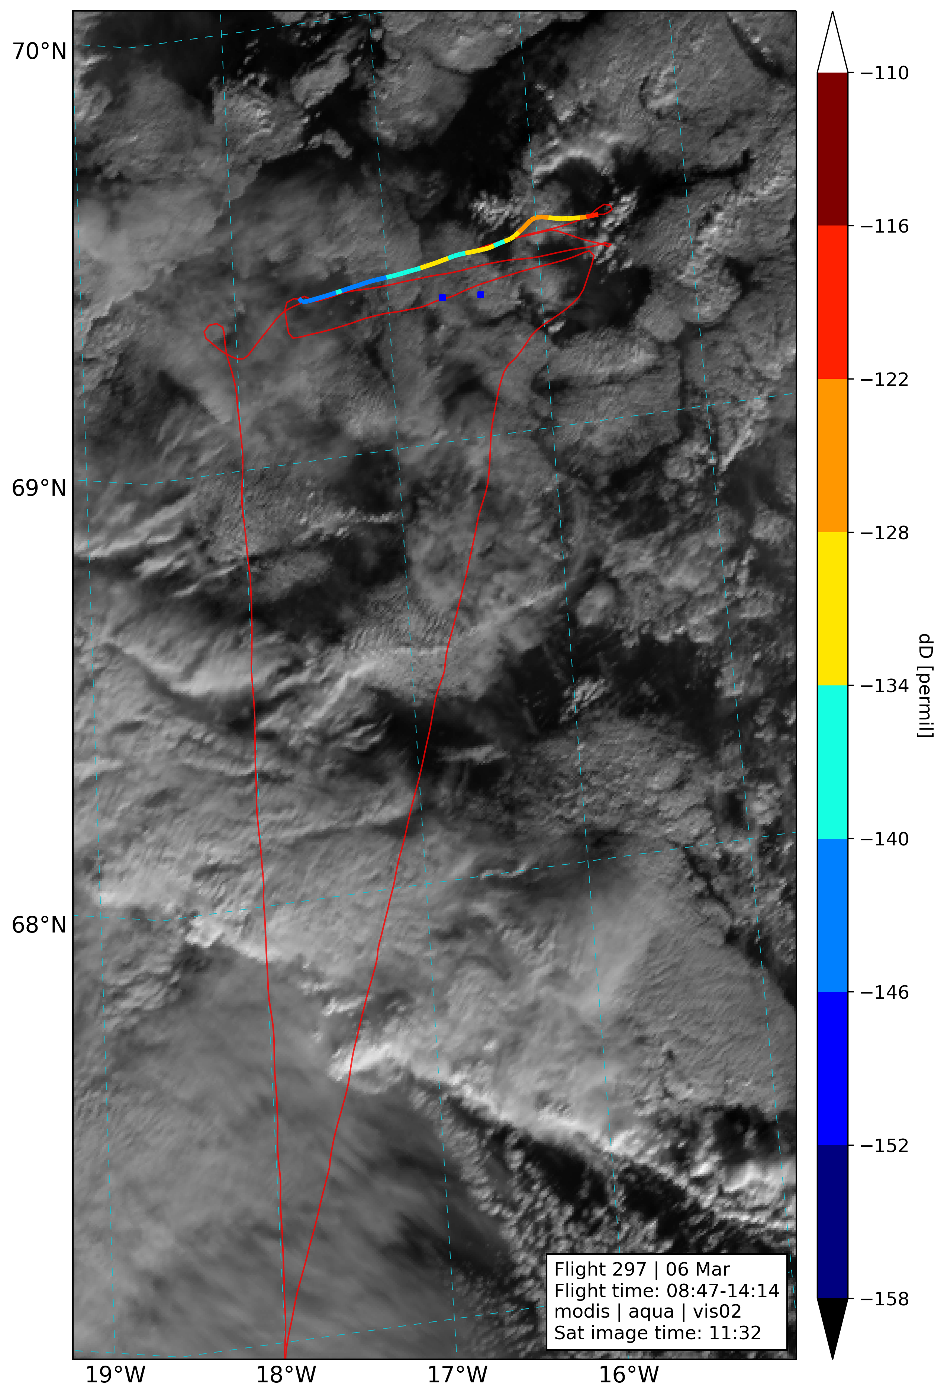
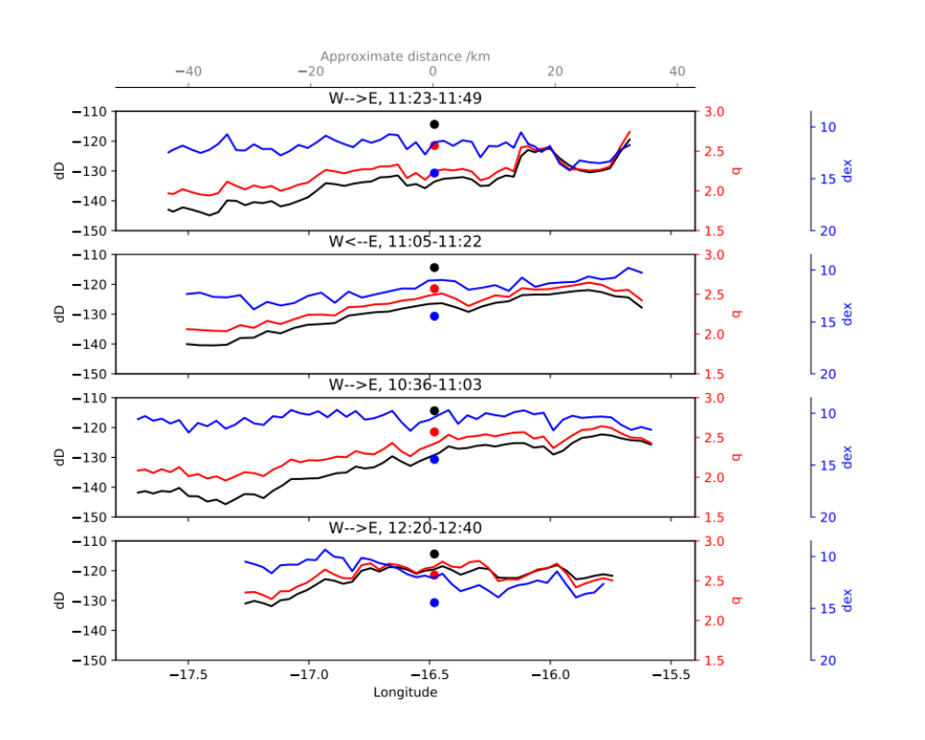


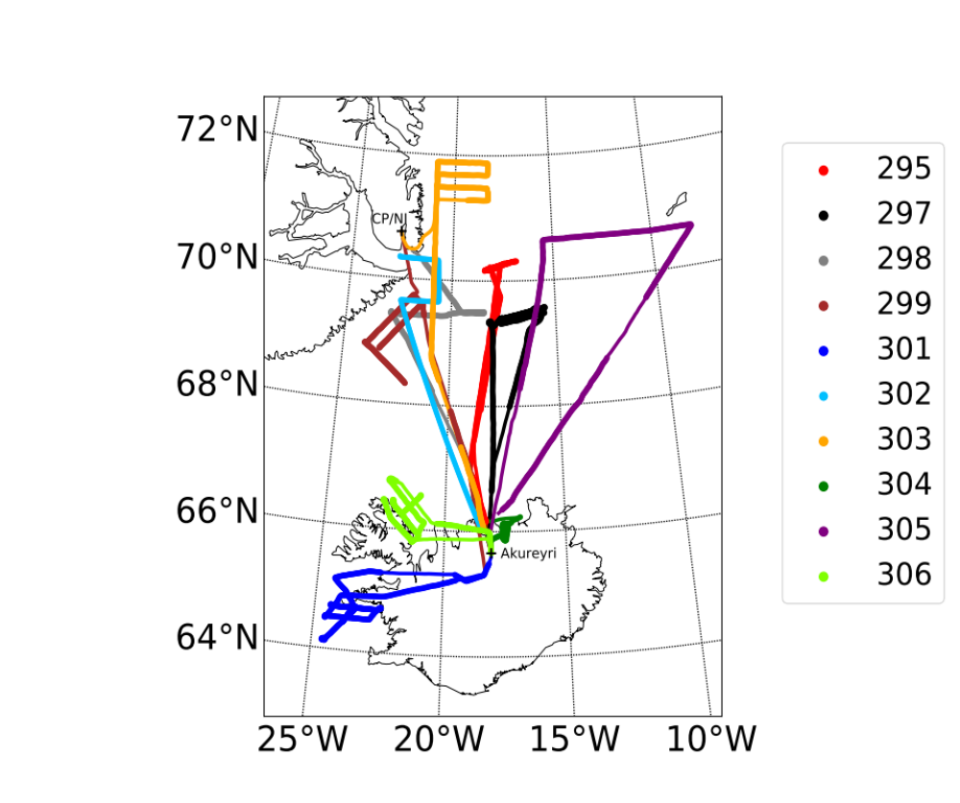
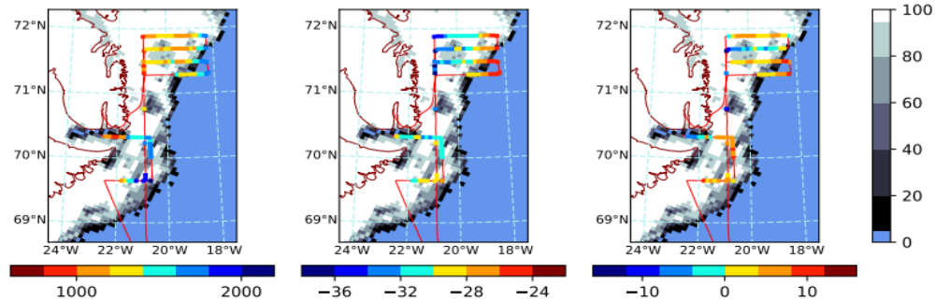
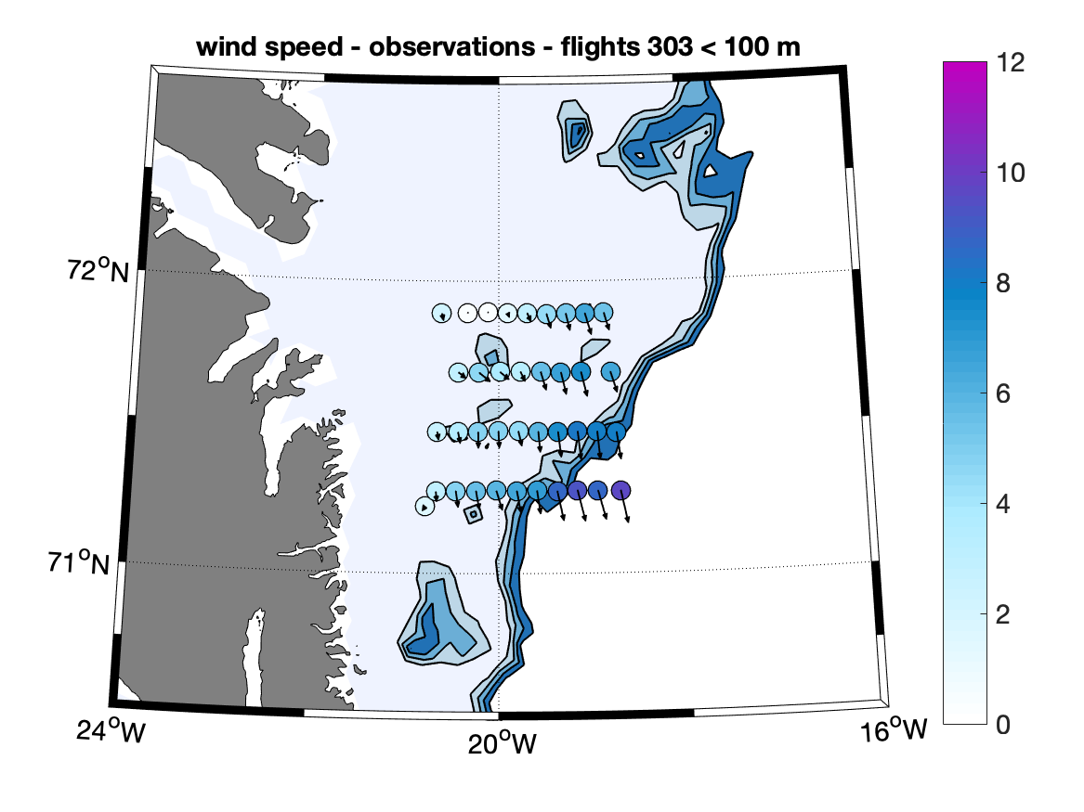
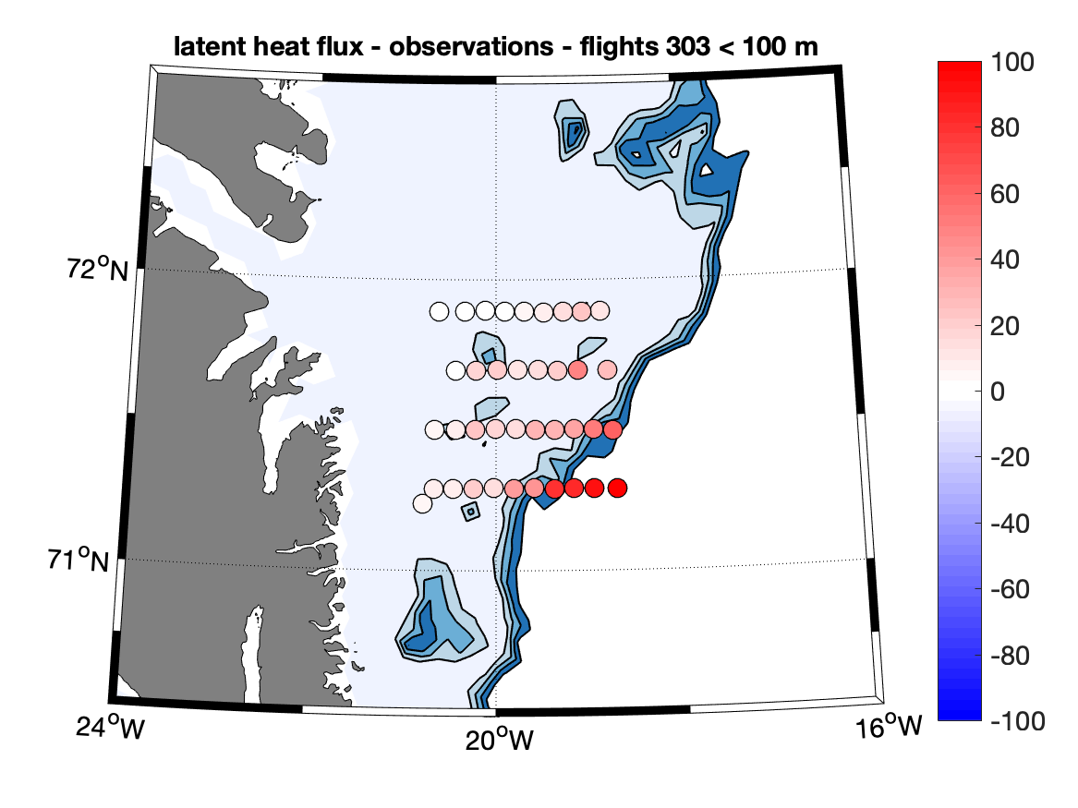
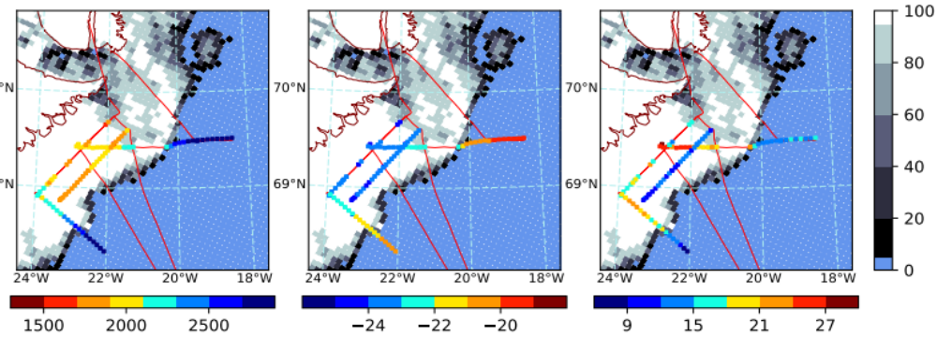
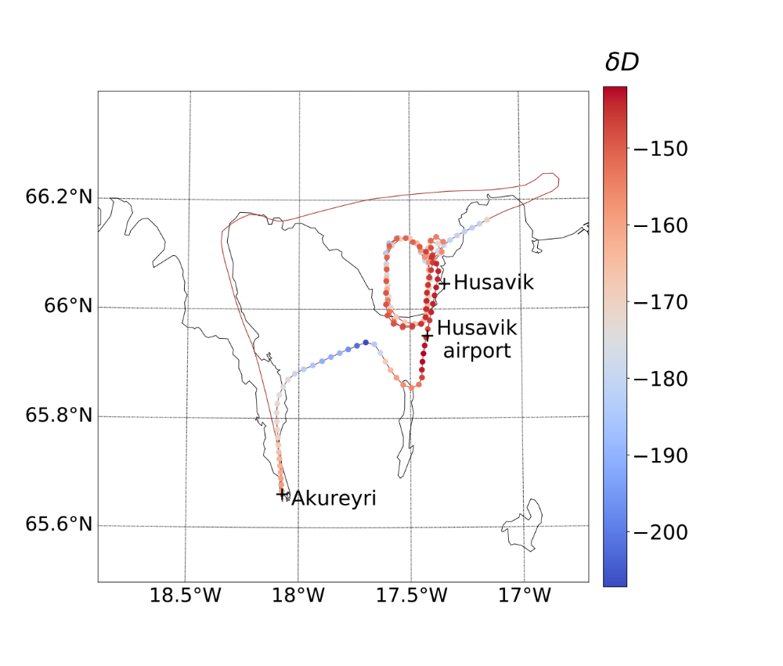
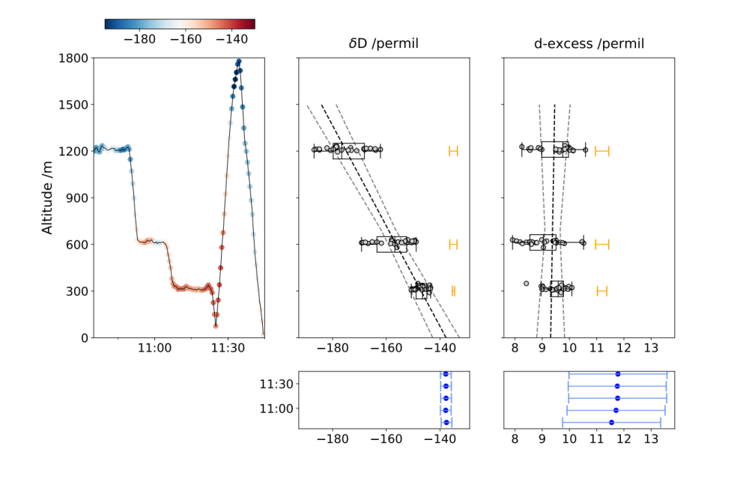

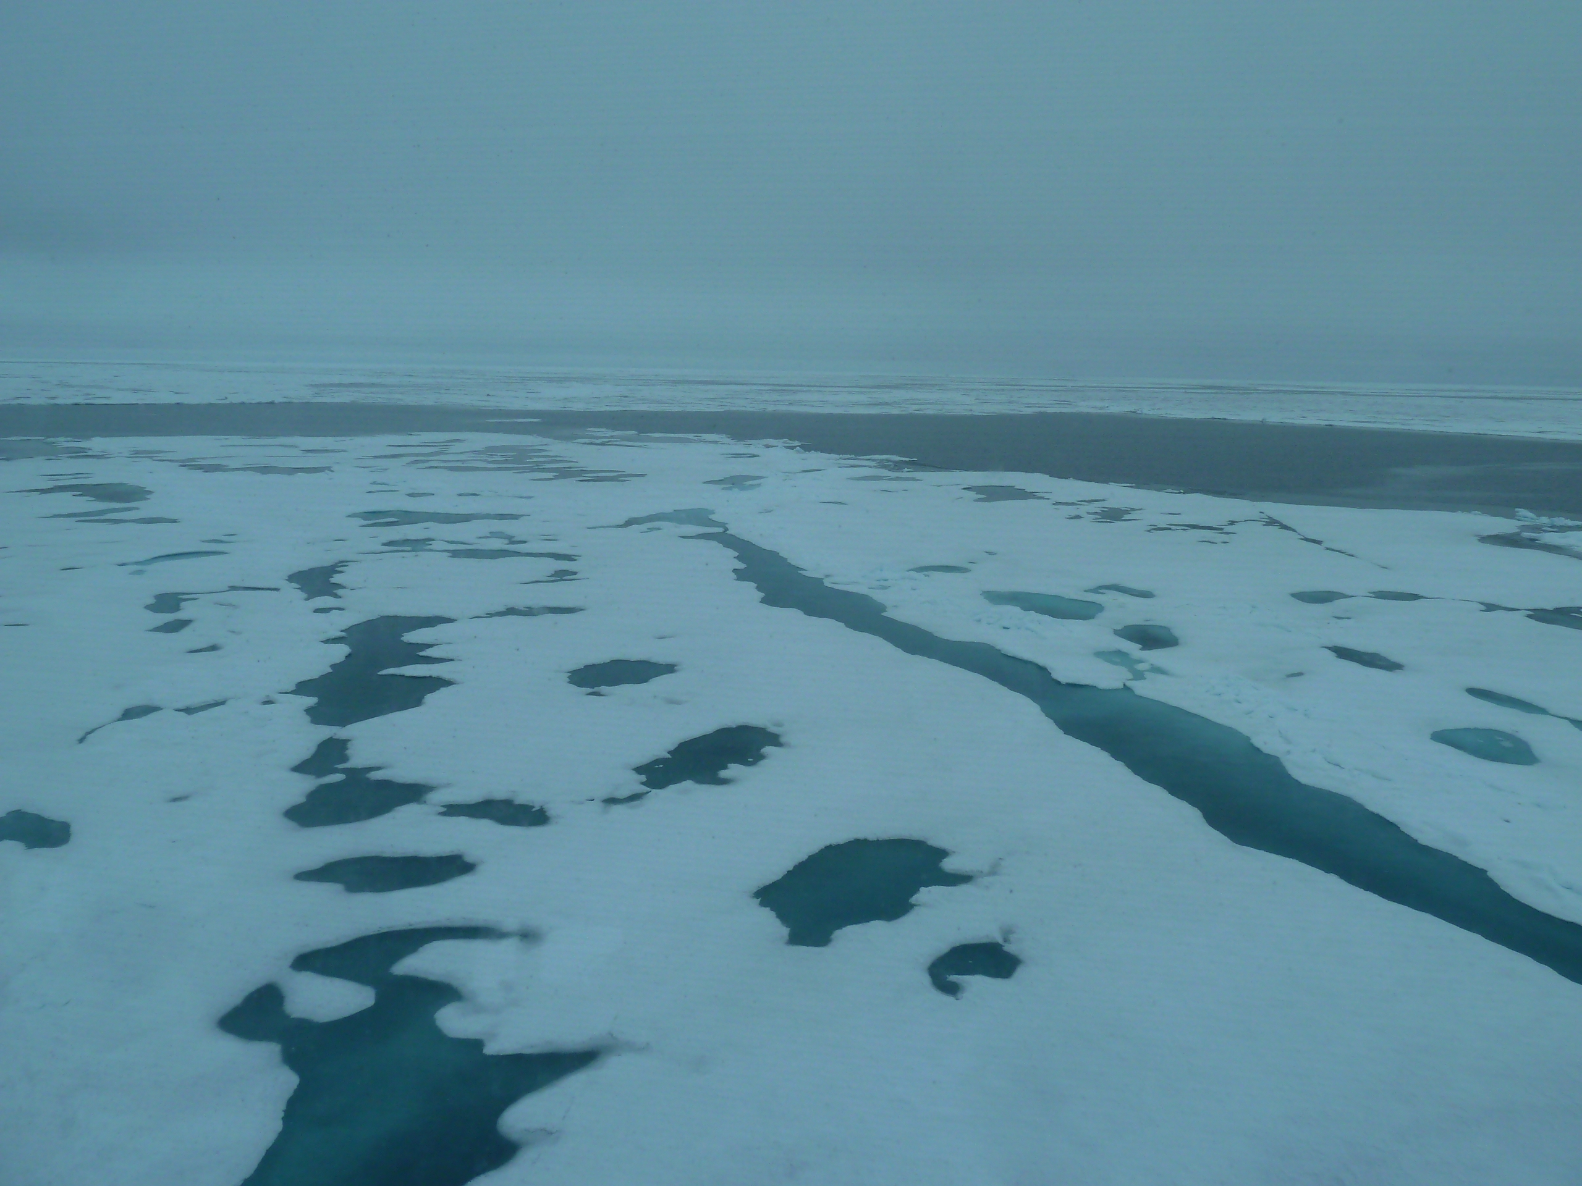
Airborne water vapour isotope measurements over the Iceland Sea in winter conditions
A. Touzeau, Y. Weng, S. Jons, H.-C. Steen-Larsen, I. Renfrew, T. Lachlan-Cope, A. Elvidge, H. Midtgarden Golid, H. Sodemann.
1° Motivation: isotopes as tracers of water cycle processes
4° Ocean flights: Marine Boundary Layer
Similarity between isotope oscillations
and cloud organization
(cellular convection)
Contact: alexandra.touzeau@uib.no
S
S
S
S
S
S
Geophysical Institute, University of Bergen,
Bjerknes Center for Climate Research
Processes
In presentation mode: Click on pictures or
on the speakers for a quick explanation (with/without zooming on the picture).
Use ‘back’ to come back to this first slide.
2° Study area: the Iceland Sea in winter
5° Sea-ice flights
Winter in the Iceland Sea:
Dominant Cold Air Outbreak situation
10 flights with vapor isotopes
Profiles over the sea-ice and
in the Marine Boundary Layer
303
302
298
Land-sea gradients in isotopes
Small-scale features (leads) imprint on isotopes
299
3° Calibration flight, comparison to ground station
6° Conclusions
Flight vapor isotope observations:
-are coherent with ship & ground observations
-show horizontal structures in the Marine Boundary Layer, that could correspond to convection cells
-show sea-ice/sea-water gradients at the sea-ice edge
-also seem to react to small-scale features such as leads in sea-ice.
Good agreement between ground and aircraft measurements

Slide 2

1° Motivation: isotopes as tracers of water cycle processes

Slide 3
2° Study area: the Iceland Sea in winter
Winter in the Iceland Sea:
Dominant Cold Air Outbreak situation
10 flights with vapor isotopes
Profiles over the sea-ice and
in the Marine Boundary Layer

Slide 4
3° Calibration flight, comparison to ground station
Good agreement between ground and aircraft measurements

Slide 5
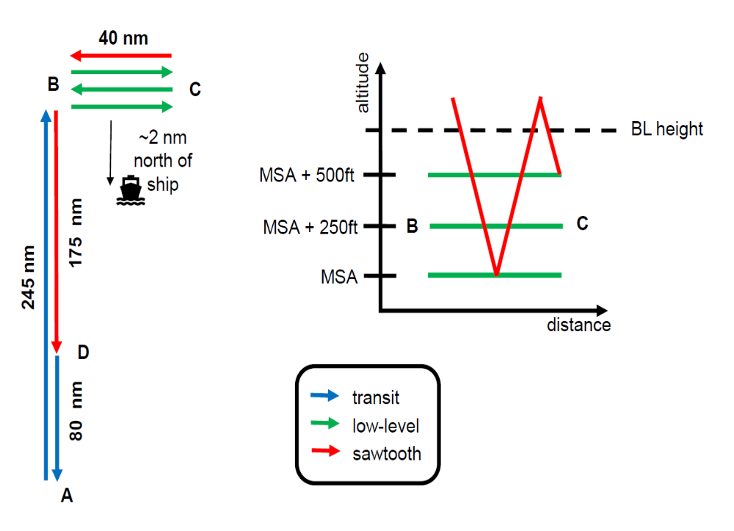

4° Ocean flights: Marine Boundary Layer
305
295
297
Flight pattern: transit+ stack of low-levels

Slide 6
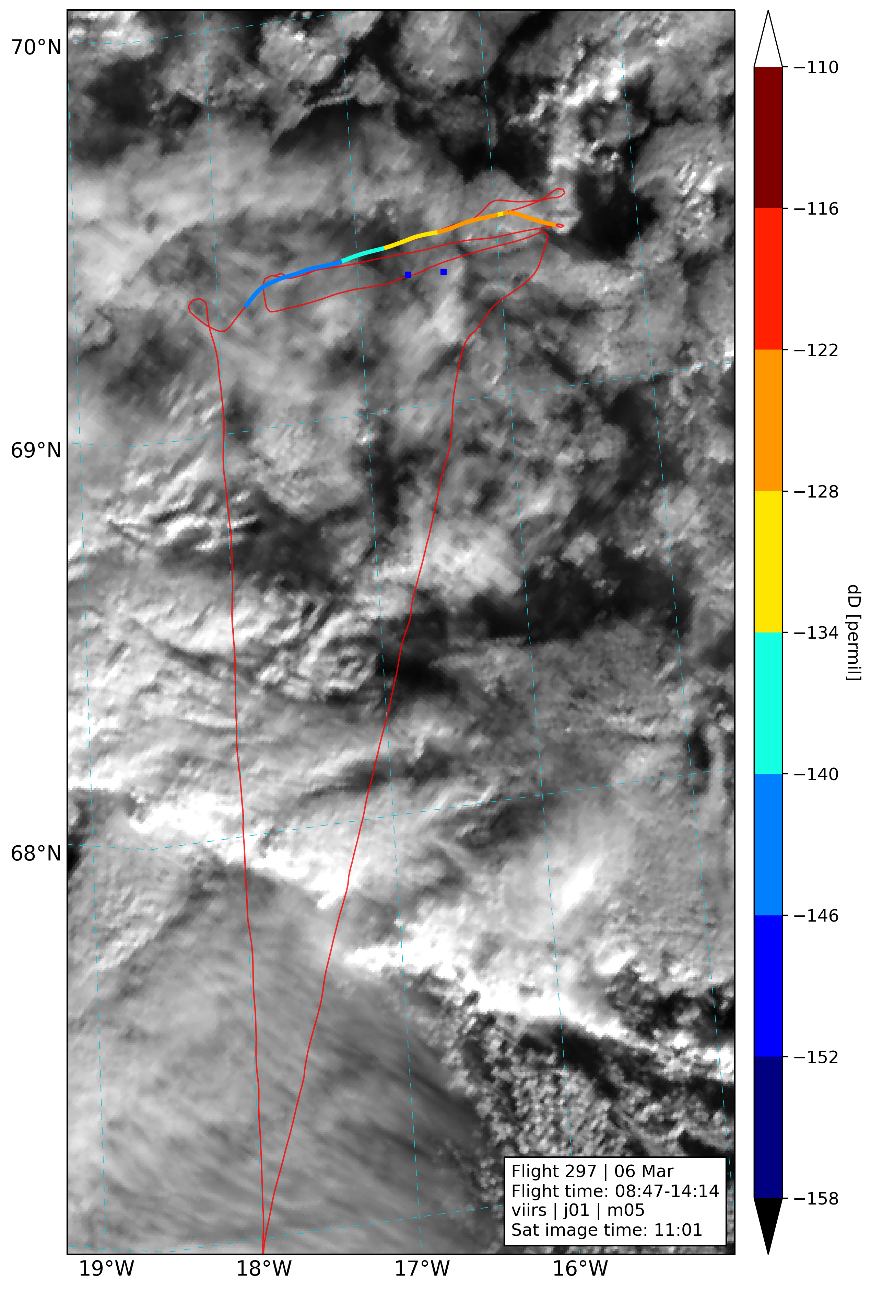
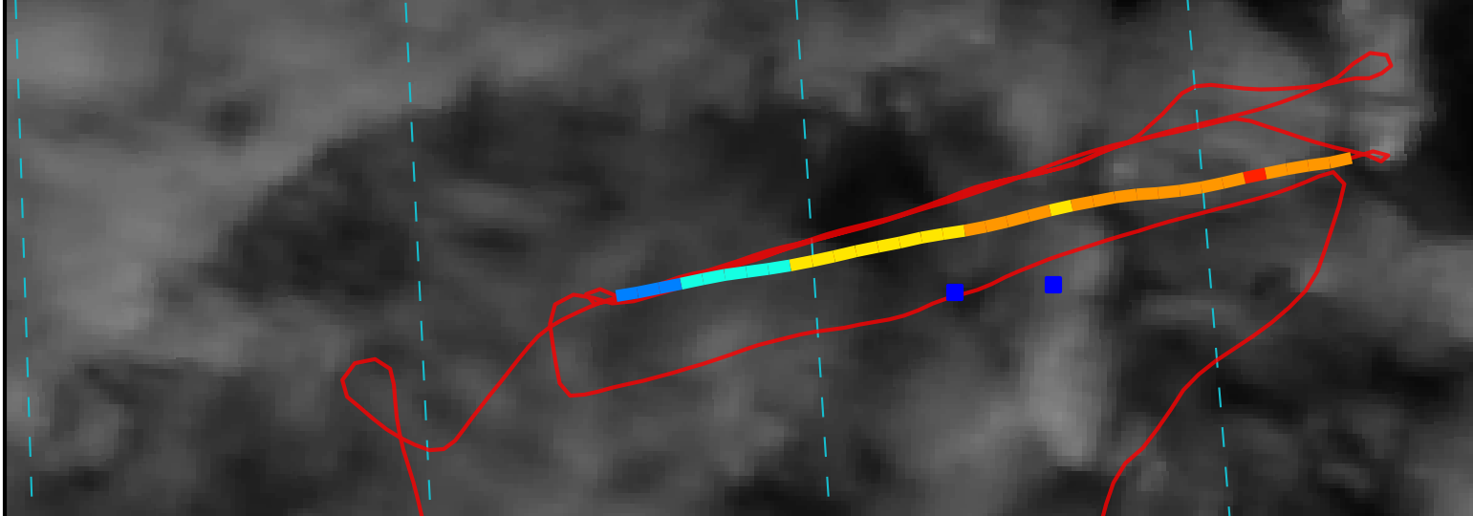
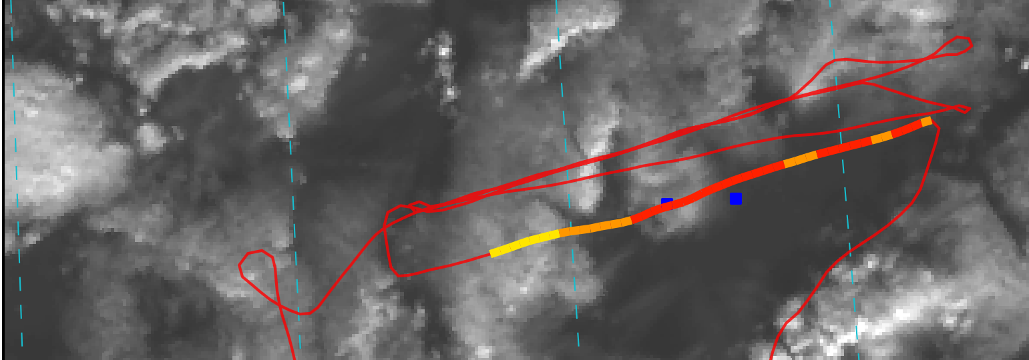
4° Ocean flights: Marine Boundary Layer
180 m
Observations
First two levels (45, 90 m):
-more/thicker clouds to the east/higher dD
Third low-level (180 m):
-also relatively high values in clouds to the east, lower in thinner clouds/open areas
Fourth low-level (40 m):
-high dD, overall open area
-coherent with ship values
3
90 m
2
≠
40 m, ship latitude
45 m
4
1

Slide 7
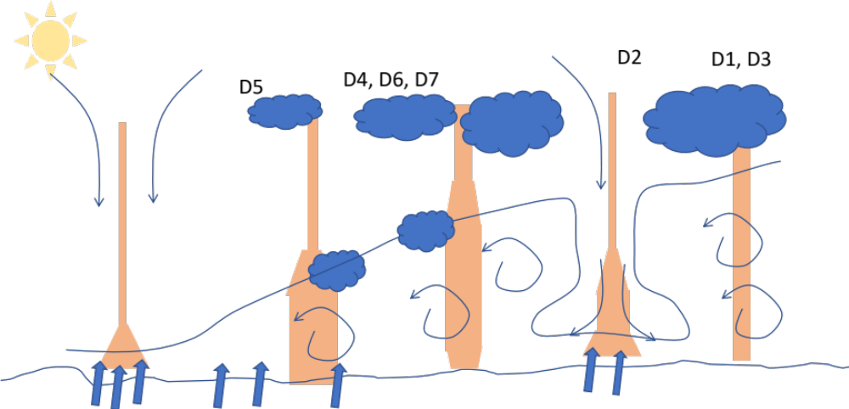
4° Ocean flights: Marine Boundary Layer
180 m
Interpretation
3
90 m
2
40 m, ship latitude
45 m
4
1

Slide 8
4° Ocean flights: Marine Boundary Layer
East-west gradient
Waves superimposed
Scale 5-20km
cf. Duscha et al., submitted:
‘A ship-based characterization of coherent boundary-layer structures over the lifecycle of two marine cold air outbreaks’

Slide 9
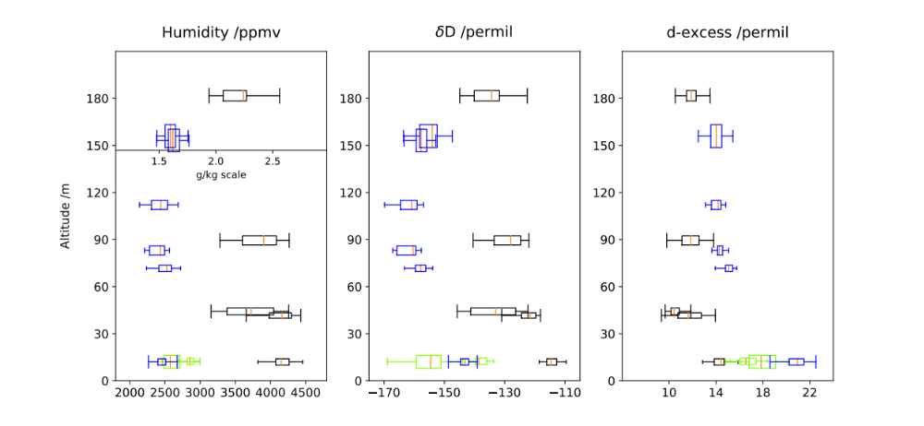
4° Ocean flights: Marine Boundary Layer
S
S
S
S
S
S
Stronger/active CAO (295, 305) vs. average conditions (very mild CAO, 297)
Ship comparison (S)

Slide 10
5° Sea-ice flights
303
302
Opposition sea-ice/seawater
Effect of leads
Synoptic conditions
298
299

Slide 11
5° Sea-ice flights

Slide 12
5° Sea-ice flights
303
302
298
299

Slide 13
6° Conclusions
Flight vapor isotope observations:
-are coherent with ship & ground observations
-show horizontal structures in the Marine Boundary Layer, that could correspond to convection cells
-show sea-ice/sea-water gradients at the sea-ice edge
-also seem to react to small-scale features such as leads in sea-ice.
Thanks for your interest!

