Slide 1
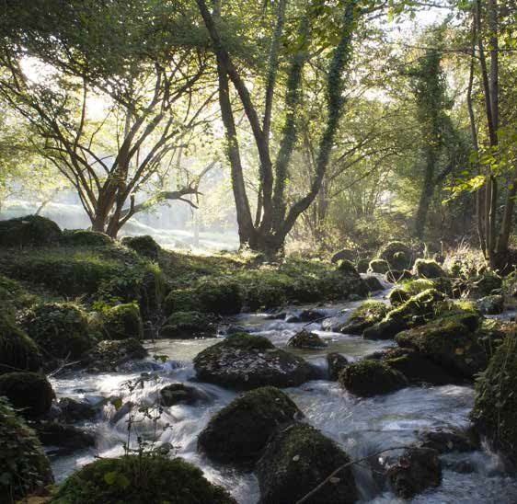





Hydrogeological controls on stream discharge dynamics in bedrock catchments: exploring the combined effects of seepage development and heterogeneity
Nicolas Cornette (Géosciences Rennes)
Jean-Raynald de Dreuzy (Géosciences Rennes)
Alexandre Boisson (BRGM)
Clément Roques (Géosciences Rennes)
Guillaume Pajot (OSUR)
Josette Launay (CRESEB)
Léguer Amont : Eco-bretons.info

Slide 2
Introduction
Methods
Conclusion
Results
Characterization of the water resource on a regional scale
Quantitative aspect: Flows (streamflow, piezometry, …).

Slide 3
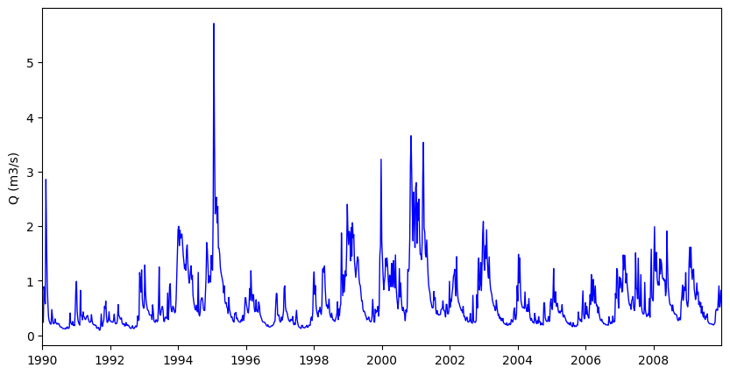
Introduction
Methods
Conclusion
Results
Characterization of the water resource on a regional scale
Quantitative aspect: Flows (streamflow, piezometry, …).
Nancon watershed (1990-2009)
Streamflow series :
  Watershed scale.
  Wide spatial and temporal range.
  Readily available.
  Integrates information about surface as well as underground environment.

Slide 4
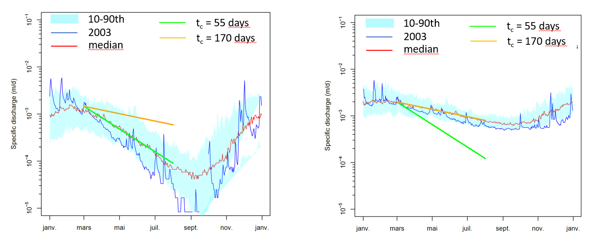
Introduction
Methods
Conclusion
Results
Jan.
Mar.
May
Jul.
Sep.
Nov.
Jan.
Jan.
Mar.
May
Jul.
Sep.
Nov.
Jan.
Arguenon watershed
Horn watershed
Within a region, there is a significant variability in river dynamics

Slide 5
Introduction
Methods
Conclusion
Results
Jan.
Mar.
May
Jul.
Sep.
Nov.
Jan.
Jan.
Mar.
May
Jul.
Sep.
Nov.
Jan.
Arguenon watershed
Horn watershed
What are the processes and factors that will control this variability of hydrological response ?

Slide 6
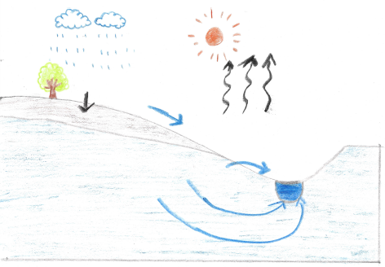
Introduction
Methods
Conclusion
Results
Water cycle in a crystalline aquifer context
Precipitation
Evapotranspiration
Runoff
Infiltration
Seepage
Deep flow

Slide 7
Introduction
Methods
Conclusion
Results
Water cycle in a crystalline aquifer context
Precipitation
Evapotranspiration
Runoff
Infiltration
Surface flow
Seepage
Deep flow
Subsurface flow

Slide 8
Introduction
Methods
Conclusion
Results
Water cycle in a crystalline aquifer context
Precipitation
Limited aquifer capacities
Low permeability
Evapotranspiration
Runoff
Infiltration
Surface flow
Seepage
Deep flow
Subsurface flow

Slide 9
Introduction
Methods
Conclusion
Results
Water cycle in a crystalline aquifer context
Precipitation
Limited aquifer capacities
Low permeability
Evapotranspiration
Runoff
Infiltration
Promote surface/subsurface interactions
Seepage
Ogden and Watts., 2000; Tromp-van Meerveld and McDonnell., 2006; Wenninger et al., 2004, …
Deep flow

Slide 10
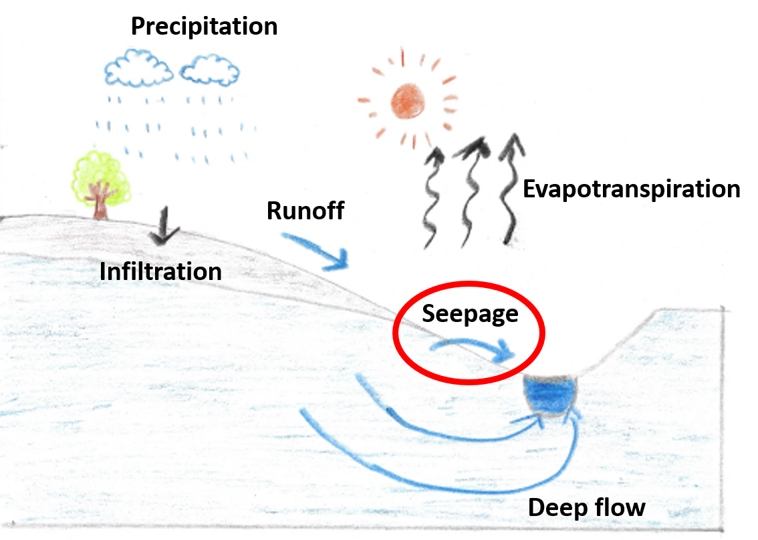
Introduction
Methods
Conclusion
Results
Water cycle in a crystalline aquifer context
Limited aquifer capacities
Low permeability
Promote surface/subsurface interactions
Ogden and Watts., 2000; Tromp-van Meerveld and McDonnell., 2006; Wenninger et al., 2004, …
Aim : Investigating the combined effects of surface/subsurface interactions and geological heterogeneity in a crystalline basement region under temperate climate

Slide 11
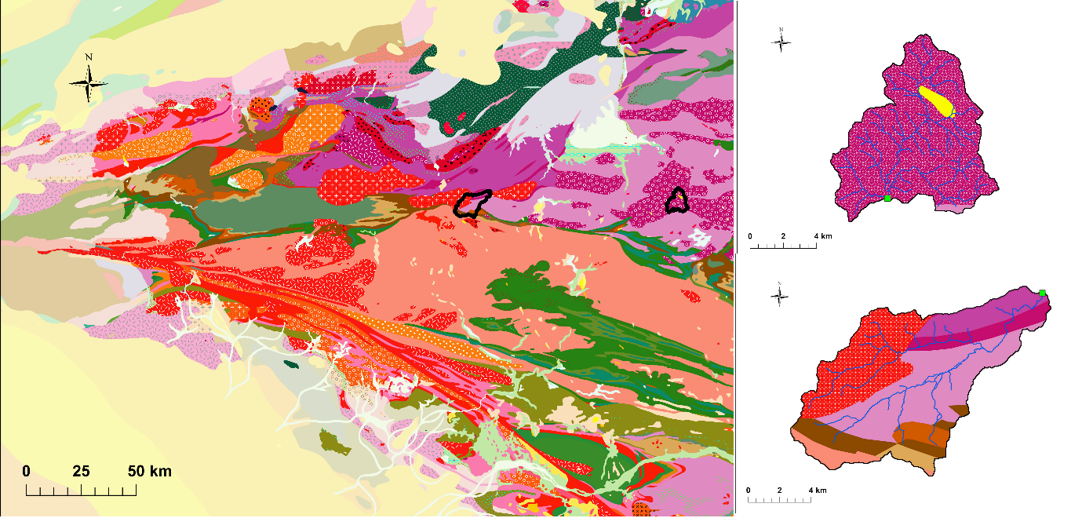
Introduction
Methods
Conclusion
Results
Application on Brittany
Nancon watershed
Arguenon watershed

Slide 12
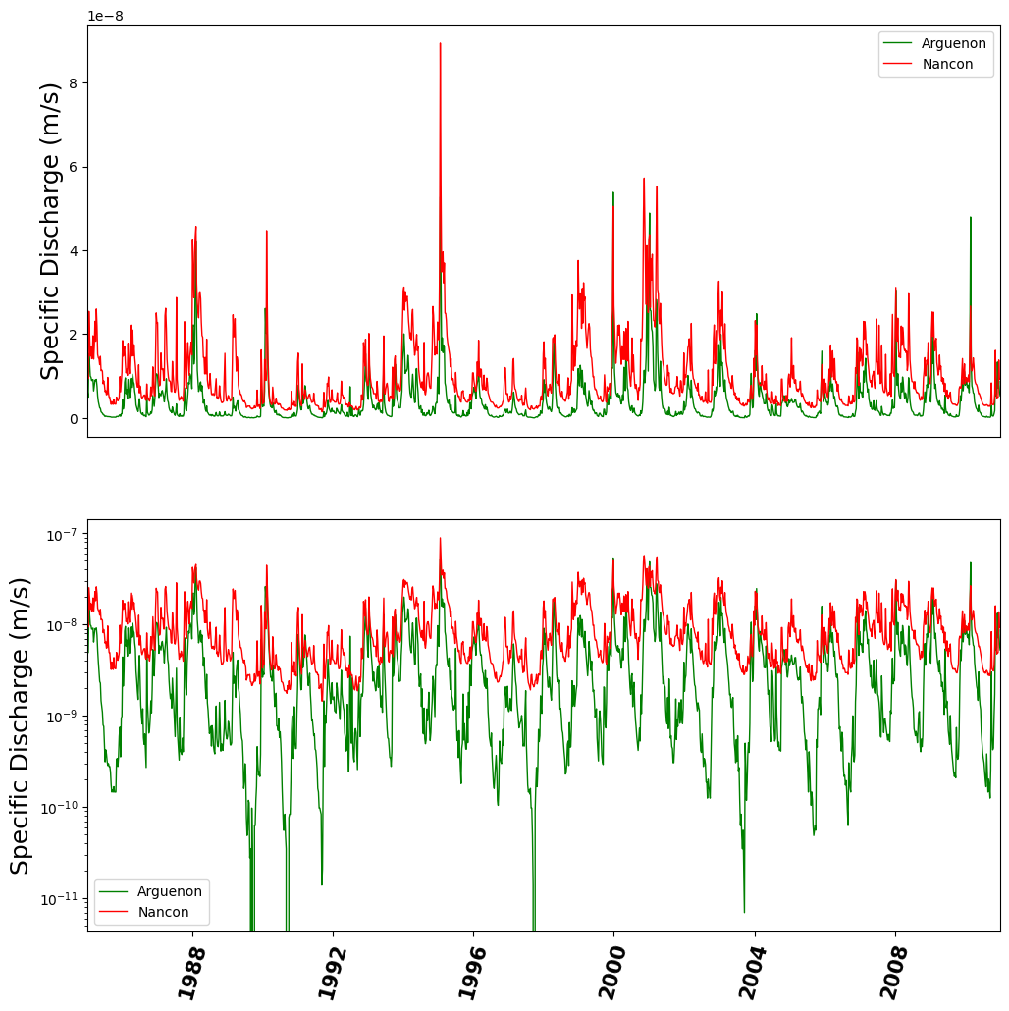
Introduction
Methods
Conclusion
Results
Application on Brittany
Global dynamic on a regional scale based on flow data

Slide 13
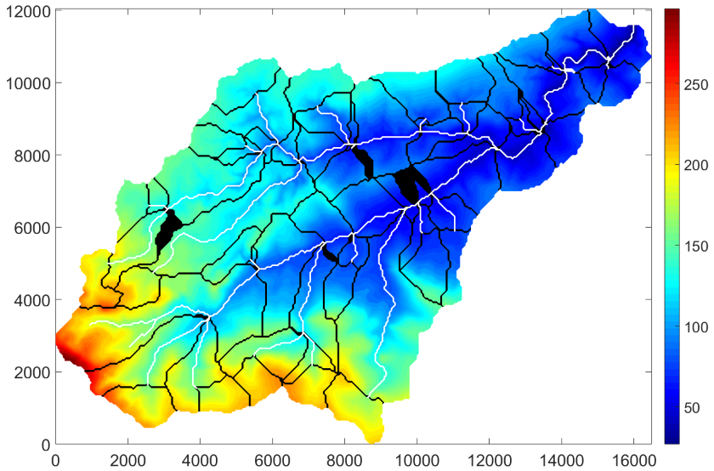
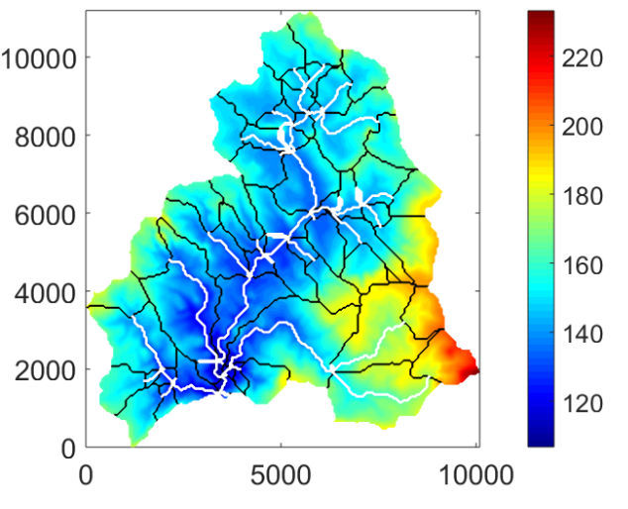
Introduction
Methods
Conclusion
Results
Application on Brittany
hs1D model (Quentin Courtois)
Global dynamic on a regional scale based on flow data
Subsurface flow simulation at the hillslope scale

Slide 14
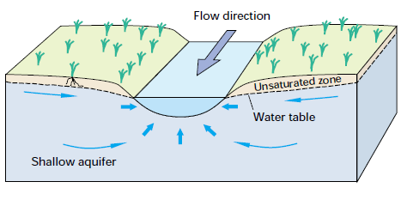
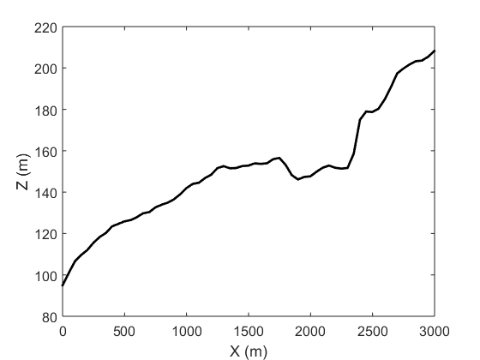
Introduction
Methods
Conclusion
Results
Winter et al., 1998
w
x
Equivalent hillslope: Average topographic profile of all hillslopes.
A topographic profile is associated with each hillslope

Slide 15
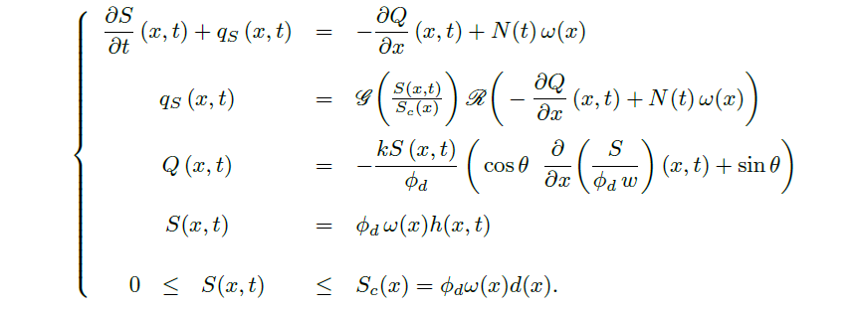
Introduction
Methods
Conclusion
Results
Winter et al., 1998
w
x
Marçais et al., 2017
Simulation of groundwater flow and seepage processes at the hillslope scale in 1D using Boussinesq equations (1877)
Equivalent hillslope: Average topographic profile of all hillslopes.
A topographic profile is associated with each hillslope

Slide 16

Introduction
Methods
Conclusion
Results
Calibration by a systematic parameter space exploration
Parameter space exploration :
Hydraulic conductivity (K)
  10⁻⁴ à 10 m/h; n = 50
Porosity x Aquifer depth (θ.D)
  0 à 15 m; n = 50
Objective function :
Infiltration (SURFEX)
Runoff (SURFEX)
Unsaturated zone
2. Seepage
Saturated zone
K, θ.D
Homogeneous geology
River
1. Boussinesq flow

Slide 17
Introduction
Methods
Conclusion
Results
Incorporating hydraulic heterogeneity
Equivalent hillslope 1
Contribution : 50%
Equivalent hillslope 2
Contribution : 50%
K₁, θD₁
K₂, θD₂
Heterogeneous geology
Q_{T} = Q₁ ₊ Q₂
Q₁
Q₂

Slide 18
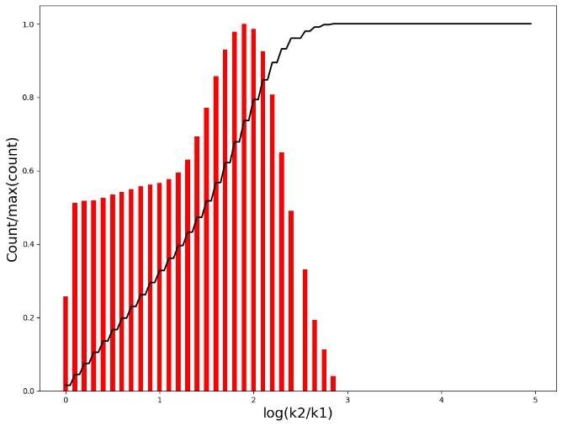

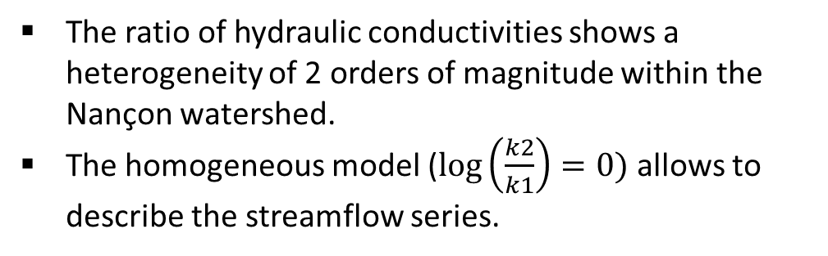
Introduction
Methods
Conclusion
Results
Best model distribution :
Selection criteria: ${NSE}_{log} = {0.9 NSE}_{log}^{max}$
The ratio of hydraulic conductivities shows a heterogeneity of 2 orders of magnitude within the Nançon watershed.
The homogeneous model ($log\left(\frac{k2}{k1}\right)=0)$ allows to describe the streamflow series.
Nancon watershed

Slide 19
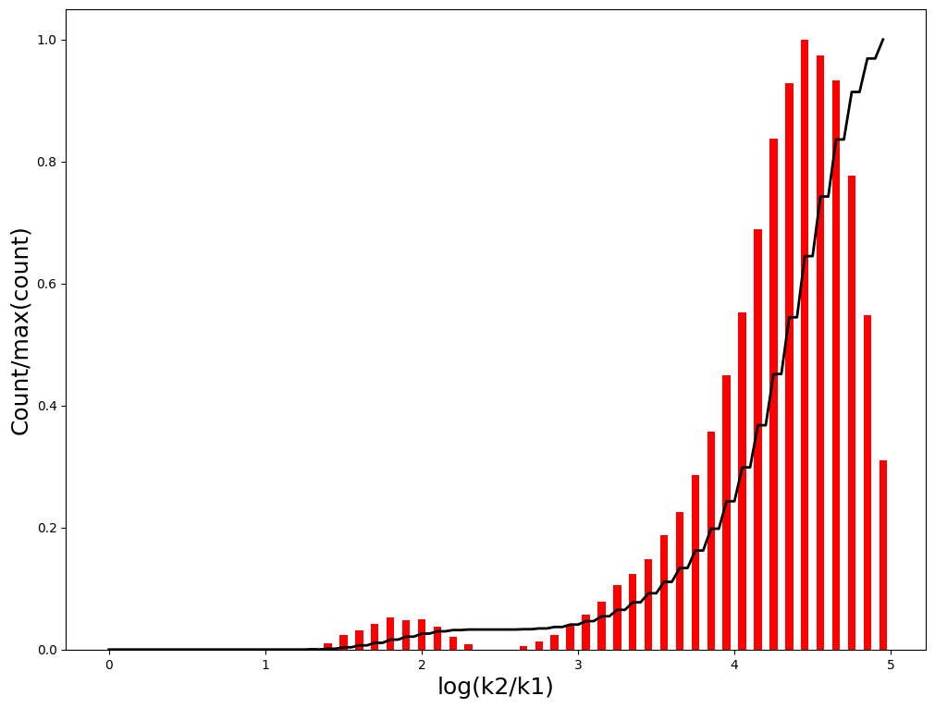

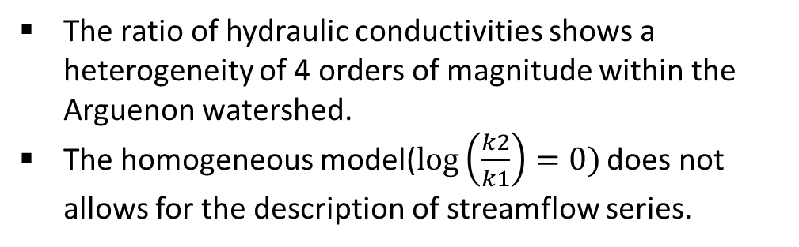
Introduction
Methods
Conclusion
Results
Best model distribution :
Selection criteria : ${NSE}_{log} = {0.9 NSE}_{log}^{max}$
The ratio of hydraulic conductivities shows a heterogeneity of 4 orders of magnitude within the Arguenon watershed.
The homogeneous model($log\left(\frac{k2}{k1}\right)=0)$ does not allows for the description of streamflow series.
Arguenon watershed

Slide 20
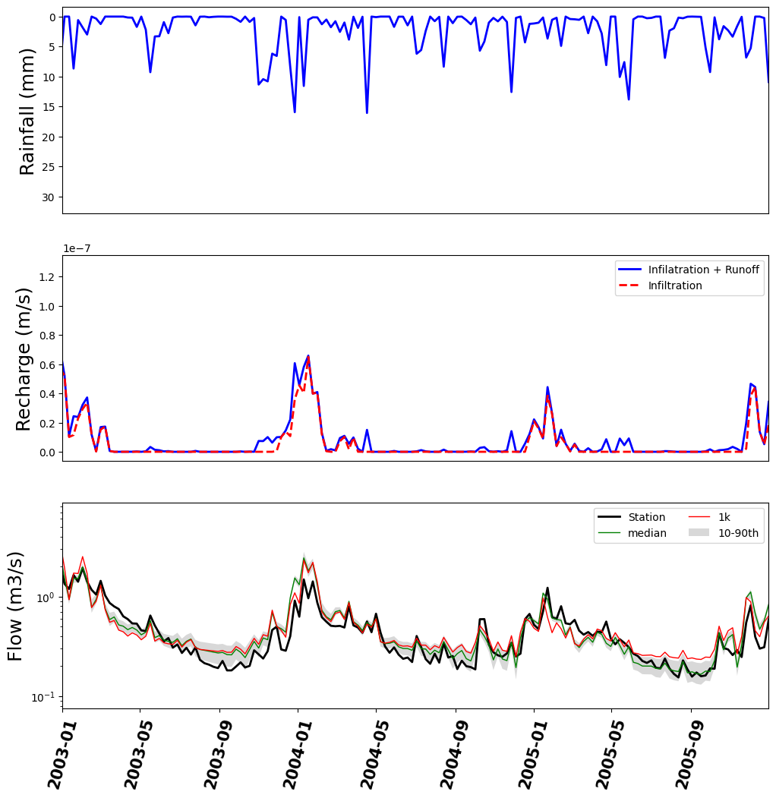
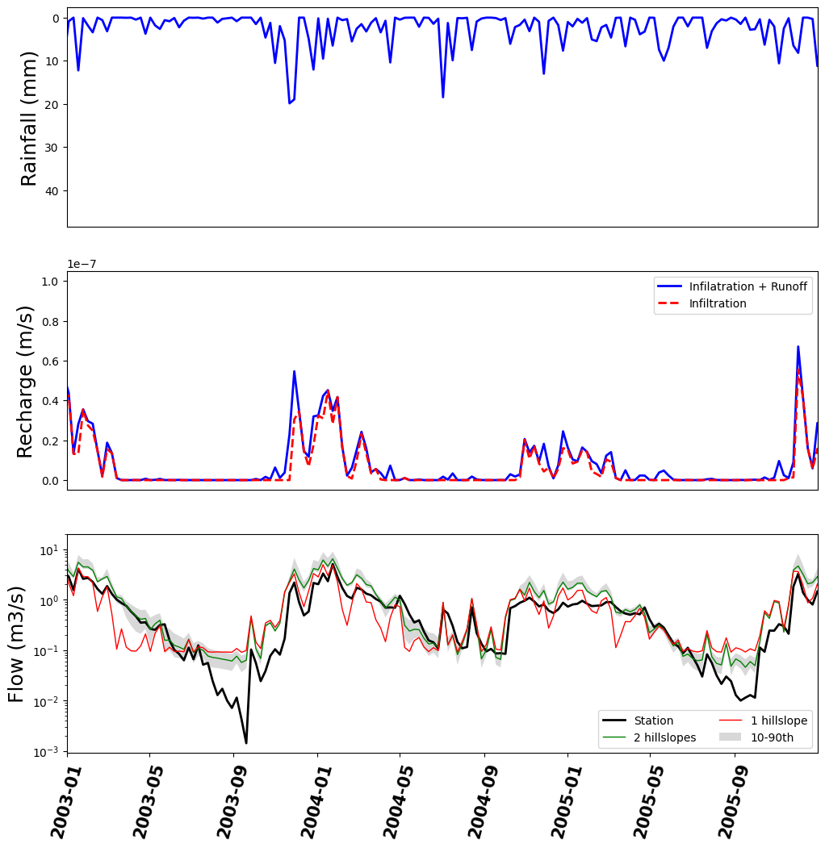

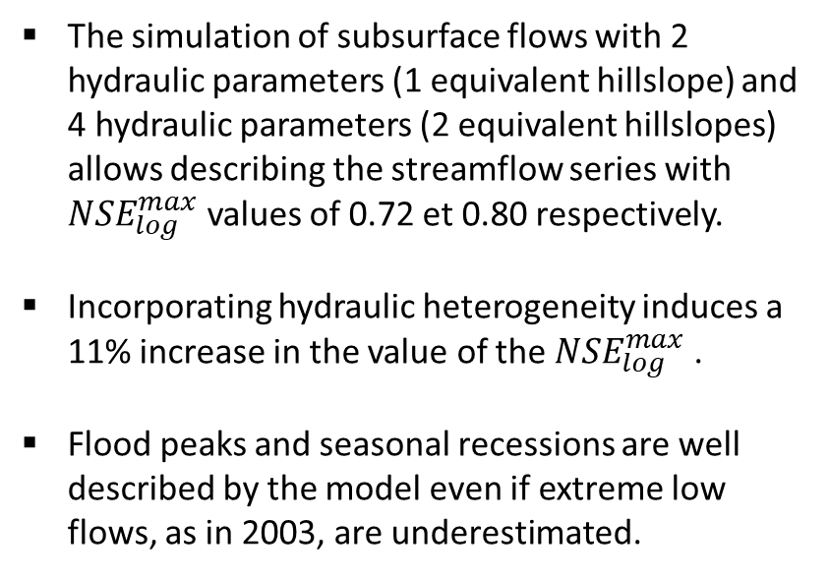
Introduction
Methods
Conclusion
Results
Best model distribution :
Selection criteria : ${NSE}_{log} = {0.9 NSE}_{log}^{max}$
The simulation of subsurface flows with 2 hydraulic parameters (1 equivalent hillslope) and 4 hydraulic parameters (2 equivalent hillslopes) allows describing the streamflow series with ${NSE}_{log}^{max}$ values of 0.72 et 0.80 respectively.
Incorporating hydraulic heterogeneity induces a 11% increase in the value of the ${NSE}_{log}^{max}$ .
Flood peaks and seasonal recessions are well described by the model even if extreme low flows, as in 2003, are underestimated.
Nancon watershed

Slide 21
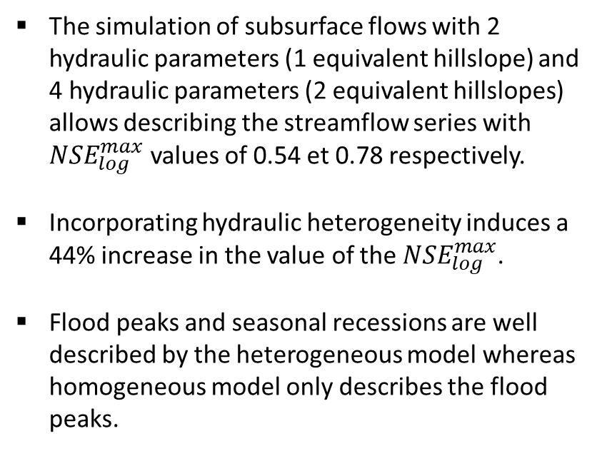
Introduction
Methods
Conclusion
Results
Best model distribution :
Selection criteria : ${NSE}_{log} = {0.9 NSE}_{log}^{max}$
The simulation of subsurface flows with 2 hydraulic parameters (1 equivalent hillslope) and 4 hydraulic parameters (2 equivalent hillslopes) allows describing the streamflow series with ${NSE}_{log}^{max}$ values of 0.54 et 0.78 respectively.
Incorporating hydraulic heterogeneity induces a 44% increase in the value of the ${NSE}_{log}^{max}$.
Flood peaks and seasonal recessions are well described by the heterogeneous model whereas homogeneous model only describes the flood peaks.
Arguenon watershed

Slide 22
Introduction
Methods
Conclusion
Results
hs1D model with only 4 parameters allows describing the streamflow series on Nançon and Arguenon watersheds with NSE_{log} values of 0.80 and 0.78 respectively.
Incorporating hydraulic heterogeneity induces a 44% increase of NSE_{log} value in the Arguenon watershed. This improvement is not systematic at the regional scale (Nancon watershed).
This improvement is reflected by a distributional change of the flow during the year.
Differences between catchments hints on the potential identification of hydrogeological properties at the regional scale by the combined use of geological map and hydrographs.

