Slide 1
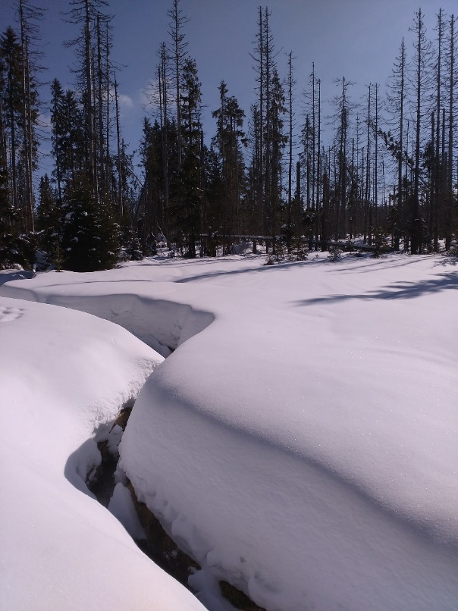
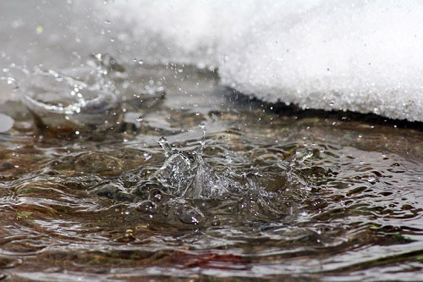
Snowpack energy balance and changes in the frequency and extremity of rain-on-snow events in the warming climate
vEGU21: 19-30 April 2021
Ondrej Hotovy¹ and Michal Jenicek¹
Charles University, Department of Physical Geography and Geoecology, Prague, Czechia ondrej.hotovy@natur.cuni.cz, michal.jenicek@natur.cuni.cz
The research is supported by the Charles University Grant Agency, project no: GAUK 272119
Seasonal snowpack significantly influences the catchment runoff and thus represents an important input for the hydrological cycle. Understanding the role of the individual snowpack energy balance (SEB) components on snowmelt processes enables to better estimate a potential runoff. Heat from liquid precipitation constitutes one of the snowpack energy balance components. Changes in the precipitation distribution and intensity, as well as a shift from snowfall to rain is expected in the future due to climate change. As a result, rain-on-snow events (ROS), which are considered to be one of the main causes of floods in winter and spring, may occur more frequently. Consequently, snowmelt and runoff may be strongly affected by these temperature and precipitation changes.
MOTIVATION
SW AND LW RADIATION
SNOWPACK ENERGY BALANCE
ENERGY CONTRIBUTIONS
STUDY AREAS
CHANGES IN ROS
MATERIAL AND METHODS
CONCLUSIONS

Slide 2
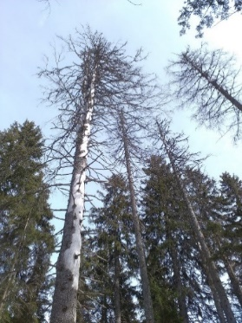
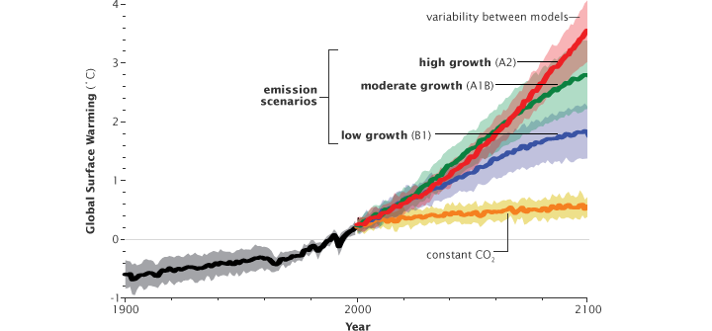
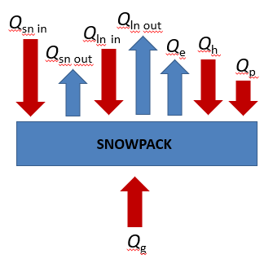
Snowpack energy balance and changes in the frequency and extremity of rain-on-snow events in the warming climate
Ondrej Hotovy and Michal Jenicek
MOTIVATION
Understanding the snowmelt processes in the different environments (clearings x forested sites) with regard to the snowpack energy balance
What is the role of the precipitation change on snowmelt, consequently on runoff?
RESEARCH OBJECTIVES
To assess the contribution of the individual snowpack energy balance component
To relate changes in the ROS frequency and extremity with the climate change
?
?
Contributions of the individual snowpack energy balance components (SWR, LWR, heat from precipitation)
Snowmelt process in the different environments
?
ROS in the warming climate
Snowpack energy balance for the different environments
HOME

Slide 3
Snowpack energy balance and changes in the frequency and extremity of rain-on-snow events in the warming climate
Ondrej Hotovy and Michal Jenicek
METHOD – SNOWPACK ENERGY BALANCE
Incoming shortwave radiation
Reflected shortwave radiation
Incoming longwave radiation
Outgoing longwave radiation
Heat from liquid precipitation Q_{p}
Physically based calculation of snow energy balance
Quantifies the fluxes on atmosphere – snow – soil ground interfaces
Q_{m} energy balance accessible for snowmelt [W.m⁻²]
+Q_{m} = snowmelt
- Q_{m} = no snowmelt
Absorbed shortwave radiation Q_{sn}
Absorbed longwave radiation Q_{ln}
Latent heat exchange Q_{e}
Sensible heat exchange Q_{h}
Ground heat flux Q_{g}
Q_{m} = Q_{sn} + Q_{ln} + Q_{e} + Q_{h} + Q_{g} + Q_{p}
HOME

Slide 4
Snowpack energy balance and changes in the frequency and extremity of rain-on-snow events in the warming climate
Ondrej Hotovy and Michal Jenicek
STUDY AREAS
Differ for each part of the research
RADIATION FLUXES AND SNOWPACK ENERGY BALANCE RESEARCH
RAIN-ON-SNOW RESEARCH
HOME

Slide 5
Snowpack energy balance and changes in the frequency and extremity of rain-on-snow events in the warming climate
Ondrej Hotovy and Michal Jenicek
STUDY AREA (SEB)
Fig. 1: Geographical location of the Ptaci Brook catchment and the position of all data stations used in the study. Each sampling site with
radiometers represents specific vegetation structure described by leaf area index (LAI); healthy dense spruce forest (a), disturbed spruce forest (b) and open meadow (c) (Hotovy et Jenicek, 2020).
HOME

Slide 6
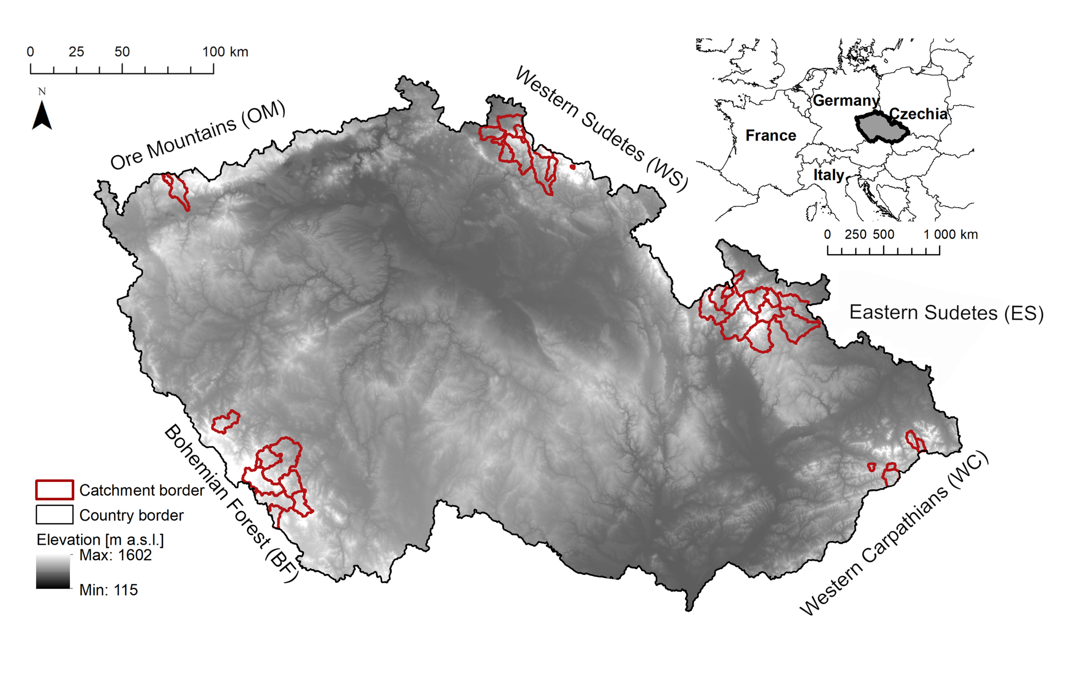
Snowpack energy balance and changes in the frequency and extremity of rain-on-snow events in the warming climate
Ondrej Hotovy and Michal Jenicek
STUDY AREA (ROS)
40 catchments located in 5 different mountain ranges in Czechia
Affected by snow
Long-time data series (1965 – 2019)
Fig. 2: Selected catchments for ROS research in Czechia.
HOME

Slide 7
Snowpack energy balance and changes in the frequency and extremity of rain-on-snow events in the warming climate
Ondrej Hotovy and Michal Jenicek
MATERIAL AND METHODS
Differ for each part of the research
RADIATION FLUXES AND SNOWPACK ENERGY BALANCE RESEARCH
RAIN-ON-SNOW RESEARCH
HOME

Slide 8
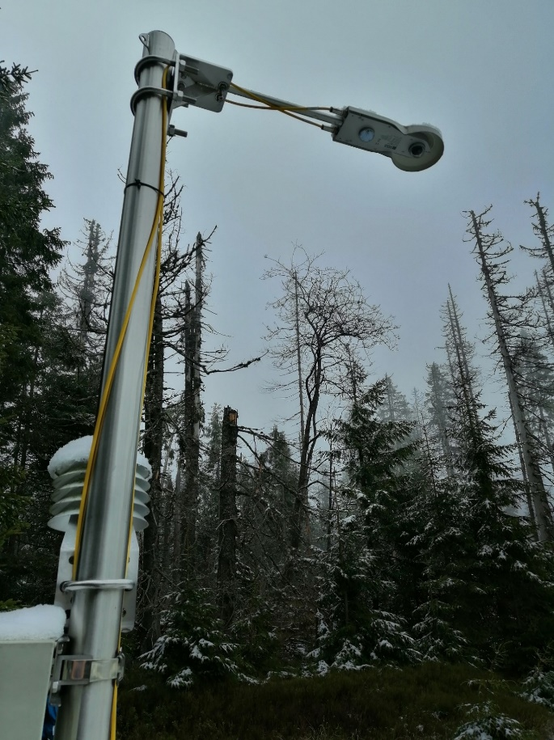
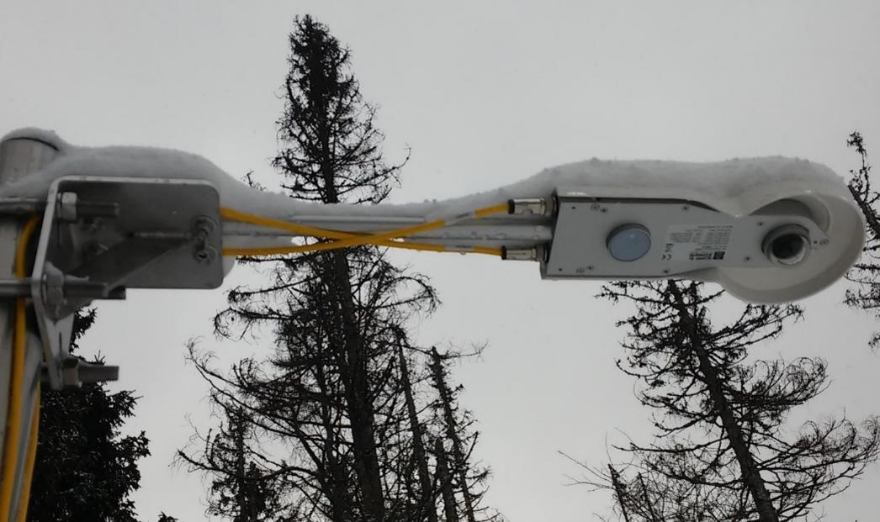
Snowpack energy balance and changes in the frequency and extremity of rain-on-snow events in the warming climate
Ondrej Hotovy and Michal Jenicek
MATERIAL AND METHODS (SEB)
LWR SWR
All three sites equippted with CNR4 Net Radiometers (Kipp & Zonen)
Two pyranometers and two pyrgeometers (oriented upward and downward)
Enable to measure both global (incoming) and reflected (outgoing) SWR and LWR
Data: three consecutive winter seasons (Dec – Apr) from 2015/16 to 2017/18 in 10 minutes resolution
Calculation of all SEB components based on Equations 2-5 in Hotovy et Jenicek, 2020
LWR SWR
Fig. 3: CNR4 Net Radiometers (Kipp & Zonen)
HOME

Slide 9
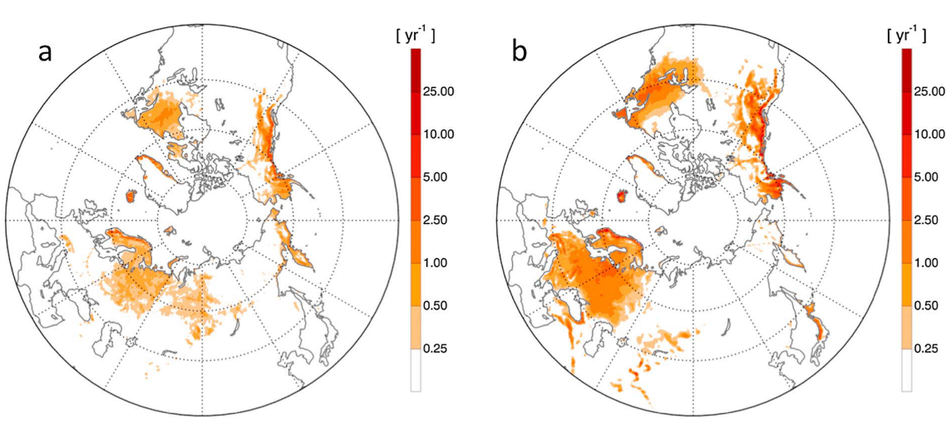
Snowpack energy balance and changes in the frequency and extremity of rain-on-snow events in the warming climate
Ondrej Hotovy and Michal Jenicek
MATERIAL AND METHODS (ROS) – ROS DEFINITION
Air temperature > 0 °C
Snow water equivalent ≥ 10 mm
Rainfall intensity ≥ 10 mm/day
Snow depth/snow water equivalent decrease
To recognise ROS → trends in ROS occurrence in the past (from 1965 to 2019)
MODELLING APPROACH
CLIMATE SCENARIOS
Fig 4: The number of ROS events across the Northern Hemisphere for (a) September–November (SON) and (b) December–February (DJF) for the period 1979-1980 to 2013-2014 (Cohen et al., 2015)
HOME

Slide 10
Snowpack energy balance and changes in the frequency and extremity of rain-on-snow events in the warming climate
Ondrej Hotovy and Michal Jenicek
MATERIAL AND METHODS (ROS) – MODELLING APPROACH
Semi-distributed conceptual model HBV-light for runoff and snow water equivalent simulations
Consists of different routines (Fig. 5)
Input data – T, P, E_{pot}
Calibration period: 1980 – 1997
Validation period: 1998 – 2014
Simulations for the future (2020 – 2100) with regard to the climate change → ROS change?
PRECIPITATION
SNOW ROUTINE
SOIL ROUTINE
GROUNDWATER ROUTINE
ROUTING ROUTINE
SIMULATED RUNOFF
ROS DEFINITION
Fig. 5: Schematic structure of the HBV model (Seibert, 2005; Seibert et Vis, 2012).
CLIMATE SCENARIOS
HOME

Slide 11
Snowpack energy balance and changes in the frequency and extremity of rain-on-snow events in the warming climate
Ondrej Hotovy and Michal Jenicek
MATERIAL AND METHODS (ROS) – CLIMATE SCENARIOS (in progress)
Climate scenarios (EURO-CORDEX) implemented into calibrated HBV model
4 GCM x 6 RCM x 3 RPC (2.6, 4.5, 8.5)
17 downscaled scenarios
To assess the impact of climate change on the frequency and extremity of ROS
Expectations:
- more precipitation in liquid form → more frequent ROS
- shorter periods with snowcover → less frequent ROS
- temporal variability (changes during winter season)
- spatial variability (based on different elevation)
?
ROS DEFINITION
MODELLING APPROACH
HOME

Slide 12
Snowpack energy balance and changes in the frequency and extremity of rain-on-snow events in the warming climate
Ondrej Hotovy and Michal Jenicek
RESULTS (SEB) – SWR ANALYSIS
7%
SWR intensity is determined by sun position
SWR varies significantly according to the vegetation structure and meteorological conditions
Forest shading reduces the total amount of solar SWR and thus influences the SEB
The disturbed forest site became more open to SWR due to forest decay
28%
34%
66%
100%
LWR RESULTS
SEB RESULTS
Fig. 6: Hourly average of incoming SWR in the different environments during cold seasons 2015/16, 2016/17 and 2017/18. Red lines represent sunrise and sunset times. Grey colour within red lines represents missing data (Hotovy et Jenicek, 2020).
HOME

Slide 13
Snowpack energy balance and changes in the frequency and extremity of rain-on-snow events in the warming climate
Ondrej Hotovy and Michal Jenicek
RESULTS (SEB) – LWR ANALYSIS
LWR (emitted by vegetation) as the primary source of energy for snowmelt at the forested sites
The forest decay caused the significant decrease in net LWR from winter 2015/16 to winter 2017/18
SWR RESULTS
SEB RESULTS
Fig. 7: Hourly average of net LWR in the different environments during cold seasons 2015/16, 2016/17 and 2017/18. Red lines represent sunrise and sunset times. Grey colour within red lines represents missing data (Hotovy et Jenicek, 2020).
HOME

Slide 14
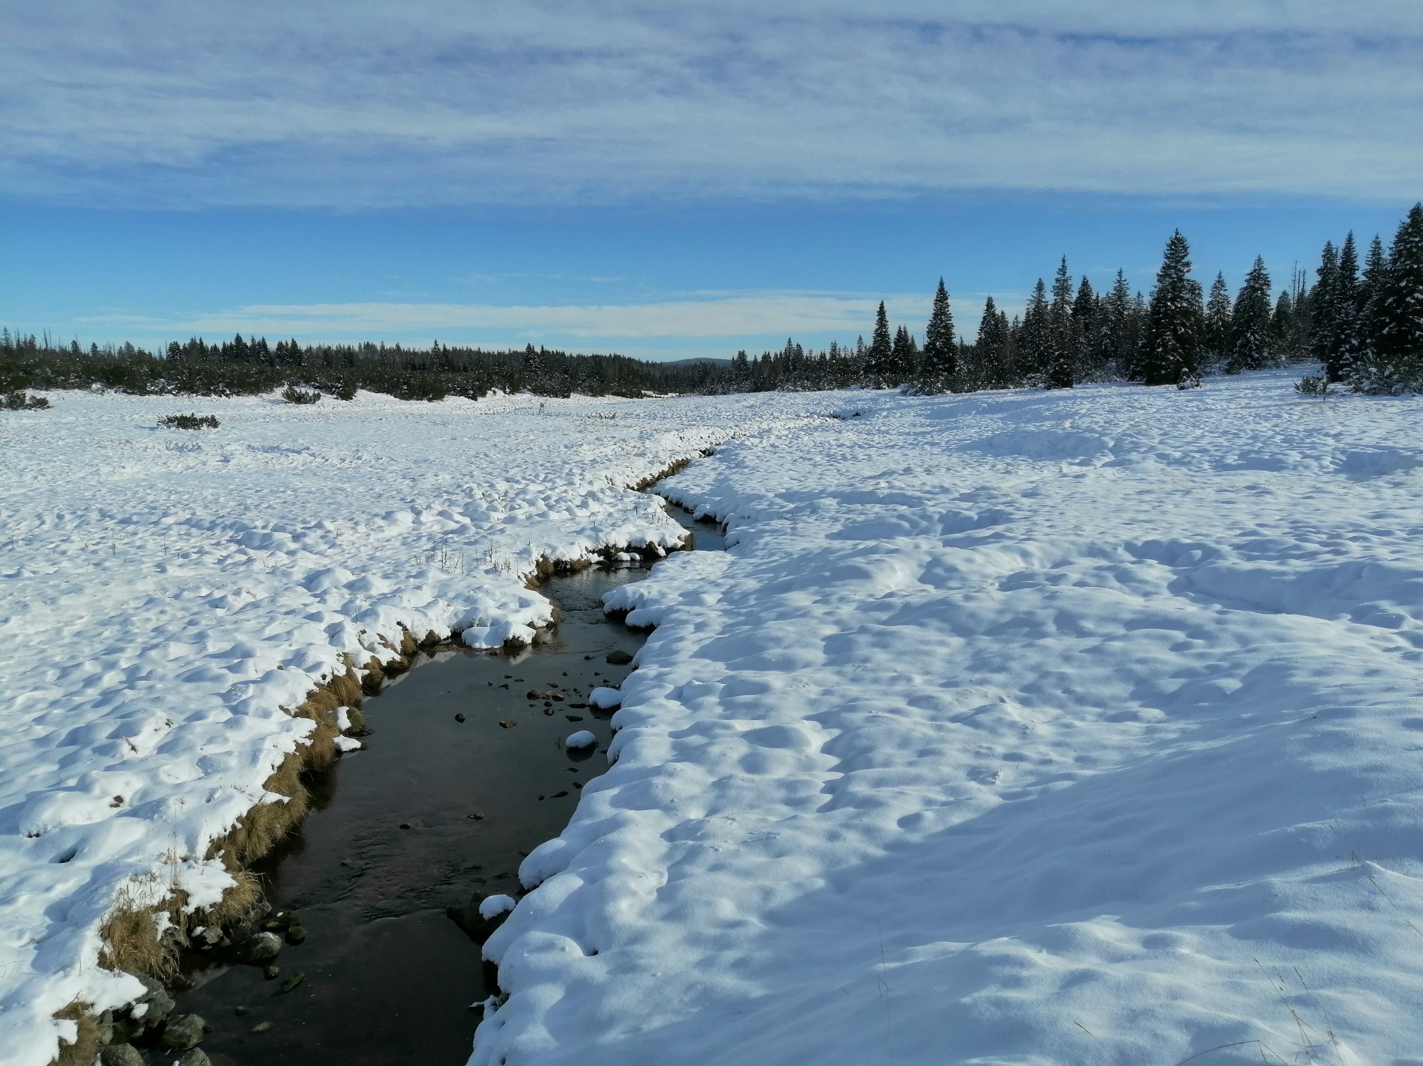
Snowpack energy balance and changes in the frequency and extremity of rain-on-snow events in the warming climate
Ondrej Hotovy and Michal Jenicek
RESULTS (SEB) – ENERGY CONTRIBUTIONS
Incoming shortwave radiation
Reflected shortwave radiation
Heat from liquid precipitation
1% 3%
Incoming longwave radiation
Outgoing longwave radiation
Absorbed shortwave radiation clearing 55% forest 23%
Absorbed longwave radiation
25% 41%
Sensible heat exchange
8% 8%
Latent heat Exchange
10% 16%
SWR RESULTS
Ground heat flux
1% 9%
LWR RESULTS
Hotovy, O., Jenicek, M. (2020): The impact of changing subcanopy radiation on snowmelt in a disturbed coniferous forest. Hydrological Processes, 34 (26): 5298-5314.
HOME

Slide 15
Snowpack energy balance and changes in the frequency and extremity of rain-on-snow events in the warming climate
Ondrej Hotovy and Michal Jenicek
RESULTS (SEB + ROS) – HEAT SUPPLIED BY THE RAIN
The heat supplied by rain represented rather minor contributions to snowmelt at seasonal resolution, however this heat input is important for snowmelt generation at daily resolution
For instance, heat input from rain constituted from 13 to 29% of all energy inputs during ROS in 18/03/2017 (displayed by grey colour)
Fig 8: Simulated SWE at individual study sites and observed SWE at a nearby open meadow during the main spring snowmelt periods in seasons 2016, 2017 and 2018 (first line panels). Relative daily contribution of individual energy fluxes to snowmelt rates at the healthy forest
site (second line panels), disturbed forest site (third line panels) and open site (fourth line panels) (Hotovy et Jenicek, 2020).
ROS RESULTS
SEB RESULTS
HOME

Slide 16
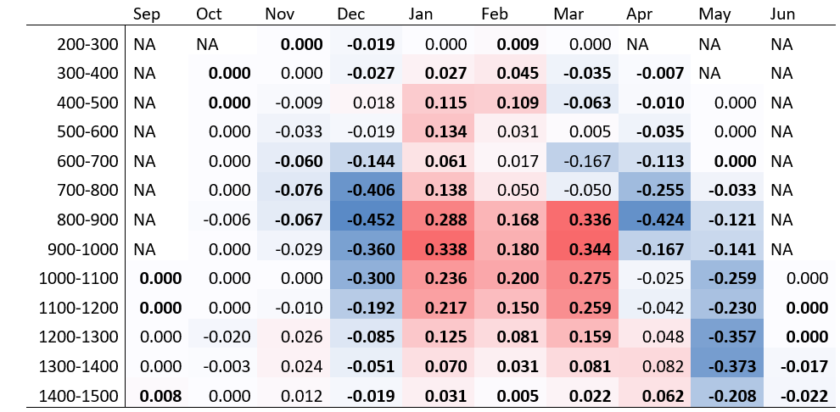
Snowpack energy balance and changes in the frequency and extremity of rain-on-snow events in the warming climate
Ondrej Hotovy and Michal Jenicek
PRELIMINARY RESULTS (ROS)
Elevation zone [masl]
Fig 10: Change in days with ROS in the 40 catchments in Czechia based on the different elevation zones for the period 1965-2019. The significance and direction of trends derived for the 10-year moving windows by the Mann–Kendall test. Trends are highlighted by blue color (decrease) and red color (increase) according to their statistical significance (bold for p < 0.05).
ROS RESULTS
SEB RESULTS
Fig 9: ROS occurence in the 40 catchments in Czechia. Relative numbers for the periods 1965-1992 and 1993-2019.
HOME

Slide 17
Snowpack energy balance and changes in the frequency and extremity of rain-on-snow events in the warming climate
Ondrej Hotovy and Michal Jenicek
CONCLUSIONS (SEB + ROS)
A canopy structure, or consequently forest disturbance significantly affect SWR and LWR parametres and the entire snowpack energy balance.
The SWR was a major source of the energy for snowmelt at the open site.
The LWR was the primary source of energy for snowmelt at the forested sites
The heat supplied by rain represented rather minor contributions to snowmelt rates. This heat input is important for snowmelt generation at lower temporal resolutions (during days with ROS)
ROS events, which are considered to be one of the main causes of floods in winter and spring, may occur more frequently due to climate change
ROS change according to climate change differs temporally (changes during winter season) and spatialy (based on the different elevation)
More frequent ROS with higher extremity is associated with faster snowmelt, consequently with higher flood risk.
HOME

Slide 18
Snowpack energy balance and changes in the frequency and extremity of rain-on-snow events in the warming climate
Ondrej Hotovy and Michal Jenicek
REFERENCES
Cohen J, Ye H, Jones J. 2015. Trends and variability in rain-on-snow events. Geophysical Research Letters 42 (17): 7115–7122 DOI: 10.1002/2015GL065320.
Hotovy O, Jenicek M. 2020. The impact of changing subcanopy radiation on snowmelt in a disturbed coniferous forest. Hydrological Processes 34 (26): 5298-5314 DOI: 10.1002/hyp.13936.
Seibert J. 2005. HBV light user’s manual. Uppsala: Uppsala University.
Seibert J, Vis MJP. 2012. Teaching hydrological modeling with a user-friendly catchment-runoff-model software package. Hydrology and Earth System Sciences 16: 3315–3325 DOI: 10.5194/hess-16-3315-2012.
HOME

