Slide 1
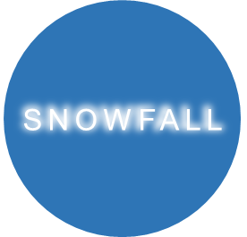
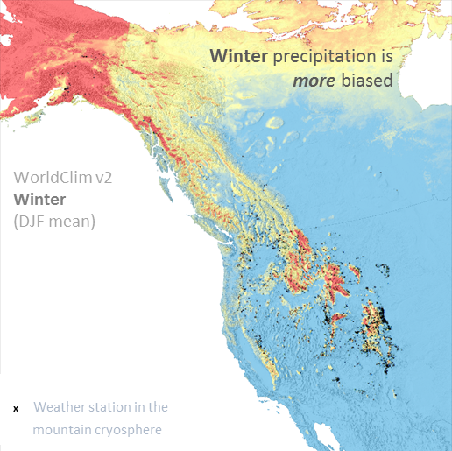
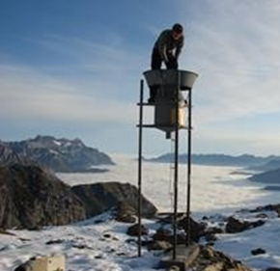
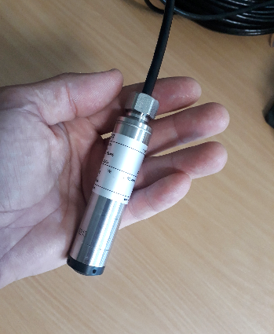
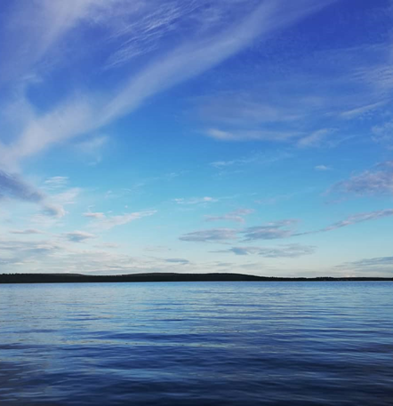
EGU21-7507
Snow Falling on Alpine Lakes
Measuring snowfall SWE on the landscape scale using lake water pressure
Hamish Pritchard*, Daniel Farinotti° and Steven Colwell*
*British Antarctic Survey °WSL, Switzerland
1. We’re getting snowfall wrong
2. We need better measurements
3. Here’s a new way
4. It works!
5. Summary

Slide 2
1) The problem: we’re getting mountain snowfall wrong
EGU21-7507
Slide summary:
Mountain snowfall is not observed well enough…
…even where there are lots of weather stations (like in the western US).
Summer precipitation amounts are biased by this much
The greatest biases are in the mountains in winter
WorldClim v2
Summer
(June-July-August mean)
WorldClim v2
Winter
(December-January-February mean)
…and other climatologies have the same problem
Bias-correction factor for precipitation
x Weather station in the
mountain cryosphere
CHELSA v1.2
Winter
CHPclim v1
Winter
Mountain snowfall biases are a global problem
WorldClim v2
Winter
Bias-correction factor: PBCOR for WorldClim v2, Beck et al. (2020) Bias correction of global high-resolution precipitation climatologies using streamflow observations. Weather stations: selected Global Historical Climatology Network stations located in mountains where January or July mean temperature is below freezing. Mountains: as defined by Karagulle et al. (2017) Modeling global Hammond landform regions from 250‐m elevation data.
Notes:
Full Beck ref: Beck HE, Wood EF, McVicar TR, Zambrano-Bigiarini M, Alvarez-Garreton C, Baez-Villanueva OM, et al. Bias Correction of Global High-Resolution Precipitation Climatologies Using Streamflow Observations from 9372 Catchments. J Clim. 2020;33(4):1299-315.
Shows GloH2O’s PBCOR for WorldClim v2 climatologies in June-July-August (left) and December-January-February (right), with the GHCN Daily stations located in the mountain cryosphere as black crosses. Shows widespread precip low bias in mountains, worse in winter than summer. Note also that gridded products CHELSA v12 and CHPClim v1 have similar biases.
Shows that mountain precip, and particularly snowfall, are not adequately represented in leading gridded products even in Western States where observations are relatively dense.

Slide 3
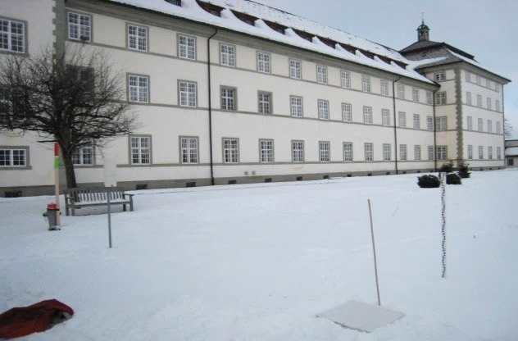
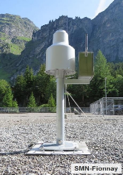
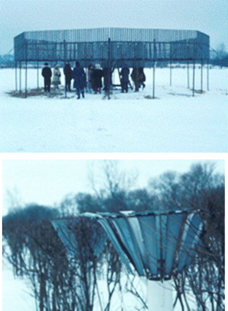
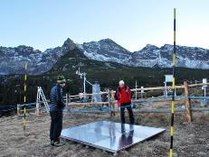
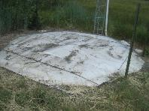
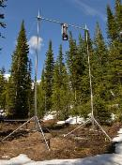
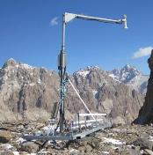
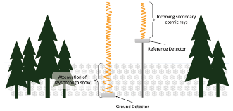
2) What’s wrong with existing snowfall observations?
EGU21-7507
Lots of options:
Manual observations of SWE (Snow Water Equivalent) - infrequent
Pluviometers – often biased
WMO reference station
>$7000
Fences and bushes reduce wind bias but are rarely used.
Other SWE gauges – rare, expensive, range or bias problems
pillow
$17,000
scales
too few (difficult, expensive to install and maintain)
too biased (undercatch, sensor saturation etc.)
$28,000
Most importantly: too small! (point measurements)
gamma
impedance
cosmic ray
$34,000
$27,000
$21,000

Slide 4
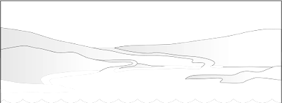
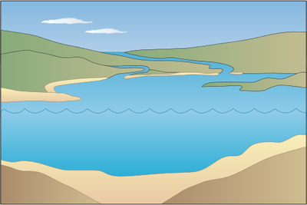
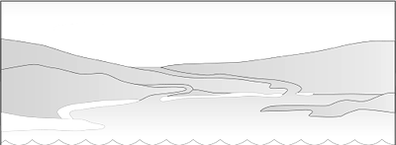
3) There is another way - use lakes to measure snowfall SWE
EGU21-7507
Find a lake
Add a water-pressure sensor
Wait for winter (runoff stops)
Falling snow increases pressure
And repeat
water pressure
P+
summer
winter
Practicality advantages
a) low cost, low power, lightweight, easy to deploy, simple, robust
Accuracy advantages
b) no bias from wind ‘undercatch’ (submerged sensor)
c) no bias from ‘bridging’ (larger than pillows)
d) no bias from sensor ‘saturation’ (large range, e.g. 10 m WE)
e) no need to guess density etc. (direct measurement of mass = SWE)
Pritchard HD et al. (2021) Measuring Changes in Snowpack SWE Continuously on a Landscape Scale Using Lake Water Pressure. J. Hydrometeorology. 22(4):795-811.

Slide 5
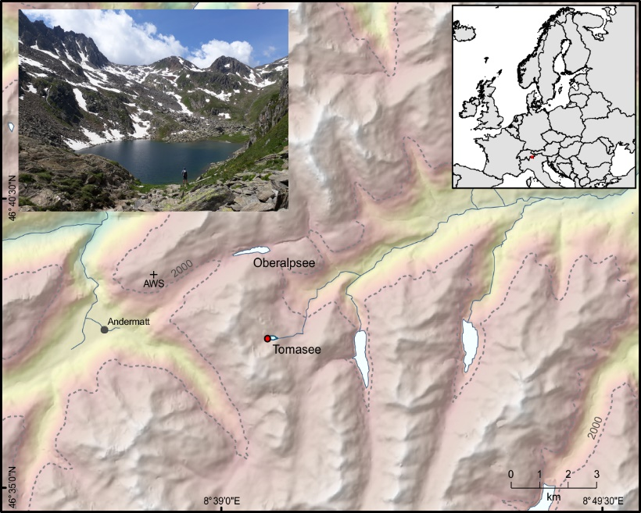
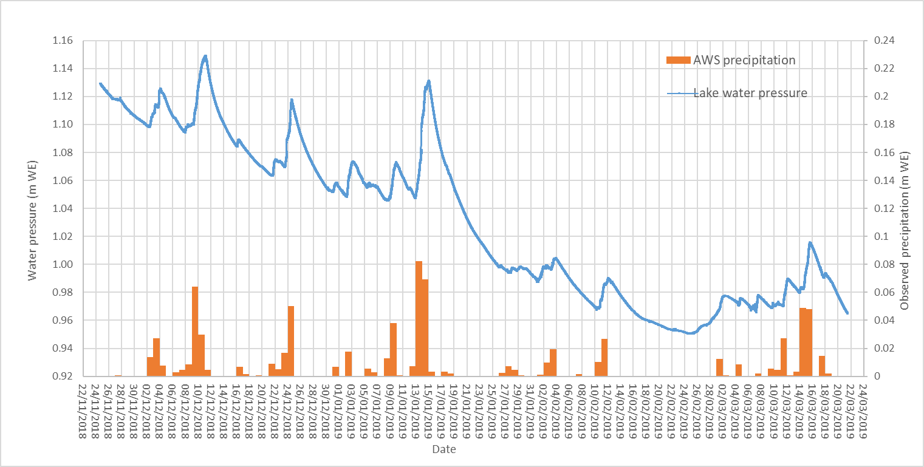
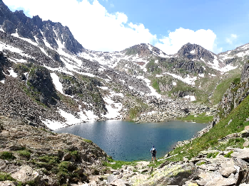
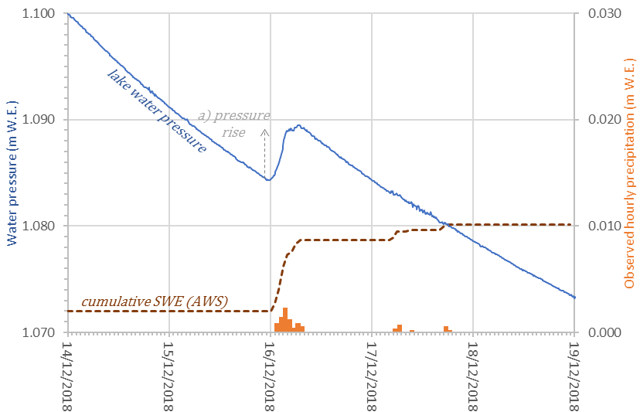
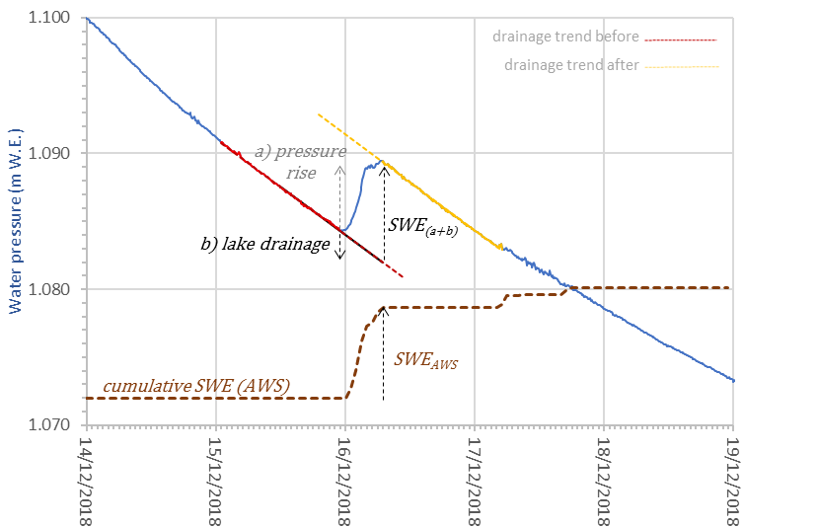
4) Using lakes to measure snowfall SWE: Swiss Alps
EGU21-7507
Winter 2018/19 water-pressure from Tomasee, and precipitation from nearby AWS
Lake Tomasee, Switzerland (alt. 7700 ft), source of the River Rhine.
NB/ Tomasee is 1.25 million times larger than the AWS pluviometer.
Correcting for lake drainage to get snowfall SWE:
Measure the pressure rise…
..to get snowfall SWE and its uncertainty e.g.:
= 7.3 ± 0.3 mm W.E.
(± 4%)
…and correct for drainage…
Precision advantages
f) uncertainty quantified from the observations
Pritchard HD et al. (2021) Measuring Changes in Snowpack SWE Continuously on a Landscape Scale Using Lake Water Pressure. J. Hydrometeorology. 22(4):795-811.

Slide 6
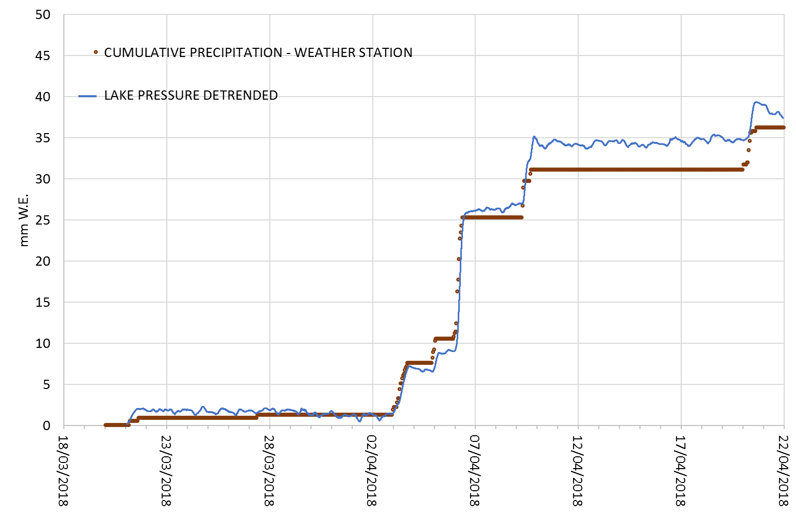
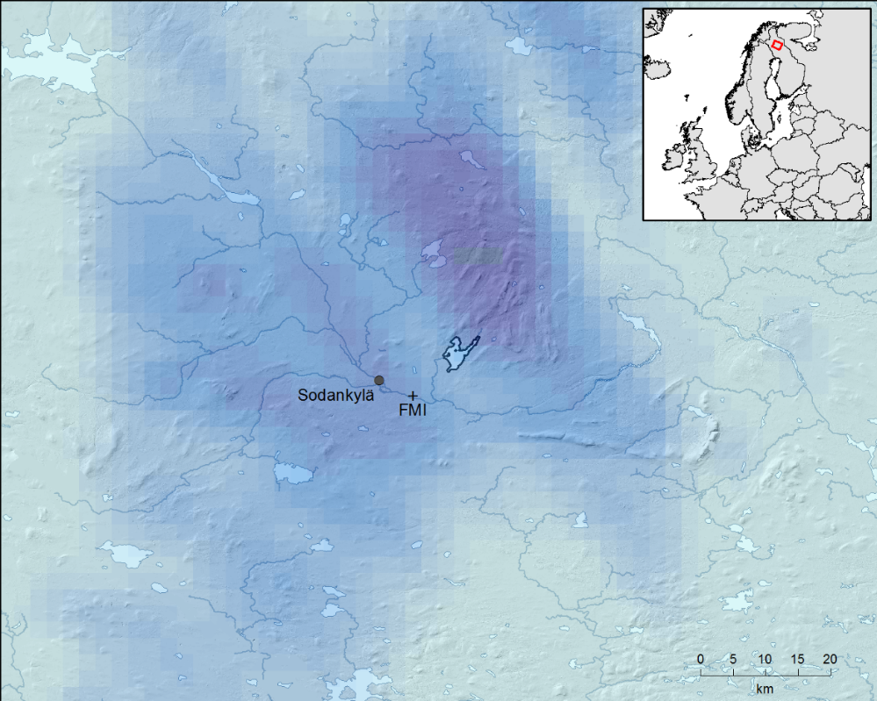
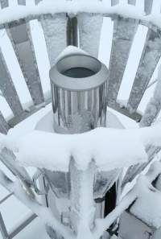
It works on big lakes too: Finnish Arctic
EGU21-7507
AA
AA = AROME-Arctic 2.5 km weather model
Lake Orajärvi: 10.95 km²
(274 million times larger than the nearest pluviometer)
big lake vs
tiny AWS
Sampling advantages of a lake sensor
g) no need to scale-up from point measurements (lakes can be as big as grid cells)
h) very large potential sample (e.g., 25,000 mountain lakes just in the contiguous USA)
5. Summary
Existing snow measurements are too sparse, too poorly distributed, too infrequent, too biased and too small to represent snowfall SWE in mountain landscapes.
Snowfall SWE can instead be measured using lake water pressure.
This has important advantages in accuracy, practicality, precision and sampling over existing instruments.
Pritchard HD et al. (2021) Measuring Changes in Snowpack SWE Continuously on a Landscape Scale Using Lake Water Pressure. J. Hydrometeorology. 22(4):795-811.
Patent pending: PCT/GB2021/050398

