Slide 1

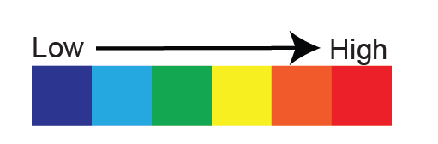
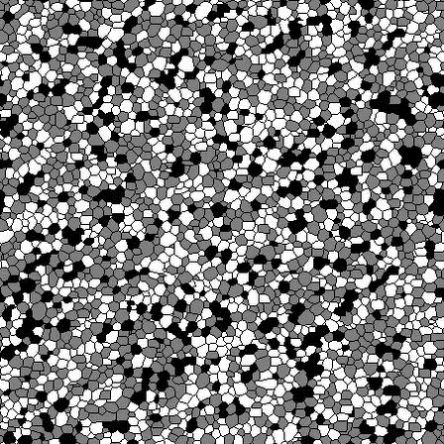
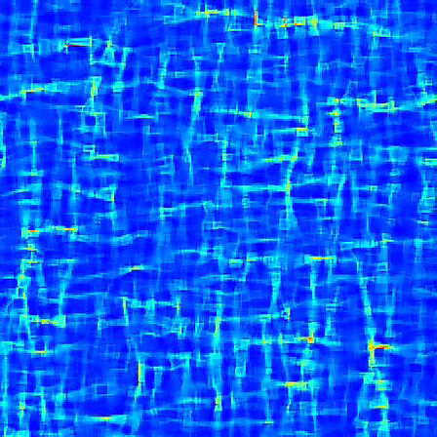
melanie.finch@monash.edu | www.melaniefinch.net |
@melaniefinch_
Medium phase strength contrast
IP = 2.5 x WP
SP = 5 x WP
15% weak phase
SP
IP
WP
Strain rate

