Slide 1
Global NWP modeling of urban environments at ~1km resolution
EGU 2021
Joe McNorton, Nicolas Bousserez, Gabriele Arduini, Anna Agusti-Panareda, Gianpaolo Balsamo, Souhail Boussetta, Margarita Choulga, Ioan Hadade, Robin Hogan and Richard Engelen
ECMWF, Reading, UK
27/03/2021

Slide 2
Why use an urban scheme in a global NWP and atmospheric chemistry system?
>50% of population live in urban areas.
Improved forecasts offer clear societal benefits.
Global NWP models reaching km-scale.
Urban conurbations can now be resolved.
Urban energy and moisture fluxes are noticeable different.
The Urban Heat Island effect can be modelled.
Trace gas emissions from residential activities correlate with NWP variable.
Heating degree days, can represent fluxes.
Temperature
Emissions from heating

Slide 3
The Integrated Forecasting System (IFS)
The IFS is the operational NWP model used at the ECMWF.
Operational forecasts currently at ~9km horizontal resolution with plans for ~4km.
Urban areas are not represented: Urban Heat Island Effect.
Proposed scheme based on previous studies (Harman et al., 2004; Porson et al., 2010; Oleson et al., 2008)

Slide 4
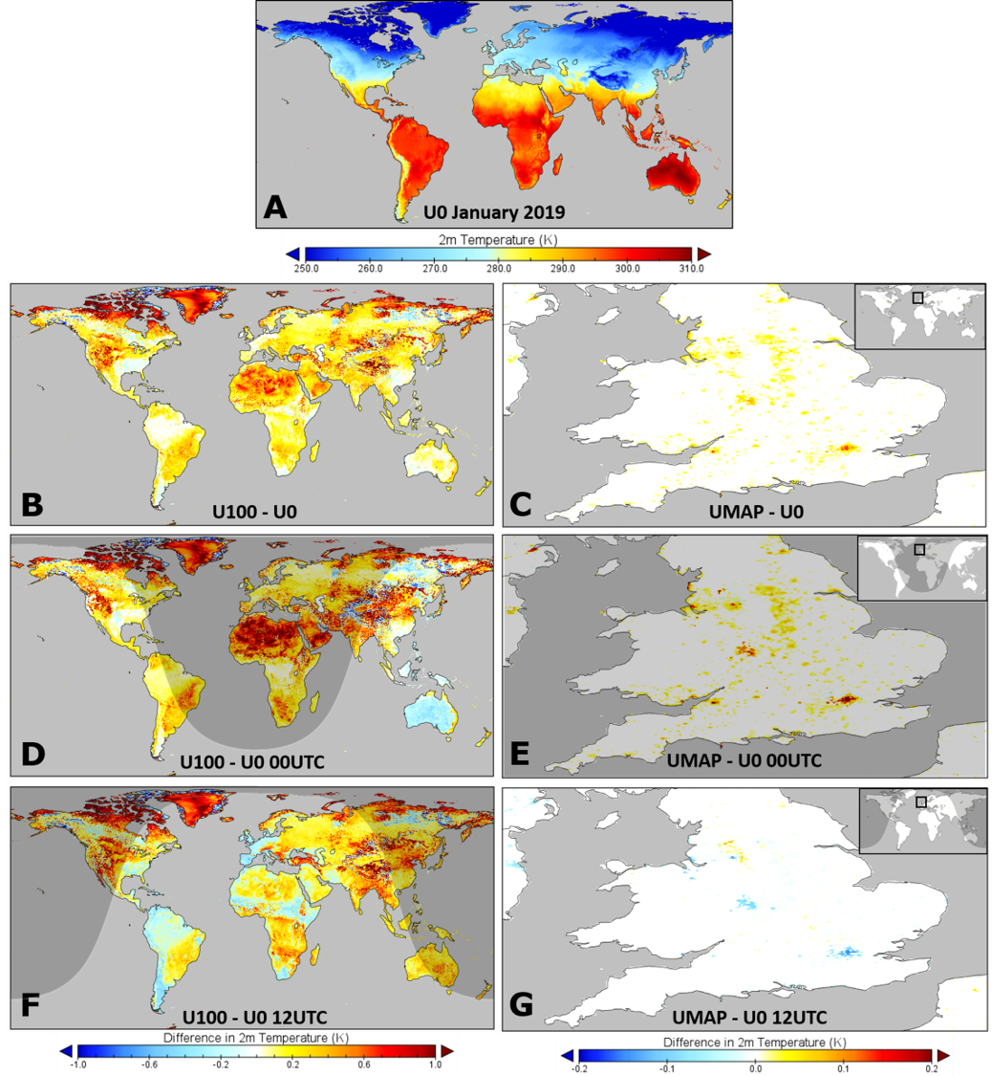
The urban scheme - 2m temperature (1km surface simulations)
Urban - Control
Urban - Observations
100% Urban
Mapped
January
Average
Urban world 0.2 K warmer
January
00:00
Urban world 0.5 K warmer at night
Improved diurnal cycle
Urban - Control
January
12:00
Urban world 0.0 K difference during day
UHI noticeable at night.

Slide 5
Should we already be using a simple urban scheme?
Difference between simulations including the mapped urban scheme and control
Ensemble Forecast Resolution (~30km)
Operational High-Res Forecast (~9km)
Global land surface only simulations.
Ensemble resolution smoothes out urban signal into unrealistically large domain.
High-Res resolves large urban conurbations but not smaller ones
Experimental product captures urban structure of large conurbations and general signal from smaller conurbations.
Conurbations larger than 1,000 km² (solid), 500 km² (dashed) and 100 km² (dotted) are denoted with boxes.
Experimental Resolution (~1km)

Slide 6
Relevance to Modelling Trace Gas Emissions
An urban representation permits an online residential emissions model:
Spatiotemporal disaggregation of national inventories.
2.1 Use of NWP variables (heating degree days) to modulate existing emission inventories.
2.2. Elaboration of standard heating degree days including mapped ancillary information about building properties (internal temperature / fuel types / material thermal properties etc.)

Slide 7
Any Questions?

