Slide 1
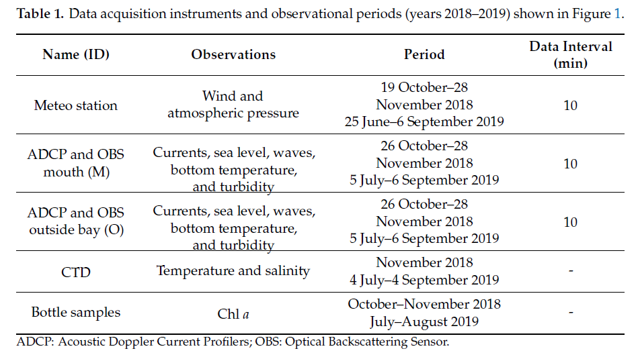
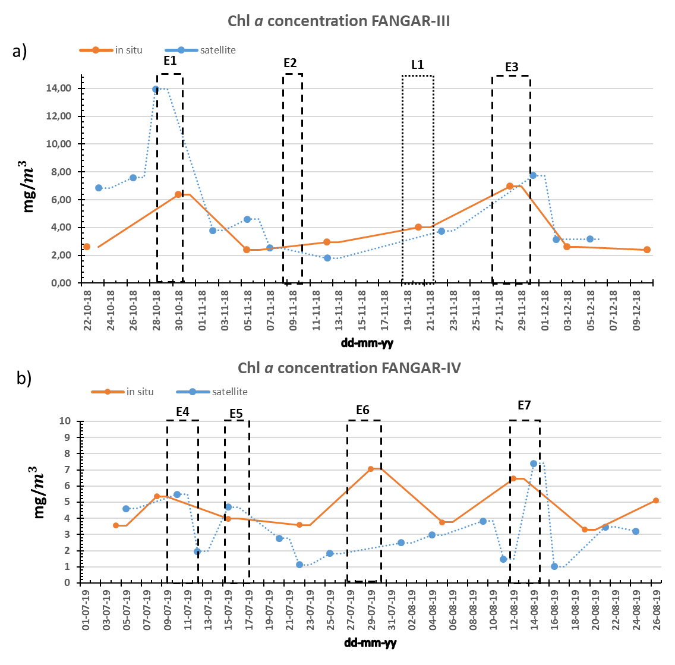
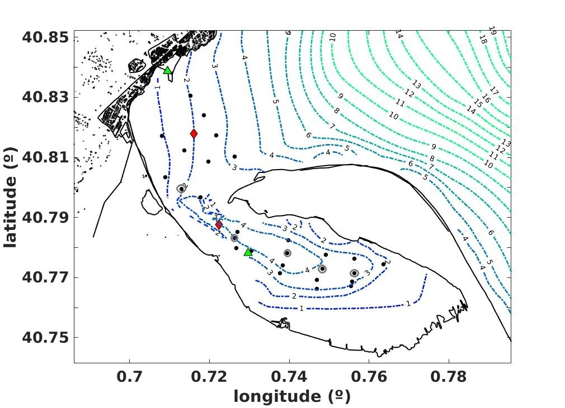
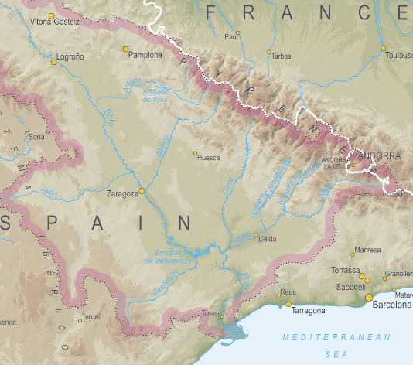
Influence of the hydrodynamics in spatio-temporal variability of clorophyll a in a small-scale and microtidal bay: Fangar Bay case (Ebro Delta)
${\text{Marta} \text{F}\text{−}\text{Pedrera} \text{Balsells}}^{1}$, ${\text{M}\text{anel} \text{Grifoll}}^{1}$, ${\text{M}\text{anuel} \text{Espino}}^{1}$, ${\text{Mar}\text{garita} \text{Fern}\text{á}\text{ndez}}^{2}$ and ${Agustín Sánchez−Arcilla}^{1}$
(1) Universitat Politècnica de Catalunya, Laboratori d’Enginyeria Maritima, Barcelona, Spain, (2) Institute of Agriculture and Food Research and Technology (IRTA), Sant Carles de la ràpitar, Spain. $1$
Abstract
Estuaries and coastal bays are areas of large spatial-temporal variability in physical and biological variables due to environmental factors such as local wind, light availability, freshwater inputs or tides. The physical characteristics of an estuary affect its hydrodynamics. These in turn modify the behaviour of biological variables such as the concentration of chlorophyll a (Chl a). In a small-scale, micro tidal bay such as the Fangar Bay (Ebro Delta), hydrodynamics is influenced above all by local winds, as well as by fresh water contributions. The results of two field campaigns and Sentinel-2 images show how the concentration of Chl a is affected by strong wind episodes typical of this area (NW-E winds). With these episodes of strong wind (> 10 m-s-1) mixing occurs in the water column causing an increase in the concentration of Chl a. On the other hand, with sea breezes (< 6 m-s-1) the water column is stratified causing a decrease in the Chl a concentration. However, the spatial-temporal variability of Chl a in small-scale estuaries and coastal bays is quite complex due to the many factors involved and deserves more intensive field campaigns and additional numerical modelling efforts.
E1
E2
L1
E3
E4
E5
E6
E7
3. Results
Results based reveals that intense winds from both NW (offshore) and E-NE (onshore) cause mixing in the water column and an increase in the concentration of Chl a at surface in Fangar Bay.
1. Study Area
FANGAR III
m/s
E1
E2
L1
E3
The satellite data not always coincide with the in situ data (sometimes overestimating and sometimes underestimating), both patterns were similar.
The Fangar Bay (north of Ebro Delta) is a semi-closed area that act as estuaries, since the fresh waters of the irrigation canals flow into them almost all year round. There is a strong transverse variability on water flow due to the bathymetry and the complex geometry.
(a)
(b)
It has been concluded that the mixing produced by the strong winds favours an accumulation of Chl a concentration, while the stratification, that causes a positive estuarine circulation, reduces this accumulation.
(c)
O
E episodes
L episodes
(°)
O1
FANGAR IV
E4
E5
E6
E7
N
Ebro River
ADCP
(d)
Meteo station
C1
C2
I
Ebro River
SF
(e)
+764m
Sant Carles de la Ràpita
M-SC
Alfacs
Fangar
Mediterranean Sea
(°)
2. Field campaigns and satellite data
Two intensive field campaigns (FANGAR-III and FANGAR-IV) were conducted. The measurement periods and instruments are summarized in Table 1.
The responsible mechanisms of Chl a increase during the wind episodes are the horizontal mixing and the bottom resuspension (linked also to the breakage of the stratification) that presumably resuspends Chl a containing biomass and/or incorporates nutrients in the water column. On the other hand, sea-breeze is not capable of breaking up the stratification, so the Chl a concentration does not change significantly during sea-breeze events
Acknowledgments
The authors acknowledge from ECOSISTEMA-BC project (CTM2017-84275-R/MICINN-AEI-FEDER,UE) and the European Maritime and Fisheries Fund (EMFF) and the Fisheries Directorate of the Catalan government through the project ARP029/18/00008. More information in F-Pedrera Balsells et al (2021), Water 2021, 13, 701. https://doi.org/10.3390/w13050701
The satellite images used were Sentinel-2. Chlorophyll a concentration is computed automatically by the Sentinel Application Platform (SNAP).

