Slide 1
Good morning, good afternoon, and good evening
Thank you for visiting my presentation

Slide 2
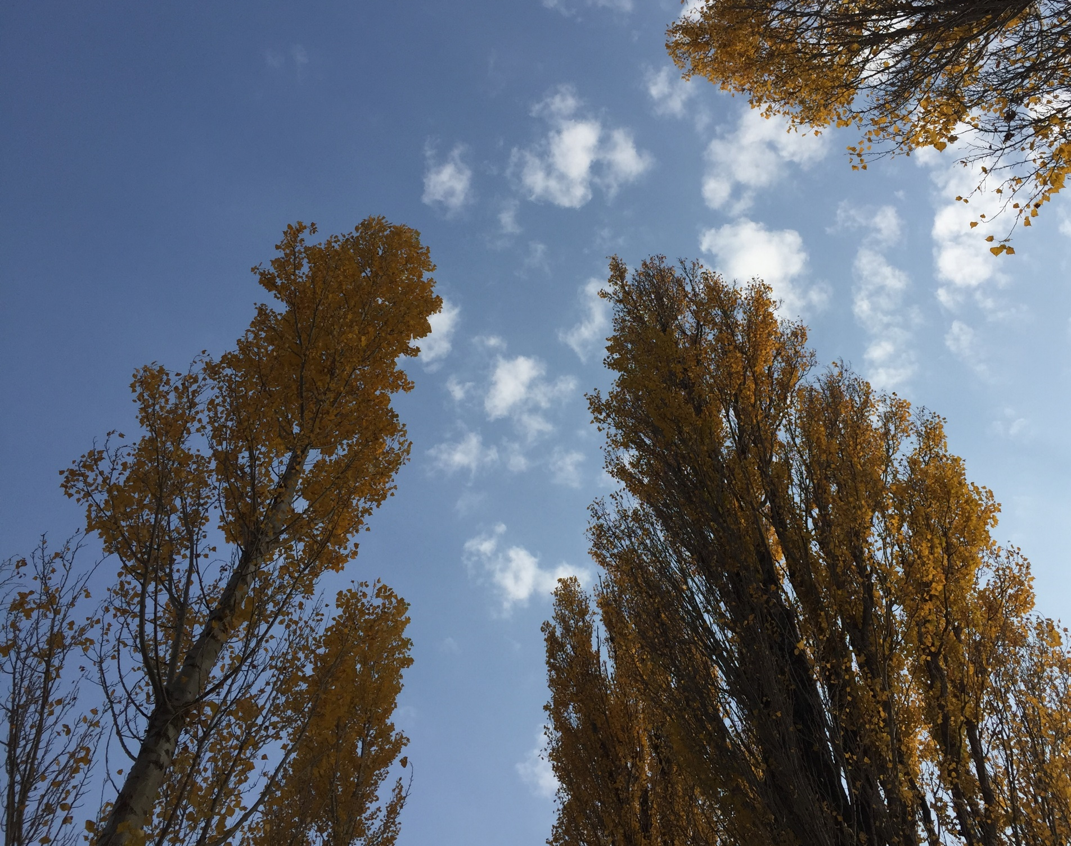
2021 EGU virtual meeting (vEGU21)
Slow earthquake signatures in the ratio
between AW and IGW amplitudes
in coseismic ionospheric disturbances
Kosuke Heki, and Yuki Takasaka
Hokkaido University, Sapporo, Japan

Slide 3
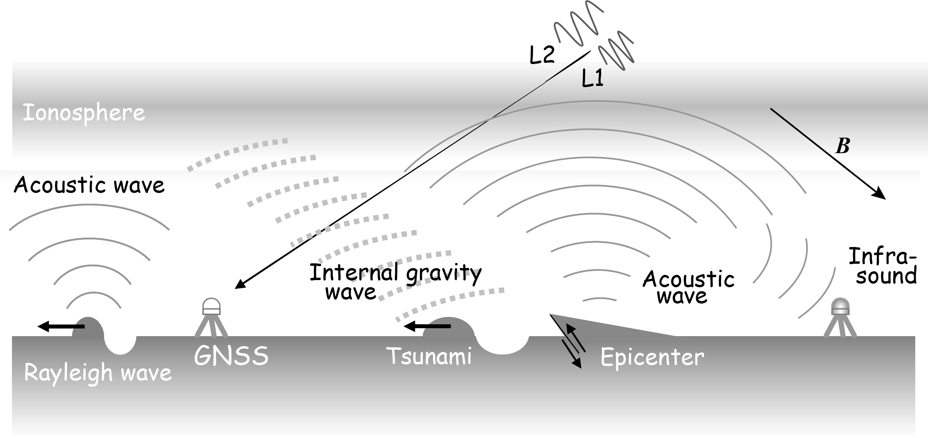
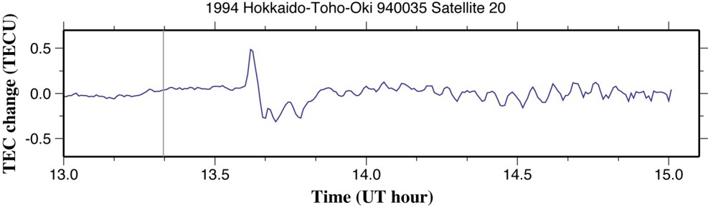
Three different atmospheric waves by an earthquake
Internal Gravity Wave (IGW) Periods 10-20 minutes
Velocity 0.2-0.3 km/s
Acoustic Wave (AW) Periods ~4 minutes
Velocity 0.8-1.0 km/s
Rayleigh Surface Wave (RW)
Periods ~4 minutes
Velocity ~4 km/s
AW pulse amplitude reflects M_{w}

Slide 4
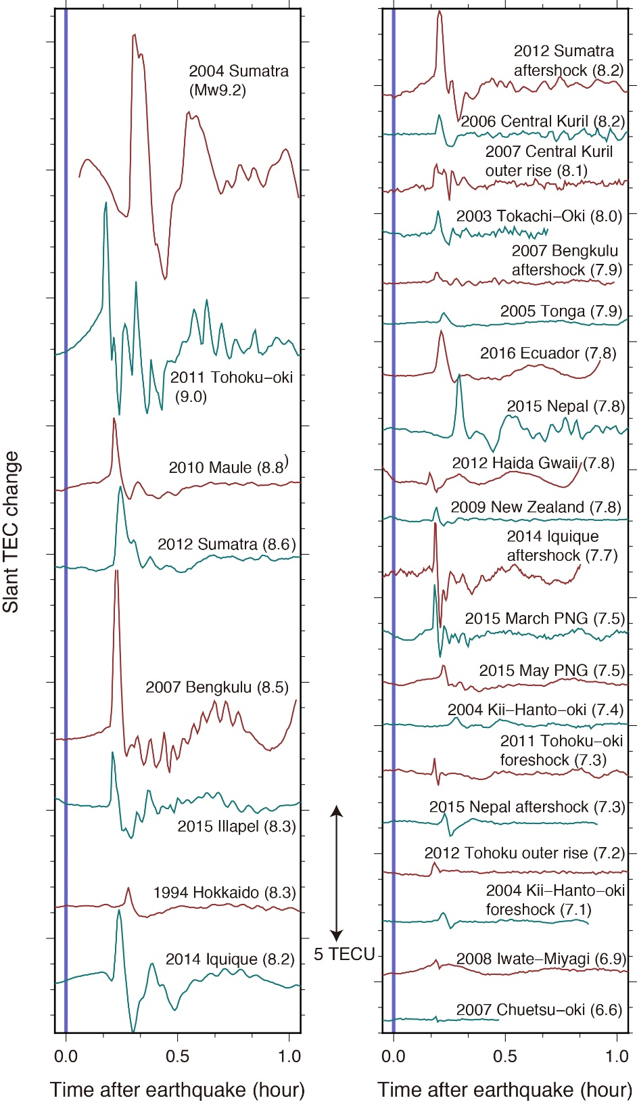
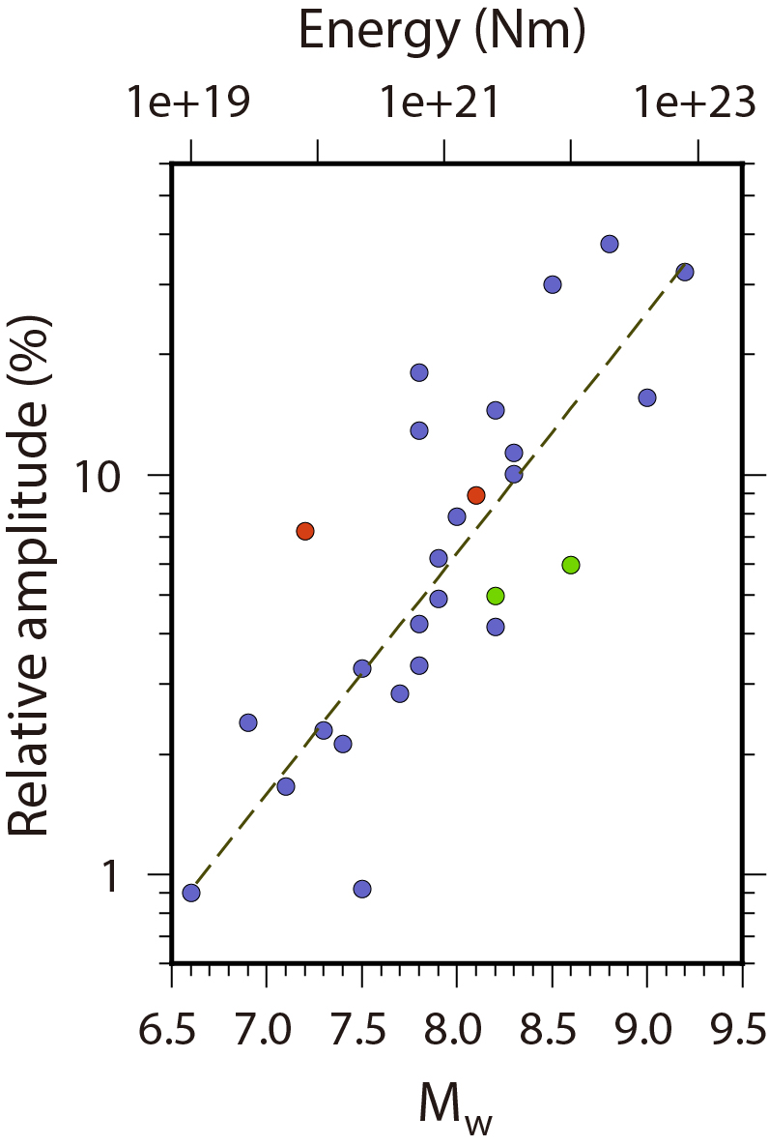
AW amplitudes and M_{w} (Heki, 2021)
How about Internal Gravity Wave (IGW) ?
x4 for M_{w}+1

Slide 5
How do the three waves appear in time-distance diagram?
ΔTEC
near
Rayleigh Wave
(RW)
Acoustic Wave (AW)
Slope indicates propagation velocity
Distance
ΔTEC
t
high
middle
RW AW IGW
far
Internal Gravity Wave (IGW)
t
Wavelet transformation
far
middle
low
8-10 min.
near
Time to reach ionosphere
t
0
t
20-30 min.

Slide 6
Different wavelets isolate different components

Slide 7
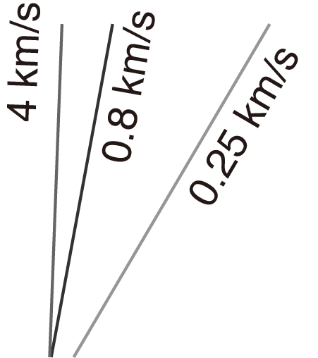
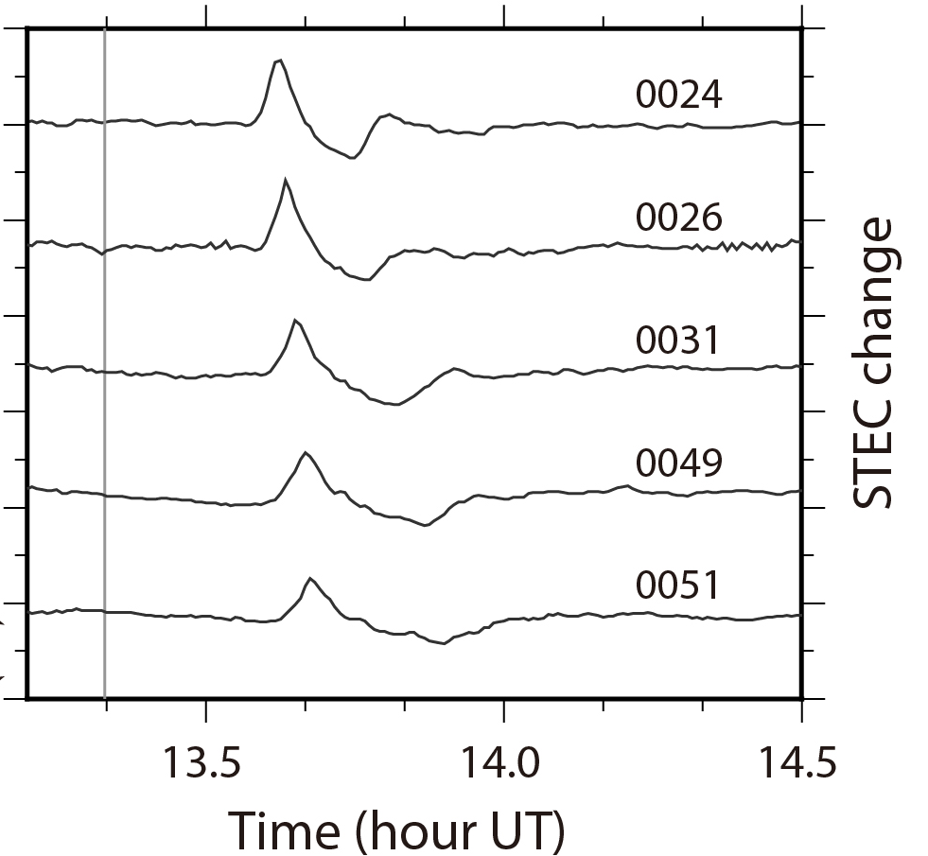
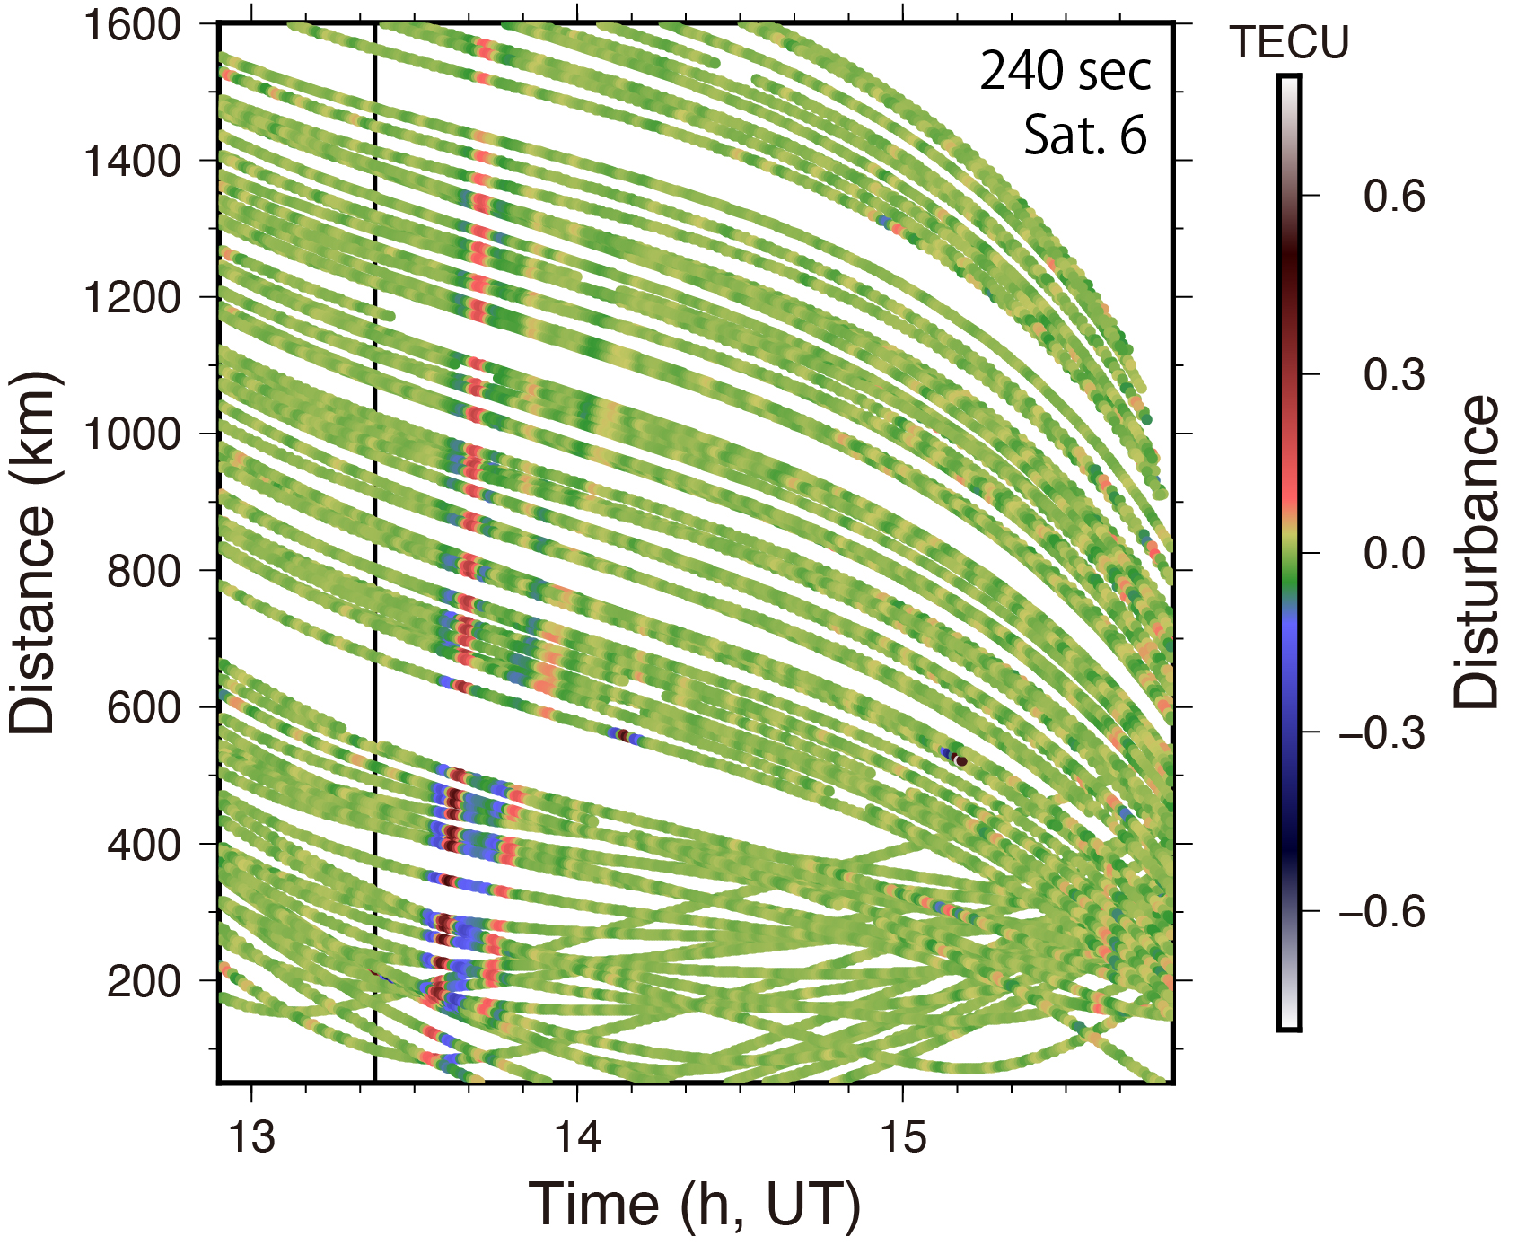
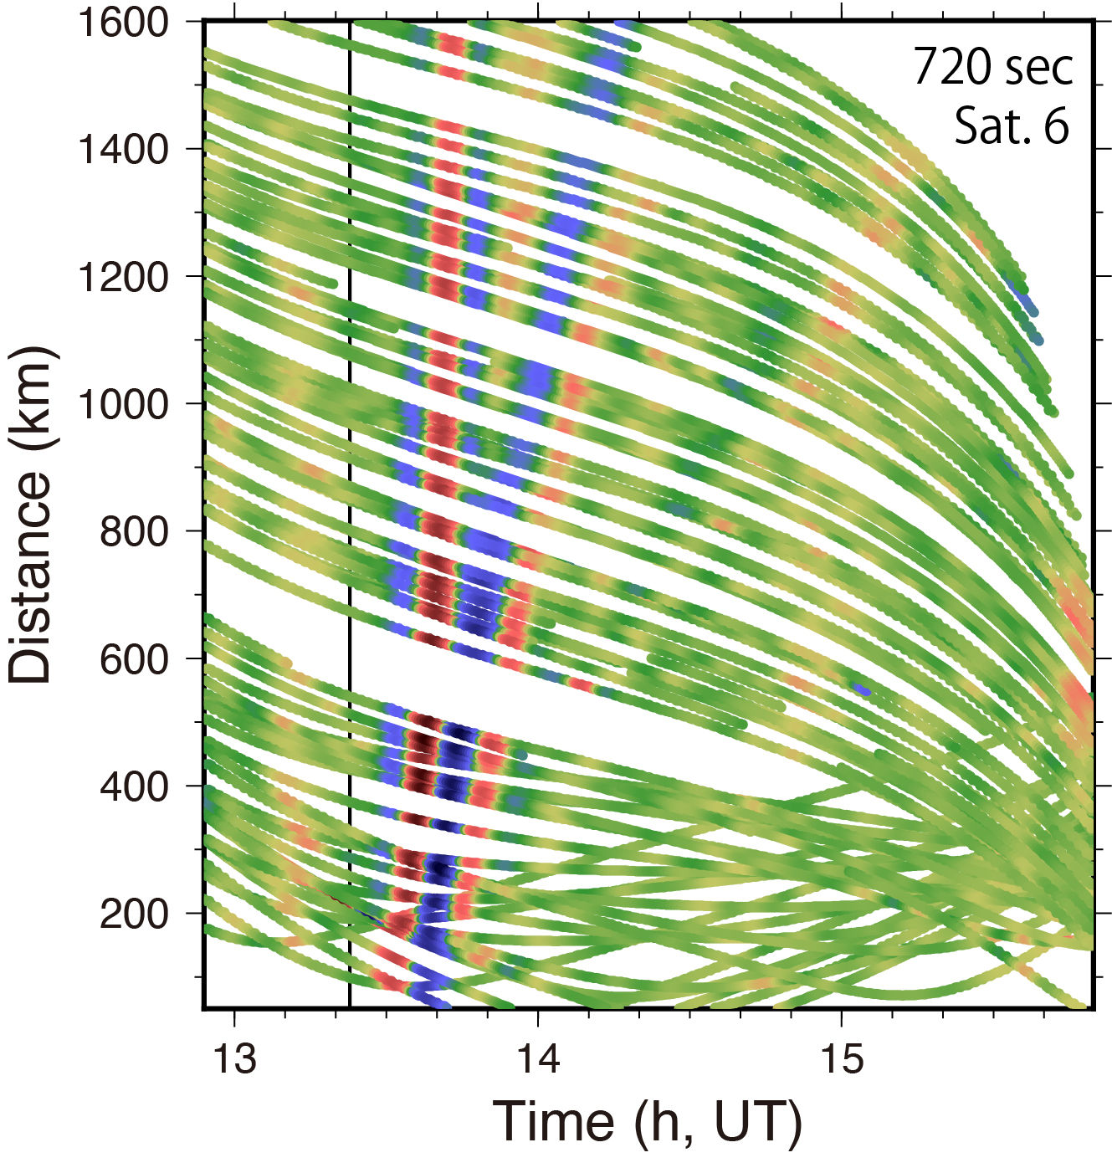
Short-period (4 min.) components (AW)
Long-period (12 min.) components (IGW)
Eq.
IGW
Three waves in the 1994 Hokkaido-toho-oki (M_{w}8.3) eq.

Slide 8
We compare AW and IGW amplitudes
Regular earthquake
Tsunami earthquake
AW
AW
IGW
IGW
Weak IGW
Strong IGW

Slide 9
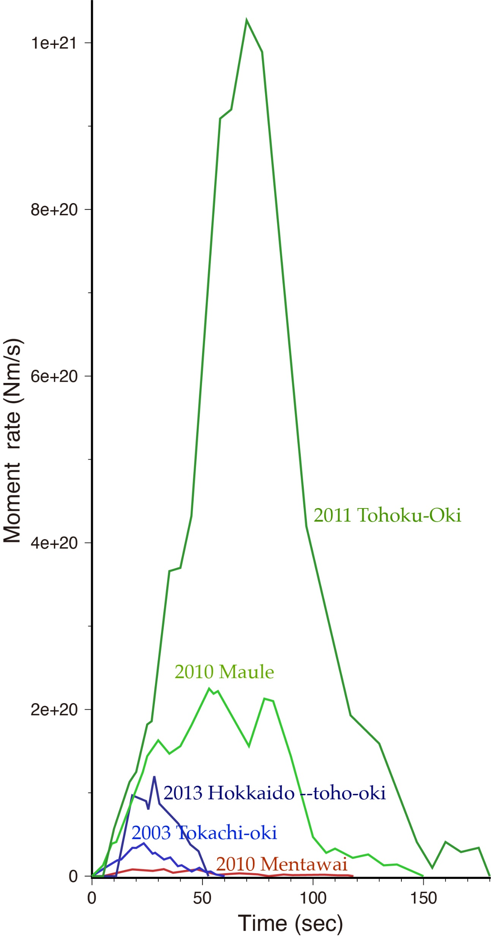
Five earthquakes with both AG/IGW signatures
Source time functions
1994 Hokkaido (Mw8.3)
2003 Tokachi-oki (Mw8.0)
2011 Tohoku-oki (Mw9.0)
2010 Mentawai (Mw7.9)
Tsunami earthquake
2010 Maule (Mw8.8)

Slide 10
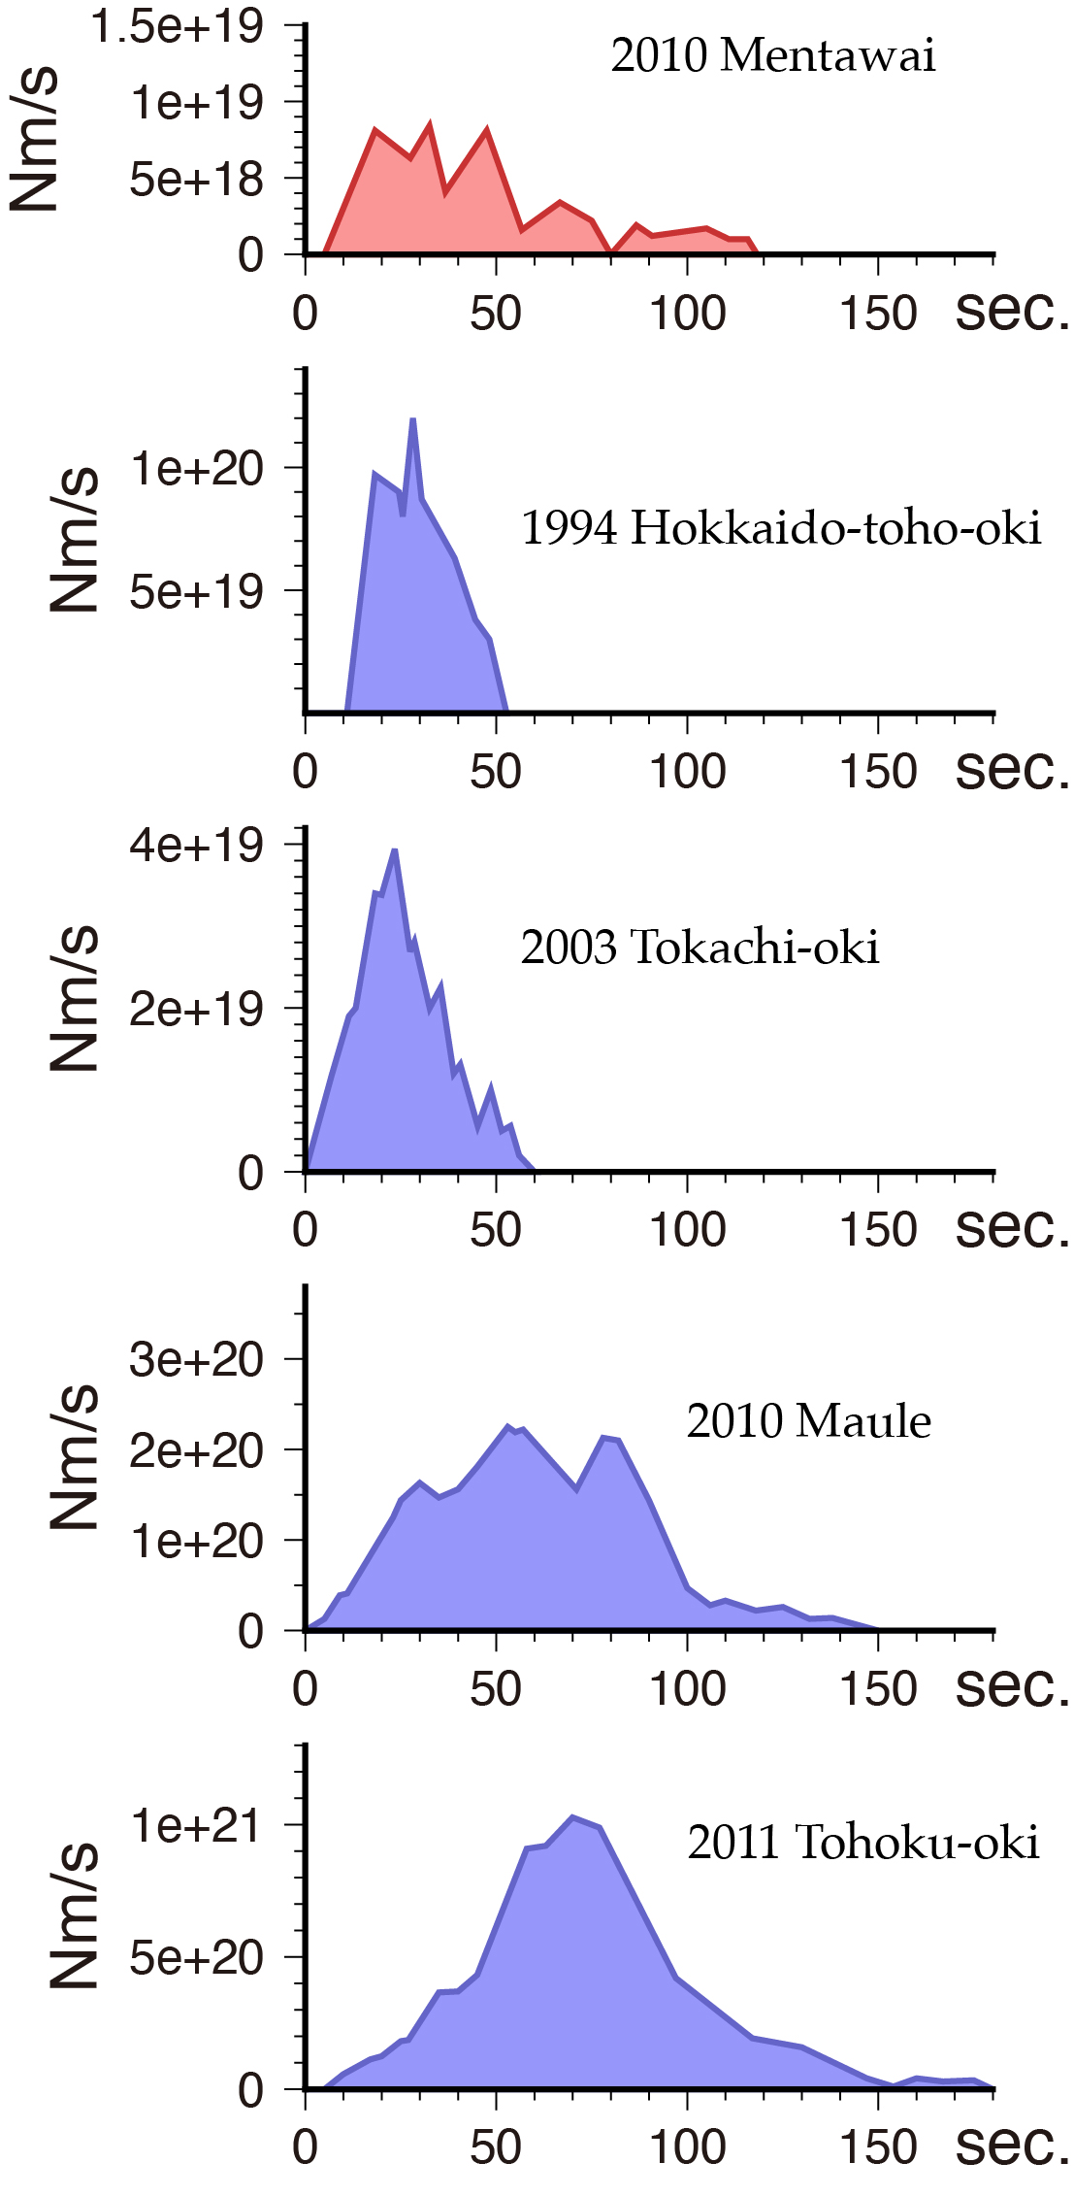
Five earthquakes with both AG/IGW signatures
~50 sec
~50 sec
1994 Hokkaido (Mw8.3)
2003 Tokachi-oki (Mw8.0)
2011 Tohoku-oki (Mw9.0)
~150 sec
~150 sec
2010 Mentawai (Mw7.9)
Tsunami earthquake
>100 sec!
2010 Maule (Mw8.8)

Slide 11
Let us see one by one

Slide 12
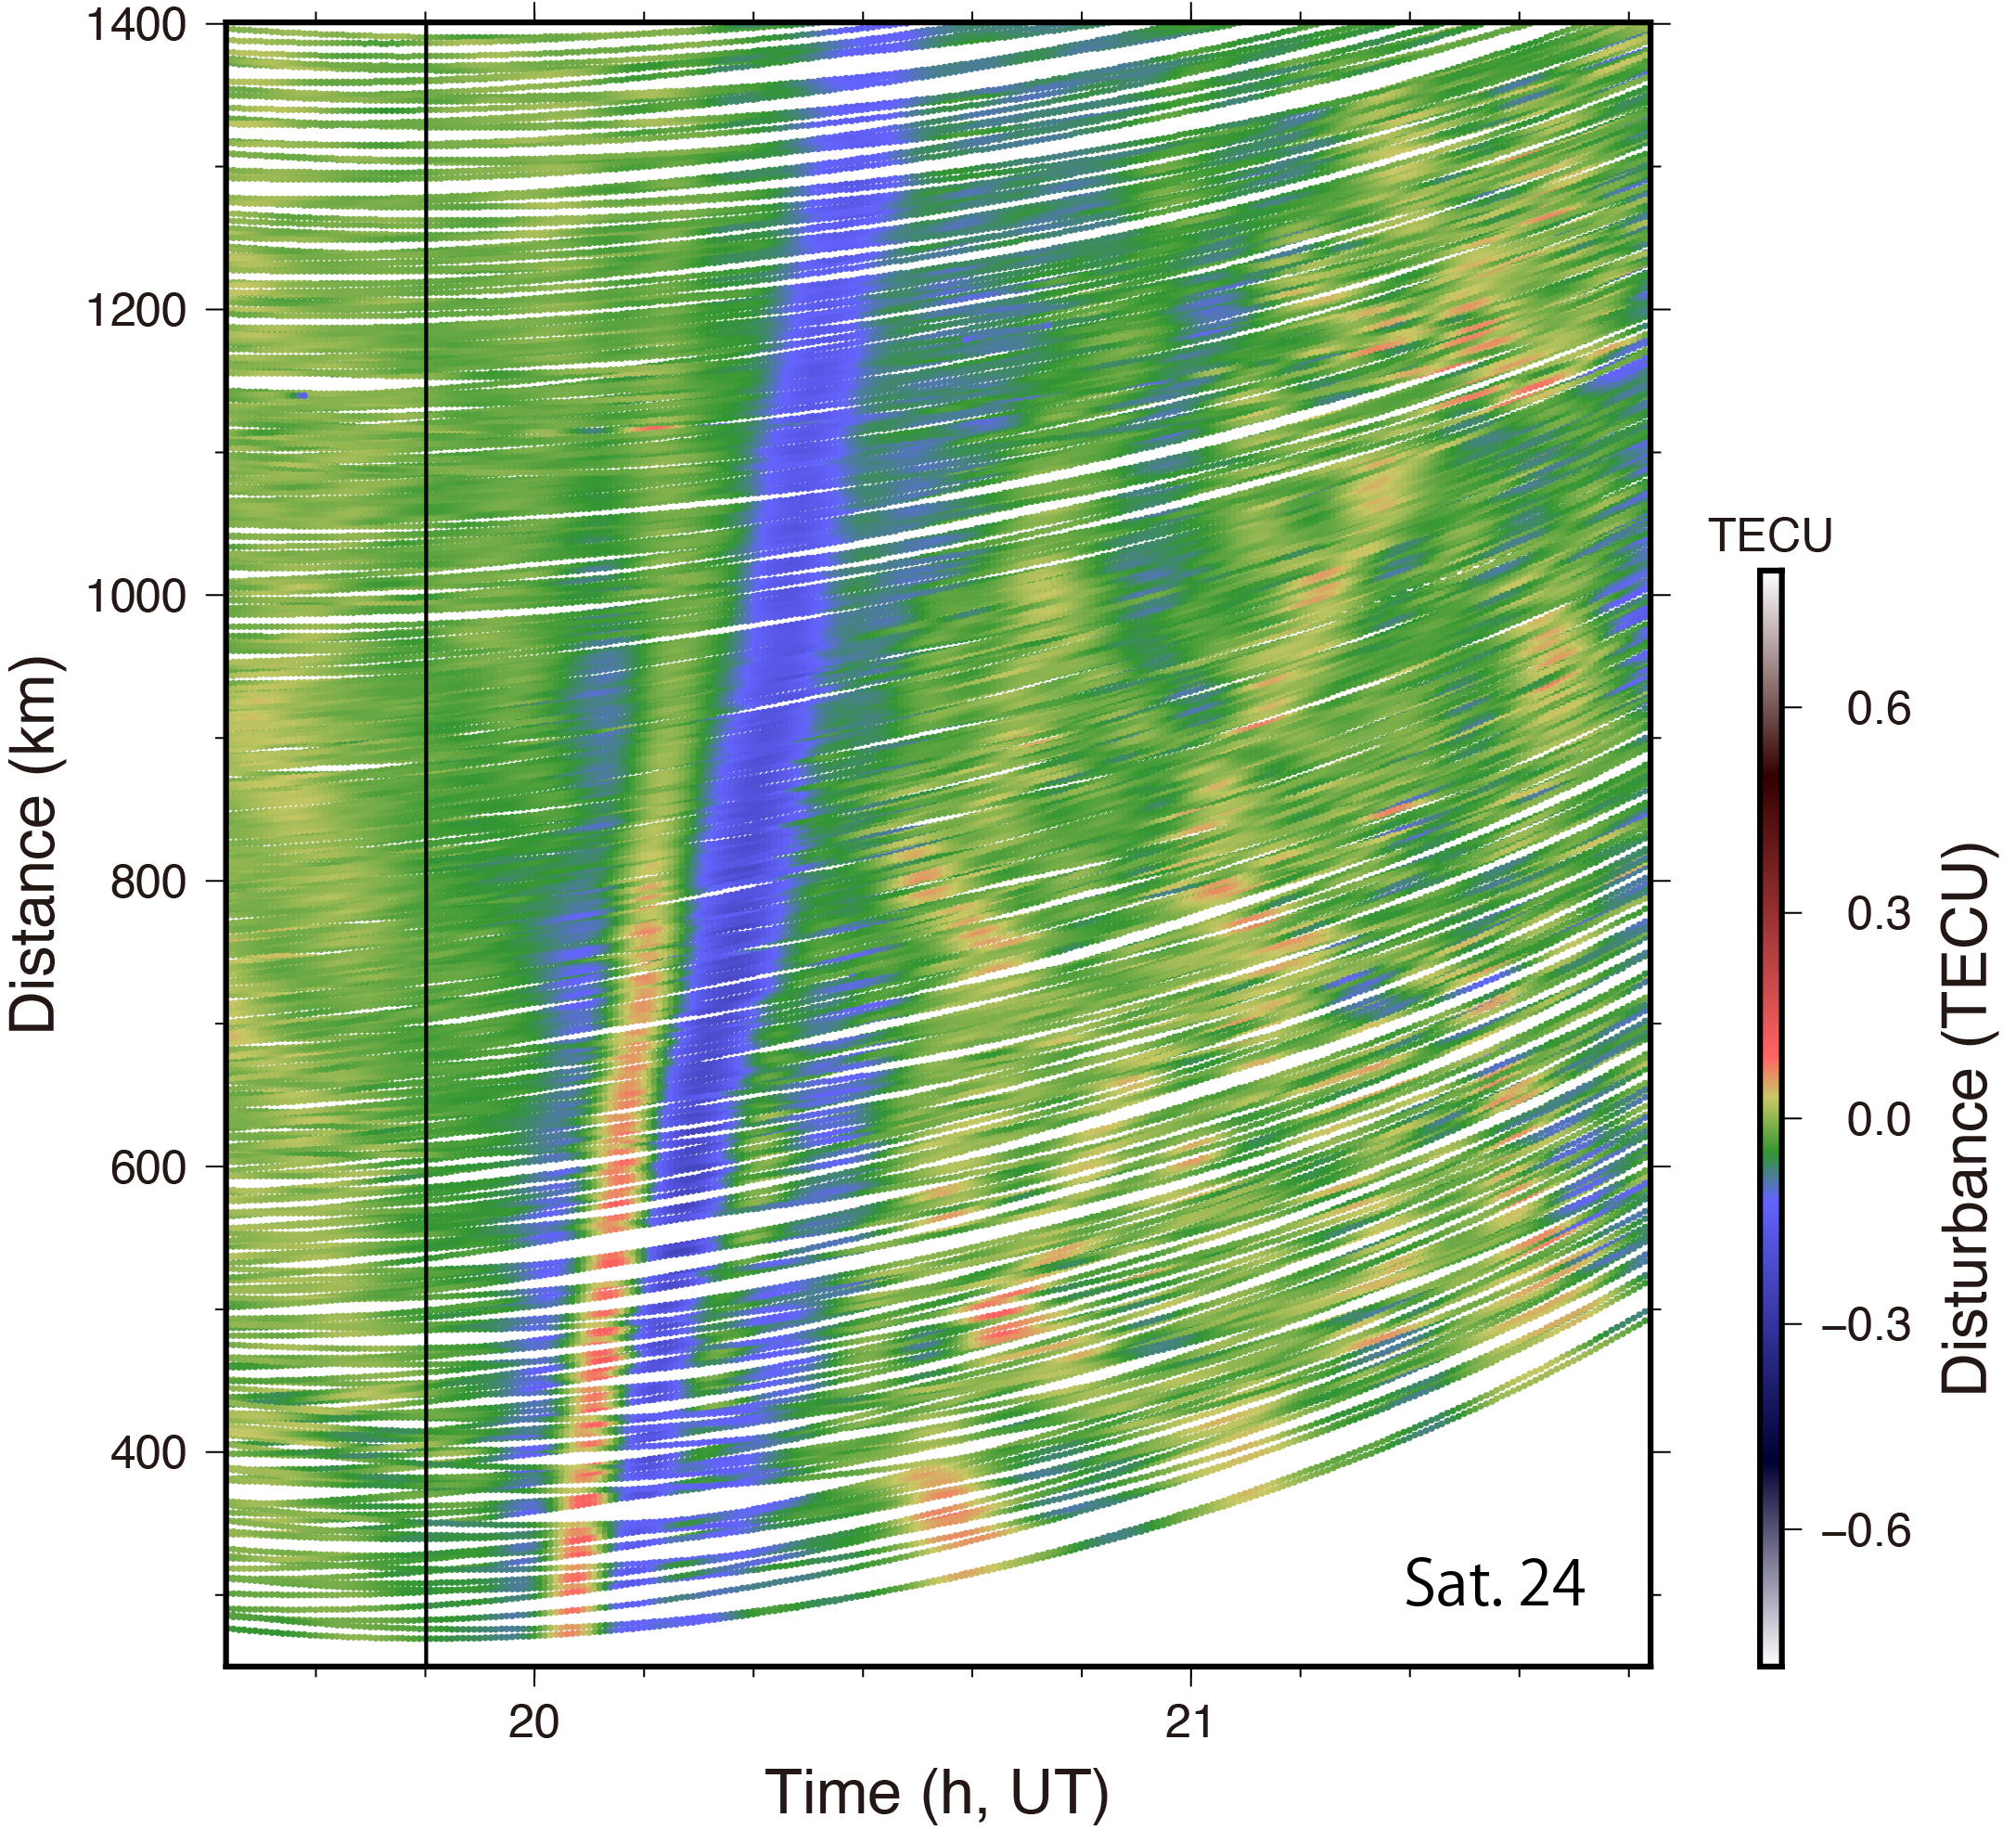
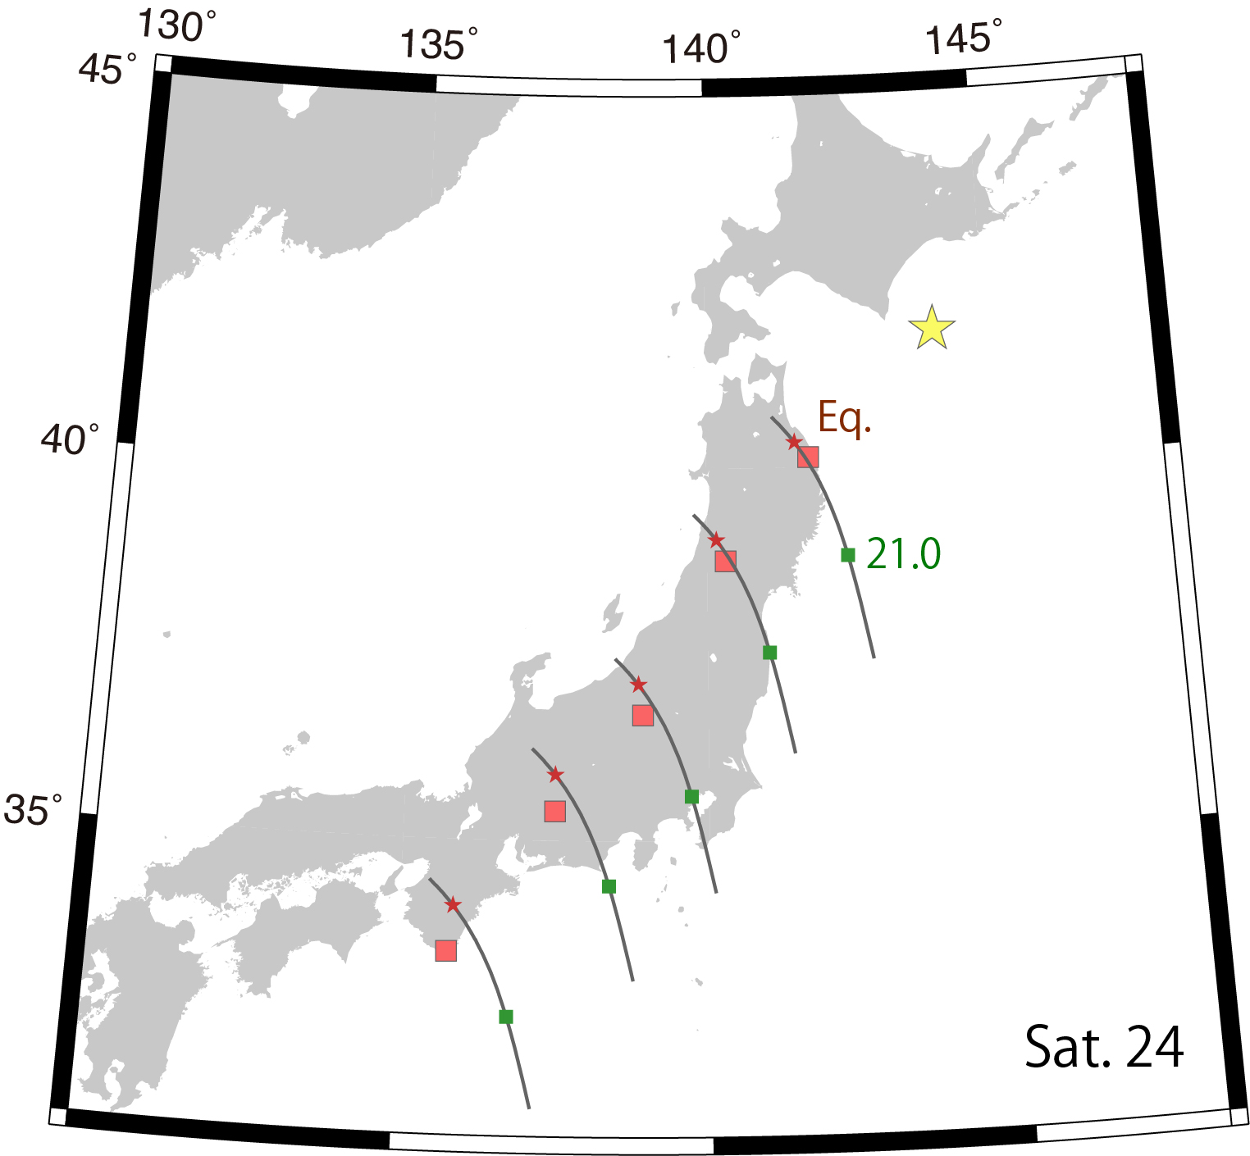

2003 Tokachi-Oki eq. (M_{w}8.0)
IGW
~50 sec
IGW amplitude: 0.031±0.001 TECU
(TECU=${10}^{16}el/m^{2})$

Slide 13
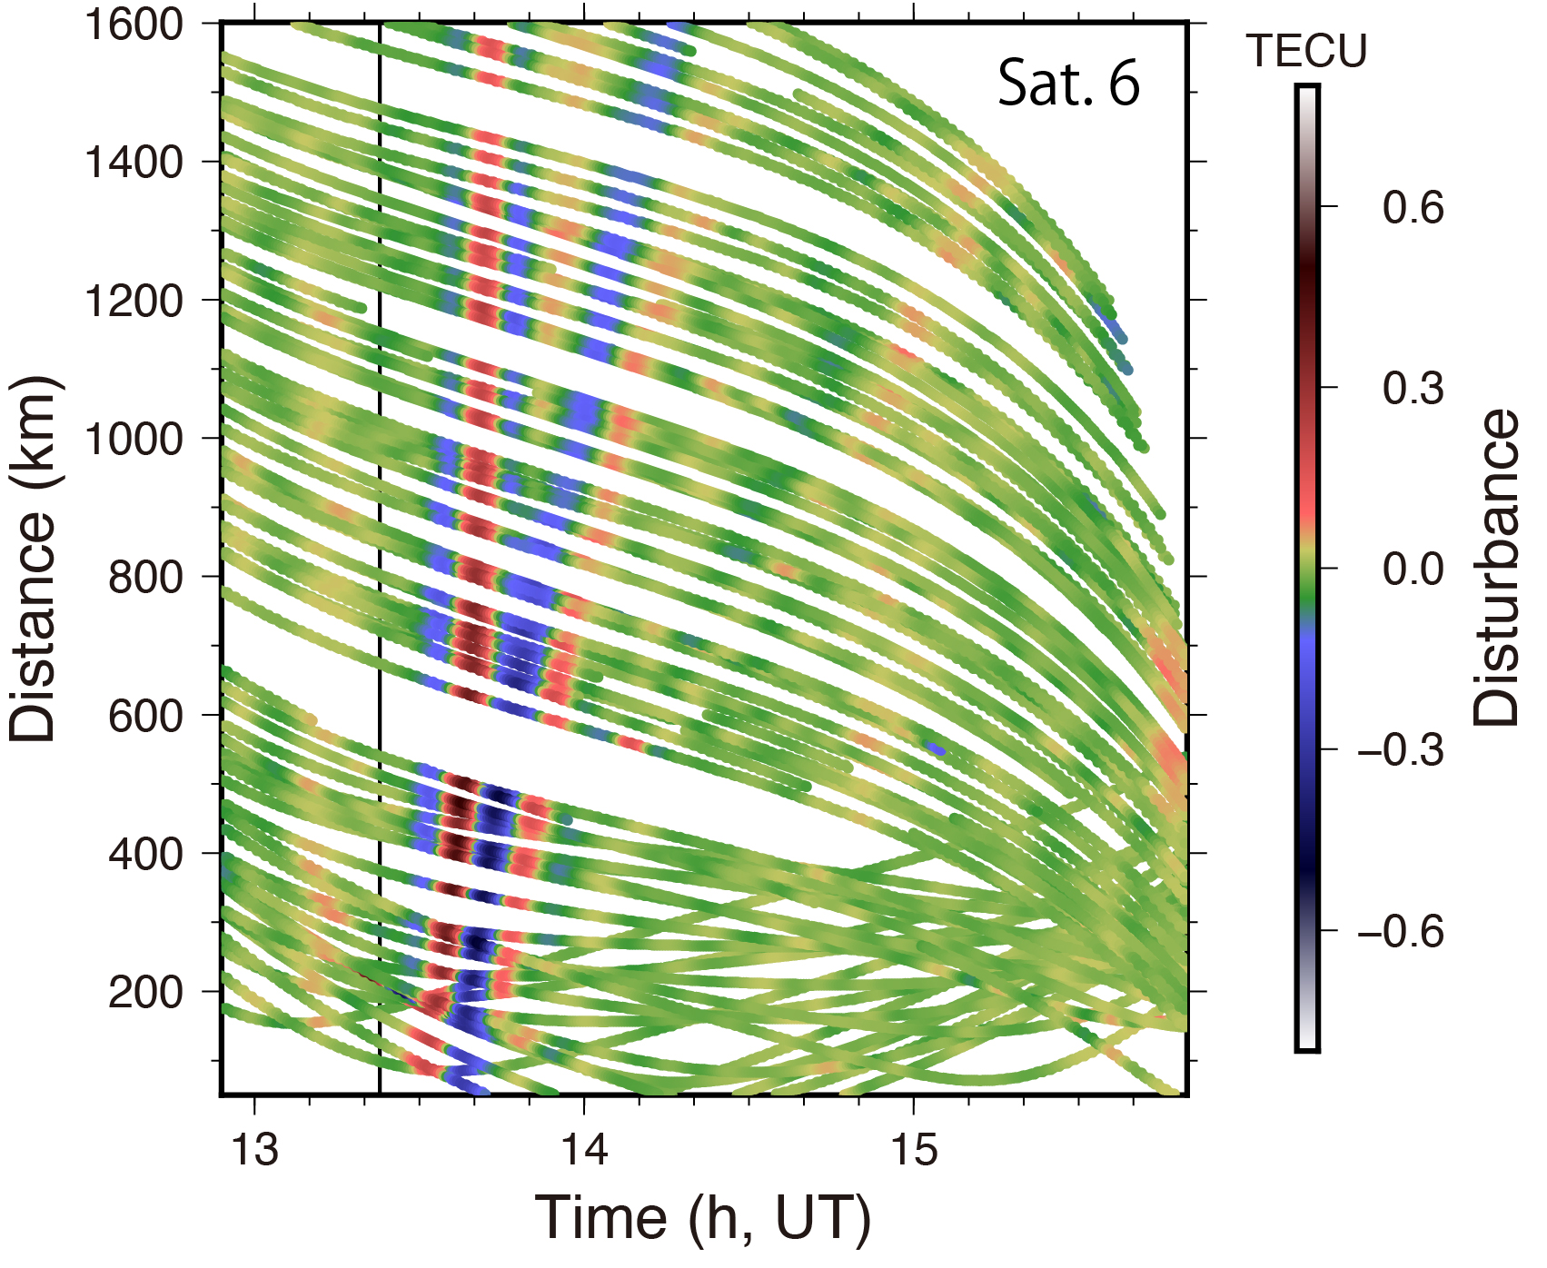
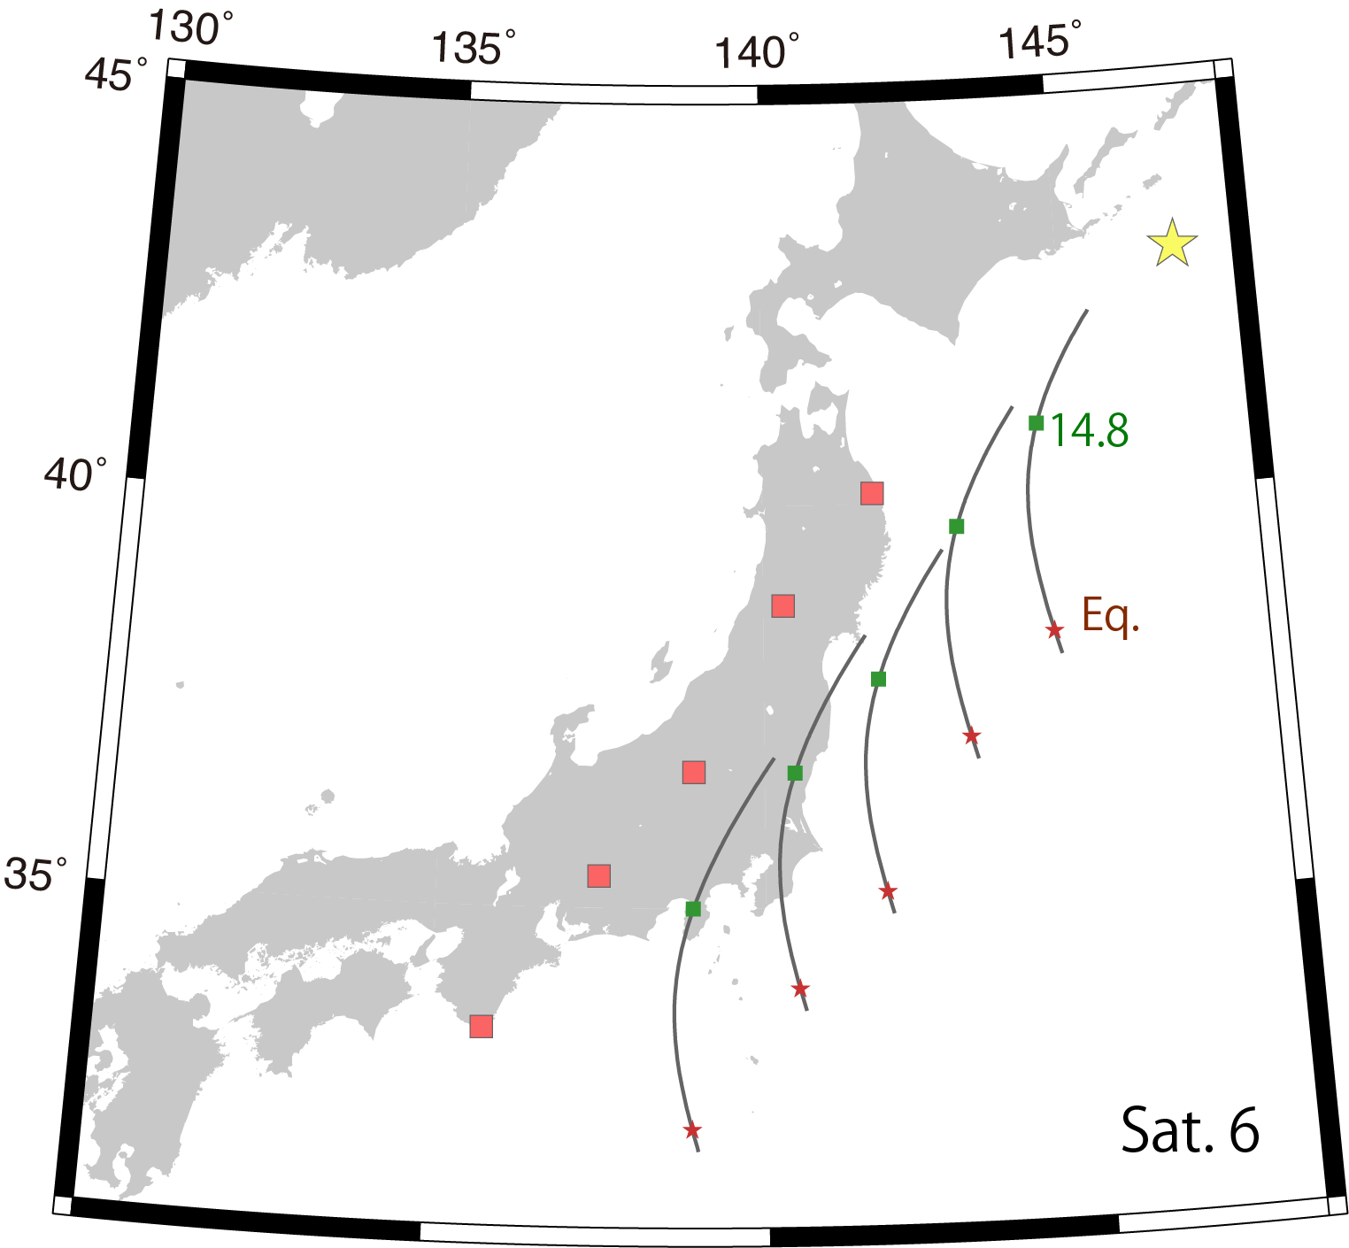
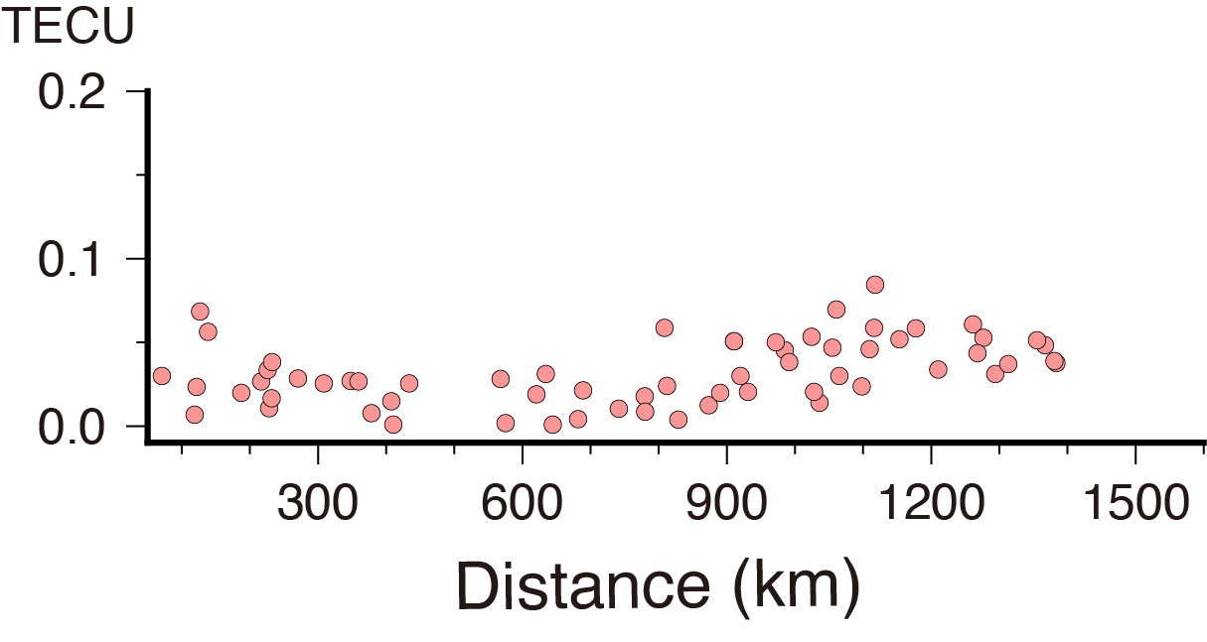
1994 Hokkaido-Toho-Oki eq. (M_{w}8.3)
~50 sec
IGW
Average 0.032 TECU
IGW Amplitude : 0.032±0.002 TECU

Slide 14
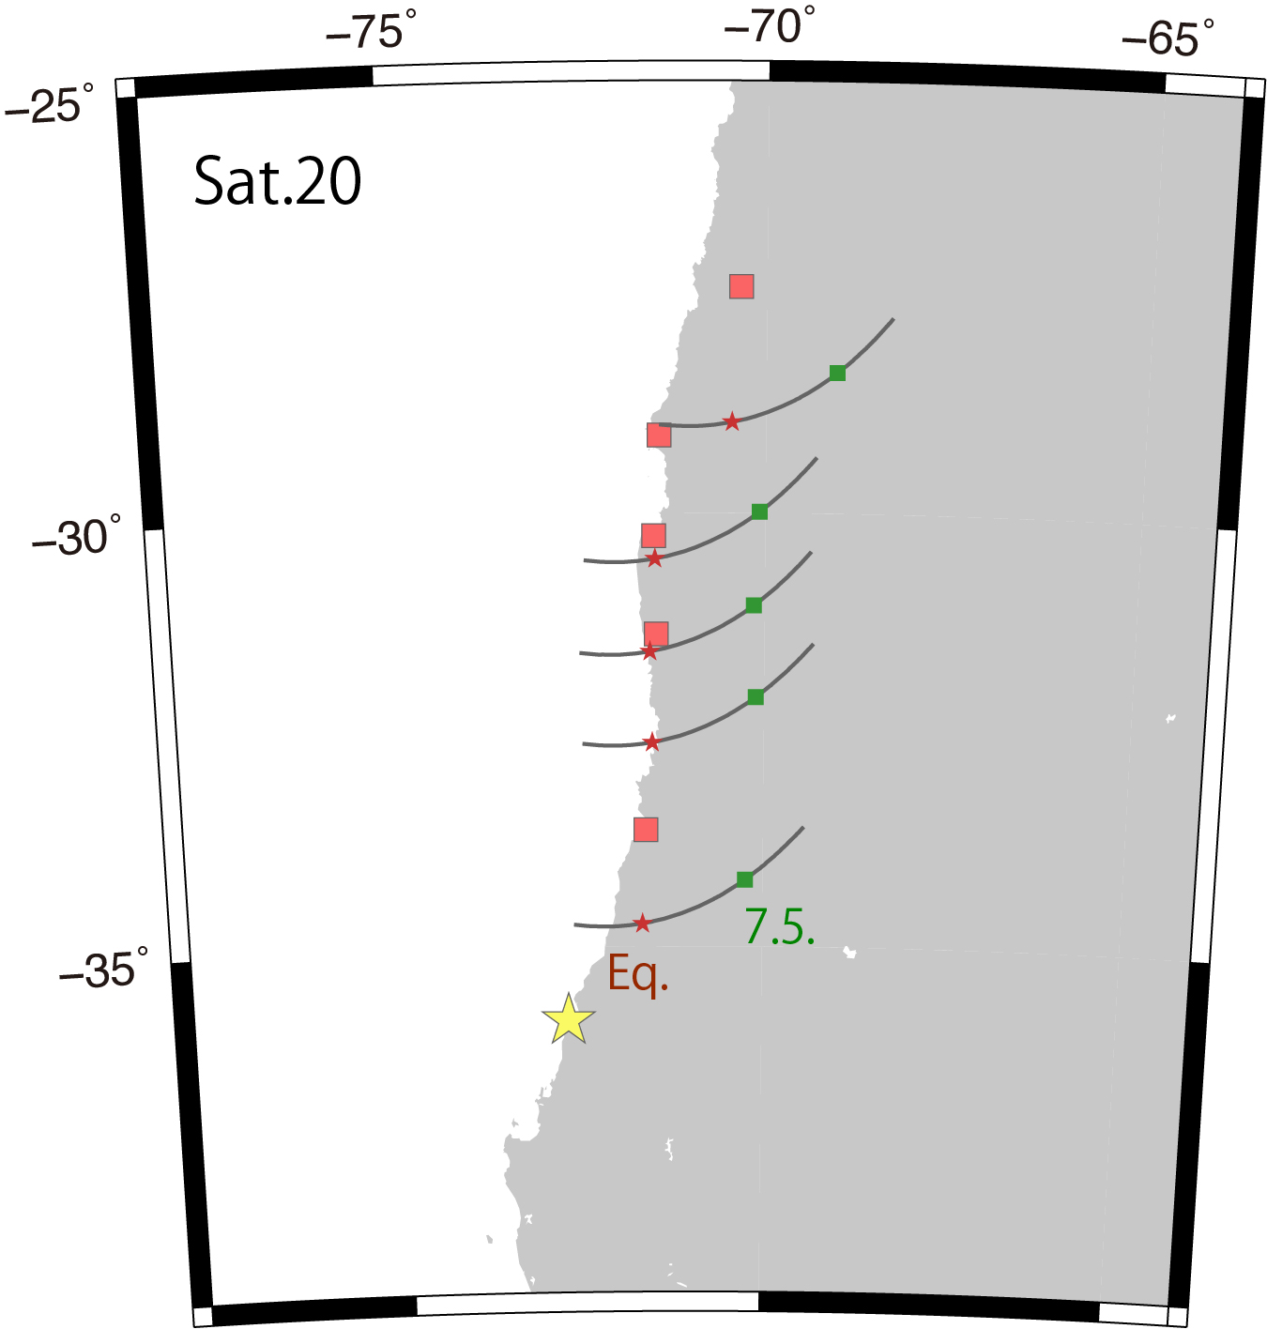
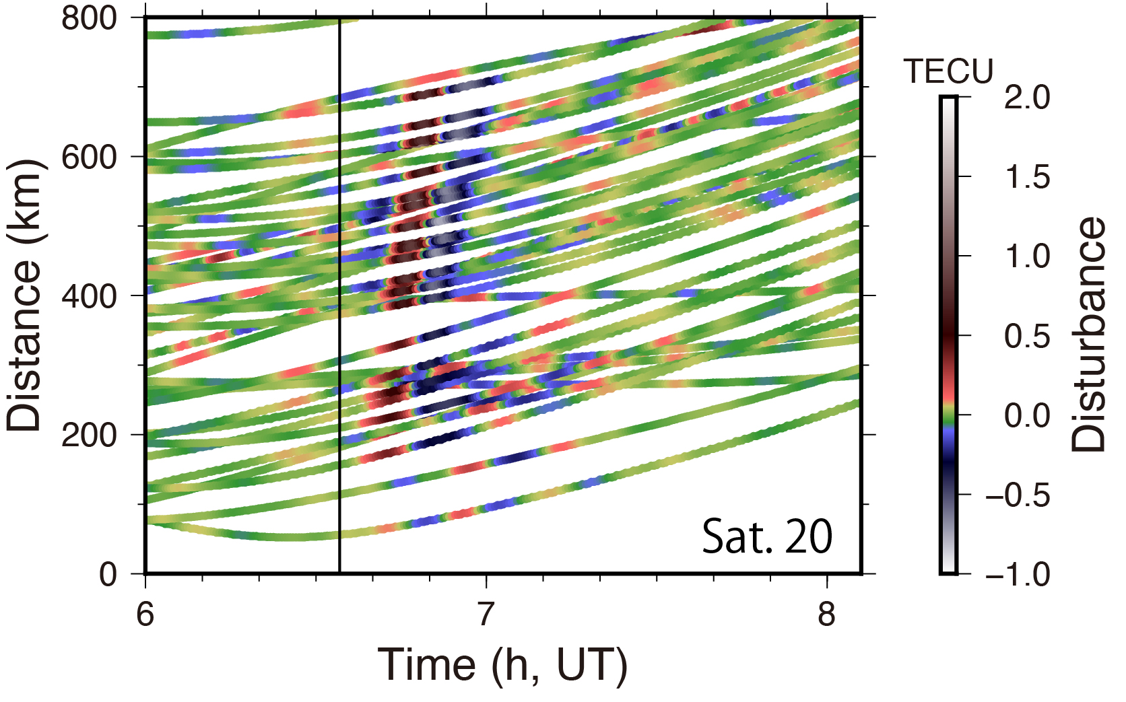
2010 Maule eq. (M_{w}8.8)
Stronger IGW signature!
IGW
~150 sec
IGW amplitude: 0.103±0.012 TECU

Slide 15
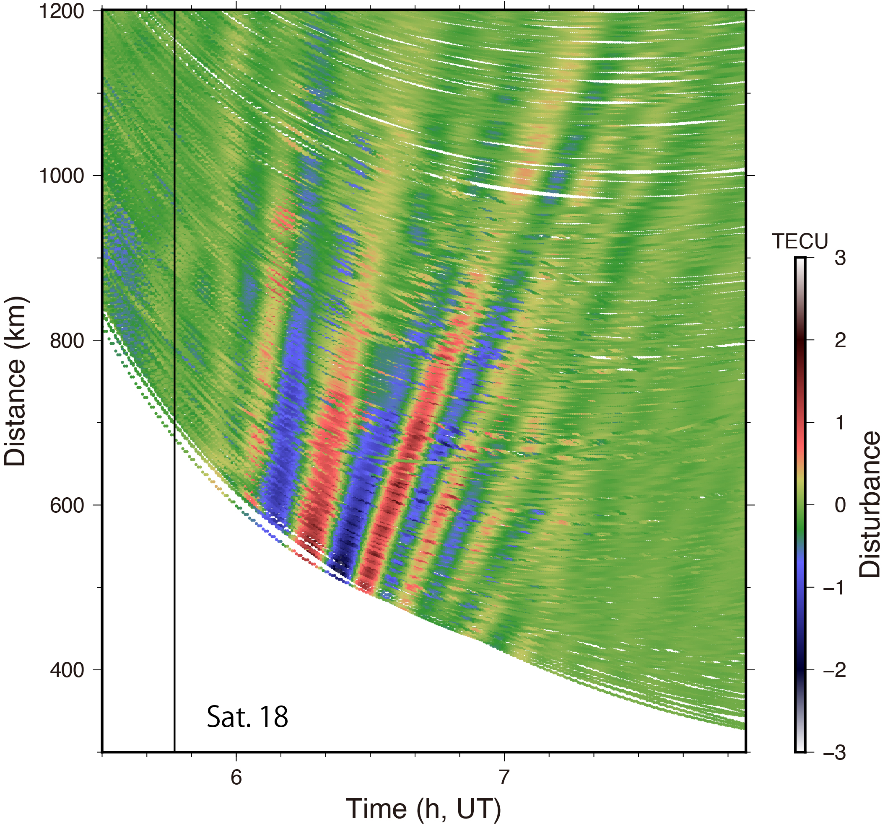
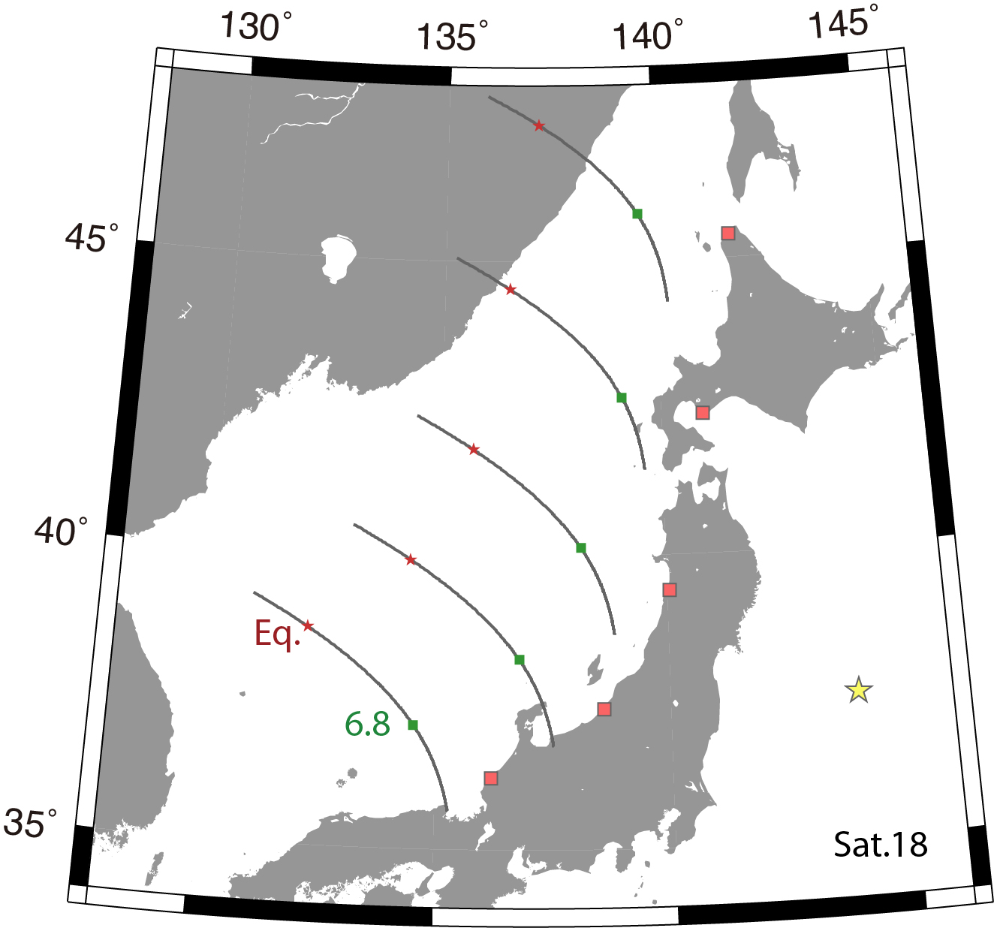
Strong IGW signature!
2011 Tohoku-Oki eq. (M_{w}9.0)
True IGW
IGW excited by AW reaching ionosphere
~150 sec
IGW amplitude: 0.529± 0.011 TECU

Slide 16
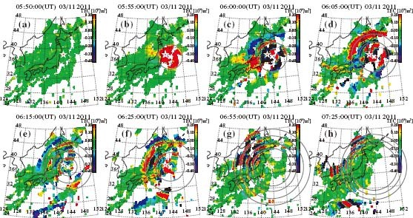
IGW made beautiful concentric wavefronts (Tsugawa et al., 2011)
5 min
10 min
15 min
20 min
30 min
40 min
70 min
100 min

Slide 17
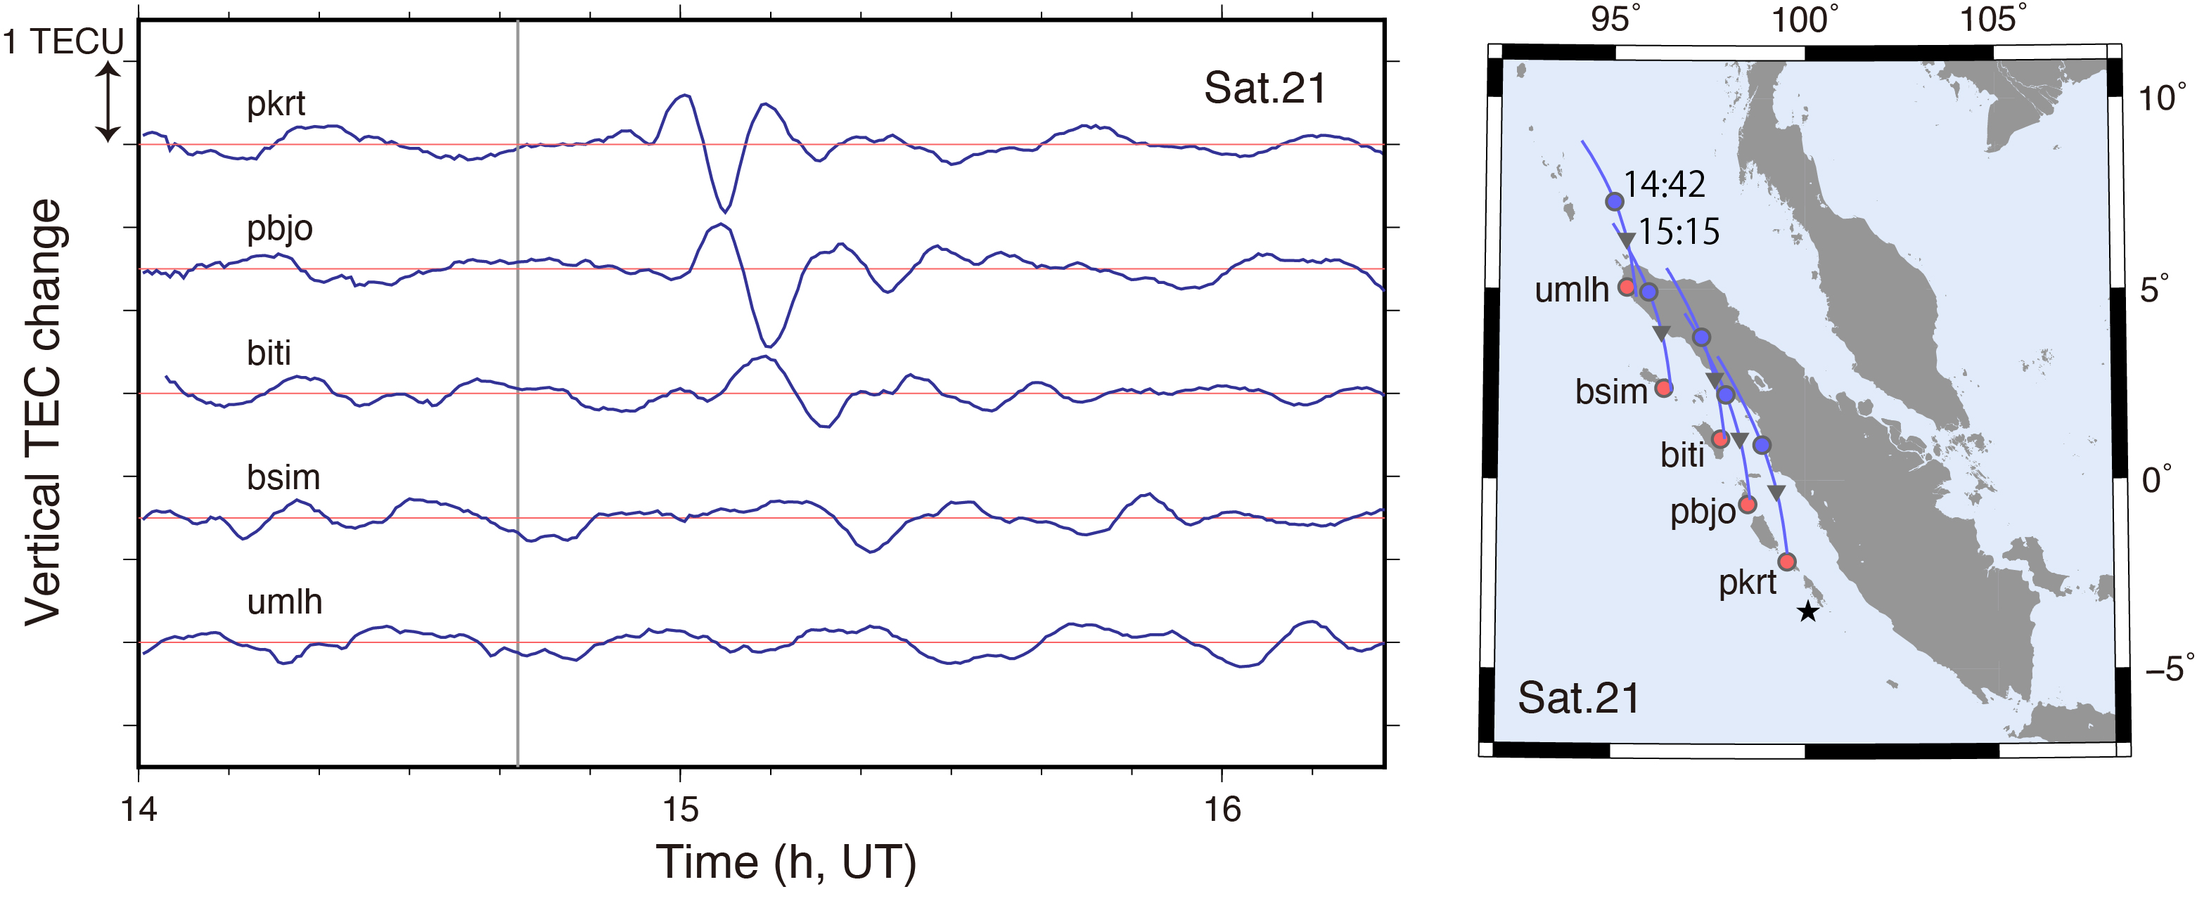
2010 Mentawai earthquake (M_{w}7.9): AW/IGW propagation
AW
IGW

Slide 18
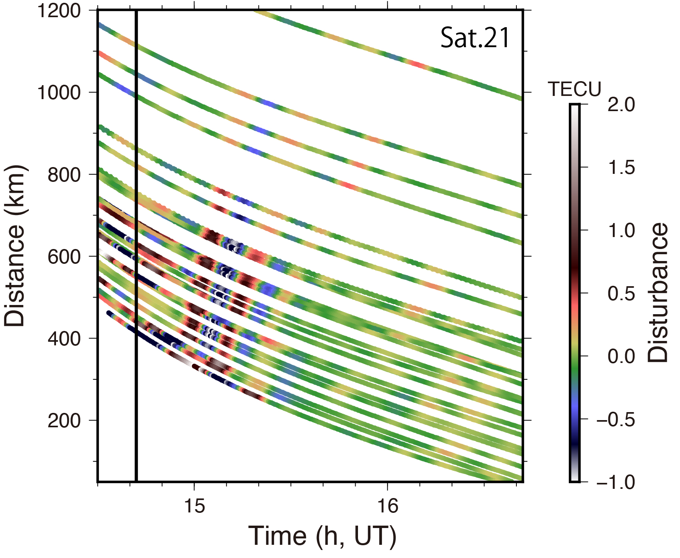
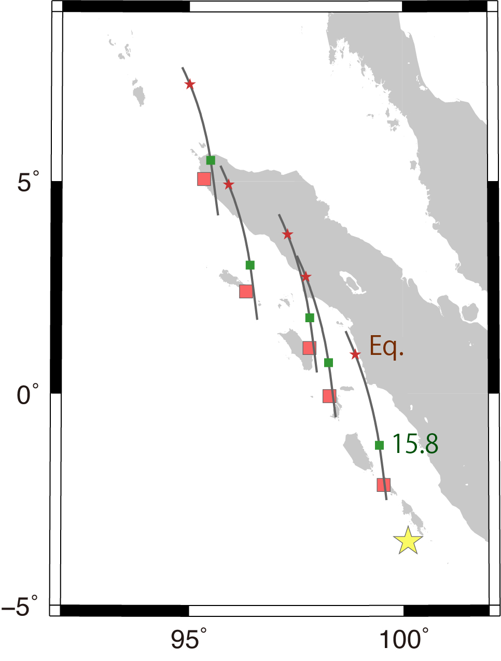
2010 Mentawai earthquake (M_{w}7.9)
Too strong IGW for M_{w}7.9
>100 sec
IGW
IGW amplitude: 0.241±0.042 TECU

Slide 19
Let us compare their AW/IGW amplitudes

Slide 20
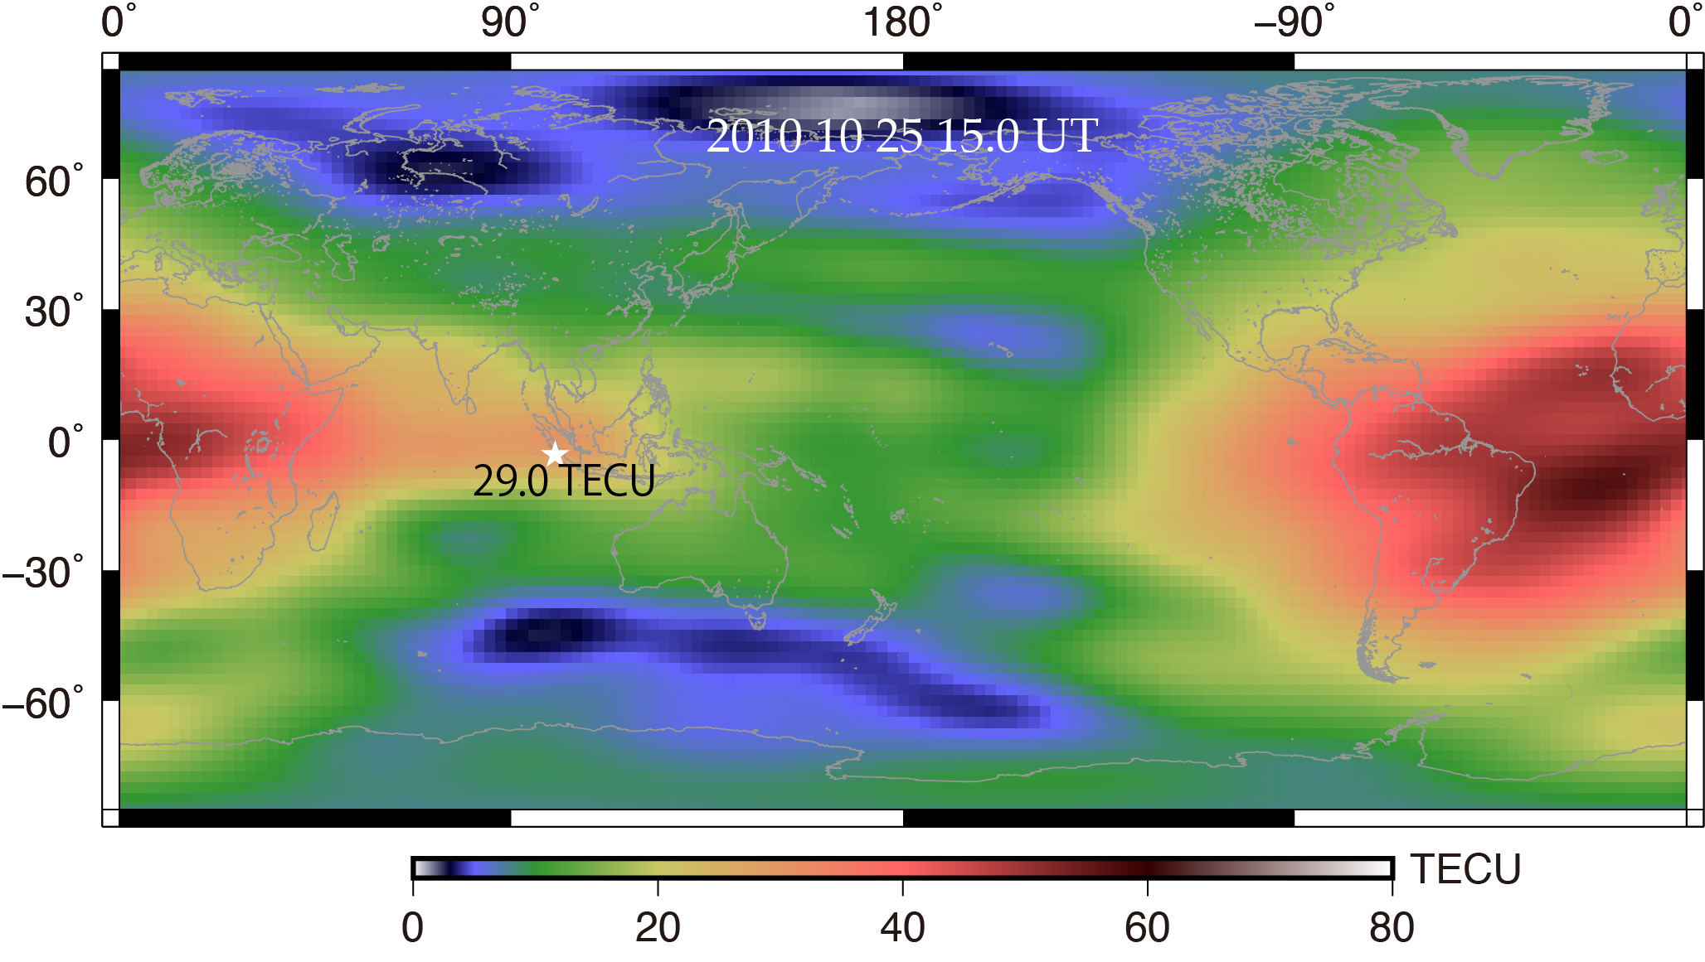
AW Amplitude of five earthquakes relative to background
Maule
Tohoku-oki
1994 Hokkaido (Mw8.3)
2003 Tokachi-oki (Mw8.0)
Mentawai
Tokachi-oki
2011 Tohoku-oki (Mw9.0)
Hokkaido-toho-oki
2010 Mentawai (Mw7.9)
AW amplitudes are just normal
Tsunami earthquake
x4 for M_{w}+1
2010 Maule (Mw8.8)

Slide 21
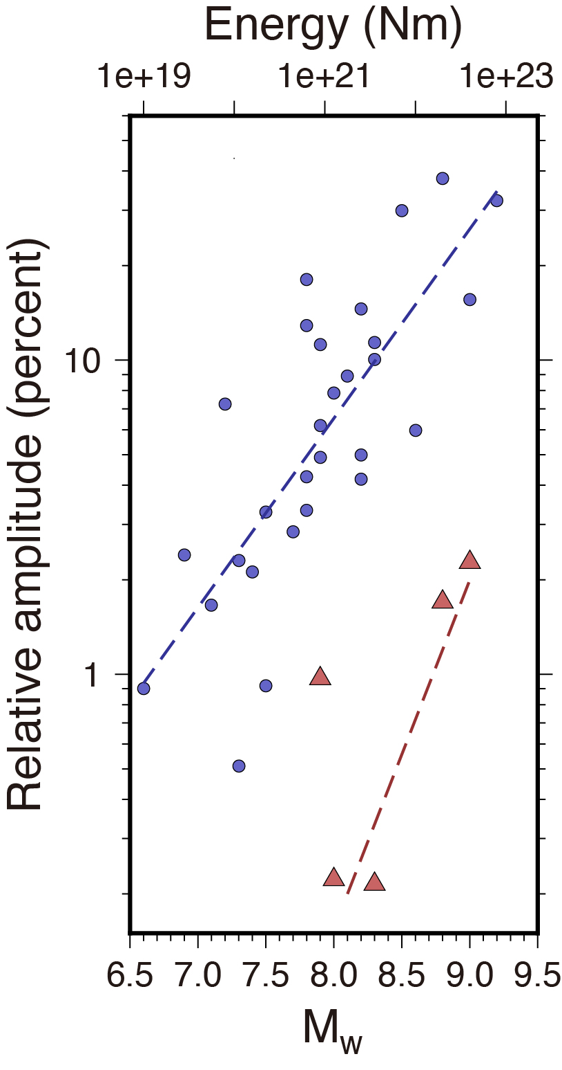
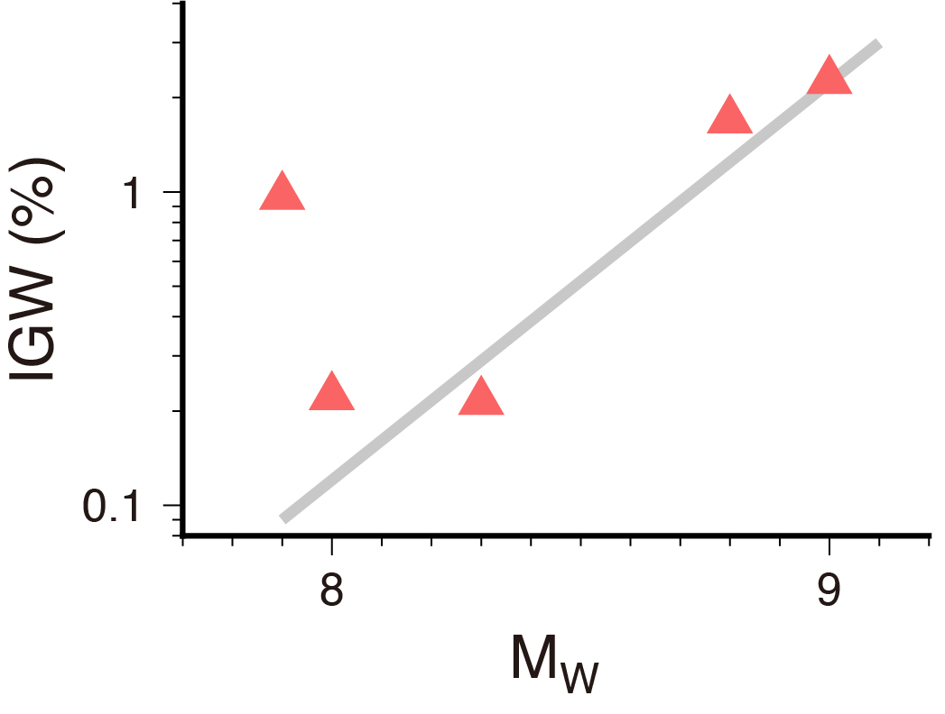
IGW Amplitude of five earthquakes relative to background
Tohoku-oki
Mentawai
Maule
1994 Hokkaido (Mw8.3)
2003 Tokachi-oki (Mw8.0)
AW
2011 Tohoku-oki (Mw9.0)
Tokachi-oki
Hokkaido-toho-oki
Mentawai
2010 Mentawai (Mw7.9)
Tsunami earthquake
IGW
IGW by Mentawai eq. anomalously large!
2010 Maule (Mw8.8)

Slide 22
AW amplitudes for M_{w}8 and M_{w}9 events
Fault size and dislocation would matter
M_{w}8 M_{w}9 (x 4)

Slide 23
For IGW, duration of faulting also matters

Slide 24
IGW amplitudes for M_{w}8 and M_{w}9 events
Fault size, dislocation, and time constant would matter
AW
Satake et al. (2012) PAGEOPH
Mentawai
An ordinary eq.
IGW
Slow eq.
M_{w}8 M_{w}9 (x 15)

Slide 25
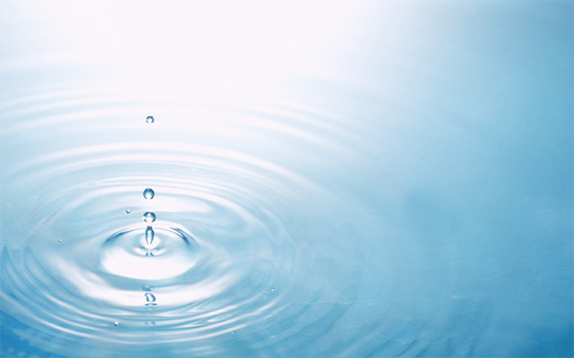
Conclusions
1. Both AW/IGW signatures in ionosphere found in 5 earthquakes
M_{w}7.9, M_{w}8.0, M_{w}8.3, M_{w}8.8, M_{w}9.0
RW AW IGW
2. AW and IGW obey different scaling laws
Reflecting different time constants for faulting
t
10%
3. 2010 Mentawai eq. (Sumatra, Indonesia) is an outlier
Tsunami eq. excites abnormally large IGW
1%
8 9
M_{w}

Slide 26
Thank you for your attention
Thank you for your attention
Thank you for your attention
Thank you for your attention
Thank you for your attention

