Slide 1
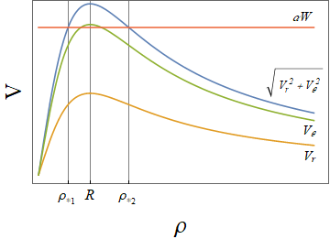
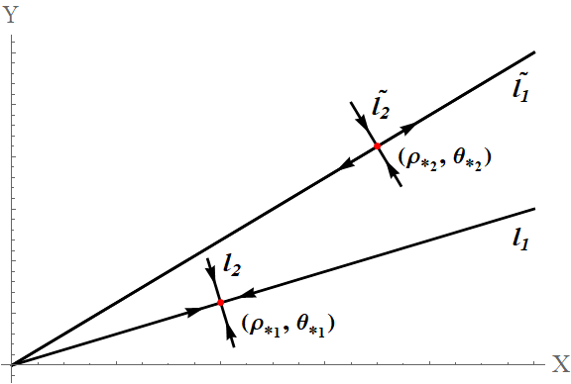

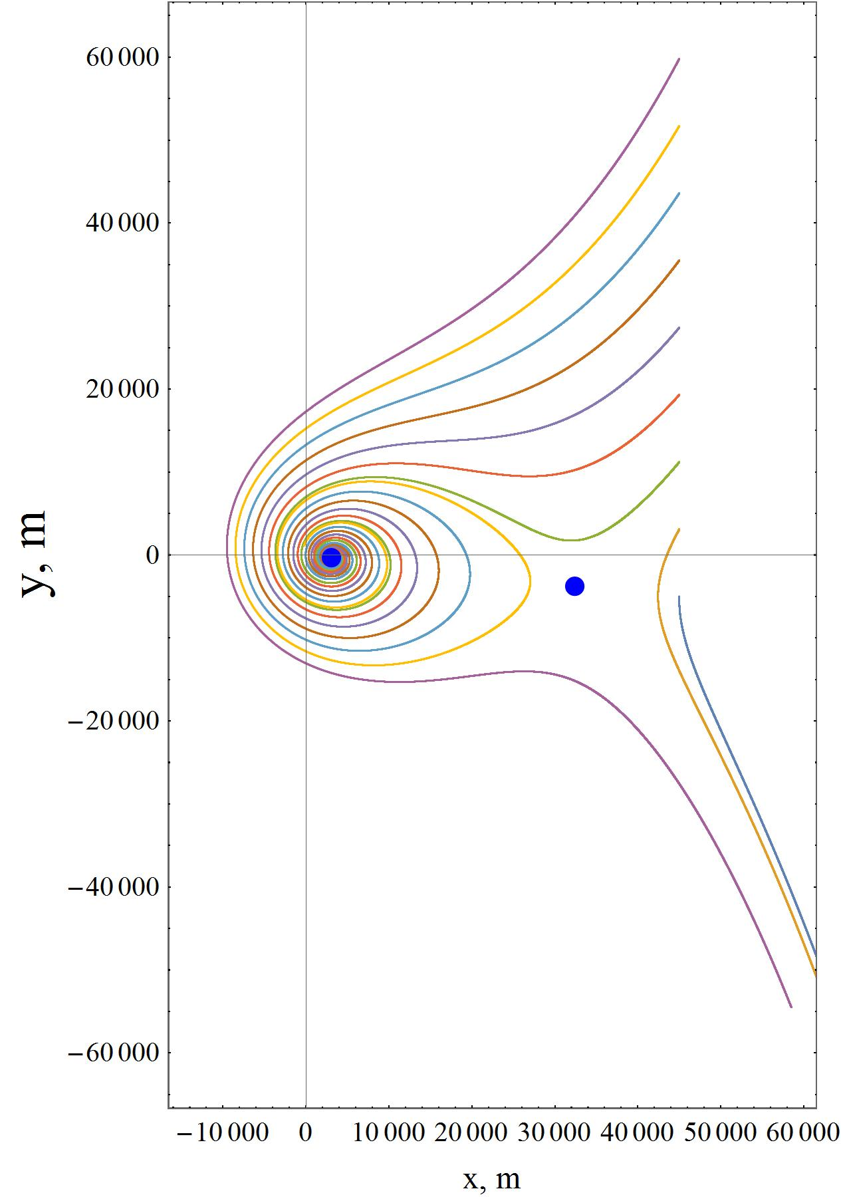
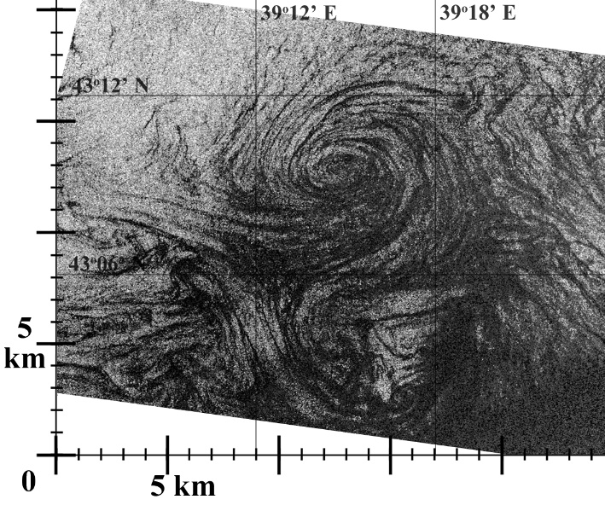


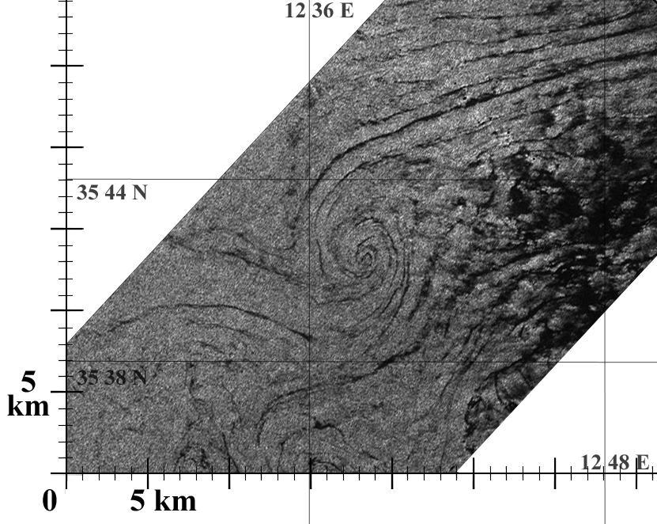
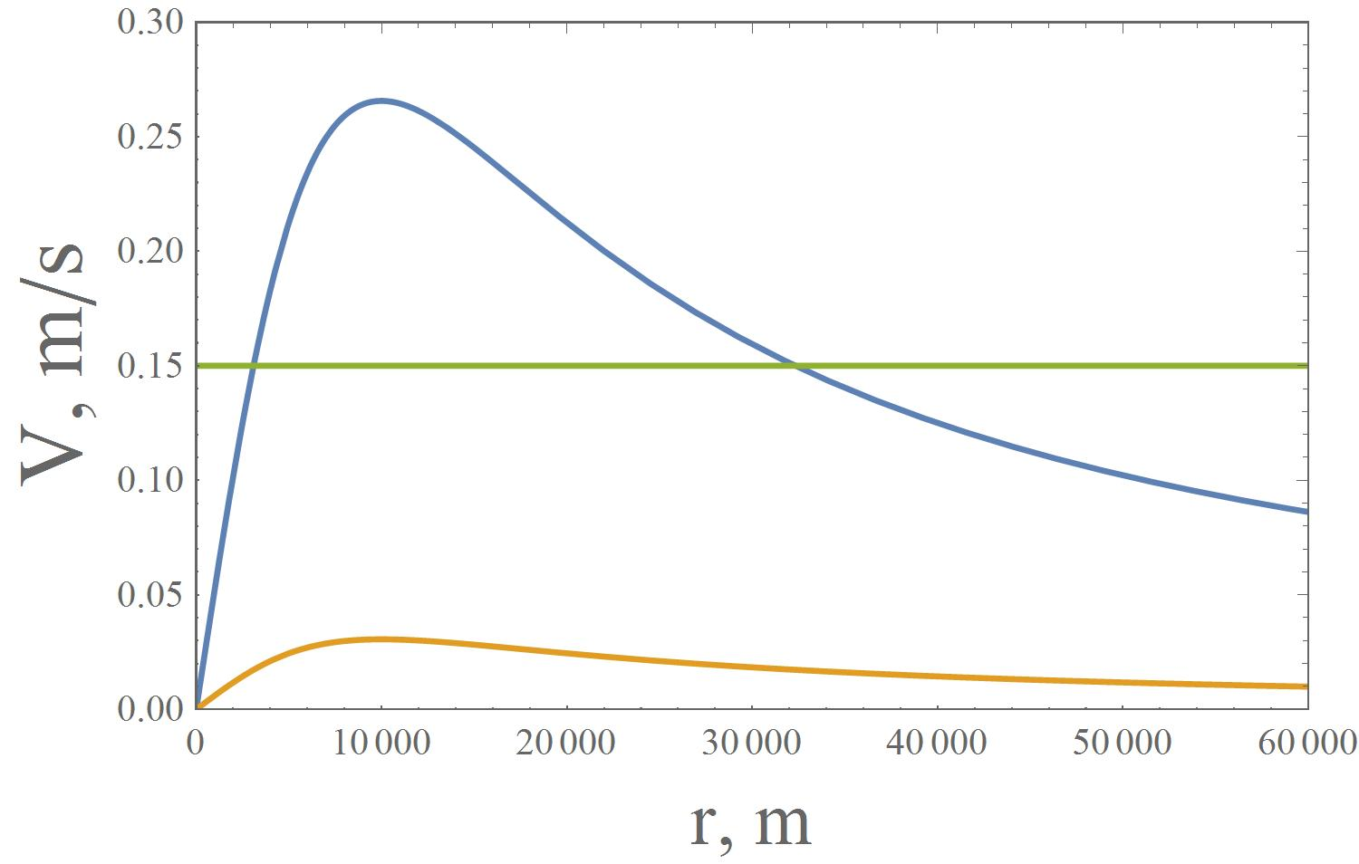


Peculiarities of marine eddy manifestation in the structure of surfactant slick band
Olga V. Shomina*ª, Tatiana V. Tarasova^{b}, Olga A. Danilichevaª, Ivan A. Kapustinª
ª Institute of Applied Physics of the Russian Academy of Science ||| ^{b} National Research University Higher School of Economics
Keywords: slicks on the sea surface, surfactants, currents, simulation, sub mesoscale marine eddies
Slick structures on the sea surface can mark processes occurring in upper ocean and atmosphere. Spiral shape of slicks observed in optical and radar images of water surface is traditionally interpreted through the manifestation of marine eddy which length scale is supposed to be equal to the scale of spiral. This assumption implies that wind has no effect on the kinematics of forming slick band, which, according to our estimation, is incorrect even at moderate wind velocities. This approach can cause misinterpretation of remote sensing data when estimating the characteristics of observed marine eddies. This study is devoted to the investigation of conditions necessary for the formation of slick spiral and to some peculiarities of its shape and scale.
The system of equations for the description of kinematics of Lagrangian particle (element of water surface covered with surface active substance) in the fields of axisymmetric eddy with non-zero radial velocity component and homogeneous wind was obtained. It is demonstrated that the spiral center is not collocated with the center of the eddy; the distance between them can achieve the eddy length scale. It is shown that the displacement of the spiral center and the direction of the main axis is quasi perpendicular to the wind direction when radial component of the eddy is small compared to the tangential component. The presence of the threshold wind velocity corresponding to the breakdown of the spiral structure is demonstrated analytically. The possibilities of correct retrieval of length scales and character velocities of observed sub mesoscale marine eddies are discussed.
Marine eddies are frequently manifested due to slick mechanism (~70% cases)
Traditionally scale of spiral is taken equal to the scale of eddy
Slick band propagation is actually affected by wind
(Kapustin, I.A.; Shomina, O.V.; Ermoshkin, A.V.; Bogatov, N.A.; Kupaev, A.V.; Molkov, A.A.; Ermakov, S.A. On Capabilities of Tracking Marine Surface Currents Using Artificial Film Slicks. Remote Sens. 2019, 11, 840.)
Singular points
0
1
2
Breakdown of the spiral when wind speed is no less that a threshold value
Traditional approach based on neglecting wind impact is basically incorrect
“saddle”
Distance between the center of forming spiral and the eddy center can be of order of radius of eddy core
ANALYTICAL DESCRIPTION
“focus”
Lagrangian particle in the stationary fields of axisimmetric vortex and homogeneous wind
Simulation and observation
y
W=5 m/s
W
Sentinel-1B SAR imagery acquired at 03:32:06 GMT on 04.10.2017.
x
x
Conditions for singular points:
XSAR shuttle imagery acquired at 02:29:53 GMT on 19.10.1994.
The center of the spiral is not collocated with the center of the eddy
CONCLUSIONS
The center of the slick spiral is not collocated with the eddy center
The distance between them can achieve the scale of eddy core
- There is a threshold wind velocity which corresponds to the breakdown of the spiral structure.
Simulation and radar observations demonstrate the possibility of appearance of a “focus” and a “saddle” in the characteristic shape of slick bands.
In perspective the correct retrieval of the genuine characteristics of observed marine eddies is based on the detailed analysis of inner structure of spiral slick.
The displacement of the spiral center is quasi perpendicular to the wind direction
This research was funded by the Russian Science Foundation (Project RSF 18-77-10066)
* Contact address: seamka@yandex.ru

