Slide 1

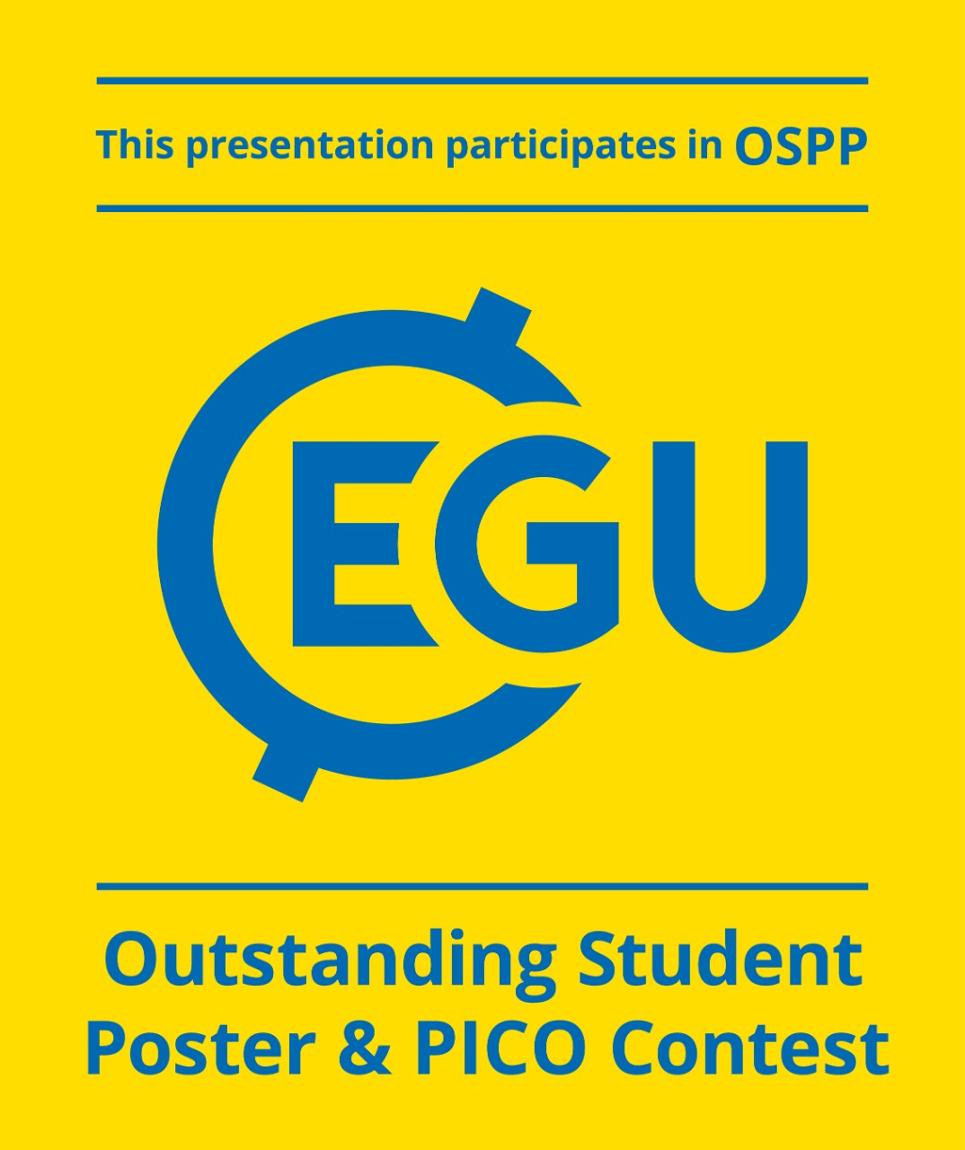

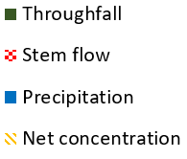
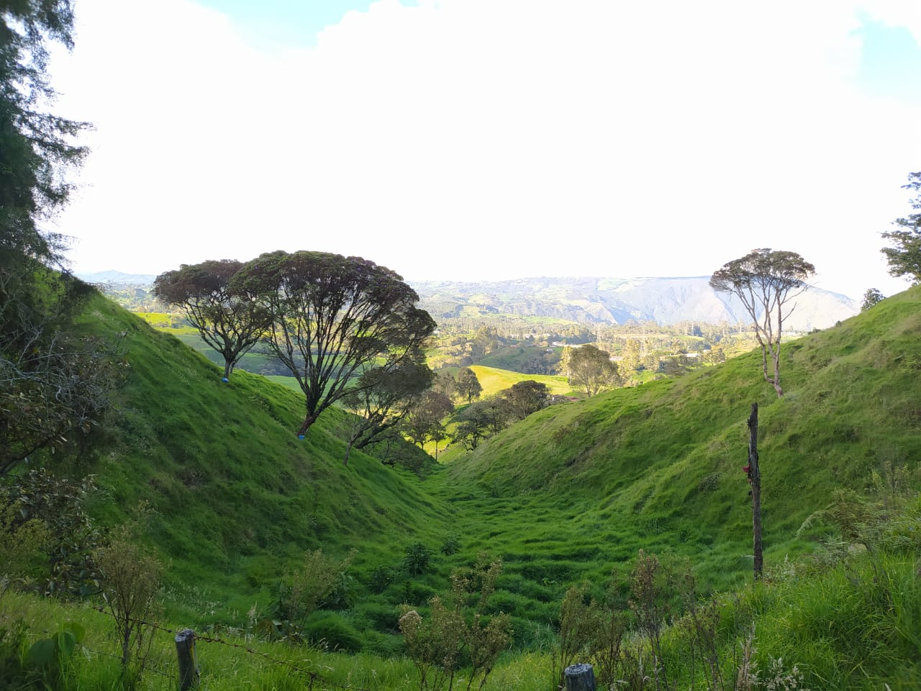
Redistribution of Phosphate into the soil via hydrological processes explained by functional traits in scattered trees of different species in the tropical Andes
Santiago Vásquez Sogamoso¹, Juan Camilo Villegas².
¹ Grupo Ecología aplicada, Facultad de ingeniería, Universidad de Antioquia, Colombia. santiago.vasquez1@udea.edu.co
²Grupo Ecología aplicada, Facultad de ingeniería, Universidad de Antioquia, Colombia. camilo.villegas@udea.edu.co
Andean ecosystems exhibit a natural limitation in nutrients such as Phosphorus that, potentially, affect the entire ecosystem´s metabolism, function and resilience to environmental perturbation. Due to this limitation in the soil, atmospheric inputs via wet or dry deposition become a determinant source of nutrients to the ecosystems.
A
B
(Cano et al., 2018)
Figure1. Scattered trees that remain in the landscape after forest conversion into other land uses
Figure2. A. Percentage of precipitation partition in each hydrological flow for the 12 events monitored in the study period. B. Average concentrations of orthophosphate in the precipitation and the evaluated fluxes (Th, Sf,) for each of the monitored species in the study period and the weighted average for the net concentration (Nc). C. Average orthophosphate concentration ratio for each of the species in the hydrological flows evaluated.
Reference
[1] Hou, E., Luo, Y. Nature Communications (2020), 11(1), 1-. 9. https://doi.org/10.1038/s41467-020-14492-w
[2] Le Roux, D. S., Ikin, K. (2018). Diversity and Distributions, 24(1), 69–81. https://doi.org/10.1111/ddi.12658
[3] Shaw, A. N., & Cleveland, C. C. (2020). Biogeochemistry, 6(C). https://doi.org/10.1007/s10533-020-00710-6
Results highlight the complex biogeochemical interactions that occur in these highly biodiverse ecosystems where plant functional traits can be useful to describe ecosystem function at the landscape scale.

