Slide 1


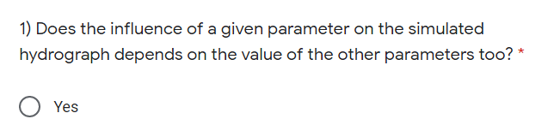
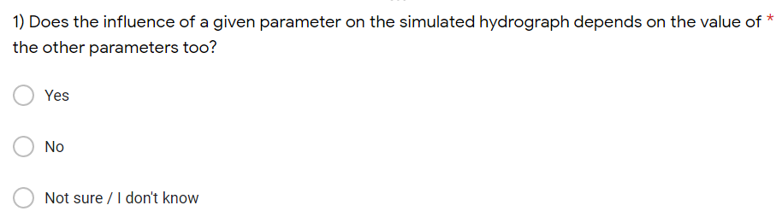

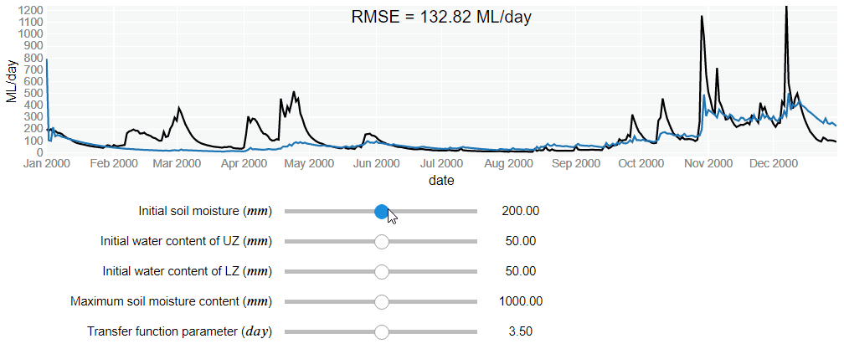
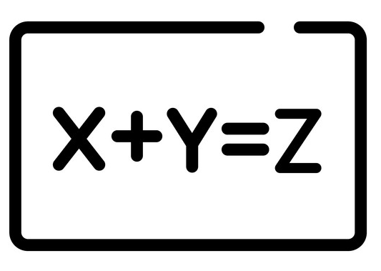

Creating a more fluent conversation between data, model and users through interactive Jupyter Notebooks
Andres Peñuela and Francesca Pianosi
github.com/AndresPenuela/iRONS
SAFE Toolbox www.safetoolbox.info
The problem: many models are hardly accesible
The opportunity: Jupyter Notebooks create interactive model documentation
How effective is this philosophy for knowledge transfer?
Survey results
Screenshot of question Q1
Design philosophy applied
Minimal & Modular
  Math-like
  coding
  Interactive
  visualization
  Accessible
  from a web
  browser
Q10
Interactive visualization to help answer Q1
Q5
Q6
Q1
Q3
Q4
Q9
Q8
Q7
Q2
This research is supported by an EPSRC "Living with Environmental Uncertainty Fellowship" on "Robust and transparent planning and operation of water resource infrastructure" [EP/R007330/1]

Slide 2
Creating a more fluent conversation between data, model and users through interactive Jupyter Notebooks
Andres Peñuela (1) and Francesca Pianosi (1,2))
(1) Department of Civil Engineering, University of Bristol, UK
(2) Cabot Institute, University of Bristol, UK
Email to: andres.penuela-fernandez@bristol.ac.uk; francesca.pianosi@bristol.ac.uk

Slide 3
Additional material

Slide 4
The results of the survey evaluating iRONS Notebooks as a method to facilitate knowledge transfer shows that the participants increase both their understanding and familiarity of the modelling concepts covered in the Notebooks.
Results of the survey
Q10
Profile of survey participant | Number of participants
PhD Student | 18
Master's student | 4
Researcher | 2
Water practitioner | 1
Total | 25
Q5
Q6
Q1
Q3
Q4
Q9
Q8
Q7
Screenshot of question Q1
Q2
Short video of the interactive visualization used in the Notebook answering Q1
76% of participants considered interactive Jupyter Notebooks better than other learning methods, such as, lecture slides, videos or books.

Slide 5
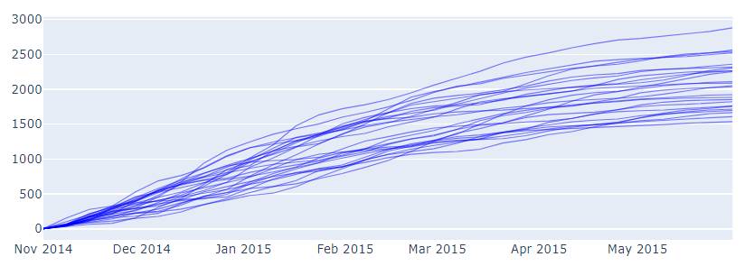
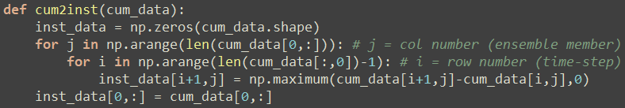
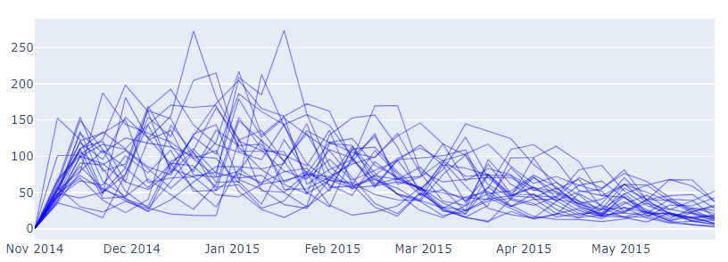

Here we illustrate this trade-off between readability and computation time with the transformation of an ensemble of cumulative hydrographs into weekly data.
The use of less efficient coding options, such as for loops, to make the code “math-like” is compensated by making the code compatible with the Numba just-in-time compiler
A
Computation time
B
C
Code readability
Code A: Math-like code (uses 2 for loops)
ML
date
Code B: More efficient code (no loops)
ML / week
Code C: Math-like code + just-in-time compiler
+ Code A
date

Slide 6
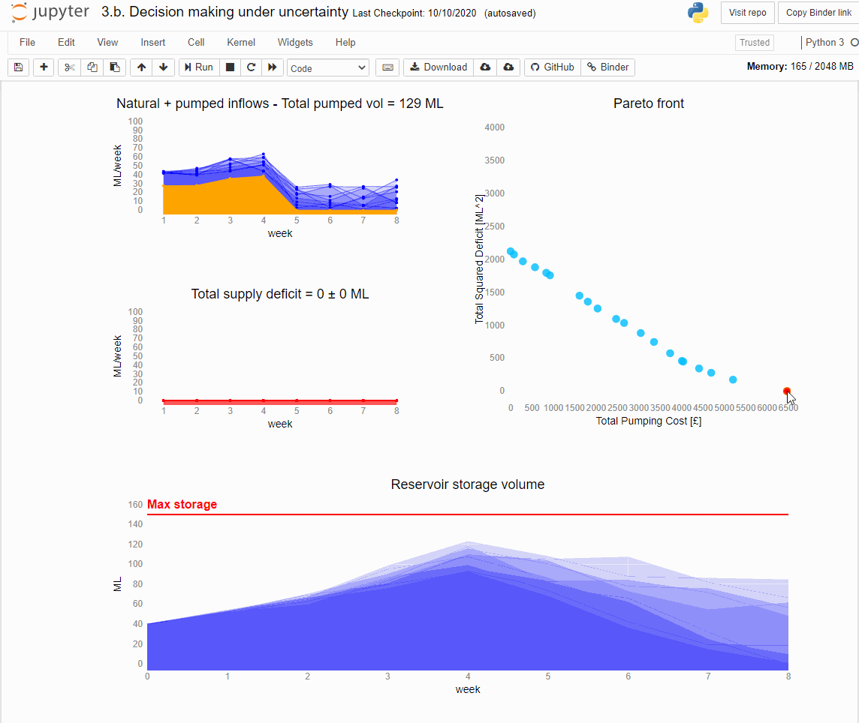




github.com/AndresPenuela/iRONS
The iRONS (interactive Reservoir Operation Notebooks and Software) Knowledge transfer Notebooks cover a range of concepts, such as:
manual vs automatic calibration of rainfall-runoff models;
optimisation under conflicting objectives and under uncertainty;
different shapes of operating policies for different reservoir purposes such as domestic or irrigation supply, flood control, or hydropower production.
You can run them and do the survey online, you only need to click on this link:
mybinder.org/v2/gh/AndresPenuela/iRONS.git/master

Slide 7
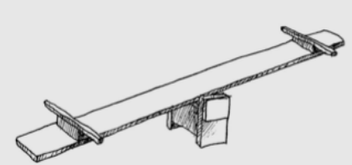
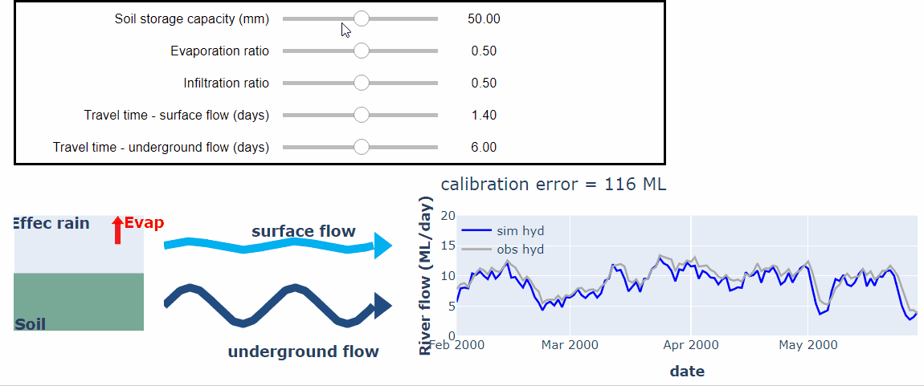

SAFE Toolbox
The SAFE (Sensitivity Analysis For Everybody) Toolbox provides a set of functions to perform Global Sensitivity Analysis (GSA). The SAFE interactive Notebooks provide with an introduction to the benefits of GSA. You can run them by clicking on these links:
What are the most important parameters in a mathematical model?
Using GSA to enhance model-informed decisions
What are the key controls of a system?
www.safetoolbox.info
If you want to discuss possible collaborations, please email us:
andres.penuela-fernandez@bristol.ac.uk; francesca.pianosi@bristol.ac.uk
If you want to know more about what we do, please visit our website:
www.resimop.info
Short video of the interactive visualization used in the Notebook What are the most important parameters in a mathematical model?
This research is supported by an EPSRC "Living with Environmental Uncertainty Fellowship" on "Robust and transparent planning and operation of water resource infrastructure" [EP/R007330/1]

