Slide 1
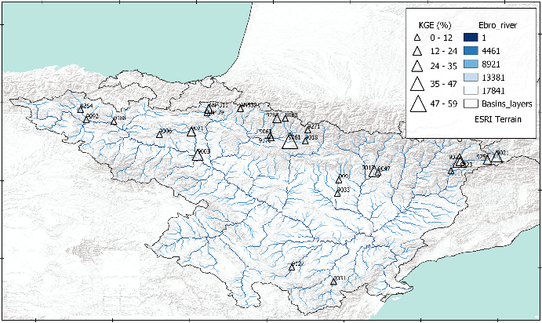
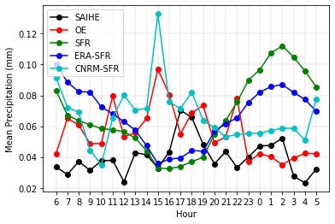
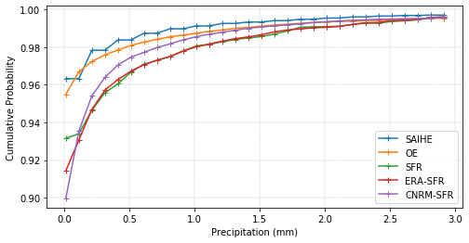
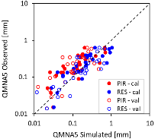
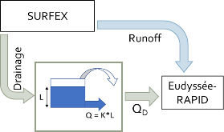
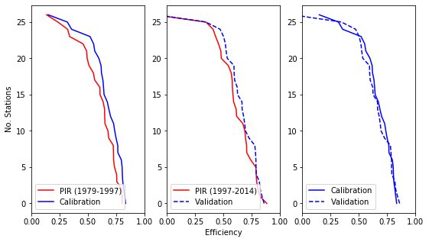
Improvement of the simulation of high and low flows in the LSM based hydrological modeling chain SASER applied to the Ebro river basin
Omar Cenobio-Cruz¹ (ocenobio@obsebre.es), Anaïs Barella-Ortiz¹, Pere Quintana-Seguí¹, and Luis Garrote²
¹ Observatori de l’Ebre (URL - CSIC), Spain. ² UPM, Madrid, Spain
CGL2017-85687-R https://doi.org/10.5194/egusphere-egu21-7779
Introduction
The SASER (Safran-Surfex-Eaudysee-Rapid) hydrological modelling chain is a physically-based and distributed hydrological model and it is used for drought studies (HUMID project) and water resources analysis (PIRAGUA project)
Data
Spatial resolution
SAFRAN and SURFEX:
5 km (Iberian domain)
2.5 km (Pyrenean domain).
RAPID
1 km in both cases.
Temporal resolution
SAFRAN analyzes daily observed precipitation, which is then interpolated to the hourly scale.
Daily streamflow is calculated by the RAPID river routing scheme
Improvement distribution of hourly precipitation
Mean hourly precipitation
SAFRAN (green line), observed (black and red line), corrected precipitation using ERA-5 (blue line) and RCM simulation from the CORDEX project (cyan line).
Cumulative probability improving
Improvement percentage in KGE values regarding default simulation (PIR), and QMNA (5 years) values scatter plot.
.
r | Cal | Val
PIR (default) | 0.73 | 0.56
RES | 0.77 | 0.72
Improvement Low-Flows
We chose to introduce a linear reservoir in most near-natural sub-basins, following the steps of Artinyan et al (2008) and Getinara et al. (2014).
Conclusions and further work
We now produce more realistic temporal patterns or hourly precipitation and improve the precipitation intensities.
We are evaluating the daily runoff response using the corrected hourly precipitation, although results don't show a clear improvement.
The reservoir is able to improve low flows in most near-natural sub-basins.
Now we are working to set reservoir parameters in non-natural sub-basins.
Objectives
Improving high flows by correcting the distribution of hourly precipitation
Adding linear reservoirs to improve low flows.
Reservoir scheme
Efficiency [ KGE(√Q) ]

