Slide 1
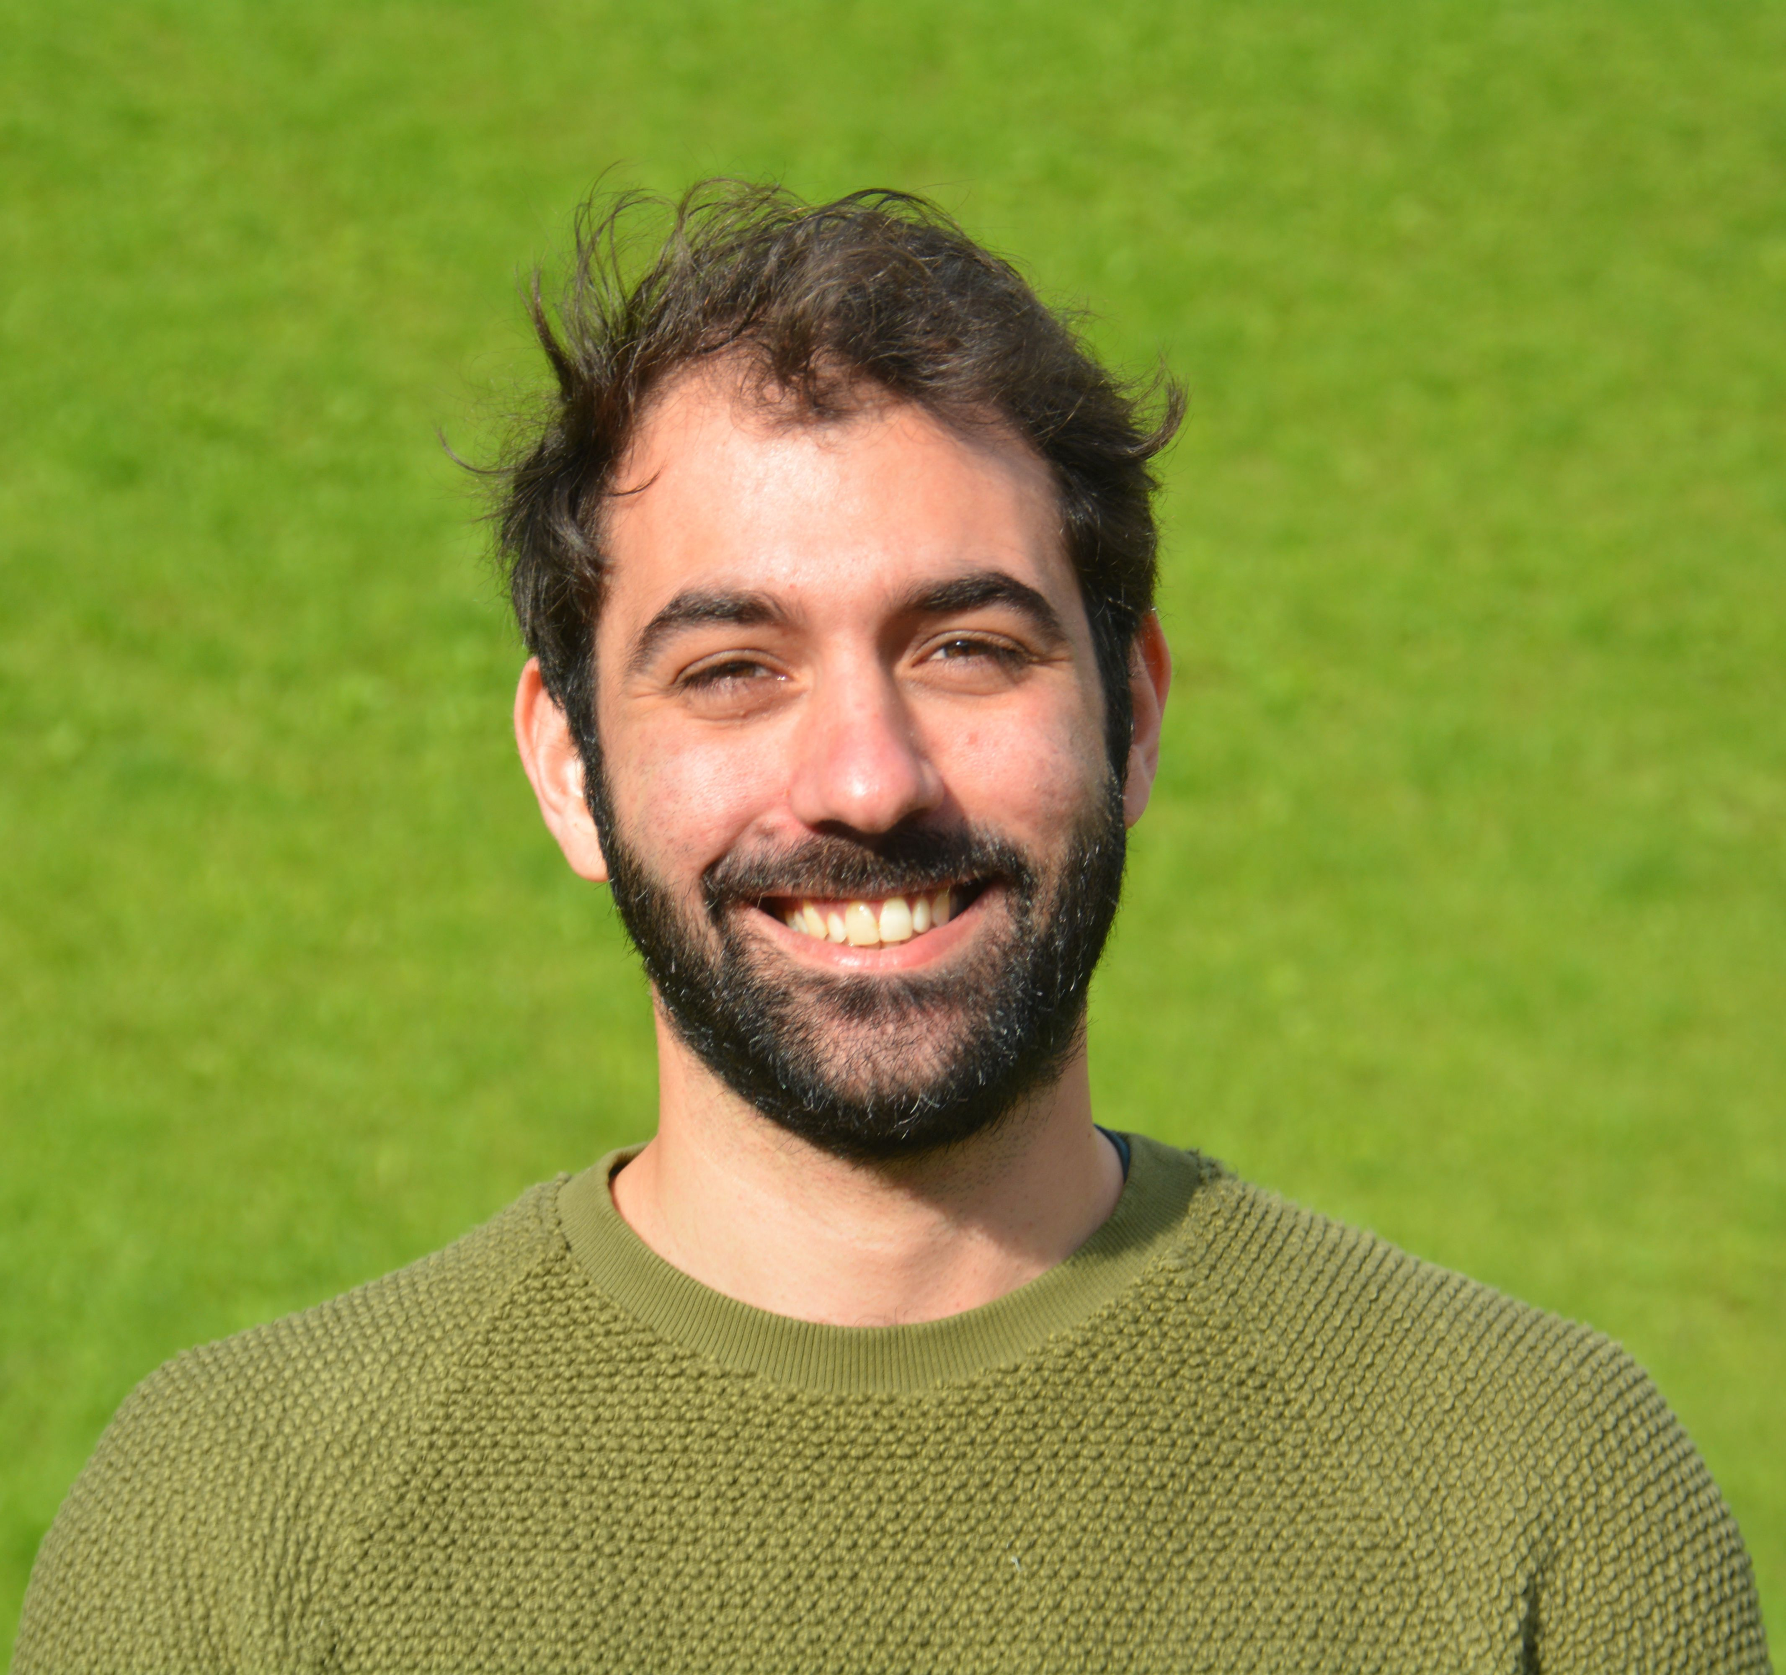
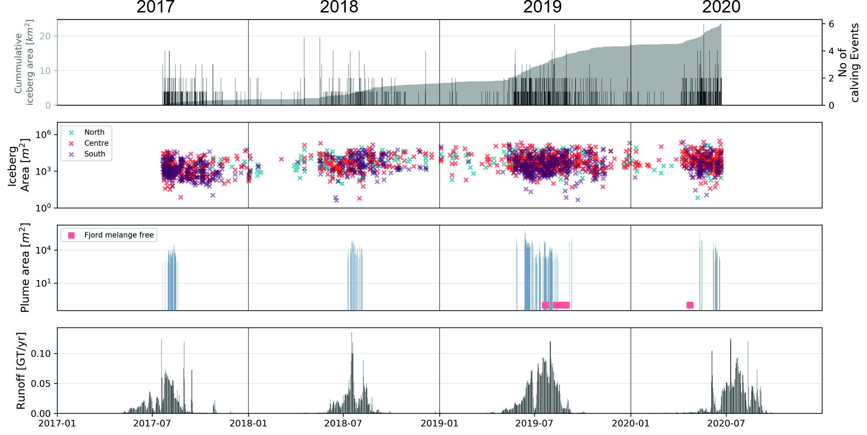
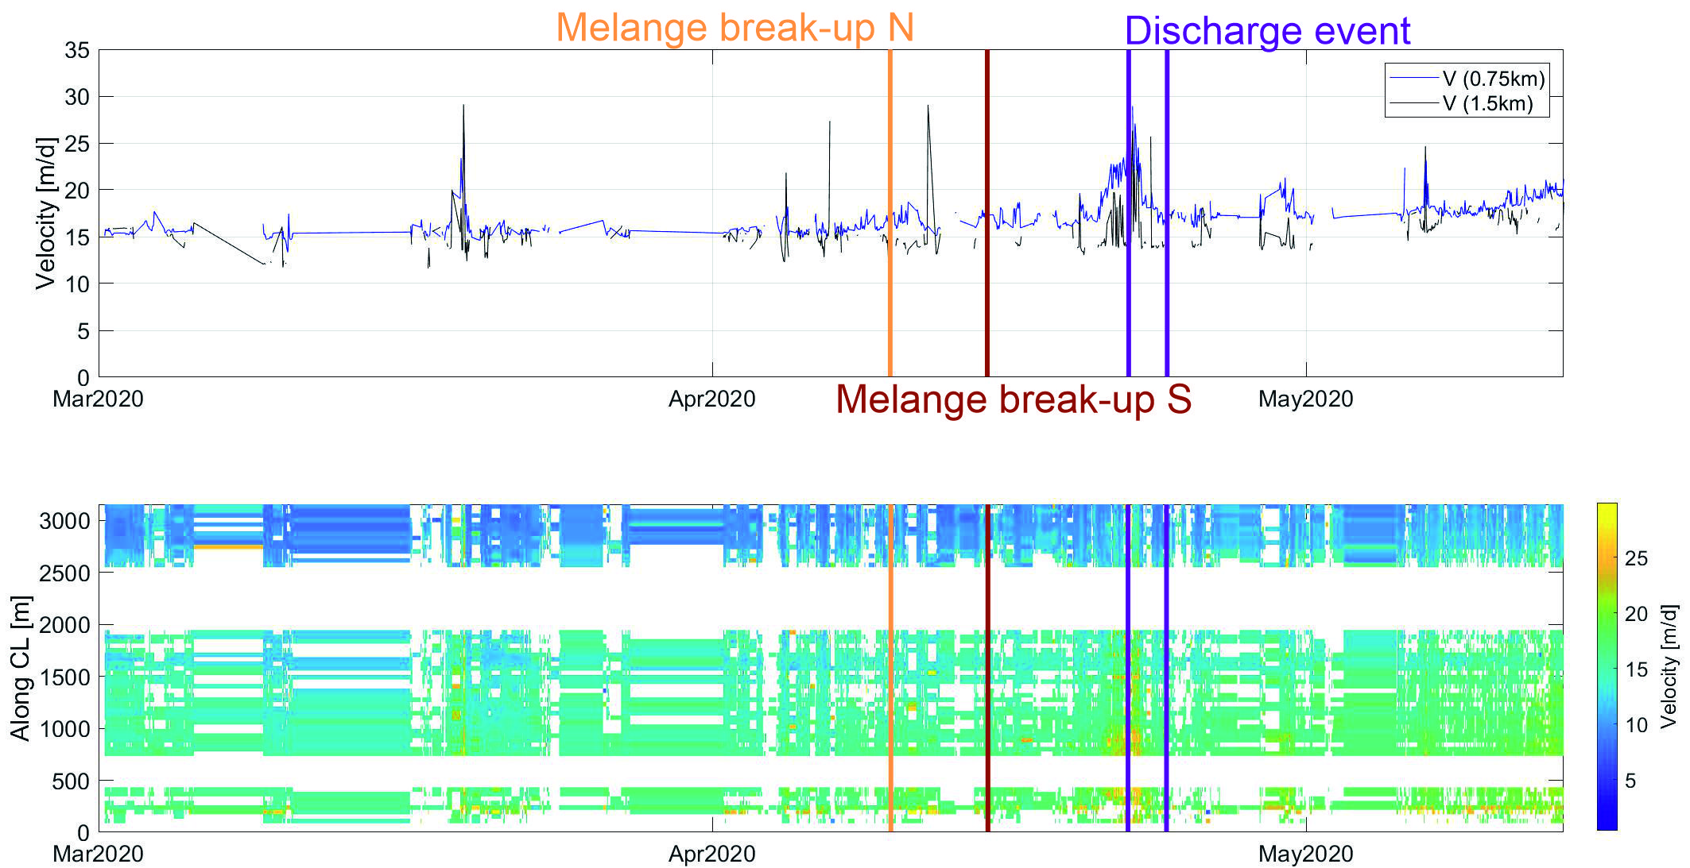
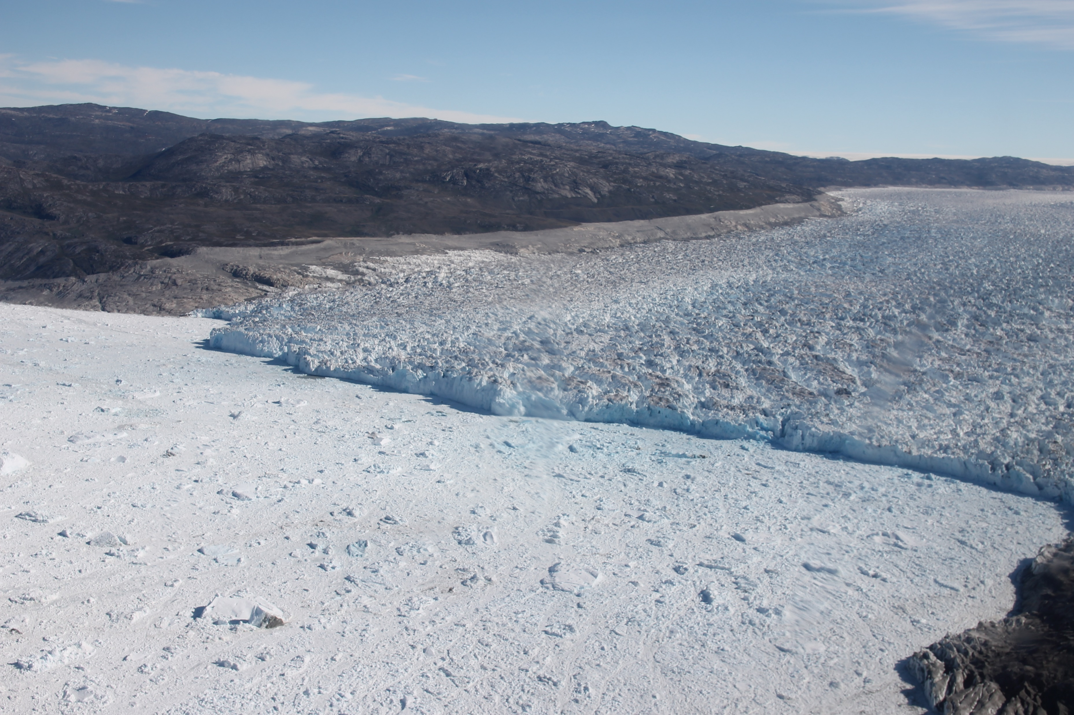
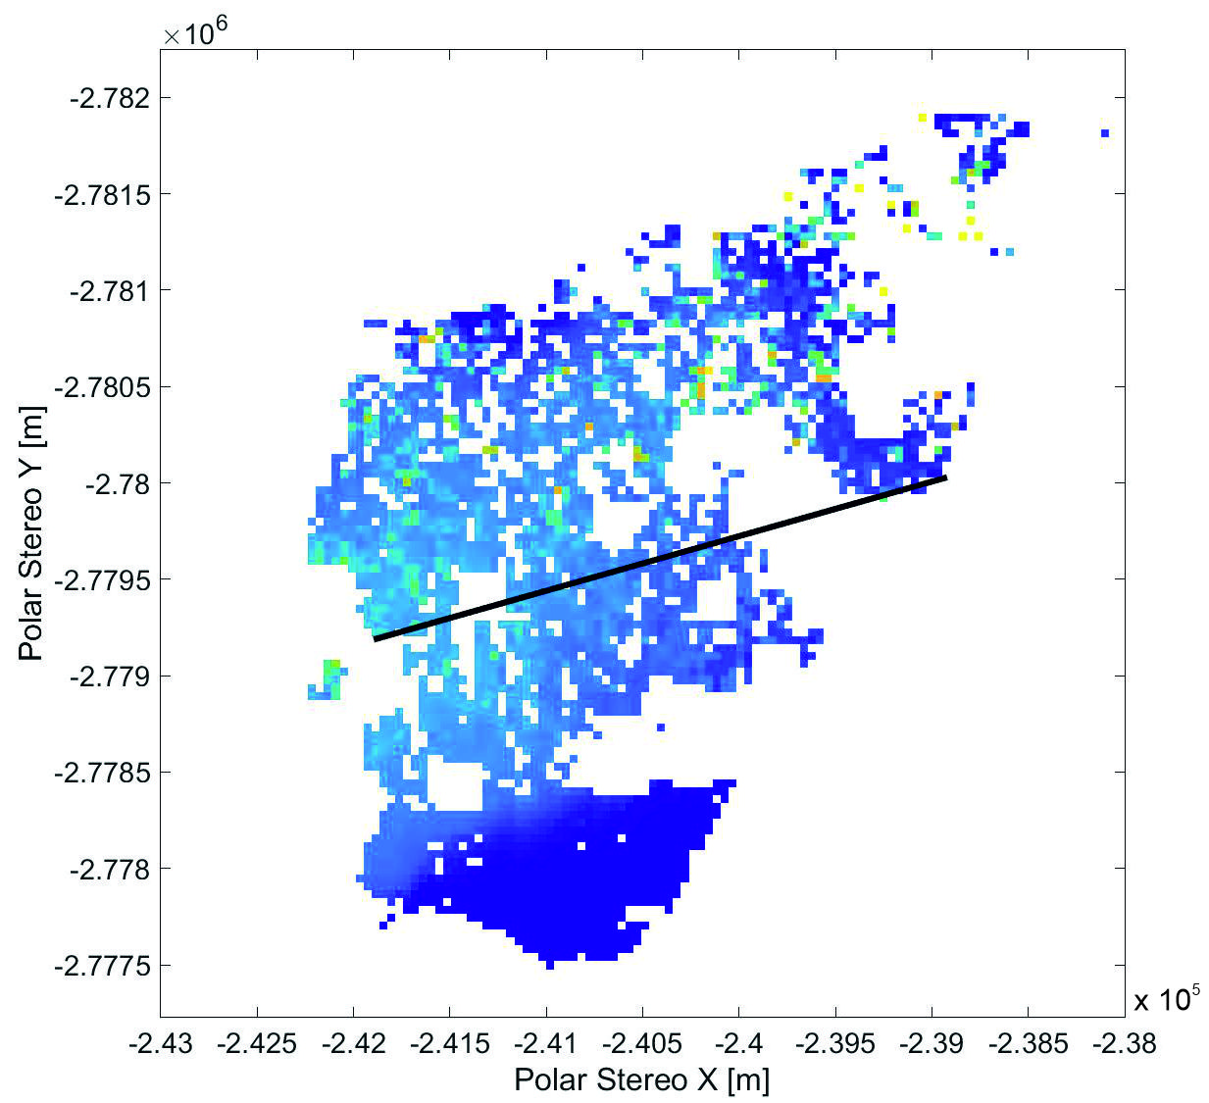
Using sub-daily timelapse imagery to investigate the behaviour of Narsap Sermia, SW Greenland
Dominik Fahrner^{1,2} James M. Lea¹ Stephen Brough¹ Jakob Abermann^{3,4}
¹University of Liverpool, Department of Geography and Planning ²University of Liverpool, Institute for Risk and Uncertainty
³Karl-Franzens Universität Graz, Department of Geography and Regional Science ⁴Asiaq Greenland Survey, Nuuk
D.Fahrner@Liverpool.ac.uk
@DominikFahrner
Introduction
Results
Outlook – Drainage Event 22-24 April 2020
Time lapse imagery has been used in previous studies to assess the behaviour of tidewater glaciers (e.g. Ahn & Box,2010, How et al, 2020). We use hourly, multi-annual time lapse data to investigate changes in glacier behaviour at Narsap Sermia, SW Greenland, which has shown a velocity increase in the last decade (Motyka et al., 2017).
Calving
Increase in calving size by 61% (2017-18), 97% (2018-19)
Number of calving events stable at ~400 events/year.
Slight shift in calving location from South to Central/North.
Plumes
Plumes apparent early in melt season starting 2019
Melange-free fjords in August 2019/ April 2020
Velocities (12pm -12pm) filtered using vector direction (Unnatural flow directions removed).
Further outlier removal using 3x3 pixel sliding window.
Velocity increase with Melange break-up & during discharge event.
Click to play
Methods
Time lapse camera at Narsap Sermia, takes hourly images from 07/2017 – 06/2020 up to ~4 km from terminus.
Processing Steps:
Manual Filtering of 25,000 images.
Orthorectification using smoothed 2017 ArcticDEM (ImGRAFT; Messerli & Grinsted, 2015).
Manual plume Mapping.
Manual calving event mapping.
Feature Tracking to derive Velocities. (ImGRAFT; Messerli & Grinsted, 2015)
Basemap from
Morlighem et al., 2017
Velocities
Orthorectification with RMSE of
44 pixels.
Multi-annual velocities are currently being processed.
Calculated as offset between
images that are 24h apart to
account for RMSE.
Future Work
Short-term changes (speed-up, Mélange-free fjords).
Influence of climate on calving events and plumes.
Relationship between velocity evolution, climate and runoff.
Determine drivers of drainage event(s).
References
How P, Hulton NRJ, Buie L and Benn DI (2020) PyTrx: A Python-Based Monoscopic Terrestrial Photogrammetry Toolset for Glaciology. Frontiers in Earth Science 8, 21. Ahn Y and Box JE (2010) Glacier velocities from time-lapse photos: technique development and first results from the Extreme Ice Survey (EIS) in Greenland. J. Glaciol. 56(198), 723–734. Motyka RJ, Cassotto R, Truffer M, Kjeldsen KK, Van As D, Korsgaard NJ, Fahnestock M, Howat I, Langen PL, Mortensen J and others (2017) Asynchronous behavior of outlet glaciers feeding Godthåbsfjord (Nuup Kangerlua) and the triggering of Narsap Sermia’s retreat in SW Greenland. J. Glaciol. 63(238), 288–308. Messerli A and Grinsted A (2015) Image georectification and feature tracking toolbox: ImGRAFT. Geosci. Instrumentation, Methods Data Syst. 4(1), 23. Morlighem M, Williams CN, Rignot E, An L, Arndt JE, Bamber JL, Catania G, Chauché N, Dowdeswell JA, Dorschel B and others (2017) BedMachine v3: Complete bed topography and ocean bathymetry mapping of Greenland from multibeam echo sounding combined with mass conservation. Geophys. Res. Lett. 44(21).

