Slide 1

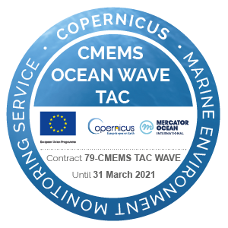
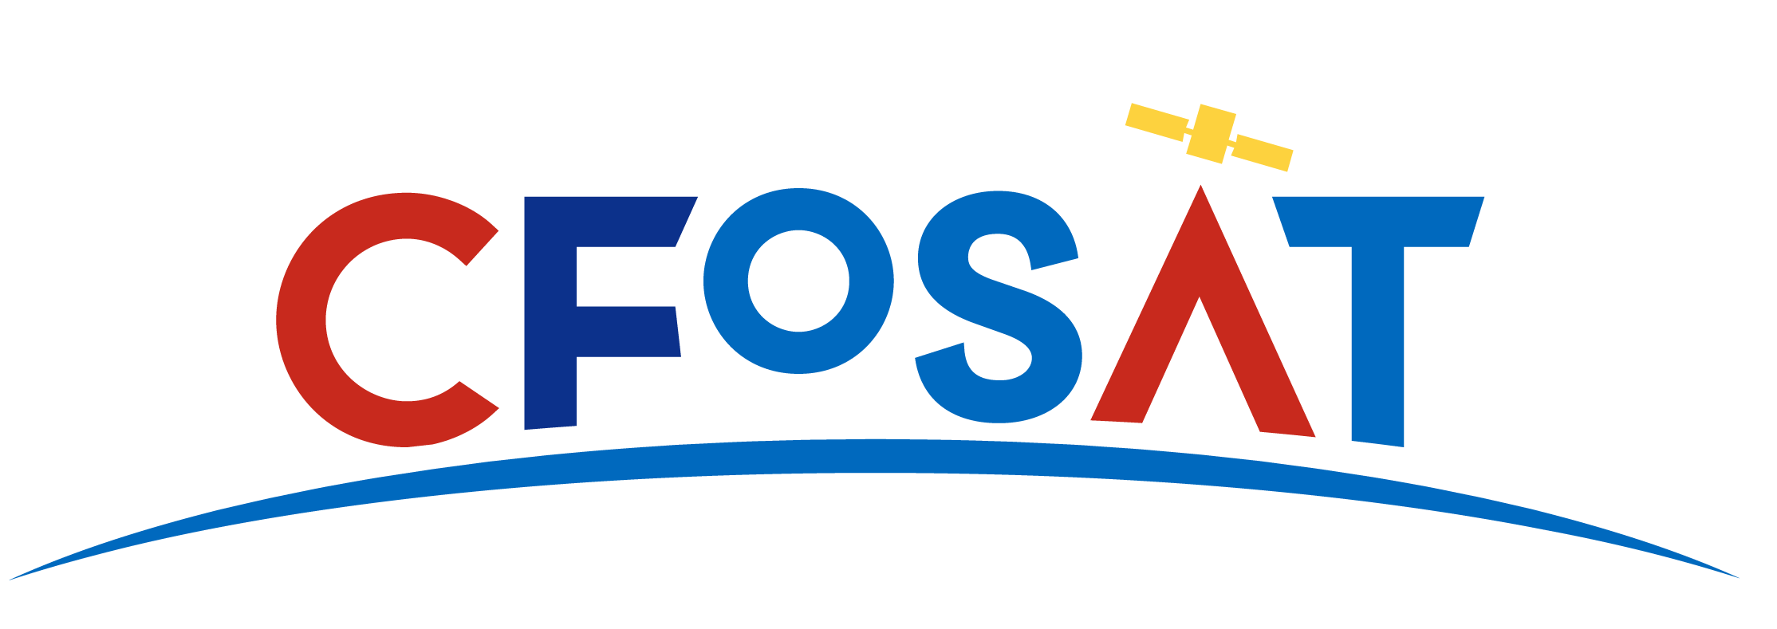

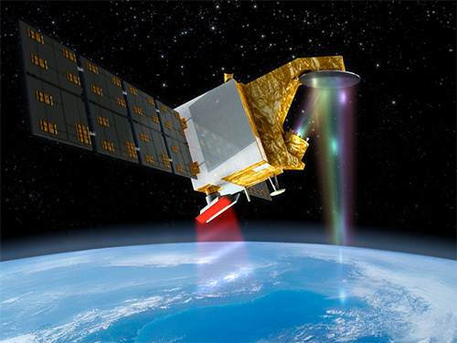
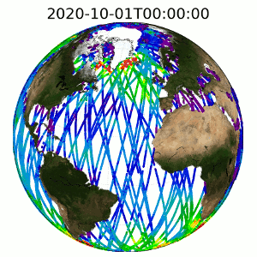
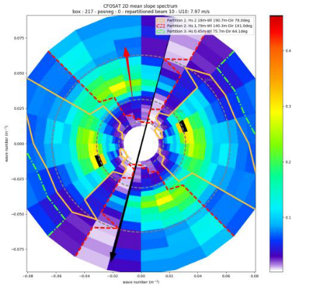
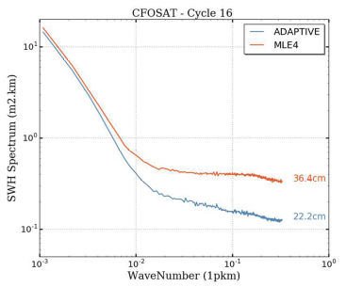
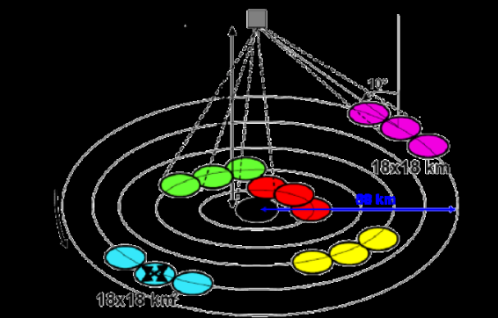
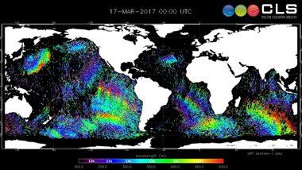






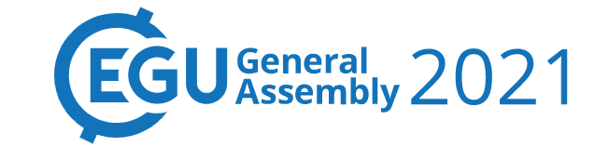
CFOSAT joining the family of CMEMS Wave products!
Annabelle OLLIVIER, Gerald Dibarboure, Romain Husson, Gael Goimard, Daniele Hauser, Cedric Tourain, and Lotfi Aouf
Contact:
aollivier@groupcls.com
CFO Nadir Product | Type/when? | Commment
1Hz SPC_NRT: L3 and L4 | Operational Since July 2019 | Homogeneous to Nadir constellation
1Hz L3 Climat oriented | Operational: Nov 2021 | Reprocessed from the BOM (Nov 2018), calibrated on CCI Sea State time series
5Hz L3 High resolution | Internal : Aug 2021 | Leveraging the innovative/performing retracking (Tourain et al. IEEE)
https://resources.marine.copernicus.eu/
L2P off nadir products :
1 valid spectrum flags
1 valid partition flag
1 type of spectrum
1 types of nadir Hs (nbox)
4 wave param estimations
  1 for total spectrum
  3 for the partitions
1 type of nadir Wind (nbox)
Nadir Data
First mission entirely dedicated to ocean wind and waves
innovative instrumental concepts
China-France cooperation
Ready for applications and scientific exploitation
Aready breakthrough results which open new perspectives (more than 25 publications)
Along track spectral content of nadir Hs compared to usual retracking MLE4.
Future L3 CFO Fireworks (here S1)
SWIM slope spectrum
Hs, Direction, wavelength
Off Nadir Data
Have a try!
CFO Nadir Product | Type/when? | Commment
L2P products | Aviso product: Aug 2021 | Simplified and enhanced L2 like: Leveraging the CFOSAT calval group sudies. Input of the L3 fireworks. Usable for assimilation. Including partitions and wave parameters.
L3 fireworks | Operational: Nov 2021 | Homogeneous to Sentinel-1 fireworks formats
Direct access to SWIM full, raw data via: ftp-access.aviso.altimetry.fr/cfosat

