Slide 1
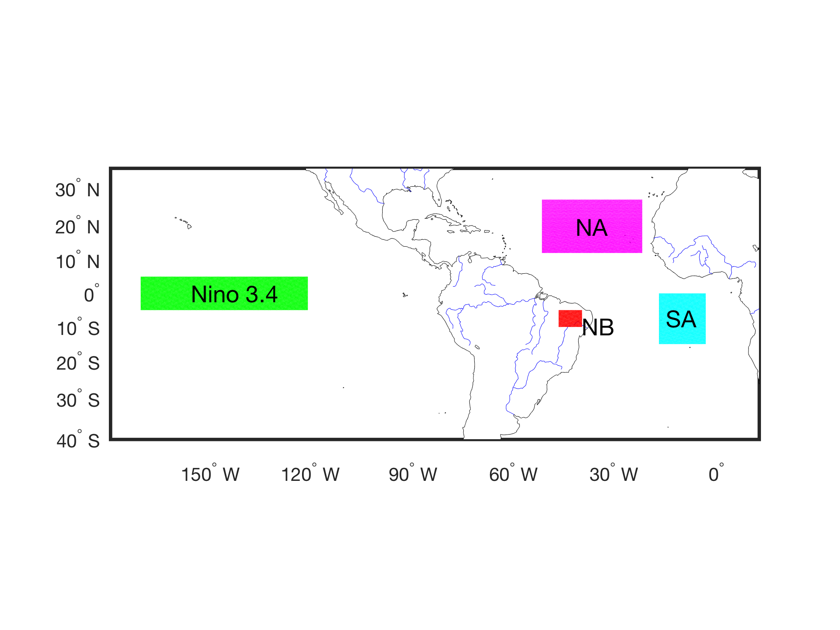
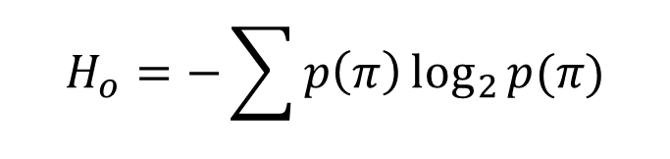
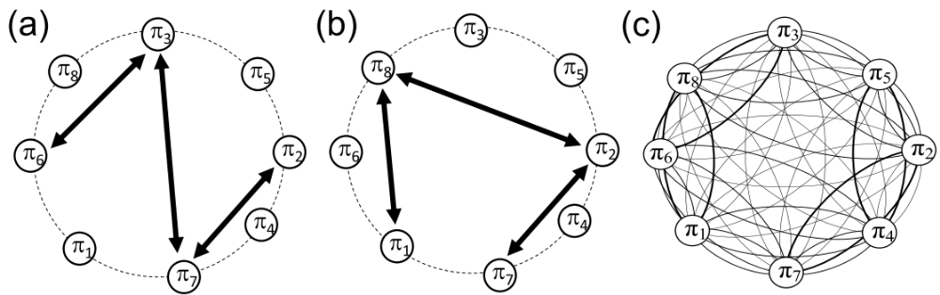
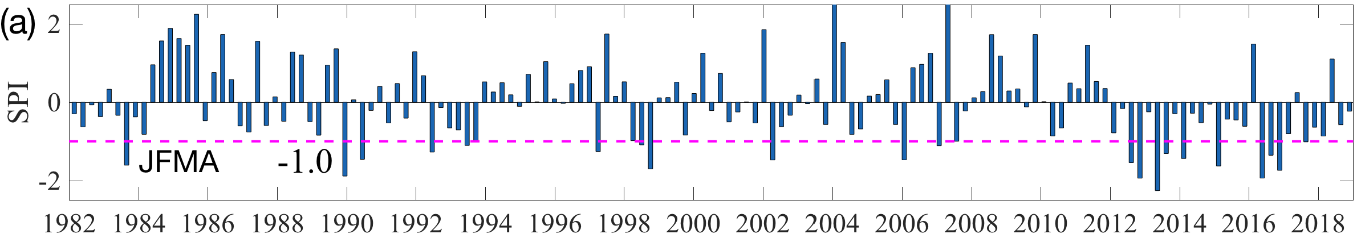
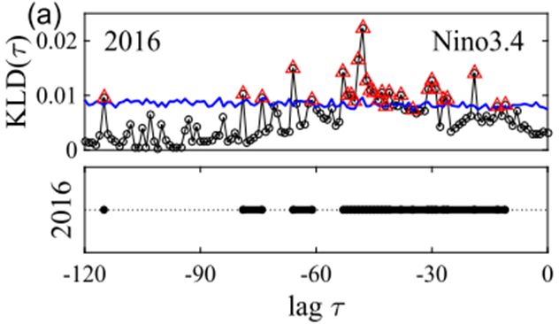

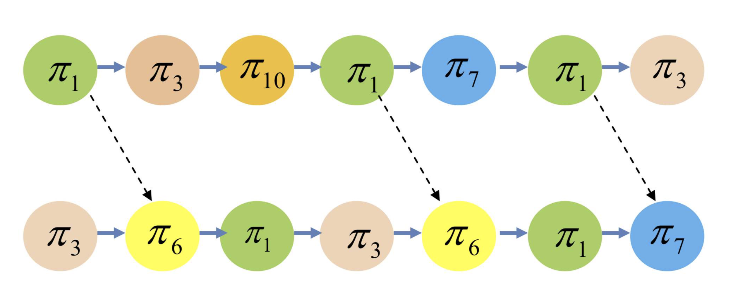
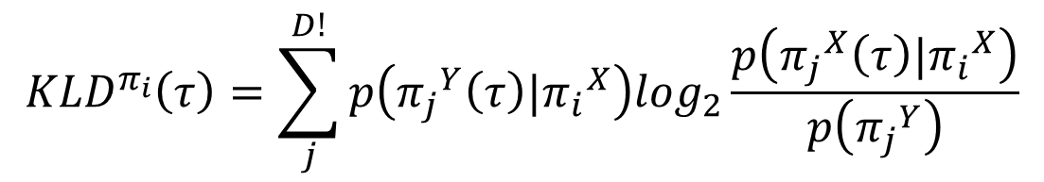
Ordinal partition transition network for climate data
Yong Zou
yzou@phy.ecnu.edu.cn
East China Normal University, Shanghai, China
Collaborators: E. Macau, R. Donner
Methodologies:
Climate data:
Ordinal patterns and transition networks
π₁ π₂ π₃
π₄ π₅ π₆
Permutation entropy:
Coupling analysis of ordinal transition networks
Kullback Leibler divergence
References:
Y. J. Ruan, R. V. Donner, et al，Chaos, 2019, 29(4), 043111
H. Y. Wu, Y. Zou, E. Macau, et al. Chaos, 2020, 30(5), 053104
Y. Zou, R. V. Donner, et al. Phys. Rep., 2019, 787, 1 - 97

