Slide 1

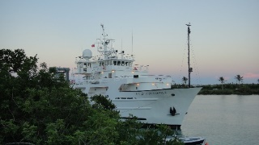
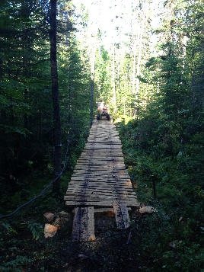
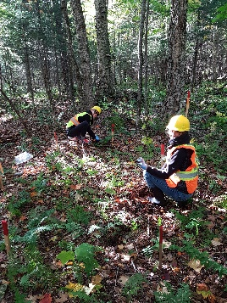
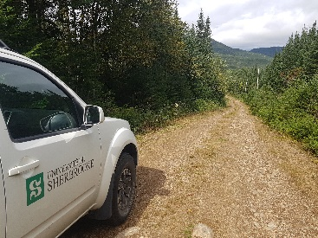
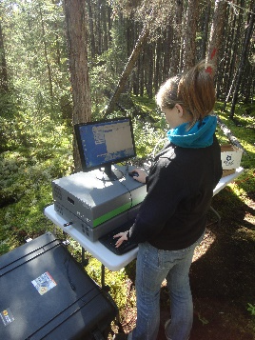
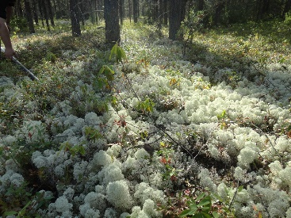
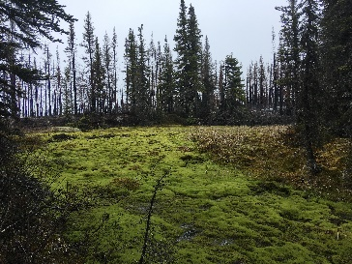
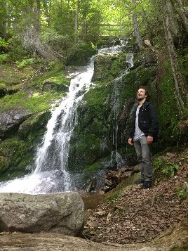
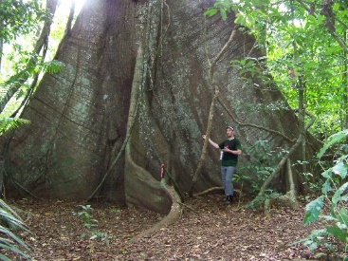
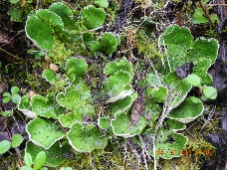


Ecosystem scale evidence for the contribution of vanadium-based nitrogenase to biological nitrogen fixation
Romain Darnajoux¹, Nicolas Magain², Marie Renaudin³, François Lutzoni², Jean-Philippe Bellenger³, Xinning Zhang^{1,4}.
¹Department of Geosciences, Princeton University, Princeton, 08544, NJ, USA
²Department of Biology, Duke University, Durham, 27708, NC, USA
³Centre Sève, Département de Chimie, Université de Sherbrooke, J1K 2R1, QC, Canada
⁴Princeton Environmental Institute, Princeton University, Princeton, 08544, NJ, USA

Slide 2
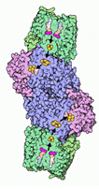

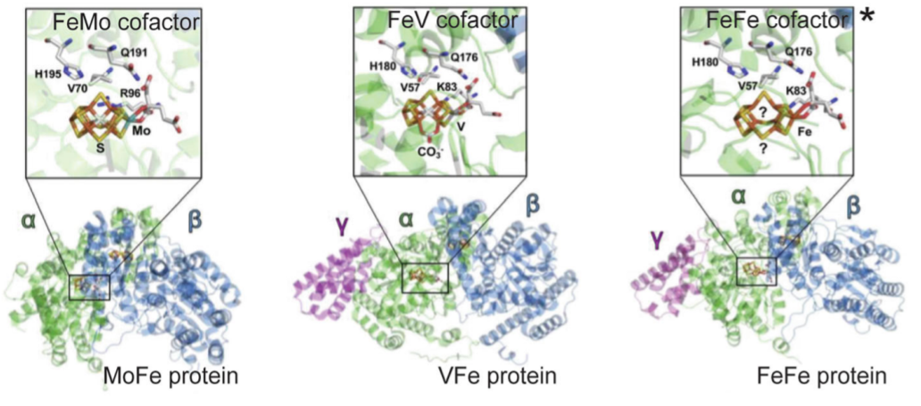

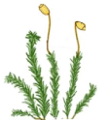


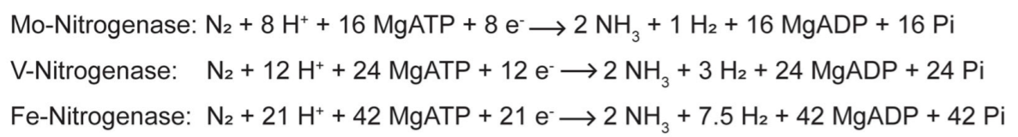
Quick recap on nitrogenases diversity.
N₂
Nitrogenase
N₂
NH₃
NH₄⁺

Slide 3
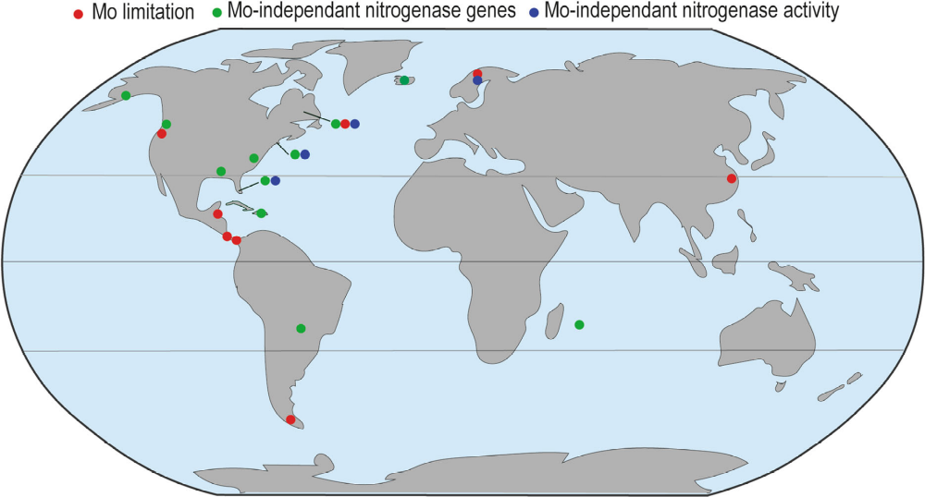


Quick recap on nitrogenase diversity.
Despite the description of alternative nitrogenases almost half a century ago, BNF has long been considered to primarily rely on the Mo-Nase.
Over the last 15 years mounting evidences suggest that alternative nitrogenases might be more important than previously believed.
?
V, Fe
Mo
► Bellenger et al (2019) Biogeochemistry. 149: 53-73
What is the contribution of alternative Nases to BNF at the ecosystem scale?

Slide 4
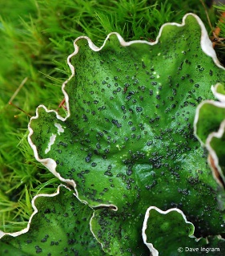
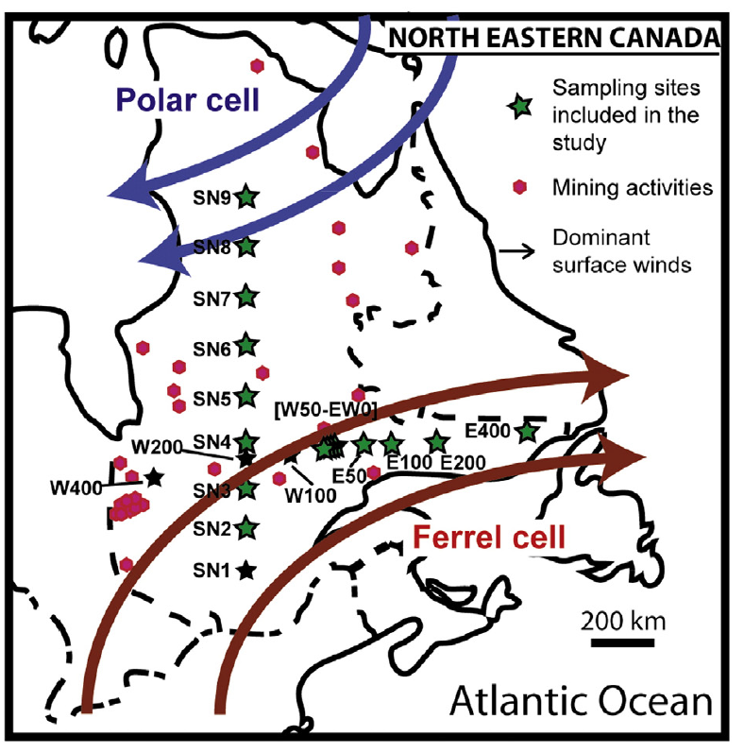
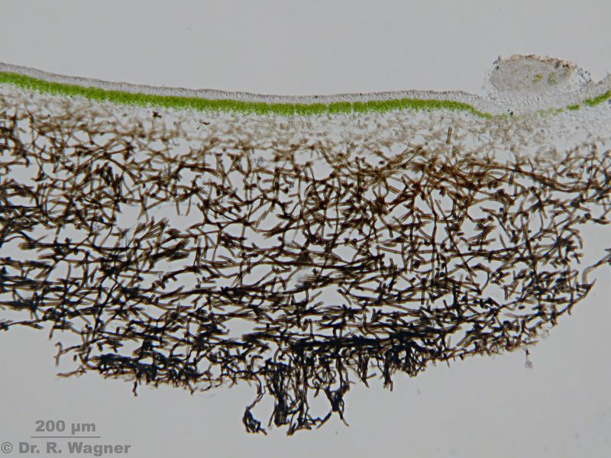
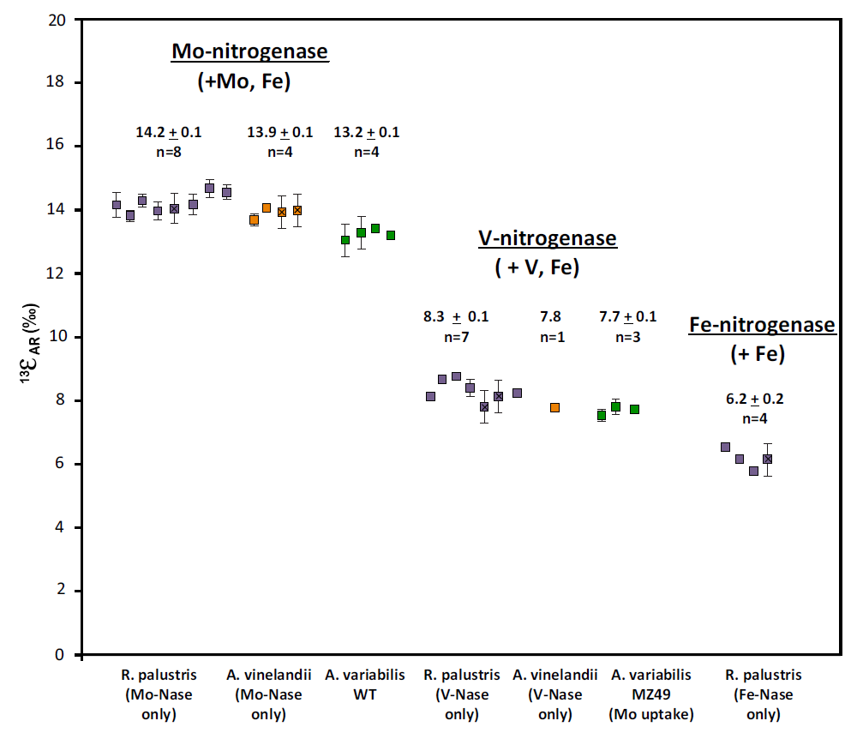
To what extend alternative Nases contribute to BNF?
  Cyanolichens: The ideal model for the study of nitrogenases.
  Eastern Canada atmospheric and climatic gradients
Cyanobacteria: Nostoc
  ISARA (ISotopic Acetylene Reduction Assay)
► Darnajoux et al (2014) New Phytologist. 202:765-771
~6‰
~8‰
► Darnajoux et al (2015) Science of the Total Environment 533:1-7
Metal deposition
► Zhang et al (2016) Biogeochemistry 127:189-198

Slide 5
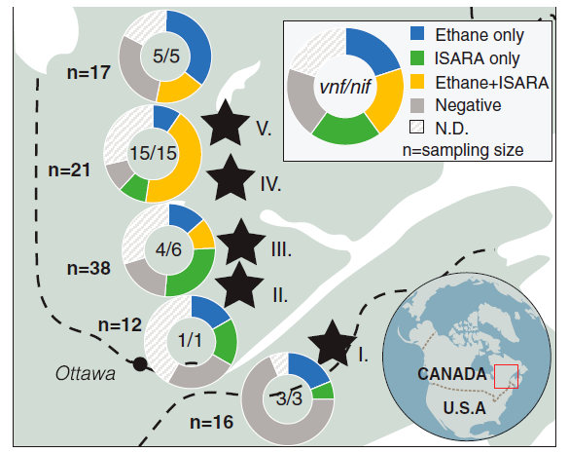
To what extend alternative Nases contribute to BNF?
Alternative nitrogenases are active in all tested sites (15 to 50%).
► Darnajoux et al (2019) Proceedings of the National Academy of Sciences USA. 116: 24682-24688

Slide 6
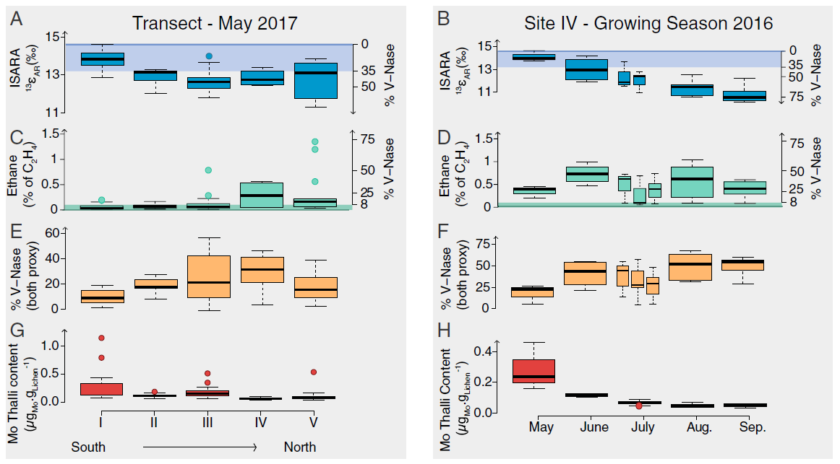
To what extend alternative Nases contribute to BNF?
The contribution of alt. nitrogenases is influenced by the latitude and the season.
► Darnajoux et al (2019) Proceedings of the National Academy of Sciences USA. 116: 24682-24688

Slide 7
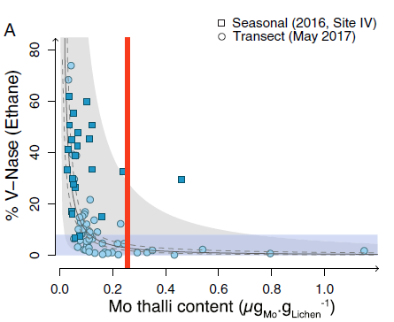
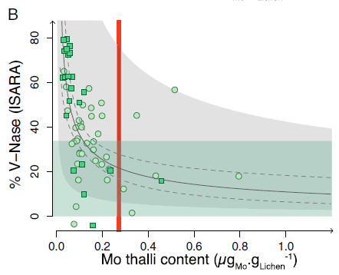
To what extend alternative Nases contribute to BNF?
The contribution of alt. Nases can be predicted by [Mo] in cyanolichens.
► Darnajoux et al (2019) Proceedings of the National Academy of Sciences USA. 116: 24682-24688

Slide 8
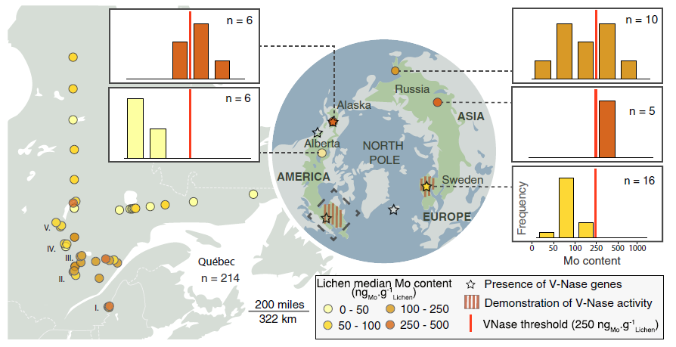
To what extend alternative Nases contribute to BNF?
The contribution of alternative nitrogenases is likely widespread in boreal ecosystems.
► Darnajoux et al (2019) Proceedings of the National Academy of Sciences USA. 116: 24682-24688

Slide 9
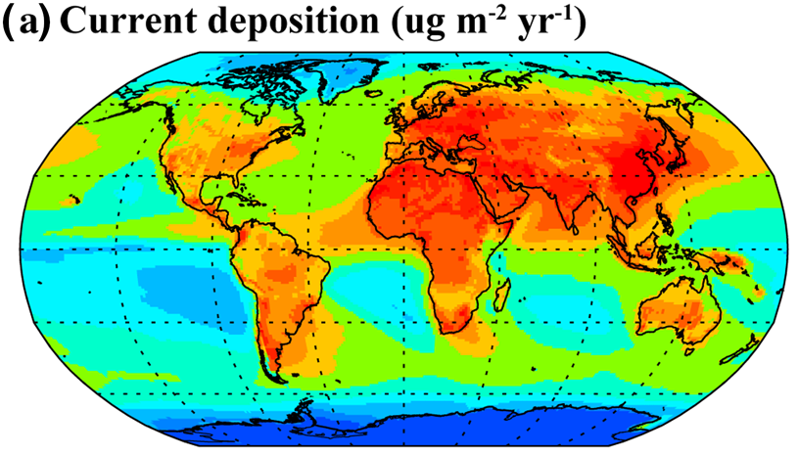
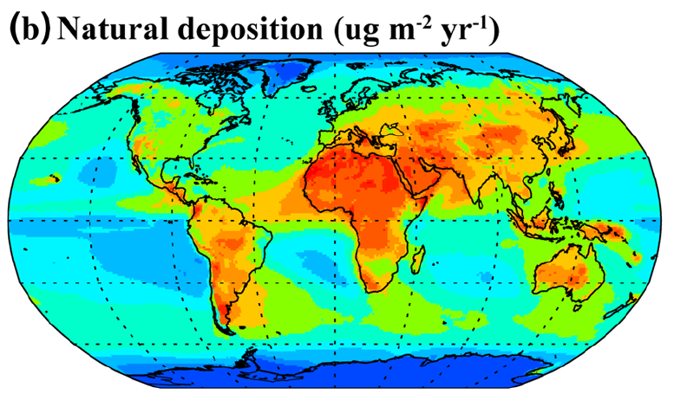
To what extend alternative Nases contribute to BNF?
Alternative nitrogenases likely contribute to BNF in many other matrices and ecosystems.
► Bellenger et al (2020) Biogeochemistry. 149: 53-73
Alternative nitrogenases may have even been more important for BNF in the preindustrial world.
► Wong et al (2019) Global Biogeochemical Cycles. 35: e2020GB006787

Slide 10


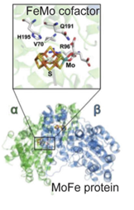
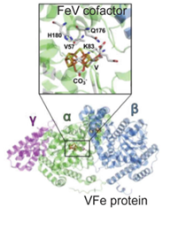
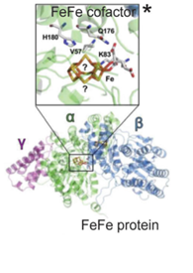
Conclusion
Quick recap:
  Alternative nitrogenases play an important role in BNF in boreal ecosystems, and likely in other ecosystems and matrices.
  Alternative nitrogenases should be considered “complementary” nitrogenases used by many organisms to sustain BNF under various environmental stressors.
The concept of hierarchy
The concept of complementarity
1
BNF
2
3
The BNF Champions

Slide 11



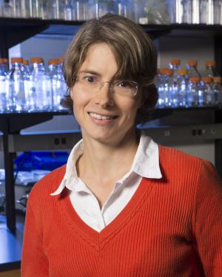










Renaudin M..
Darnajoux R.
Kraepiel A.
Zhang X.
Miadlikowska J.
Lutzoni F.
Magain N.
Recent reviews on Alternative nitrogenases:
► Mus et al (2019) Free radical biology and medicine 140: 250-259
► Bellenger et al (2020) Biogeochemistry. 149: 53-73
► Harwood (2020) Annual Revews of Microbiology 74: 247-266
► Jasniewski et al (2020) Chemical Reviews 120:5107-5157

