Slide 1







Comparison of MODIS-based thin-ice thicknesses with ice draft measurements in the Laptev Sea & Chukchi Sea
European Geoscience Union – General Assembly 2021
Chukchi Sea
MODIS – Corrected Reflectance | 22 Mar 2010 NASA Worldview
BUTTONS ARE CLICK-ABLE ☺
HOME MENU
Background & Approach
Andreas Preußer¹, H. Jakob Belter², Yasushi Fukamachi^{3,4}, Günther Heinemann¹
Ice draft measurements
1 Environmental Meteorology, University of Trier, Germany
2 Alfred-Wegener-Institute: Helmholtz-Centre for Polar and Marine Research, Bremerhaven, Germany
3 Institute of Low Temperature Science, Hokkaido University, Sapporo, Japan
4 Arctic Research Center, Hokkaido University, Sapporo, Japan
MODIS thin-ice thickness retrieval
Results
Conclusions
ABSTRACT
CONTACT

Slide 2
Comparison of MODIS-based thin-ice thicknesses with ice draft measurements in the Laptev Sea & Chukchi Sea
European Geoscience Union – General Assembly 2021
Chukchi Sea
MODIS – Corrected Reflectance | 22 Mar 2010 NASA Worldview
BUTTONS ARE CLICK-ABLE ☺
Results
HOME MENU
>> BACK TO HOME <<
Background & Approach
MODIS thin-ice occurrences
Andreas Preußer¹, H. Jakob Belter², Yasushi Fukamachi^{3,4}, Günther Heinemann¹
Laptev Sea
Chukchi Sea
Ice draft measurements
Time series ice thickness (MODIS vs. IPS)
Scatter plots
(MODIS vs. IPS)
Statistics
(Overview tables)
1 Environmental Meteorology, University of Trier, Germany
2 Alfred-Wegener-Institute: Helmholtz-Centre for Polar and Marine Research, Bremerhaven, Germany
3 Institute of Low Temperature Science, Hokkaido University, Sapporo, Japan
4 Arctic Research Center, Hokkaido University, Sapporo, Japan
MODIS thin-ice thickness retrieval
Laptev Sea
Chukchi Sea
Laptev & Chukchi Sea
Laptev Sea comparison
Results
Conclusions
ABSTRACT
CONTACT

Slide 3
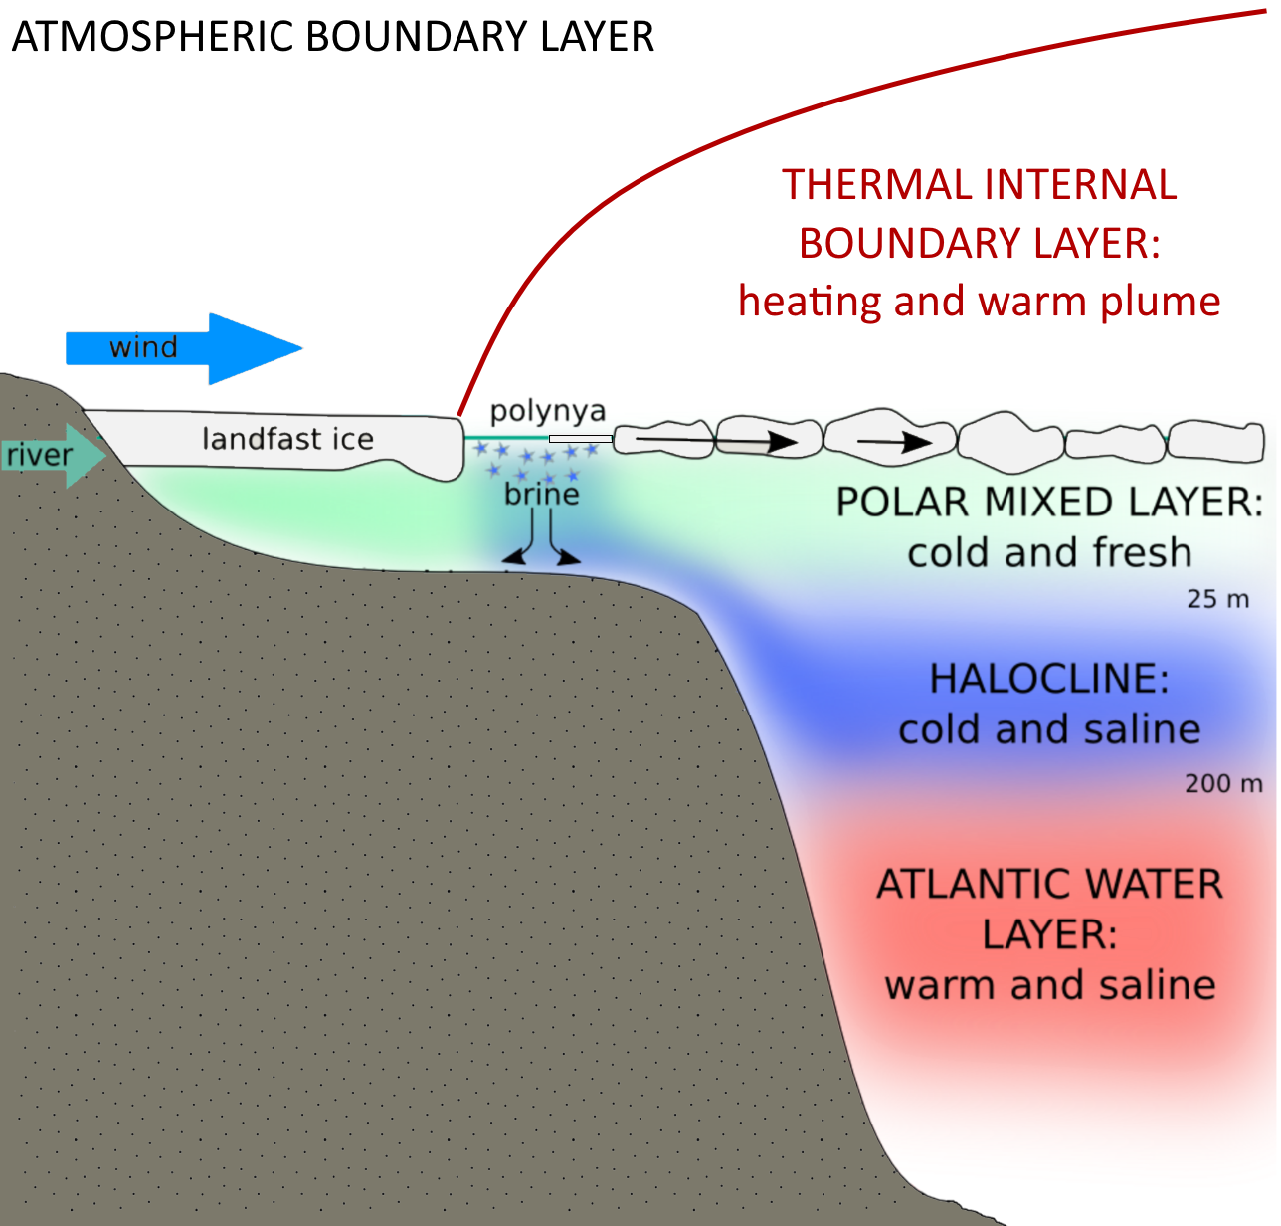
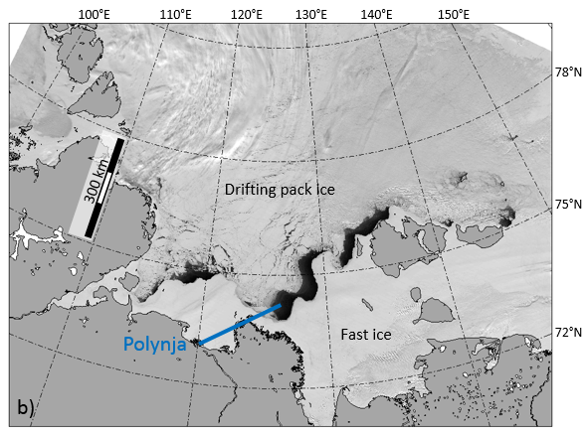
Polynyas
Fixed hotspots for atmosphere-ice-ocean processes
Comparison of MODIS-based thin-ice thicknesses with ice draft measurements in the Laptev Sea & Chukchi Sea
European Geoscience Union – General Assembly 2021
Open water & thin sea-ice (~ up to 20cm)
→ Enhanced exchange-processes between:
Atmosphere
  Heat-, momentum- & moisture-transport
  Aerosol supply
  Gas exchange
Sea-ice
  Winter: continuous ice formation (negative energy balance)
  Ice formation → salt flux into the ocean
Ocean
  Salt input has influence on ocean stratification
  Feedback to ocean heat-flux
LAPTEV SEA MYD09 (NIR) | 30 Apr 2008
Tap!
LOCATIONS in the Arctic
Modified from Itkin et al. (2015)
>> CLICK <<
BACKGROUND
HOME
ABSTRACT
CONTACT
Itkin, P., M. Losch, and R. Gerdes (2015): Landfast ice affects the stability of the Arctic halocline: Evidence from a numerical model. J. Geophys. Res.Oceans,120, 2622–2635, doi:10.1002/2014JC010353.

Slide 4
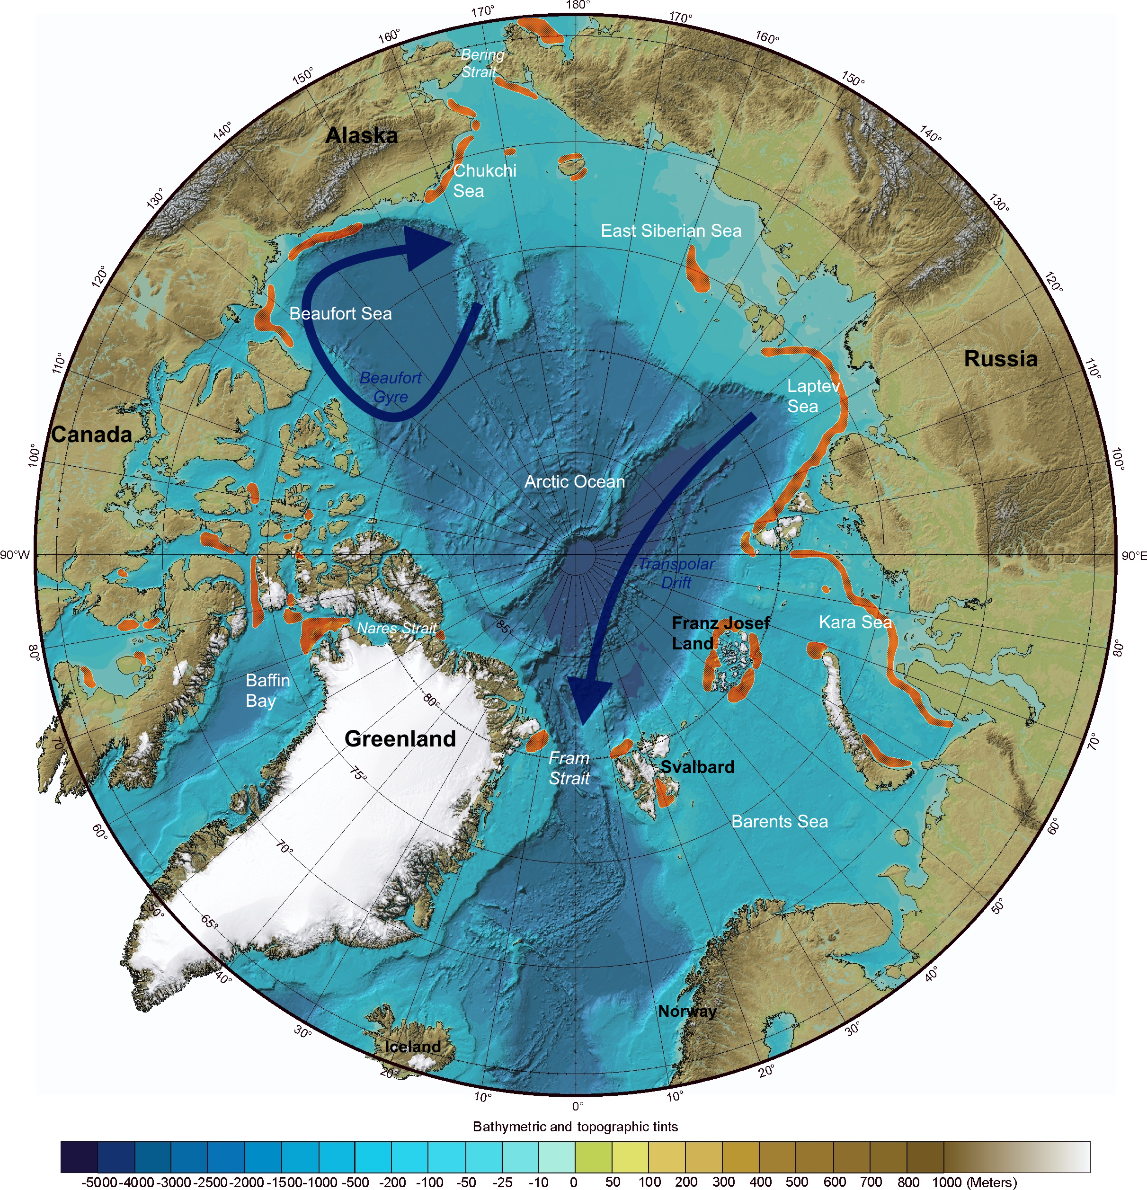
Polynyas
Fixed hotspots for atmosphere-ice-ocean processes
Comparison of MODIS-based thin-ice thicknesses with ice draft measurements in the Laptev Sea & Chukchi Sea
European Geoscience Union – General Assembly 2021
Known locations of recurring polynyas
Open water & thin sea-ice (~ up to 20cm)
→ Enhanced exchange-processes between:
Atmosphere
  Heat-, momentum- & moisture-transport
  Aerosol supply
  Gas exchange
Sea-ice
  Winter: continuous ice formation (negative energy balance)
  Ice formation → salt flux into the ocean
Ocean
  Salt input has influence on ocean stratification
  Feedback to ocean heat-flux
Modified from Jokobsson et al. (2012)
>> CLICK <<
BACKGROUND
HOME
ABSTRACT
CONTACT
Jakobsson, M., et al. (2012), The International Bathymetric Chart of the Arctic Ocean (IBCAO) Version 3.0, Geophys. Res. Lett., 39, L12609, doi:10.1029/2012GL052219.

Slide 5
Comparison of MODIS-based thin-ice thicknesses with ice draft measurements in the Laptev Sea & Chukchi Sea
European Geoscience Union – General Assembly 2021
Abstract
Acquiring information about the thickness of thin Arctic sea-ice is an important aspect of assessing atmosphere – sea-ice – ocean interactions, as the ice thickness directly relates to the magnitude of energy fluxes at the sea-ice interfaces. In winter, these fluxes are linked to sea-ice formation and hence accompanying processes such as physically-induced upper-ocean convection and turbulent mixing of the lower atmospheric boundary layer. It remains a big challenge to validate satellite-derived thin-ice thicknesses, first and foremost due to the lack of suitable in-situ data in these remote areas.
In order to address this issue, we here present the first insight into a comparison between high-resolution (2km) MODIS thermal infrared satellite data (available for 2002/2003 to 2017/2018) and time series of ice-draft data obtained from moored Ice Profiling Sonar (IPS) data in the Chukchi Sea (2009/2010 to 2011/2012) and Laptev Sea (2013/2014 to 2014/2015). The MODIS data set is based on a 1D energy balance model, where thin-ice thicknesses (0 to 50 cm) are directly derived from ice-surface temperature swath-data and ERA-Interim atmospheric reanalysis data. In order to facilitate the comparison, the 1Hz IPS ice-draft data is first empirically converted to ice thickness and afterwards resampled to 5-minute modal-values to find matching MODIS swath data.
It shows that the agreement between the MODIS and IPS ice-thickness data largely depends on the thickness of the ice sampled by the IPS. We found the highest agreement for ice thickness values below 20 cm, which tend to appear more frequently at the Chukchi Sea mooring location. More generally, ice thicknesses up to approximately 40 cm seem to be overestimated by MODIS. For thicker ice, the limitations of the MODIS ice-thickness retrieval result in an underestimation.
HOME
ABSTRACT
CONTACT

Slide 6
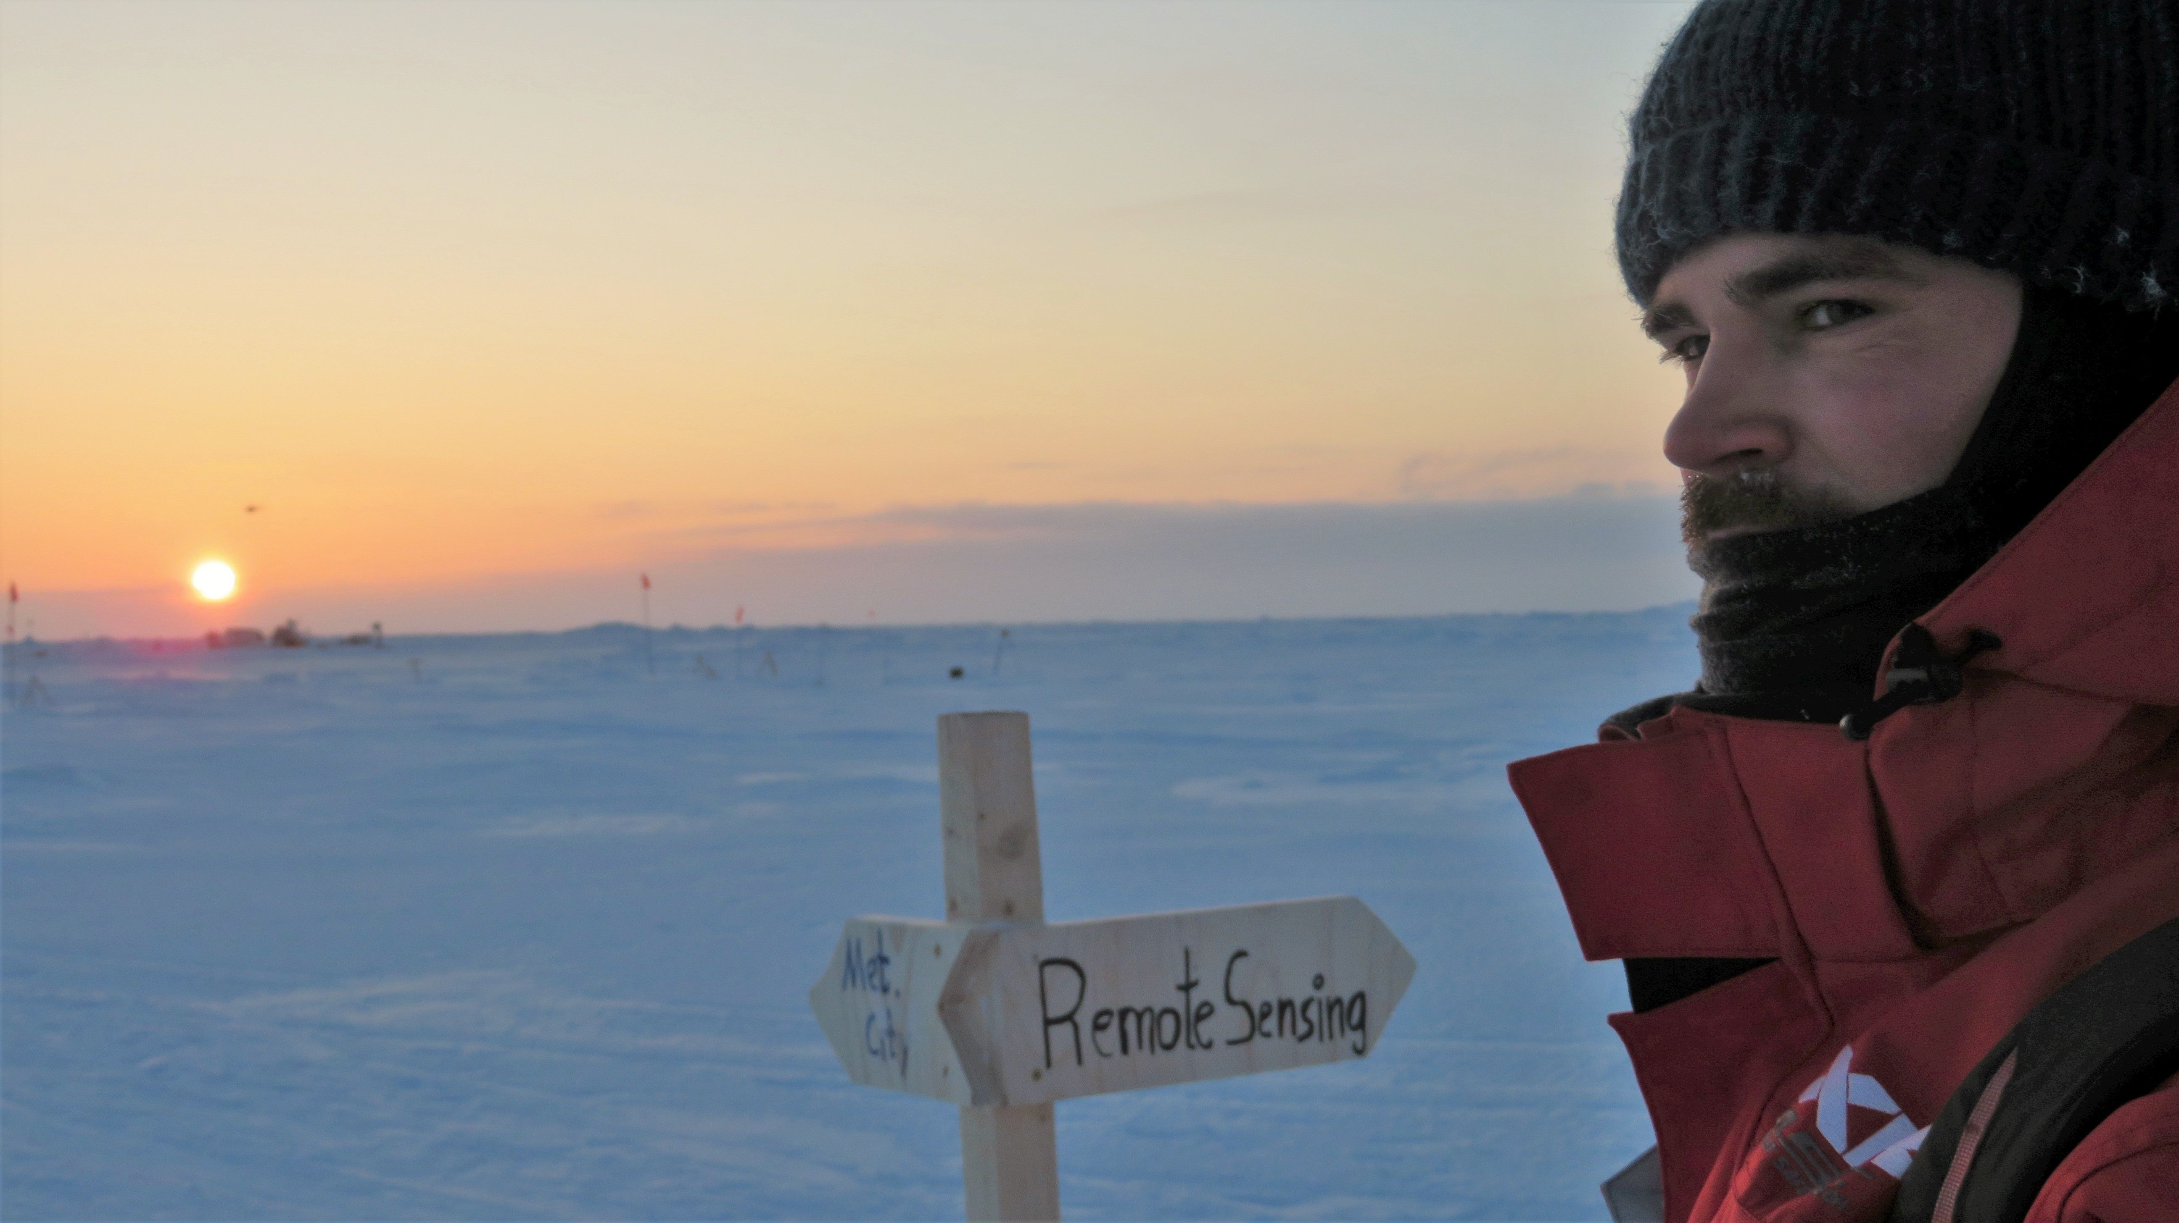


Comparison of MODIS-based thin-ice thicknesses with ice draft measurements in the Laptev Sea & Chukchi Sea
European Geoscience Union – General Assembly 2021
Andreas Preußer
Environmental Meteorology
University of Trier
Behringstr. 21
54296 Trier
Germany
+49(0)651-201-4622
preusser@uni-trier.de
@polar_andi
© Julia Schmale
HOME
ABSTRACT
CONTACT

Slide 7
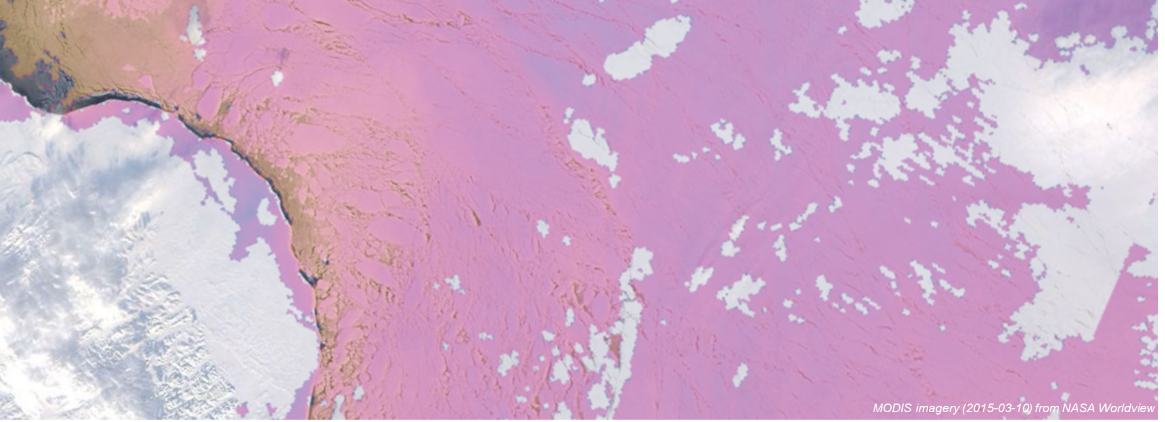
Comparison of MODIS-based thin-ice thicknesses with ice draft measurements in the Laptev Sea & Chukchi Sea
European Geoscience Union – General Assembly 2021
Background
MODIS thermal infrared satellite data (1km spatial resolution) frequently used to derive the thickness of thin-ice in Arctic & Antarctic polynyas due to its inverse relationship with the ice surface temperature
In-situ measurements of thin-ice extremely challenging, especially during wintertime (nighttime conditions)
Utilizing data from Ice Profiling Sonars (IPS; also referred to as Upward Looking Sonars – ULS) can partially overcome this problem at some fixed locations on the continental shelf
Hence: First evaluation of MODIS-derived ice thicknesses with IPS measurements highly interesting
>> CLICK <<
APPROACH OF THIS STUDY
>> CLICK <<
What is a polynya and why do we care?
HOME
ABSTRACT
CONTACT

Slide 8
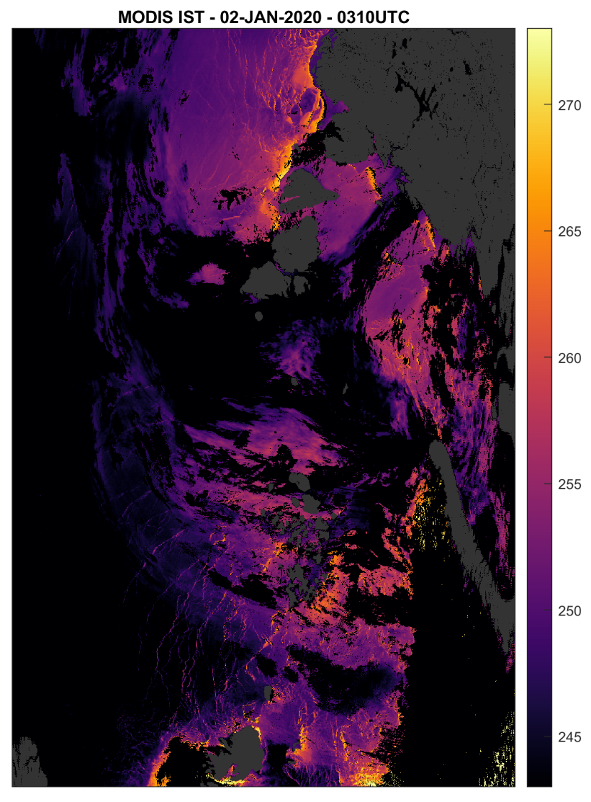
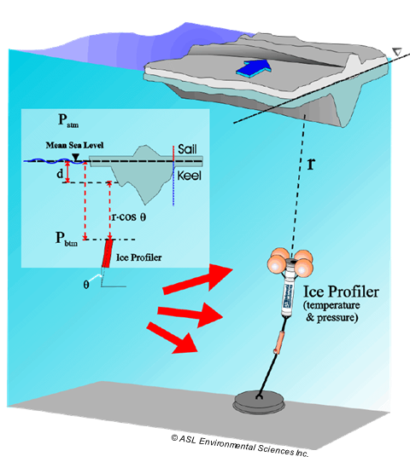
Comparison of MODIS-based thin-ice thicknesses with ice draft measurements in the Laptev Sea & Chukchi Sea
European Geoscience Union – General Assembly 2021
Approach
Extract MODIS ice thickness around mooring position
  Median thickness in approx. 5km radius
  MODIS swath data: one image requires 5-minutes of acquisition
  Swath-data available for Oct-Apr
Process 1Hz / resampled 1Minute IPS data
  Find times when MODIS thickness data is available & IPS thickness is below 50 cm
  Taken as the mode from all IPS values for the 5 minutes after acquisition of the MODIS image
Calculate statistics & plot comparisons
>> CLICK <<
BACKGROUND
HOME
ABSTRACT
CONTACT

Slide 9
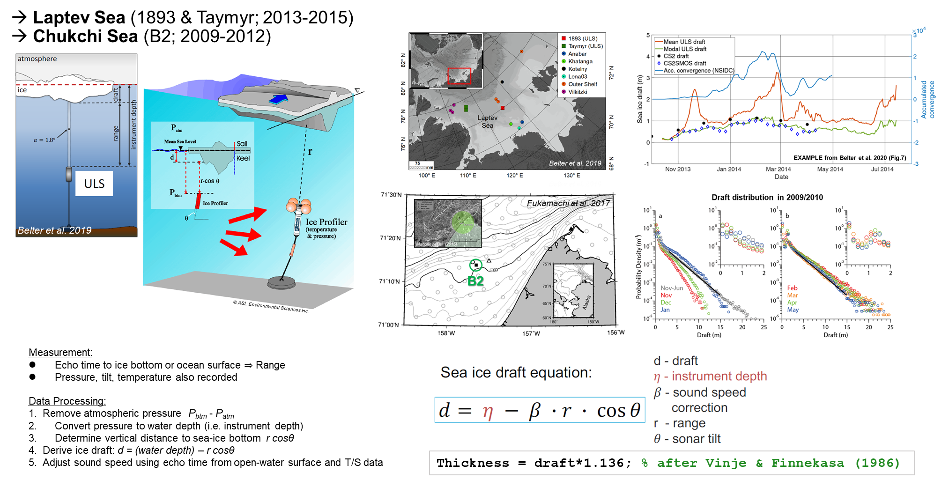
Comparison of MODIS-based thin-ice thicknesses with ice draft measurements in the Laptev Sea & Chukchi Sea
European Geoscience Union – General Assembly 2021
Ice Profiling Sonar (IPS) data (Fukamachi et al. 2017, Belter et al. 2019 & 2020)
Belter, H. J., Krumpen, T., Hendricks, S., Hoelemann, J., Janout, M. A., Ricker, R., and Haas, C.: Satellite-based sea ice thickness changes in the Laptev Sea from 2002 to 2017: comparison to mooring observations, The Cryosphere, 14, 2189–2203, https://doi.org/10.5194/tc-14-2189-2020, 2020.
Fukamachi, Y., Simizu, D., Ohshima, K., Eicken, H., Mahoney, A., Iwamoto, K., Moriya, E., Nihashi, S. (2017). Sea-ice thickness in the coastal northeastern Chukchi Sea from moored ice-profiling sonar. Journal of Glaciology, 63(241), 888-898. doi:10.1017/jog.2017.56
Vinje, T. and Finnekasa, O. (1986): The ice transport through Fram Strait,vol. 186, Norsk Polarinstitutt Skrifter, Norsk Polarinstitutt, 1986.
HOME
ABSTRACT
CONTACT

Slide 10
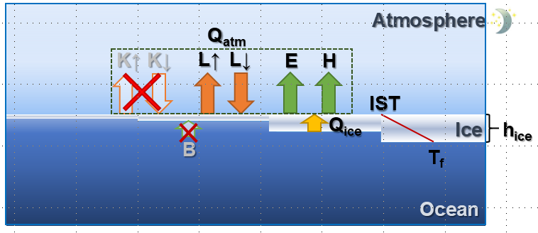
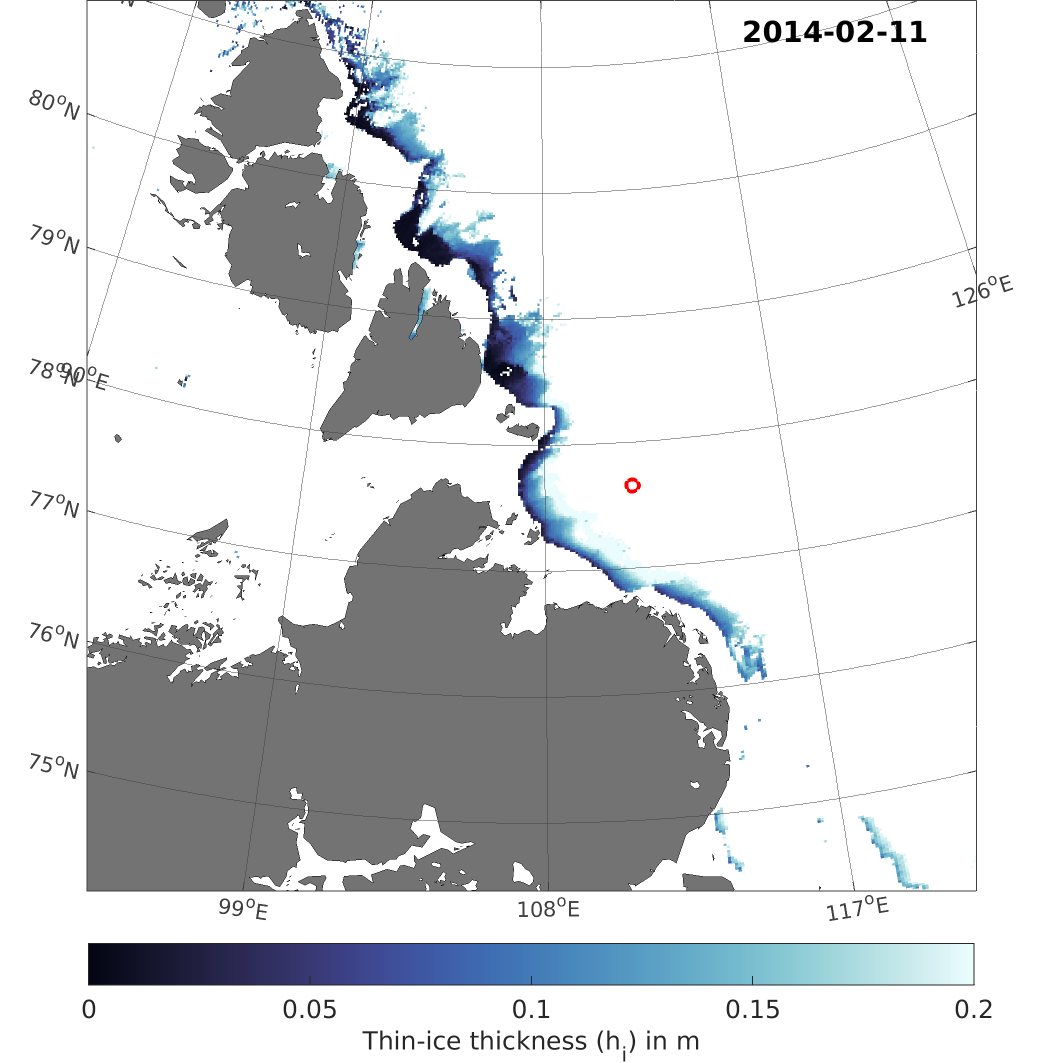
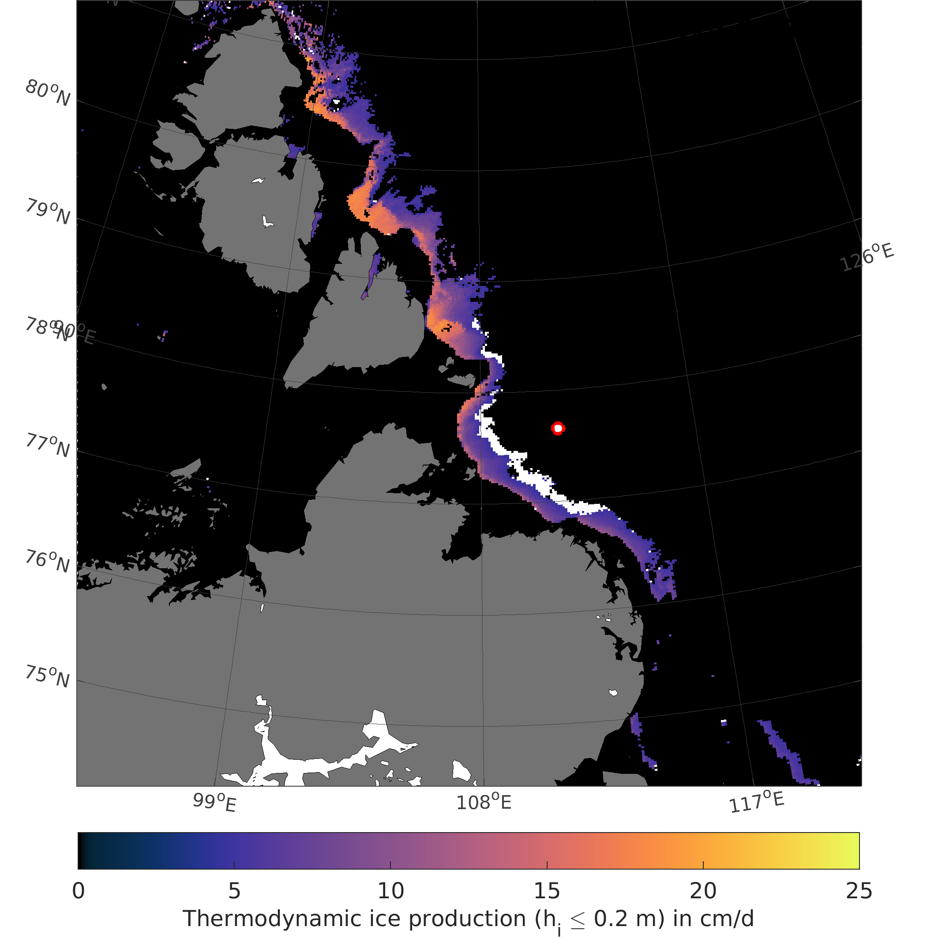
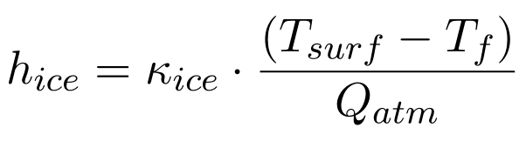
Comparison of MODIS-based thin-ice thicknesses with ice draft measurements in the Laptev Sea & Chukchi Sea
European Geoscience Union – General Assembly 2021
MODIS thin-ice thickness retrieval (as published in Preußer et al. 2019)
>> CLICK <<
ANIMATION FOR WINTER 16/17
MODIS Ice Surface Temperature (MxD29 C6)
* Feat. cloud filtering & spatial interpolation
1-D energy balance model
Swath-wise thin-ice thickness (TIT)
Daily TIT composites*
Heat flux
(Q_{i} = Q_{atm})
Ice production
Atmospheric data
Polynya
characteristics
e.g., Polynya area
For retrieval in the Arctic:
ERA-Interim (former standard approach)
COSMO CLM @15km (future studies)
ERA5 (future studies)
>> CLICK <<
Laptev Sea polynyas
2002-2018
Chukchi Sea polynya
2002-2018
HOME
ABSTRACT
CONTACT
Preußer, A., Ohshima, K. I., Iwamoto, K., Willmes, S., & Heinemann, G. (2019). Retrieval of wintertime sea ice production in Arctic polynyas using thermal infrared and passive microwave remote sensing data. Journal of Geophysical Research: Oceans, 124, 5503– 5528. https://doi.org/10.1029/2019JC014976

Slide 11
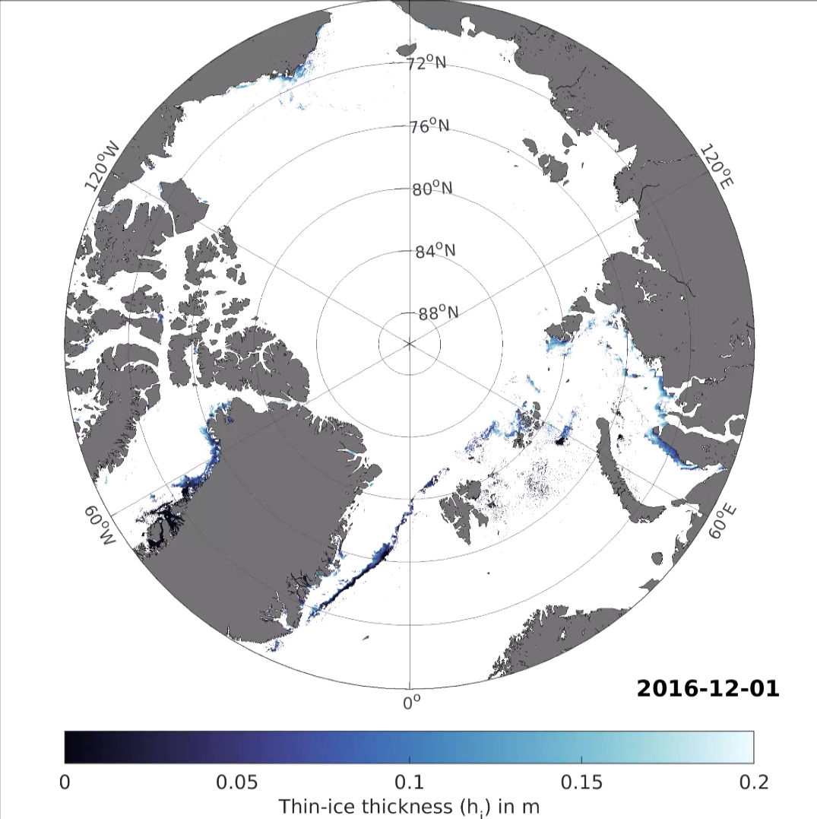
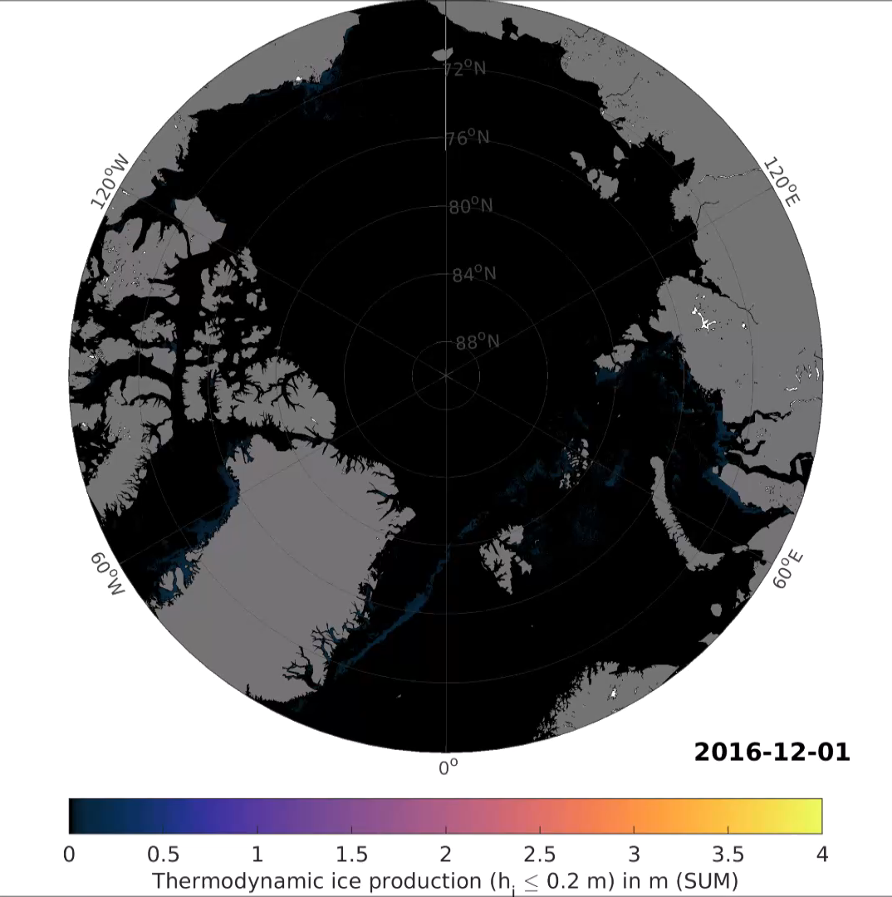
Comparison of MODIS-based thin-ice thicknesses with ice draft measurements in the Laptev Sea & Chukchi Sea
European Geoscience Union – General Assembly 2021
MODIS thin-ice thicknesses (daily composites) and accumulated ice production 2016/2017 (DJFM)
BACK
HOME
ABSTRACT
CONTACT

Slide 12
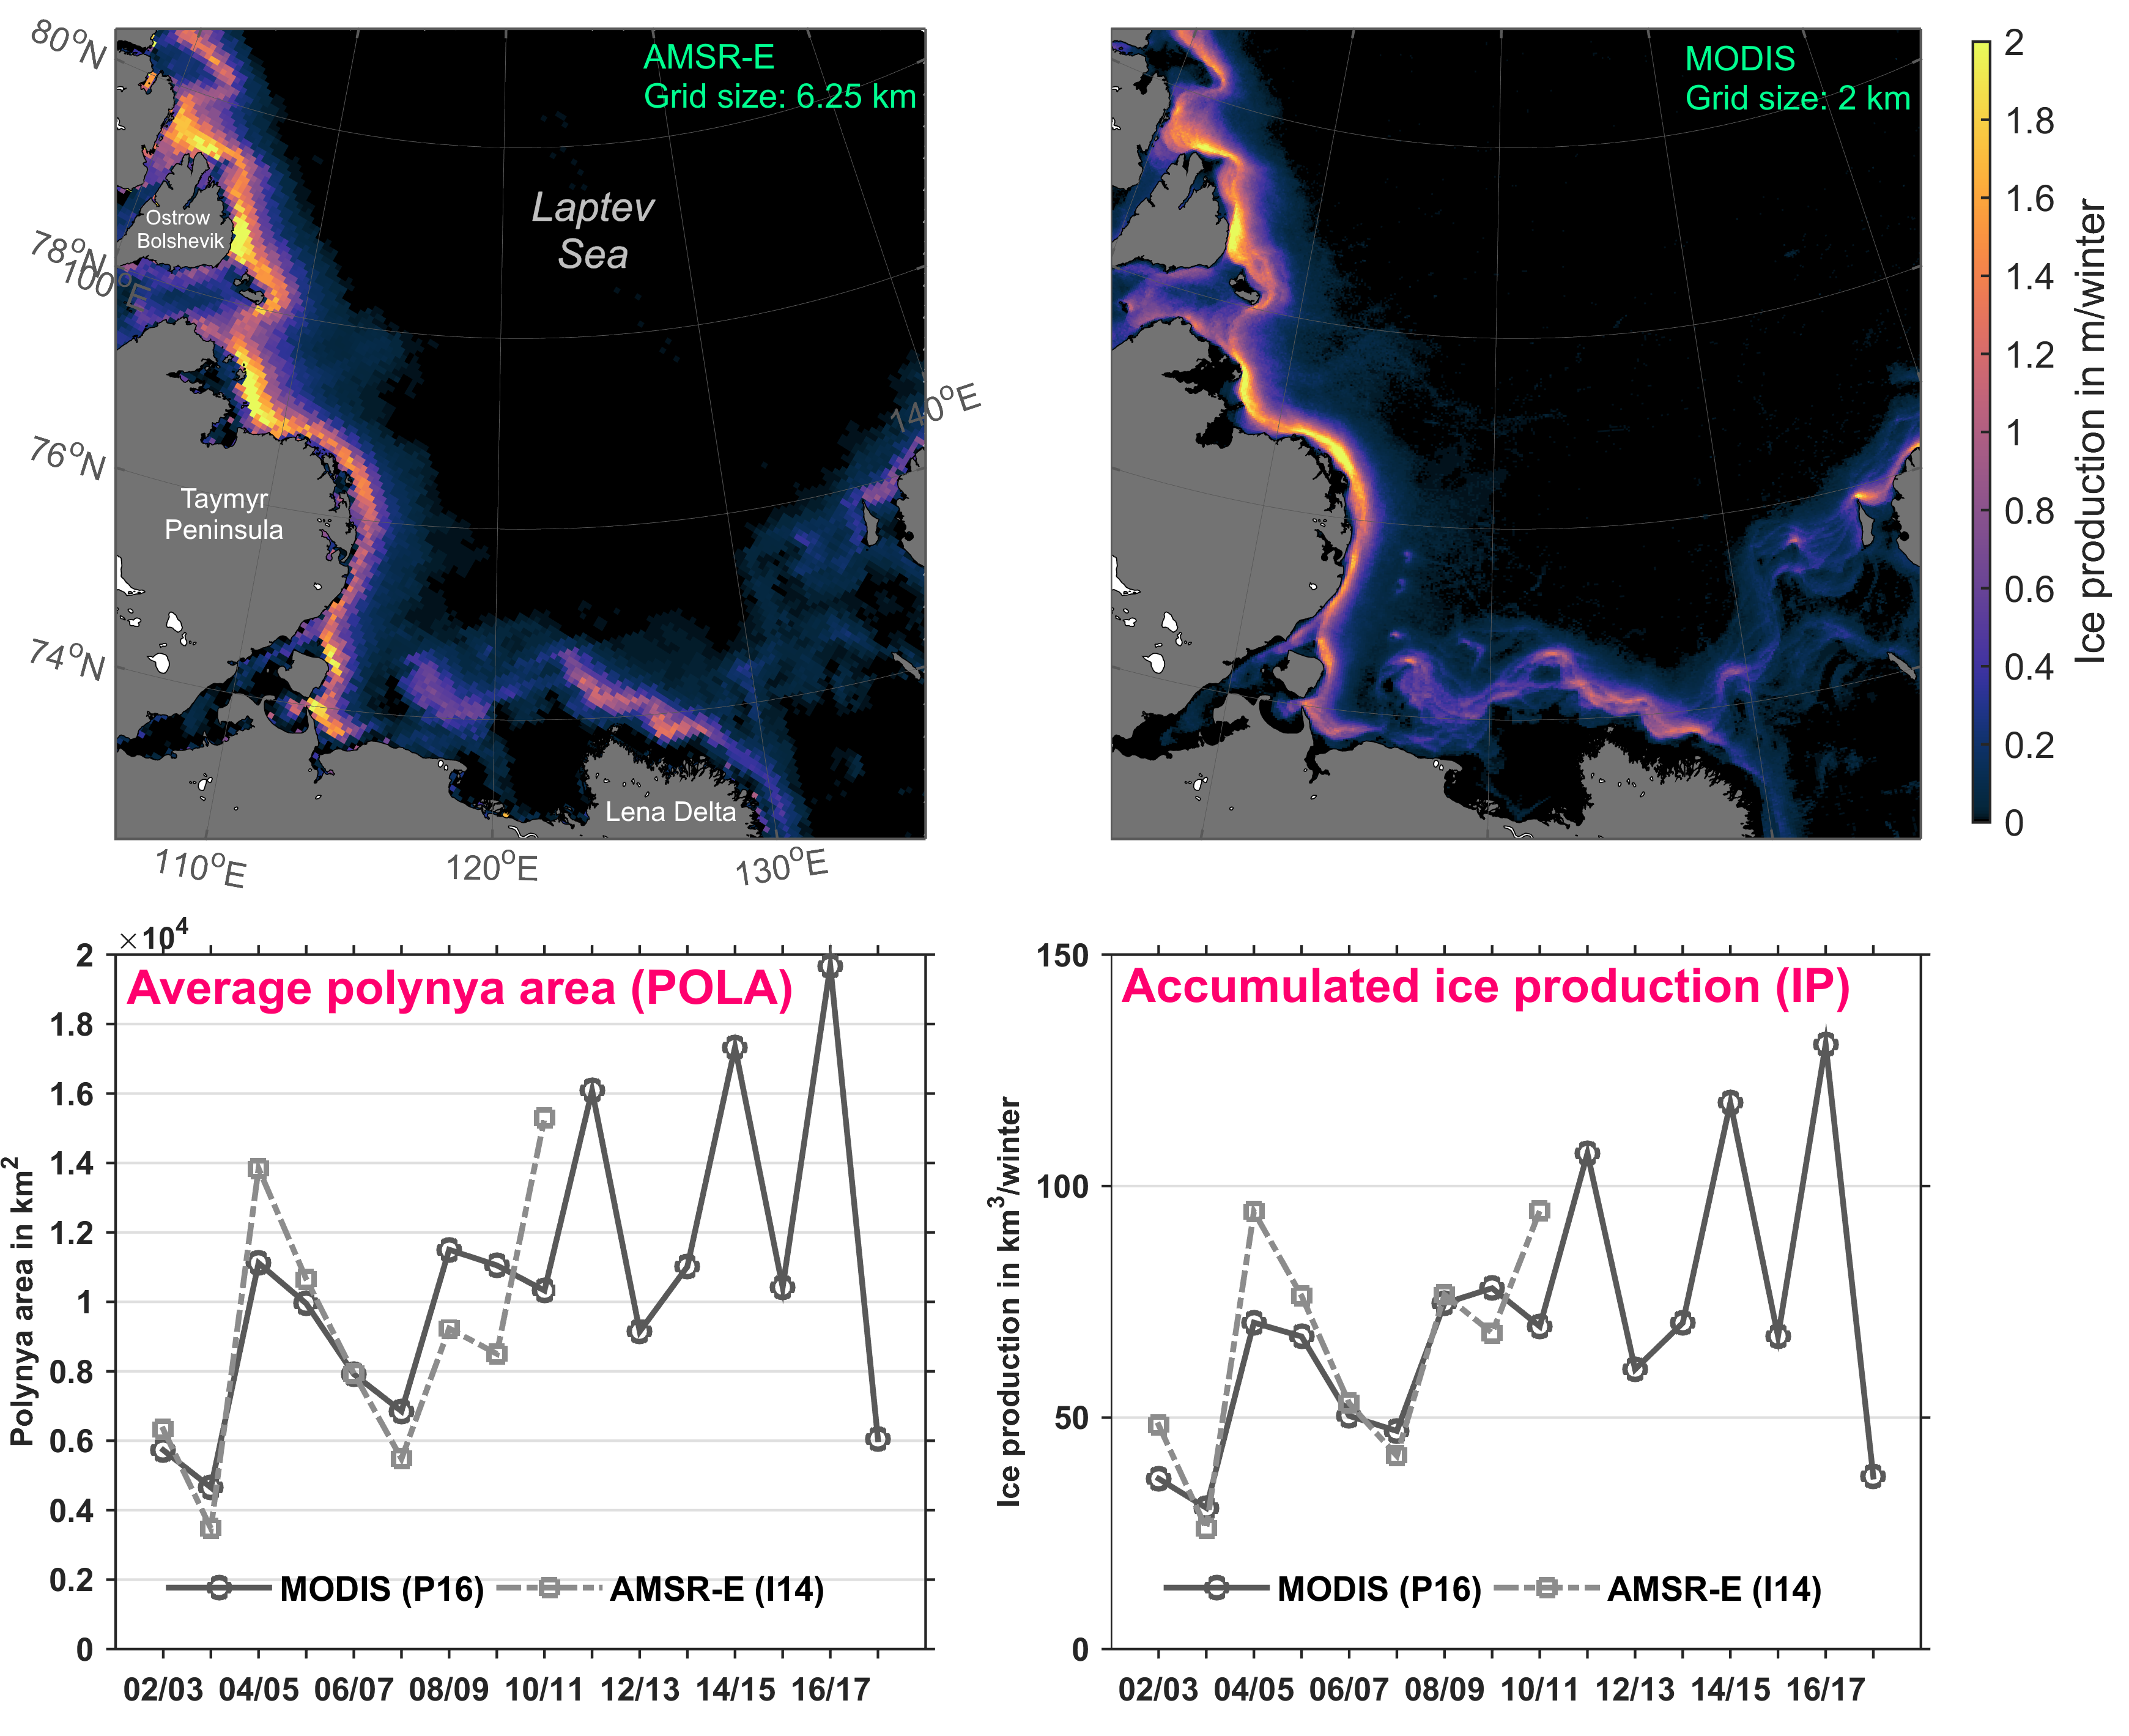
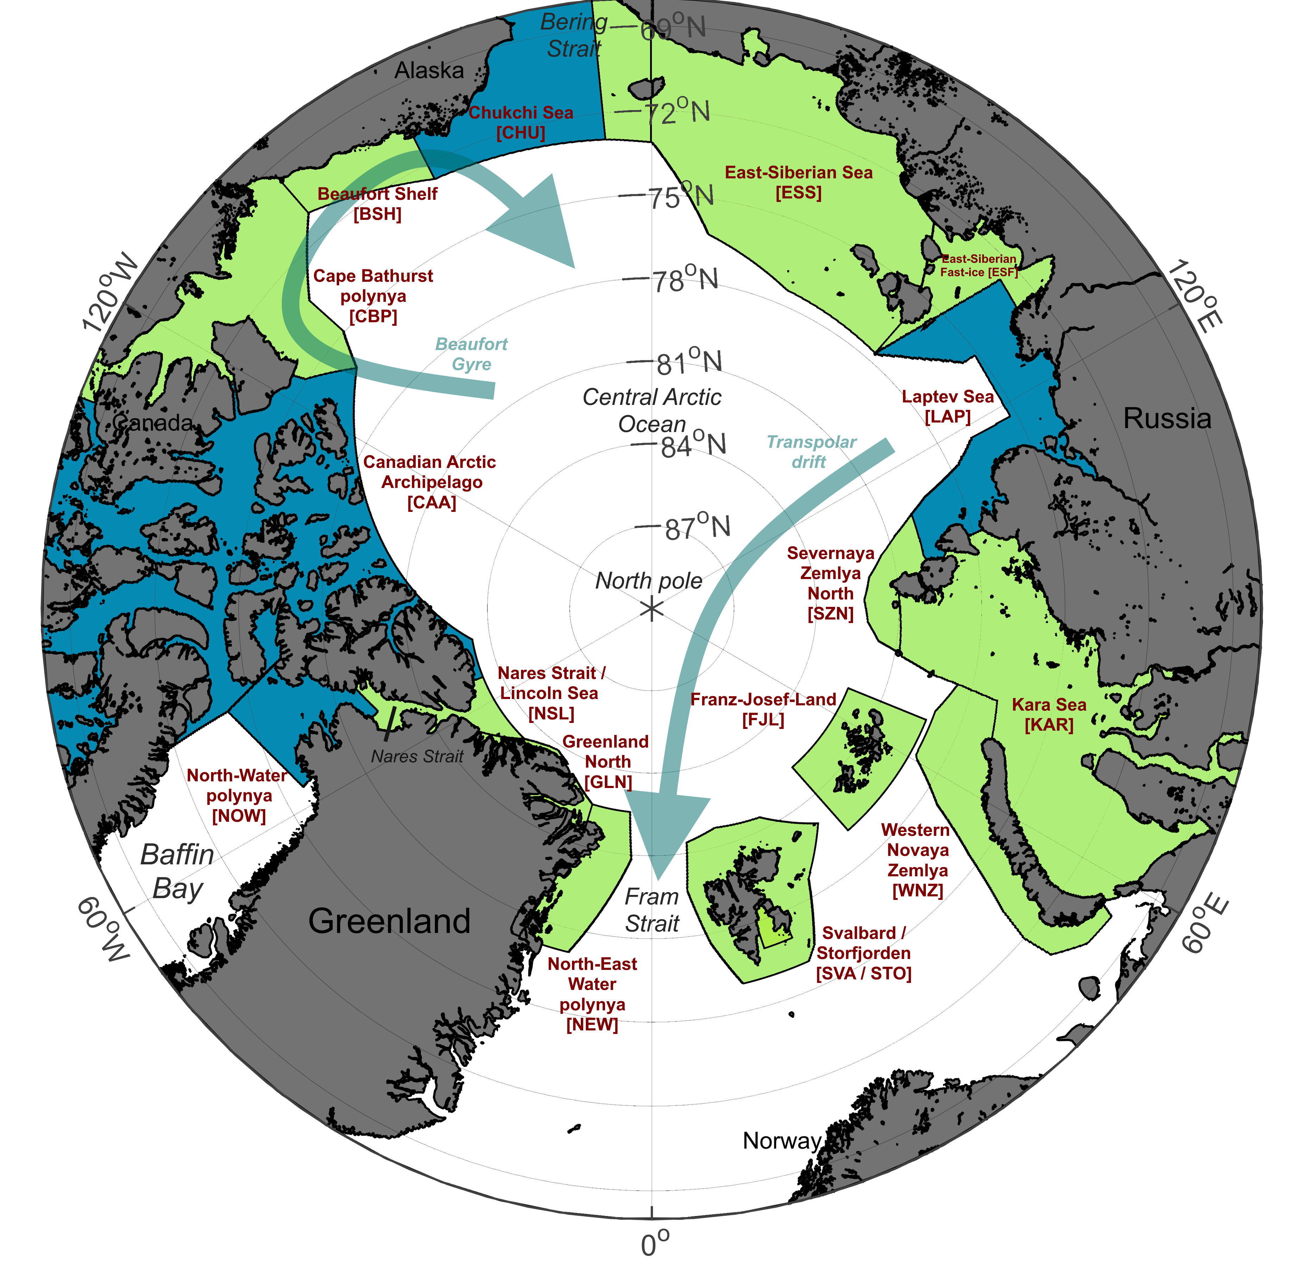
Comparison of MODIS-based thin-ice thicknesses with ice draft measurements in the Laptev Sea & Chukchi Sea
European Geoscience Union – General Assembly 2021
Laptev Sea polynyas
Comparison polynya characteristics in the Laptev Sea between the cloud-corrected MODIS data set (P16) and the AMSR-E data set (I14). The two upper panels show spatial distributions of the average (2002/2003 to 2010/2011) accumulated ice production (m per winter) during winter (December to March) for each sensor. The lower left and right panels illustrate a time series of the annual average polynya area (POLA; TIT ≤ 0.2m) in km² and the annual accumulated ice production (IP) in km³, respectively, from 2002/2003 to 2017/2018. Both sensor systems (MODIS / AMSR-E) are compared, where dark and light grey lines denote to MODIS (P16) and AMSR-E (I14), respectively.
Preußer et al. (2019) - JGRO
BACK
HOME
ABSTRACT
CONTACT
Preußer, A., Ohshima, K. I., Iwamoto, K., Willmes, S., & Heinemann, G. (2019). Retrieval of wintertime sea ice production in Arctic polynyas using thermal infrared and passive microwave remote sensing data. Journal of Geophysical Research: Oceans, 124, 5503– 5528. https://doi.org/10.1029/2019JC014976

Slide 13
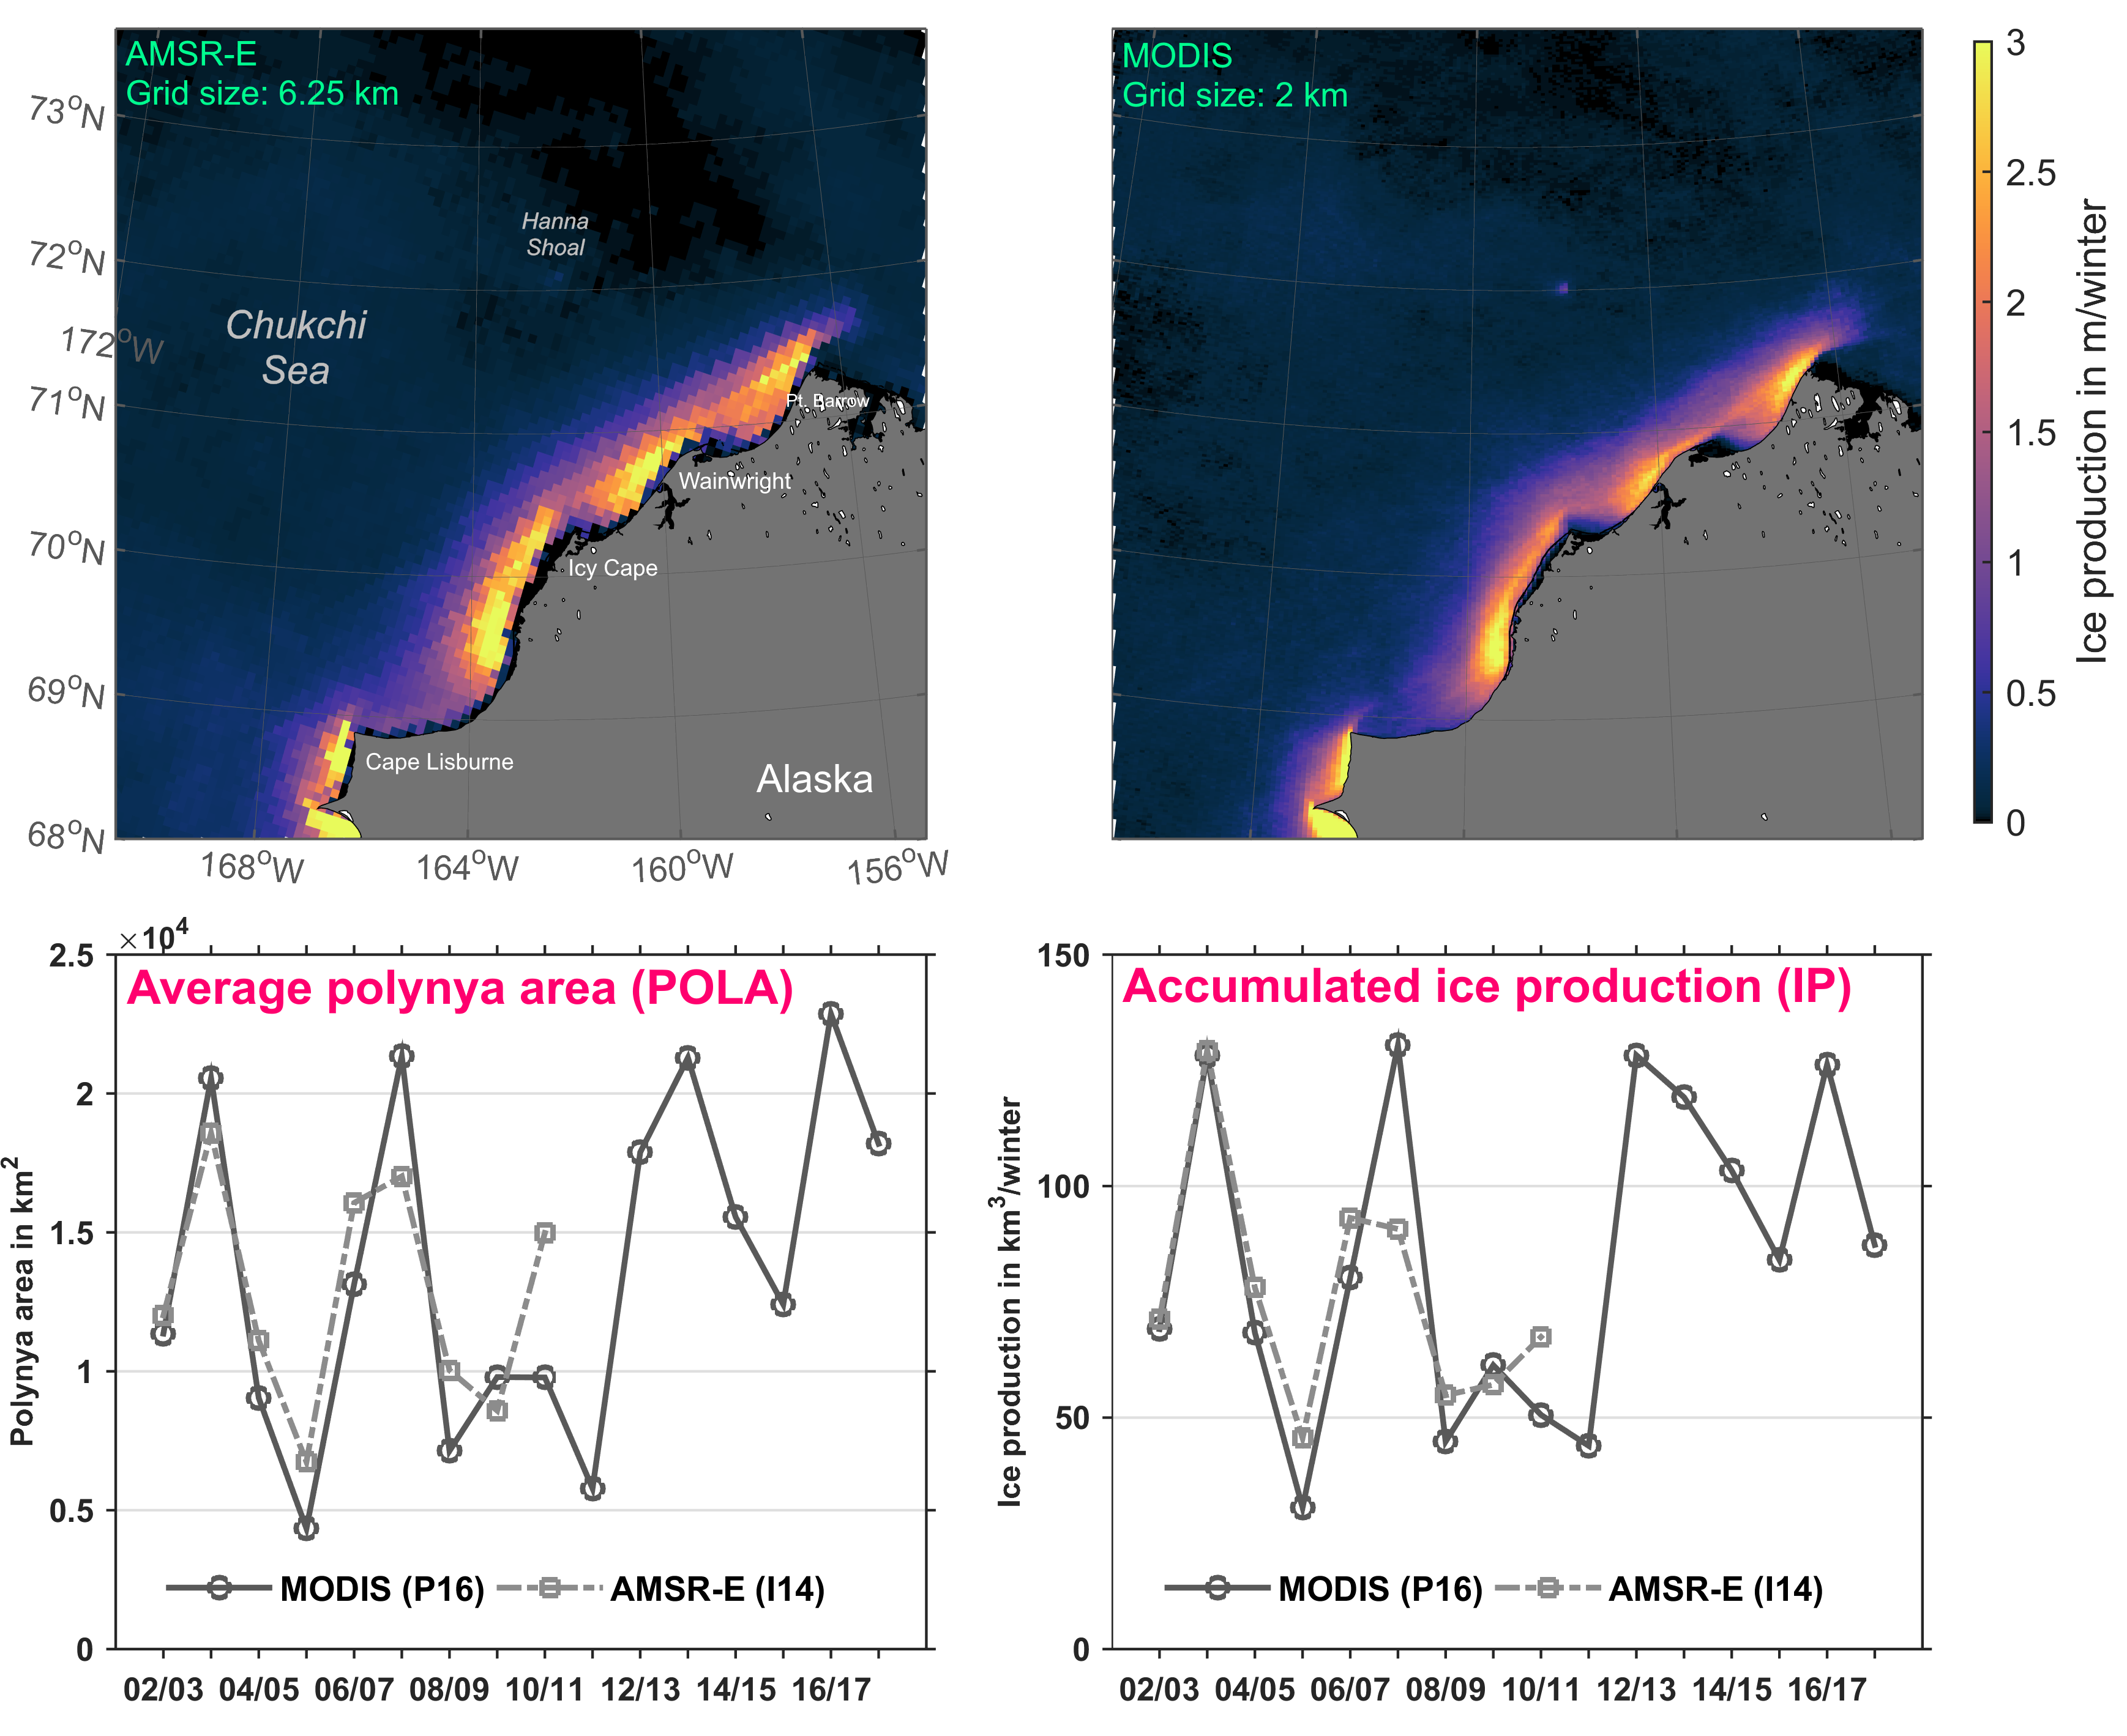
Comparison of MODIS-based thin-ice thicknesses with ice draft measurements in the Laptev Sea & Chukchi Sea
European Geoscience Union – General Assembly 2021
Chukchi Sea polynyas
Comparison polynya characteristics in the Chukchi Sea between the cloud-corrected MODIS data set (P16) and the AMSR-E data set (I14). The two upper panels show spatial distributions of the average (2002/2003 to 2010/2011) accumulated ice production (m per winter) during winter (December to March) for each sensor. The lower left and right panels illustrate a time series of the annual average polynya area (POLA; TIT ≤ 0.2m) in km² and the annual accumulated ice production (IP) in km³, respectively, from 2002/2003 to 2017/2018. Both sensor systems (MODIS / AMSR-E) are compared, where dark and light grey lines denote to MODIS (P16) and AMSR-E (I14), respectively.
Preußer et al. (2019) - JGRO
BACK
HOME
ABSTRACT
CONTACT
Preußer, A., Ohshima, K. I., Iwamoto, K., Willmes, S., & Heinemann, G. (2019). Retrieval of wintertime sea ice production in Arctic polynyas using thermal infrared and passive microwave remote sensing data. Journal of Geophysical Research: Oceans, 124, 5503– 5528. https://doi.org/10.1029/2019JC014976

Slide 14
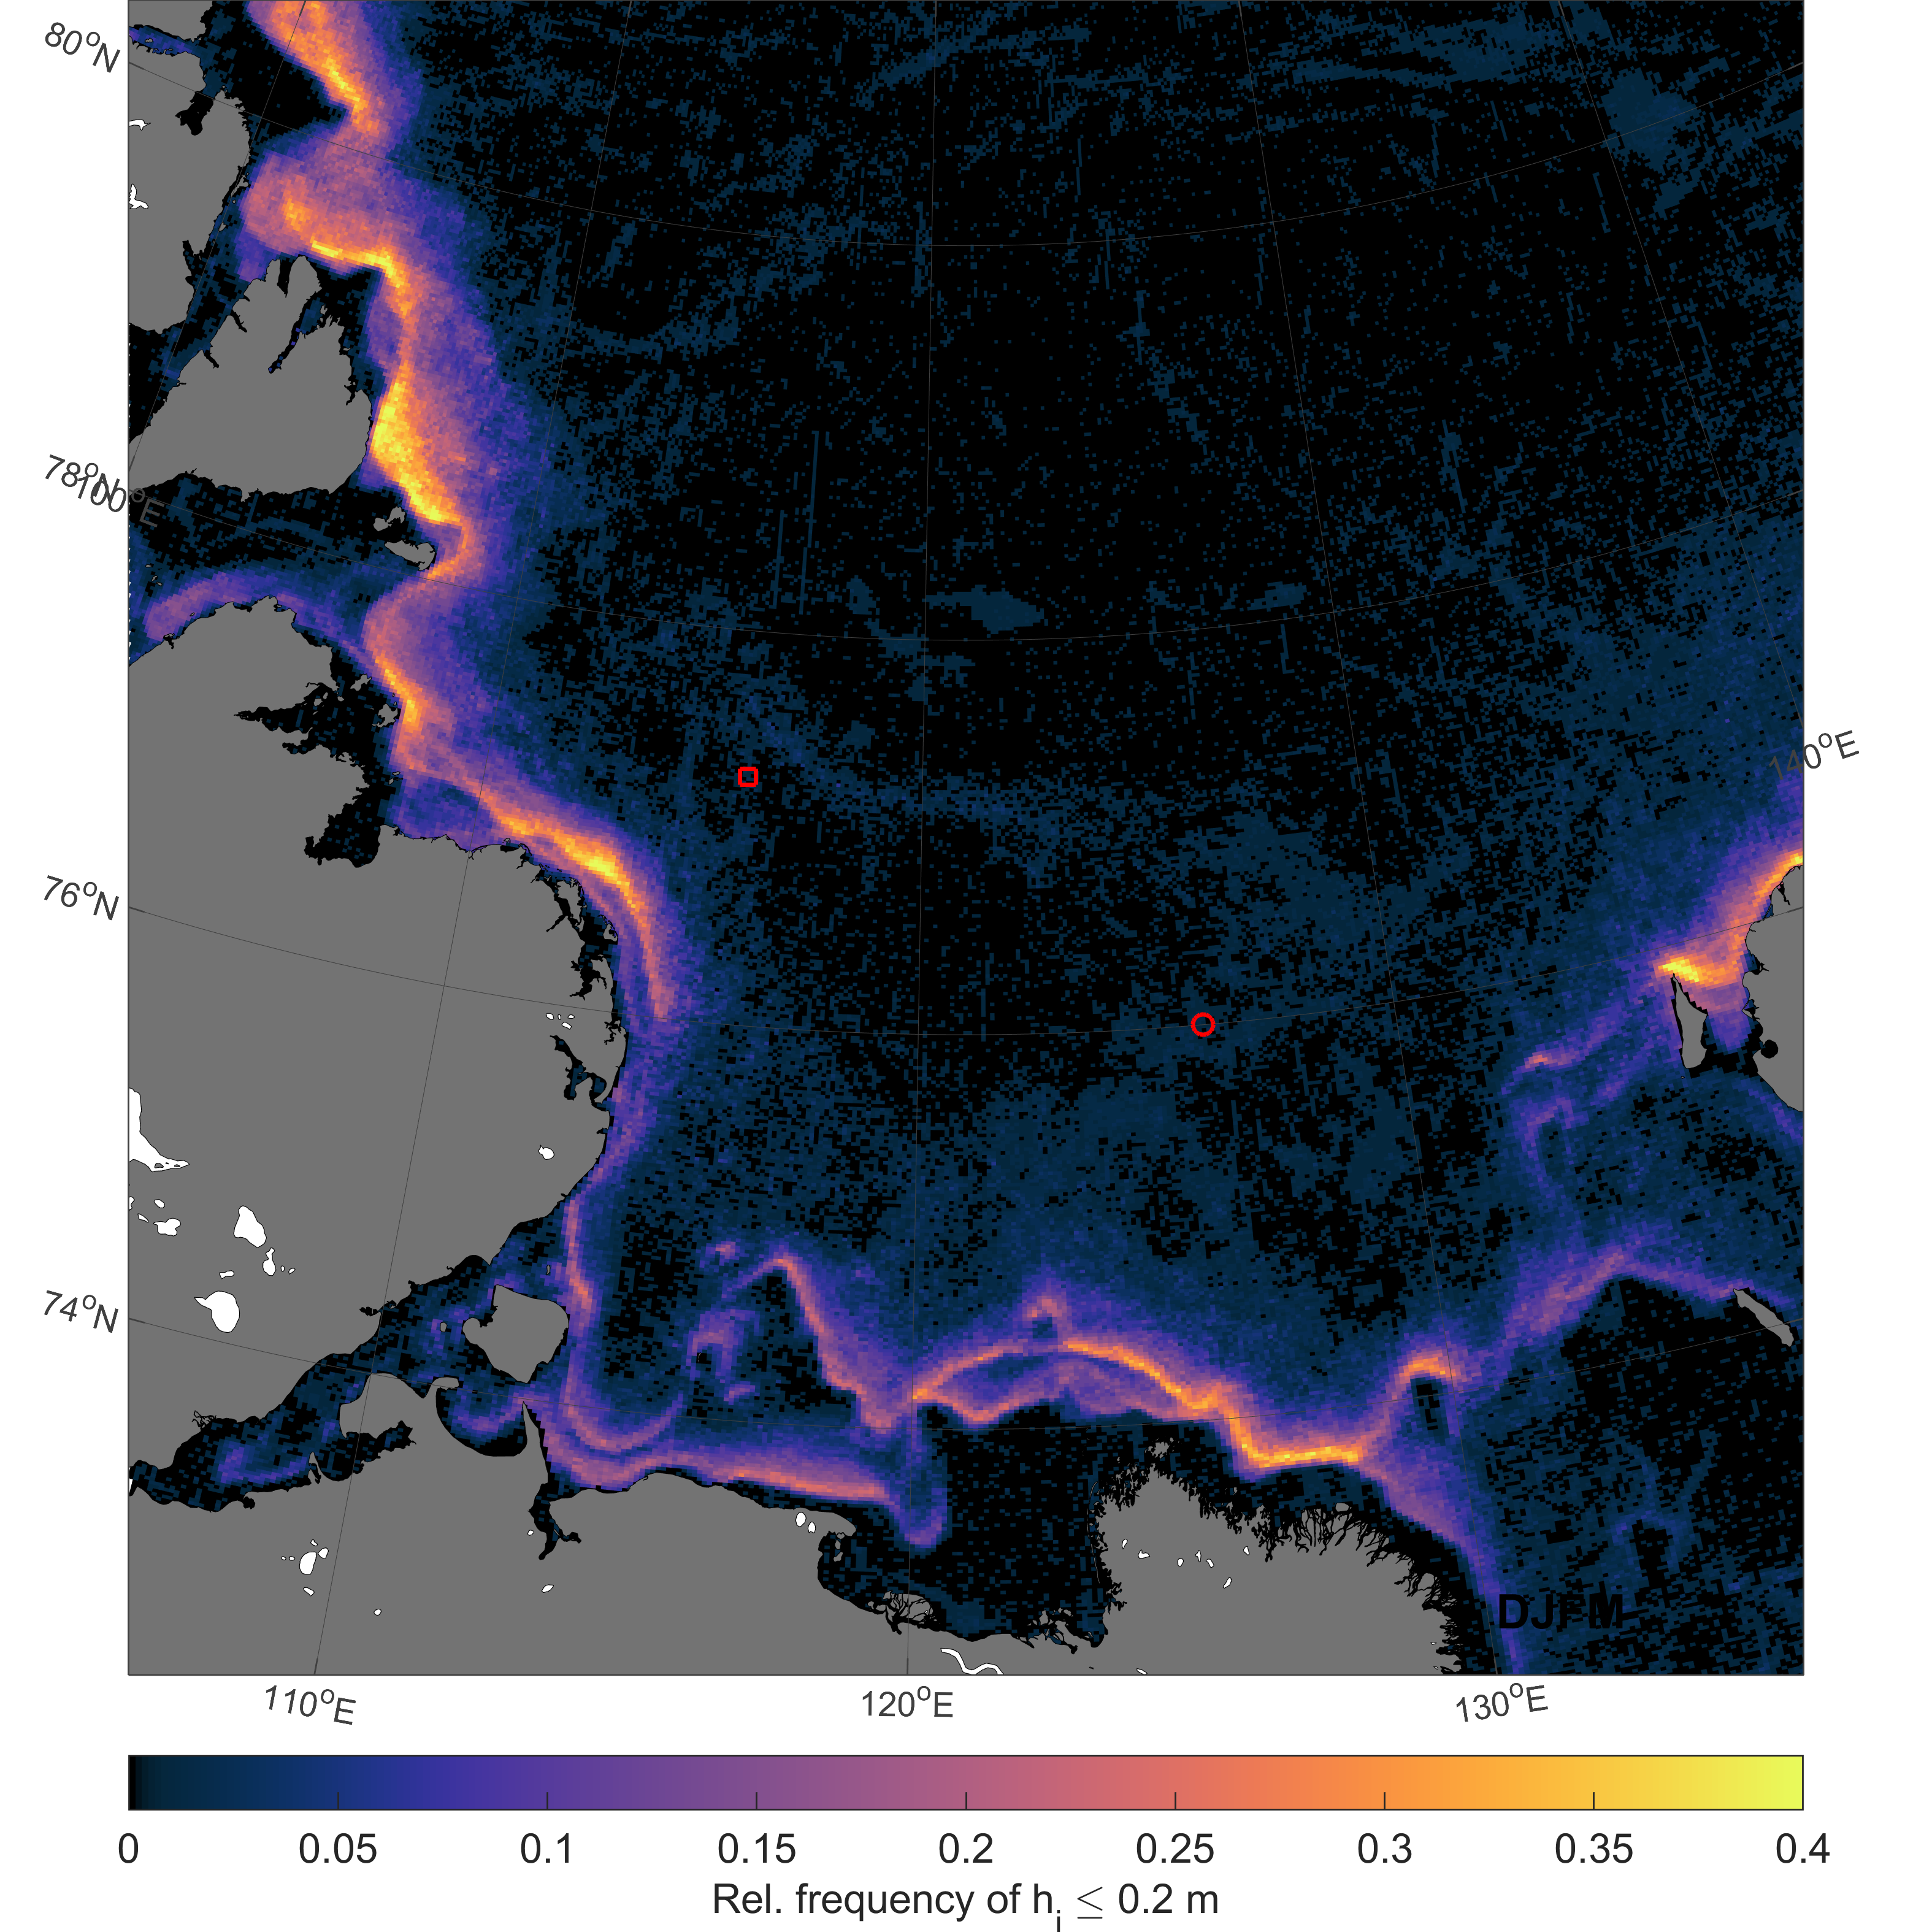
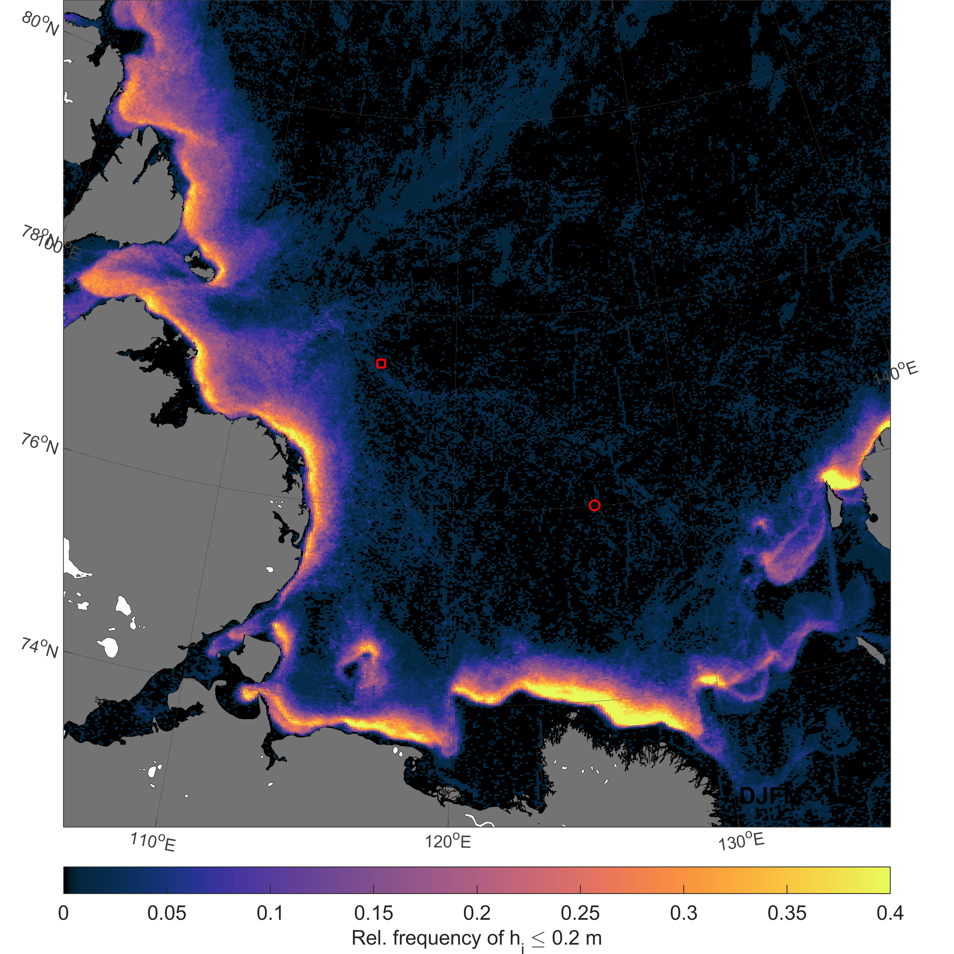
Comparison of MODIS-based thin-ice thicknesses with ice draft measurements in the Laptev Sea & Chukchi Sea
European Geoscience Union – General Assembly 2021
Relative frequencies of MODIS thin-ice thicknesses below 20 cm (DEC-MAR)
2013/2014
2014/2015
IPS more affected by lead openings
TAYMYR
TAYMYR
1893
1893
Chukchi Sea
Raw counts, no add. filters applied
Raw counts, no add. filters applied
Laptev Sea
HOME
ABSTRACT
CONTACT

Slide 15
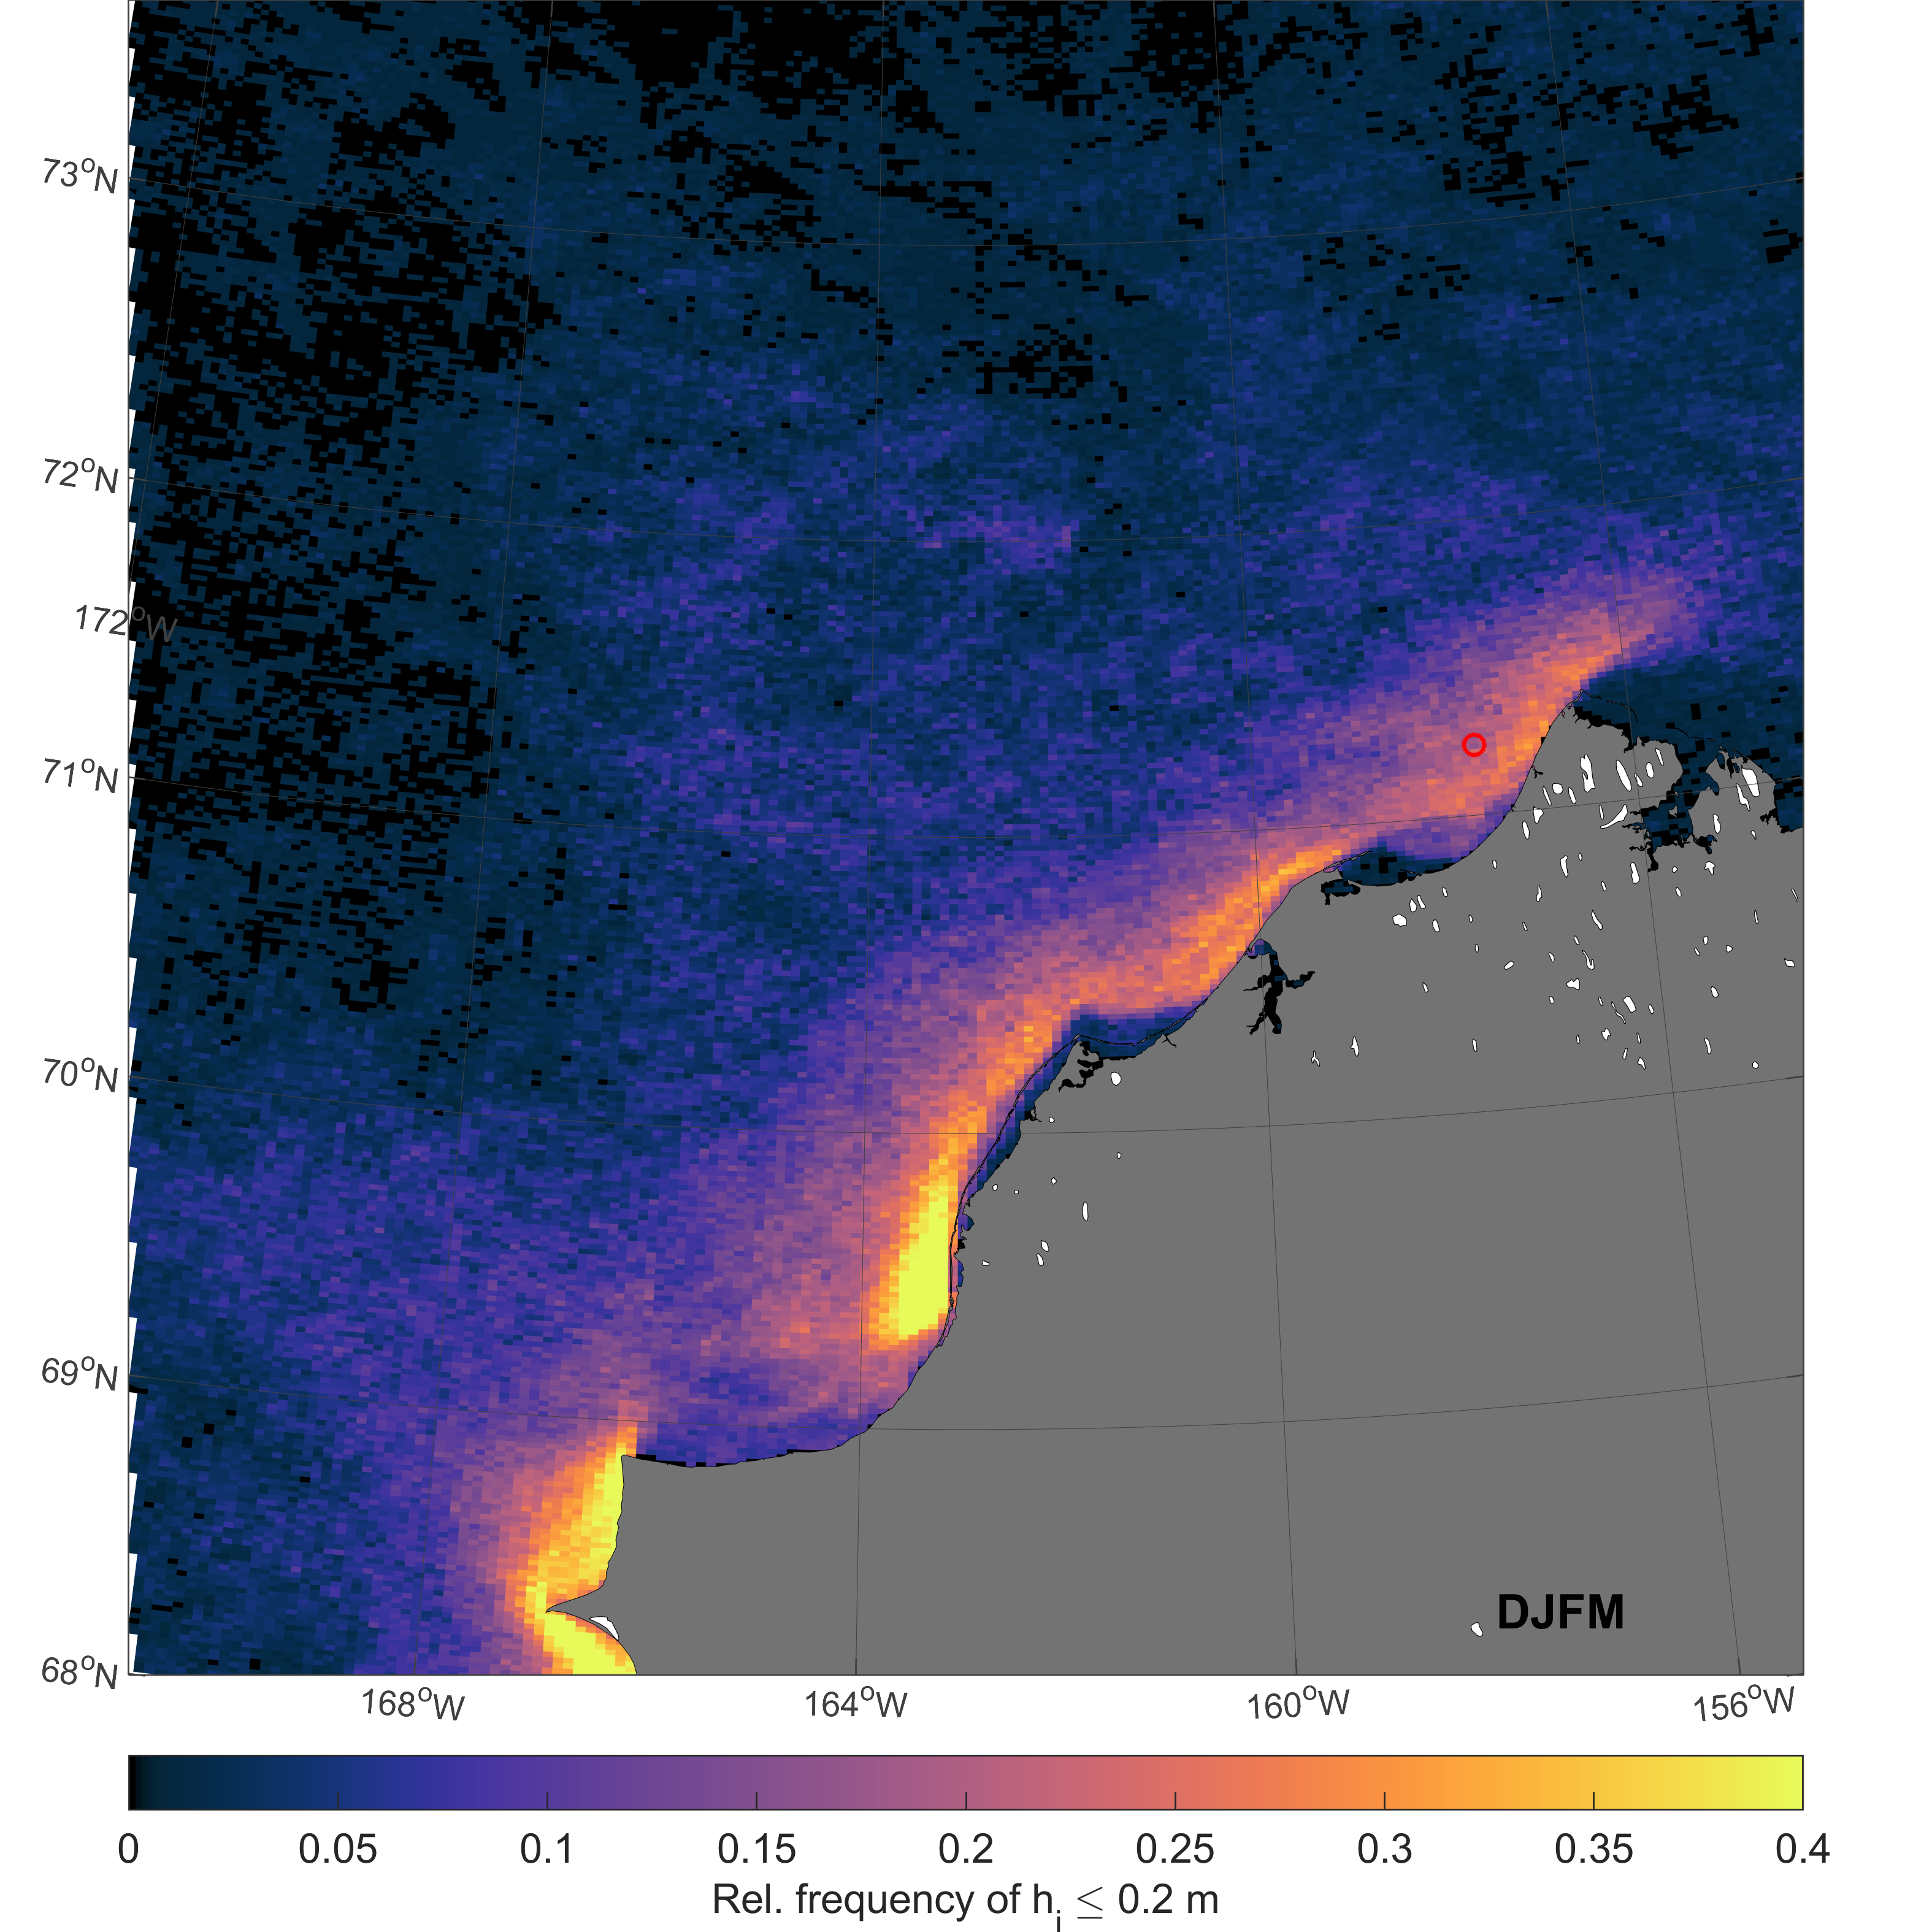
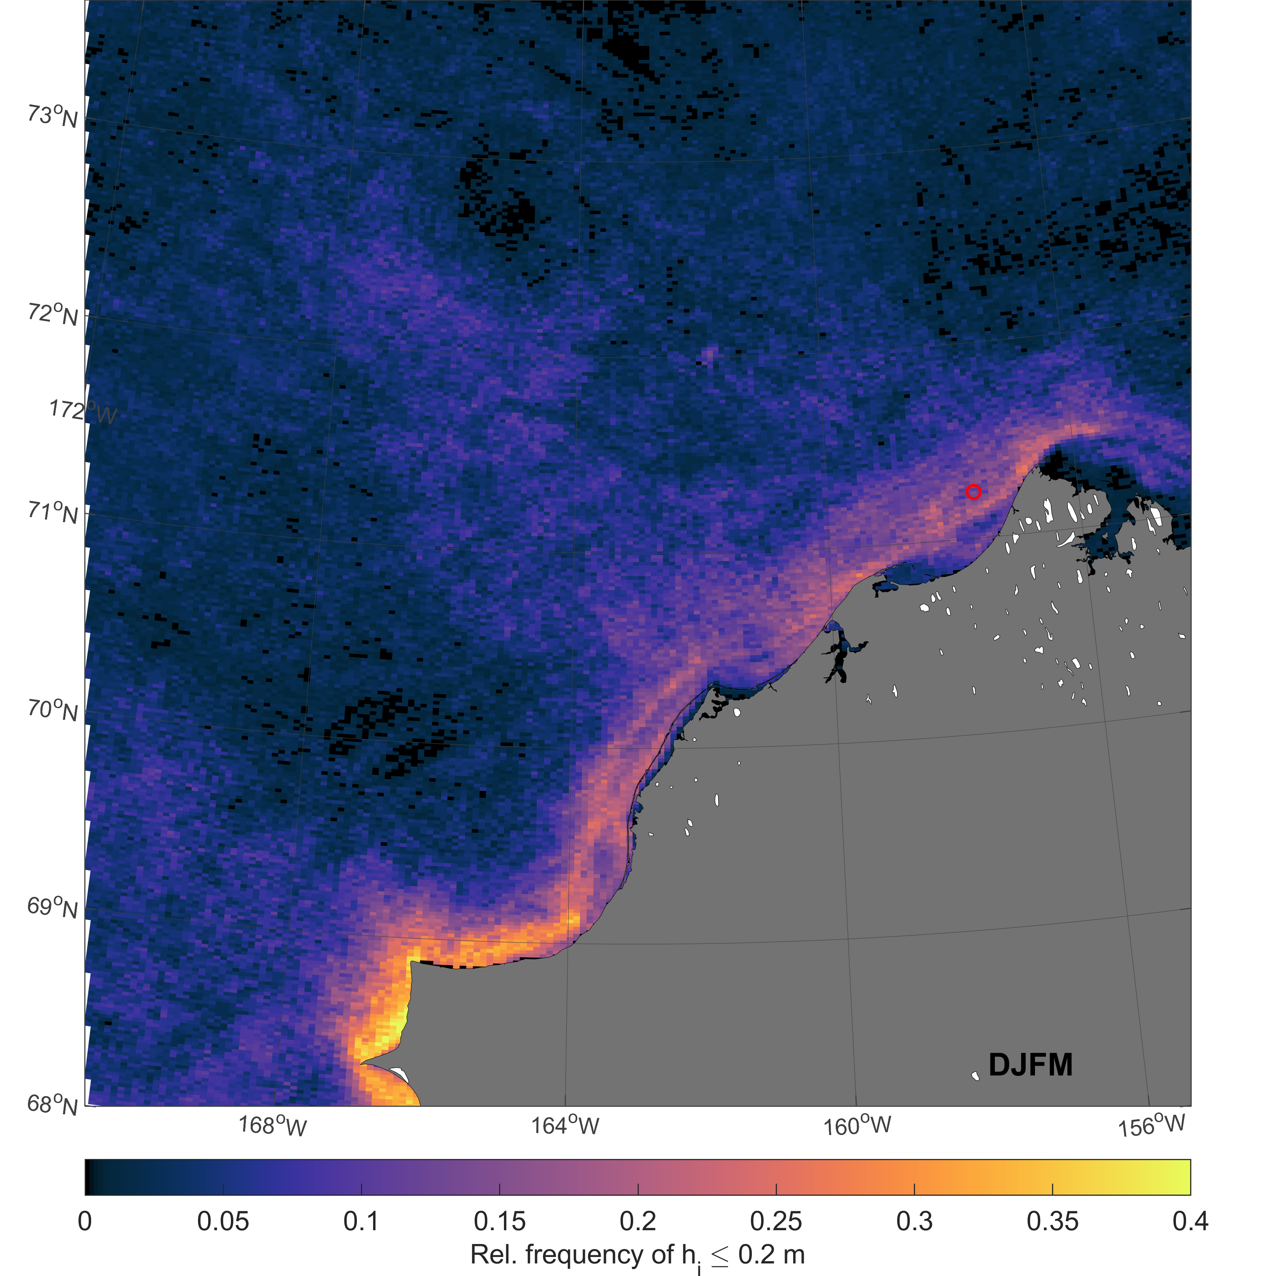
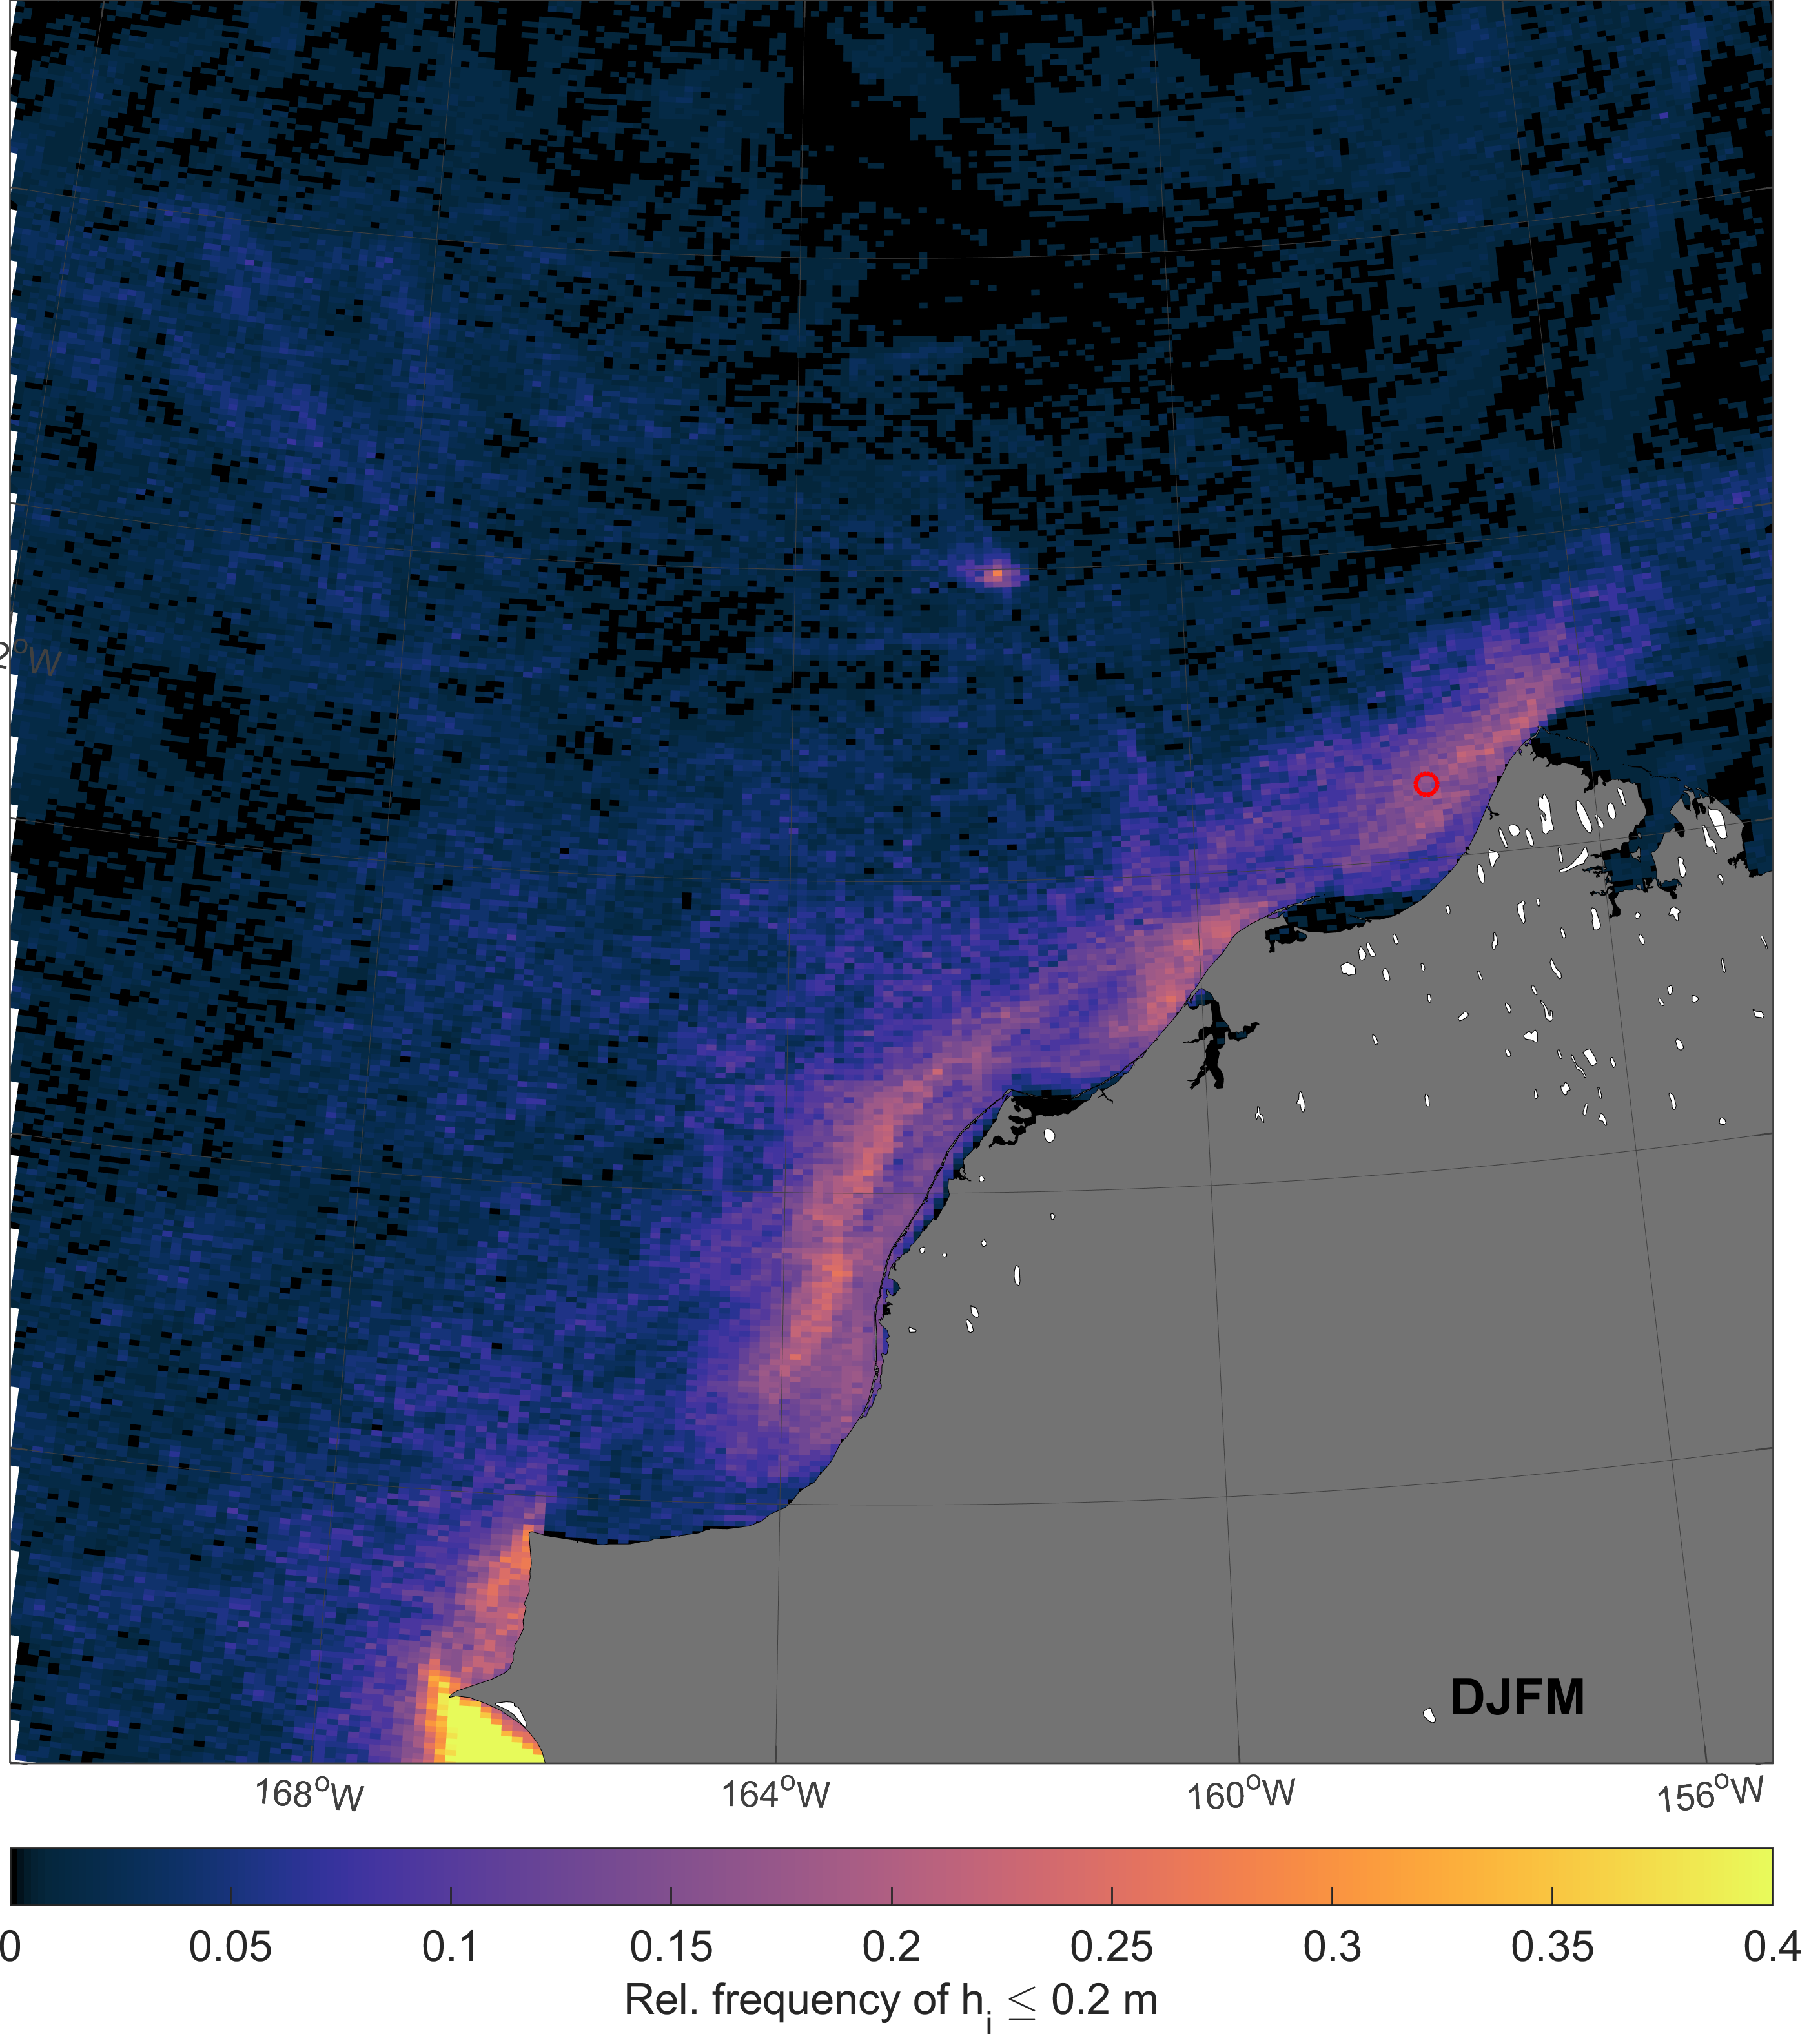
Comparison of MODIS-based thin-ice thicknesses with ice draft measurements in the Laptev Sea & Chukchi Sea
European Geoscience Union – General Assembly 2021
Relative frequencies of MODIS thin-ice thicknesses below 20 cm (DEC-MAR)
Raw counts, no add. filters applied
2009/2010
2010/2011
2014/2015
2011/2012
Raw counts, no add. filters applied
Raw counts, no add. filters applied
IPS directly within active polynya
B2
B2
B2
Chukchi Sea
Laptev Sea
HOME
ABSTRACT
CONTACT

Slide 16
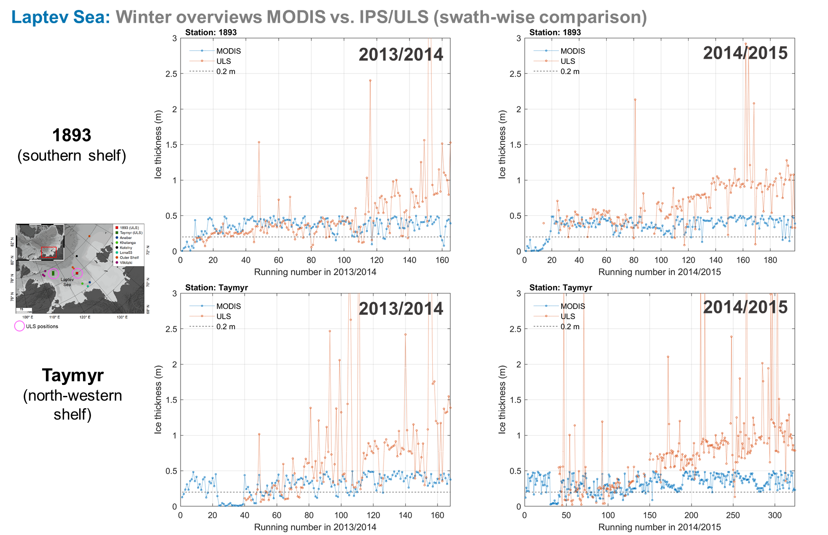
Comparison of MODIS-based thin-ice thicknesses with ice draft measurements in the Laptev Sea & Chukchi Sea
European Geoscience Union – General Assembly 2021
HOME
ABSTRACT
CONTACT

Slide 17
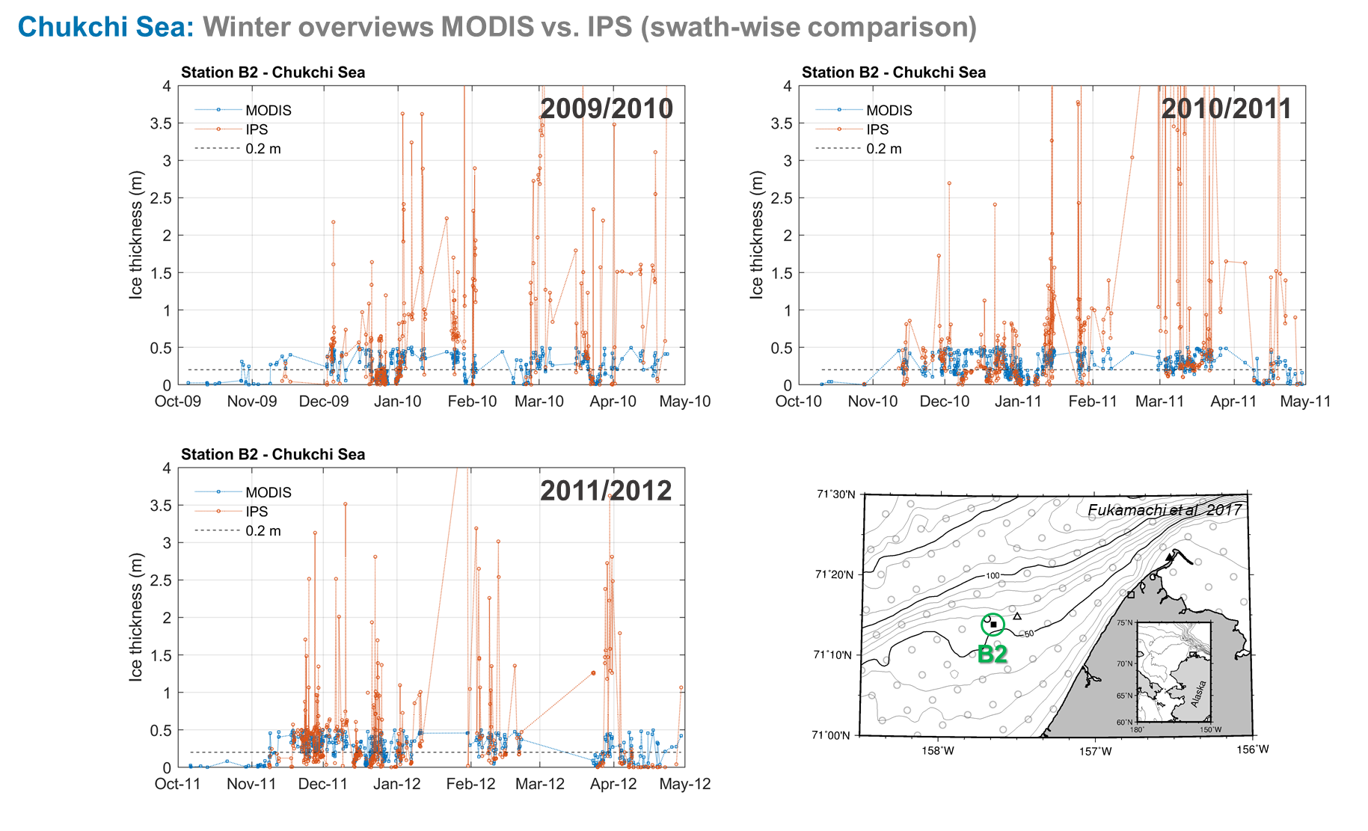
Comparison of MODIS-based thin-ice thicknesses with ice draft measurements in the Laptev Sea & Chukchi Sea
European Geoscience Union – General Assembly 2021
HOME
ABSTRACT
CONTACT

Slide 18
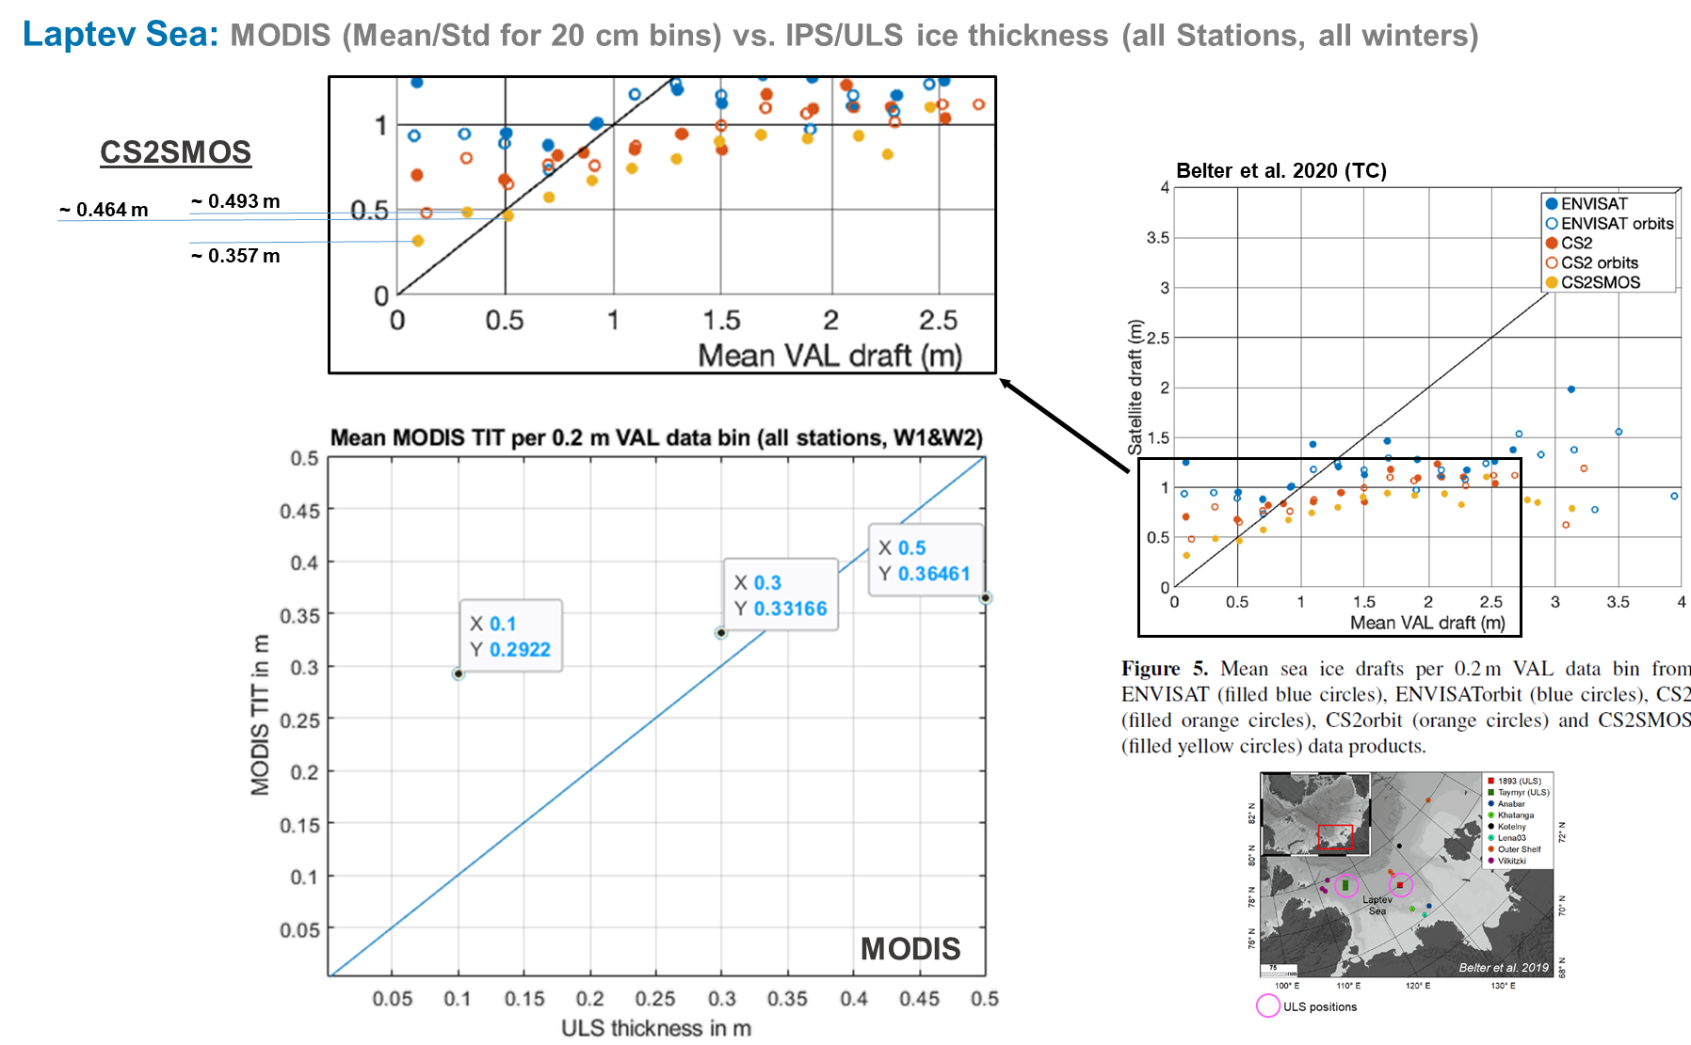
Comparison of MODIS-based thin-ice thicknesses with ice draft measurements in the Laptev Sea & Chukchi Sea
European Geoscience Union – General Assembly 2021
HOME
ABSTRACT
CONTACT

Slide 19
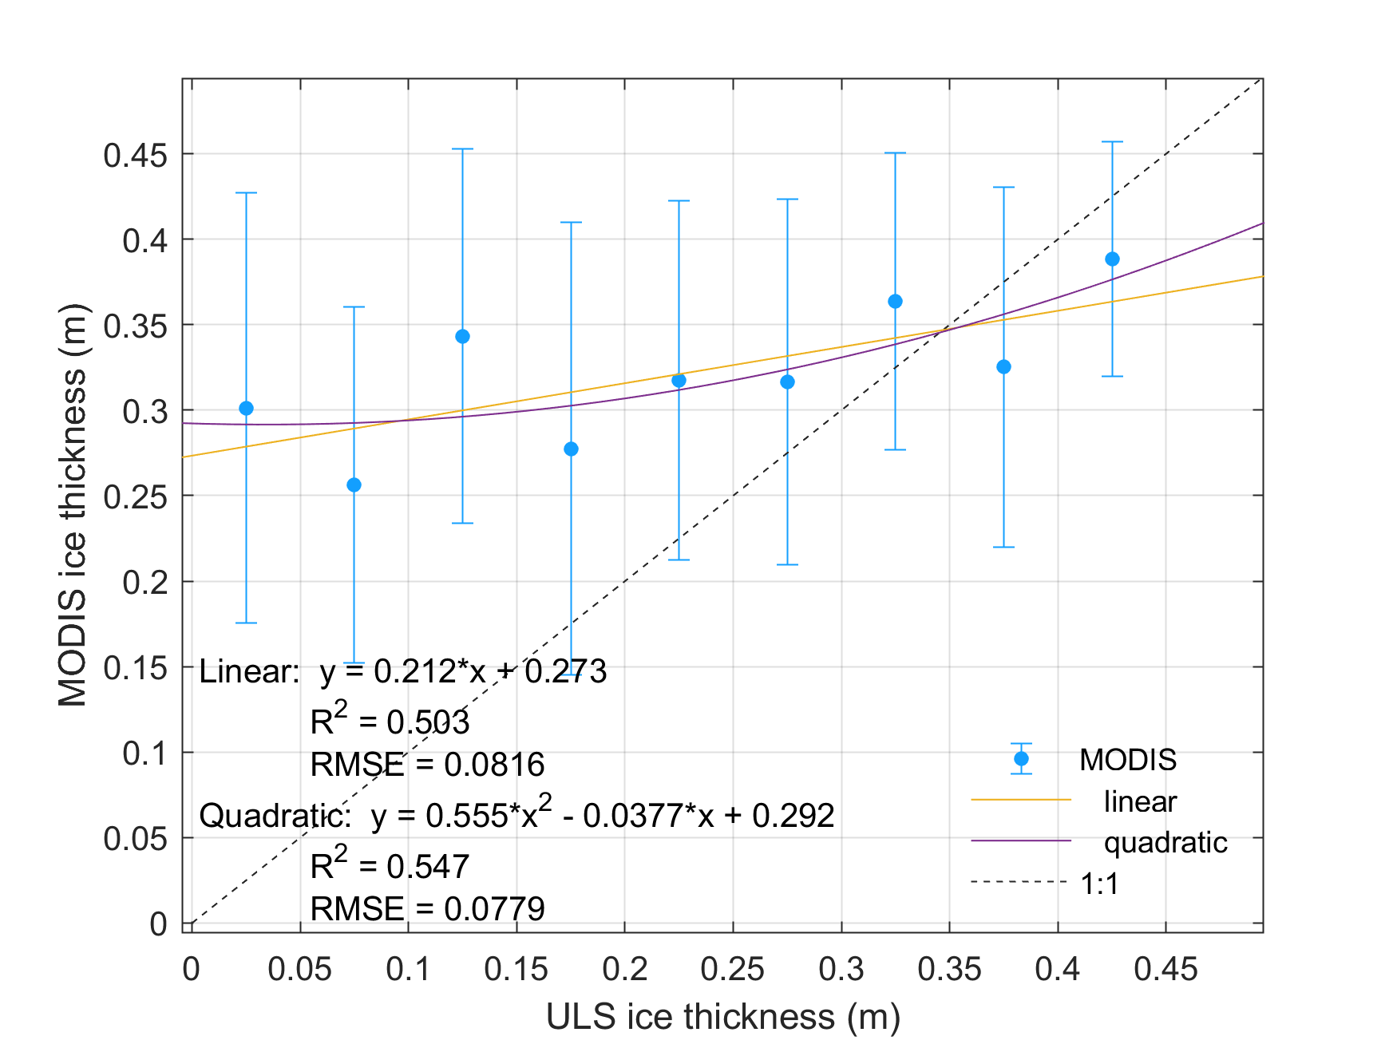
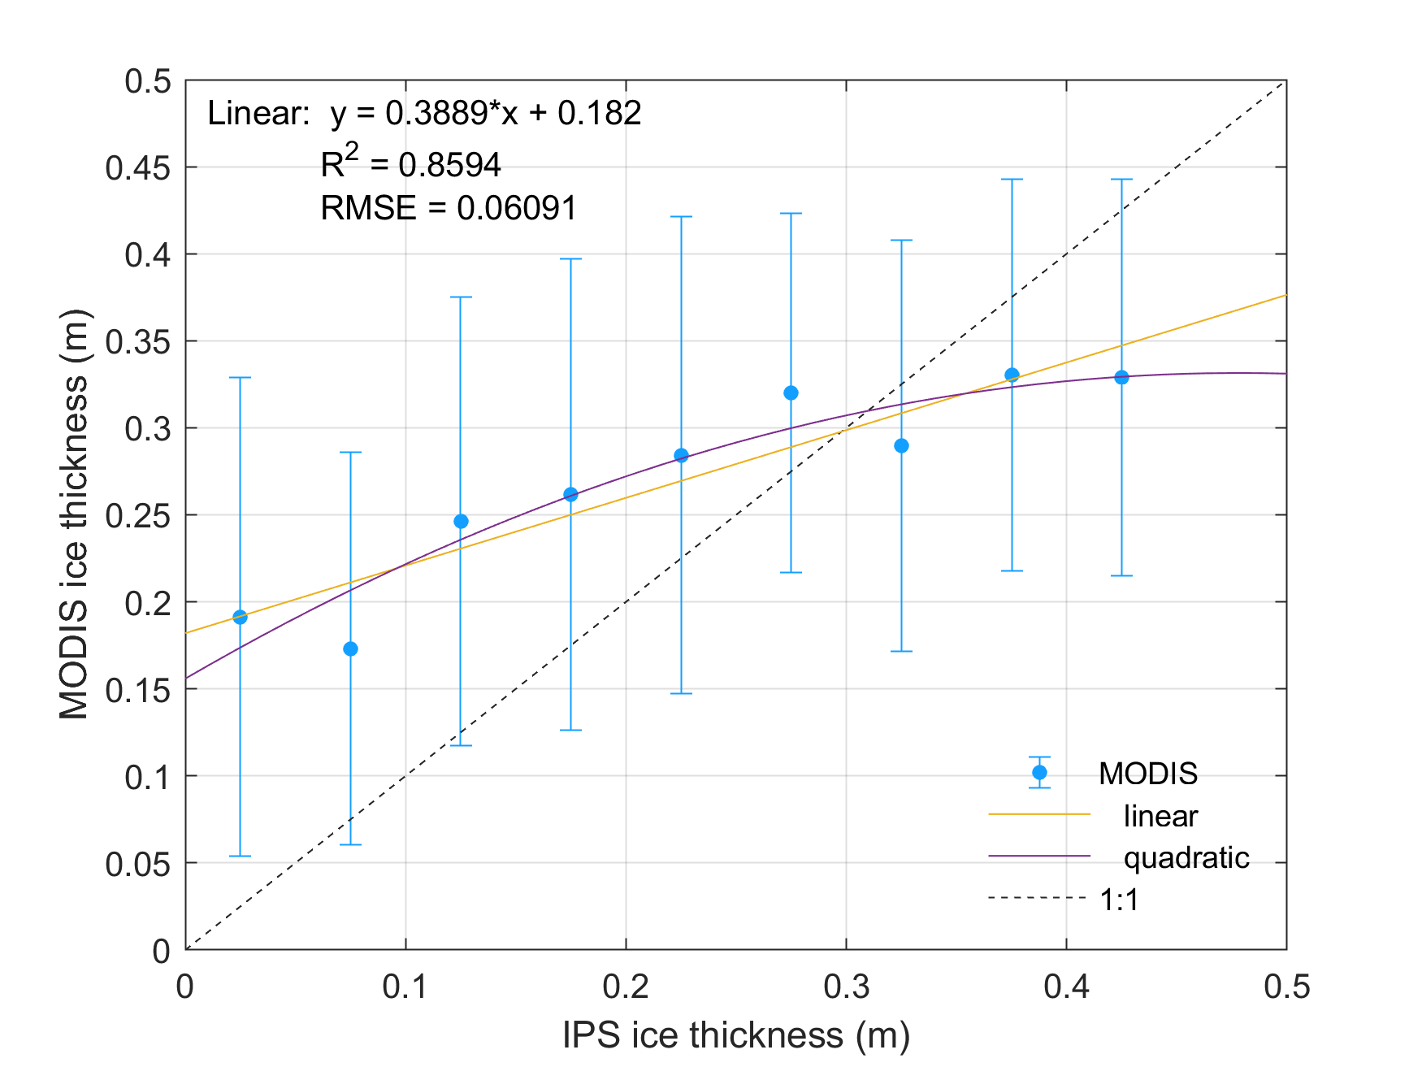
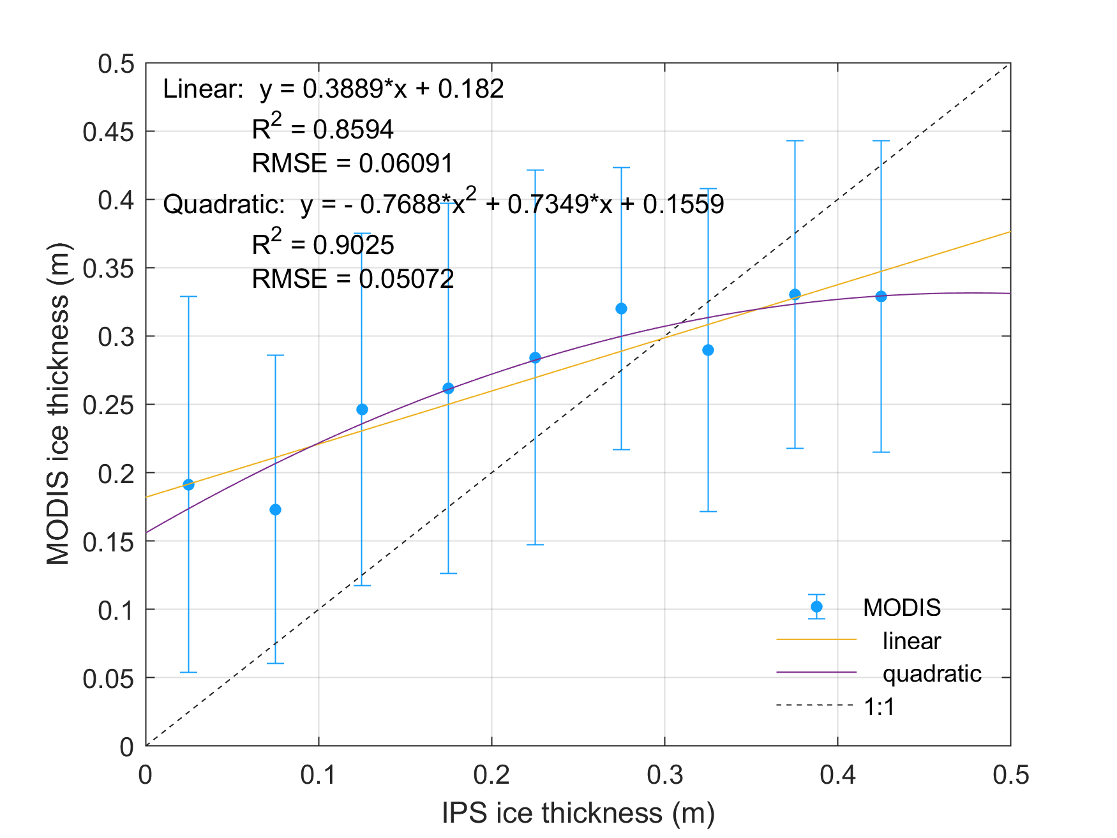
Comparison of MODIS-based thin-ice thicknesses with ice draft measurements in the Laptev Sea & Chukchi Sea
European Geoscience Union – General Assembly 2021
Relation between binned ULS/IPS thicknesses (up to 50 cm) & corresponding MODIS thicknesses
Laptev Sea
Chukchi Sea
HOME
ABSTRACT
CONTACT

Slide 20
Comparison of MODIS-based thin-ice thicknesses with ice draft measurements in the Laptev Sea & Chukchi Sea
European Geoscience Union – General Assembly 2021
Statistics
 |  |  |  | MODIS vs. VAL
Period | Station | MODIS TIT-range | N | RMSE | Mean Diff. (m) | Median Diff. (m) | R
2013-2014 | 1893 | ≤ 0.5 m | 110 | 0.0910 | 0.0658 | 0.0611 | 0.2188
 | 1893 | ≤ 0.2 m | 5 | 0.0451 | -0.0936 | -0.0607 | 0.5493
 | Taymyr | ≤ 0.5 m | 56 | 0.1070 | 0.0391 | 0.0525 | 0.3730
 | Taymyr | ≤ 0.2 m | 15 | 0.0414 | -0.0637 | -0.0557 | 0.0459
2014-2015 | 1893 | ≤ 0.5 m | 56 | 0.0798 | 0.0040 | 0.0152 | 0.0942
 | 1893 | ≤ 0.2 m | 1 | --- | --- | --- | ---
 | Taymyr | ≤ 0.5 m | 69 | 0.1145 | 0.0373 | 0.0167 | 0.1071
 | Taymyr | ≤ 0.2 m | 18 | 0.0346 | -0.0684 | -0.0563 | 0.2572
2013-2015 | ALL | ≤ 0.5 m | 291 | 0.1027 | 0.0420 | 0.0445 | 0.2564
 | ALL | ≤ 0.2 m | 39 | 0.0395 | -0.0759 | -0.0607 | 0.1121
Laptev
Sea
 |  |  |  | MODIS vs. VAL
Period | Station | MODIS TIT-range | N | RMSE | Mean Diff. (m) | Median Diff. (m) | R
2009-2010 | B2 | ≤ 0.5 m | 159 | 0.1260 | 0.0318 | 0.0109 | 0.3189
 | B2 | ≤ 0.2 m | 92 | 0.0436 | -0.0391 | -0.0262 | 0.2136
2010-2011 | B2 | ≤ 0.5 m | 256 | 0.1221 | 0.0786 | 0.0691 | 0.4054
 | B2 | ≤ 0.2 m | 76 | 0.0465 | -0.0164 | 0.0102 | 0.4948
2011-2012 | B2 | ≤ 0.5 m | 303 | 0.1199 | 0.0772 | 0.0560 | 0.3750
 | B2 | ≤ 0.2 m | 108 | 0.0509 | 0.0119 | 0.0281 | 0.4012
2009-2015 | B2 | ≤ 0.5 m | 718 | 0.1252 | 0.0677 | 0.0495 | 0.3863
 | B2 | ≤ 0.2 m | 276 | 0.0500 | -0.0129 | 0.0107 | 0.3477
Chukchi
Sea
HOME
ABSTRACT
CONTACT

Slide 21
Comparison of MODIS-based thin-ice thicknesses with ice draft measurements in the Laptev Sea & Chukchi Sea
European Geoscience Union – General Assembly 2021
CONCLUSIONS
First comparison of MODIS-derived ice thickness with IPS measurements yields mixed results
Varying agreement depending on thickness range:
  Highest agreement below 20 cm
  Indications for an overestimation of low ice thickness range by MODIS (up to ~40 cm)
  Thicker ice underestimated
Laptev Sea: similar result as CS2SMOS product (Belter et al. 2020)
Generally slightly better agreement in Chukchi Sea area
Comparison to be reevaluated with a new reprocessed MODIS TIT data set
Limitations / notes on error-sources
MODIS data:
  Uncertainty TIT retrieval ~ 4.7cm (up to 20 cm ice thickness)
  No snow considered in energy balance model → potential overestimation of ice thickness (i.e., heat loss)
IPS/ULS data:
  Sea ice draft time series with an approximate precision of +/- 0.05 m (but: Conversion of draft → thickness introduces potential error-source)
  5-min modal value of IPS draft could mask the “true” thickness at acquisition time
HOME
ABSTRACT
CONTACT

