Slide 1
Joint interpretation of macroseismic and strong motion data for recent large shallow mainshocks of the Aegean area using a Monte Carlo optimization of finite-fault stochastic simulations
M. Ravnalis¹, Ch. Kkallas¹, C. Papazachos¹, B. Margaris², Ch. Papaioannou²
¹ Geophysical Laboratory, Aristotle University of Thessaloniki, Thessaloniki, GREECE
² Institute of Engineering Seismology and Earthquake Engineering (ITSAK), Thessaloniki, GREECE

Slide 2
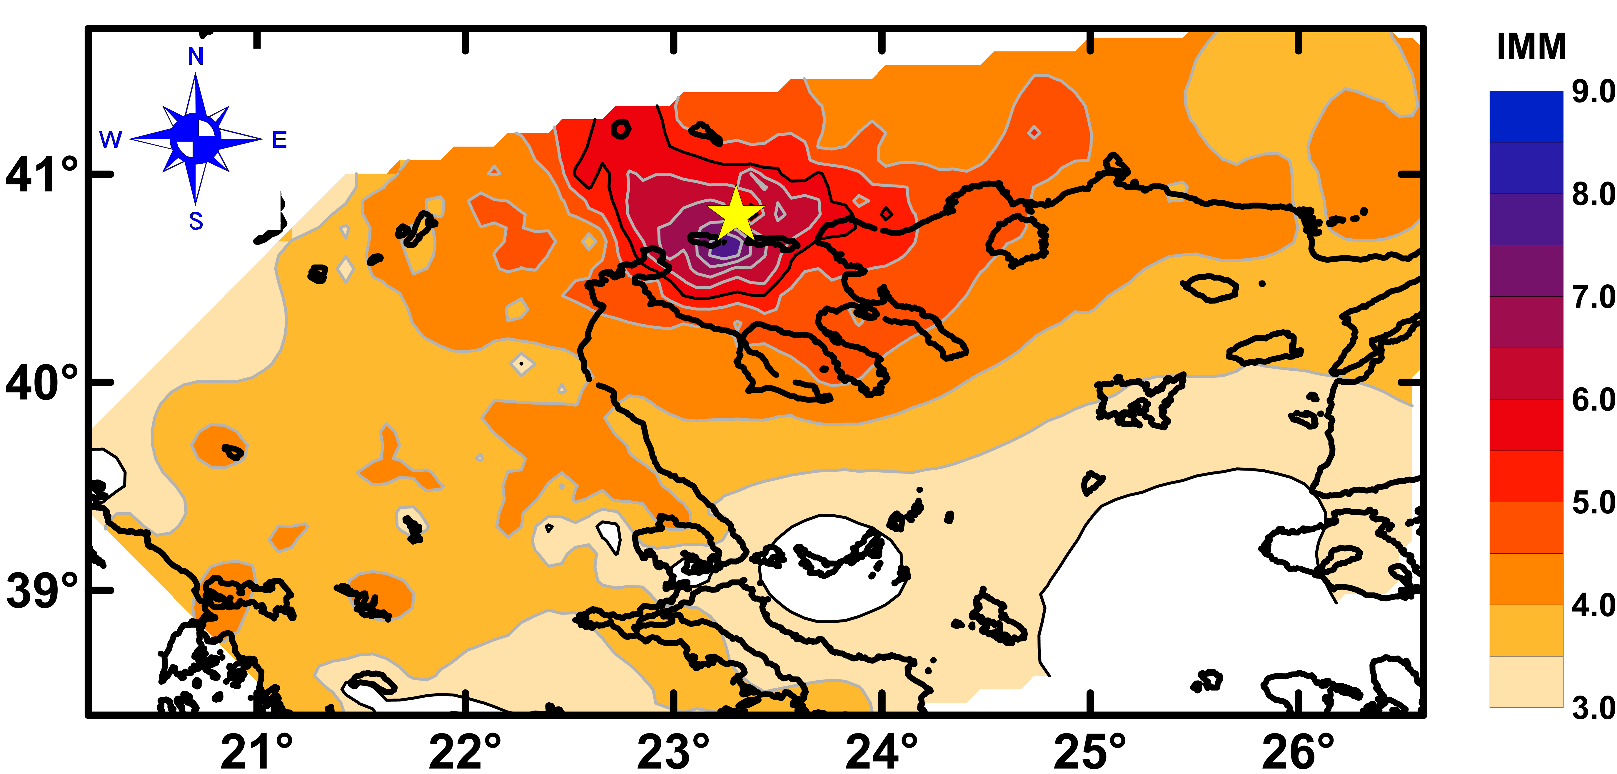
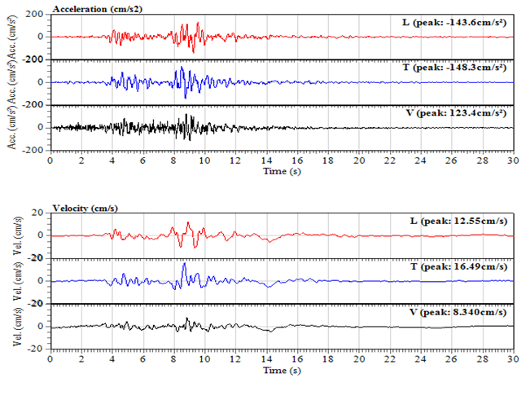
Target of the present study
Macroseismic data provide important constraints on the area that suffered the heaviest damage caused by an earthquake. They, also, provide indirect but valuable information on the seismic source, path attenuation and site amplification effects (e.g. the largest macroseismic intensities usually cluster and often delineate the near-fault source region). They are the only source of strong-motion effects for historical and mainly pre-1970 mainshocks.
Strong ground-motion data, especially near the source, also provide valuable quantitative constraints for the study of various earthquake parameters (source, propagation path, etc.), with their number exponentially increasing during the last 4 decades.
The scope of this work is to test the simultaneous, quantitative interpretation of both types of data (macroseismic and strong motion data) for shallow earthquakes with M≥6.0 in Greece.
The study focuses on events that occurred during a specific time period, for which an adequate number of both types if data types is available.
http://www.itsak.gr/head

Slide 3
Macroseismic and strong-motion processing approach
Approach for the simultaneous quantitative modeling of macroseismic data and strong ground motion records:
A) Several source-path-site effect parameters for this approach were automatically calibrated based on a priori information (e.g. moment magnitude, EN1998 soil class for generic site effect assessment, etc.). Other parameters (e.g. fault type and geometry, depth, etc.) were pre-determined based of published information, usually derived during standard earthquake analysis.
B) Synthetic time series were produced using a stochastic simulation approach.
C) The simulated time series were used to obtain:
Spectral and peak ground motion values (PGA & PGV)
Synthetic macroseismic intensity values (IMM) from I_{MM} calibration relations with PGA and PGV.
D) Synthetic results were compared with real data (observed macroseismic and strong-motion data).

Slide 4
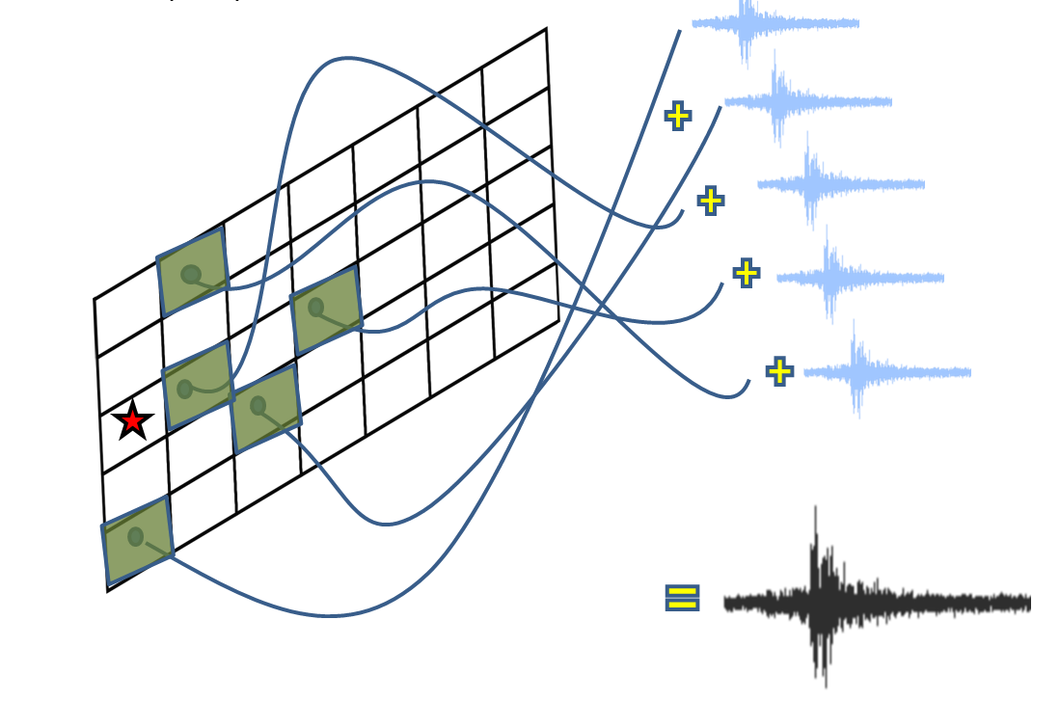
Simulation Approach: Finite-fault stochastic simulation (EXSIM)
A widely used tool that is employed to generate synthetic data to study the spatial distribution of strong ground motion after a significant earthquake.
EXSIM algorithm: Open-source FORTRAN algorithm that generates time series of ground motion for earthquakes (Motazedian and Atkinson 2005; Boore, 2009; Atkinson et al., 2009).

Slide 5
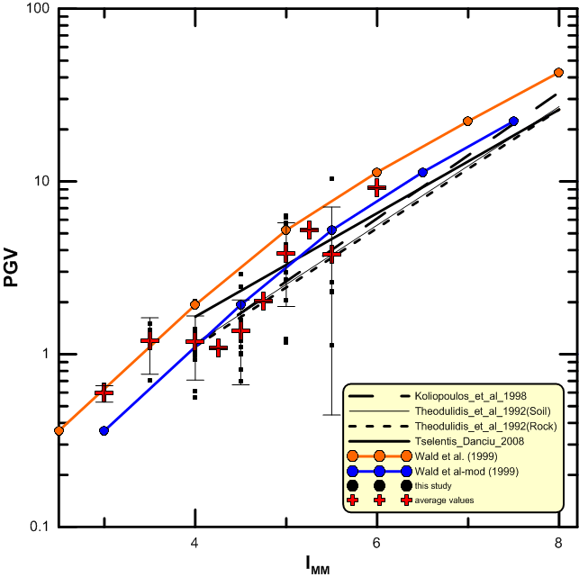
Macroseismic and strong-motion processing approach Conversion relation from strong ground motion parameters (PGA, PGV) to macroseismic intensities (I_{MM})
Kkallas et al. (2018)
(Modified from Wald et al. [1999])

Slide 6
The figure presents the smoothed annual collection rate of strong ground motion records and macroseismic observations with I_{MM} > 5 (blue and red line, respectively) in Greece. The orange rectangle depicts the time period (1978-1996) for which adequate data were available for both types of data. For this reason, we considered events exclusively from this time period.
Data selection
Ravnalis (2020)

Slide 7
Focal mechanisms and simplified faults for the earthquakes that were studied in the present work
Data selection
We simulated ground motions for three (3) shallow, normal faulting, strong (M≥6.0) earthquakes that occurred in the broader Aegean region between 1978 and 1996:
1: Stivos earthquake (1978/06/20, M6.5)
2: Kalamata earthquake (1986/09/13, M6.0)
3: Kozani earthquake (1995/05/13, M6.6)

Slide 8
Parametric (Monte Carlo) search for stress parameter Fourier Amplitude Spectra optimization
Instead of modeling the PGA and PGV values of each strong motion record, we simulated (using EXSIM) the Fourier Amplitude Spectra (FAS) for the frequency range for which each FAS was reliable (as this was determined from the strong-motion record processing).
We computed the relative RMS misfit between observed (red and blue lines in figure) and determined the minimum-misfit stress parameter value.
The optimal (minimum-misfit) synthetic FAS is depicted by a green line.

Slide 9
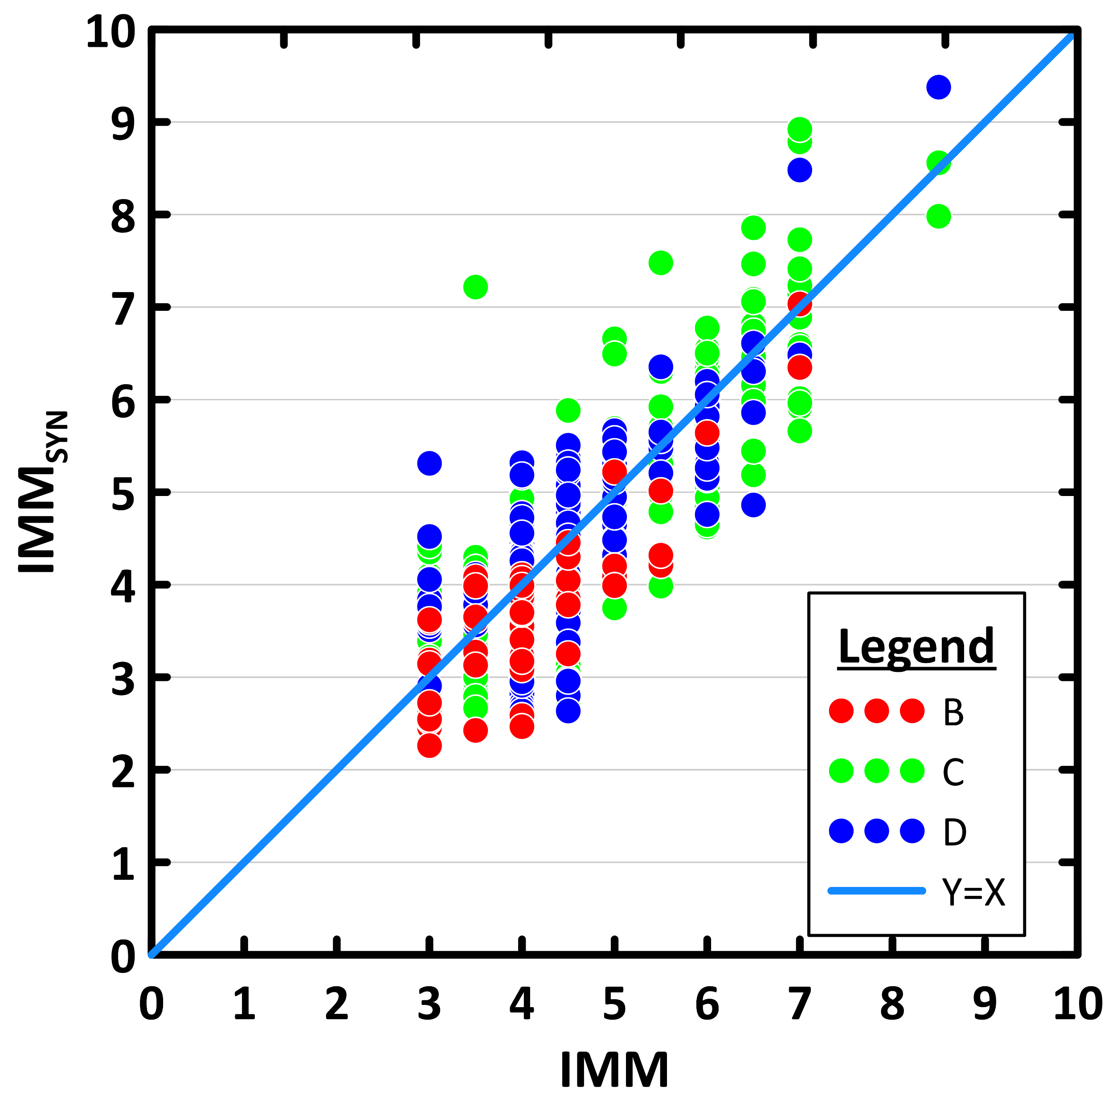
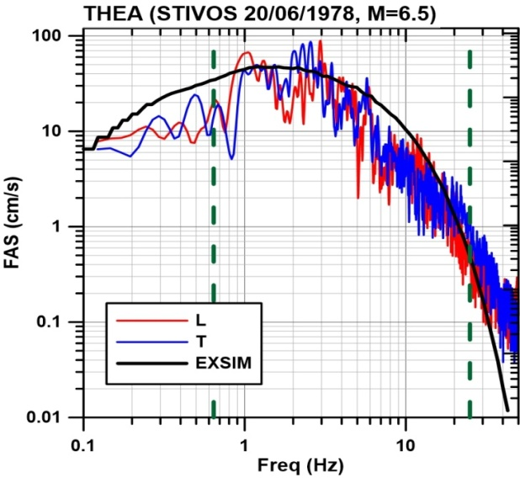
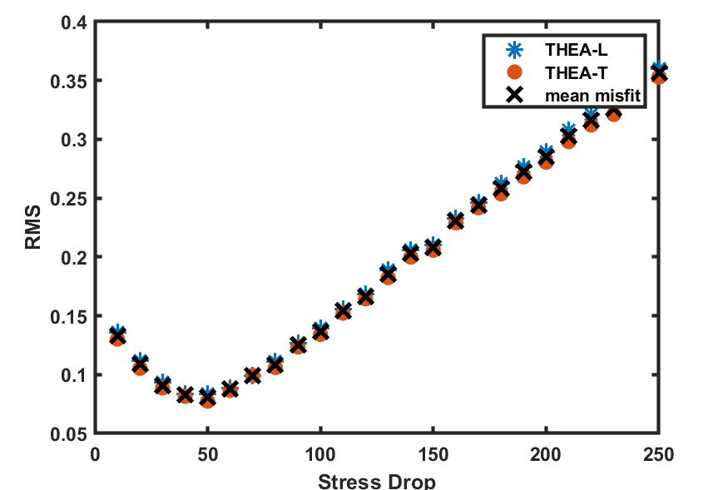
Monte Carlo search for stress parameter optimization
Independent misfit from macroseismic & strong-motion data
Macroseismic data
Strong motion data
Optimal stress parameter
value from macroseismic data:
~ 90 bars
Optimal stress parameter
value from strong-motion data ~ 50 bars
90bar
50bar

Slide 10
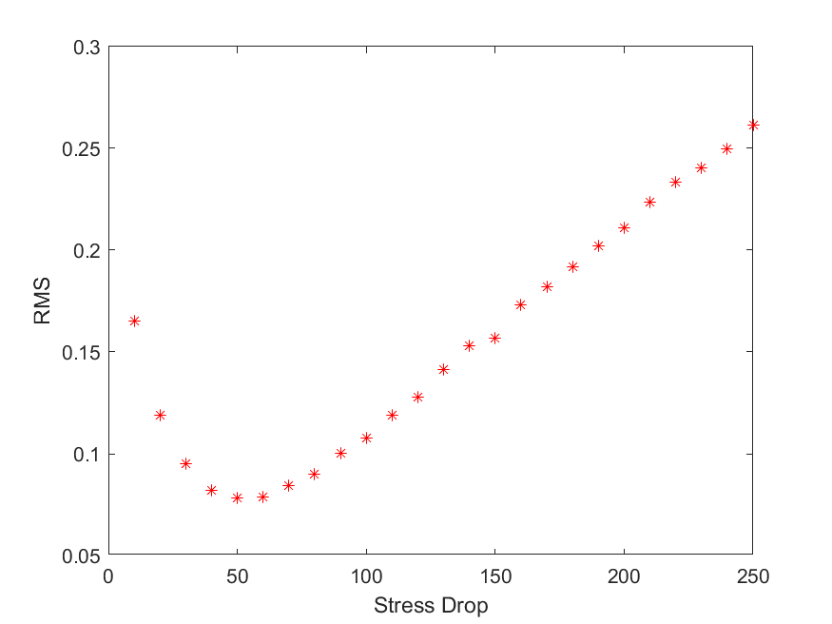
Monte Carlo search for stress parameter optimization
Joint misfit from macroseismic & strong-motion data
50%
50%
Joint macroseismic/strong-motion FAS
RMS relative misfit for the Stivos earthquake
(1978, M6.5, normal fault)
The optimal stress parameter value
is ~50 bars
~50bar

Slide 11
Monte Carlo search for stress parameter optimization Joint misfit from macroseismic & strong-motion data

Slide 12
Monte Carlo search for stress parameter optimization Joint misfit from macroseismic & strong-motion data
Τhe results suggest that a joint-misfit simultaneous optimization of macroseismic and strong-motion data (FAS) is a useful tool, especially when a limited number of instrumental data is available.
Optimal stress parameter values only from macroseismic data are higher (65-110 bars) compared to optimal stress parameter values (~50-90) from strong-motion data.
The average Optimal stress parameter value from joint relative RMS misfit is equal to ~60-65 bars, similar to results obtained from other researchers for the area of Greece (Margaris & Boore, 1998; Margaris & Hatzidimitriou, 2002, etc,).
Stress parameter values determined from the independent (top) and joint (bottom) relative RMS misfit optimization of macroseismic and strong-motion data, for the examined earthquakes with M$≥$6.0 between 1978-1995.

Slide 13
Thank you

