Slide 1



Hydrological modelling of Sahelian hydrological paradox: accounting for explicit land use/land cover change in the simulation of hydrological processes
Roland Yonaba¹, A. C. Biaou¹, M. Koita¹, T. Fowé¹, A. L. Mounirou¹, C. O. Zouré¹, P. Queloz², K. Karambiri¹ ,H. Yacouba¹
¹International Institute for Water and Environmental Engineering (2iE),
Laboratory for Water, Hydro-Systems and Agriculture (LEHSA), Burkina Faso (roland.yonaba@gmail.com)
²Institute of Territorial Engineering (INSIT)
School of Management and Engineering Vaud (HEIG-VD), Yverdon-les-Bains, Switzerland.
https://doi.org/10.5194/egusphere-egu21-7974

Slide 2
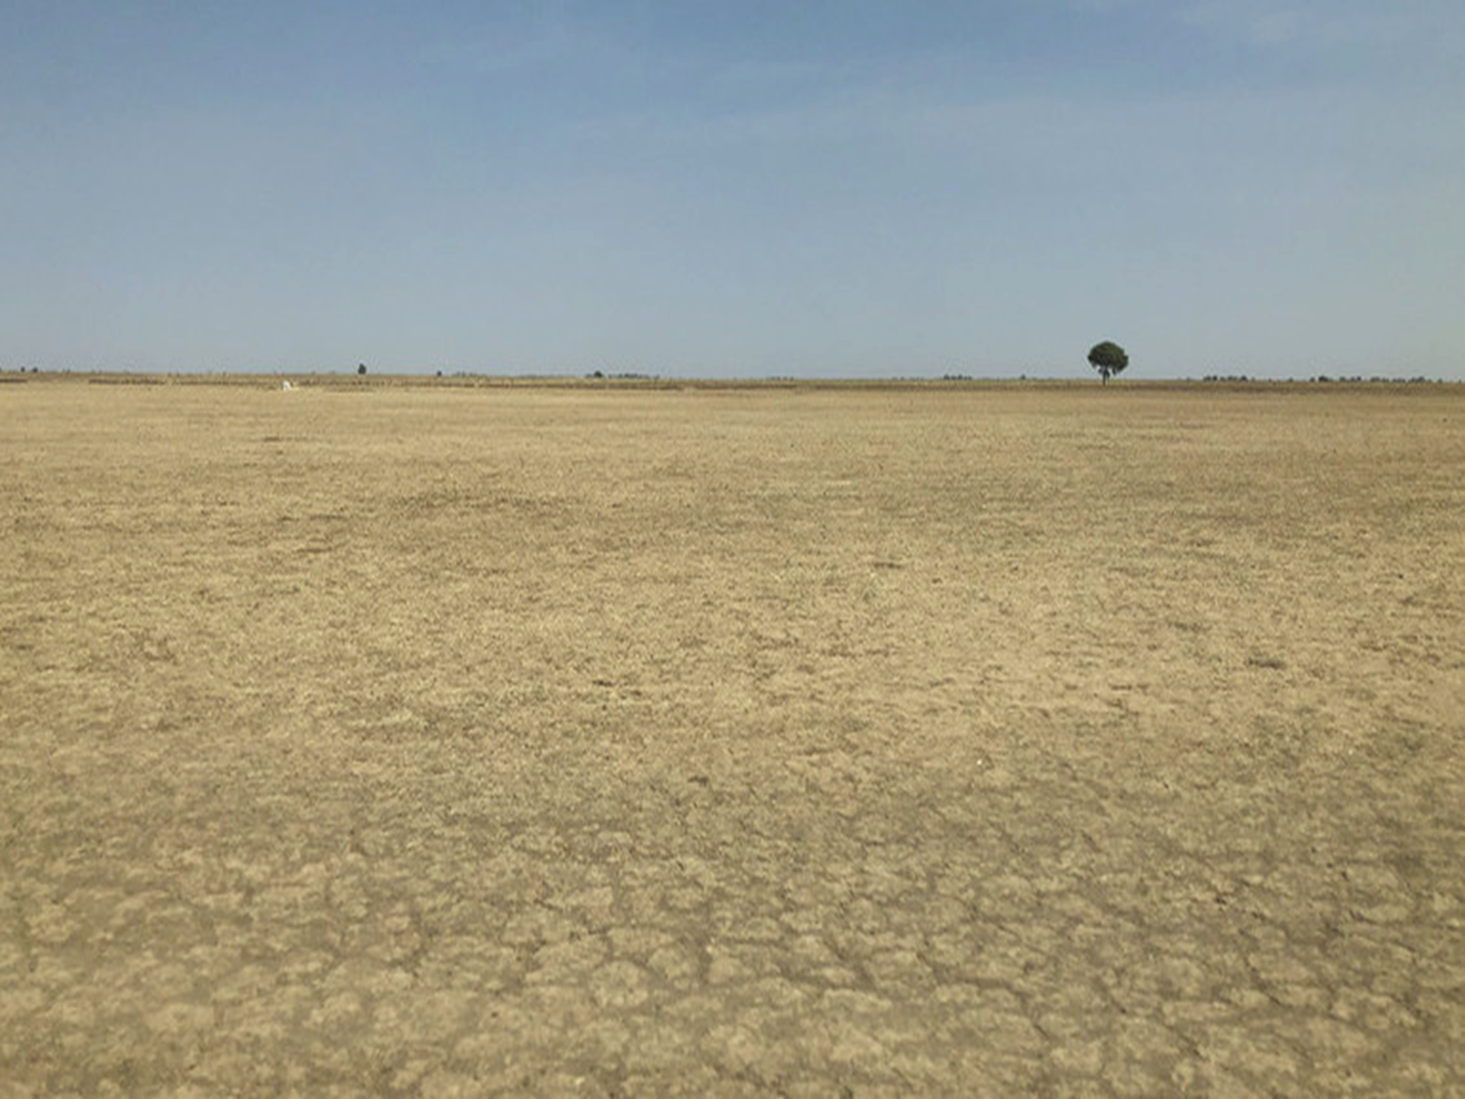
Hydrological modelling of Sahelian hydrological paradox: accounting for explicit land use/land cover change in the simulation of hydrological processes
OVERVIEW
1. Problem statement / Context
PICO Navigation
2. Study area
The orange ‘Home’
Button takes you to
this section menu
The left/right arrows
take you to the
previous/next page
3. Modelling work and key findings
4. Key conclusions
5. Published papers for more

Slide 3
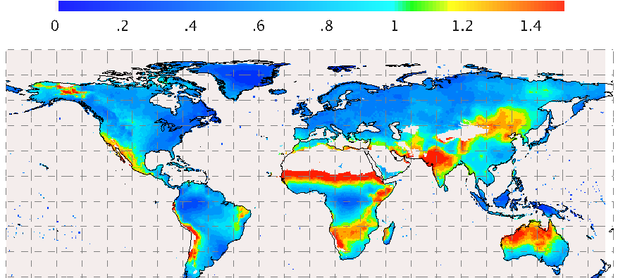

The problem: Modelling Hydrology in the West African Sahel
The West African Sahel context
High variability in the rainfall
(Buontempo et al., 2012)
High anthropic pressure (Potts et al., 2013)

Slide 4
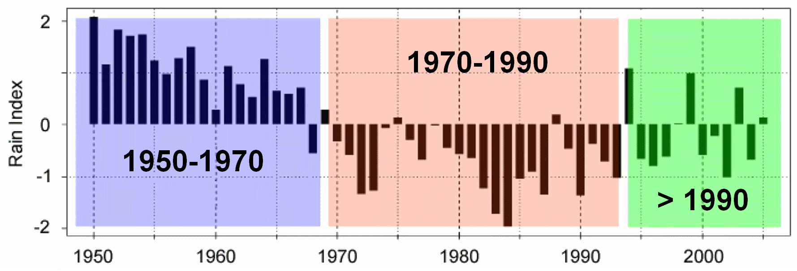
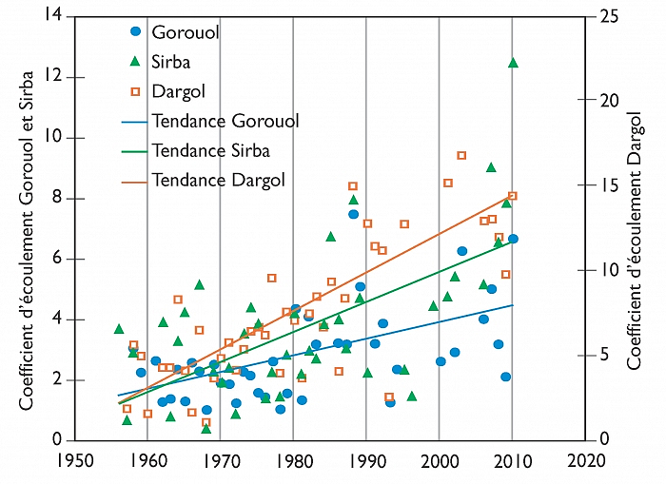
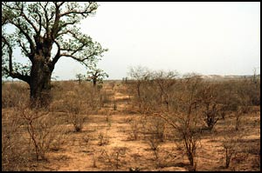
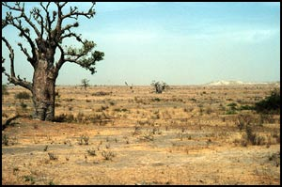
The problem: Modelling Hydrology in the West African Sahel
The Sahelian hydrological paradox
1
Severe droughts occured in the period 1970-1990 over the entire Western Sahel…
3
Despite the rainfall decrease, a significant increase in surface runoff coefficients has been observed on most Sahelian hydrosystems, termed as the Sahelian hydrological paradox (SHP)
(Descroix et al., 2013)
2
It resulted in loss of vegetation, soil surface crusting and sealing, land degradation…
1983
1995

Slide 5
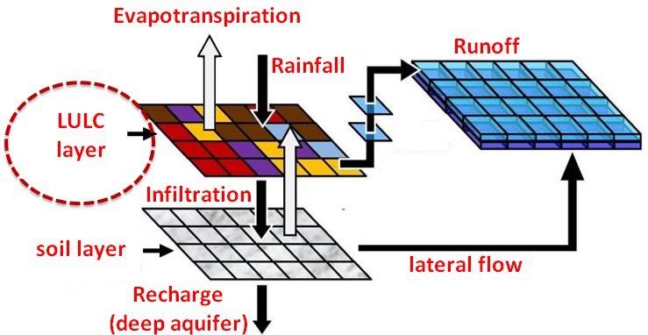

The problem: Modelling Hydrology in the West African Sahel
Sahelian context is a challenge for hydrological modelling
The SHP is an key indicator of the tight coupling between LULC changes and hydrological processes (HP) in the Sahelian context
The SHP cannot be reproduced within hydrological models : a decrease in rainfall translates to a decrease in runoff….
The issue arises because the LULC layer is kept static during the simulation, hence inducing stationarity in the runoff response to rainfall
Is the SHP effectively simulated in an hydrological model when integrating spatial and temporal LULC changes dynamically ?

Slide 6
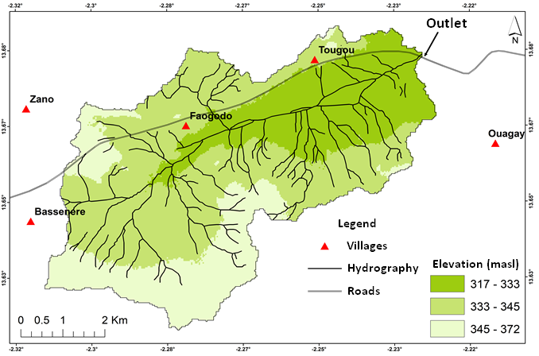
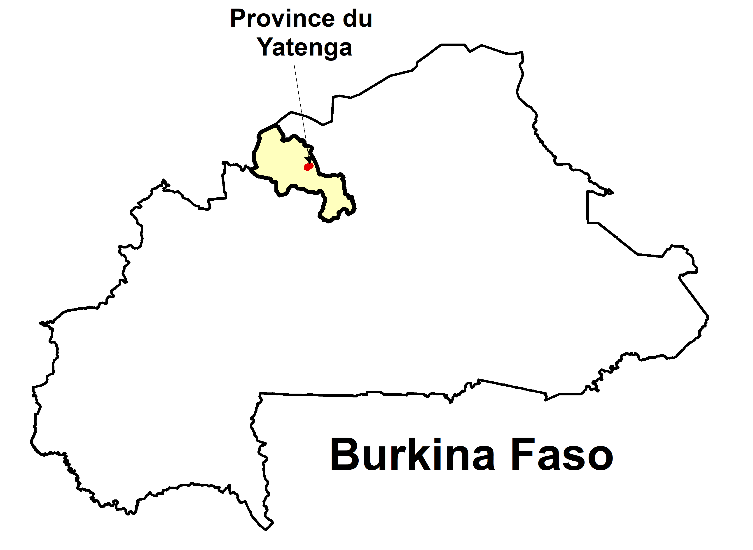
The study area : Tougou watershed
Yatenga province
Tougou watershed
37 km²
Located in northern Burkina Faso (West Africa)
Strong interrelations between climate, populations and environment, representative of the sahelian strip (Diello, 2007; Barbier et al., 2009)
Semi-arid climate (rainfall ~ 604 mm/yr - Avg. T°: 16-40°C – PET : 2095 mm/yr)
Daily Rainfall/runoff data monitoring during the period 2004-2018

Slide 7
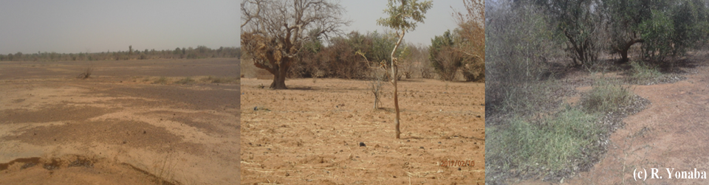
The study area : Tougou watershed
Land use/Land cover types found within the watershed (Yonaba et al., 2021b)
Bare / Degraded
Cultivated
Vegetation
Develops surface crusting and sealing
Low infilt. rates (6.2 ± 2.3 mm/hr)
High runoff potential
Limited crusting because of labour
High infilt. rates (44.7 ± 10.8 mm/hr)
Low/Moderate runoff potential
Develops surface crusting and sealing
Moderate infilt. rates (32.9 ± 8.2 mm/hr)
Low runoff potential

Slide 8
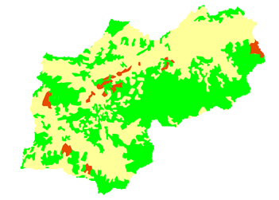
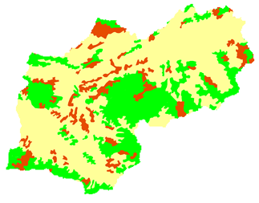
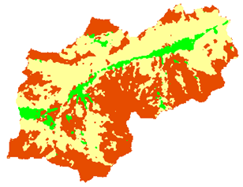
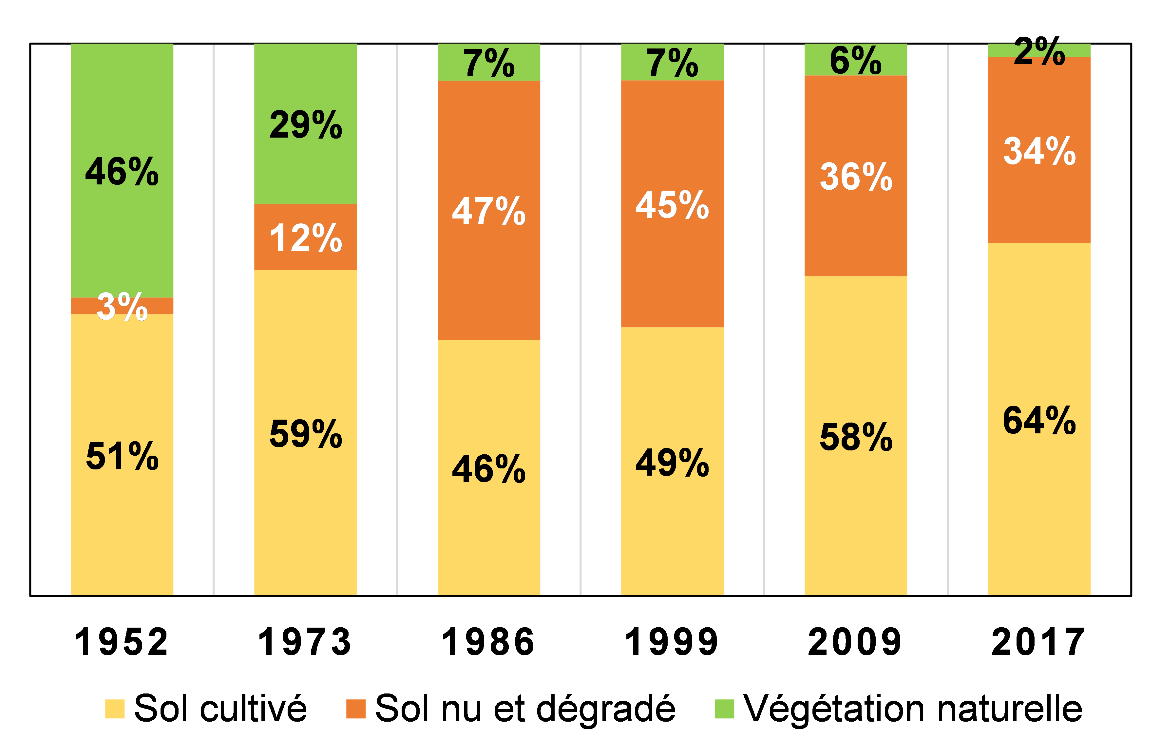
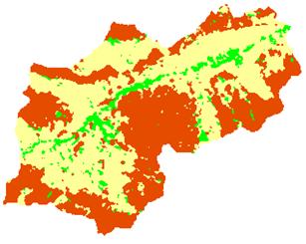
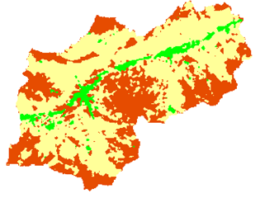
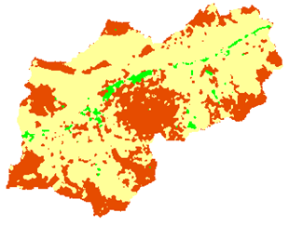
The study area : Tougou watershed
Landscape evolution in the Tougou watershed (Yonaba et al., 2021b)
Wet
Dry
Wet (period)
1952
1973
1986
1999
2009
2017
1952-1973: conversion of vegetation to cultivated
1973-1986: increase in bare/degraded (droughts)
1986-2017: recovery of bare/degraded to cultivated

Slide 9

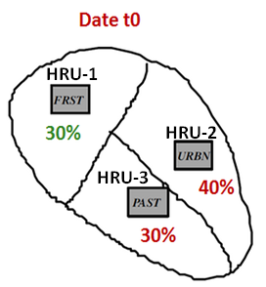
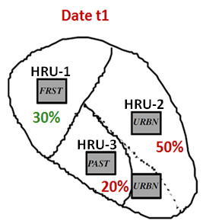
Modelling work and key findings
Model Used
SWAT features a Land use UPdate module (LUP) which integrates dynamical LULC during the simulation by updating the fractional area occupied by a given HRU (HRU_FR) at discrete and user-predefined time-points (Pai et Saraswat, 2011; Yonaba et al., 2021a)
Modelling the water balance with the SWAT model (Arnold et al., 1998)
SWAT: physically-based, continuous, semi-distributed hydrological model simulating the water balance at the scale of Hydrologic Response Units (HRU)
HRUs: set of unique and homogeneous combination of LULC, soil type, slope

Slide 10
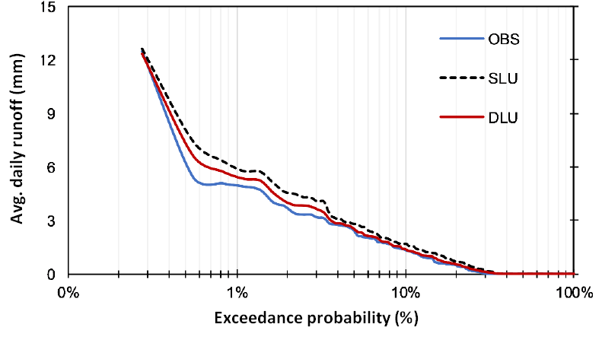
Modelling work and key findings
Simulation is quite satisfactory in both cases, however with an overestimation bias is SLU
Modelling scenarios and results
Criterion | Calibration |  | Validation
 | SLU | DLU | SLU | DLU
KGE | 0,84 | 0,95 | 0,86 | 0,94
PBIAS (%) | -14,30 | -2,30 | -7,30 | 2,90
Daily rainfall/Runoff/climate data : 2004-2018
Two modelling scenarios are compared:
  SLU : static land use scenario
  DLU : dynamic land use scenario (where LULC is dynamically updated*)
2004-2005
2006-2012
2015-2018
Warm-up
LULC 1999
Calibration
LULC 1999
Validation
LULC 1999
SLU
Warm-up
LULC 1999
Calibration
LULC 2009
Validation
LULC 2017
DLU
* For intermediate dates in a period, fractional HRU_FR values are interpolated

Slide 11
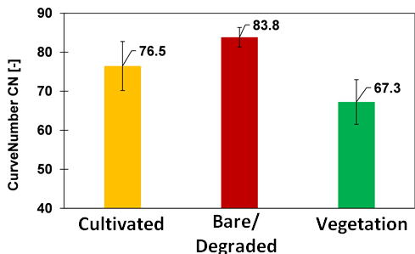
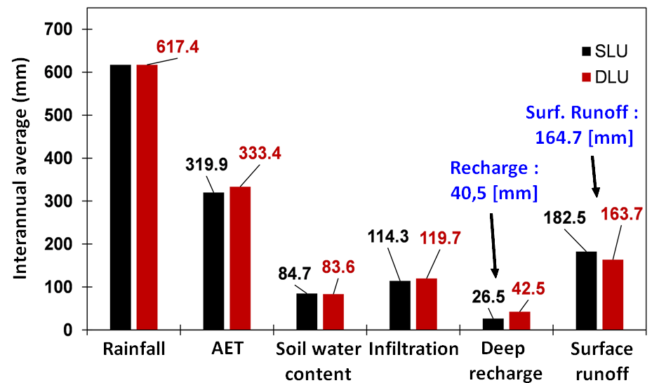
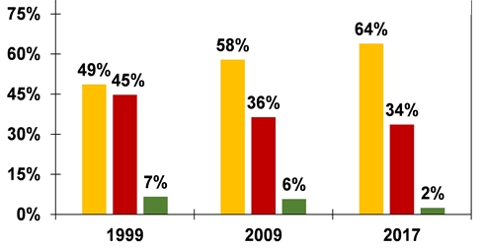
Modelling work and key findings
This increased accuracy might be explained by the runoff potential (CN values) for LULC conditions within the watershed
The depiction of the water balance is more accurate for deep aquifer recharge and for surface runoff using a dynamic LULC input
… which are updated in DLU mode!
*Values in blue are annual average from observed runoff values (for surface runoff)
and from Koita et al. (2017) for deep aquifer recharge.

Slide 12
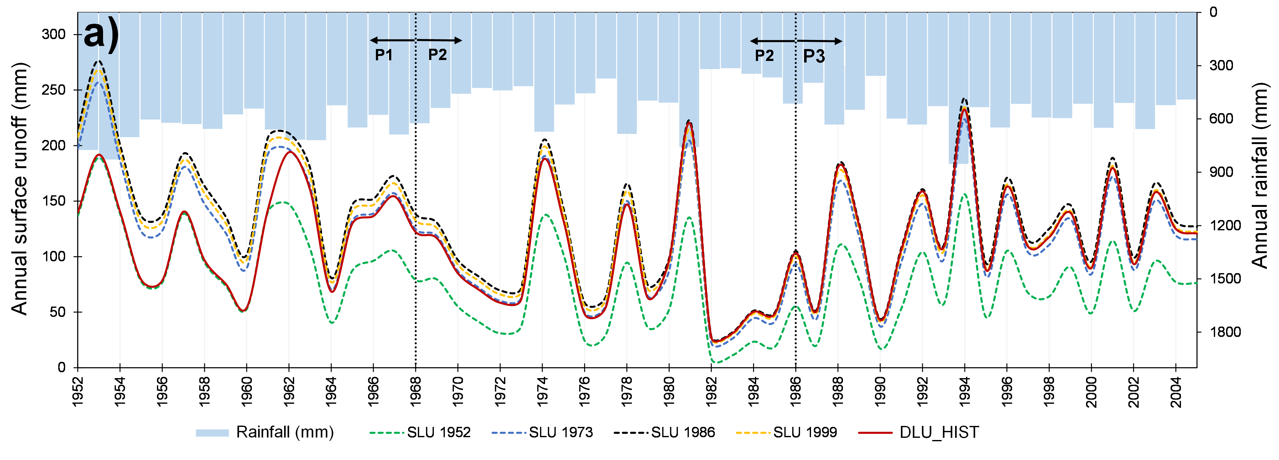
Modelling work and key findings
Surface runoff was therefore simulated over past periods (P1: 1952-1968, wet; P2: 1969-1985, dry and P3: 1986-2005, wet) using each of the LULC maps of the watershed in static mode (1952, 1973, 1986, 1999), which was compared with a dynamic scenario integrating all these LULC maps (DLU_HIST)

Slide 13
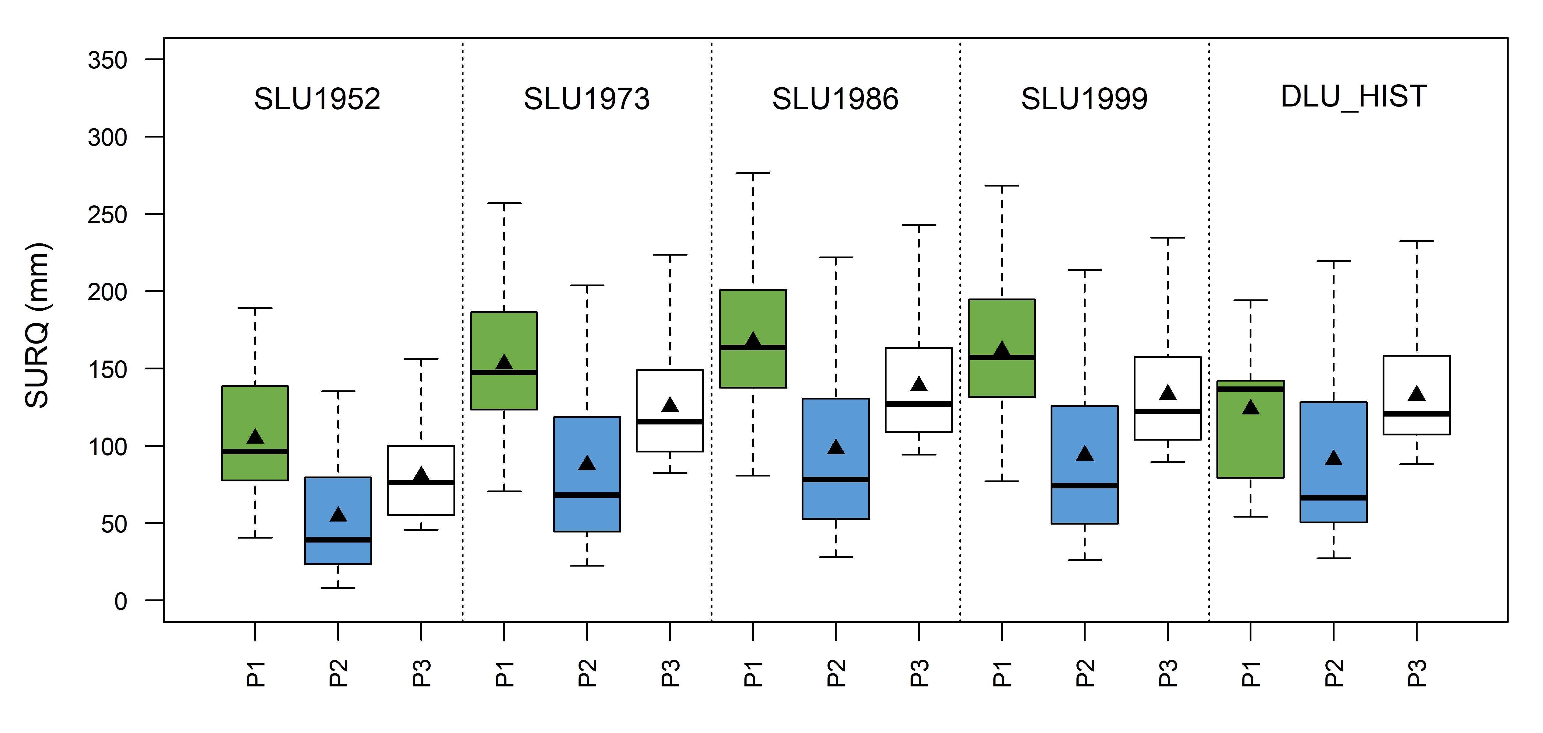
Modelling work and key findings
The Sahelian Hydrological Paradox is only reproduced in DLU_HIST scenario, i.e. when explicitely accounting for LULC spatial and temporal changes within the watershed
In static LULC scenarios (SLU1952, SLU1973 and SLU1986), when rainfall decrease, surface runoff decreases as well.
The Sahelian Hydrological Paradox cannot be simulated.
Surface runoff increase between P1 and P3 despite the decrease in rainfall

Slide 14
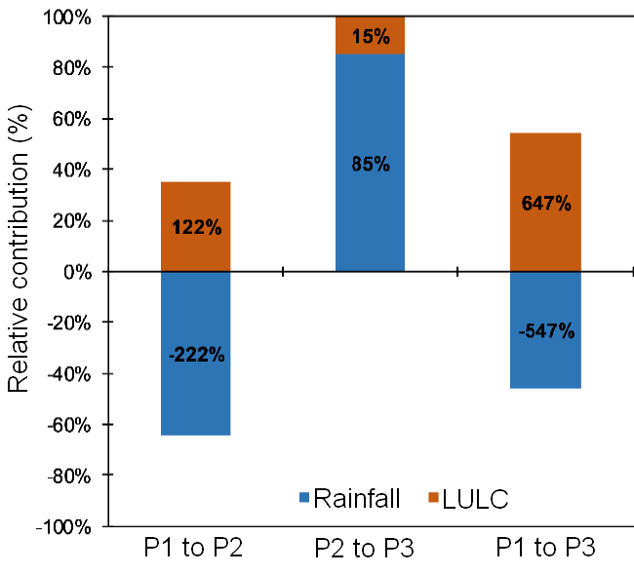
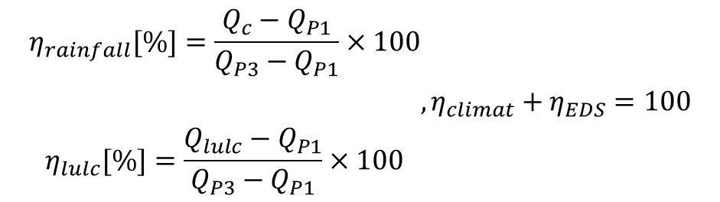
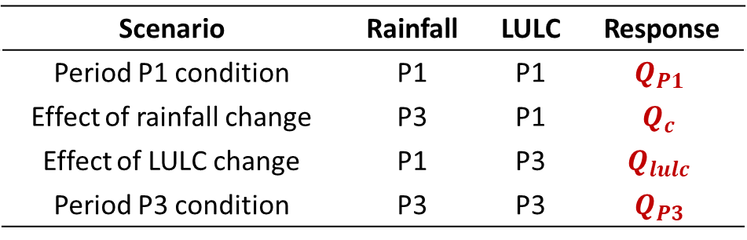
Modelling work and key findings
Disentangling annual rainfall variability and LULC changes impact on surface runoff
Crossing multiple scenarios (Yonaba et al., 2021a)
Scenario | Rainfall | LULC | Response
Period P1 condition | P1 | P1 | $$Q_{P1}$$
Effect of rainfall change | P3 | P1 | $$Q_{c}$$
Effect of LULC change | P1 | P3 | $$Q_{lulc}$$
Period P3 condition | P3 | P3 | $$Q_{P3}$$
From P1 to P2 and P2 to P3, surface runoff is more sensitive to rainfall, but the effect is contrasted : rainfall tends to reduce runoff (P1 to P2), then to increase runoff (P2 to P3)
Overall, from P1 to P3, surface runoff is more sensitive to LULC changes, which tends to increase runoff.
$$\begin{aligned}η_{rainfall}[\%]=\frac{Q_{c}−Q_{P1}}{Q_{P3}−Q_{P1}}×100 \\ \\ \\ η_{lulc}[\%]=\frac{Q_{lulc}−Q_{P1}}{Q_{P3}−Q_{P1}}×100\end{aligned},η_{climat}+η_{EDS}=100$$

Slide 15
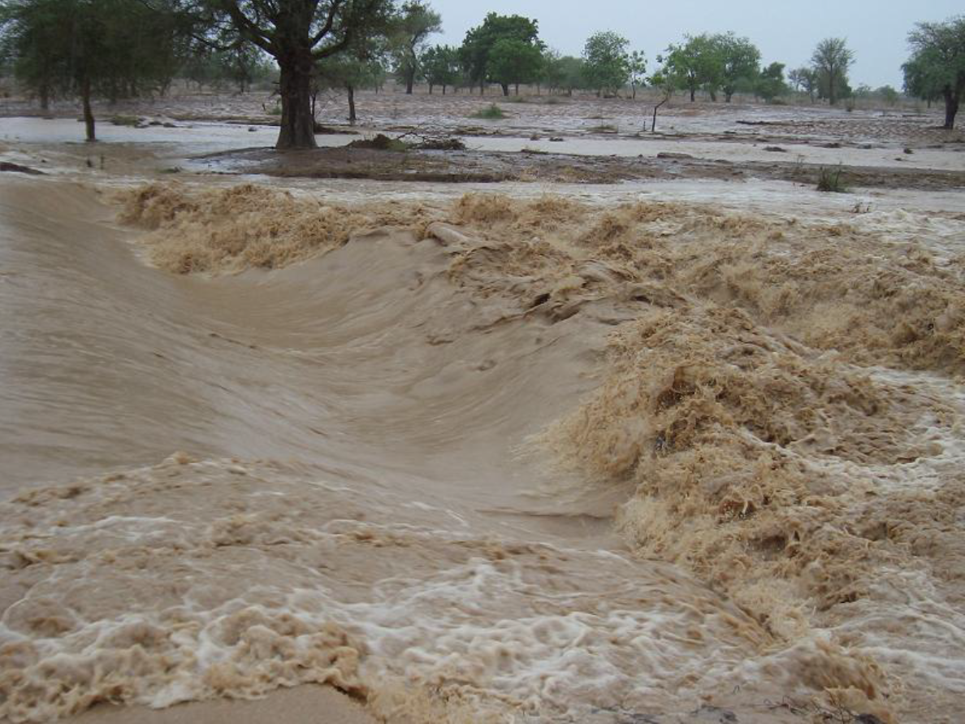
Key conclusions
Sahelian hydrology remains a challenge to hydrologists, especially for hydrological processes modelling
In this context, there is a tight coupling and interactions between land, climate, surface runoff and other hydrologicals. Such interactions are not yet fully understood and pose serious challenges to modelling
There is a need to account for spatial and temporal changes in LULC during hydrological simulation in order to simulate accurately specific processes in such environnments
There is a need to develop integrated modelling platforms or environnement coupling hydrological modelling and evolution of LULC conditions

Slide 16


Published papers for more….
Yonaba, R., Biaou, A.C., Koïta, M., Tazen, F., Mounirou, L.A., Zouré, C.O., Queloz, P., Karambiri, H., Yacouba, H., 2021. A dynamic land use/land cover input helps in picturing the Sahelian paradox: assessing variability and attribution of changes in surface runoff in a Sahelian watershed.
https://doi.org/10.1016/j.scitotenv.2020.143792
Yonaba, R., Koïta, M., Mounirou, L.A., Tazen, F., Queloz P., Biaou A. C., Niang D., Zouré, C.O., Karambiri, H., Yacouba, H.. Spatial and transient modelling of land use/land cover (LULC) dynamics in a Sahelian landscape under semi-arid climate in northern Burkina Faso.
https://doi.org/10.1016/j.landusepol.2021.105305

