Slide 1
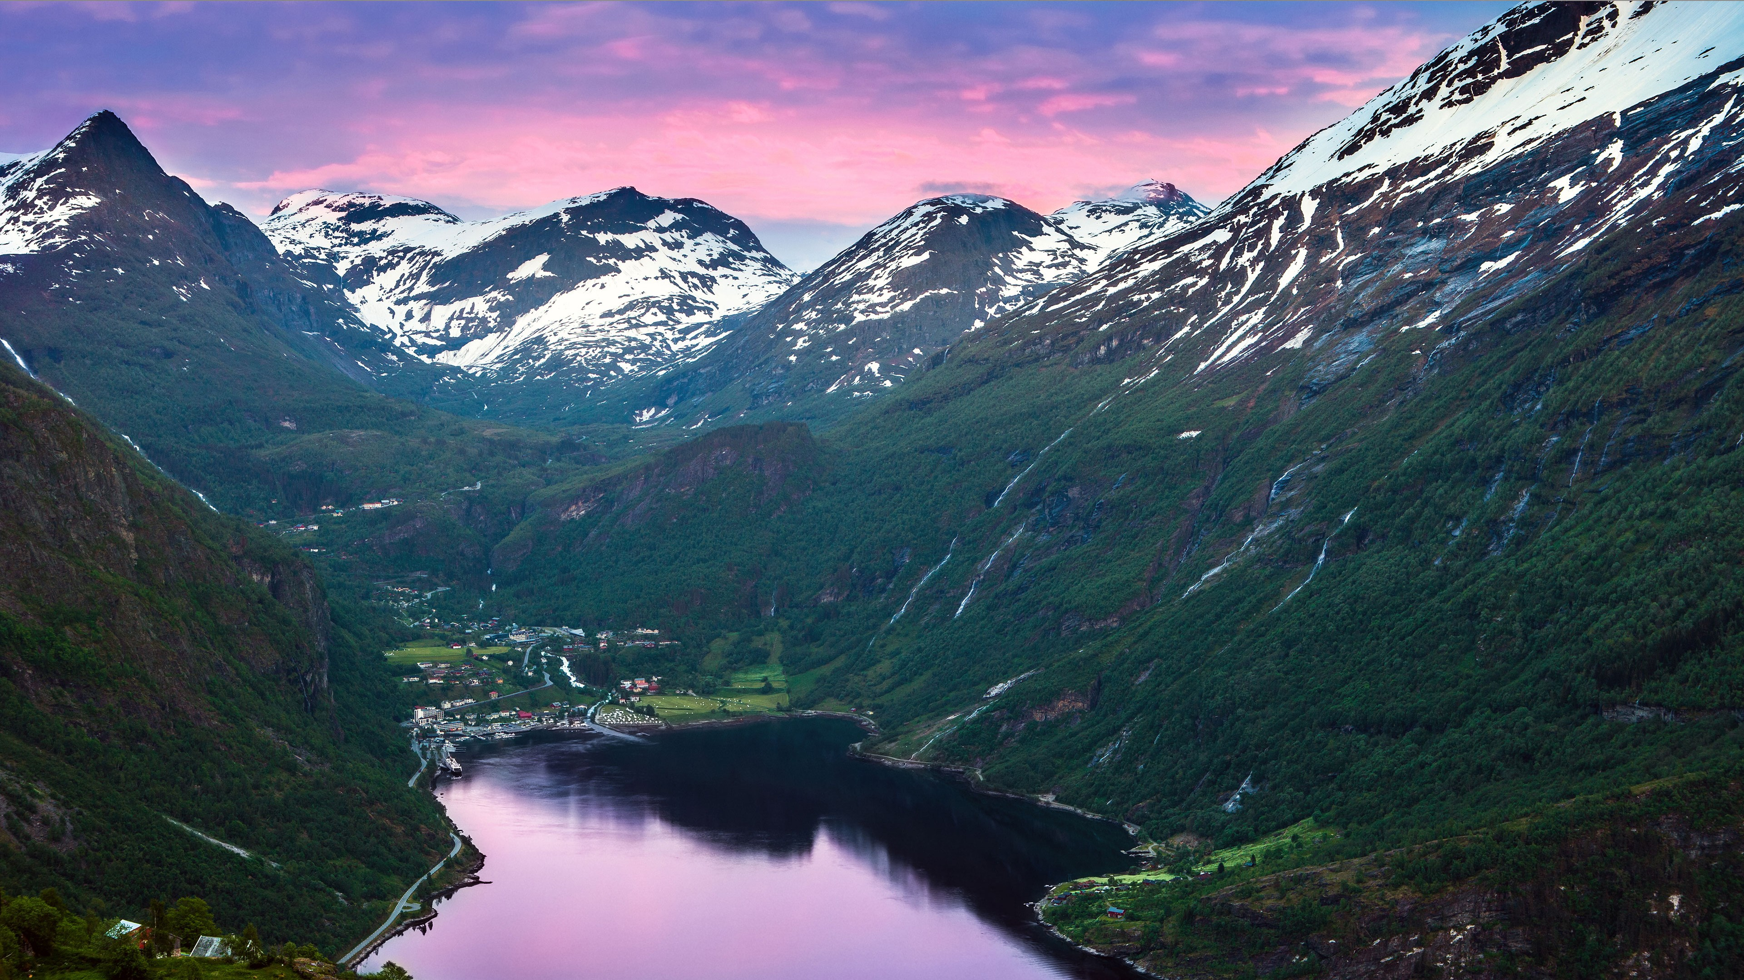

Comparison of modelled radiation budgets with observations over lichens and shrubs at Mount Imingfjell, Norway
Anastasiia Vasiakina, Hans Renssen, and Peter Aartsma
University of South-Eastern Norway

Slide 2
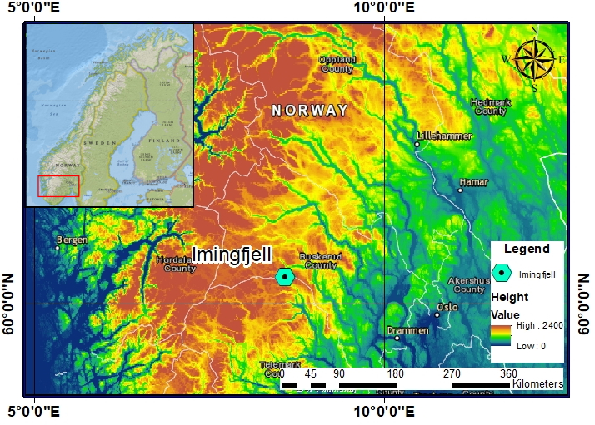
Studied area
A study site on Mount Imingfjell located in Southern Norway was used.
Latitude - 60°11’11.7"N Longitude - 8°34’45.2"E
Altitude - 1191 meters
Size of the site – 2.5 x 0.2 km
Microclimate for 2 types of vegetation – lichen and shrub
Notes:
A study site on Mount Imingfjell with an altitude of around 1200 meters located in Southern Norway was used in this study. Microclimate measurements over this site were taken from the Peter Aartsma’s Ph.D. project. The main problems at the Imingfjell site were that measurements of radiation fluxes weren’t continuous and weren’t performed for all energy fluxes (i.e. the sensible heat and latent heat fluxes were not measured). Thus, CLM4.5 was used to verify the physical consistency of the measurements and check its accuracy by comparing model results with observed measurements over Imingfjell.

Slide 3
CLM4.5 brief description
The Community Land Model (CLM 4.5) is a one-dimensional model that is the default land component for the Community Earth System Model version 1.2 (CESM1.2).
In CLM4.5, the Earth’s surface is divided into grid cells, which can consist of up to 3 subgrid levels.
CLM4.5 can either be run in offline mode, receiving its input from an existing dataset, or in coupled mode, interacting constantly with the Community Atmospheric Model.
CLM4.5 simulates various processes such as hydrological and biogeochemical cycles and surface energy fluxes.
The model calculates these processes based on the balances of surface energy, water, and carbon.
Notes:
CLM4.5 can either be run in offline mode, receiving its input from an existing dataset (observed or modelled), or in coupled mode, interacting constantly with the Community Atmospheric Model (CAM, the atmospheric component in CESM).

Slide 4
Modelled radiation budget for “extremely warm” regime

Slide 5
Observed radiation budget (Lichens) for “extremely warm” regime

Slide 6
Observed radiation budget (Shrubs) for “extremely warm” regime

Slide 7
Modelled radiation budget for “normal” regime

Slide 8
Observed radiation budget (Lichens) for “normal” regime

Slide 9
Observed radiation budget (Shrubs) for “normal” regime

Slide 10
Modelled radiation budget for “cold” regime

Slide 11
Observed radiation budget (Lichens) for “cold” regime

Slide 12
Observed radiation budget (Shrubs) for “cold” regime

Slide 13
T-test results
Temperature regime/t_{tabular} | Datasets | K_{in} | K_{out} | K*¹ | L_{in} | L_{out} | L*¹ | Q*¹
extremely warm/2,06 | m/l² | 0,24 | 3,78 | 1,65 | 0,63 | 2,99 | 2,53 | 4,37
 | m/s³ | 0,28 | 4,11 | 0,48 | 0,60 | 1,50 | 1,53 | 0,37
normal/2,03 | m/l | 0,42 | 4,18 | 0,88 | 1,21 | 4,92 | 1,58 | 2,78
 | m/s | 0,42 | 3,26 | 1,09 | 1,28 | 3,48 | 0,60 | 1,32
cold/2,07 | m/l | 1,90 | 1,52 | 3,23 | 2,28 | 0,09 | 2,09 | 3,54
 | m/s | 1,95 | 3,91 | 1,56 | 2,22 | 1,65 | 2,82 | 0,69
blue cells mean that datasets are similar (the null hypothesis is not rejected), and orange cells – datasets are different (the null hypothesis is rejected)
¹t-values were obtained for the calculated data sets, not observed
²m/l – t-value between modelled and lichen datasets
³m/s – t-value between modelled and shrub datasets

Slide 14
Conclusion
K_{in}, L_{in} and K* for both lichens and shrubs were proven similar to modelled, with exception of L_{in} and K* in the “cold” period.
The modelled K_{out} differed from observed in almost all regimes.
T-test results for L*, and Q* and L_{out} varied between the type of vegetation (lichens or shrubs) and temperature regimes, without a clear pattern of regularity.
Still, about 70% of the modelled fluxes closely resembled the shrub ones, while only around 50% resembled lichens.
In conclusion, CLM4.5 most likely modelled credible values for radiation fluxes, but further research is needed for greater clarity.
Notes:
The modelled fluxes were closer to the shrub data with 25% rejection of the null hypothesis (datasets are different) than the lichen data with 46%.

