Slide 1




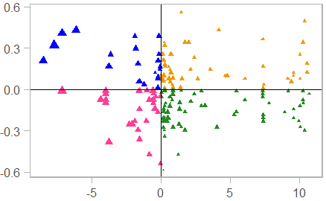
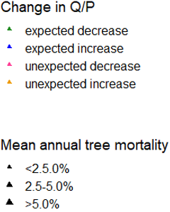
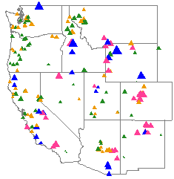
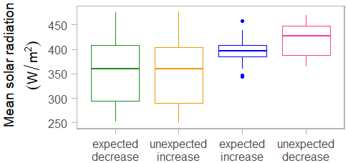
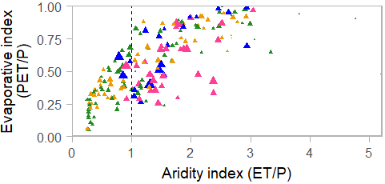
Assessing annual streamflow response to forest disturbance in the western US: A large-sample hydrology approach
<- Click for audio
Sara A. Goeking (sara.goeking@usda.gov) & David G. Tarboton
Hypothesis: Forest cover and runoff are inversely related.
Observed exceptions to hypothesis:
Unexpected increases in Q/P in the absence of disturbance in wetter watersheds with less incoming solar radiation.
Unexpected decreases in runoff ratio (Q/P) after disturbance (tree growth <0) in arid watersheds with high incoming solar radiation.
Data sources:
Hydrology & climate: CAMELS (2000-2014); Daymet and USGS datasets (2014-2019)
Tree growth: US Forest Service, Forest Inventory & Analysis (data collected 2010-2019; represents tree growth for 2000-2019)
N = 177 watersheds
Trend in Q/P
(Kendall’s tau; unitless)
Q = annual streamflow
P = annual precipitation
ET = annual evapotranspiration
PET = annual potential evapotranspiration
Net tree growth (m³ ha⁻¹ yr⁻¹)

