Slide 1
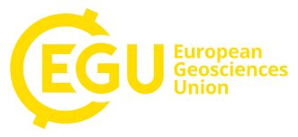



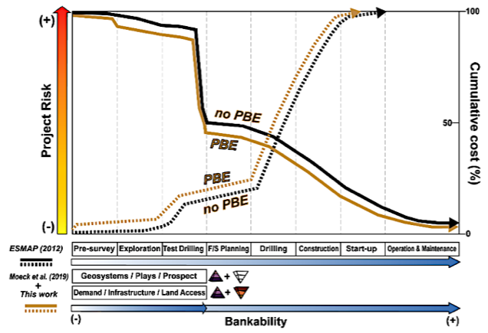
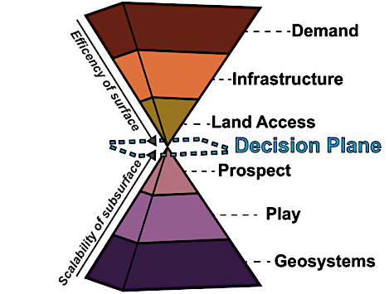



Identification of the socio-technical factors within geothermal exploration based on Plays with examples from Central America
Javiera Chocobar¹, Bernhardt Johst², Rolf Bracke^{1,3,4}, and Erik H. Saenger^{1,3,4}
Click me
Motivation and aims
Results
Research of technical, economic and social factors during the play based geotermal exploration process.
Demand
Demand context Geothermal resource context Deep social territorial diagnosis Social Institutional Education Technical Regulation Economic Financial
Infrastructure
Social Technical Education Regulation Economic Financial
Land access
Social Technical Analysis of land access Regulation Economic Financial
Discussion and conclusion
Methods
Qualitative
research
Literature review
Survey method
Interview method
Qualitative-comparative method
Dimension
Study area
The technical, economic and social factors identified are fundamental in geothermal exploration for Central American countries.
The factors must be evaluated in the geothermal exploration process based on Plays in order to develop a successful geothermal Project.

Slide 2
Play-based geothermal exploration is an important breakthrough and innovation for geothermal exploration. It is a new exploration strategy defines a series of structured steps, from a geosystem scale focus to a local scale focus, for the analysis of the subsoil conditions and it is represented graphically with a Pyramid.
Geosystem
Geologic system analysis as a whole
Play
Understanding the geothermal play
Prospect
Play level analysis in the prospect area
Plate setting
Tectonostratigraphic framework
Play Identification
Geosystem history
Rocks and fluids
Stratigraphci sequences
- Play level identification
Play mapping
Play elelemt
Summary of play maps
Common risk segment maps
Exploration targerts
Prospect selection
- Geophysical evaluation on prospect scale
Geologicas model building
Volumetric model
Technical risk evaluation
Confidence assessment for a range of models and prospects
Play execution activities
However, the geological and geothermal conditions of the subsoil are not the only determining factors for the efficiency of a geothermal resource, but also the local energy demand, infrastructure and Land acces (surface conditions; technical-social-economic dimension).
The factors of the social pyramid have not been identified and the necessary activities to be carried out during geothermal exploration projects are still lacking. For this reason, this study will looking for these results.
Modified from Moeck et al. (2020)

Slide 3
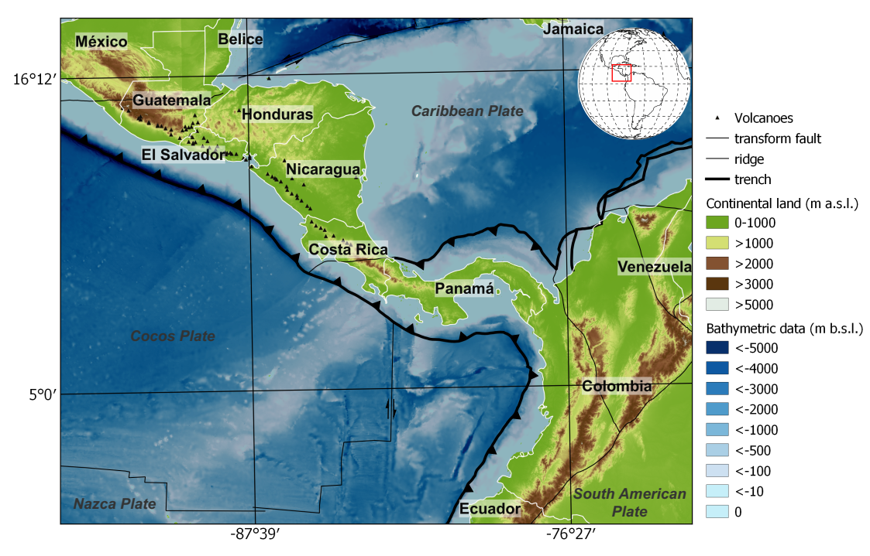
This new methodology could be an alternative for the development of geothermal projects and the use of this resource in different regions of our planet. The region of Central America, where the final consumption of the countries in the region shows a high tendency towards oil derived products and traditional energies, appears as a promising and appropriate area to conduct our field survey.
The region of Central America
Central America is a narrow strip of land or ‘isthmus’ connecting the southernmost part of Mexico (Tehuantepec region) to Panama across the Pacific Ocean to the west and the Caribbean Sea to the east .
Central America bases its economy on three main activities: agriculture, tourism and some industries (e.g., Sugar cane, coffee, cotton, wood and fish).
Central America main topographical and tectonic features. Geological Society of America (https://www.geosociety.org/gsa) and topography and bathymetrical data from http://srtm.csi.cgiar.org/ and https://www.gebco.net/ respectively.
Final energy consumption by source has varied in recent years and this is due to the economic development in each Central American country. However, there is still a greater tendency to Oil derived products and traditional energies.
Country | Fossil fuels (%) | Biomass (%) | Electricity (%)
Guatemala | 32,9 | 59,9 | 7,2
Honduras | 42 | 41,9 | 16,1
Costa Rica | 61 | 7,9 | 31,1
Panamá | 73,5 | 7,5 | 19
El Salvador | 62,8 | 15,7 | 21,5
Nicaragua | 41 | 44,2 | 14,8
Country | Fossil fuels (%) | Biomass (%) | Electricity (%)
Guatemalaª | 36 | 56 | 8
Honduras^{b} | 45 | 41 | 14
Costa Rica^{c} | 63 | 13 | 24
Panamá^{d} | 68 | 9 | 23
El Salvador^{e} | 62 | 21 | 17
Nicaragua^{f} | 46 | 42 | 12
Final energy consumption percentage by country in 2013 from Ventura et al. (2015).
Final energy consumption percentage by country in recent years (aMinisterio de Energía y Minas de Guatemala; 2016, 2017 and 2018; bSecretaría de Energía, 2018; cSkowron et al., 2019; dConsejo Nacional de Energía, 2017; ehttp://estadisticas.cne.gob.sv; fMinisterio de Energía y Minas, 2017).

Slide 4
Qualitative
research
Literature review
Survey method
Questionnaire technique
Interview method
Interview technique
Qualitative-comparative method
﻿Comparative Methodology: PV GRID and PV LEGAL

Slide 5
Narrative Interview technique
People from Central America’s National energy companies, institutions, policymakers, and private companies have been interviewed. The interviews were scheduled during office hours in Central America time and consisted in a ca. 45-minute videocall structured in three set of questions. The questions were the same for all the interviewees and their answers have been compiled into personal professional opinions of a specific topic and considerations within play-dimensions.
Questionnaire technique
To support the results obtained from the interview of the Central American region, people from all around the world answered the questionnaire that was available in the International Geothermal Association (IGA) website. The questionnaire was structured in nine questions in a Google Forms® environment. Three out of nine were closed question (a-f) while in six of them the interviewee could answer in an open redaction format.
Literature review
To overcome possible limited access and assures that the findings in the interviews are still reliable, a bibliographic compilation was made covering the different areas of application of geothermal energy (electricity production, heating, and cooling). This bibliographic analysis was carried out in three steps: (i) grouping the information by dimension, (ii) selecting the technical socio-economic factors for each dimension and, (iii) grouping and categorising the factors considered in the research papers or technical reports. The last step groups and categorizes the variables mentioned to get a broader view of the topic.

Slide 6
 | Dimension
 | Demand | Infrastructure | Land access
Factors | ﻿Demand context Geothermal resource context Deep social territorial diagnosis Social Institutional Education Technical Regulation Economic Financial | Social Technical Education Regulation Economic Financial | Social Technical Analysis of land access Regulation Economic Financial
The final factors are determined by the qualitative comparative analysis.
Some of them will be present in all three dimensions. The determination of the factors allows to better understand which activities should be performed in each dimension and during the exploration process.
The determination of the factors allows to better understand which activities should be performed in each dimension and during the exploration process.
The analysis finally determines the activities with a social focus that should be carried out during the geothermal exploration with plays.
Demand
Infrastructure
Land access
Demand context analysis
Geothermal resource context verification
Deep social territorial diagnosis
Social involkvement
Institutionl analysis
Educatiomaö data collection
Compilation of technical information
Analysis of the existing regulatio and exploration permit requirement
Economic evaluation
Financial evaluation
Socialization
Physical technical evaluation
Analysis of access to the land
Environmental evaluation
Final Economic study
Socialization
Technical área
Implementation in educational áreas
Environmental impact mitigation
Economic evaluation
Financial evaluation
ACTIVITIES

Slide 7
In order to find out which factors/activities are currently considered in the geothermal exploration process in each Central American country, a questionnaire of three closed questions with a scale from "never" to "always" was applied (﻿Comparative Methodology: PV GRID and PV LEGAL).
1 | It is never done in the process of geothermal exploration
2 | It is almost never done in the process of geothermal exploration
3 | It is sometimes done in the process of geothermal exploration
4 | It is frequently done in the process of geothermal exploration
5 | It is always done in the process of geothermal exploration

Slide 8
Here are the results for each dimension, with the activities and each country.
Infrastructure
Demand
Activivities | Panamá | El Salvador | Guatemala | Honduras
Socialization
Technical area
Implementation in educational areas
Environmental impact mitigation
Economic evaluation
Financial evaluation
Activivities | Panamá | El Salvador | Guatemala | Honduras
Demand context analysis
Geothermal resource context verification
Deep social territorial diagnosis
Social involvement
Institutional analysis
Educational data collection
Compilation of technical information
Analysis of the existing regulation and exploration permit requirement
Economic evaluation
Financial evaluation
Land access
Activities | Panamá | El Salvador | Guatemala | Honduras
Socialization
Technical area
Analysis of access to the land
Environmental evaluation
Final economic study
Financial evaluation

Slide 9

The integration of the identified factors within the geothermal PBE allows developing a preliminary catalogue of the activities (or factors) required during the analysis of the social dimension in play-based geothermal exploration is presented.
This methodological guide will benefit the developer of geothermal projects as the prior assessment of the societal dimension in geothermal PBE will reduce the risks associated with the development of a geothermal project (electricity, heat or cold generation). This can be represented graphically, as it is show in the graph.
This graph shows a comparison between the methodology proposed by ESMAP and Geothermal Play Based Exploration. It shows that in GPBE the upfront costs increase. This is related to the need to include the costs of hiring social researchers. On the other hand, risks decrease in the initial steps before drilling because having more information about the social reality can avoid possible associated costs during this phase and later phases, and even anticipate avoiding the impediment of the continuity of the project.

Slide 10
Conclusions:
The resulting factors identified (Demand context, Geothermal resource context, Deep social territorial diagnosis, Social, Institutional, Educational, Technical, Regulation, Economic and Financial) are fundamental in geothermal exploration for Central American countries.
To develop a successful geothermal Project (electricity, heat or cold generation), the above-mentioned factors must be evaluated beforehand in the process of geothermal exploration based on Plays.
The integration of social factors into the Play-based geothermal exploration delivers more security for future investors and developers of geothermal projects.
Further research on social factors is necessary, to build a robust methodology that offers the ability to adapt to the needs of each country, while remaining an efficient process.

Slide 11
Identification of the socio-technical factors within geothermal exploration based on Plays with examples from Central America
Javiera Chocobar¹, Bernhardt Johst², Rolf Bracke^{1,3,4}, and Erik H. Saenger^{1,3,4}
1Department of Civil and Environmental Engineering, Bochum University of Applied Sciences, Bochum, Germany (jp.chocobarvillegas@gmail.com)
2Deutsche Gesellschaft für Internationale Zusammenarbeit (GIZ) GmbH, San José, Costa Rica.
3Institute of Geology, Mineralogy and Geophysics, Ruhr-University Bochum, Bochum, Germany.
4Fraunhofer IEG - Institution for Energy Infrastructures and Geothermal Energy, Bochum, Germany.

