Slide 1
Designing an optimal flood forecasting chain using convective-scale ensembles: a sensitivity study
Dr. Céline Cattoën,
Dr. Stuart Moore,
Dr. Trevor Carey-Smith
celine.cattoen-gilbert@niwa.co.nz
With grateful acknowledgment to Dr. Maria-Helena Ramos for recent discussions and suggestions

Slide 2
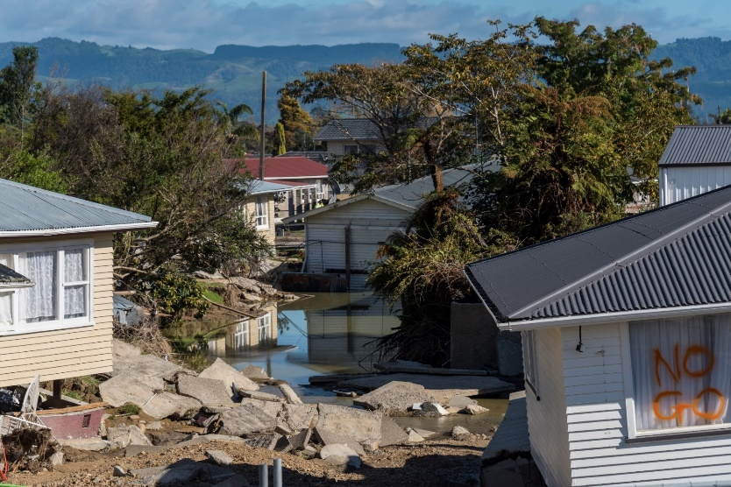
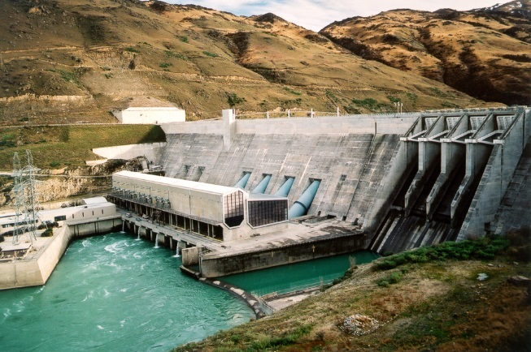
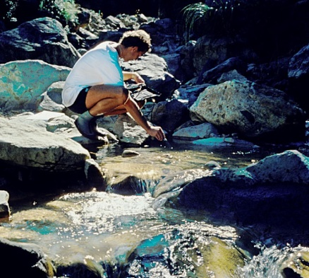

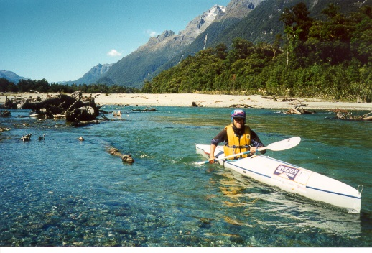
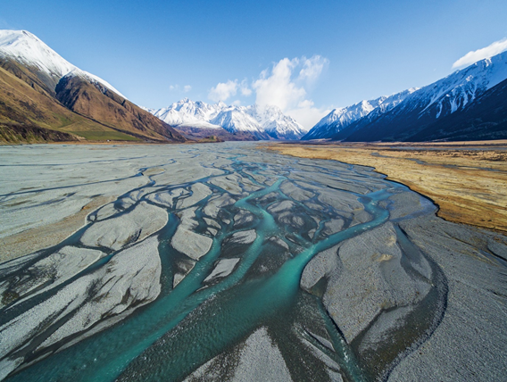
Water plays a key socio-economic role in New Zealand
Insurance Costs¹ :
Between 1996-2014:
$442 Million (NZD)
2017-2019:
>$350 Million (NZD),
6 ex-cyclones
Responsibilities for floods:
Local authorities are the primary agents responsible for civil defence emergency management (CDEM)
Responsibilities for weather warnings:
MetService
Photos: Dave Allen
¹Reference: Insurance Council of New Zealand (ICNZ)
Notes:
There are many aspects to water use in New Zealand, from an economic, recreational, environmental and cultural perspective.
Hydropower: largest source of renewable energy
Tourism and agriculture sectors: largest earners.
Floods: most frequent natural disaster in NZ.
$135.5 Million dollars in 2017 (Insurance council of NZ) nearly 3 times the average.
Cyclone Debbie and Cook April 2017 (photo)
Despite important needs and reliability on water in New Zealand, there are currently no mandate for a flow forecasting service in NZ.
Regional councils responsible for calling civil defense, some have models some don’t. Disparity of resources.
NIWA is the National Institute of Water and Atmospheric research is mandated to do research in weather and related hazards.
1) Flooding = NZ’s most frequent natural disaster
2) Recent events have been much more intense and frequent.
3) Context of insurance costs, ex-cyclones
4) Responsibility for floods in NZ: local authorities
Recent events have been much more intense and frequent. This raises questions about what role the unusually high Tasman sea temperatures had in maintaining Fehi and Gita and whether this is a mechanism by which NZ might be more exposed to extreme weather under climate change.
Local authorities (city, district and regional councils or unitary authorities*) are the primary agents responsible for civil defence emergency management (CDEM).
Photograph: Edgecumbe has joined a long list of New Zealand towns and cities who know how devastating flood damage can be and what it takes to get back to normal. Photograph by Dave Allen.,
Loaded byDave.Allen@niwa.co.nz
Flooding is New Zealand’s most frequent natural disaster with an average annual cost of approximately $51 million. The New Zealand Insurance Council reports costs related to flood events as $135.5 million for 2017 alone, making it one of the most damaging years for extreme weather events in recent times. Cyclone Debbie (April 5th -6th 2017) caused $66.4 million in insured losses alone, with the town of Edgecumbe inundated when a Rangitāiki River bank burst, while Cyclone Cook (April 13-16th 2017) cost insurers $18 million. Increased urbanisation and the modification of the precipitation regime associated with climate change will likely increase our vulnerability to flooding in the coming decades .

Slide 3
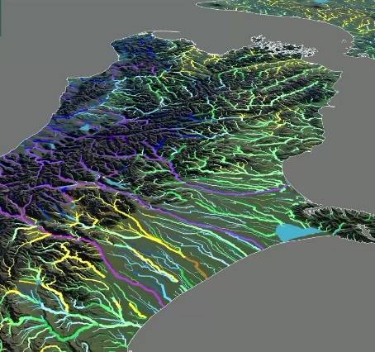
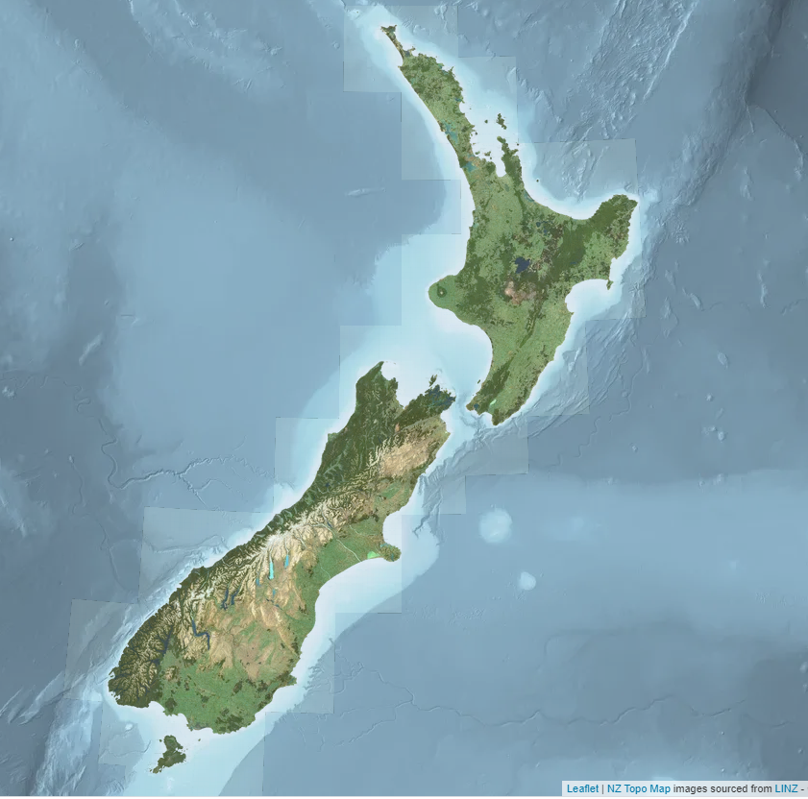
Background: convective-scale flow forecasting in New Zealand
Challenges:
NZ complex topography
Fast-responding rivers
High uncertainties in precipitation forecasts, lack of data
Convective-scale models:
computationally demanding, trade-offs ensemble sizes
Ensemble configuration studies on small forecast samples (~1-3 months)
& focus on meteorological variables (e.g. precipitation)

Slide 4
Literature: Convective-scale weather ensembles
References | Horizontal resolution | Ensemble size | Evaluation period | Focus
(Schwarz et al 2010) | 4km | 10 members | ~35 days | Precipitation
(Clark A.J. et al 2011) | 4-200km | 17 members | ~35 days | Precipitation
(Raynaud, Bouttier 2016) | 2.5-4km | 6-12 members | ~ 1 month | Precipitation, temperature, wind
(Raynaud, Bouttier 2017) | 1.3-2.5km | 12-34 members | ~ 2 months | Precipitation, temperature, wind
(Hagelin et al. 2017) | 2.2km | 12 members | ~ 3 months | Precipitation, temperature, wind, cloud
(Porson et al. 2019) | 4.5km | 18/51 members | ~ 1 month | Precipitation, temperature, wind
Notes:
International work on convective-scale ensembles looks at following questions:
Ensemble size, frequency of forecast issue times and model initialisation, weather model physics, resolution, domain size and data assimilation strategies
How to initialiase to have enough spread, impact of model phyics
- Small number of ensembles.
- But short evaluation period: floods??
Clark, A. J., et al. (2011) Probabilistic Precipitation Forecast Skill as a Function of Ensemble Size and Spatial Scale in a Convection-Allowing Ensemble. Monthly Weather Review, 139, 1410-1418.
Raynaud, L., and F. Bouttier, 2016: Comparison of initial perturbation methods for ensemble prediction at convective scale. Quarterly Journal of the Royal Meteorological Society, 142, 854-866.
Raynaud, L., and F. Bouttier, 2017: The impact of horizontal resolution and ensemble size for convective-scale probabilistic forecasts. Quarterly Journal of the Royal Meteorological Society, 143, 3037-3047.
Schwartz, C. S., and Coauthors, 2010: Toward Improved Convection-Allowing Ensembles: Model Physics Sensitivities and Optimizing Probabilistic Guidance with Small Ensemble Membership. Weather and Forecasting, 25, 263-280.
Hagelin, S., J. Son, R. Swinbank, A. McCabe, N. Roberts, and W. Tennant, 2017: The Met Office convective-scale ensemble, MOGREPS-UK. Quarterly Journal of the Royal Meteorological Society, 143, 2846-2861.
Porson, A. N., S. Hagelin, D. F. A. Boyd, N. M. Roberts, R. North, S. Webster, and J. C.-F. Lo, 2019: Extreme rainfall sensitivity in convective-scale ensemble modelling over Singapore. Quarterly Journal of the Royal Meteorological Society, 145, 3004-3022.

Slide 5
Convective-scale weather forecasting is computationally expensive
Weather models at NIWA
 | NZLAM-12 (12km) | NZLAM-4 (4km) | NZCSM (1.5km) | NZENS (4.5km)
Domain Size | 324 x 324 x 70 (L70_80km) | 900 x 900 x 70 (L70_80km) | 1200 x 1350 x 70 (L70_40km) | 400 x 450 x 70 (L70_40km)
Dynamics timestep (Δt) | 300 s | 120 s | 60 s | 120 s
Forecast period / frequency | T+75 (4x daily) | T+75 (4x daily) | T+48 (4x daily) | T+60/T+120 (1x daily)
# HPCF nodes | 272 (7 nodes) | 1024 (26 nodes) | 1080 (40 nodes) | 440 (11 nodes)
Wallclock time | ~20 mins | ~100 mins | ~145 mins | ~21/43 mins
Notes:
Quick comparison of the current operationally run NZLAM-12 and NZCSM HPC resource requirements and the in-test NZLAM-4 and NZENS
Figures are for running on the Kupe HPC based in Auckland and NZENS on Maui in Wellington
Operations will transition to the Wellington-based Maui HPC in mid 2019.

Slide 6
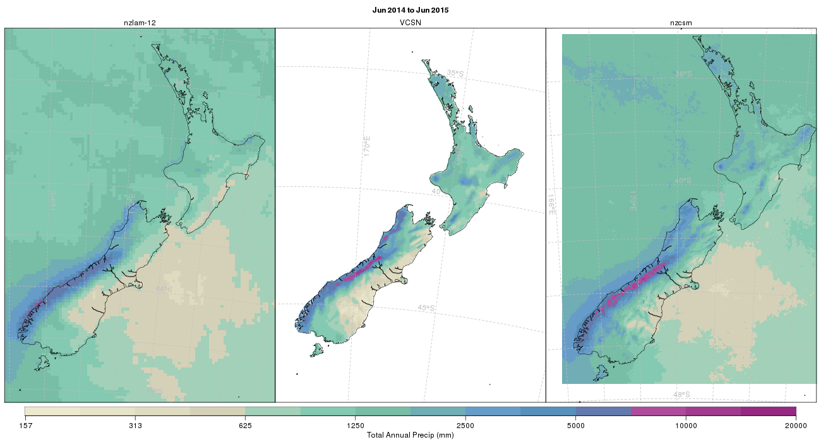
Forecasting Floods – High-resolution weather forecast
Cloud-resolving model gives a much more realistic annual mean rainfall distribution in New Zealand
Forecast 12km – Large scale
Forecast 1.5km- Convective scale
“observed” product 5km (VCSN)
June 2014 - June 2015
Notes:
1) High-res gets the details, eps. On N. Island, but too wet on lee of S. Alps
2) Better representation at national scale.

Slide 7
Aim:
Design an optimal convective-scale ensembles for flood forecasting
What is the most efficient and affordable operational flood ensemble configuration in terms of both scientific and computational performance?
How do convective-scale ensemble strategies (ensemble size, frequency) impact accuracy and uncertainty representation for flow and flow forecasting?
How much skill do hydrometeorological forecasts have out to 5 days?

Slide 8
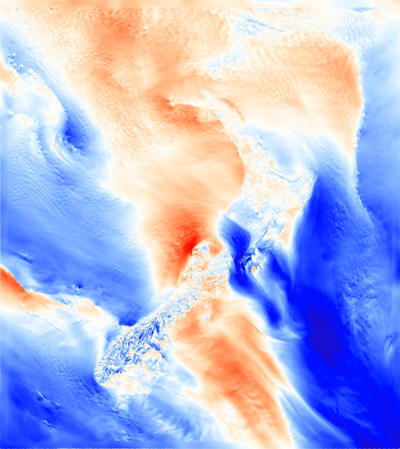
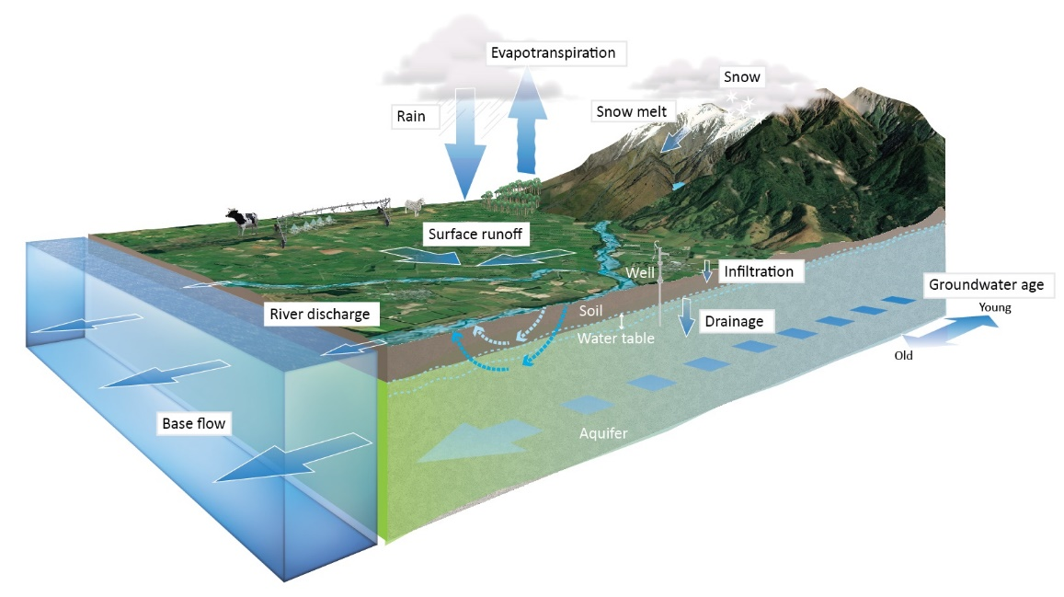
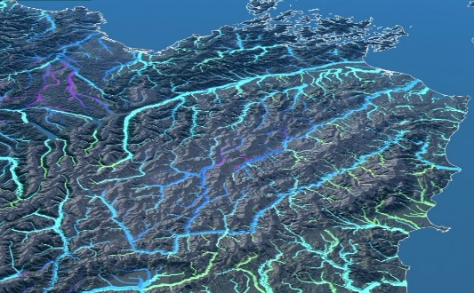
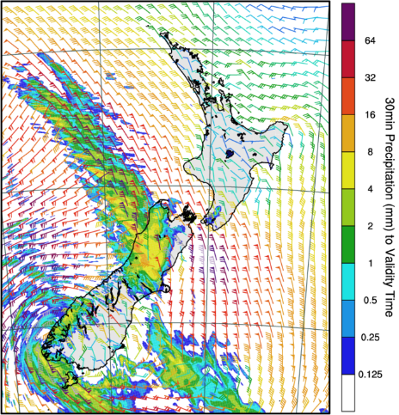
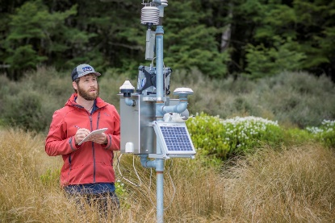
Hydrometeorological system
Weather model
Hydrological model
Flow forecast
NZ Water Model
Initial conditions
NIWA: Unified Model Partner
Notes:
NIWA part of UM consortium
Weather based on UN local implementation: convective-scale, stat perturbation
Hydro model physically based and semi-distributed
Flow forecast processed to relative flow from a climatology.
Obs forcing hydro model to produce initial condition (delay of couple of days briging using past forecast)
1) Overview of how models and data are integrated for flow and flood forecasting.
2) Hydro model: national databases (land use, soil characteristics, topography), runoff and routing into rivers, key model processes represented.
Runs on HPC, all automated in a cyclic environment, runs 4 times a day,
high res weather model out to 48h
NZENS not yet running operationally
Coupled to hydrological model (physical processes solved)
Before each forecast hydrological model initiatilzed (driven by observed conditions)
Produce flow forecast, hydrographs

Slide 9
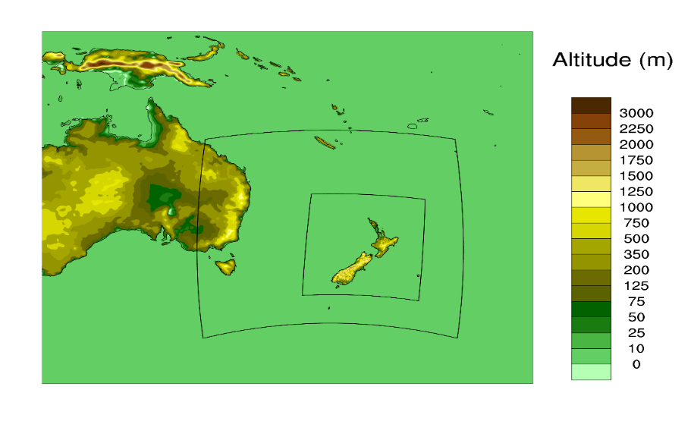
Experimental weather model configurations
Model Name | Horizontal Resolution | Convection Scheme | Data Assimilation | Domain Size
NZLAM12 | 12 km | Parameterised | Local DA | Large
NZLAM4-GA | 4.4 km | Parameterised | Local DA | Large
NZLAM4-RA | 4.4 km | Explicit/resolved | Local DA | Large
NZCSM | 1.5 km | Explicit/resolved | Local Pseudo-DA | Small
NZENS (18 members) | 4.5 km | Explicit/resolved | No local DA | Small
Global 23km/17km
NZLAM
12km/4km
NZCSM 1.5km
NZENS 4.5km
Notes:
Key configurations we look at summarised here: resolution, convection scheme, data assimilation, domain size

Slide 10
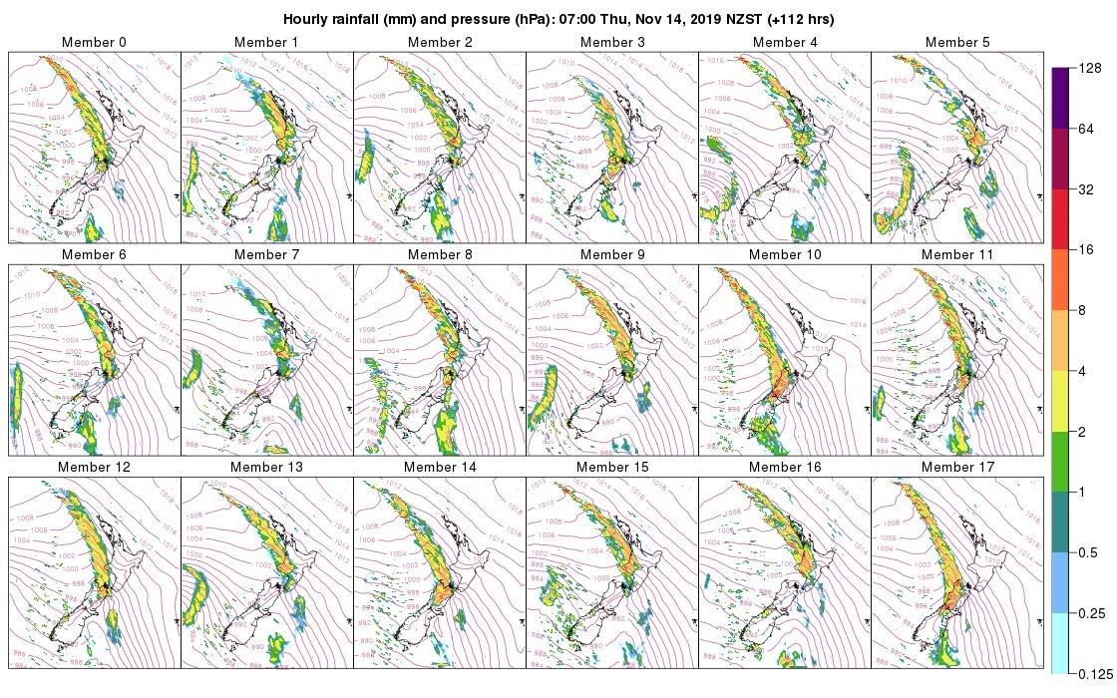
New Zealand Ensemble (~4.5 km)
NZENS
UM10.9/RA1-M
400 × 450 × 70
40km model top
18 members
IC/LBCs: MOGREPS-G
Forecast period: T+120
Output frequency: Hourly
AT: 00,12 UTC (from T+3 dump)
Notes:
A down-scaling ensemble system is in test and began routine running March 2019. The domain is the NZCSM domain – and initially run just once a day off the 00 UTC cycle.
Basic products are produced but scope to collaboratively determine optimal product requirements.
Map used is to highlight variety of scenarios. Forecast for the day was pretty benign and little difference in members!

Slide 11
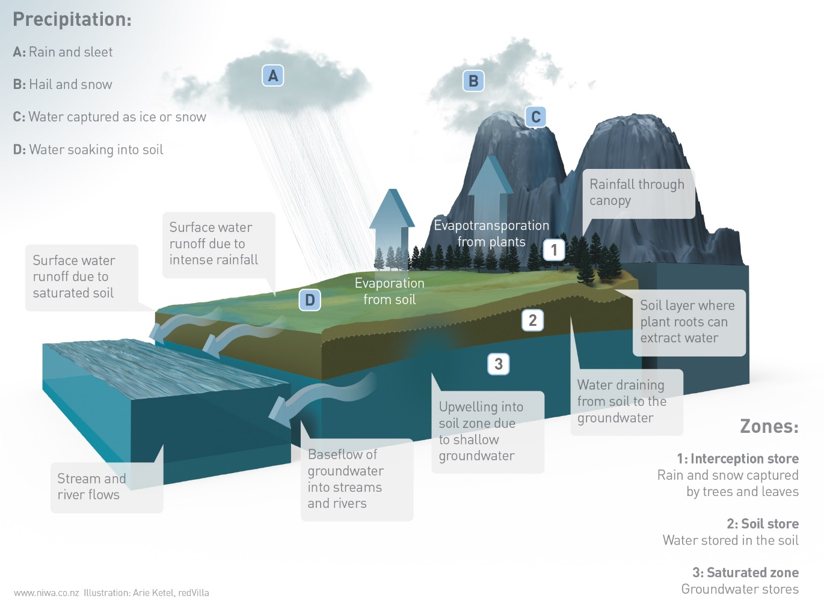
Experimental hydrological model configurations
Semi-distributed hydrological model based on Topmodel +kinematic river routing
Configurations
Uncalibrated/calibrated
Hourly
Strahler 1 (~1km), Strahler 3 (~5km)
Initial conditions: perfect simulations
No flow data assimilation
McMillan, H. K., Booker, D. J. & Cattoen, C. 2016. Validation of a national hydrological model. Journal of Hydrology, 541, 800-815.
Cattoen, C; McMillan, H. and Moore, S. Coupling a high-resolution weather model with a hydrological model for flood forecasting in New Zealand. Journal of Hydrology (New Zealand), Vol. 55, No. 1, 2016: 1-23.
Notes:
No radar avail so Hydro model as proxy to compar rainfall/runoff volumes
Avoid biases to forcings so uncalibrated/untuned to historical data.
Focus on forcing (precip) so no DA.
Key points:
Model processes (TopModel Keith Beven (distinguish Prof Emeritus in Hydrology in UK) when in NZ)
Semi-distributed model
A priori parameters based on Hydro/Geo Fabric
Ongoing development: GW (2 approaches), Evapotranspiration
The distributed NHM can provide water information required nationally (including for climate change applications), and exhibits the strong environmental diversity of New Zealand catchments (McMillan et al., 2016). The NHM produces time series of natural flows and is based on TOPMODEL concepts of runoff generation controlled by sub-surface water storage, and combines a water balance model within each sub-catchment with a kinematic wave channel routing algorithm (Beven et al., 1995, Goring, 1994). The NHM model parameters are based on nationally available information on catchment topography, physical and hydrological properties derived from the River Environment Classification, soil, land use and geology databases. Consequently, model parameters are independent of changes or biases in input rainfall data and are estimated using the same method in both gauged and ungauged catchments.
Based on TopModel
REC: River Environment Classification = digital data set of NZ river reaches
Physical processes in picture modelled
full water balance in each sub-basin
kinematic wave routing algorithm to route flow from multiple sub-basins along the channel network
Calibration (multipliers: estimates based on catchment topography, physical and hydrological properties, soil, land use and geology databases) (8 parameters)
+ daily data Virtual Climate Station network input used often=interpolated observed data, 20-30 years of data versus barely 1 or a couple of years of weather forecasts.
Most of hydrological processes are reproduced
Catchment scale hydrological processes focus
Time scale relevant to forecast capabilities
Uncalibrated state -No modification of parameter state to fit observation
Semi distributed: Processes description are distributed across the landscape but lumped to representative units (ie surface water catchments)
Water balance fluxes relevant to the scale of the catchment- do not resolve internal heterogeneity
Discharge based on kinematic wave approximation

Slide 12
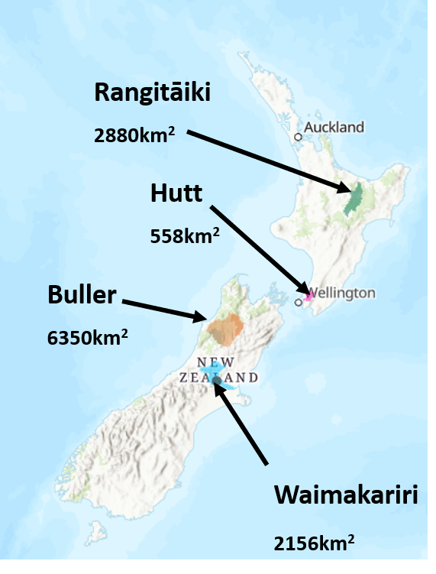
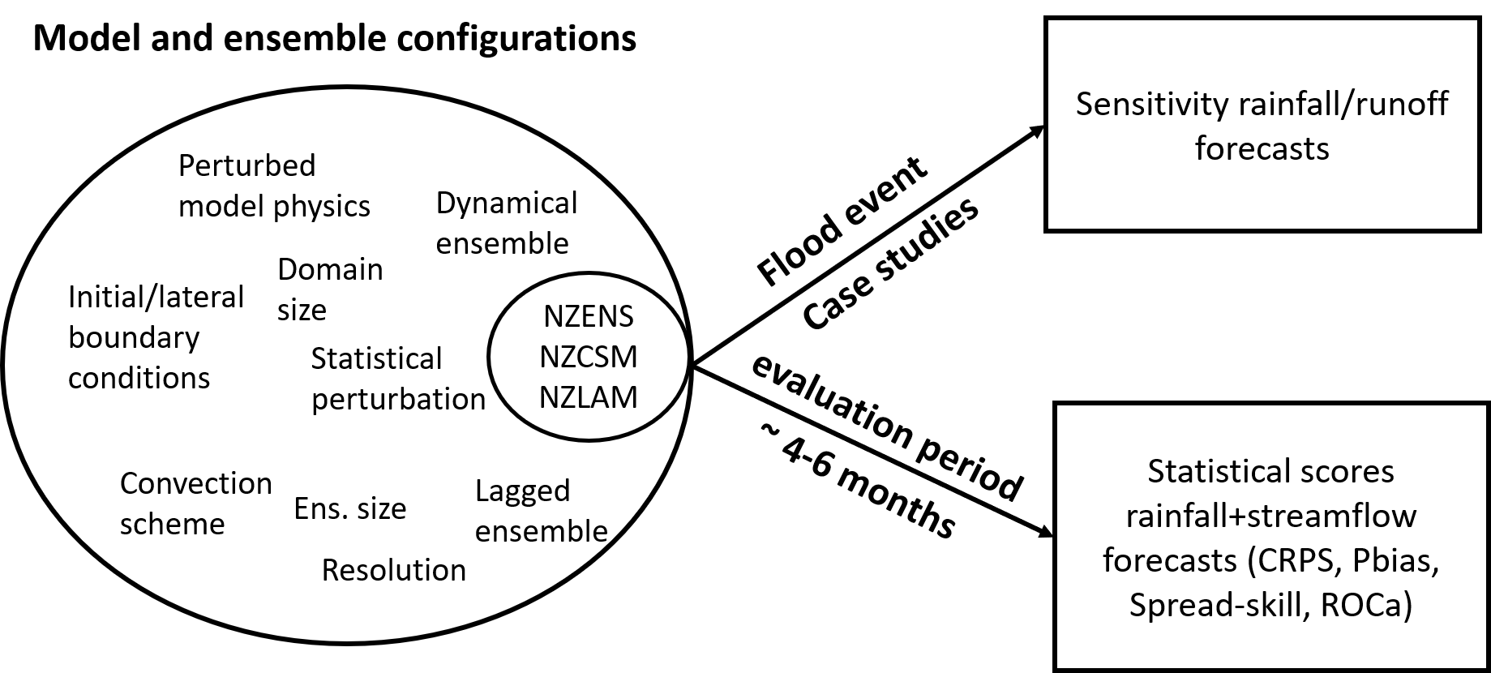
Approach
Ensemble strategies:
A: 18 members 2x/day (control)
A03: 18 members 1x/day
B: 9 members 2x/day
C: 18 members statistical perturbation¹
C-hr: C with high-res (1.5km)
¹Statistical ens. ‘precipitation multiplier’ McMillan, H. K., Hreinsson, E. Ö., Clark, M. P., Singh, S. K., Zammit, C., and Uddstrom, M. J.: Operational hydrological data assimilation with the recursive ensemble Kalman filter, Hydrol. Earth Syst. Sci., 17, 21–38, https://doi.org/10.5194/hess-17-21-2013, 2013
Notes:
Approach:
- Flood case studies as scoping exercise to understand impact of 1) ensemble initialisation, 2) sources of model uncertainties for floods 3) coarser ensemble vs high-resolution
Conventionally evaluation period over ~ several months stations, gridded product, streamflow to assess hypothesis/conclusions from the flood case studies

Slide 13
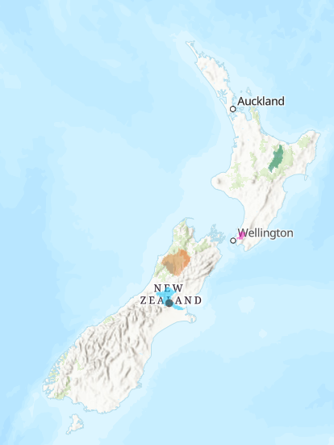
Flood case studies
Date |  | Catchment | ~Return period | Presented
2014 | 24th -25th May | Hutt | ~20 yr
 | 2nd August | Hutt | ~2 yr
2015 | 20th June | Hutt | ~2 yr
2016 | 15th November | Hutt | ~2 yr
2017 | 2nd February | Hutt | ~15-20yr
 | 4th-6th April | Rangitāiki | ~100 yr | Case study 1
2019 | 30th -31st May | Buller Waimakairi | ~5 yr ~15 yr | Case study 2
Rangitāiki
2880km²
Hutt
558km²
Buller
6350km²
Waimakariri
2156km²
Notes:
Case study catchments across NZ
2 case studies presented here to illustrate findings: Significance: cyclone Debbie (was ~500yr /inundation Edgecumbe, Recent: bridge collapse on West Coast)
Not all testing the same thing due to oper constraints and data avail.
Quick comparison of the current operationally run NZLAM-12 and NZCSM HPC resource requirements and the in-test NZLAM-4 and NZENS
Figures are for running on the Kupe HPC based in Auckland and NZENS on Maui in Wellington
Operations will transition to the Wellington-based Maui HPC in mid 2019.

Slide 14
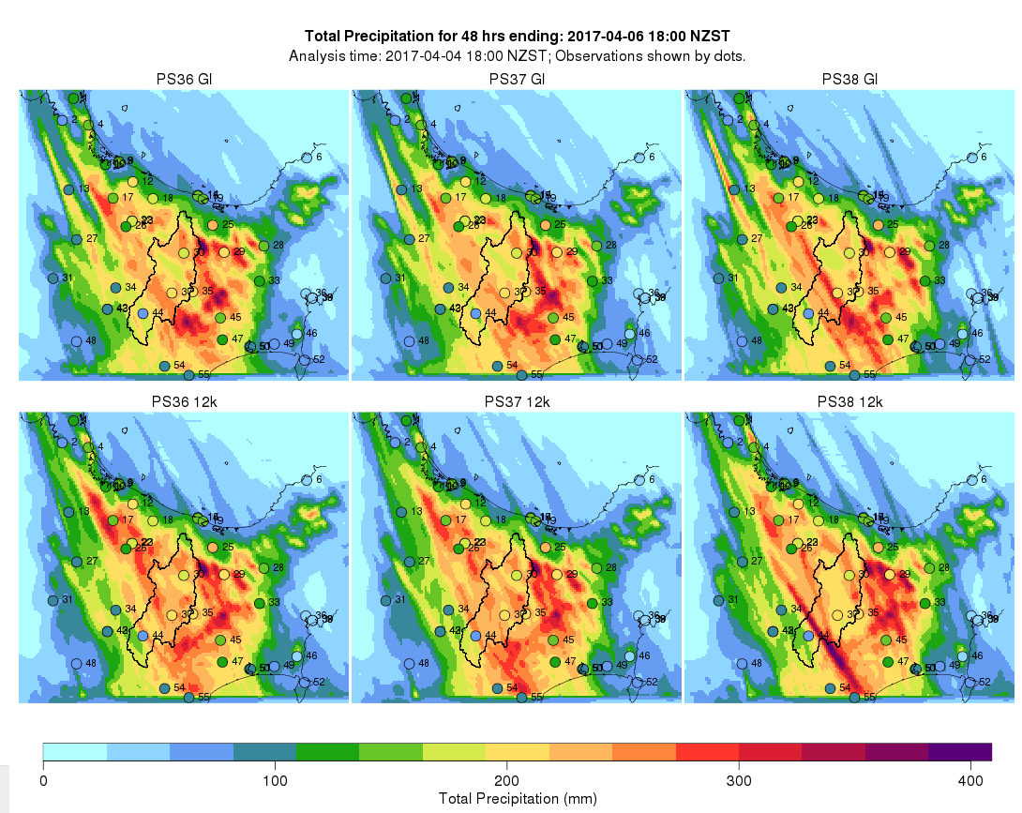
Case study 1: Ensemble forecast initialisation (Ex-cyclone Debbie 4-6th April 2017)
Model Physics 1
Model Physics 2
Model Physics 3
6 members at 1.5km, 4 issue times
Initial/lateral boundary conditions: global model
Global 17km
NZCSM 1.5km
Initial/lateral boundary conditions: NZLAM
NZLAM 12km
Notes:
About forecast inatialisation: using different IC/LBC and small physics perturbations
6 member at 1.5km for 4 consecutive issue times
48h of rainfall.
IC/LBC
Small model physics
Also statistical perturbation?
To test the initial lateral boundary conditions we forced NZCSM with the both the Global model, shown on the top
And on the bottom we forced NZCSM with the large scale model which is 12 km and shown
In total, we ran TOPNET hydrological model on six different weather model outputs
NZCSM model names
Model configurations
Ukvos36 (PS36)
Turbulent mixing scheme
Ukvos37 (PS37)
Ice microphysics settings
Ukvos38 (PS38)
Stochastic perturbation to both theta and moisture fields in boundary layer
---------------------------
In Mid 2017 (after Cyclone Debbie) NIWA implemented a new dynamical core for seamless atmospheric prediction. It much improved explicit gravity wave representation which significantly aids in atmospheric forecasting of orographic rain in fast moving extreme events.
Six different atmospheric model configurations
They differ in their handling of turbulent mixing schemes, ice micro physics, and stochastic perturbations of temperature and moisture.
A second level of comparison was achieved by driving NZCSM with lateral boundary conditions obtained directly from a 17km res global model and from an intermediate 12 km resolution limited area model.
A statistical perturbation was applied to each weather forecast ensemble member to generate a 50-member statistical flow ensemble

Slide 15
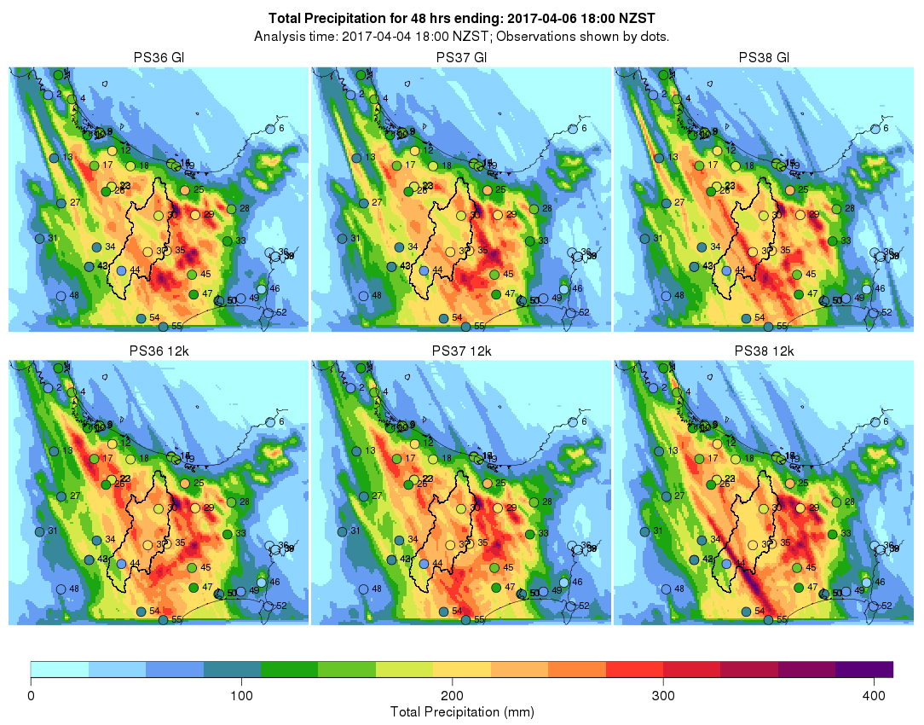
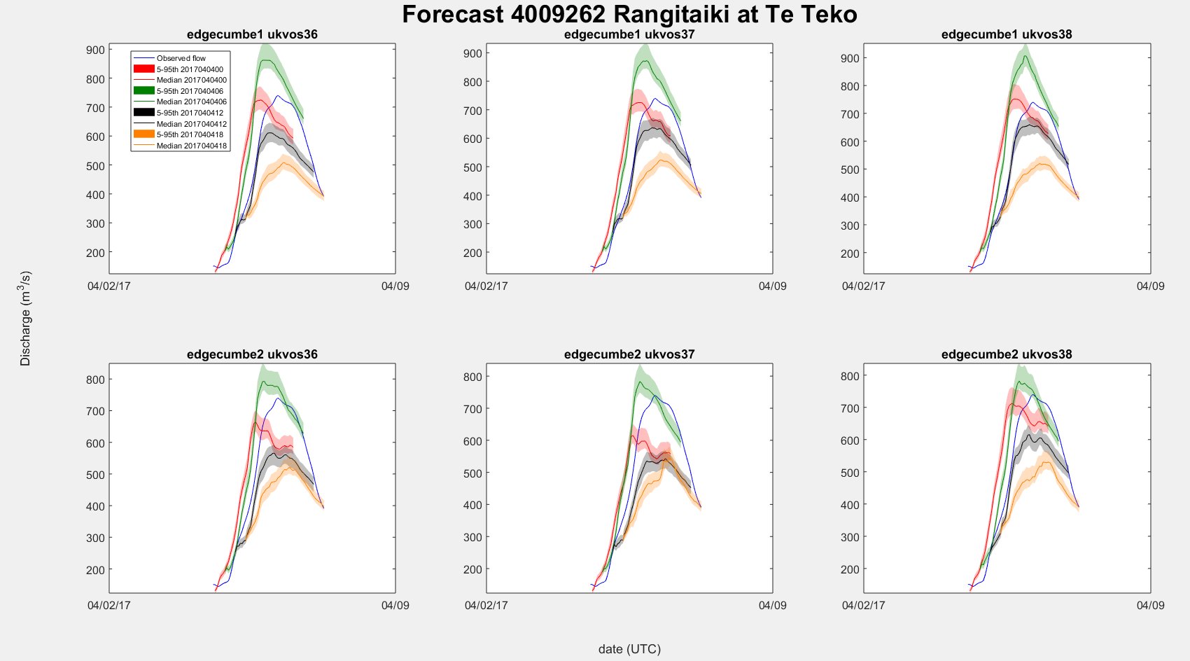
Flood forecasts seem most sensitive to issue time, initial and lateral conditions, model physics perturbations, and then simple statistical perturbations
Case study 1: Ensemble forecast initialisation (Ex-cyclone Debbie 4-6th April 2017)
Montgomery, K., Cattoën, C., Moore S., Carey-Smith, T. (2018) Assessing drivers of ensemble flood forecasting uncertainties during ex-cylcone Debbie. NZ Hydrological Society & Meteorological Society of NZ Joint Conference, Christchurch, NZ, 4-7 December 2018
Notes:
Stations in circle, lots of rain in between gauges according to forecast
Colour=consecutive forecasts
Precip Differences between model physics but no huge variability looking at flood
Precip difference between IC/LBC but no huge looking at flood
Larger differences with lag
Smallest differences is stat perturbation: multiplying the rainfall. (not calibrated)
Six different atmospheric model configurations
They differ in their handling of turbulent mixing schemes, ice micro physics, and stochastic perturbations of temperature and moisture.
A second level of comparison was achieved by driving NZCSM with lateral boundary conditions obtained directly from a 17km res global model and from an intermediate 12 km resolution limited area model.
A statistical perturbation was applied to each weather forecast ensemble member to generate a 50-member statistical flow ensemble

Slide 16
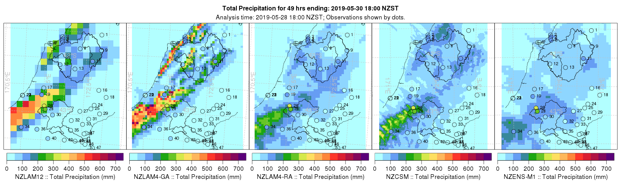
Case study 2: Model uncertainties (30th May 2019)
Buller
Waimakariri
12km parametrised
4km parametrised
1.5km
explicit
4.4km
explicit
local DA
4.5km
explicit
global DA (MOGREPS-G)
Notes:
Focus on model uncertainties with largers model physics differences compared to previous case study.
Similar event to shown on video: storm coming from west and spilling over the mountains.
Resolution, explicit conv/paramatrised, local DA vs global DA (Nzens initialised from MOGREPS-G)
Stations are an indication of totals, no radar
Geographical bias: Parametrised over-cooking on West-Coast compared to convective. Opposite on East coast.
Local DA might explain difference between NZENS and 4- RA?
Key configurations: Impact of weather IC, LBC, resolution, physics, domain, Data assimilation.

Slide 17
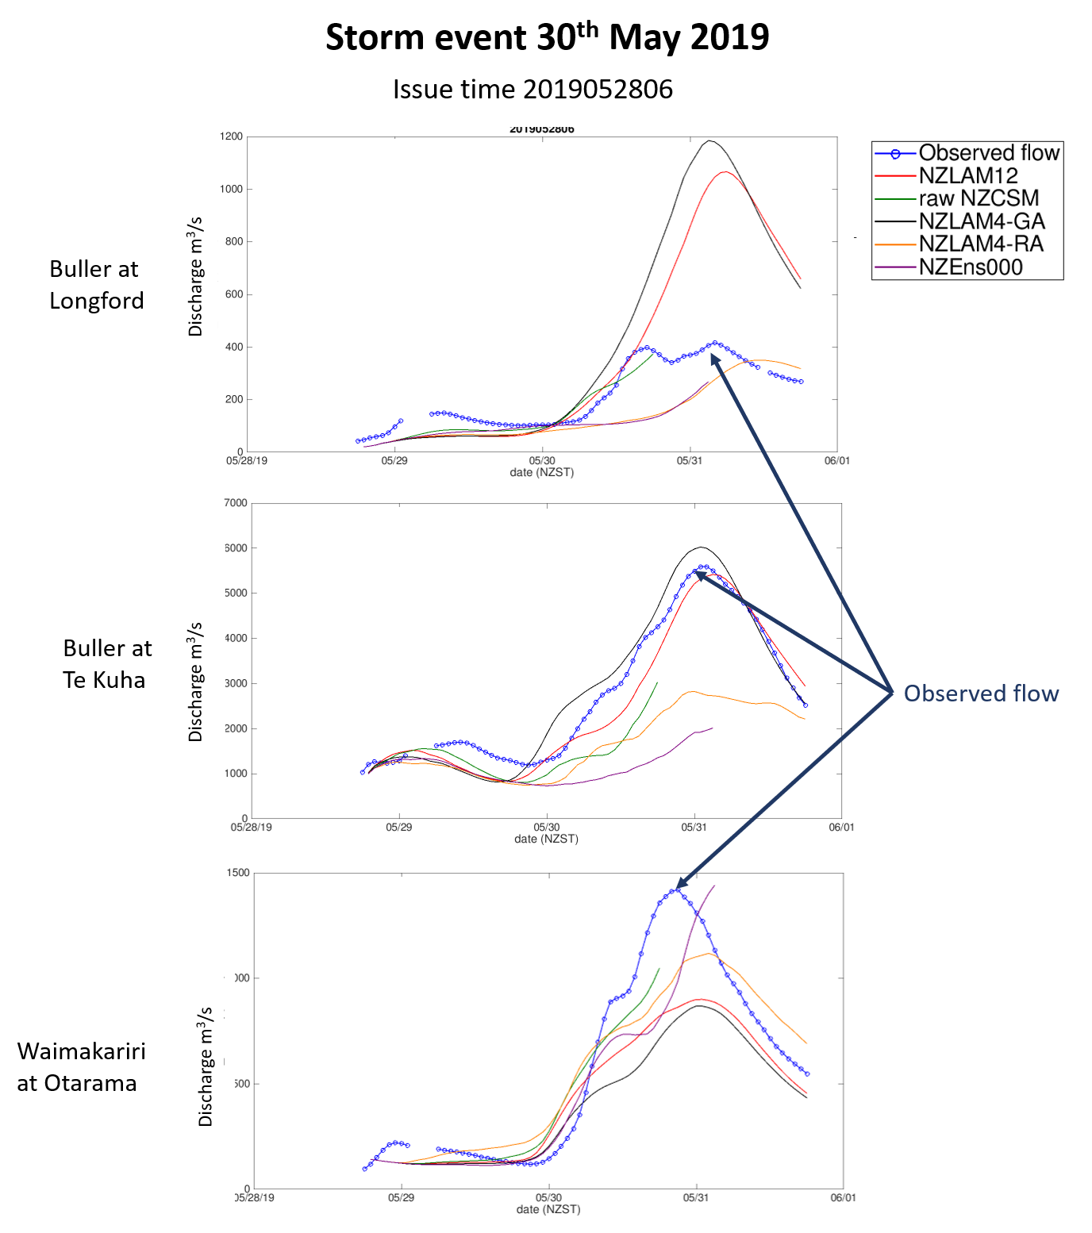
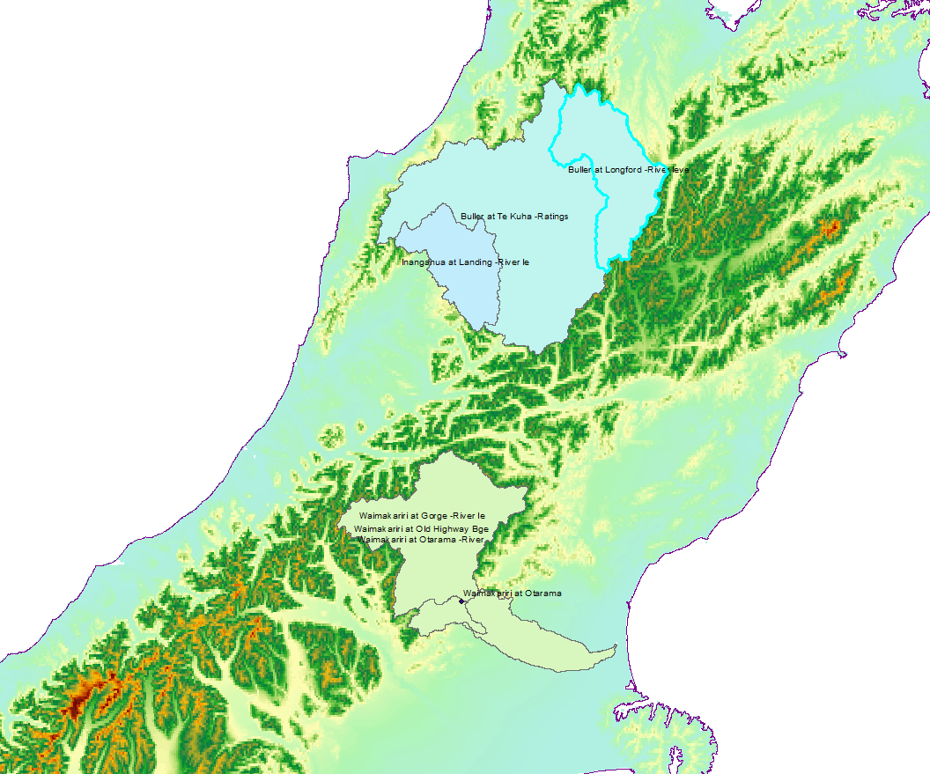
Case study 2: Model uncertainties (30th May 2019)
Buller ~ 5yr flood
Buller
Waimakariri ~15yr flood
Waimakariri
Notes:
Raw forecasts: no post-processing of biases
Runoff confirm previous results: large volume from parametrised, but right answer for wrong reasons?

Slide 18
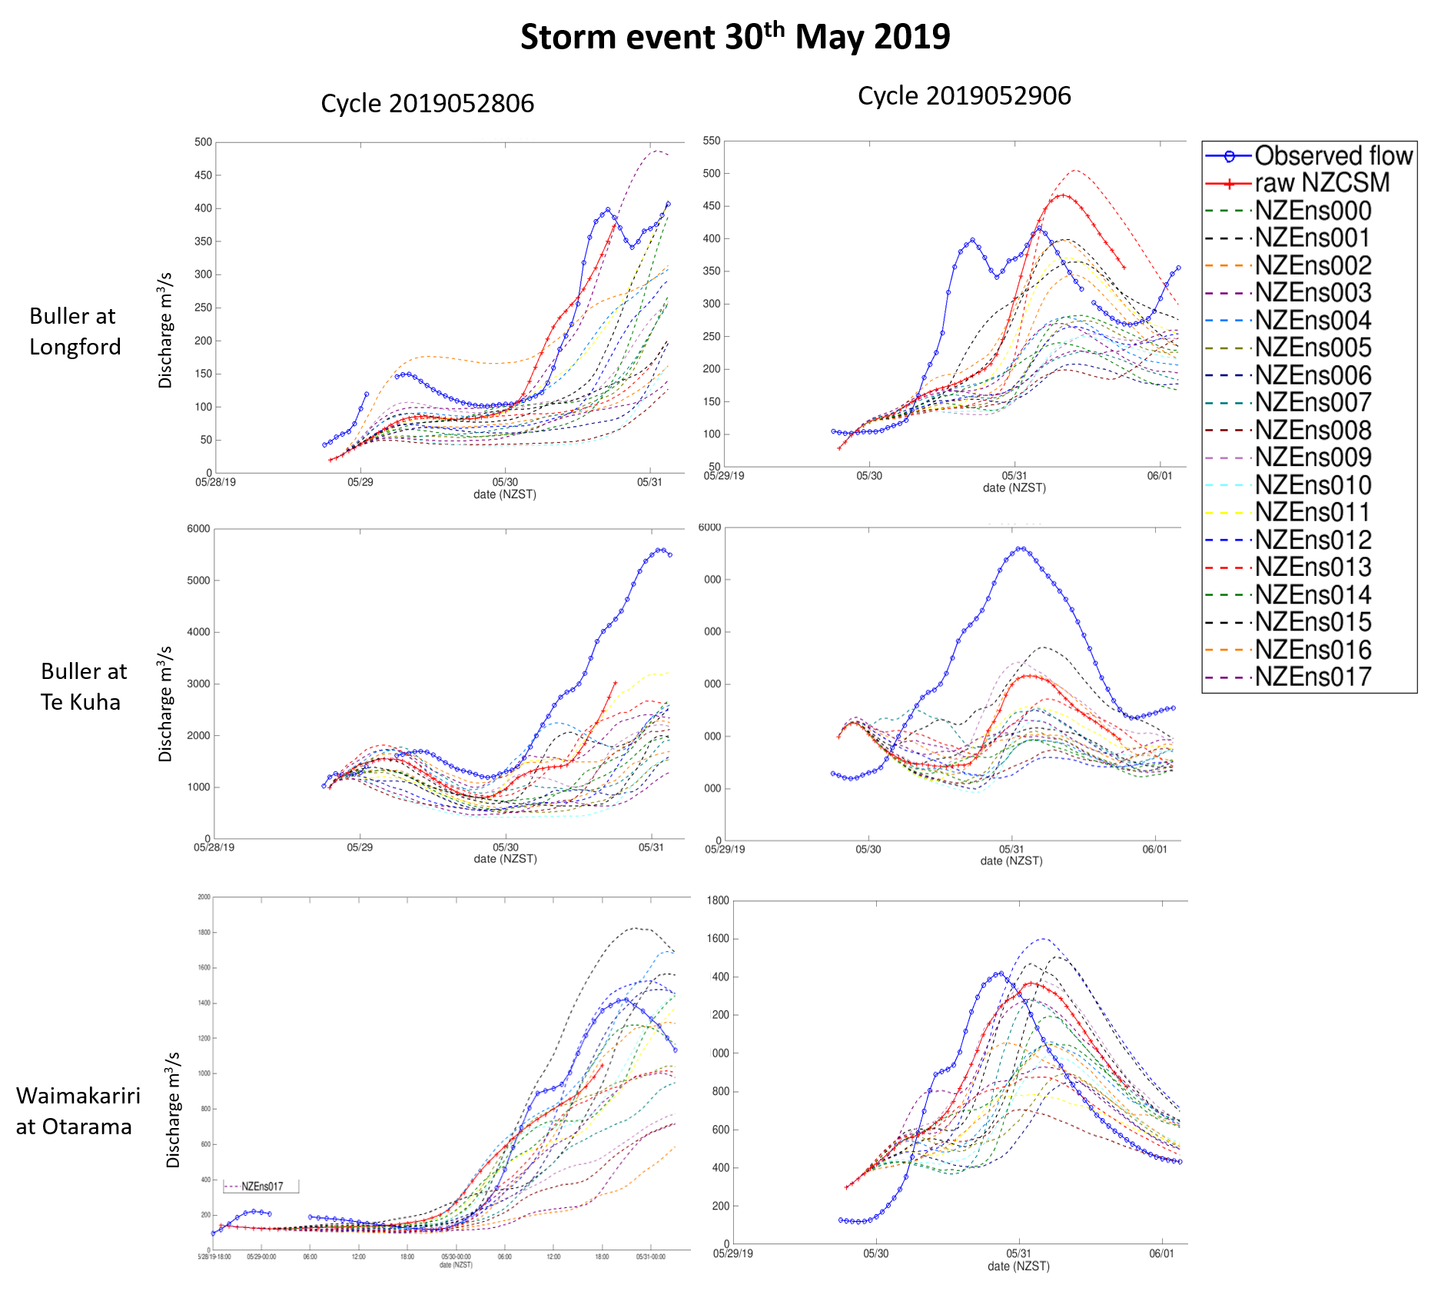
Case study 2: Ensemble 4.5km vs deterministic 1.5km (30th May 2019)
Buller
Waimakariri
Notes:
Focus on high-res at 1.5km vs ensemble at 4.5km for 2 issue time (24h apart)
High-res in top end of ensemble: worth having both.
Flood event of 30th May 2019 for the Buller at Longford and Te Kuha (West Coast), and the Waimakariri at Otarama (Canterbury). Observed and forecast flood peaks are shown for the forecast issue time 2019-05-28T06Z and 2019-05-29T06Z. Flood forecasts are driven by several weather model configurations (raw NZCSM, bias corrected NZCSM, and 18 members from the ensemble NZENS).

Slide 19
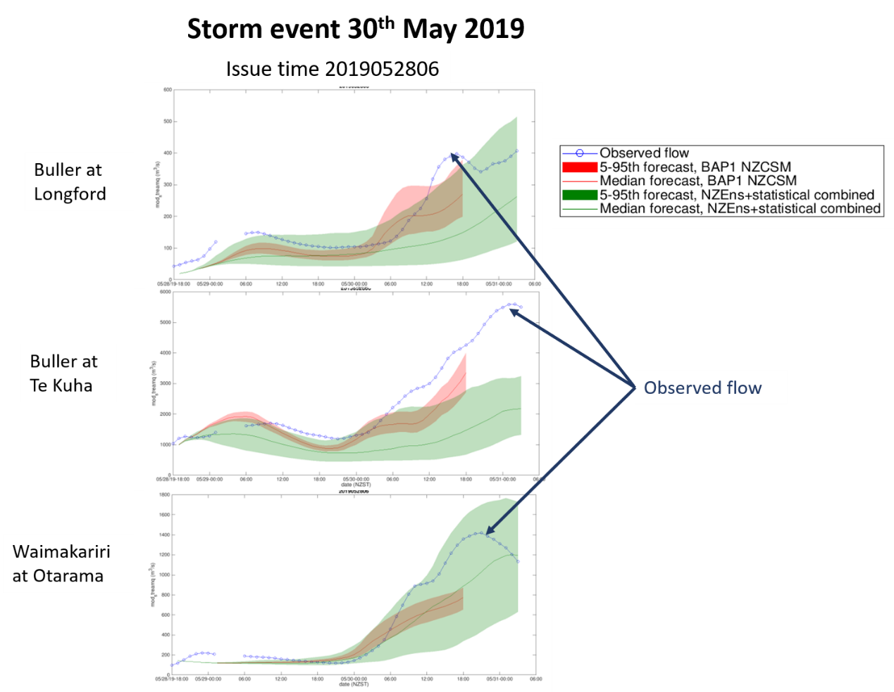
Case study 2: Ensemble 4.5km vs deterministic 1.5km (30th May 2019)
Combined statistical and dynamical ensembles
Buller
Waimakariri
Notes:
Combined statistical small perturbation for each ensemble members
Easier to see high res fitting within coarser ens. members
Flood event of 30th May 2019 for the Buller at Longford and Te Kuha (West Coast), and the Waimakariri at Otarama (Canterbury). Observed and forecast flood peaks are shown for the forecast issue time 2019-05-28T06Z and 2019-05-29T06Z. Flood forecasts are driven by several weather model configurations (raw NZCSM, bias corrected NZCSM, and 18 members from the ensemble NZENS).
The bias corrected version of NZCSM (BAP1 NZCSM) uses a simple precipitation post-processing technique to improve the flow forecast. We accounted for precipitation biases in the weather forecast model using an observed gridded product (Virtual Climate Station Network (Tait et al. 2006b)) assumed to be the “truth” and used for the hydrological model calibration. The VCSN interpolates observed meteorological values onto a grid covering New Zealand at a 5km spatial resolution. A two-step process was used to account for the differing biases at different rain rates using one year of available NZCSM forecast, VCSN and climate station precipitation data: 1) a wet/dry cut-off removed over-predicted light rain from NZCSM; and 2) a bias adjustment matched the NZCSM precipitation magnitude to the VCSN distribution using a quantile matching procedure (Cattoën et al. 2016b).

Slide 20
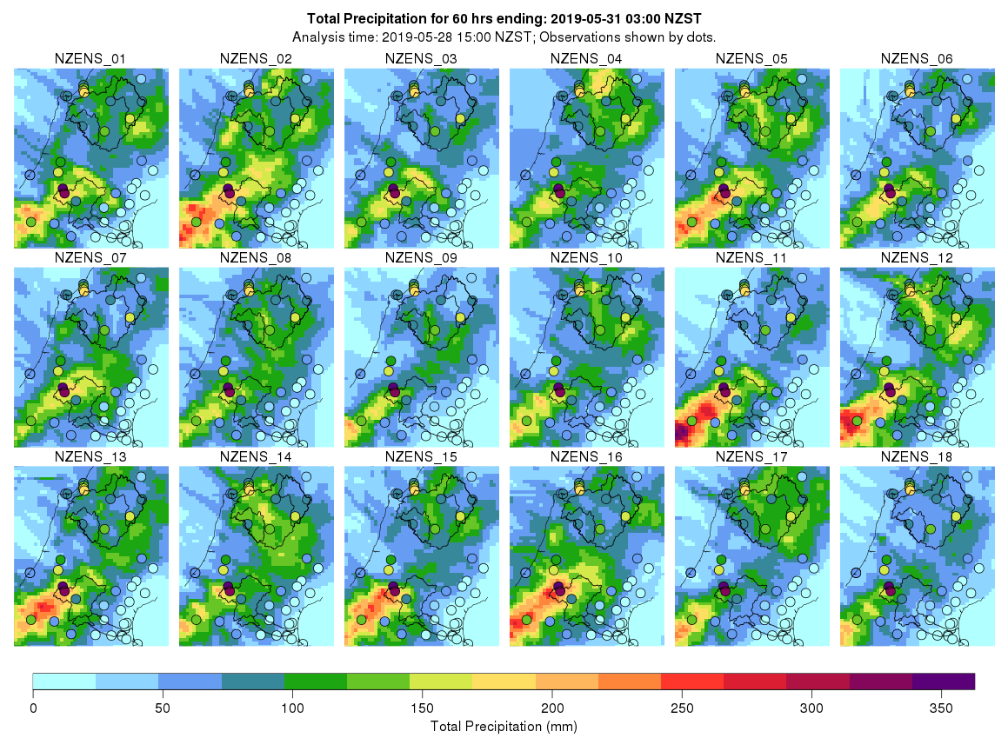
Summary flood event case studies:
Forecast initialisation
Model uncertainties
Ensemble vs high-res
Hydro-meteorological forecasts (for extreme events) most sensitive to variability from:
model initialisation times (lagged ensembles)
model initialisation at a single analysis time (degree of ensemble spread)
model physics configurations (e.g. parameterised vs. explicit convection)
statistical post-processing and calibration techniques (precipitation biases will vary considerably between model ‘versions’)
model horizontal resolution (value in generating a larger coarser ensemble than a single higher horizontal resolution model)
small(er) model perturbations (stochastic physics perturbations)
Statistical ensemble (spatiao-temporal perturbation of rain)
Importance
Notes:
Below we highlight some gaps and draw some recommendations:
Changes in weather model configurations (physics, resolution) can lead to important differences in hydrological model performance. Operational NWP configurations seldom stay fixed for more than a year or so. A key requirement for flood forecast calibration and verification is to archive forecasts from a fixed forecast system for multiple years or to include re-forecasting capability to retrospectively produce forecasts from a fixed version of the forecast system;
Initial conditions of dynamical convective-scale weather models are one of the largest sources of uncertainty. This emphasizes a critical need to further improve data assimilation techniques for kilometre-scale weather models to advance flood forecasting;
Given computational limitations in most forecasting centres, we suggest that small dynamical weather ensembles should be updated more frequently than current international conventions instead of producing larger ensemble sizes at less frequent analysis times.
Key outcomes from this research include the following:
The results provide a basis for an improved framework for a national scale flow forecasting system in New Zealand that will provide more timely and accurate information for mitigating the impacts of flooding;
These findings contribute to research into extreme rainfall forecasting and the application of ensembles for downstream forecasting by the Unified Model Partnership (~10 partner institutions from countries including the UK, New Zealand (via NIWA), Australia, the U.S., India, South Korea and Singapore).
Further studies should extend the hydrometeorological analysis to better understand the impact of hydrological initial conditions, model uncertainty, flow data assimilation and the development of ensemble flow forecast post-processing techniques.

Slide 21
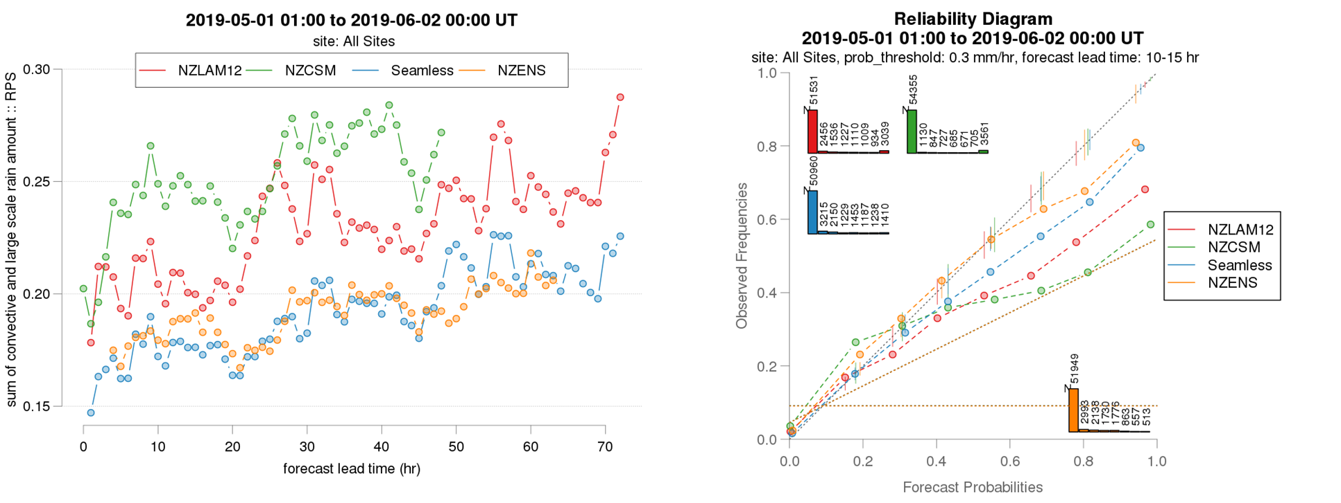
Convective-scale ensemble: precipitation evaluation ~ 350 sites
Ranked Probability Scores
Reliability Diagram
worse
better
Notes:
-Ensemble evaluation over 1 month (not for extreme rainfall)
-Scores: RPS (vs lead time) and reliability
These two figures combine all routine precip observations over NZ, so order 350 locations.
The figures compare the “real” ensemble (NZENS) against 3 different ‘post-processed’ probabilistic forecasts. Two derived directly from deterministic models (NZLAM & NZCSM) and the third (Seamless) derived from multiple deterministic models (including lagged forecasts).
Main take home message is that the NZENS performs much better than the individual deterministic models and has similar RPS to seamless, but better reliability.
validation plots here:
Attached are some selected images:
For variables other than precip:
crps_* plots compare nzens with other models mean absolute error (equivalent to crps with only one member): Generally positive.
ensSD _* plots compare the ensemble mean RMSE with mean ensemble spread (ought to be similar): shows ensemble has not enough spread
sd_me_* these plots just compare the ensemble mean with the deterministic models
Plots just for precip (for nzcsm and nzlam the “ensemble” comes from neighbourhood points):
raterainhist plot shows that all models reasonably similar (NZLAM worse than others) – (just looking at member 1 here)
rankhist plot (should be flat) compares nzens with seamless multi-model ensemble: seamless is more underdispersive (doesn’t capture high and low obs); NZENS is flat except that it biases low (too often the obs is larger than all members)
rps like crps but for binned precip bands (lower score better): seamless and nzens similar
reliability (should be on one to one line): seamless and nzens similar (depending on threshold used – more plots on website)

Slide 22
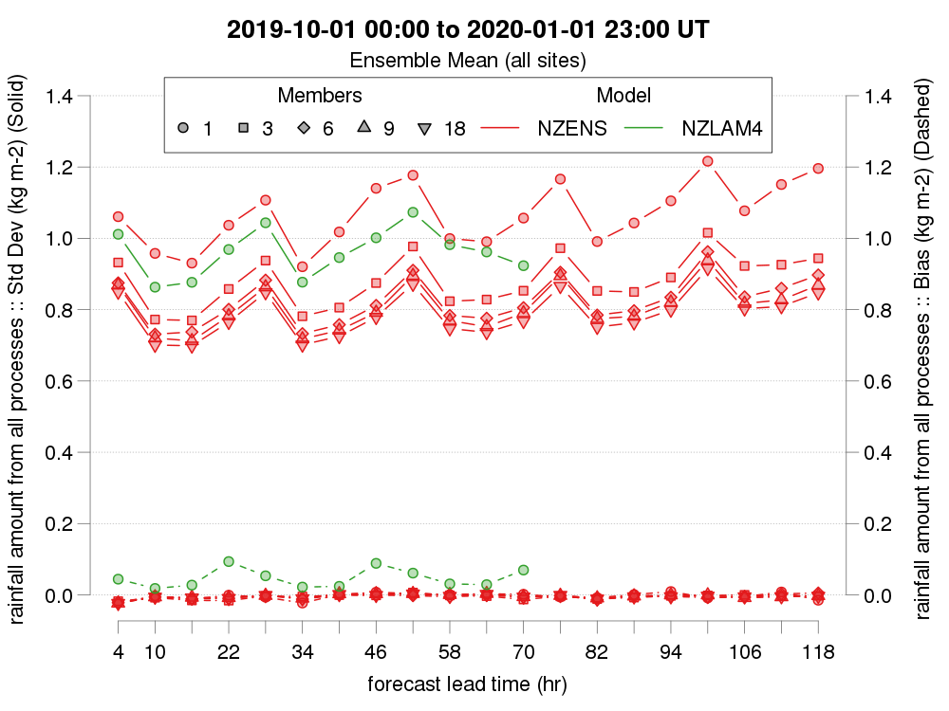
NZENS Verification
Notes:
NZENS clearly better than NZLAM4 for precip
c.f. wind on previous slide, NZLAM4 only better than a single member NZENS

Slide 23
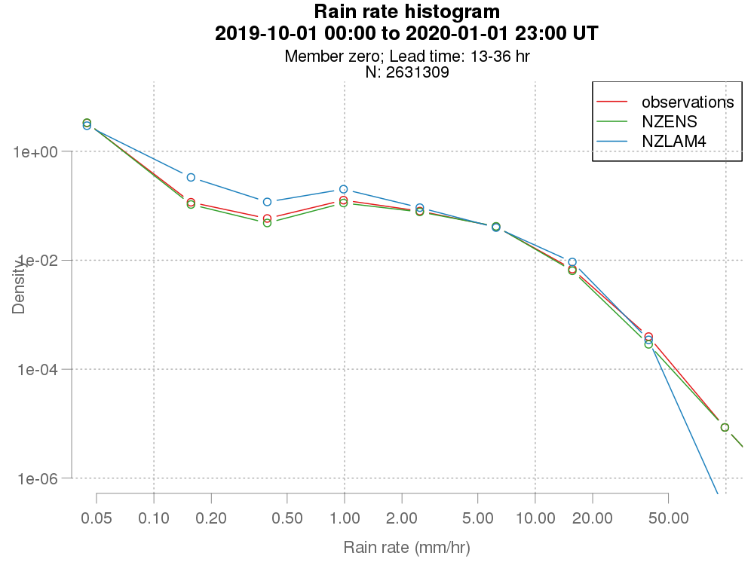
NZENS Verification
Notes:
rain rate histogram: (comparing member 0 with nzlam4), which shows NZENS doing better at getting the correct distribution of precip than NZLAM4

Slide 24
Convective-scale hydrometeorological ensemble performance
Hydrograph spaghetti plots for various ensemble strategies
NZENS 18 members at 4.5km, T03 T12
NZENS memebr0 statistically perturbed to 18 m. T03 T12
NZCSM statistically perturbed to 18 m. T00,T06,T12, T18

Slide 25
Convective-scale hydrometeorological ensemble performance
NZENS 18 members: T03 and T15 cycles
rainfall
Experiments:
A: 18 members 2x/day (control)
A03: 18 members 1x/day T03
A15: 18 members 1x/day T15
Not much dependence on lead time 24-80h
Strong diurnal pattern biases for larger catchment
streamflow

Slide 26
Convective-scale hydrometeorological ensemble performance:
Impact of various strategies on ens. size, frequency and dynamical/statistical
Ensemble strategies:
A: 18 members 2x/day (control)
A03: 18 members 1x/day
B: 9 members 2x/day
C: 18 members statistical perturbation
1400km²
Basin rainfall
6300km²
Dynamical ensembles superior to statistical ensembles (accuracy, ens. spread & event discrimination)
Similar performance 9 vs 18 members (18 better)
Streamflow (vs pseudo-obs)
80% exceedance threshold
Ideal: RMSE & spread of the same magnitude of the RMSE
Notes:
Spread-skill ratio (Wilks 2006):
Requirements of an ensemble prediction is that the spread between members is large enough to cover uncertainty in the prediction. Therefore, a correlation between RMSE and spread should exist. For a well-calibrated ensemble, the spread should be of the same magnitude of the RMSE
Ratio of spread/RMSE lower than 1 indicate a lack of spread.

Slide 27
Convective-scale hydrometeorological ensemble performance
Statistical ensembles: impact of resolution
Experiments:
C: NZENS (4.5km) member 0 with 18 members statistical perturbation 2x/day
C-hr: NZCSM (1.5km) with 18 members statistical perturbation 2x/day 4x/day
rainfall
Both high-resolution (1.5km) and coarser resolution (4.5km) strategies show an highly underdispersed ensemble.
Less diurnal biases patterns with NZCSM possibly due to frequency of 4x/day and/or resolution.
High-res model ‘wetter’ than coarser resolution
streamflow

Slide 28
Conclusion & limitations:
Conclusions:
Initial conditions – critical need for improved data assimilation techniques for km-scale weather models
Computational limitations – smaller dynamical weather ensembles updated more frequently instead of larger ensemble sizes at less frequent analysis times could be optimal
Limitations:
Statistical score evaluation for more catchments, statistical significance, increase verification period to ~6 months.
Include hydrological initial conditions and flow data assimilation

Slide 29
Thank you
Céline Cattoën-Gilbert
  +64 21 142 5503
  celine.cattoen-gilbert@niwa.co.nz

