Slide 1




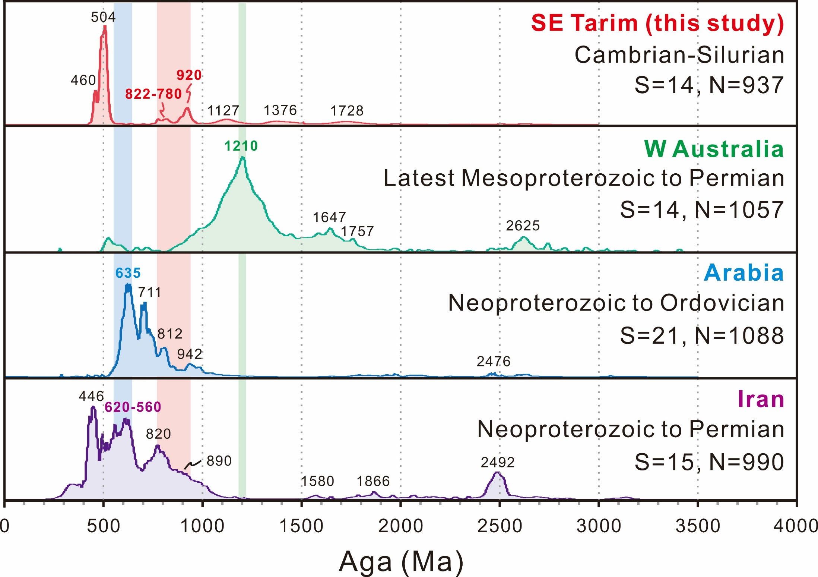
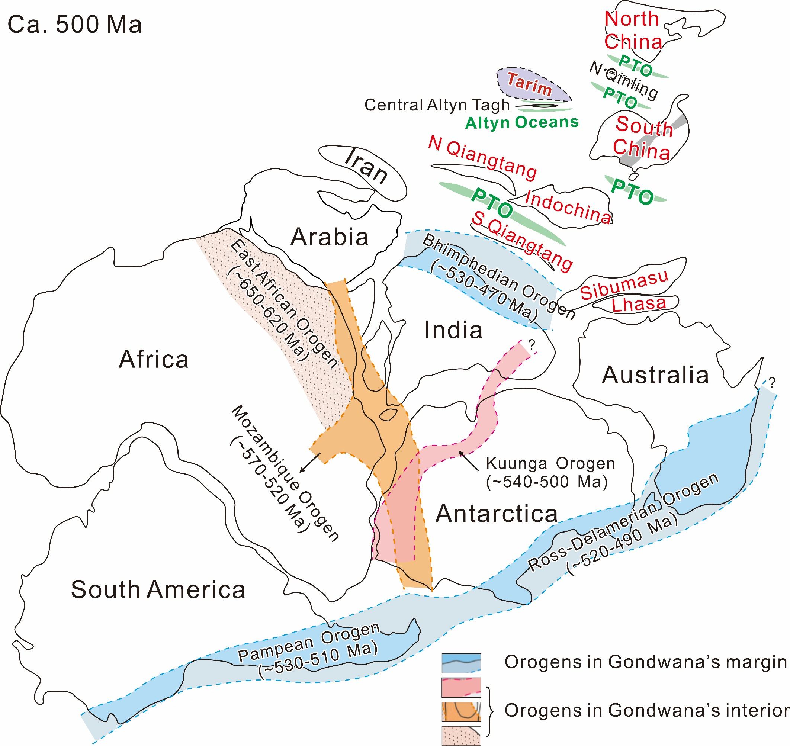
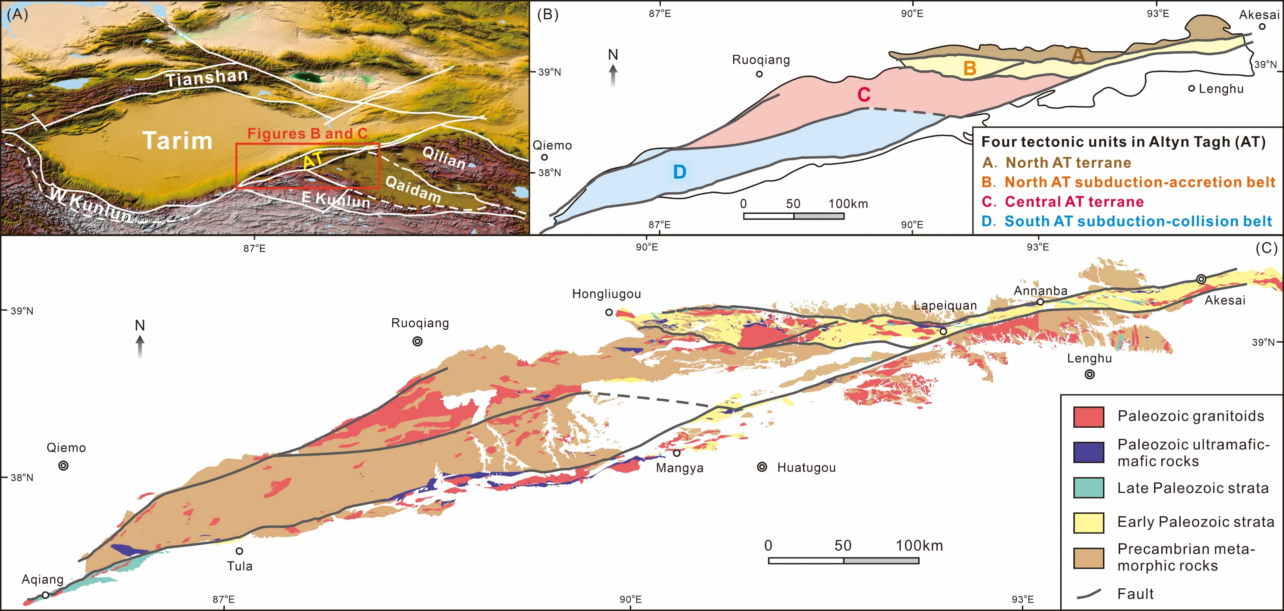
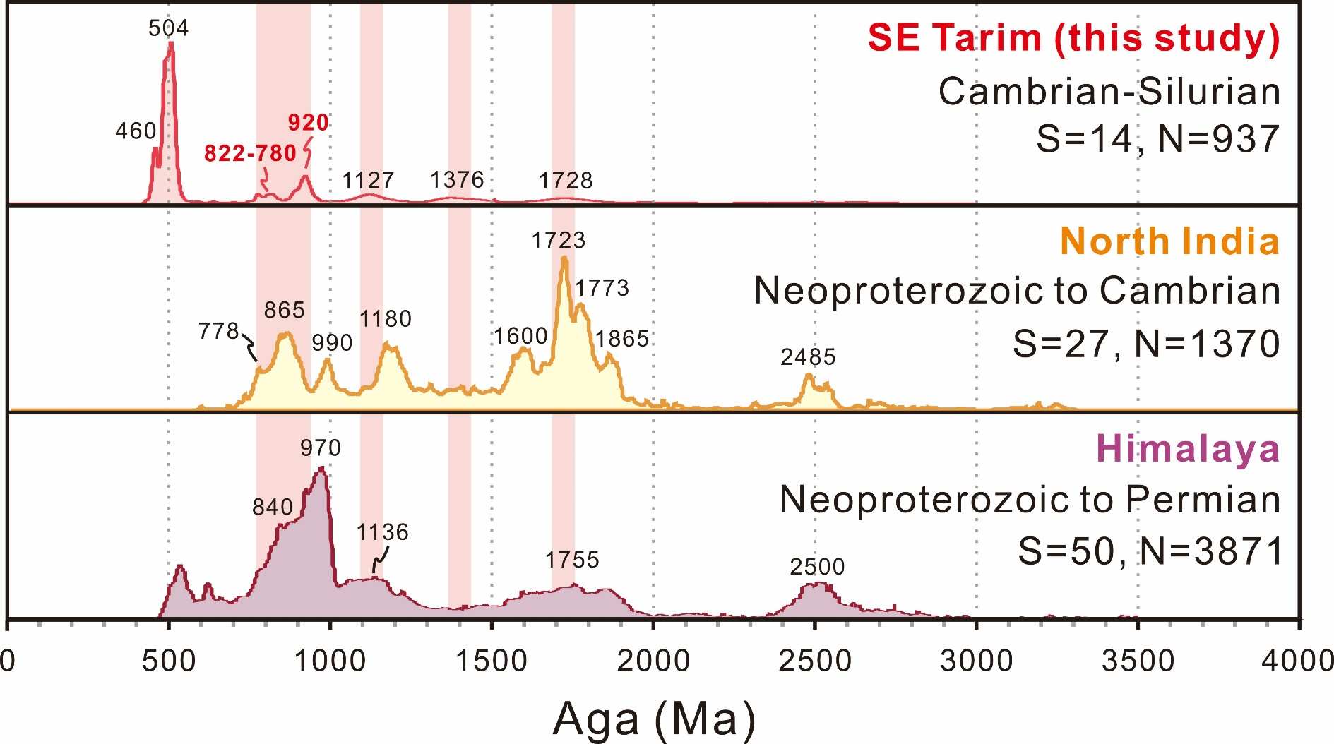
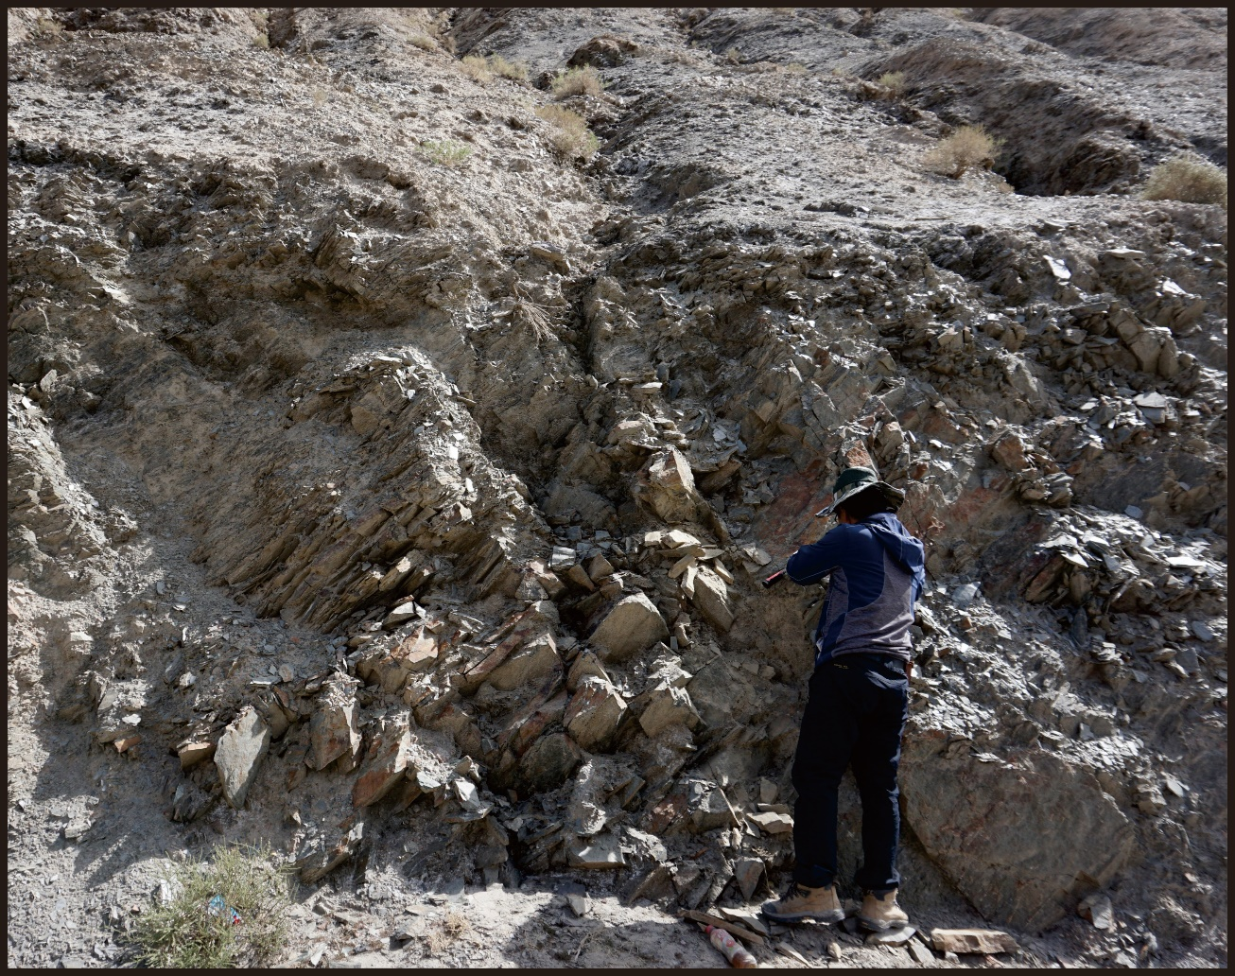
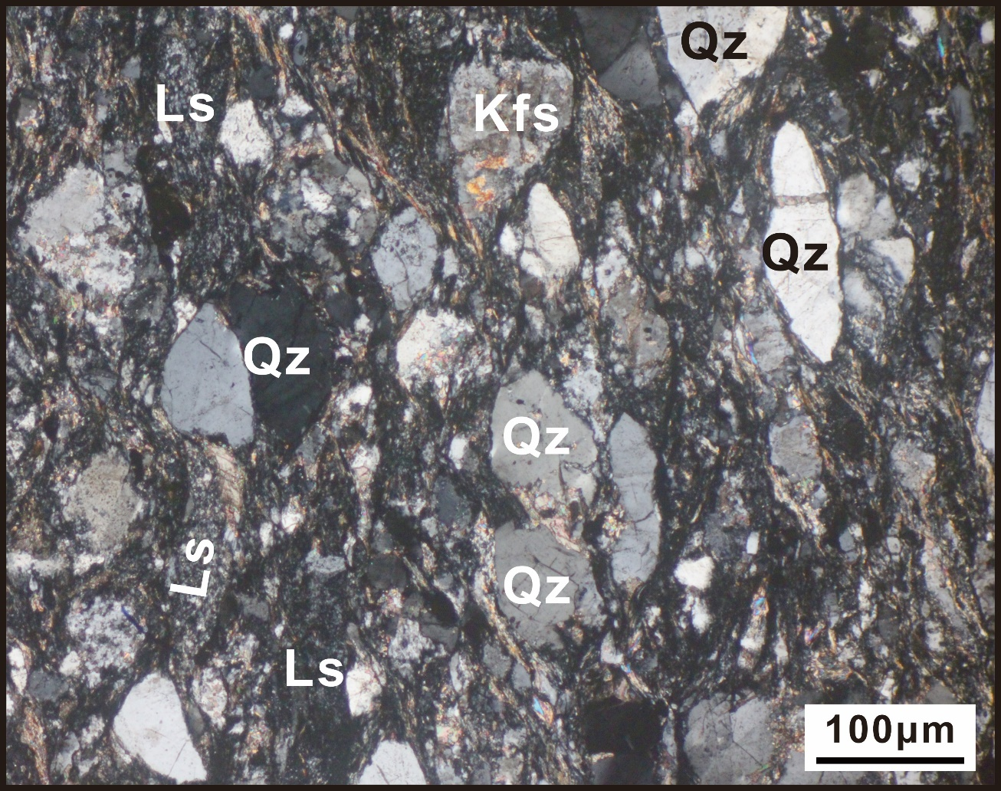
A Tarim-North India connection in northern Gondwana: Constraints from provenance of early Paleozoic sedimentary rocks in the Altyn Tagh orogen, southeastern Tarim
Qian Liu ^{1,2}, Toshiaki Tsunogae ^{2,3}, Guochun Zhao ^{4,5}, Yigui Han ⁵, Jinlong Yao ⁵, Jianhua Li ⁶, Peng Wang ⁴
1. International Research Fellow of Japan Society for the Promotion of Science (JSPS); 2. University of Tsukuba, Japan (niuniuliu880330@geol.tsukubai.ac.jp); 3. University of Johannesburg, South Africa; 4. The University of Hong Kong, Pokfulam Road, Hong Kong, China; 5. Northwest University, China; 6. China Institute of Geomechanics, China
1. Introduction
3. Results and discussion
4. A new perspective
Locating Tarim during the assembly of Gondwana remains controversial, with different paleomagnetic studies advocating a Tarim-Australia linkage or a Tarim-Arabia connection. This study targeted the early Paleozoic sedimentary rocks in the Altyn Tagh orogen along southeastern Tarim and proposed a Tarim-North India connection in northern Gondwanan based on detrital zircon age comparison.
520 Ma
Sample location
Figure 5.
Figure 5. Location of Tarim in northern Gondwana at ca. 520 Ma.
Figure 1. (A) Topographic and location of the Altyn Tagh orogen. AT- Altyn Tagh, WKL- West Kunlun, and EKL- East Kunlun. (B) Tectonic division of the Altyn Tagh orogen. (C) Geological map of the Altyn Tagh orogen.
5. Conclusion
2. Samples
New detrital zircon ages challenge previous models linking Tarim with Australia or Arabia.
A Tarim-India connection is suggested during the amalgamation of Gondwana.
This work would be a significant contribution towards understanding the Gondwana configuration.
The early Paleozoic strata in eastern Altyn Tagh consists mainly of foliated sandstone, siltstone, and mudstone, with minor basalt interlayers.
Figure 2. Field photograph and photomicrograph (crossed nicols). Qz- Quartz, Kfs- K-feldspar, and Ls- Sedimentary lithic grain.
For more information, please refer to our paper published in GSAB, 2021, 133 (3-4), 502-522, https://doi.org/10.1130/B35576.
Figures 3 and 4. Probability curves for detrital zircon ages in this study and precious work. S- number of samples; N- number of analyses.

