Slide 1




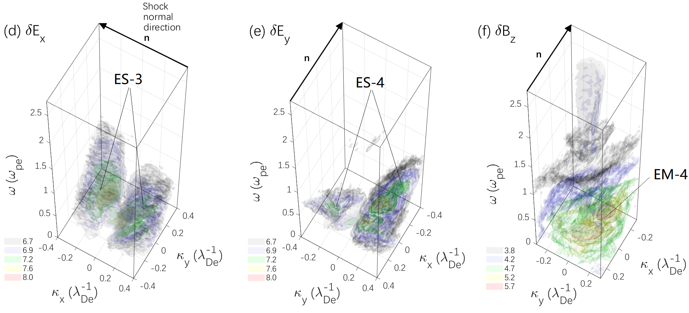
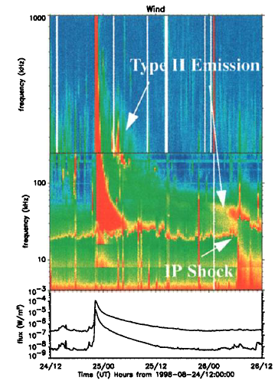
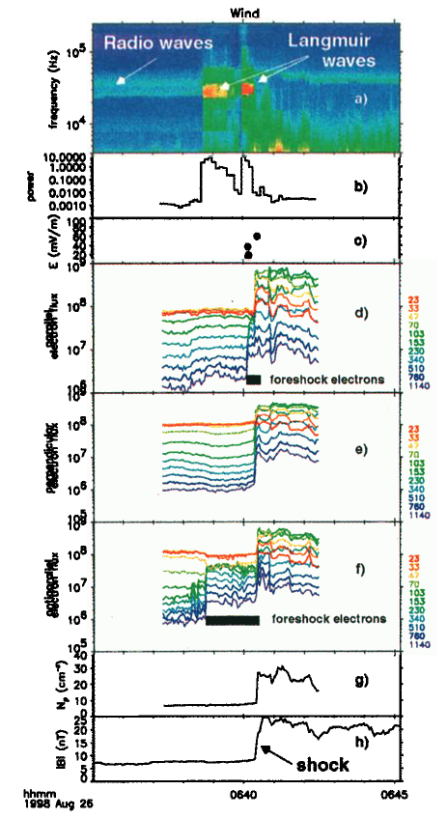
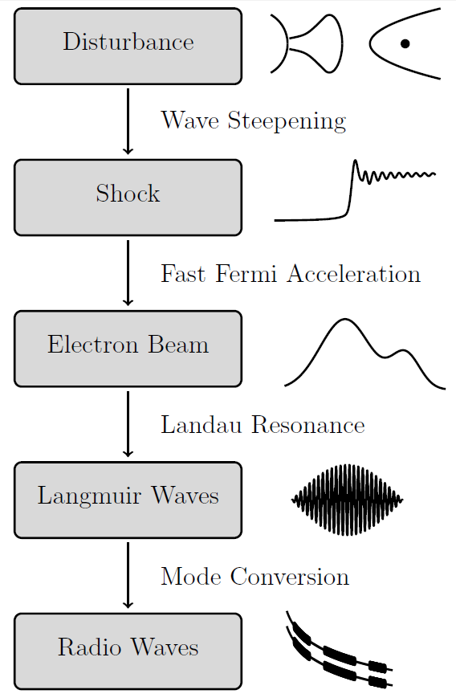
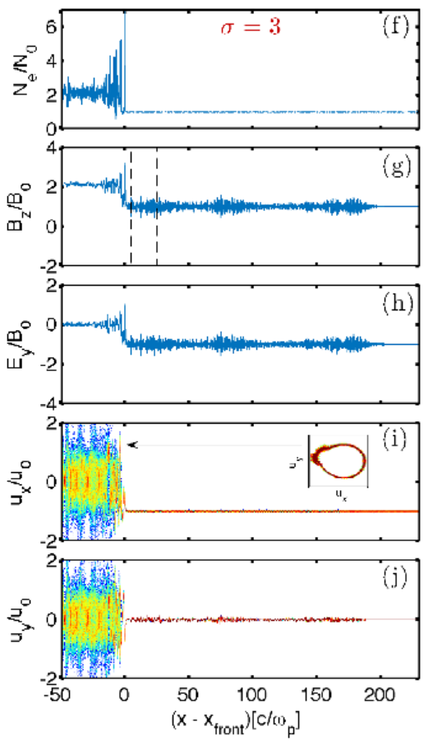
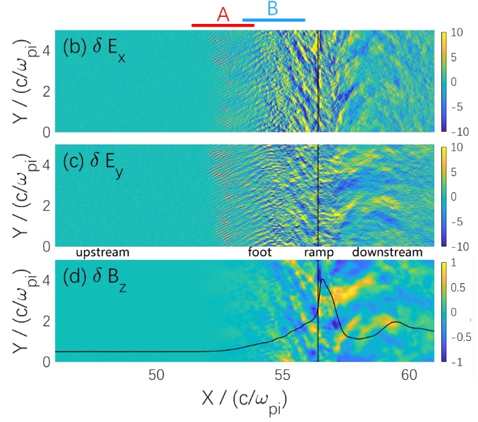
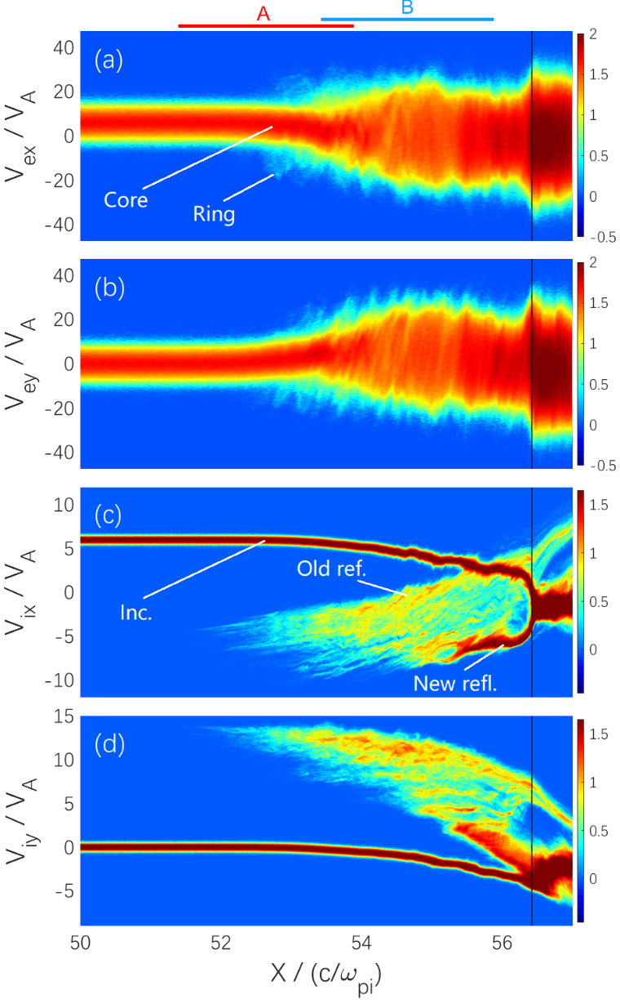
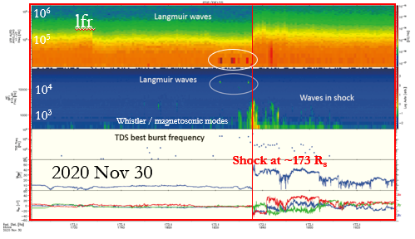
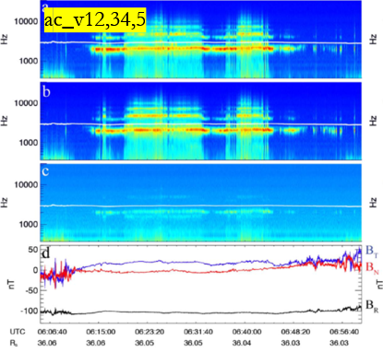
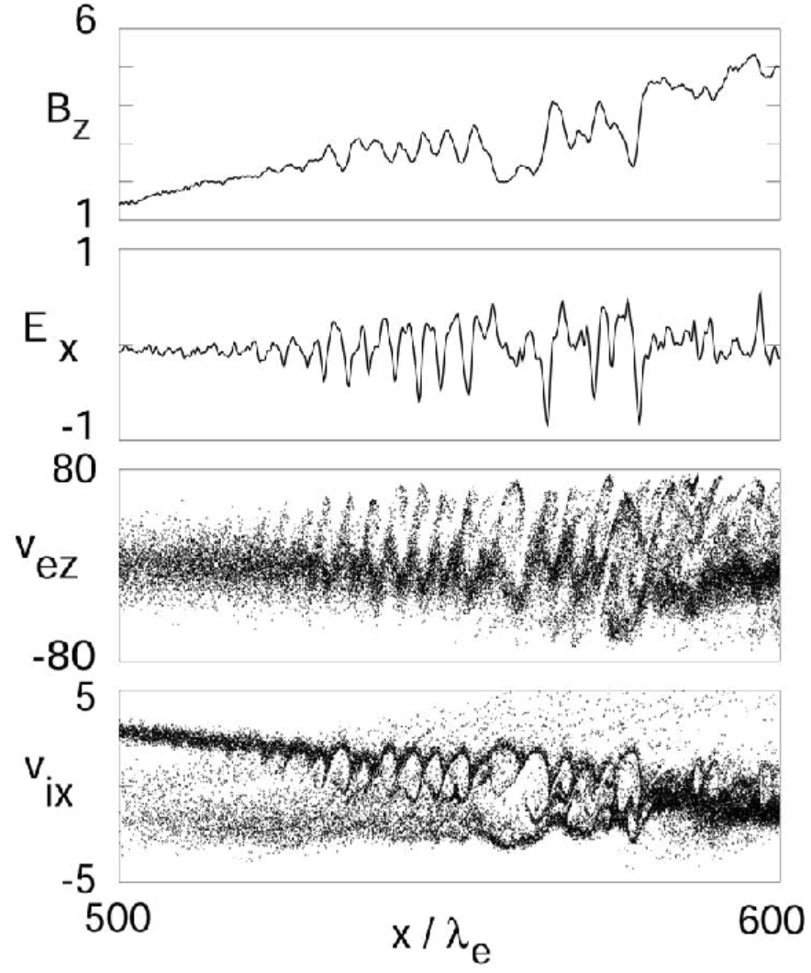
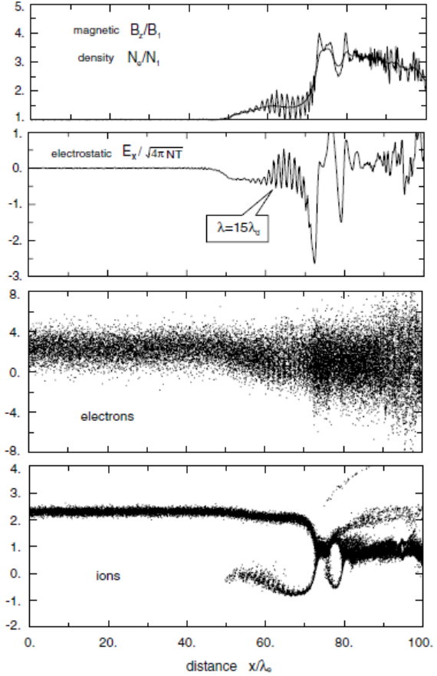
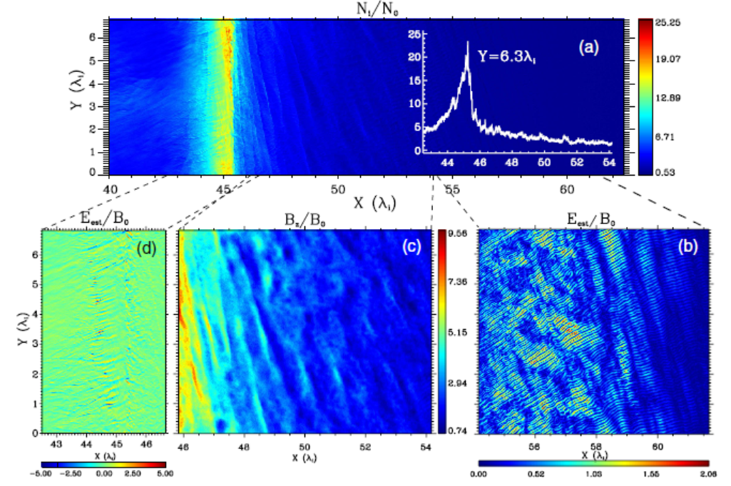
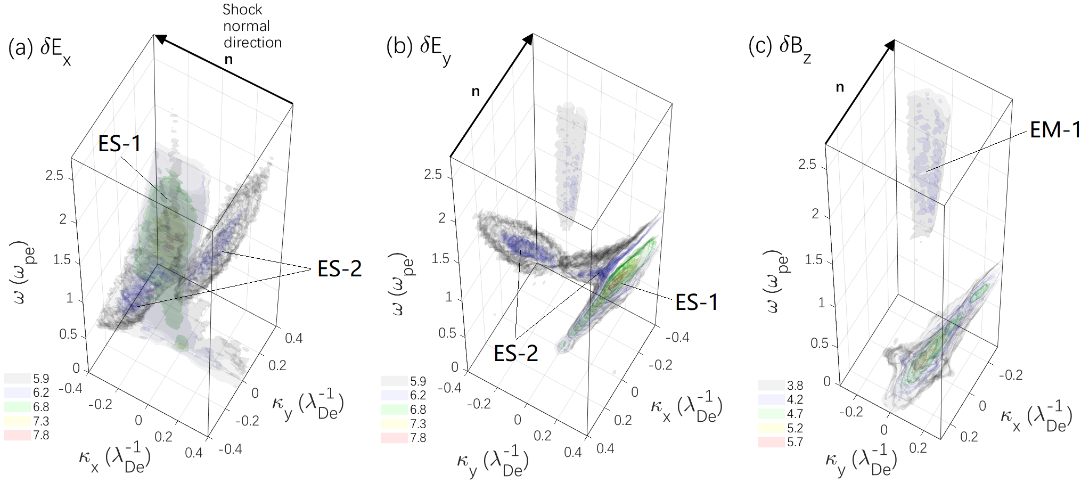
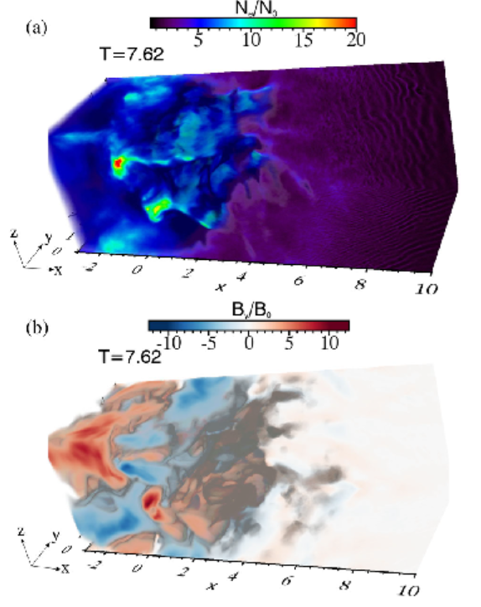
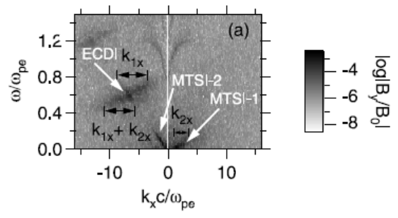
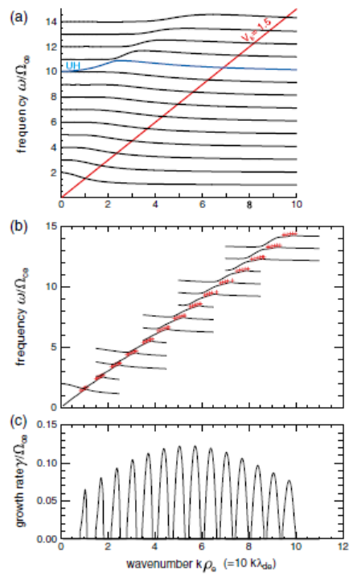
Microinstabilities and plasma waves at Near-Sun Solar Wind collisionless Shocks: Predictions for PSP and SO
Zhongwei Yang¹, Shuichi Matsukiyo², Huasheng Xie⁴, Mingzhe Liu⁵, Fan Guo⁶, Xinliang Gao³, Quanming Lu³, and Chi Wang¹
¹State Key Laboratory of Space Weather, National Space Science Center, CAS, Beijing, China (zwyang@swl.ac.cn, zwyang1984@gmail.com)
²Faculty of Engineering Sciences, Kyushu University, 6-1 Kasuga-Koen, Kasuga, Fukuoka, Japan
³CAS Key Laboratory of Geospace Environment, CAS, University of Science and Technology of China, Hefei, 230026, China
⁴ENN Science and Technology Development Co., Ltd., Langfang, 065001, China
⁵LESIA, Observatoire de Paris, Université PSL, CNRS, F-92195 Meudon, France
⁶Los Alamos National Laboratory, Los Alamos, NM 87545, USA
EGU21-8114
Main results are published on
Yang et al. (ApJ, 2018; ApJL, 2020).
1. Introduction
2. Simulation model
Waves in region B (near the ramp)
Observational studies suggest that large solar eruptions are often accompanied with shocks driven by corona mass ejections (CMEs) and type II radio bursts (Bale et al. 1999; Cairns et al. 2000; Liu et al. 2009; Gopalswamy et al. 2018; Zhao et al. 2019, Thejappa et al., 2019).
Average Ma ~ 5-7, extremely case Ma ~ 10-15
ω_{pe} / Ω_{ce} = 7.8 (in an order of 10 in the Near-Sun SW condition)
β_{e} = 0.3, β_{i} = 0.1 (T_{e}/T_{i} is applied based on HELIOS and PSP SW observations)
n_{x} * n_{y} = 60000 * 2000, Δx = 0.0025 d_{i,} L_{x} = 150 d_{i,} L_{y} = 5 d_{i,} 50 particles/cell for each species
Type-II radio bursts at CME-driven shocks
(1) Possible scenario I of EM emissions
Three-wave interactions
(2) Possible scenario II of EM emissions
Cyclotron/synchrotron maser emission
3. Simulation Results (2-D)
The shock is self-reforming in a time scale of about 1.7Ω_{ci}⁻¹. We chose field profiles in the time range Ω_{ci}⁻¹ to do wave analysis. Left panels show the field fluctuations of δE_{x}, δE_{y} and δB_{z} at t= 3.5 Ω_{ci}⁻¹ within the sampling period (marked by a white arrow in the left panel). The sampling profiles are separated into two regions: A and B for different wave properties. Particle behaviors at the shock front is shown in right panels.
Average Mach (Ma~7-9) number cases
Electrons
Protons
The ability of PSP to observe EM and ES waves at IP shocks
Bale+, 2019; Malaspina+ (ECH), 2020, Halekas+ (VDF), 2020 …
(e.g., Bale., 1999; Cairns et al., 2000; Liu et al., 2009; Gopalswamy et al., 2018; Zhao et al., 2019; Thejappa et al., 2019
(e.g., Holman & Pesses 1983; Cairns et al. 2003; Pulupa et al. 2010; Umeda, 2010, Henri et al., 2019; Lee et al., 2019)
(e.g., Wu & Lee, 1979; Hoshino & Arons, 1991; Plotnikov & Sironi, 2019; Ni et al., 2020; Li et al., 2021)
ES (e.g., ECH, whistlers) and EM waves (radio waves) can be observed by PSP very well.
Both EM emission mechanisms require pre-accelerated electrons. ES waves excited at the shock may play an important role in the electron energization.
(1) Modified two-stream instability (MTSI)
(2) Electron cyclotron drift instability (ECDI)
(3) Buneman + Weibel instability (high M_{A})
4. Conclusions and discussions
ES and EM waves excited by ECDI, BI, SMI etc. are observed in shock simulations under the near-Sun solar wind conditions.
At young CME-driven shocks with average Mach numbers, ES waves excited by ECDI are expected to be easily observed. High frequency EM mode is expected to be X mode (at least).
FIELDS on PSP can cover a broad range (from < local fce to > radio bursts, see the next page). We expect to see more IP shocks during the next solar maximum.
The first two encounters meet some corona holes at the perihelion. We would better to check new data from 4-6 encounters from other SW conditions.
Waves in region A
(leading edge of the foot)
(e.g., Scholer et al., 2003; Scholer & Matsukiyo, 2004; Matsukiyo & Scholer, 2006a, 2006b).
(e.g., Muschietti & Lembege, 2006a,b; 2011; 2013; 2017; Matsukiyo & Scholer, 2006b, Yang+, 2020a)
(e.g., Matsumoto, Amano and Hoshino, 2015; Matsumoto+2017; Bohdan+, 2020).
Our motivation: directly analysis waves at shock simulations instead of periodic simulations and search new mechanisms of EM emissions.

