Slide 1
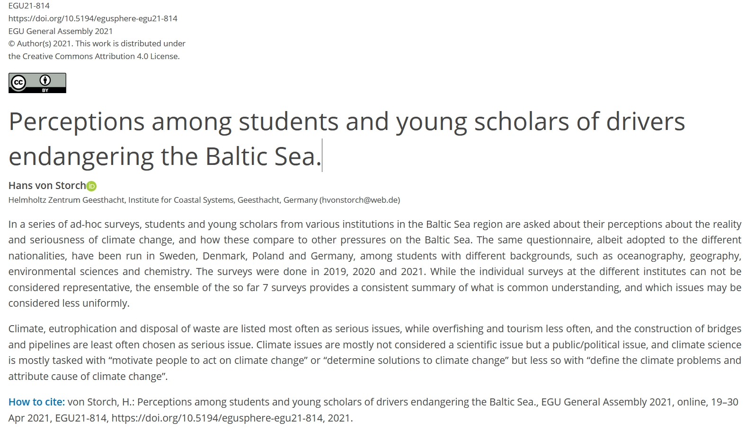

Slide 2
 | institution | samples
1 | Hamburg U, Geology, Germany | 22
2 | Hamburg U, Oceanography, Germany | 9
3 | U Gdansk, Geography and Oceanography, Poland | 69
4 | IOPAN, Oceanography, Sopot, Poland | 5
5 | U Göteborg, Marine Science, Sweden | 26
6 | U København, Chemistry | 7
7 | U Latvia, Environmental studies | 25

Slide 3
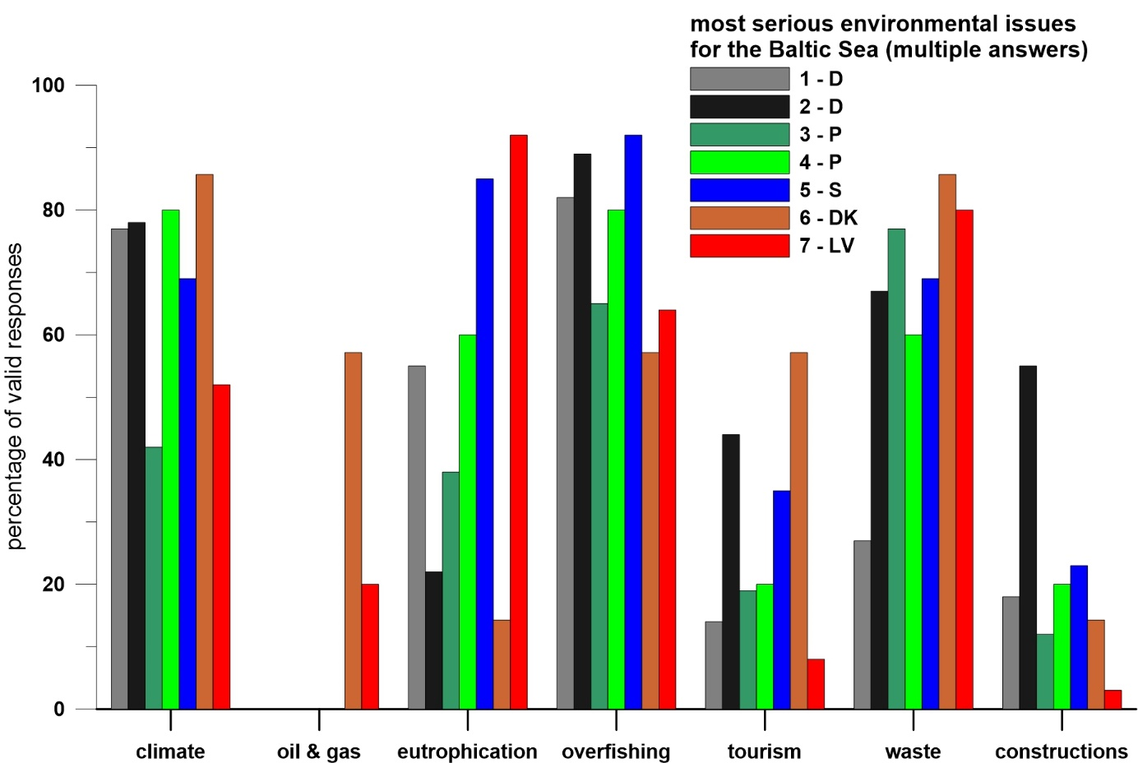
Frequency of selected issues as “most serious” for the Baltic Sea.
Respondents were asked to tick off a maximum of three issues.

Slide 4
“Is the improvement of the environmental conditions of the Baltic Sea mostly a national issue an EU issue or an international issue?”
Survey % | D (1+2) | P (3+4) | S | DK | LV
national | 0 | 9 | 0 | 0 | 4
EU | 89 | 88 | 100 | 25 | 52
international | 11 | 2 | 0 | 75 | 44

Slide 5
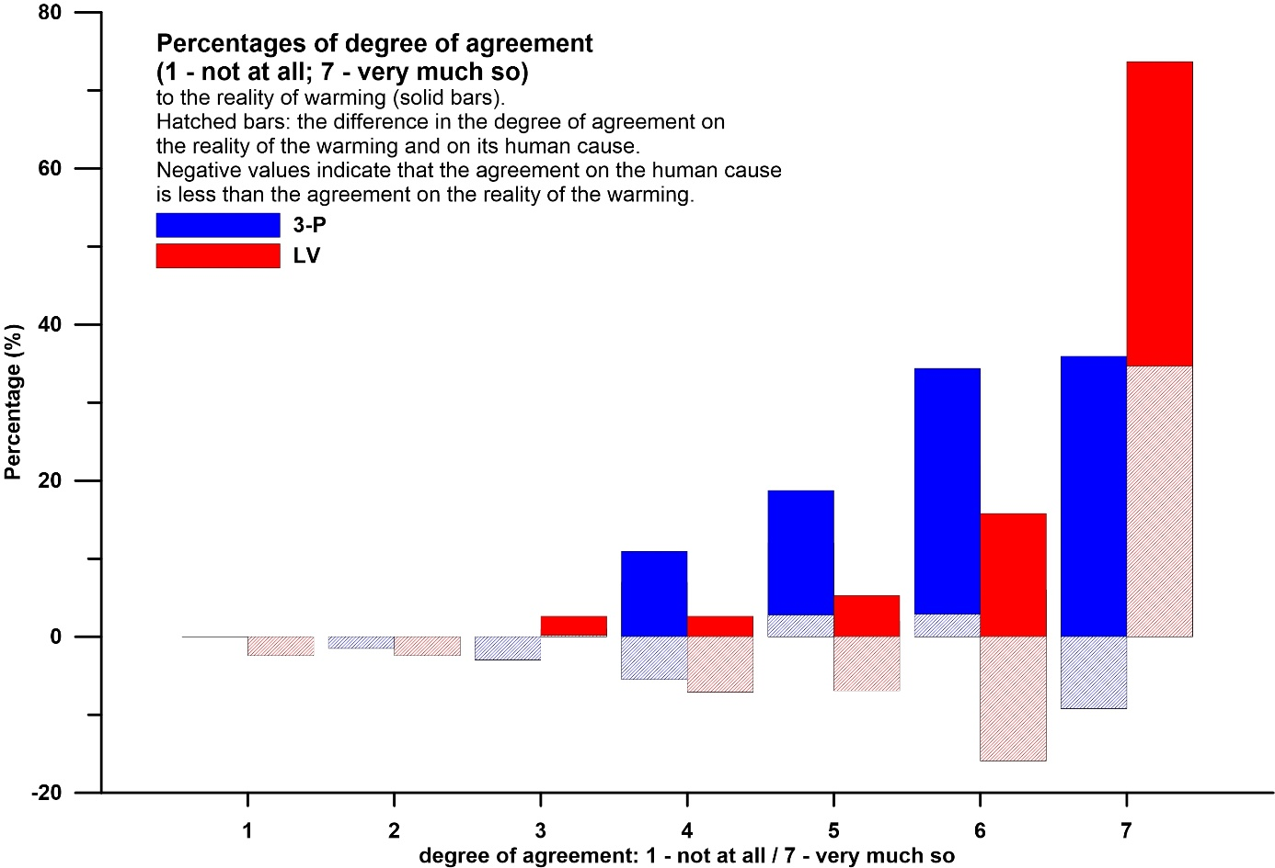
Distribution of the degree of agreement on the reality of climate change (solid bars), and the difference between this degree and the degree of agreement on the human cause of this change (hatched bars). Negative hatched bars point to a larger agreement to the assertion of a human cause than the agreement on the reality of climate change.
In percent of all valid answers. Only Poland (samples 3+4) and Baltic states (sample 7).

Slide 6
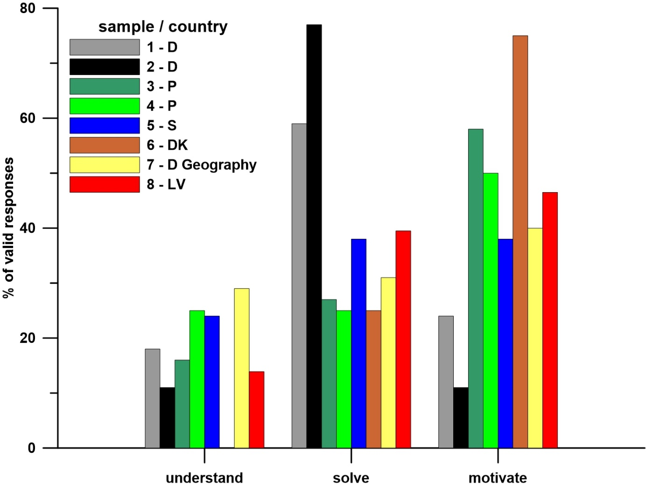
The share of choices as “most important task of climate science” in the surveys given as percent of all who gave a qualified response. “Understand” stands for “define the climate problems and attribute cause of climate change”; “solve” for “determine solutions to climate change”; and “motivate” “motivate people to act on climate change”.

