Slide 1





Potential benefits of real-time control to reduce urban flooding using distributed smart stormwater storage systems
Ruijie Liang, Mark Thyer, Holger Maier, Michael Di Matteo, Graeme Dandy

Slide 2
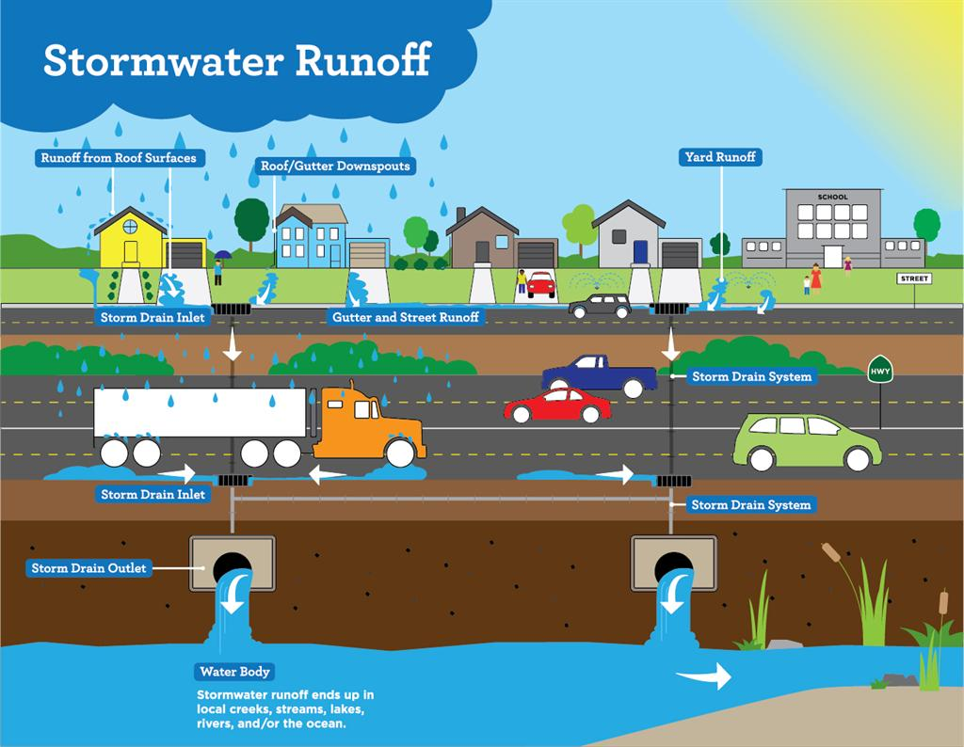


How will urban storm water systems cope with future changes?
Urbanisation
Climate Change
Increased impervious area
More extreme flood events
Increased stress on stormwater system

Slide 3
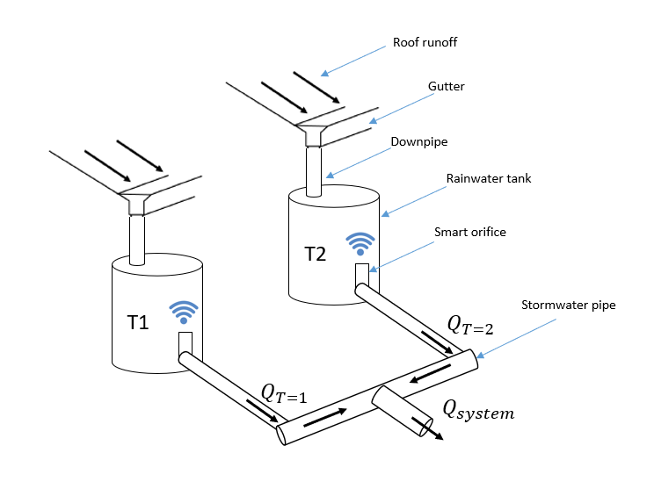
Real-time Control(RTC) - Shift Hydrographs to Avoid Large Coincident Peaks
A simple two-storage system

Slide 4
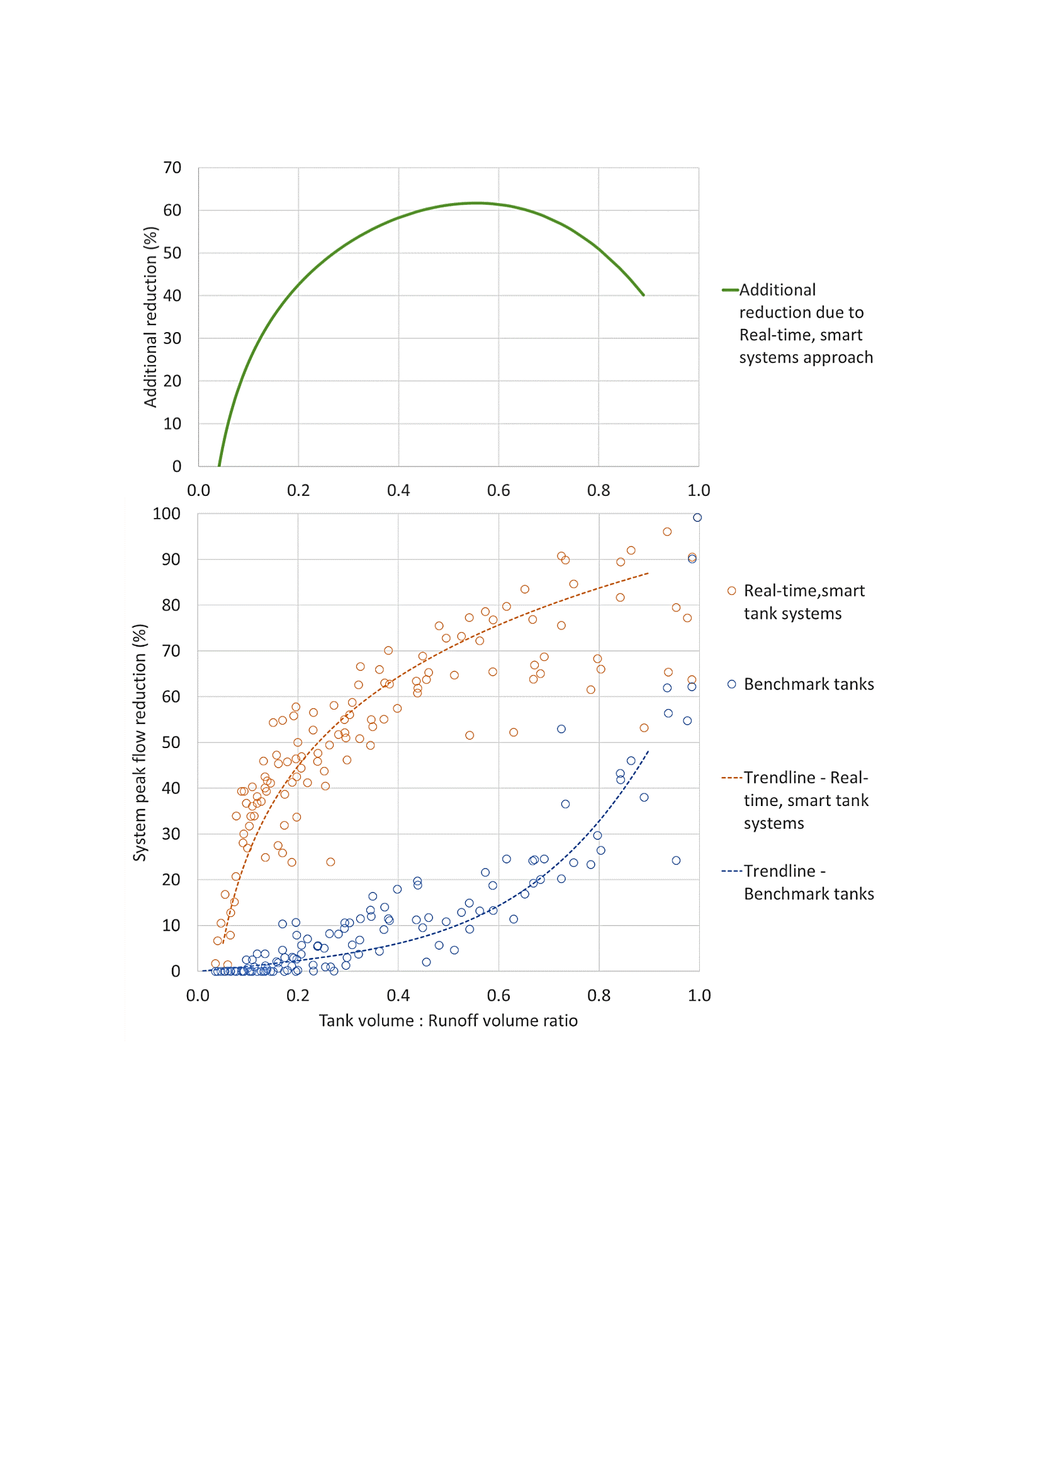
Real-time Control (RTC) is able to Achieve Significant Peak Flow Reductions, Especially for Smaller Storage Sizes
Real-time control
No Control
Small storage
Large storage
*Results From Journal Paper: Real-Time, Smart Rainwater Storage Systems: Potential Solution to Mitigate Urban Flooding. DOI:https://doi.org/10.3390/w11122428

Slide 5
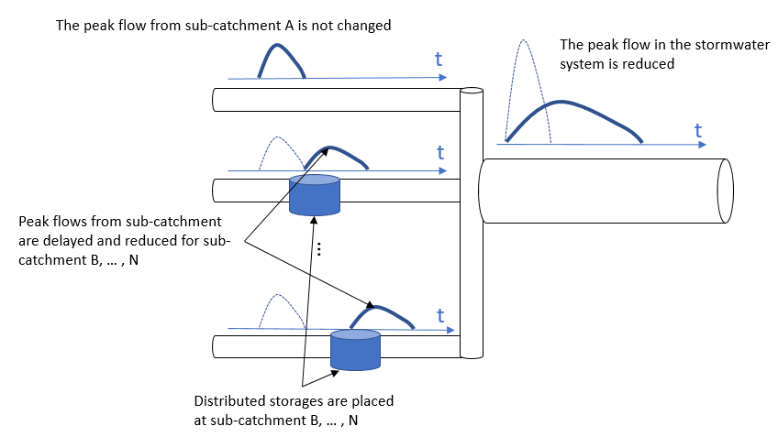
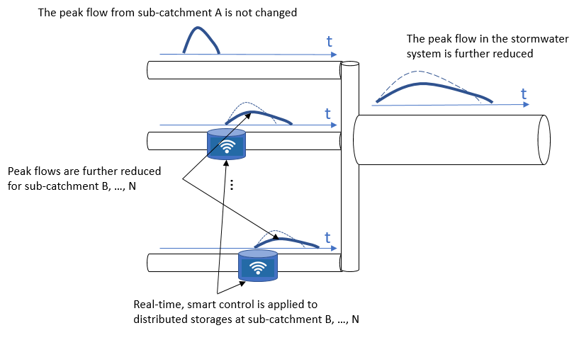
For a large-scale catchment, the peak flow reduction is also influenced by the storage layouts
(a) Storage layouts (locations and sizes)
(a) Real-time Control (RTC)

Slide 6
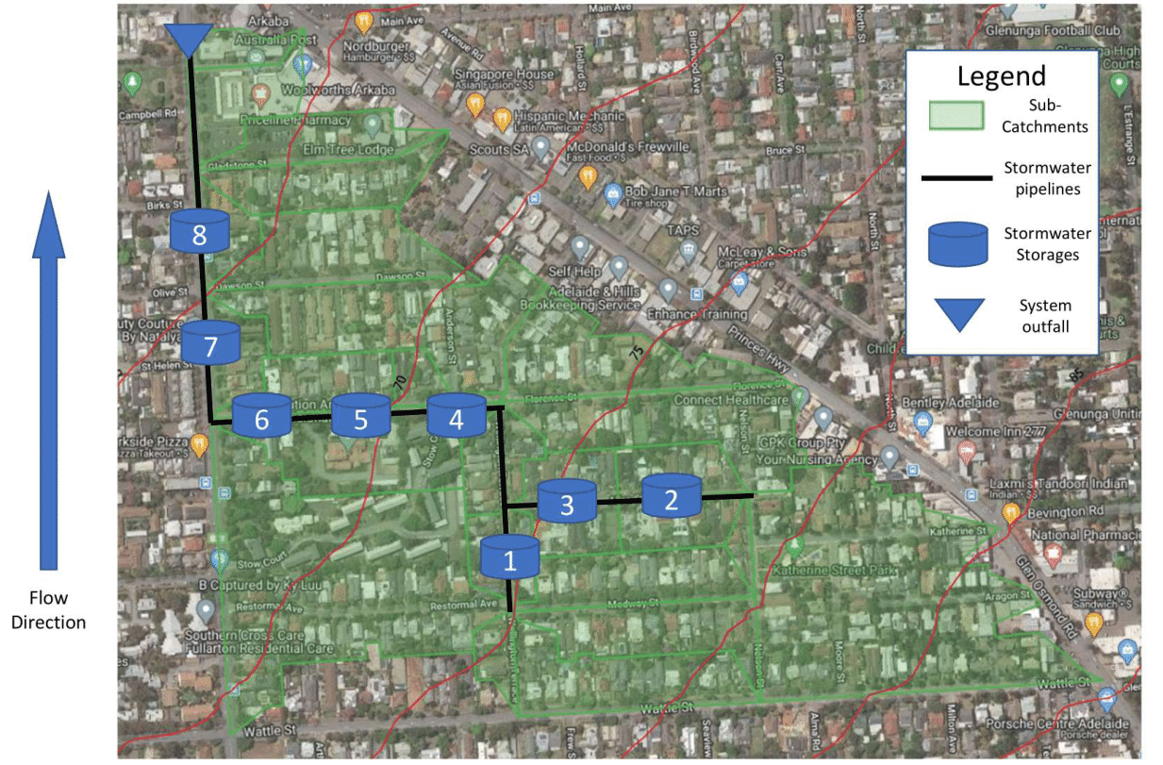
Separate Contribution of Storage Layout and Real-time Control (RTC) to Reduce Peak Flows
Case study information:
Case Study Location: Adelaide, SA, Australia
8 Potential storage locations
36ha total catchment area

Slide 7
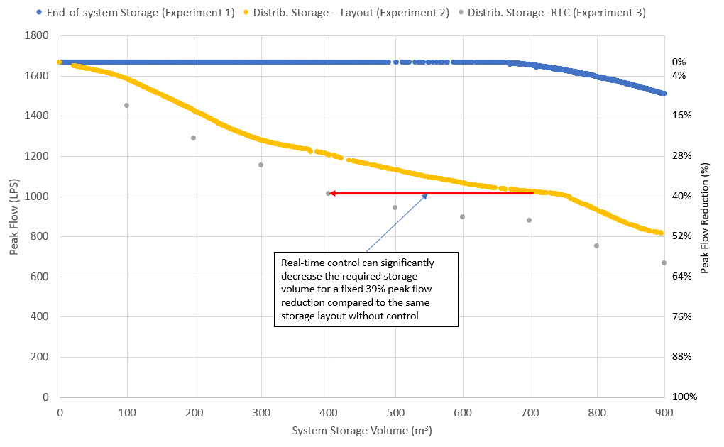
Key results:
Two-step optimisation identifies contribution of layout/RTC to reduce peak flows
RTC achieves higher relative peak flow reduction for a smaller storage volume
Flood hydrograph analysis provides insights on peak flow reduction mechanisms
*Results From a Submitted Manuscript(Journal of Hydrology): Optimising the design and real-time operation of systems of distributed stormwater storages to reduce urban flooding at the catchment scale

Slide 8
Thank You

Slide 9
Appendix: Comparison between RTC and No Control
*Results From Journal Paper: Real-Time, Smart Rainwater Storage Systems: Potential Solution to Mitigate Urban Flooding. DOI:https://doi.org/10.3390/w11122428

Slide 10
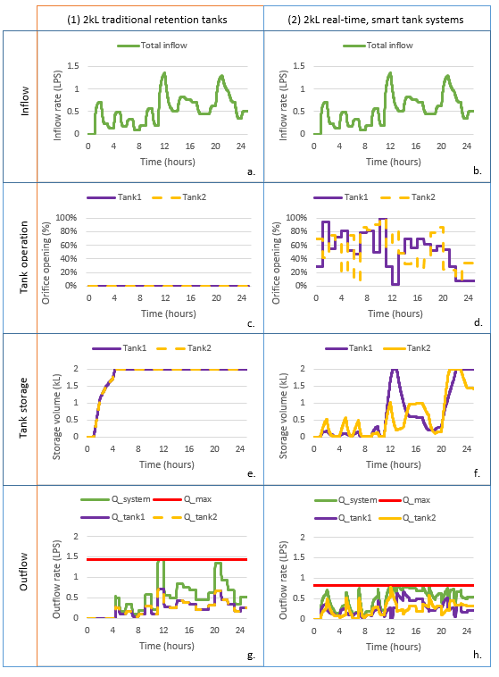
Appendix: Control rules and Hydrographs for 2kL Storage With and Without RTC
*Results From Journal Paper: Real-Time, Smart Rainwater Storage Systems: Potential Solution to Mitigate Urban Flooding. DOI:https://doi.org/10.3390/w11122428

Slide 11
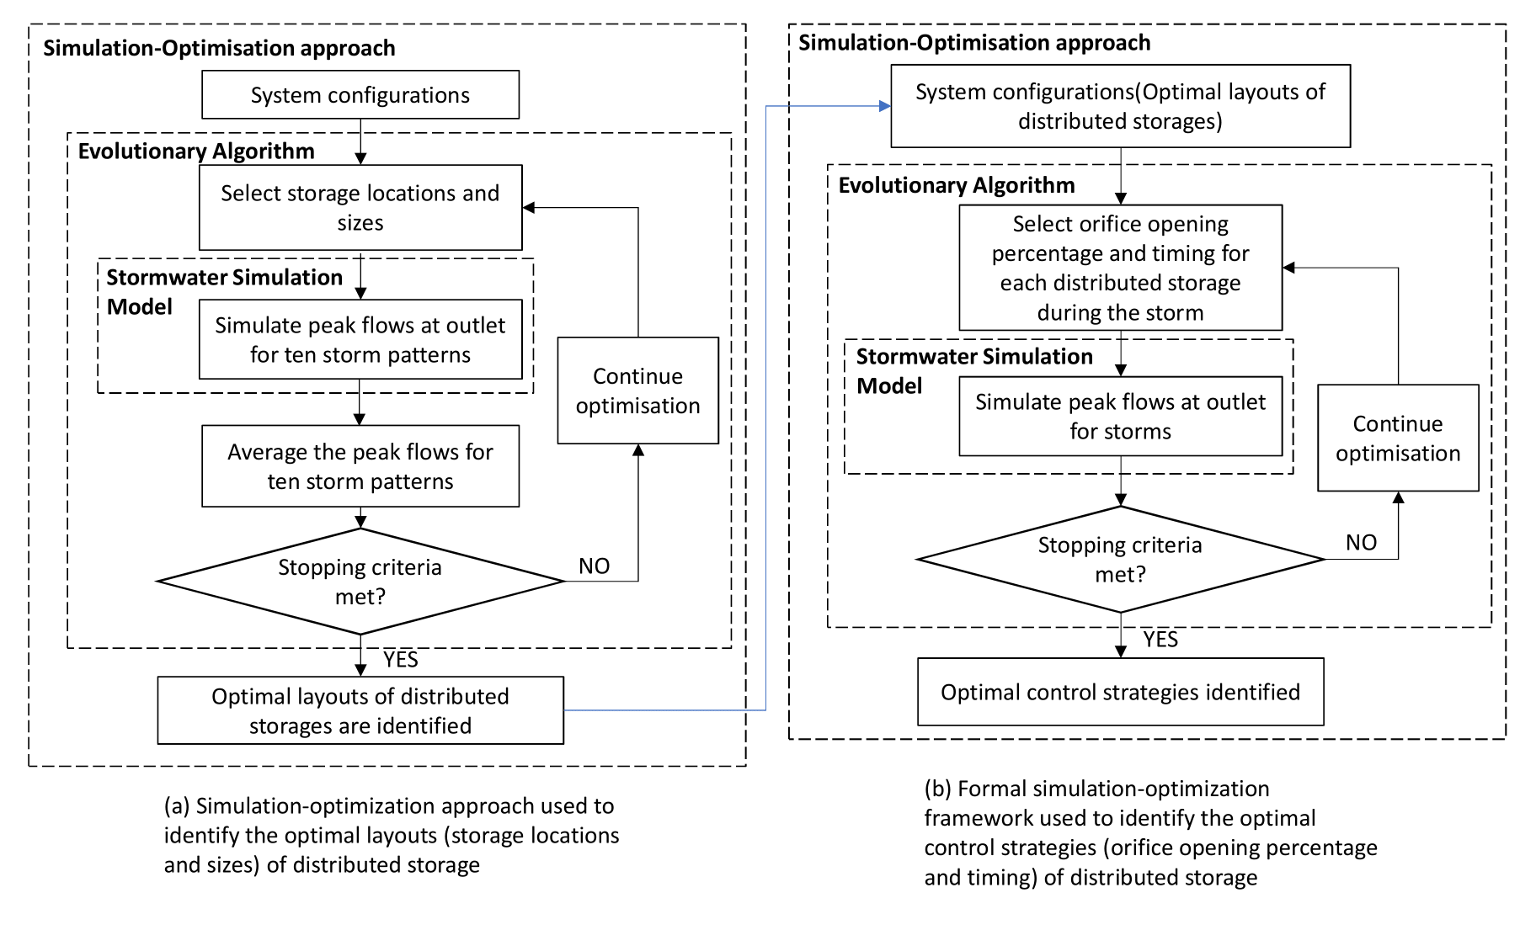
Appendix: Two-step Optimization Structure
*Results From a Submitted Manuscript(Journal of Hydrology): Optimising the design and real-time operation of systems of distributed stormwater storages to reduce urban flooding at the catchment scale

Slide 12
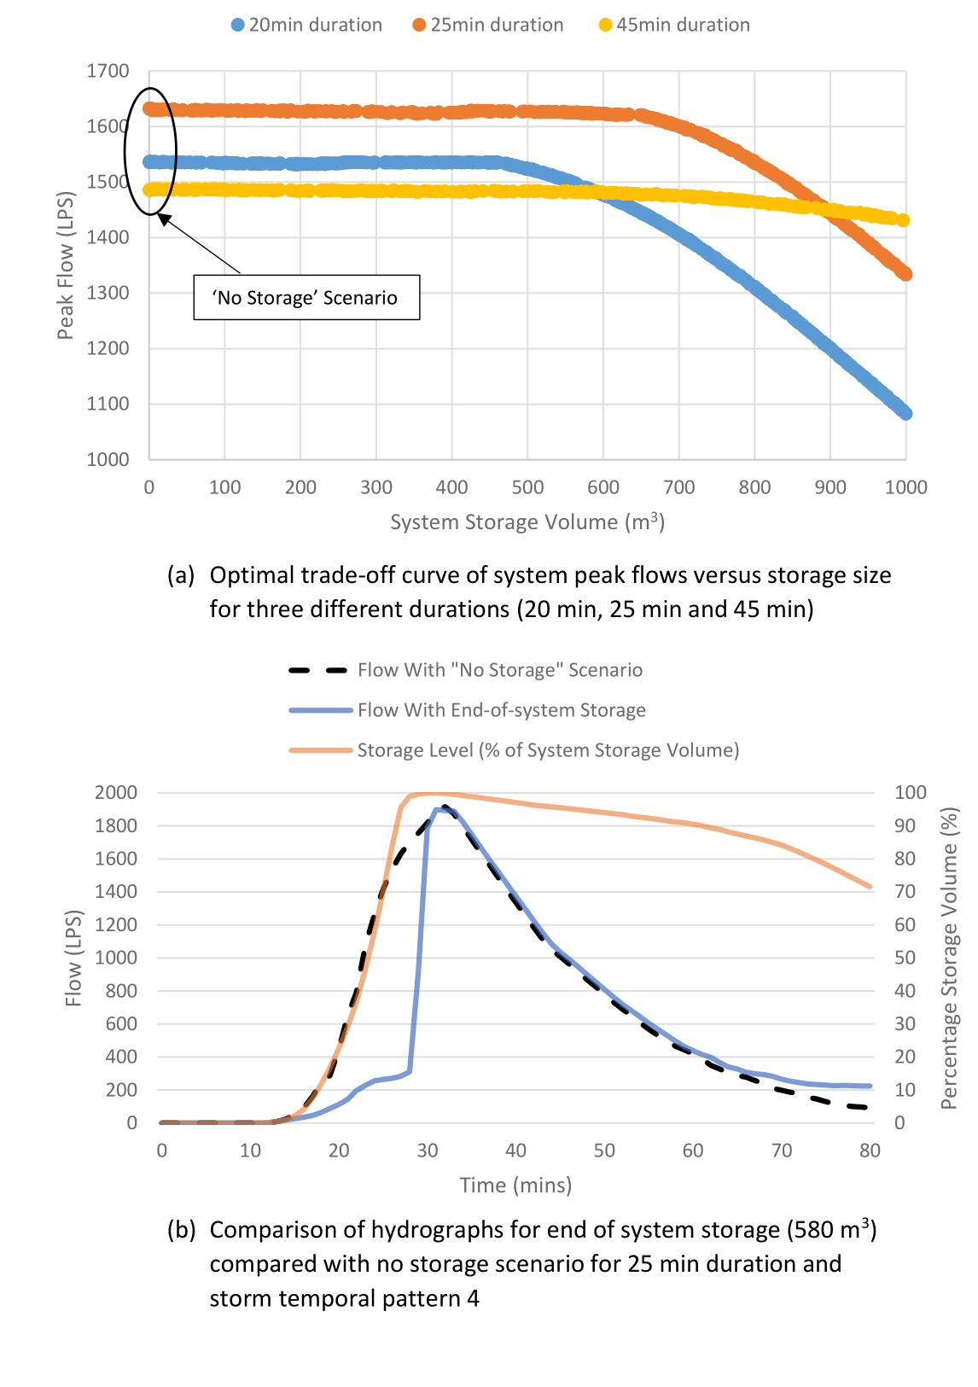
Appendix: Performance of End-of-system Storage
*Results From a Submitted Manuscript(Journal of Hydrology): Optimising the design and real-time operation of systems of distributed stormwater storages to reduce urban flooding at the catchment scale

Slide 13
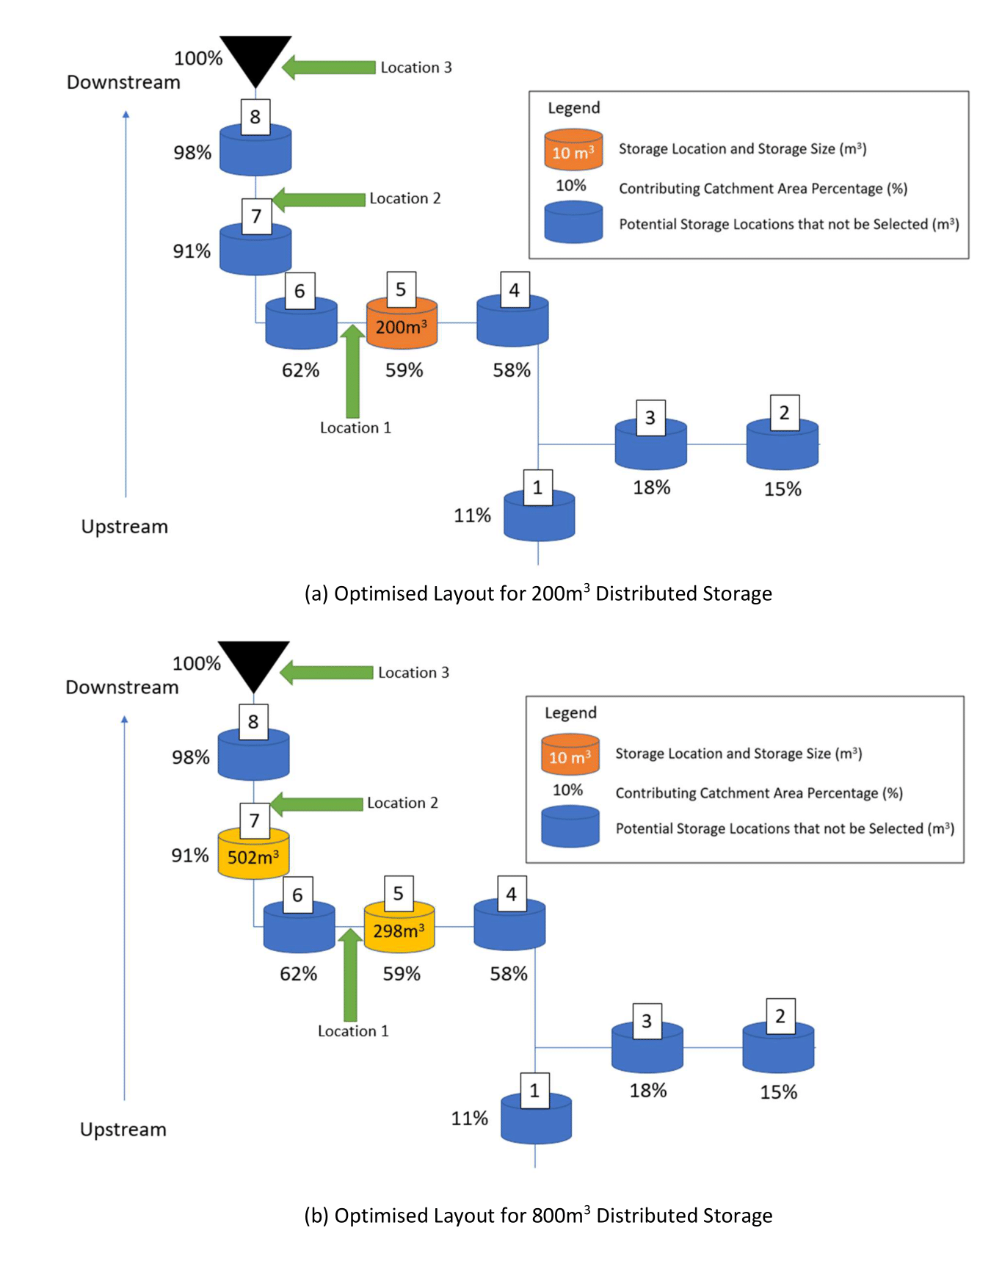
Appendix: Optimised Storage Layouts
*Results From a Submitted Manuscript(Journal of Hydrology): Optimising the design and real-time operation of systems of distributed stormwater storages to reduce urban flooding at the catchment scale

Slide 14
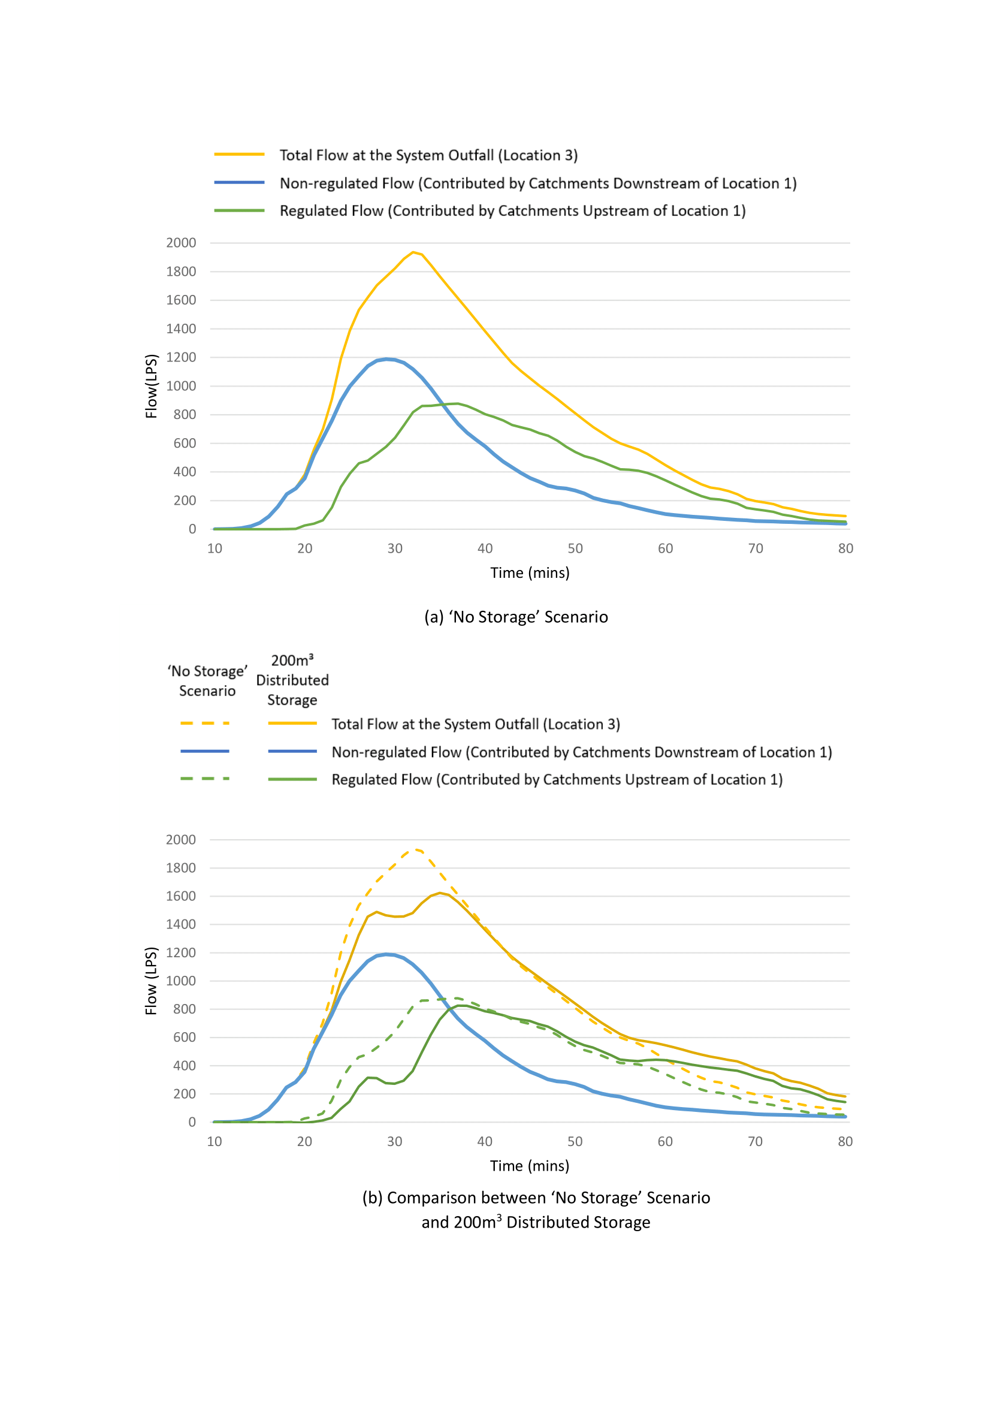
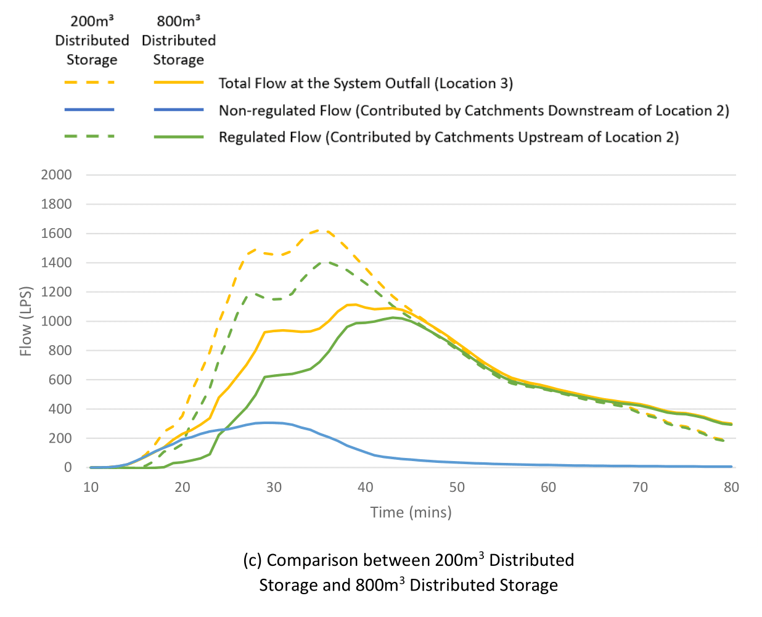
Appendix: Hydrographs (Distributed Storage With Optimised Layout)
*Results From a Submitted Manuscript(Journal of Hydrology): Optimising the design and real-time operation of systems of distributed stormwater storages to reduce urban flooding at the catchment scale

Slide 15
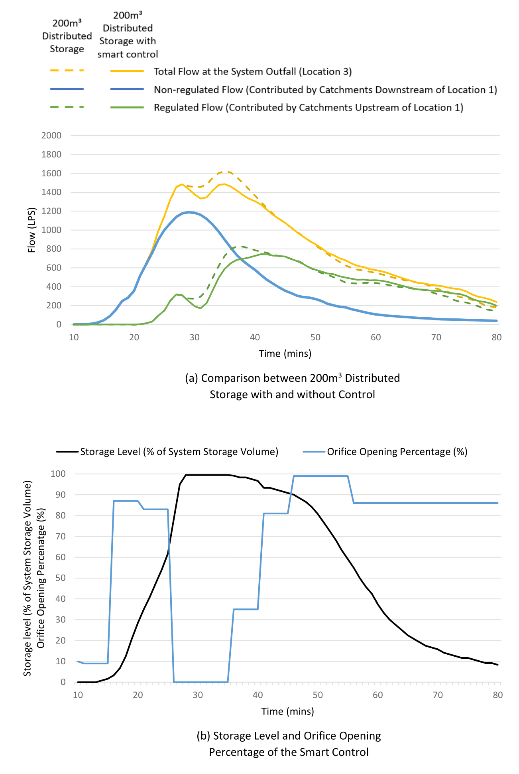
Appendix: Hydrographs(Distributed Storage With RTC)
*Results From a Submitted Manuscript(Journal of Hydrology): Optimising the design and real-time operation of systems of distributed stormwater storages to reduce urban flooding at the catchment scale

