Slide 1


Climatic Effects on GPS PPP Accuracy
Aziz Saraçoğlu^{1*} and Doğan Uğur Şanlı¹
[¹] Yildiz Technical University, Civil Engineering Faculty, Department of Geomatic Engineering, Istanbul, Turkey
#vEGU General Assembly 2021 [G1.3], 19-30 April

Slide 2



Climatic Effects on GPS PPP Accuracy
Aim of the Study
We aim to provide a better representation of the positioning accuracy of GPS based on climatic change by eliminating the weak points on the available accuracy model (i.e., Saracoglu and Sanli, 2020).

Slide 3
Climatic Effects on GPS PPP Accuracy
Weak points
The available classification is not based on actual meteorological measurements
The effect of loading deformation and tectonic motion exist in the solution
Climate regions are not represented with enough number of IGS stations
Regional accuracy modelling has not yet been performed

Slide 4
Climatic Effects on GPS PPP Accuracy
Aim of the Study
Five consecutive days for each month of 2016-2020 from 50 IGS (International GNSS Service) stations to be selected, considering the Köppen - Geiger climate classification.
Length of GPS time series will be extended from 2 to 4 years to be successfully eliminate the crustal deformation
The data is freed from the effect of Geomagnetic Storms
Both continuous and campaign GNSS measurements will be used for evaluations
Synthetic GPS campaigns will be generated using the permanent stations of the IGS (International GNSS Service).
The data will be processed using the PPP module of the NASA/JPL's GipsyX software.

Slide 5
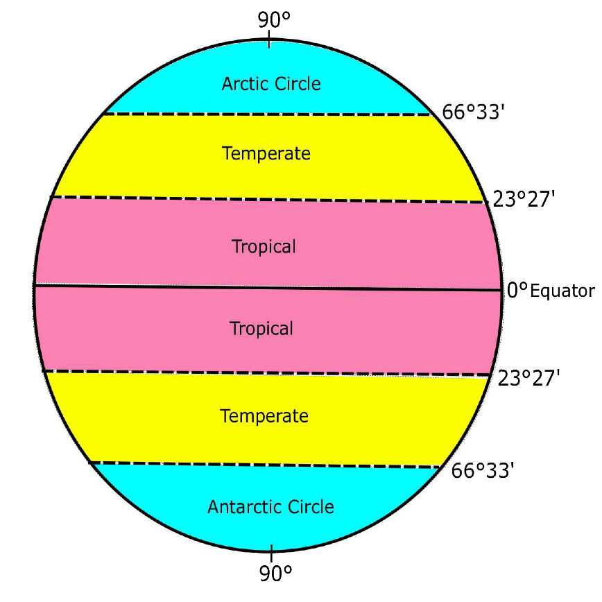
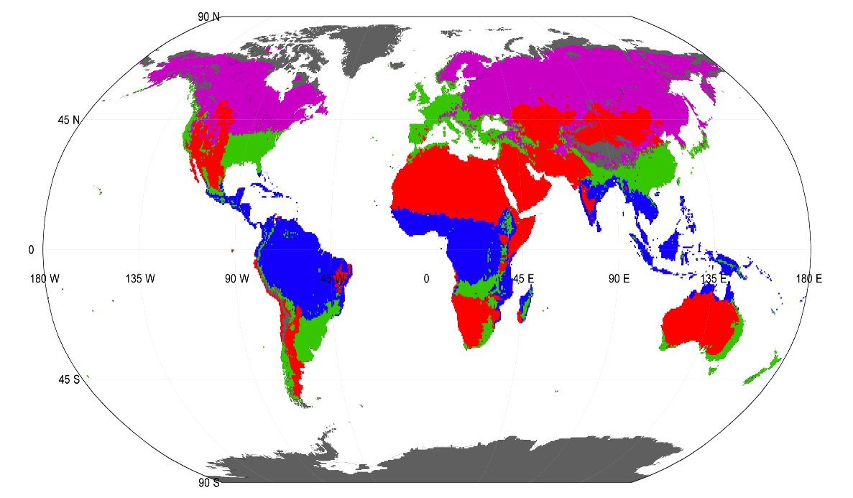
Climatic Effects on GPS PPP Accuracy
Köppen-Geiger climate classification
Note the difference between the major climate zone classification (i.e., used in Saracoglu & Sanli 2020) and the widely used Köppen Geiger climate classification [2], [3], [4]
Fig 1. Mathematical climate zones (used in Saracoglu & Sanli 2020)
Fig 2. Köppen-Geiger climate classification ^{[1]}

Slide 6
Climatic Effects on GPS PPP Accuracy
Köppen-Geiger climate classification
Created by Wladimir Petrovich Köppen in 1884 [2]
Improved with the contributions of Rudolf Geiger [3]
All cities are expressed in five climatic zones; considering the monthly, annual temperature and rainfall information of the regions,
Named as Köppen-Geiger Climate Classification, these climate groups are designated as:
A: equatorial region,
B: arid zone,
C: warm temperate zone,
D: snow zone and
E: the polar region.

Slide 7
Climatic Effects on GPS PPP Accuracy
Köppen-Geiger climate classification
Why do we use the Köppen Geiger climate classification?
Saracoglu & Sanli 2020 used mathematical climate zones in which the zones are separated by the parallels of the latitude. This is only a basic classification based on latitudinal classification. This classification does not reflect the actual climatic change.
Therefore, in this study we use the Köppen Geiger climate classification, which is not only dependent on latitudinal change, but also based on actual meteorological measurements collected.

Slide 8
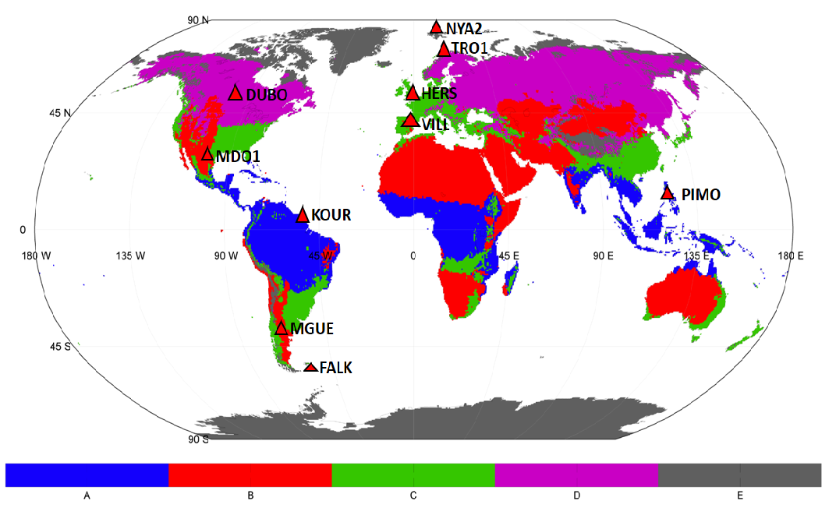
Climatic Effects on GPS PPP Accuracy
A sample trial using two IGS station per climate region
A: Equatorial
B: Arid
C: Warm Temperate
D: Snow
E: Polar
Fig 3. Station distribution according to Köppen-Geiger climate classification [4]

Slide 9
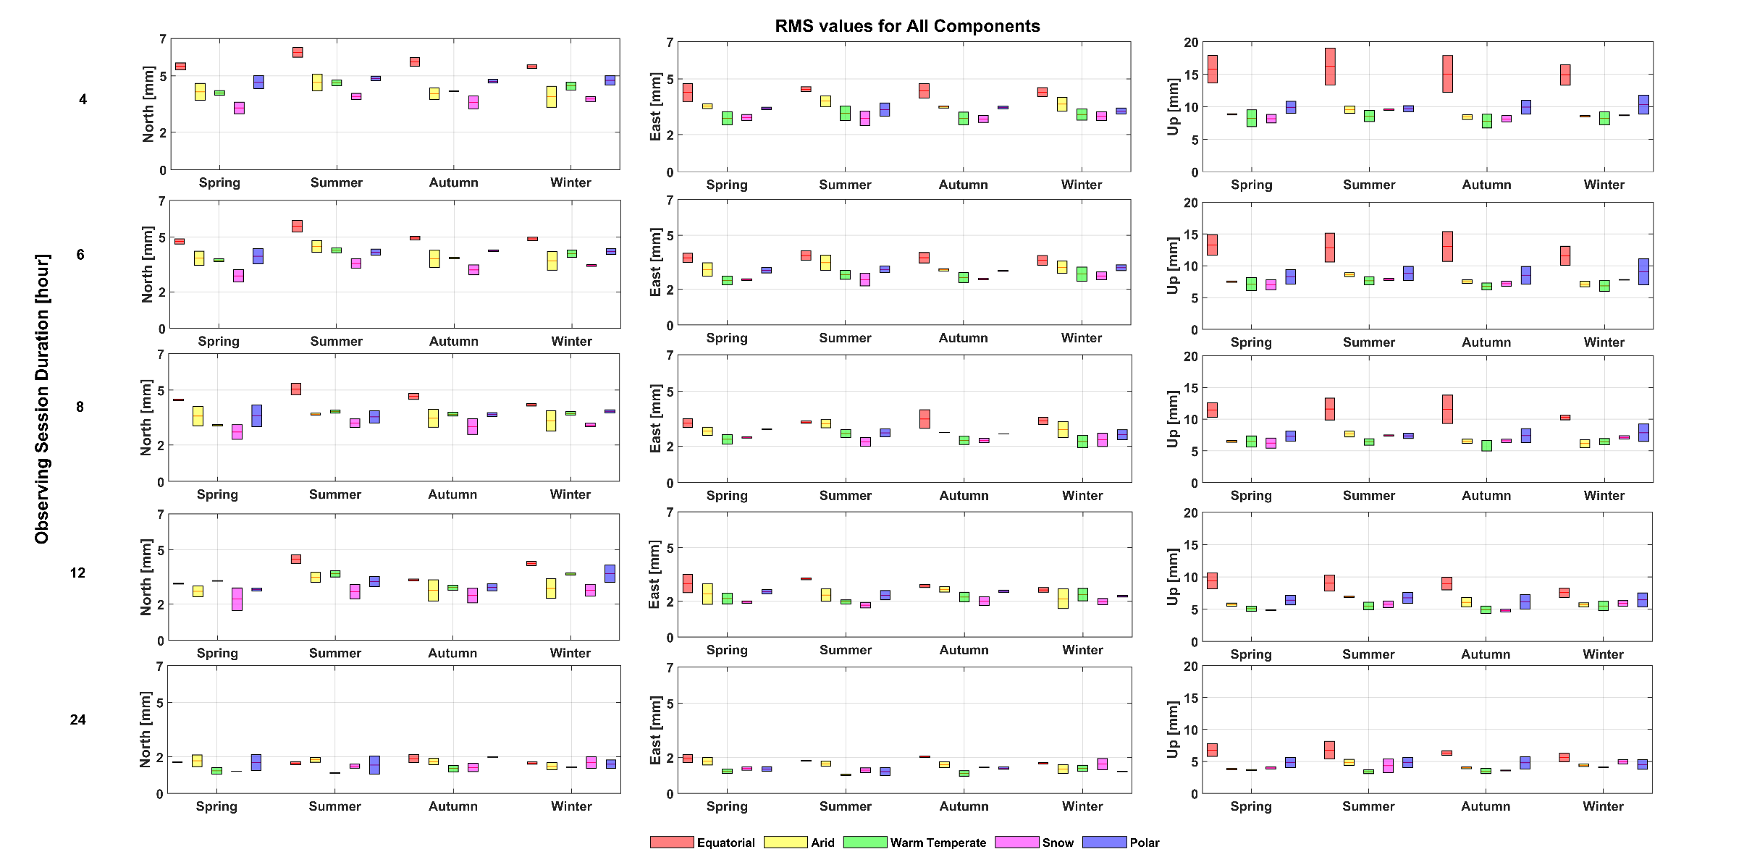
Climatic Effects on GPS PPP Accuracy
Results
Fig 4. Effects of seasonal changes on PPP accuracy with Köppen-Geiger climate classification

Slide 10
Climatic Effects on GPS PPP Accuracy
Results and Future Work
Our first impressions of this work are as follows:
1) With the elimination of ground deformation such as crustal loading and tectonic motion, the seasonal signature on GPS positions is more obvious
2) The influence is severer on GPS campaign measurements
3) As the session duration increases, the accuracy between the seasons is closer to each other.
4) The PPP accuracy in equatorial regions is coarser than other regions in all seasons
Future tasks to be applied:
1) Expand the network with about 50 IGS stations evenly covering the Köppen climate regions
2) The need for a regional accuracy modelling is clear

Slide 11
References
^{[1]} https://line.17qq.com/articles/ibobijojz.html
[2] W. Köppen,Versuch einer Klassifikation der Klimate, vorzugsweise nach ihren Beziehungen zur Pflanzenwelt,Geographische Zeitschrift 6.11. H (1900): 593-611.
[3] W. Köppen, R. Geiger Handbuch der klimatologie Berlin: Gebrüder Borntraeger, 1930.
[4] C.W. Thornthwaite An approach toward a rational classification of climate Geographical review 38.1 (1948): 55-94.
A. Saracoglu, D.U. Sanli Effect of meteorological seasons on the accuracy of GPS positioning Meas. J. Int. Meas. Confed. 152 (2020). https://doi.org/10.1016/j.measurement.2019.107301.

