Slide 1

TAMIR project: Advanced Tools for pro-Active Management of Impacts and Risks Induced by Convective Weather, Heavy Rain and Flash Floods in Europe
vEGU21 | 27 April 2021 | NH3.1 | EGU21-8194
Tero Niemi¹, C. Baugh², M. Berenguer³, A. Berruezo³, E. Hansford², M. Leinonen⁴, A. von Lerber¹, S. Park³, C. Prudhomme², S. Pulkkinen¹, and J. Ritvanen¹
¹ Finnish Meteorological Institute (FMI), Space and Earth Observation Center, Helsinki, Finland
² European Centre for Medium-range Weather Forecasts (ECMWF), Reading, UK
³ Universitat Politècnica de Catalunya, Centre de Recerca Aplicada en Hidrometeorologia (UPC-CRAHI), Barcelona, Spain
⁴ Kymenlaakso Rescue Department (KYMPE), Kotka, Finland
The content of this presentation represents the views of the author only and is his/her sole responsibility. The European Commission does not accept any responsibility for use that may be made of the information it contains.

Slide 2
Background & Aims
“Between 1980 and 2019, weather and climate-related extremes accounted for around 81 % of total economic losses caused by natural hazards in the EEA member countries.“
− EEA. 2021. Economic losses from climate-related extremes in Europe. IND-182-en
Natural disaster risks EU may face:
Flooding
Extreme weather
Forest fires
− EC. 2017. Overview of Natural and Man-made Disaster Risks the European Union may face.
TAMIR main goal:
Enhance the response capacity in emergencies caused by convective and heavy rainfall events by developing rapid risk assessment products and IT tools for improved impact forecasting to support decision making.

Slide 3
Pan-European Scale:
Improved Flash Flood Hazard and Impact Forecasting

Slide 4
Seamless Precipitation Forecasting
Flash flood hazard forecasting based on the concepts of EPIC & ERICHA systems
Basin-aggregated precipitation forecast the main forcing of the flash flood hazard forecasts
Precipitation forecast produced by seamless blending of radar based nowcasts (SBMcast¹) with NWP forecasts (ECMWF EPS) and interpolated to 1 km spatial resolution
 | Nowcasting (SBMcast) | NWP
Precipitation inputs | OPERA QPE | ECMWF EPS
Resolutions | 2 km, 1h | 18 km, 6h
Lead times | 6 h | 5 days
Update cycle | 1 h | 12 h
¹ Berenguer et al. 2011. SBMcast – An ensemble nowcasting technique to assess the uncertainty in rainfall forecasts by Lagrangian extrapolation. https://doi.org/10.1016/j.jhydrol.2011.04.033

Slide 5
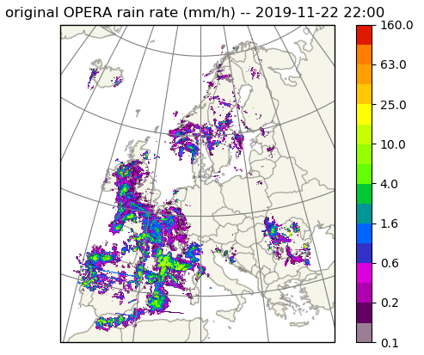
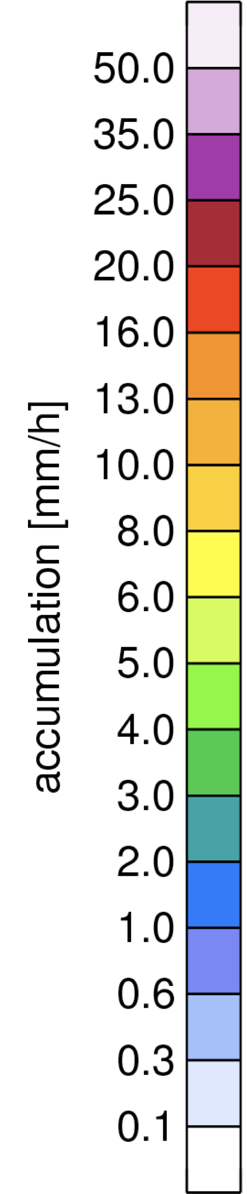
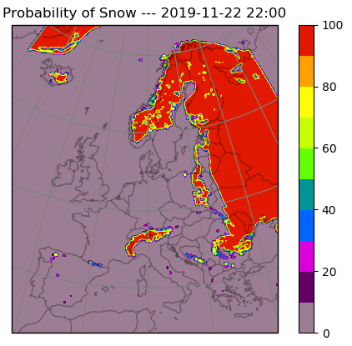
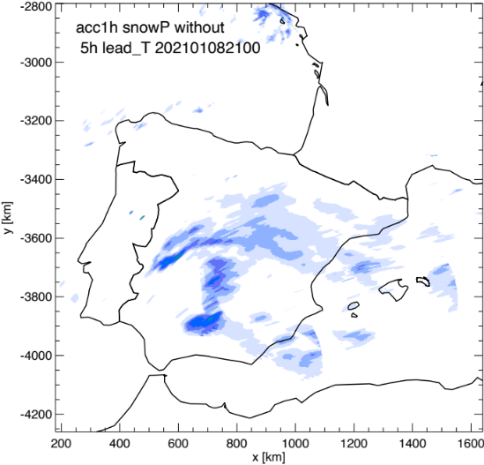
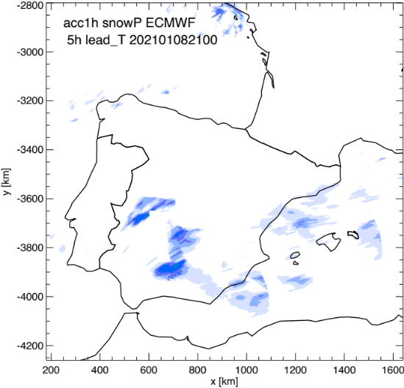
Estimating Precipitation Type
OPERA 1 h accumulation product is based on single Z-R conversion
  ➔ no information of precipitation type
Precipitation type retrieved with FMI algorithm applied to ECMWF IFS
  ➔ only consider rainfall by filtering out snow areas from radar nowcast
5 h lead time nowcast
Nowcast without the contribution of snow

Slide 6
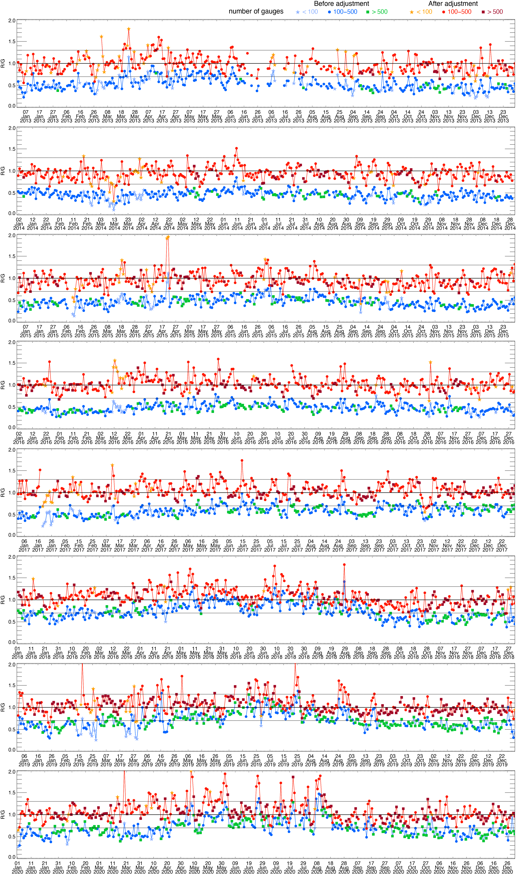
Gauge Adjustment to OPERA Precipitation Composite
Radar-based rainfall estimate typically underestimates rainfall amount on the ground due to radar measurement geometry
Real-time gauge-adjustment¹ used to improve radar QPE in TAMIR
Adjustment shown to improve radar QPE (results for 2013 and 2020 below)
¹ Park et al. 2019. Long-term analysis of gauge-adjusted radar rainfall accumulations at European scale. https://doi.org/10.1016/j.jhydrol.2019.03.093

Slide 7
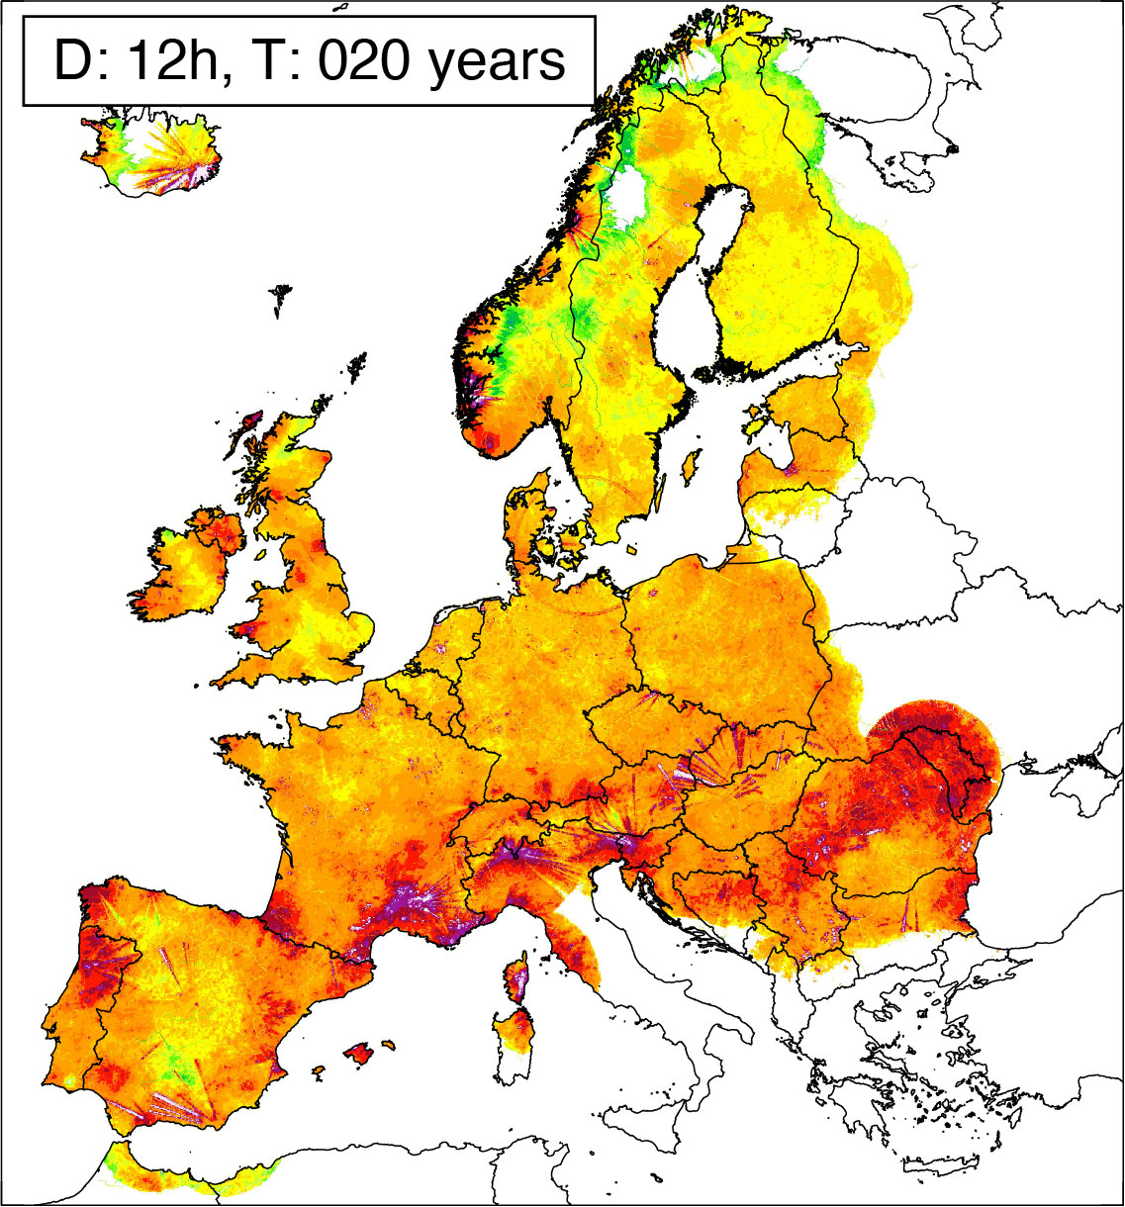
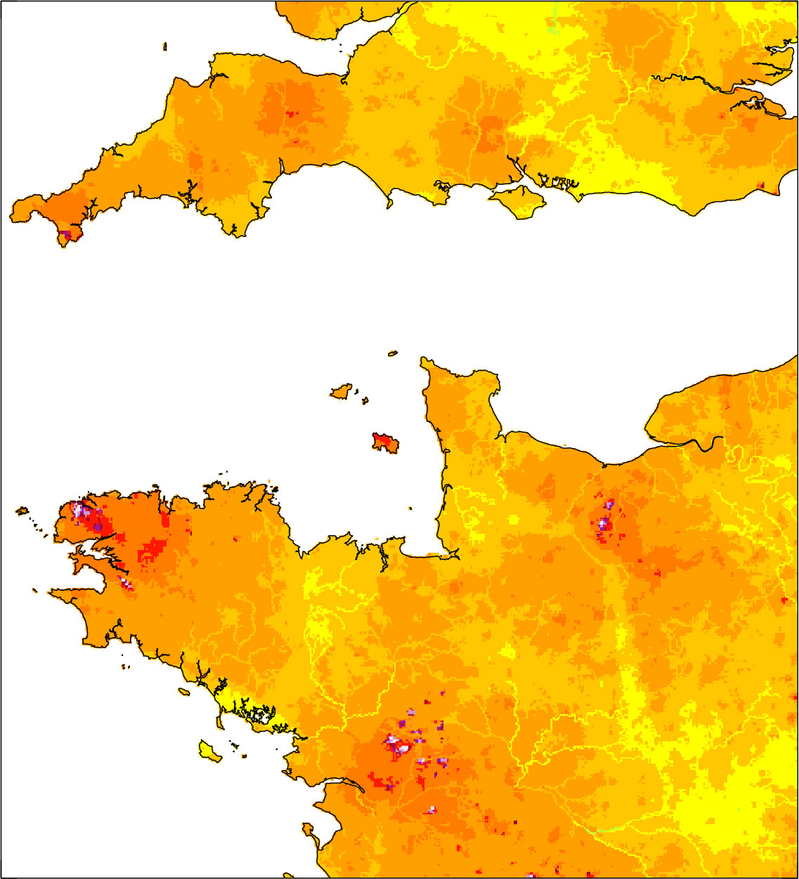
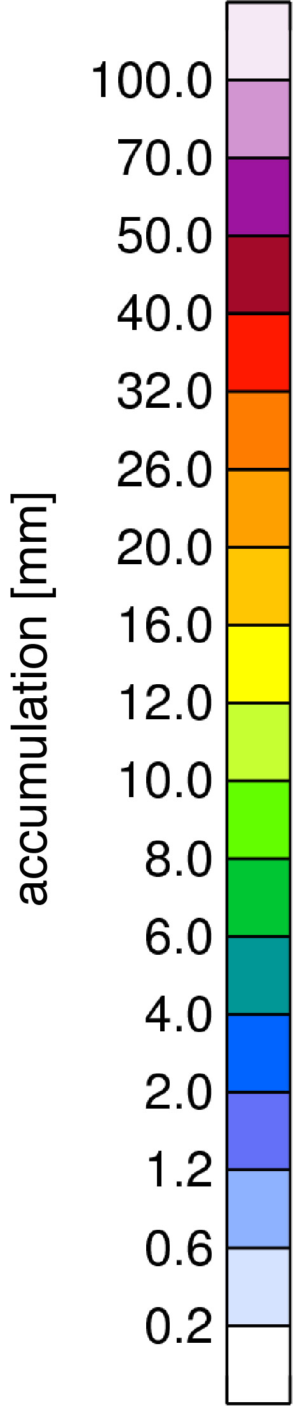
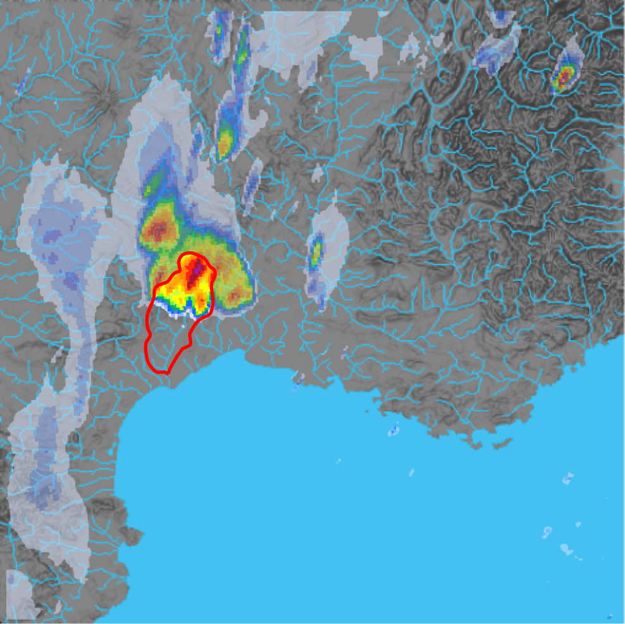
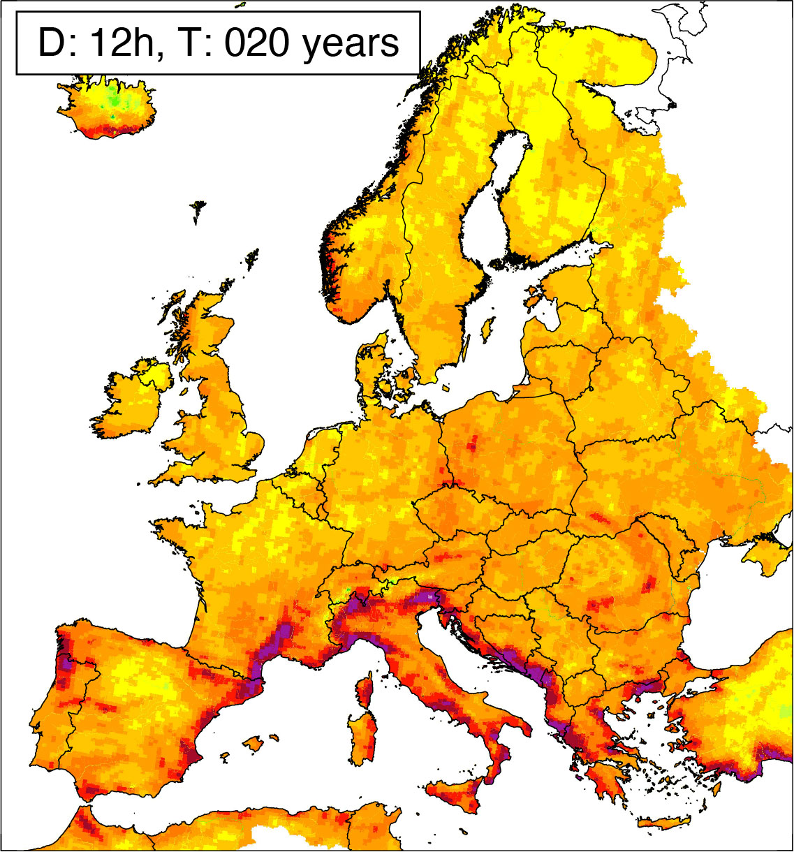
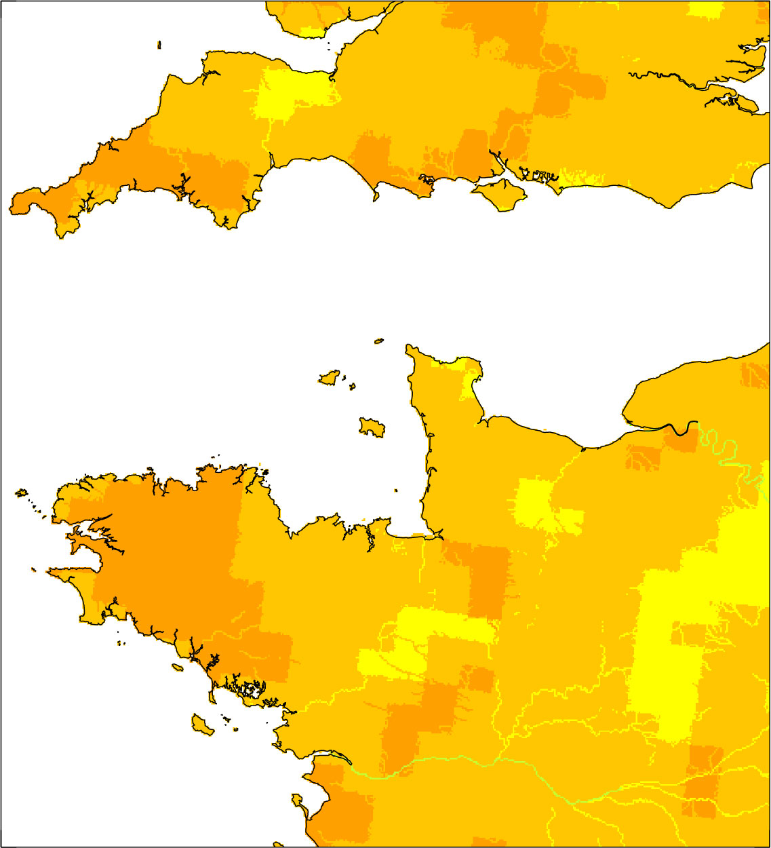
Flash Flood Hazard Assessment
Basin-aggregated rainfall converted to flash flood hazard by comparison with IDF values derived from long-term rainfall datasets
  ➔ Improved radar and NWP thresholds for seamless FF hazard assessment
8 years of gauge-adjusted OPERA radar mosaics used for durations 1, 3, 6, 12 and 24 h
Basin-aggregated rainfall accumulated over the hydrological characteristic time of the basin (1-24 hours)
20 years of ECMWF IFS NWP reforecasts used for durations 6, 12 and 24 h

Slide 8
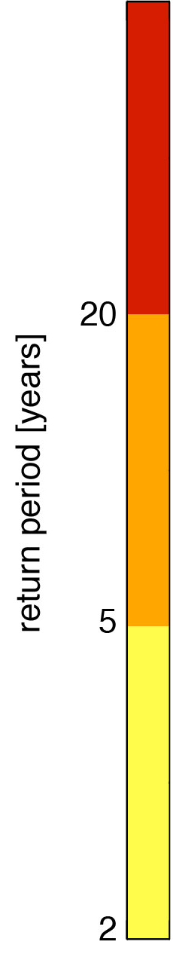
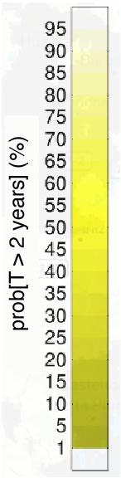
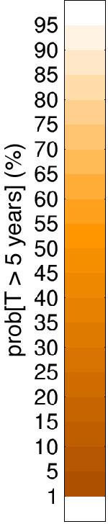
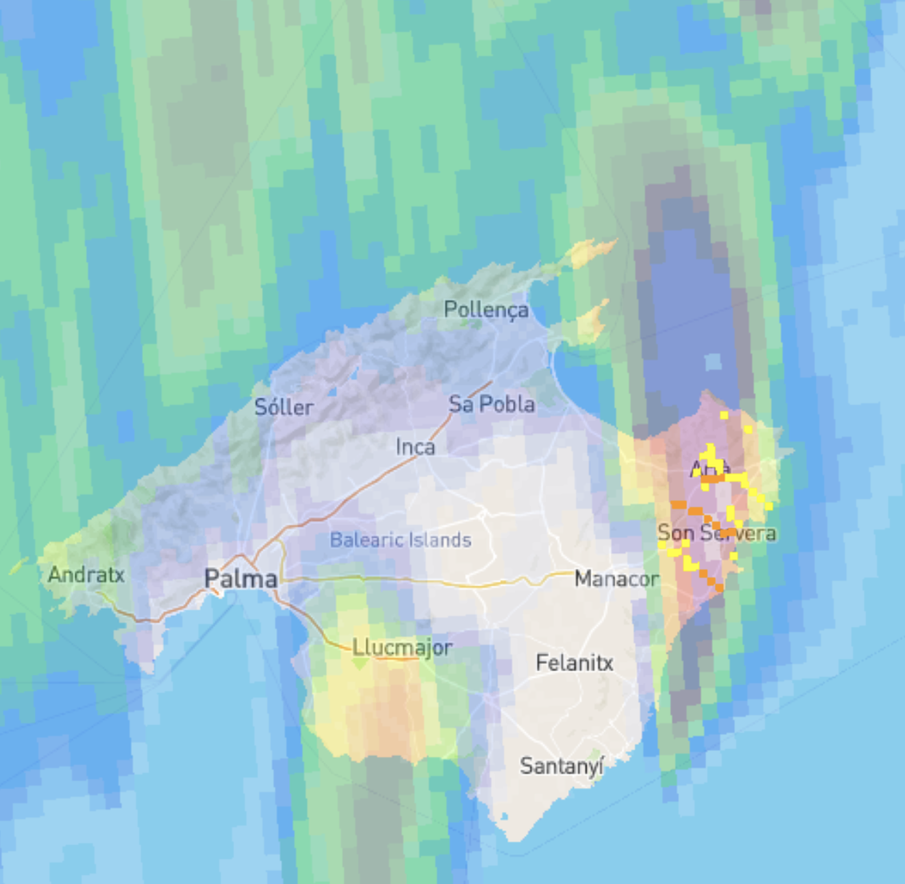
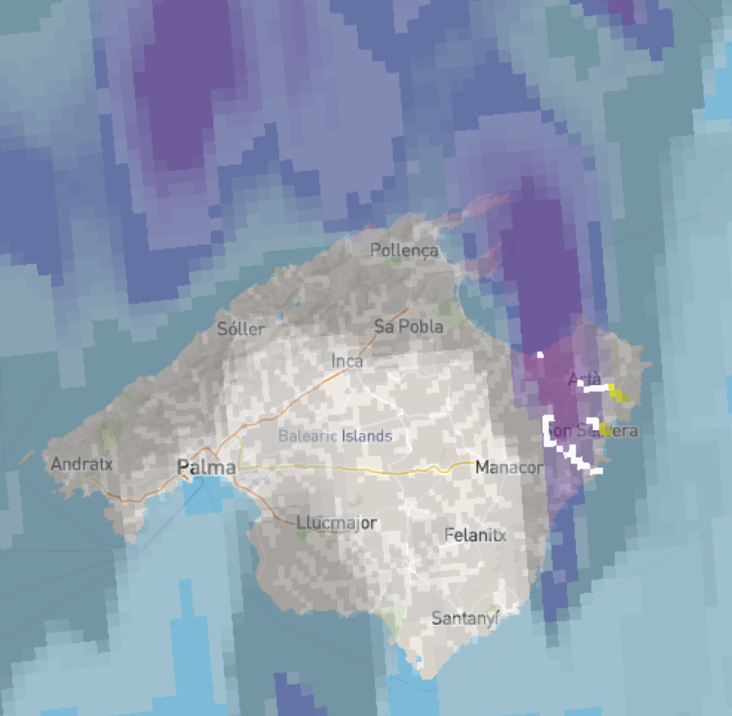
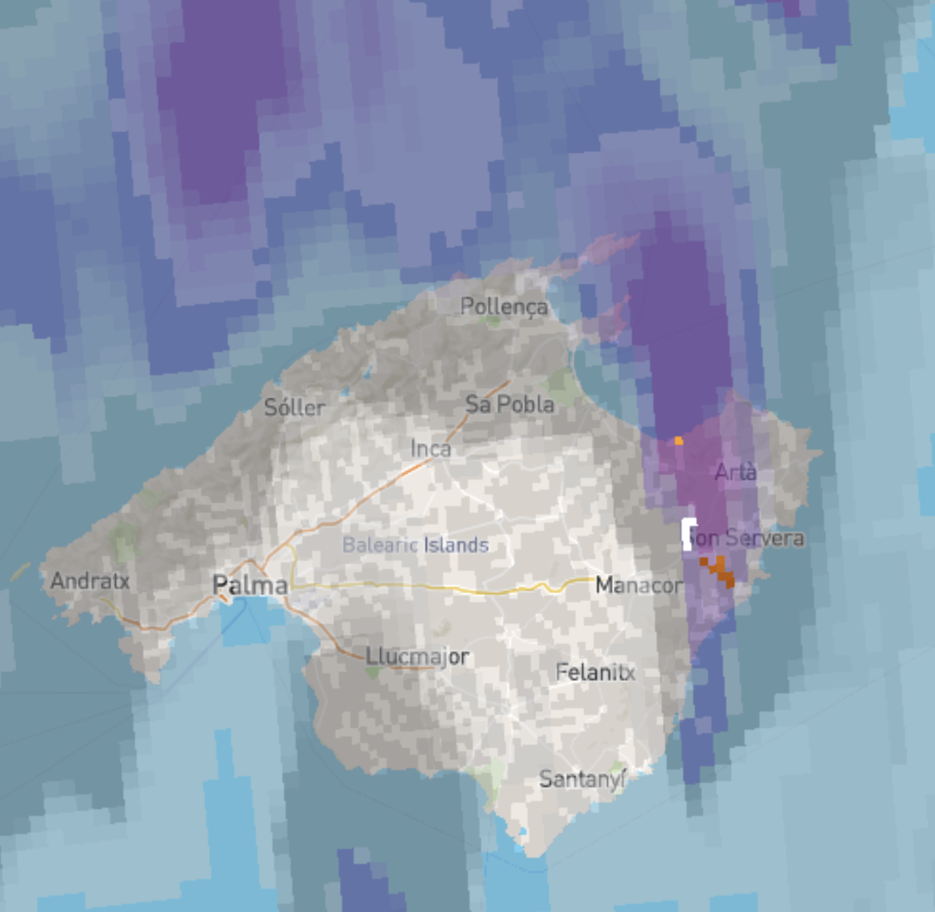
Improved Seamless Flash Flood Hazard Forecasting
Main output: probabilistic seamless flash flood hazard forecasts
Future work:
Optimal transformation of return period probabilities into simplified regional flash flood hazard warnings for end-users
Deterministic FF hazard forecast
Probability of exceeding T=2 years
Probability of exceeding T=5 years
Mallorca (Spain), 9 Oct 2018

Slide 9
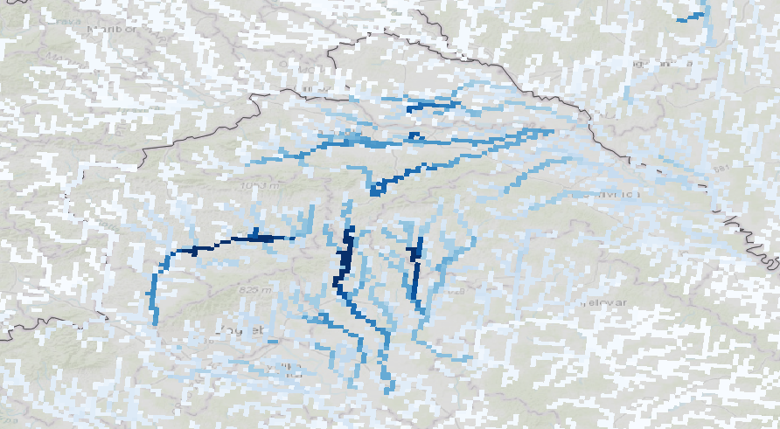
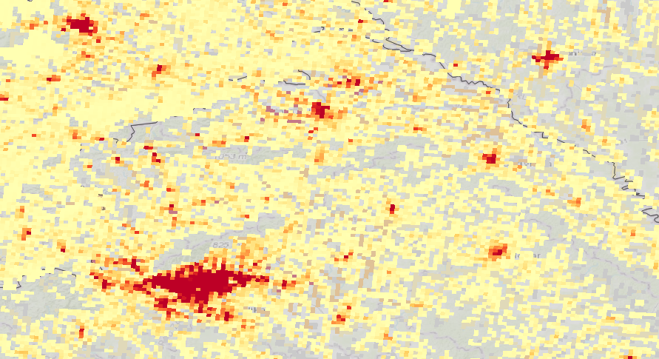
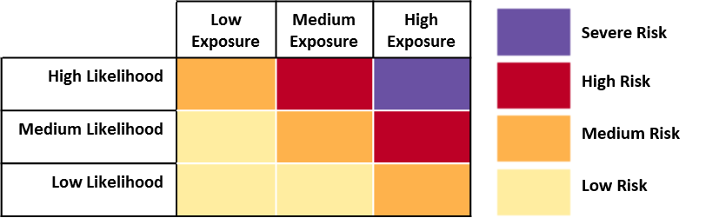
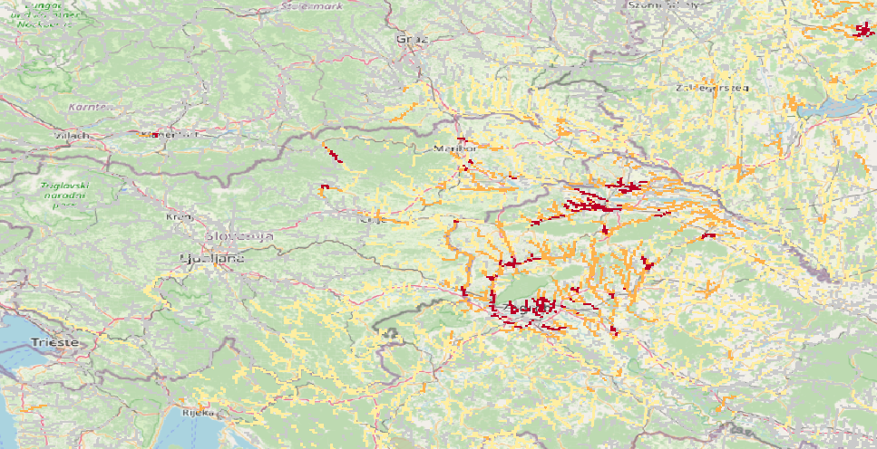

Creating Flood Impact Forecasts
Goal: Translate flood hazard forecasts into flood impacts
  ➔ Help end users prioritise emergency response to most impacted areas
$$Impact=$$
$$Hazard∗Exposure$$
Flash flood forecasts from WP3
Population/Infrastructure in path of flooding
Impact forecast expressed through impact matrix
Combined Exposure
1 km Impact forecast product
Severe Impact
Flash Flood Hazard Probability
High Impact
Medium Impact
Low Impact

Slide 10
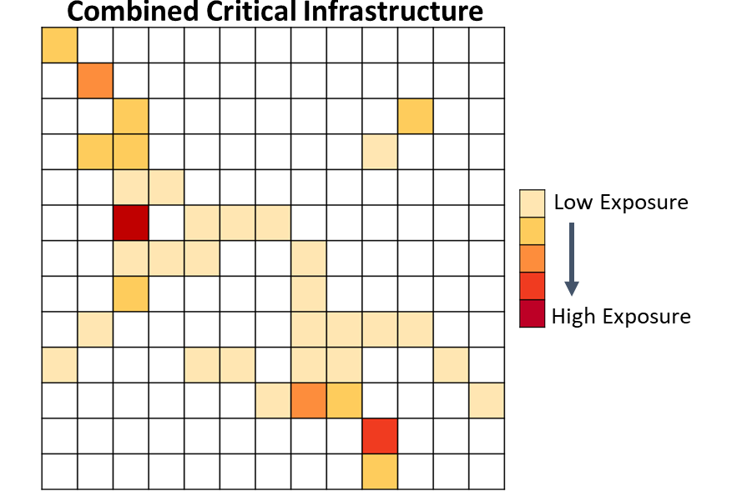
Exposure Information
Pan-European exposure datasets sourced, processed and combined into a single layer at 1 km spatial resolution
Exposure types chosen from end user engagement
Each dataset normalised and combined with equal weighting
Future work:
Compare pan-European exposure against local exposure data where available
Verify impact forecasts against observations and re-analysis
Exposure Type | Source
Population | Global Human Settlement Layer
Education facilities | JRC via OpenStreetMap
Health facilities | JRC via OpenStreetMap
Energy generation | HARCI-EU & JRC
Transportation | HARCI-EU & JRC

Slide 11
Local Scale:
Hazard and Risk Nowcasts for Thunderstorms

Slide 12
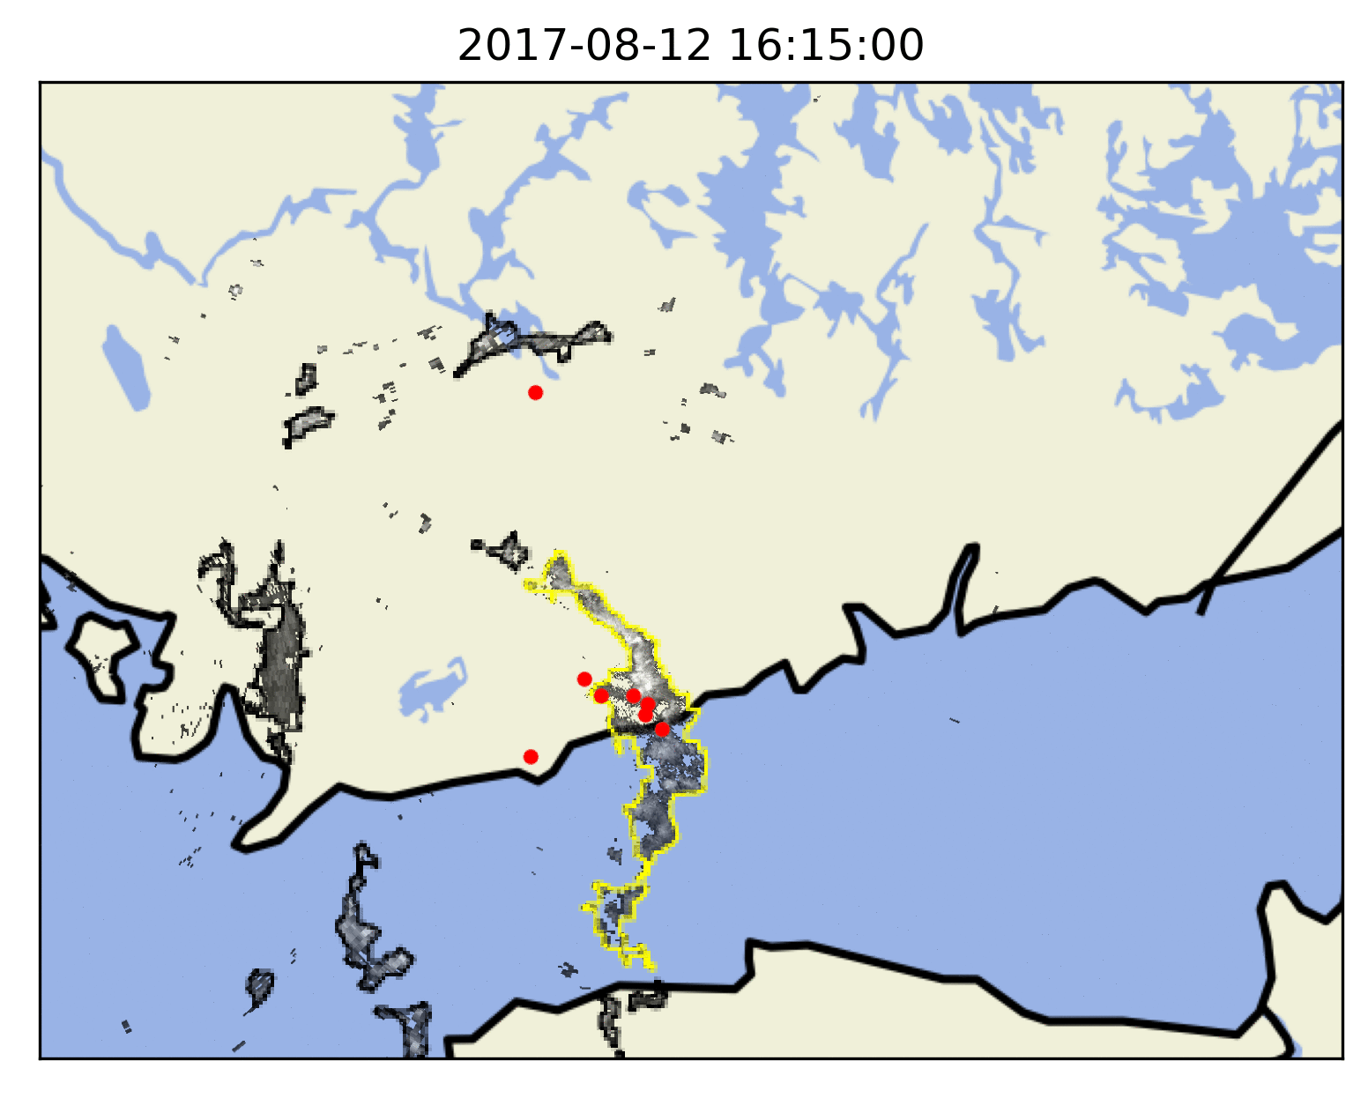
Hazard Level Estimation
¹ Rossi et al. 2013. Real-Time Hazard Approximation of Long-Lasting Convective Storms Using Emergency Data. https://doi.org/10.1175/JTECH-D-11-00106.1
² Tervo et al. 2019. Short-Term Prediction of Electricity Outages Caused by Convective Storms. https://doi.org/10.1109/TGRS.2019.2921809
Identify storm cells from historical weather radar images
Collect attributes, e.g., meteorological observations & land cover data for each cell
Estimate hazard level for storm cells from emergency calls¹
Train a random forest -type ML model² using attributes and hazard level
Real-time hazard class for thunderstorms given by the ML model based only on radar data and meteorological etc. observations
No hazard
Moderate
Severe
Extreme
Emergency calls
Meteorological
Lightning flash density
CAPE
CIN
Rainfall accum.
Radar reflectivity
Radial Doppler velocity
Hail indices
Weather stations
Temperature
Pressure
Wind speed & direction
Wind gust
Dewpoint
Geographical
Land cover index
Tree height
Surface roughness
Cell attributes
Area
Age
Speed & direction

Slide 13
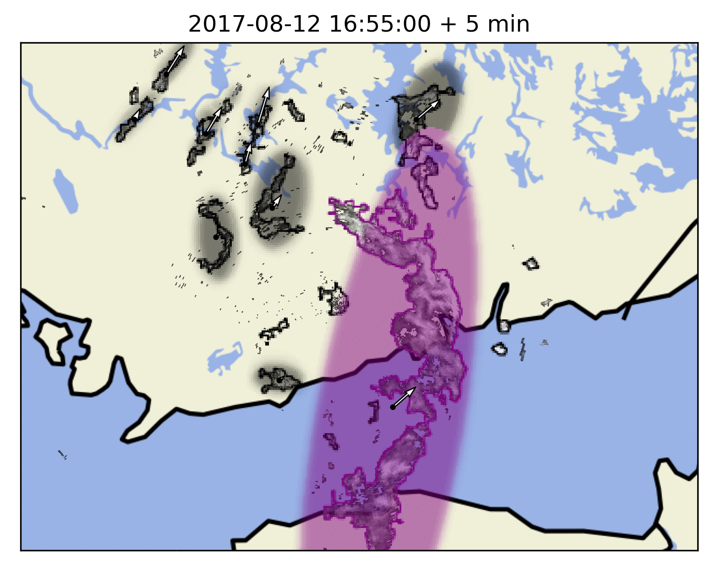
Probabilistic Nowcasts
Kalman filter applied to centroids of tracked storm cells
Ellipses fitted to the cells
Storm cell tracks linearly extrapolated using Kalman velocities
Ensemble-based probabilistic nowcasts produced by perturbing the predicted ellipse locations using Kalman covariances¹
Future work:
Combine hazard nowcasts with exposure data to produce risk nowcasts
¹ Rossi et al. 2015. Kalman Filtering–Based Probabilistic Nowcasting of Object-Oriented Tracked Convective Storms. https://doi.org/10.1175/JTECH-D-14-00184.1

Slide 14
Demonstration & Delivery

Slide 15
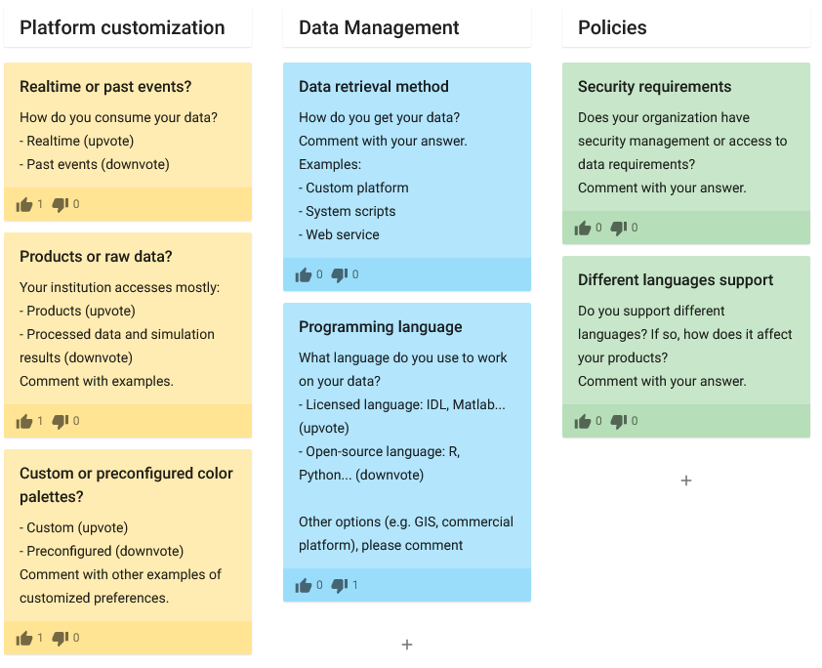
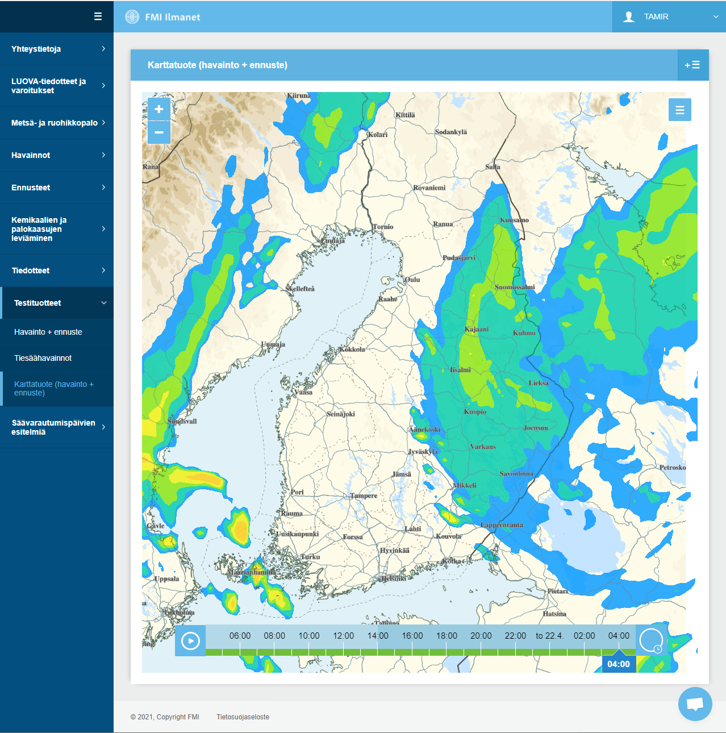
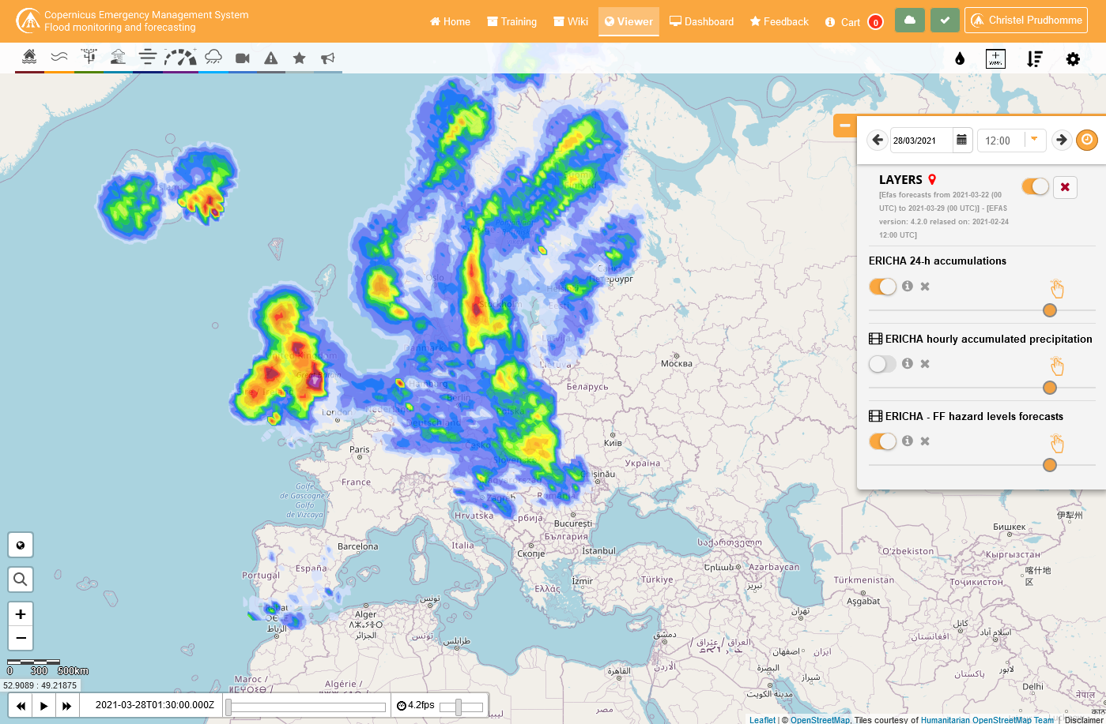
Demonstration Aims and Objectives
Technical specifications
National / Local platform
Pan-European platform

Slide 16
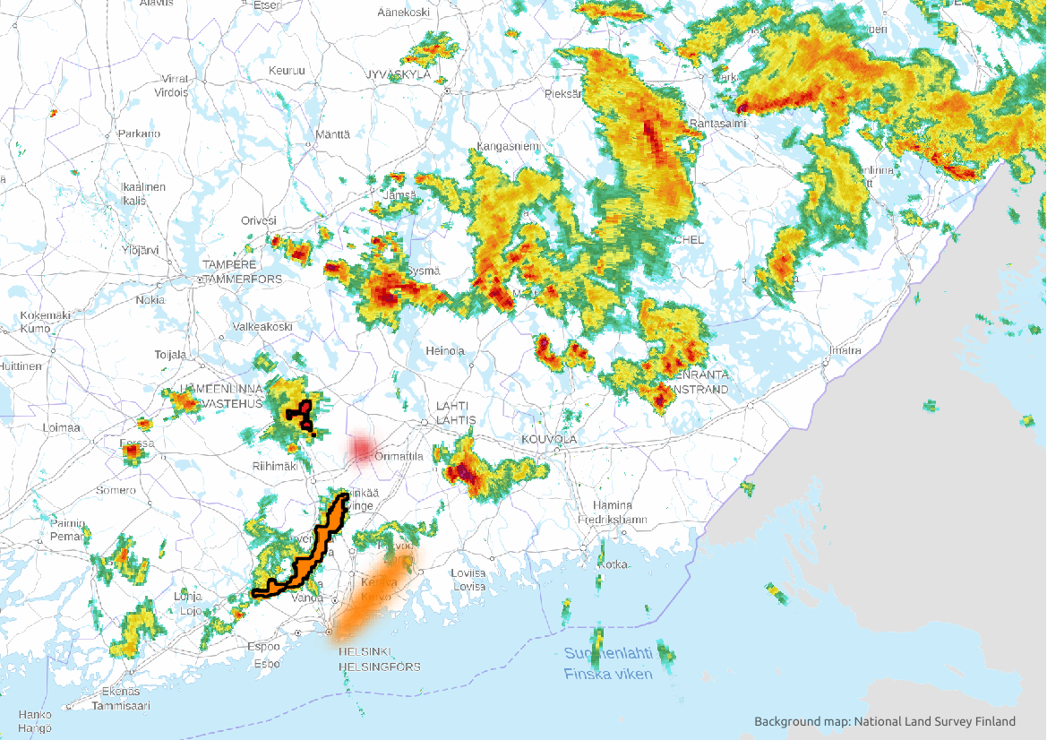
Demonstration Schedule
Pan-European demonstration
Local scale demonstration
End of Jun 21: Mock-up / prototype product(s) for a selected event shared as WMS-T and/or shown on prototype platform
Jul-Sep 21: Collecting feedback from users regarding product format and features (time step, visualization, etc. …)
Oct-Dec 21: Updated products on selected user-defined case studies accounting for user feedback
Jan-Feb 22: Setting-up of quasi-operational suites for TAMIR products
Mar-May 22: Prototype TAMIR products available in EFAS-IS and as data services
May 21: First prototype hazard layer shared on local platform
End of Jun 21: Mock-up / prototype for a selected event shown on prototype platform
Jun 21 onwards: Collecting feedback from users especially during the thunderstorm season in Finland. Updating the products based on feedback.
Sep-Oct 21: Risk layer shared on local platform

Slide 17
Summary:
Key Needs Addressed in TAMIR
Enhancing flood impact warning capacity through improved flood hazard assessments and warnings, accounting for precipitation type in flood forecasting, and better exposure estimation.
Developing multi-hazard weather nowcast products, to better account for compound hazards by thunderstorms in emergency response.
Delivery through operational platforms and new web services, for effective uptake and delivery of the TAMIR products.

Slide 18
Thank you!
Questions?
www.tamir-project.eu
tamir[at]fmi.fi | tero.niemi[at]fmi.fi
Related presentation tomorrow 28.4:
NH9.5
15:49–15:51 | EGU21-14444 | ECS
Ritter et al.: Rapid flash flood impact assessments at different spatial scales
The content of this presentation represents the views of the author only and is his/her sole responsibility. The European Commission does not accept any responsibility for use that may be made of the information it contains.
Tero Niemi, FMI
vEGU21 | 27 April 2021 | NH3.1 | EGU21-8194

