Slide 1




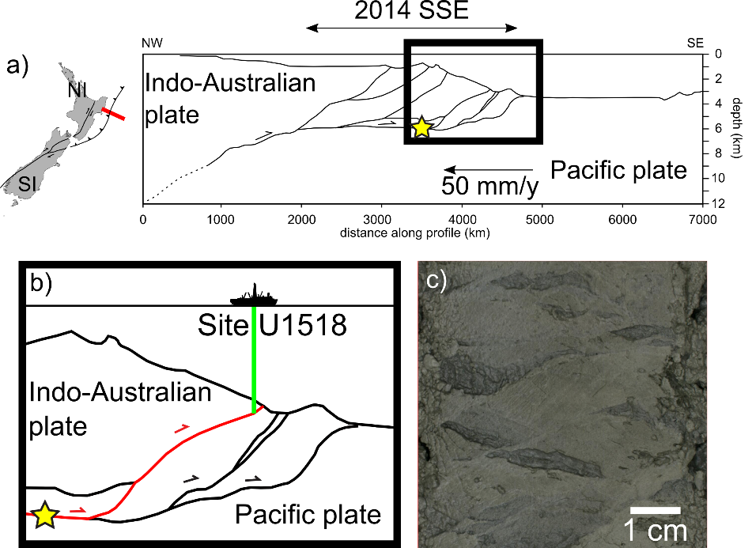
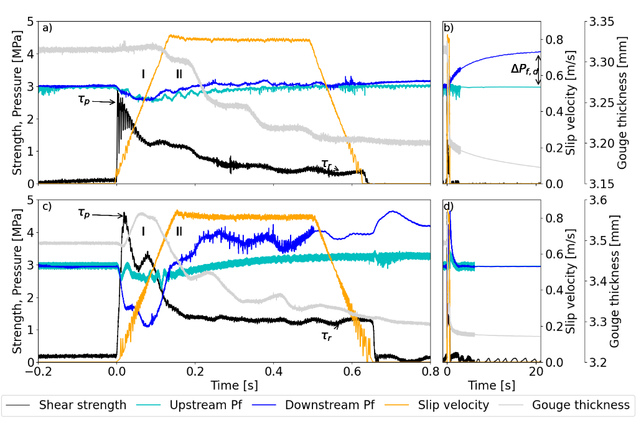
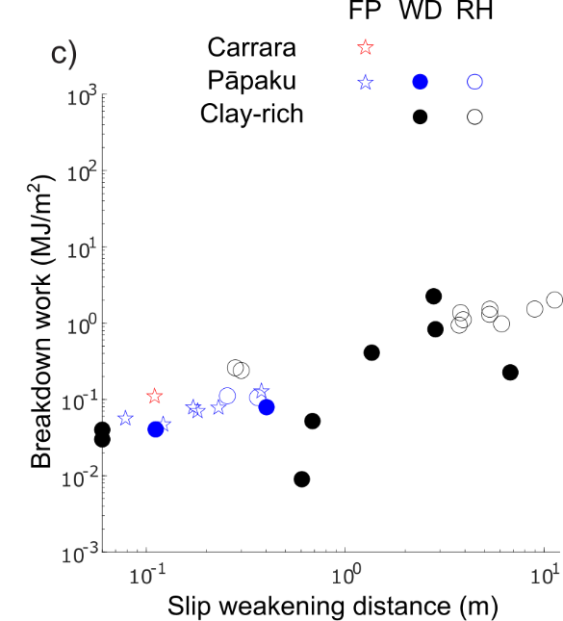
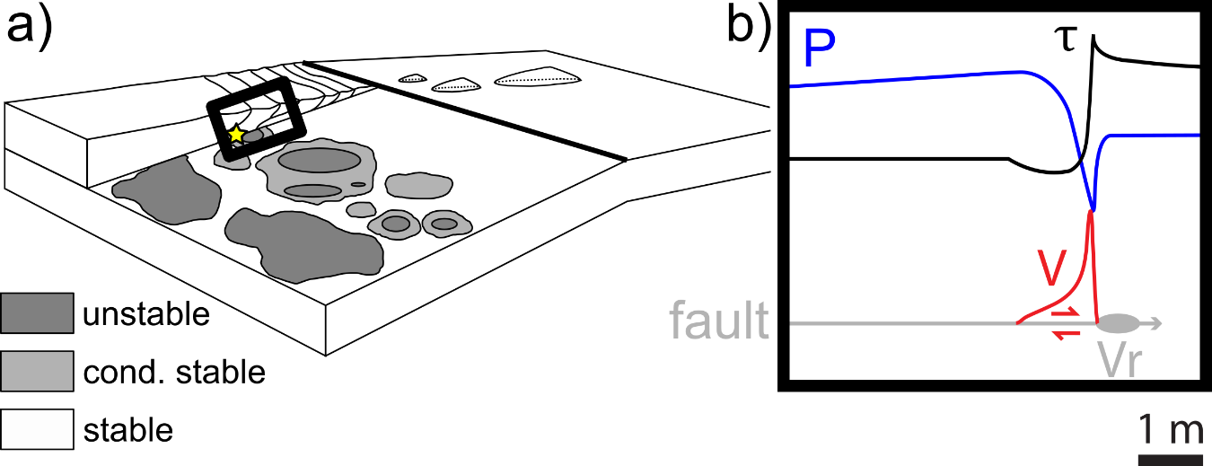
Fluid pressurisation and earthquake propagation in the Hikurangi subduction zone
Stefano Aretusini, Francesca Meneghini, Elena Spagnuolo, Christopher Harbord, and Giulio Di Toro
1. Geological setting: Hikurangi, Papaku
2. Fluid pressurised experiments
Papaku
Carrara
Clay-rich compiled from Seyler et al., (2020)
Materials from Site U1518, Papaku OOST in (N-) Hikurangi subduction zone vs. Carrara calcite marble gouge.
Independent measure of stress and fluid pressure at seismic velocity in rotary experiments with new setup.
Initial shear dilatancy at peak stress.
Taken over by fluid pressurisation during dynamic weakening.
Interplay of dilatancy versus pressurization controls earthquake propagation in impermeable clay sediments
3. Tsunami earthquakes across shallow impermeable clays
Accepted in Nature Communications (link to preprint)
stefano.aretusini@ingv.it

